Slide 1

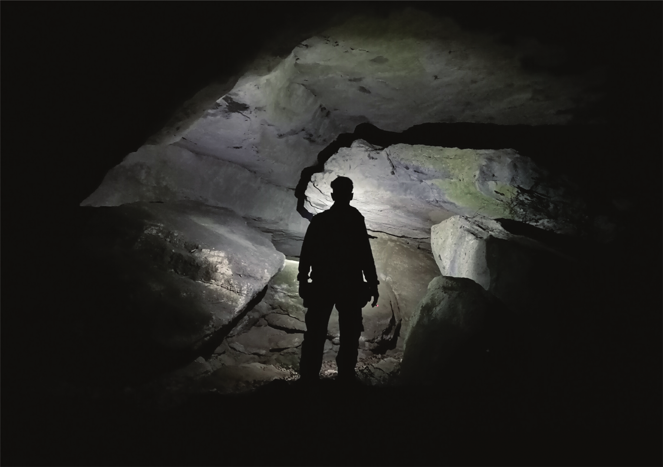
Ivica Samarđić, Iva Galić, Marija Kovačević
Goran Radonić. Marko Doboš, Goran Pavić
SPELEOLOGICAL FEATURES
OF THE PAPUK HILL
15. međunarodni simpozij Kopački rit jučer, danas, sutra 2026.
1. i 2. listopada 2026. godine na Fakultetu agrobiotehničkih znanosti Osijek, Vladimira Preloga 1, 31000 Osijek.

Slide 2
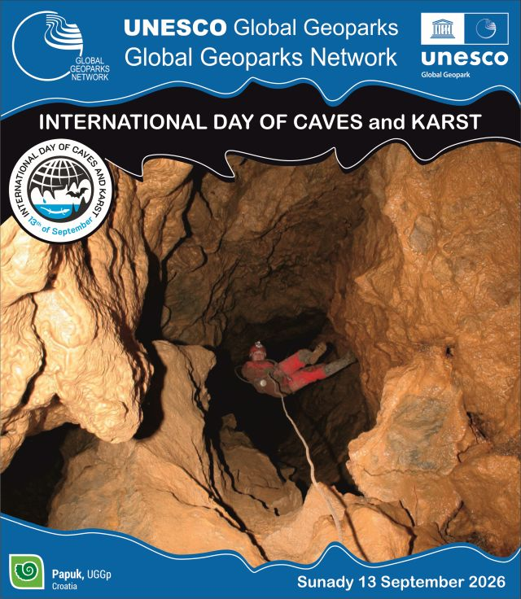
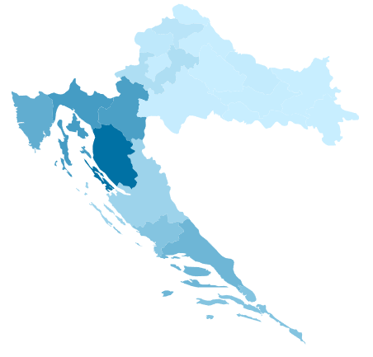

Slide 3
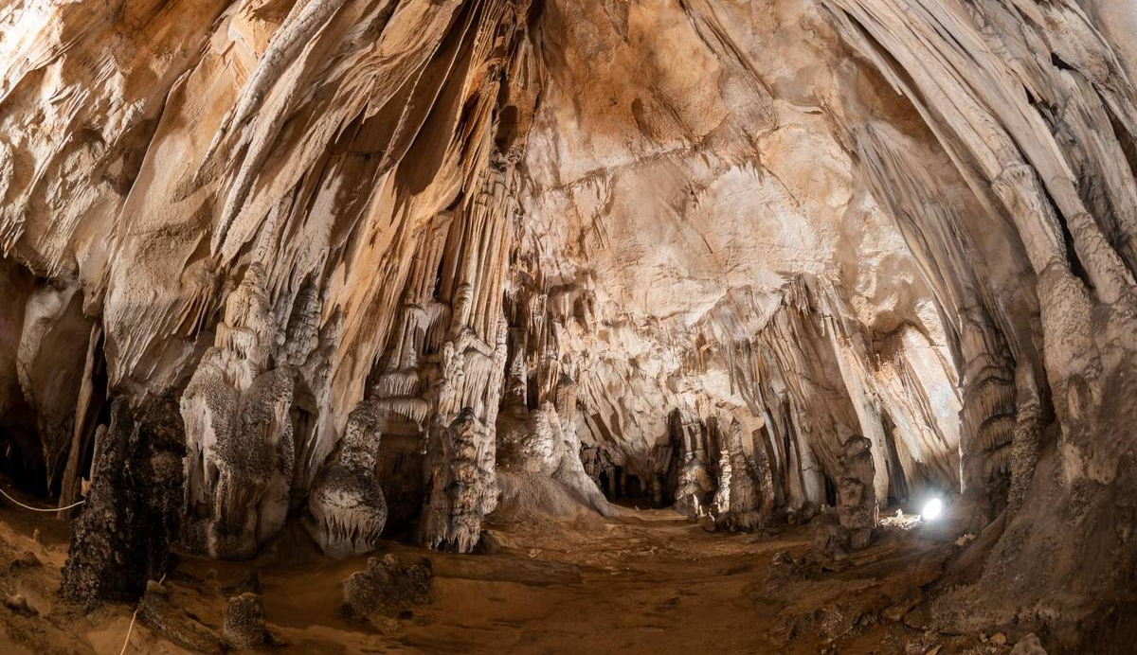
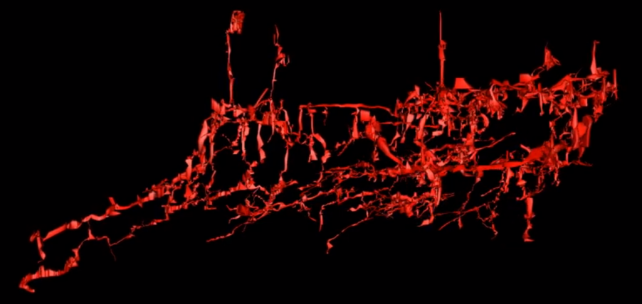
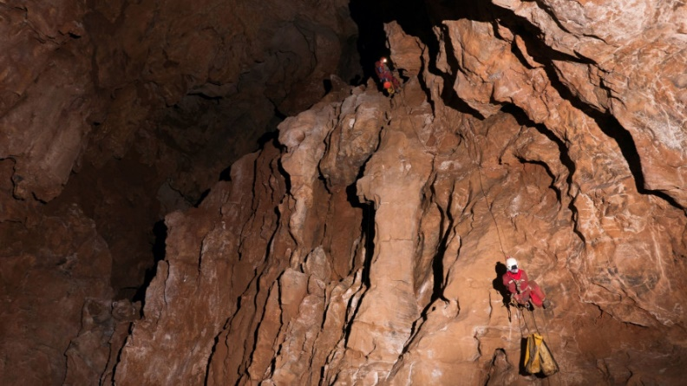
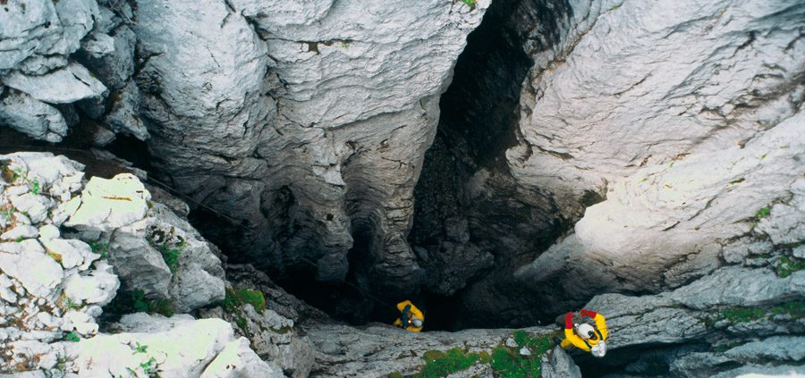
CAVES AND PITS IN CROATIA
• 55 caves deeper than 250 m
• 18 caves deeper than 500 m
• Crnopac Cave System – 59 km long
• Đulin Ponor – Medvednica – 16.4 km
• Lukina Jama – Trojama – 1.431 m deep
• Exploration is still ongoing!

Slide 4
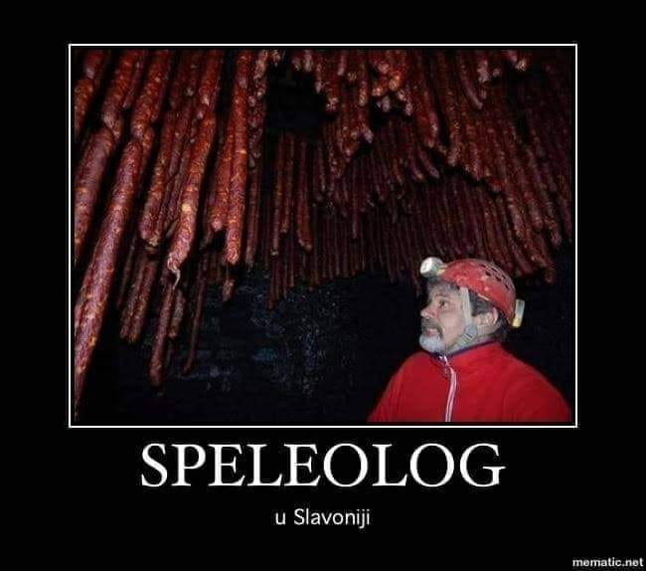
SPELEOLOGIST IN SLAVONIA REGION !

Slide 5
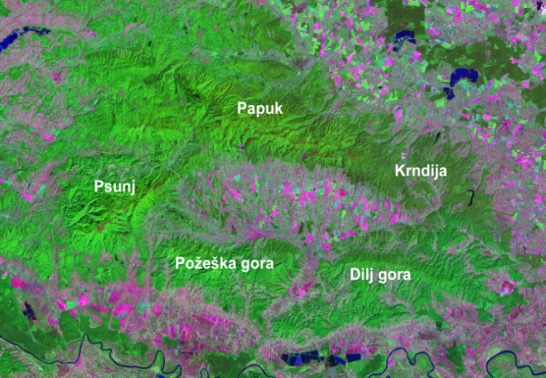
SLAVONIAN HILLS
Northern range – Papuk and Krndija
Southern range – Psunj, Požeška Gora and Dilj Gora

Slide 6
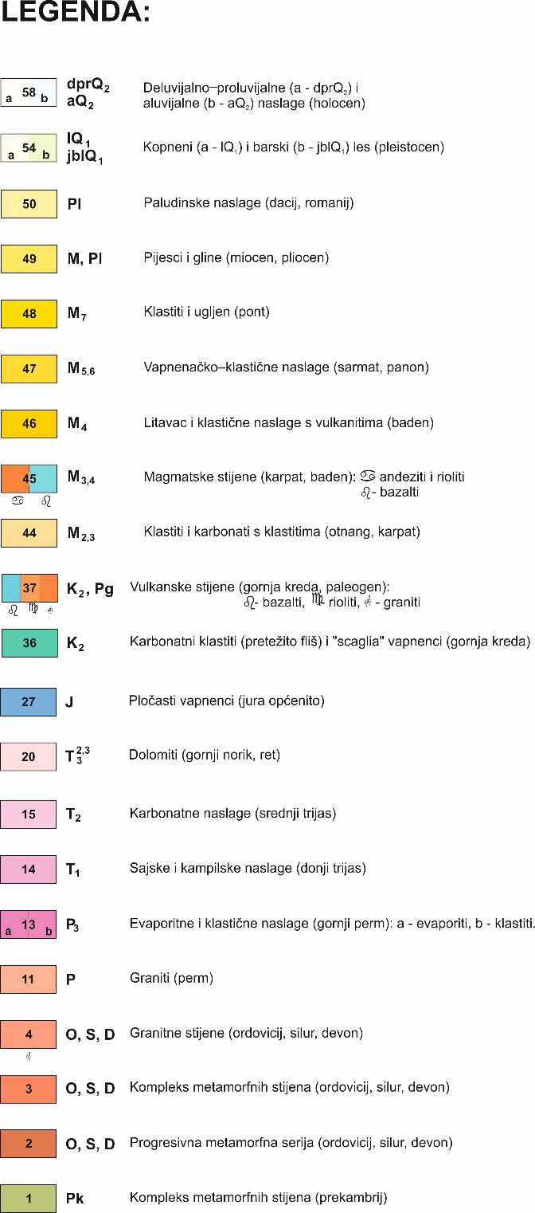
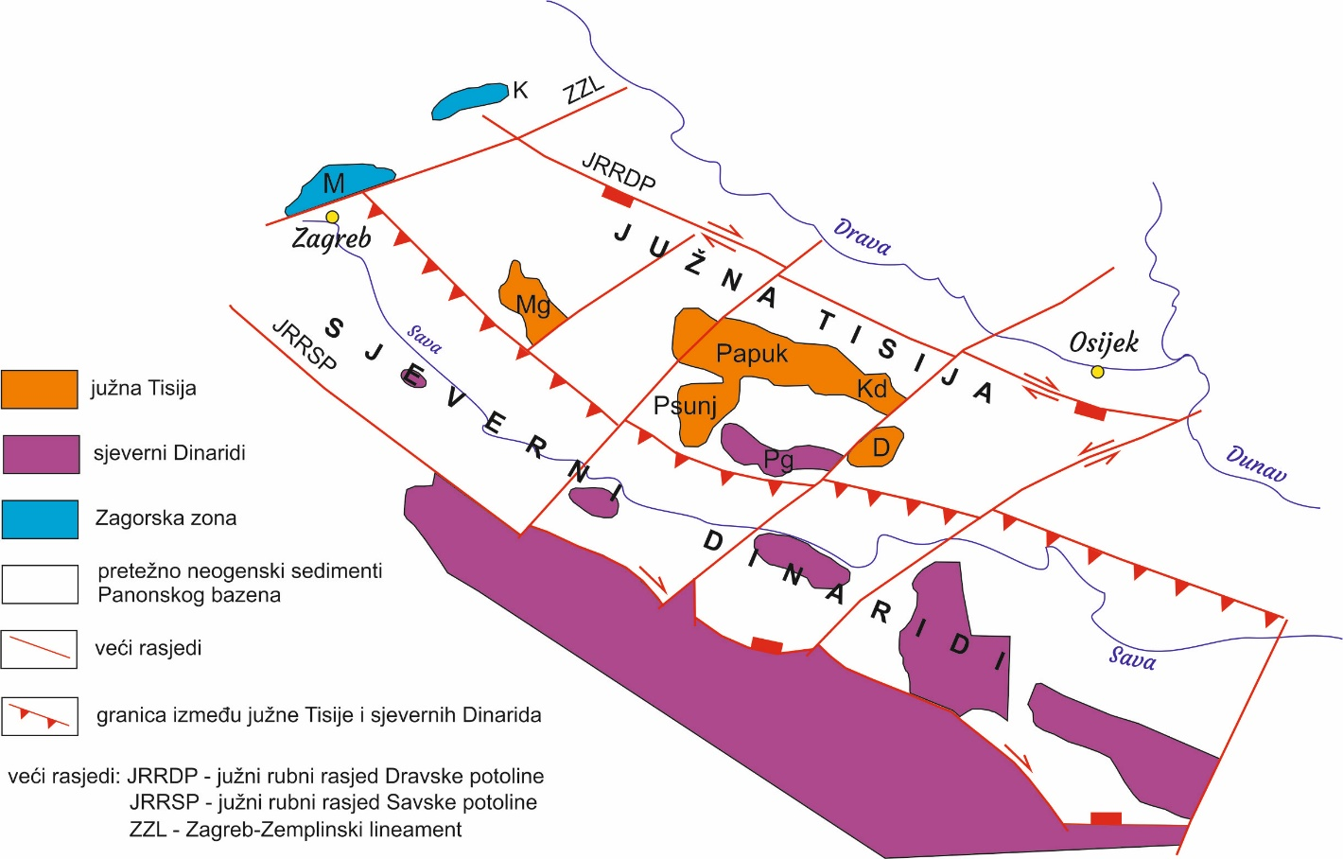
Geological map of Slavonian Hills

Slide 7
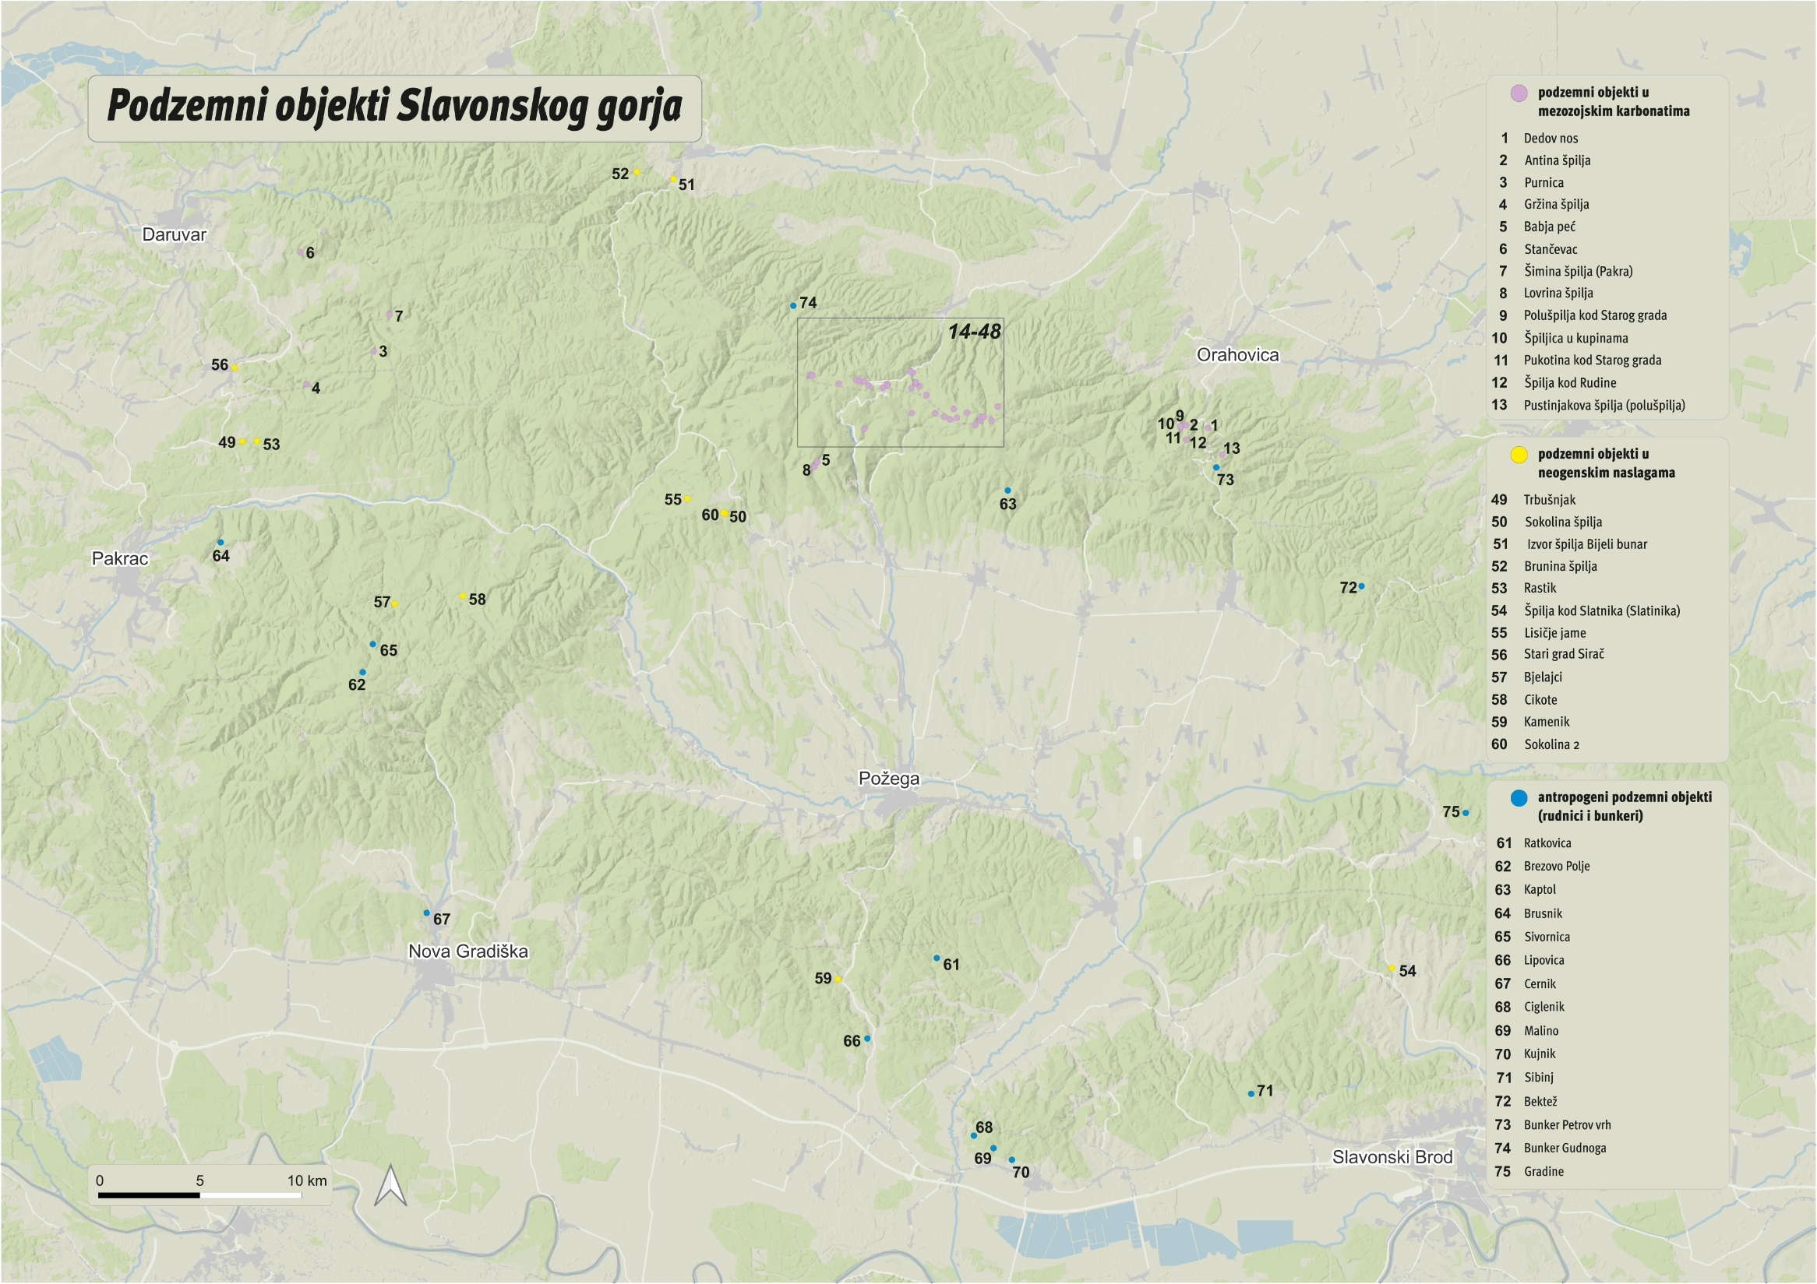
Speleological Features of the Slavonian Hills

Slide 8
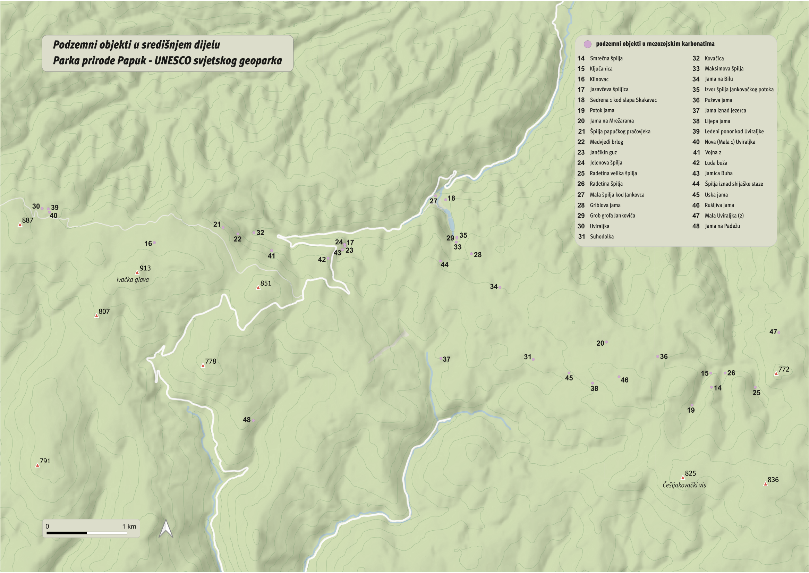
Speleological Features of the Papuk Hill

Slide 9
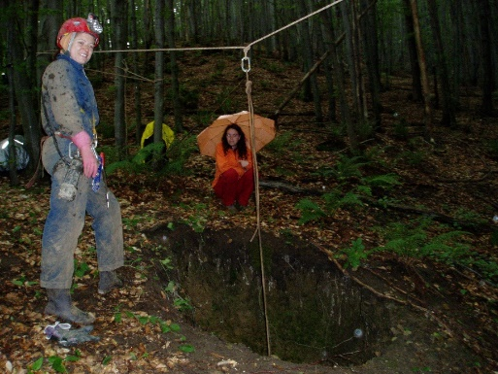
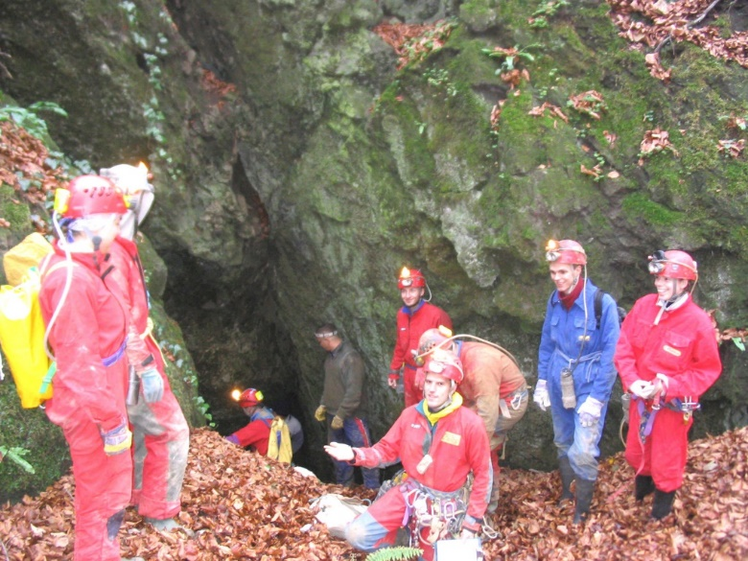
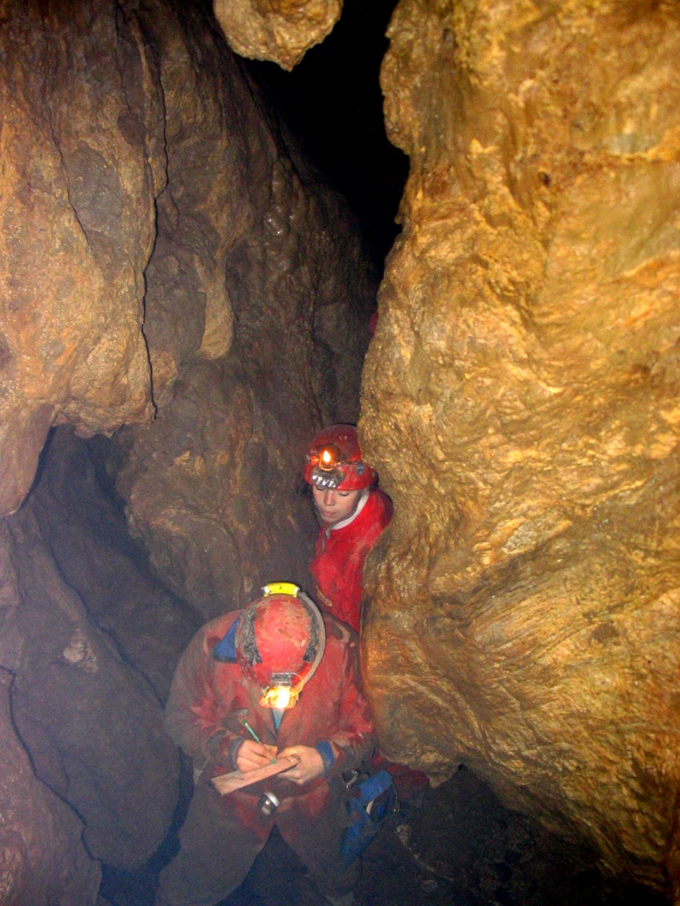
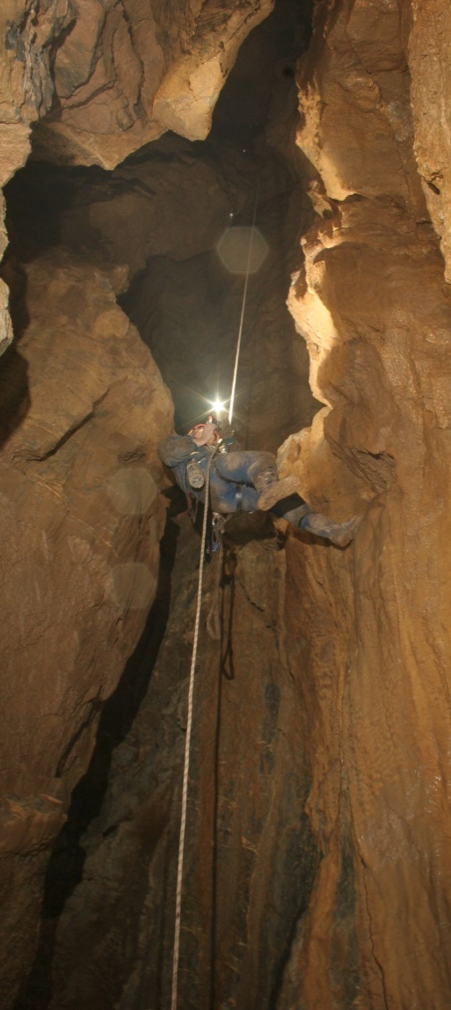
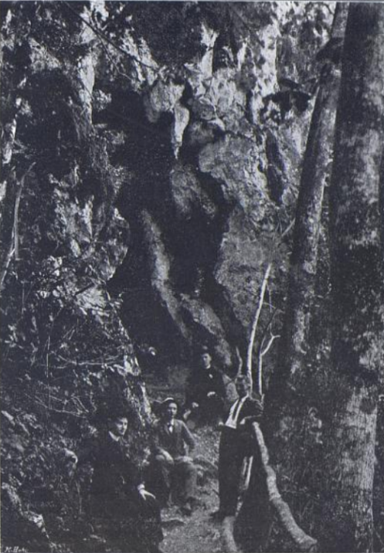
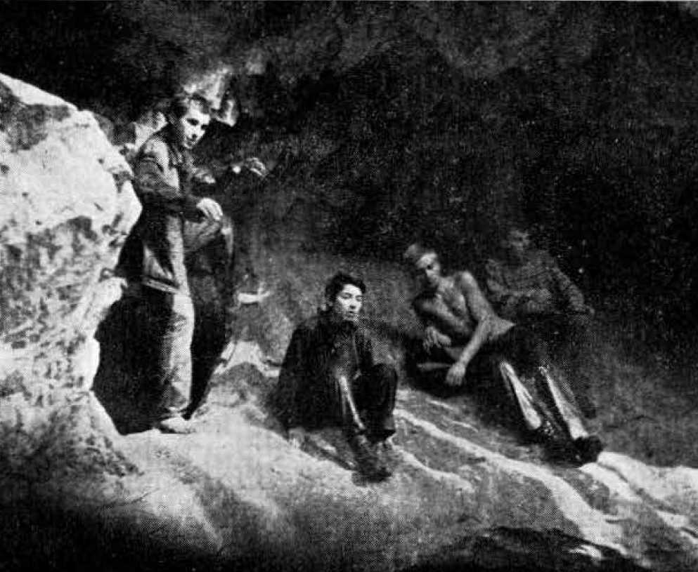
EXPLORATION OF SPELEOLOGICAL FEATURES IN THE SLAVONIAN MOUNTAINS
• Julije Kempf – 1910
• Radovan Čeplak – 1965
• Teo Barišić – 1990
• Vlado Božić – 2002
• Croatian Biospeleological Society (HBSD) and the BIUS Student Association – 2004–2010

Slide 10
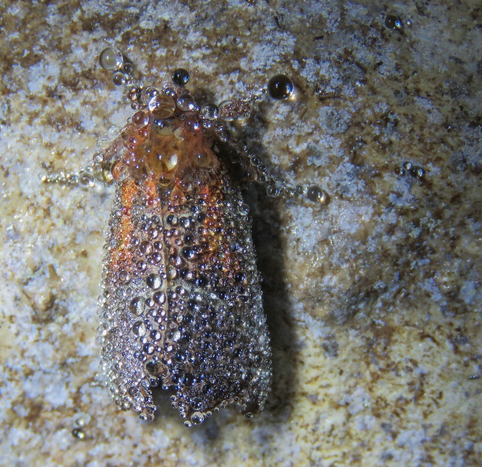
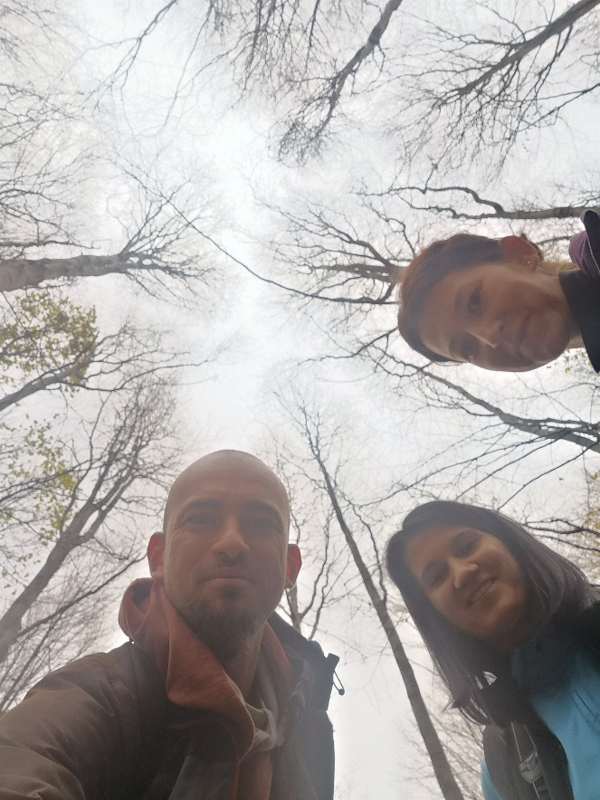
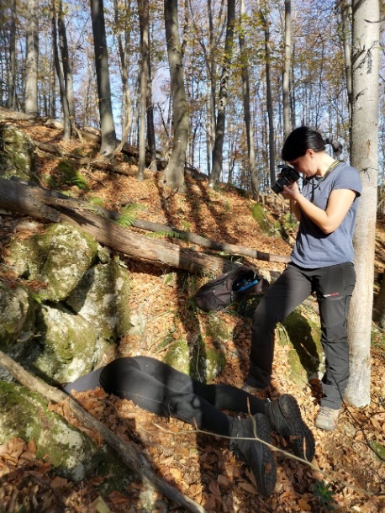
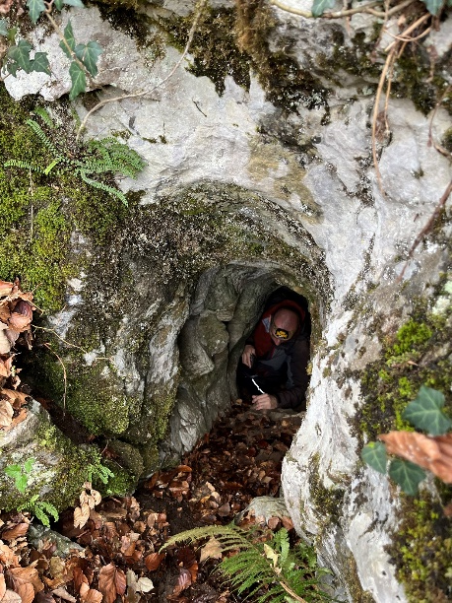
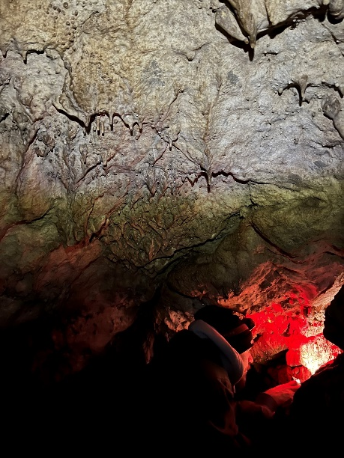
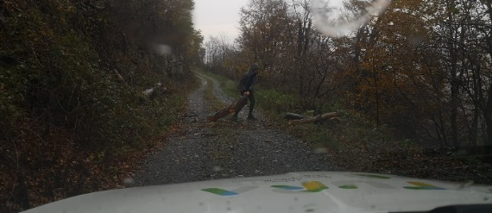
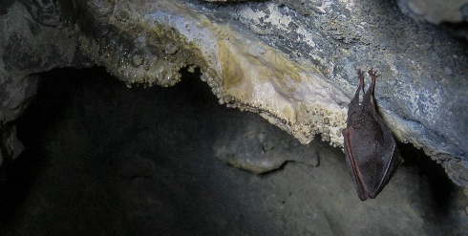
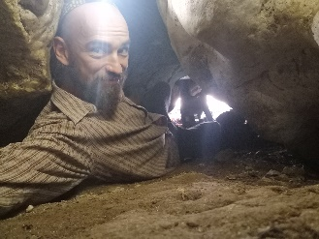
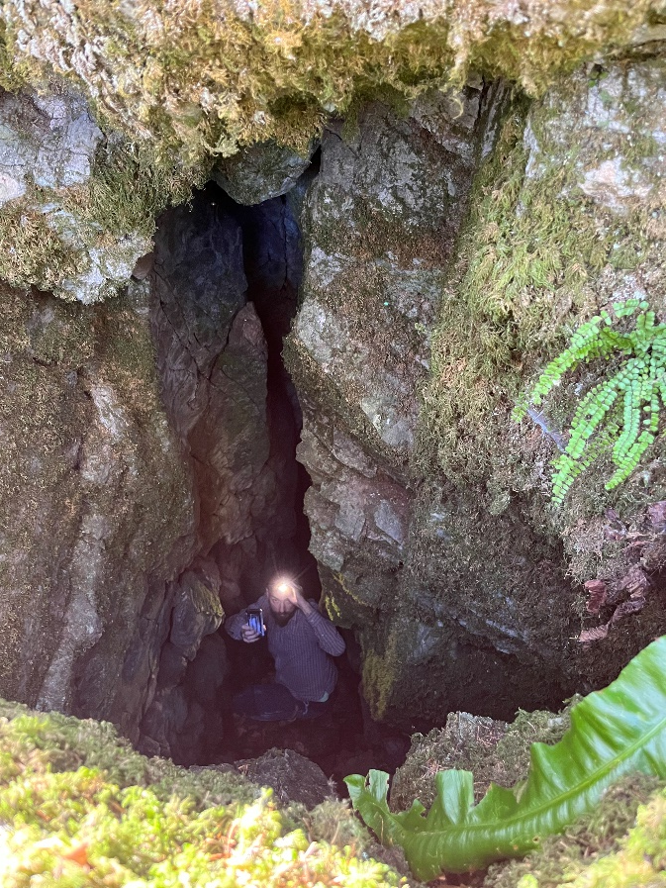
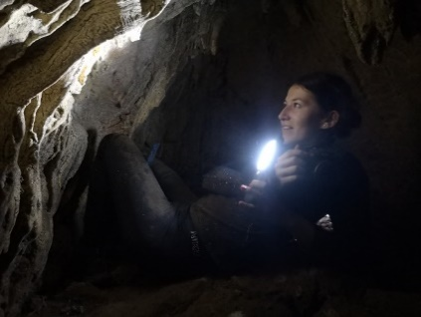
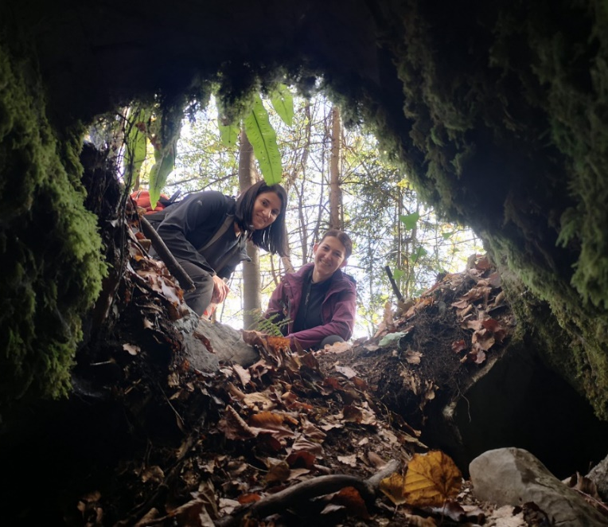
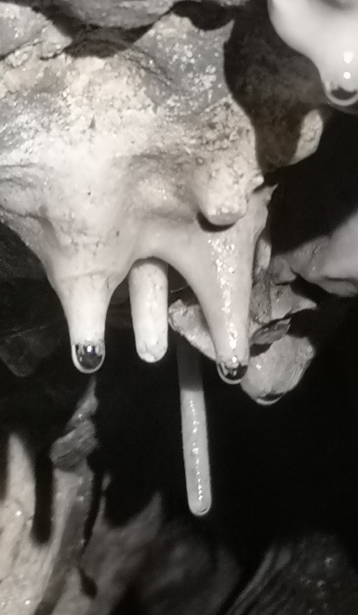
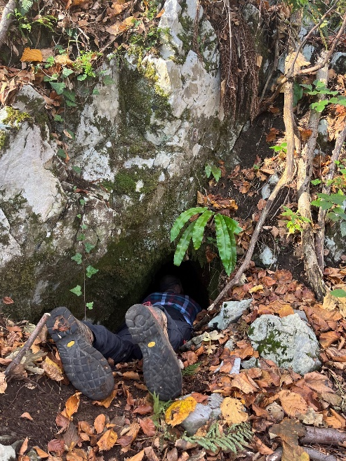
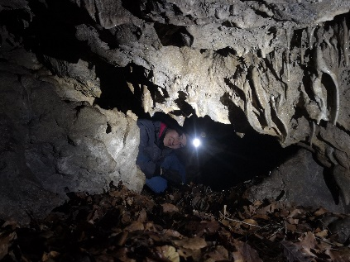

Slide 11
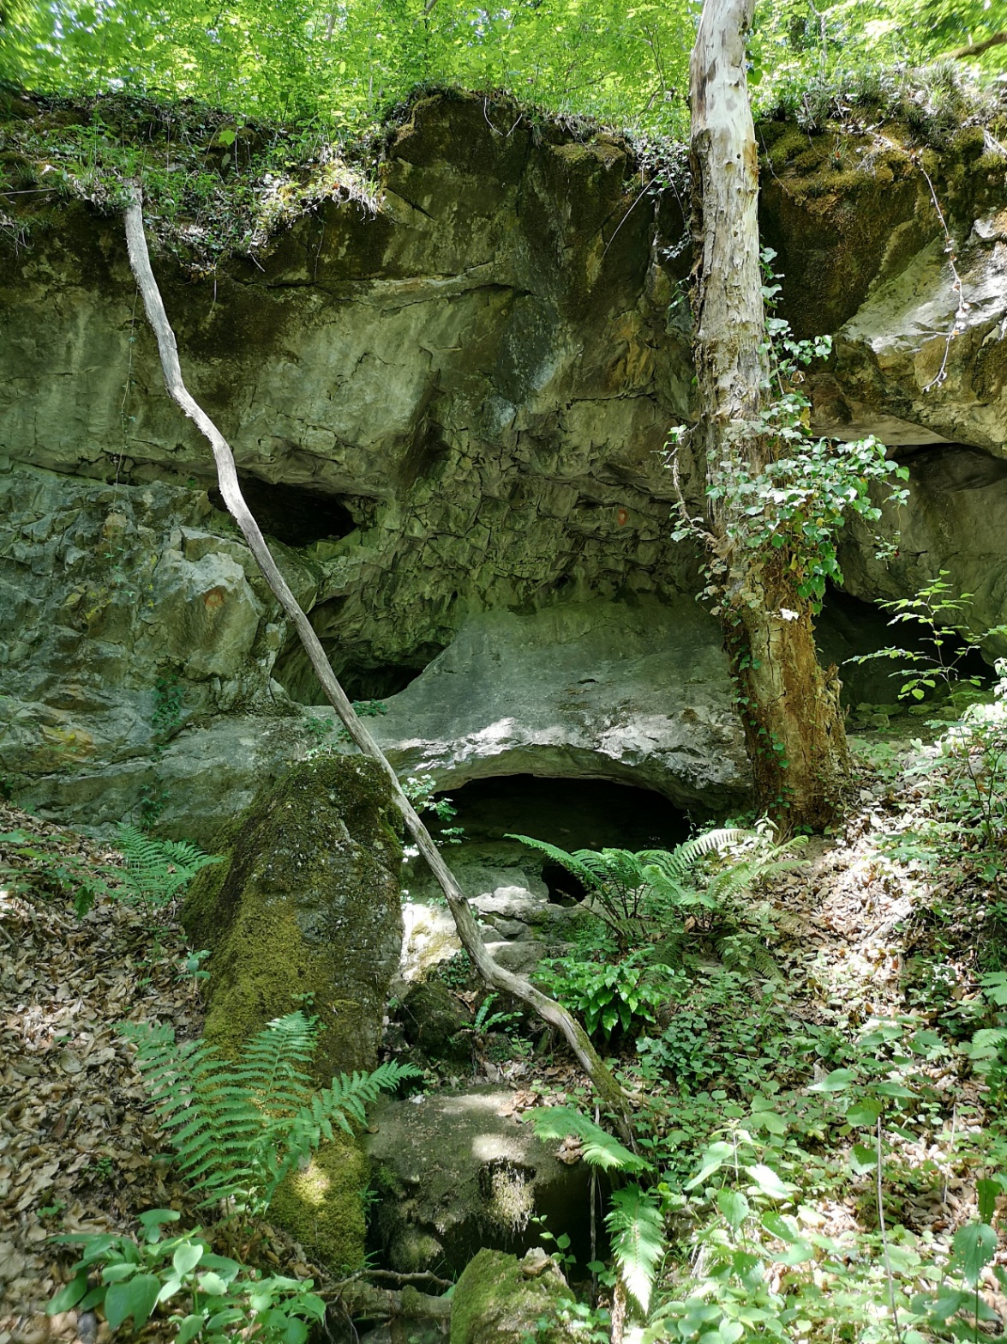
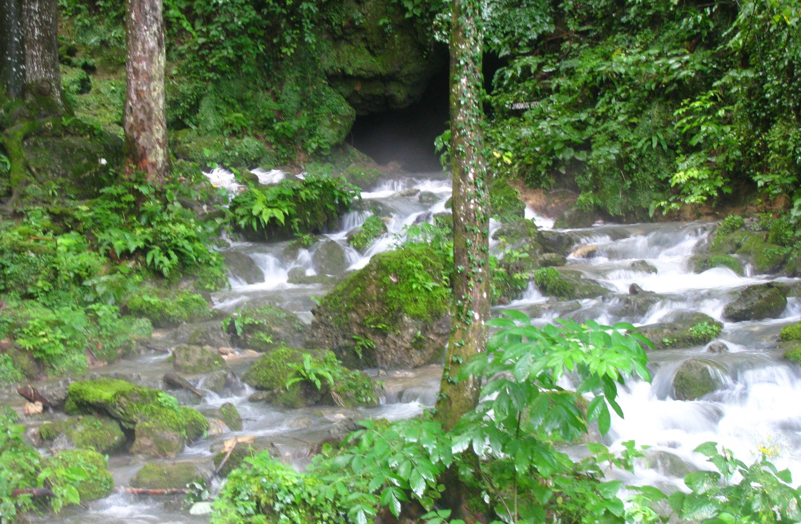
CAVES OF THE SLAVONIAN HILLS
• More than 50
• Most of them are located on Papuk
• Located at the contact between permeable and impermeable rocks, • Some known sites have not yet been fully explored

Slide 12
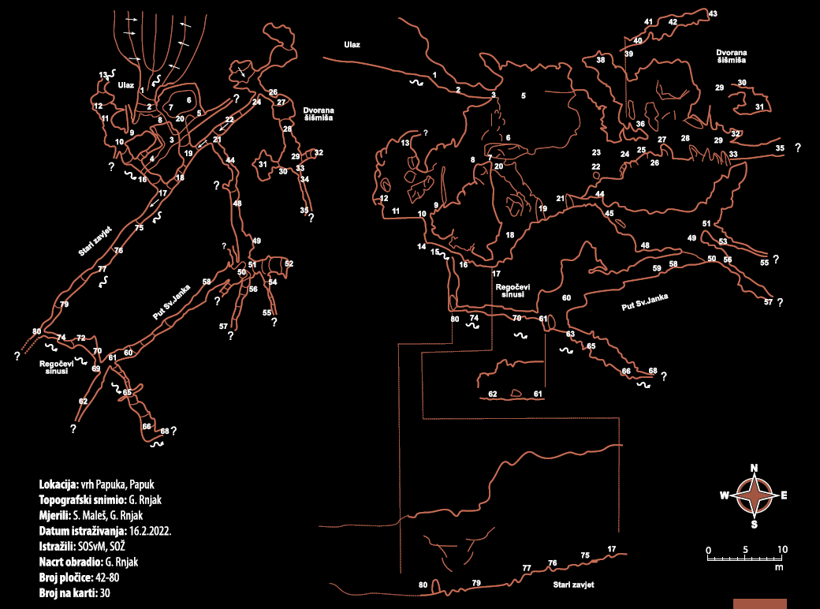
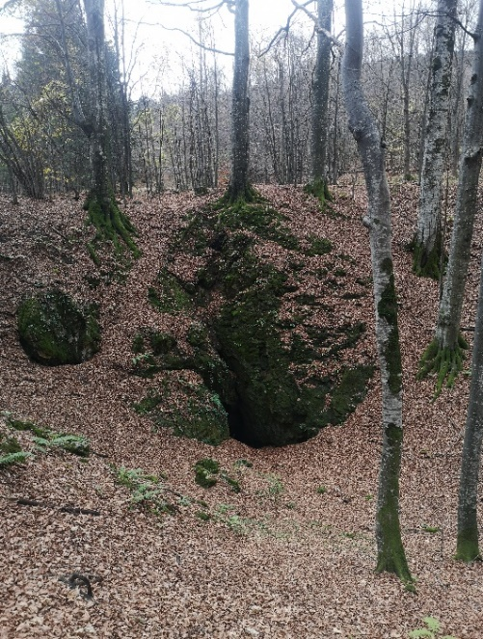
UVIRALJKA HR00205
286 m of undegroud channels
11 vrsta šišmiša na zimovanju

Slide 13
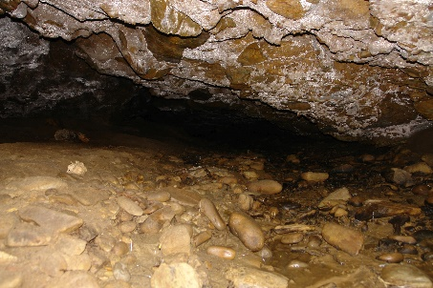
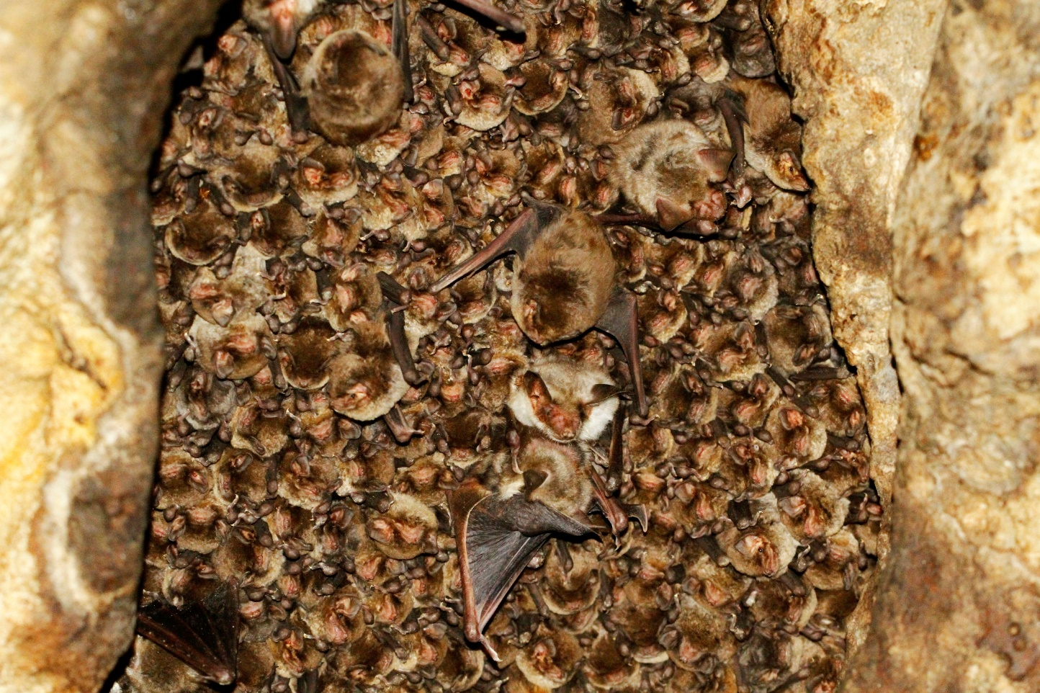
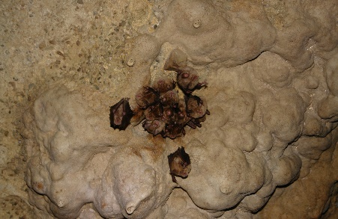
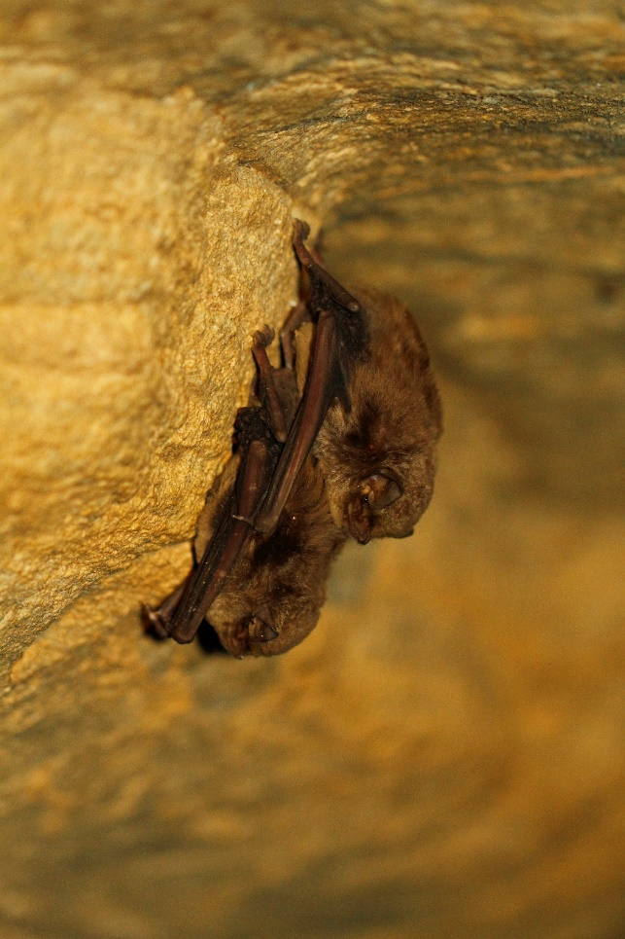
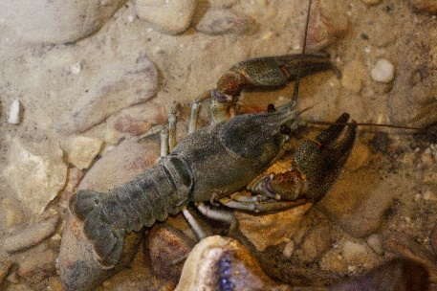
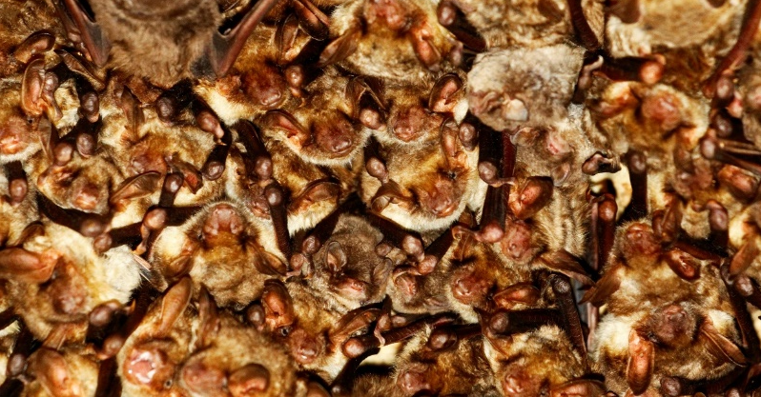
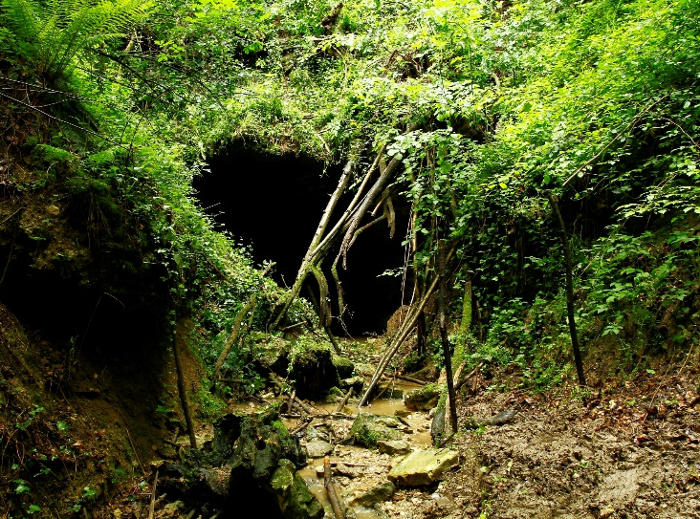
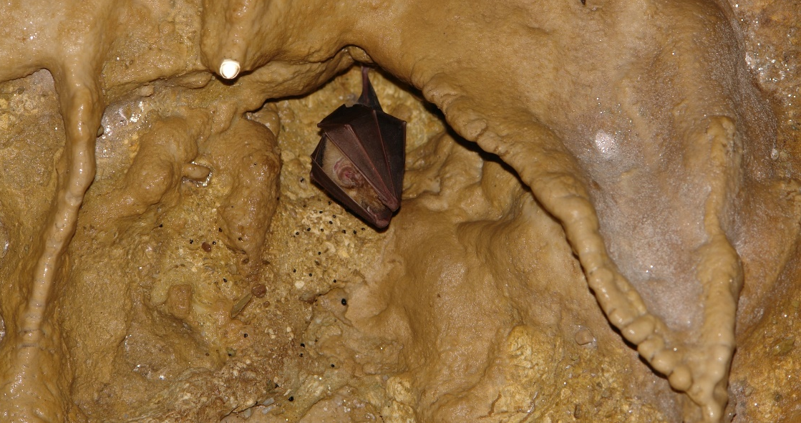
TRBUŠNJAK HR02378
Najveća porodiljska kolonija šišmiša u kontinentalnoj Hrvatskoj 25.000 – 30.000 jedinki

Slide 14
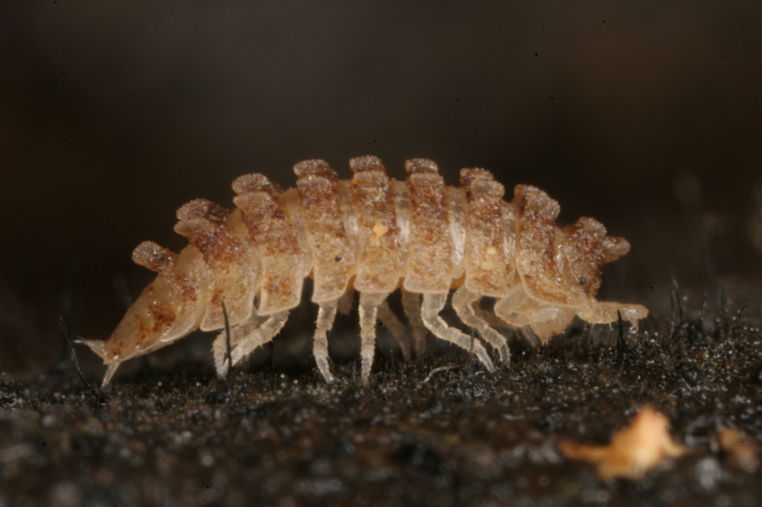
MALA ŠPILJA (SMALL CAVE) JANKOVAC
Calconiscellus gottscheensis is a species of woodlouse in the family Trichoniscidae that can be found in Slovenia. It is listed as vulnerable on the IUCN Red List.
Calconiscellus gotscheensis
Foto: Helena Bilandžija

Slide 15
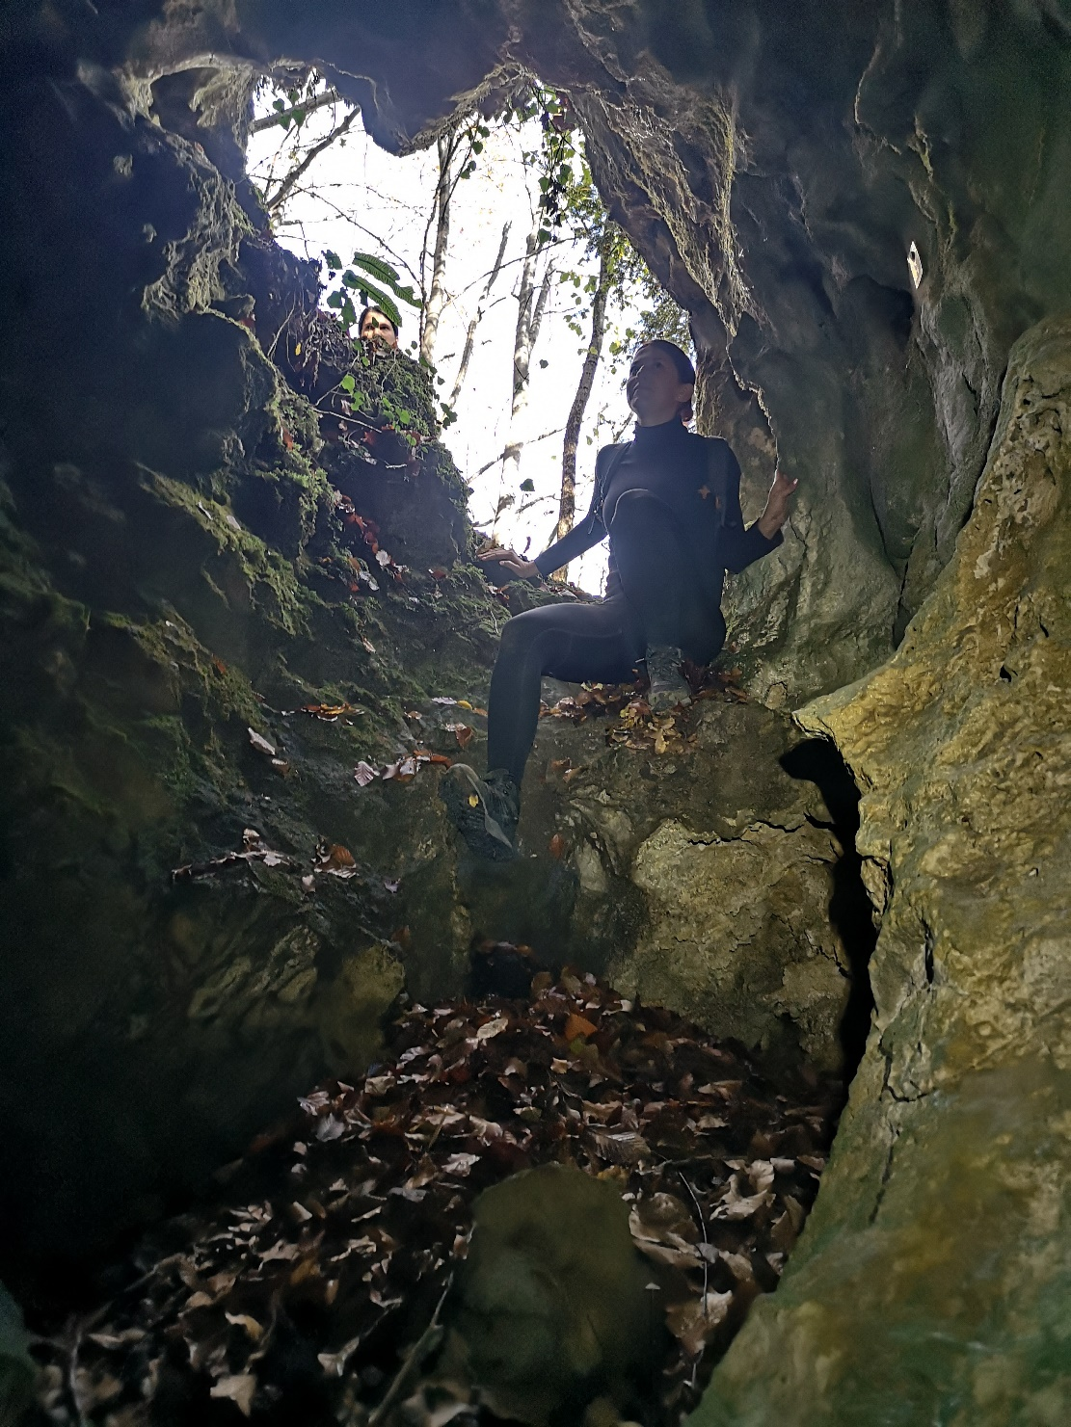
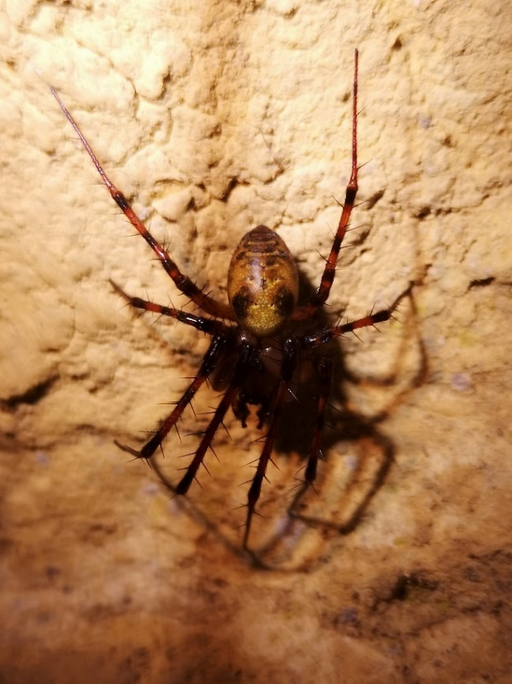
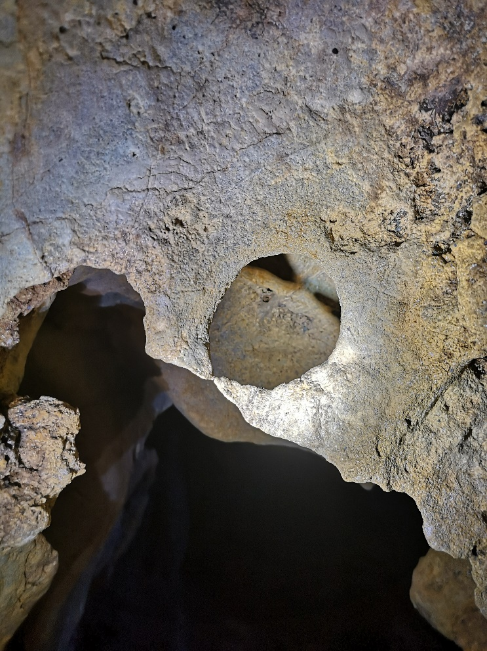
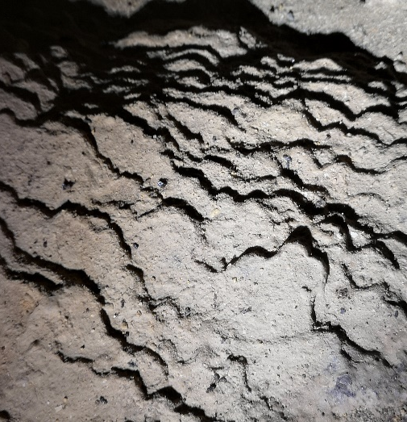
JANČIKIN GUZ (JANCIKAS BUTT?)

Slide 16

JANČIKIN GUZ
Bryaxis sp. nov.
Foto: Jana Bedek

Slide 17




PITS OF THE SLAVONIAN MOUNTAINS
• More than 20
• Most of them are located on Papuk
• Dangerous to humans and fauna
• Entry requires specialized equipment and training

Slide 18





SUHODOLKA
HR00207

Slide 19

IS THAT EVERYTHING?

Slide 20





SINKHOLES AND SINKING STREAMS
• Uviraljka Sinkhole
• Speleological potential Papuk, northern Psunj and northern Dilj
• Mrežarski Rust - Network of Sinkholes
Radovanka Stream, Kovačica – undergroud stream

Slide 21



cooperation with Department of Geography, Faculty of Sciene
Project „Research of Geomorphology and Geodiversity of carst in Papuk Nature Park
Network of sinkholes - Mrežarski rust

Slide 22






ANTHROPOGENIC UNDERGROUND FEATURES
• Mines, bunkers, excavated rock shelters
• Coal mines on the southern slopes of Psunj and Požeška Gora
• Graphite mines on northern Psunj
• cooperation with Arheological Museum Osijek

Slide 23



UNDERGROUND PROTECTION

Slide 24




THANKS

