Slide 1

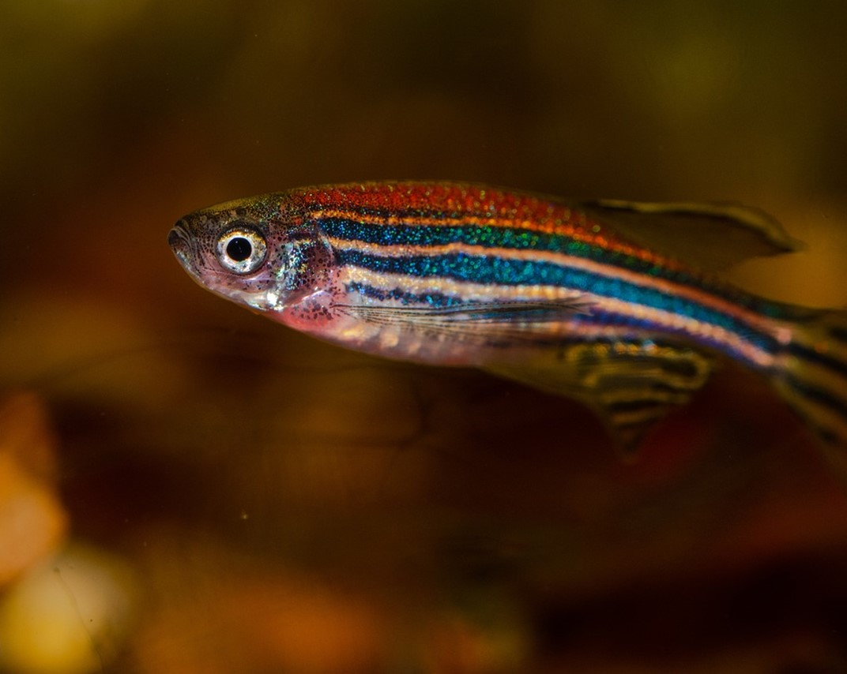
Longterm Impact of Silver Nanoparticles on Zebrafish (Danio rerio)
Jakub Martynow¹, Kacper Kawalski¹, Maciej Kamaszewski¹, Hubert Szudrowicz¹, Wiktoria Cieśla¹, Bogumił Łosiewicz^{1,2}
¹Warsaw University of Life Sciences, Faculty of Bioeconomy and Food Systems, Department of Animal Environment Biology, Ciszewskiego 8, 02-786 Warsaw, Poland
²The Kielanowski Institute of Animal Physiology and Nutrition, Polish Academy of Sciences, Department of Genetic Engineering, Instytucka 3, 05-110 Jabłonna, Poland
https://pixabay.com/pl/photos/danio-rerio-danio-utrzymuje-ryba-4996610/

Slide 2
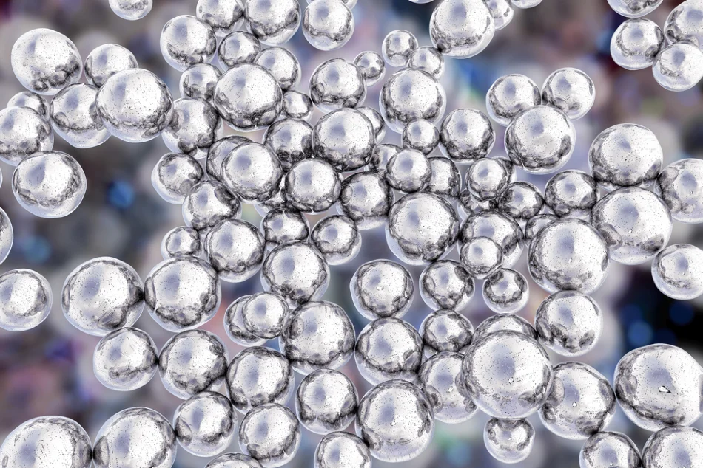
Silver nanoparticles – AgNPs
Used since XXth century and it is steadily rising.
Used in production and medicine, known for cytotoxic and antimicrobial properties.
Found in wastewater and natural aquatic environments (Dumont et al. 2015).
Poorly understood effects on maturation (Banu et al. 2021).
May disturb growth and sexual maturation (Kamaszewski et al. 2023).
Thus, there is a growing need to study their effects on living models.
https://www.azonano.com/article.aspx?ArticleID=5443

Slide 3
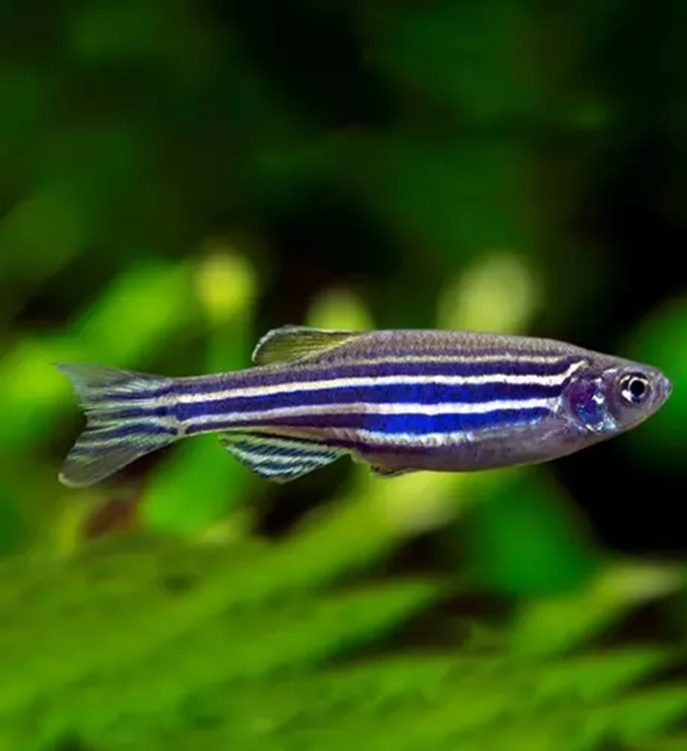
Animal model - zebrafish
Model organism.
Originates from Western part of South Asia.
Easy to maintain in captivity.
Sexual differentiation is influenced by environmental factors.
In adult individuals, sex can be determined by phenotype analysis.
Often used in toxicity tests at different levels of growth.
It is oviparous organism.
From the 5th day after hatching (21-22 days after fertilization) they feed exogenously.
Matures in 3 to 4 months after hatching.
https://sklep.roslinyakwariowe.pl/ryby-krewetki-oraz-slimaki/ryby/danio-pregowane-brachydanio-rerio-p-41399.html

Slide 4
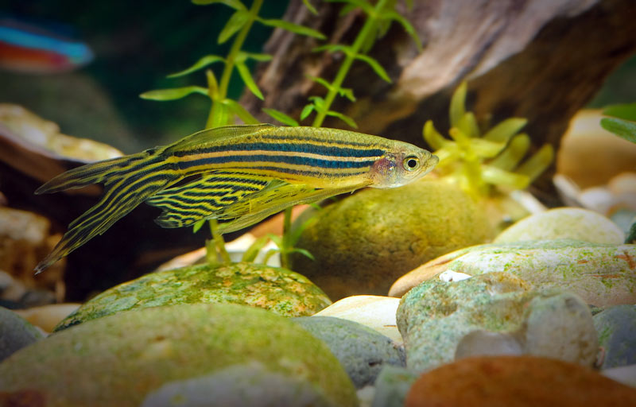
Aim of the study
To examine the impact of silver nanoparticles during exposure for 100 days on:
Female growth and development.
Female development of sexual maturation.
Sexual differentation
https://rybyakwariowe.eu/ryba-akwariowa/danio-pregowany-pregowane-brachydanio-rerio/

Slide 5
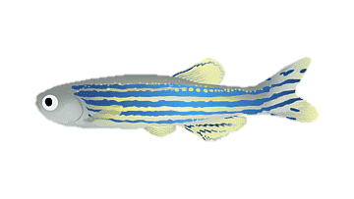





Methodology
Euthanasia with MS-222
Analysis of female specimens scans with focus on ovaries
19 day old fish
11 days of acclimation
100 days
80 fish per group
Scanning slides
Control (0 $\frac{mg}{{dm}^{3}}$)
AgNPs 0,001 $\frac{mg}{{dm}^{3}}$
Body measurements & sex identification
AgNPs 0,01 $\frac{mg}{{dm}^{3}}$
AgNPs 1 $\frac{mg}{{dm}^{3}}$
H&E Staining
Scheme 1. Diagram describing the methodology used in the research.
Fixation
6 μm
Paraffin embedding
Sectioning into slices

Slide 6
Body measurements and mortality rate
The lowest observed mortality was observed in AgNPs 0,001 group with 9,02%, the highest one was in AgNPs 1 group with 15,46% while in control it was 10,54%. However there was no statistical difference between groups.
All treated groups were lighter and shorter than control.
Specimens in AgNPs 0,001 group were the smallest with the lowest value of 18,81 (± 4,46) mm.
Specimens in AgNPs 1 group were the lightest with the lowest value of 0,10 (± 0,05) g.
A
B
Fig. 1 The graphs present mortality rate [A] and fish body parameters [B-C]. X-axis shows experimental group. Letters a and b indicate belonging to homogeneous groups as determined by Tukey's test (p<0.05, n=12-21). The bar graphs show the mean parameters ± standard error.​
C

Slide 7
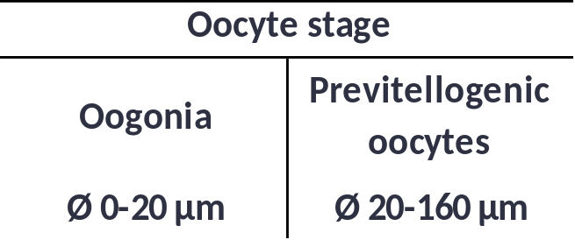
Ovary measurements and percentage of female in populations
A
Applied oocyte development stages is division by diameter proposed by van der Ven and Wester (2024).
The highest percentage of previtellogenic oocytes (58,67%) was observed in AgNPs 0,001 group, while the lowest (32,69%) was in AgNPs 0,01 group. In the control group it was 48,58%.
The most mature specimens were in AgNPs 0,001 group even exceeding control group, while less developed ones were in AgNPs 0,01 and 1 groups.
In the AgNPs 0,001 group female percentage in studied population was only 26,87% compared to 22,64%, 35,09% and 35,00% in the control, AgNPs 0,01 & 1 groups respectively.
In the treated groups, the ratio of females to males was almost 1:1 while in the control group it was about 2:3 females to.
Table 1. Oocyte development stages (van der Ven & Wester, 2024).
Fig. 2 The graphs present oocyte size distribution and percentage of females in the studied population [A-B]. Y-axis shows experimental group.
B

Slide 8
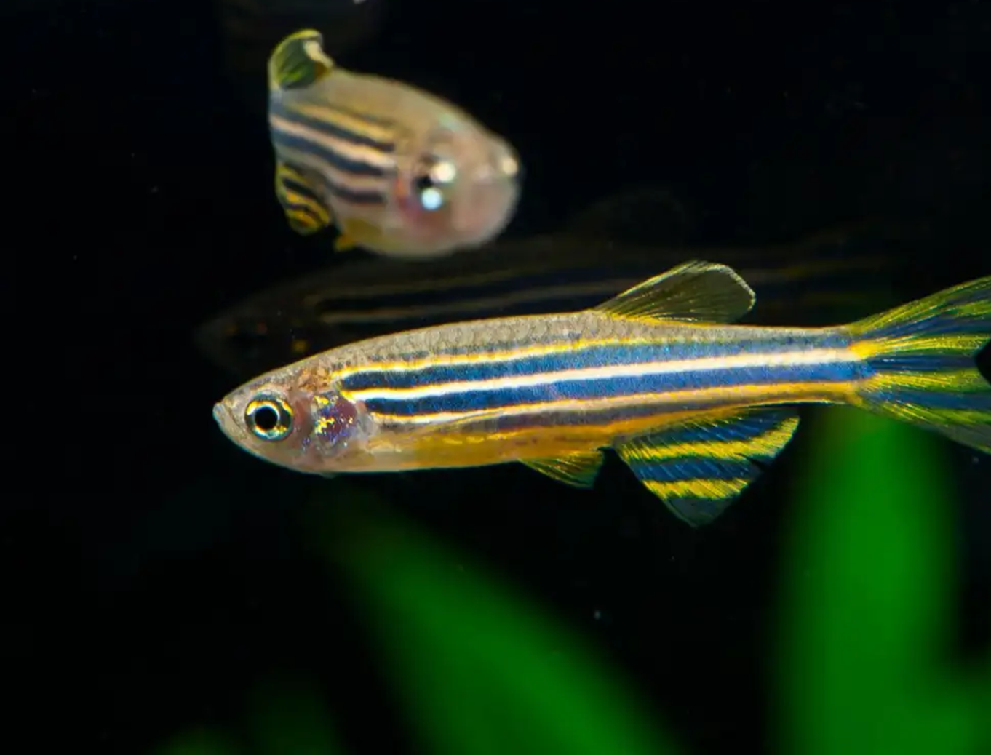
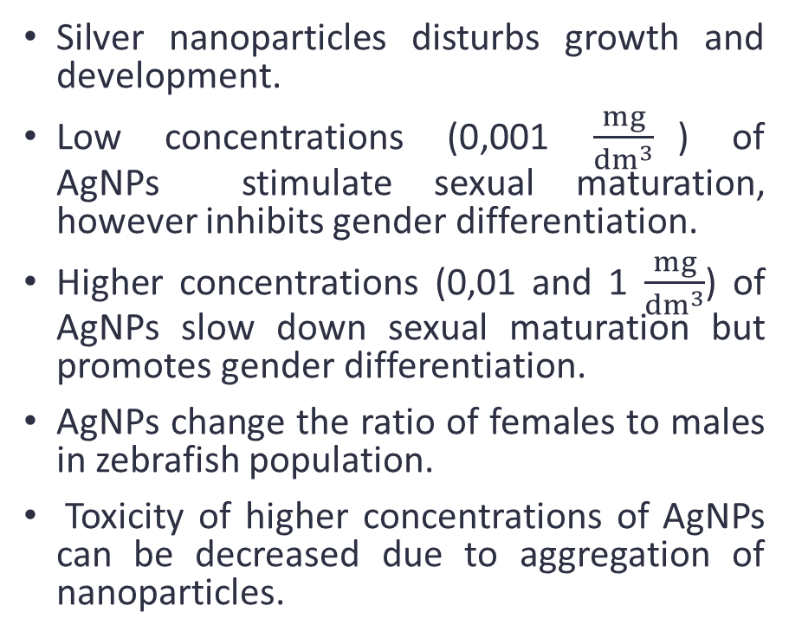
Summary
Silver nanoparticles disturbs growth and development.
Low concentrations (0,001 $\frac{mg}{{dm}^{3}}$) of AgNPs stimulate sexual maturation, however inhibits gender differentiation.
Higher concentrations (0,01 and 1 $\frac{mg}{{dm}^{3}}$) of AgNPs slow down sexual maturation but promotes gender differentiation.
AgNPs change the ratio of females to males in zebrafish population.
Toxicity of higher concentrations of AgNPs can be decreased due to aggregation of nanoparticles.
https://www.newscientist.com/article/2365966-zebrafish-seem-to-be-able-to-count-when-they-are-just-four-days-old/

Slide 9
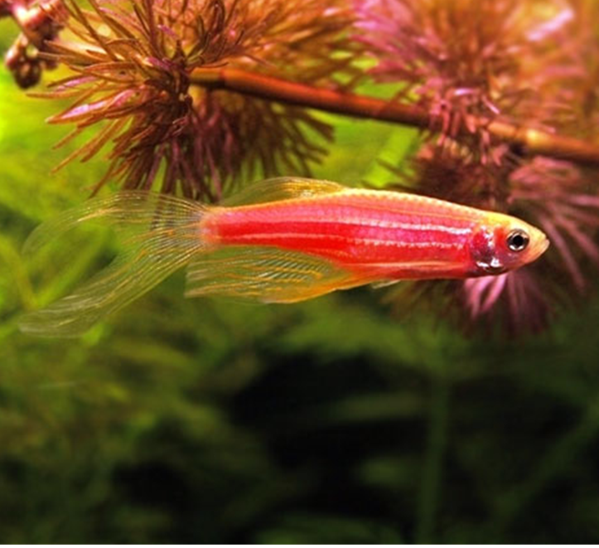
Thank you for your attention
Bibliography:
Banu, A. N., Kudesia, N., Raut, A. M., Pakrudheen, I., & Wahengbam, J. (2021). Toxicity, bioaccumulation, and transformation of silver nanoparticles in aqua biota: A review. Environmental Chemistry Letters, 19(6), 4275-4296.
Dumont, E., Johnson, A. C., Keller, V. D., & Williams, R. J. (2015). Nano silver and nano zinc-oxide in surface waters–Exposure estimation for Europe at high spatial and temporal resolution. Environmental pollution, 196, 341-349.
Kamaszewski, M., Kawalski, K., Wiechetek, W., Szudrowicz, H., Martynow, J., Adamek-Urbańska, D., ... & Aksakal, E. (2023). The Effect of Silver Nanoparticles on the Digestive System, Gonad Morphology, and Physiology of Butterfly Splitfin (Ameca splendens). International Journal of Molecular Sciences, 24(19), 14598.
Kamaszewski, M., Skrobisz, M., Wójcik, M., Kawalski, K., Szczepański, A., Bujarski, P., ... & Martynow, J. (2020). The role of transcription factors in gonad development and sex differentiation of a teleost model Fish—Guppy (Poecilia reticulata). Animals, 10(12), 2401.
van der Ven, L., Wester, P., Histology and Histopathology Atlas of the Zebrafish. Available online: http://zfin.org/hh_atlas/ (accessed on 15 March 2024).
https://rybyakwariowe.eu/ryba-akwariowa/danio-pregowany-pregowane-brachydanio-rerio/

