Slide 1


InvaScan
WebGIS application for automated detection of common ragweed and false indigo bush using satellite imagery
Ivona Žiža, Bruno Ćaleta, Damjan Hatić, Josipa Židov, Ivan Tekić
15th International Symposium
Kopački Rit: Past, Present, Future
Osijek, 1–2 October 2026
Notes:
Welcome. Today I present InvaScan, a WebGIS application developed by Oikon under the ESA PECS programme for automated satellite detection of two invasive alien plants: common ragweed and false indigo bush.

Slide 2
WHY INVASCAN?
Satellite-based detection of invasive alien plants, made usable for people who are not remote sensing specialists.
WHO
WHAT
HOW
Protected area managers
Two invasive species
Satellite imagery + AI
and other non-specialists in remote sensing
common ragweed and false indigo bush
developed under the ESA PECS programme
Notes:
The aim is to bring satellite detection of invasive plants to the people who manage the land. InvaScan is intended for protected area managers and other users who are not remote sensing experts.

Slide 3
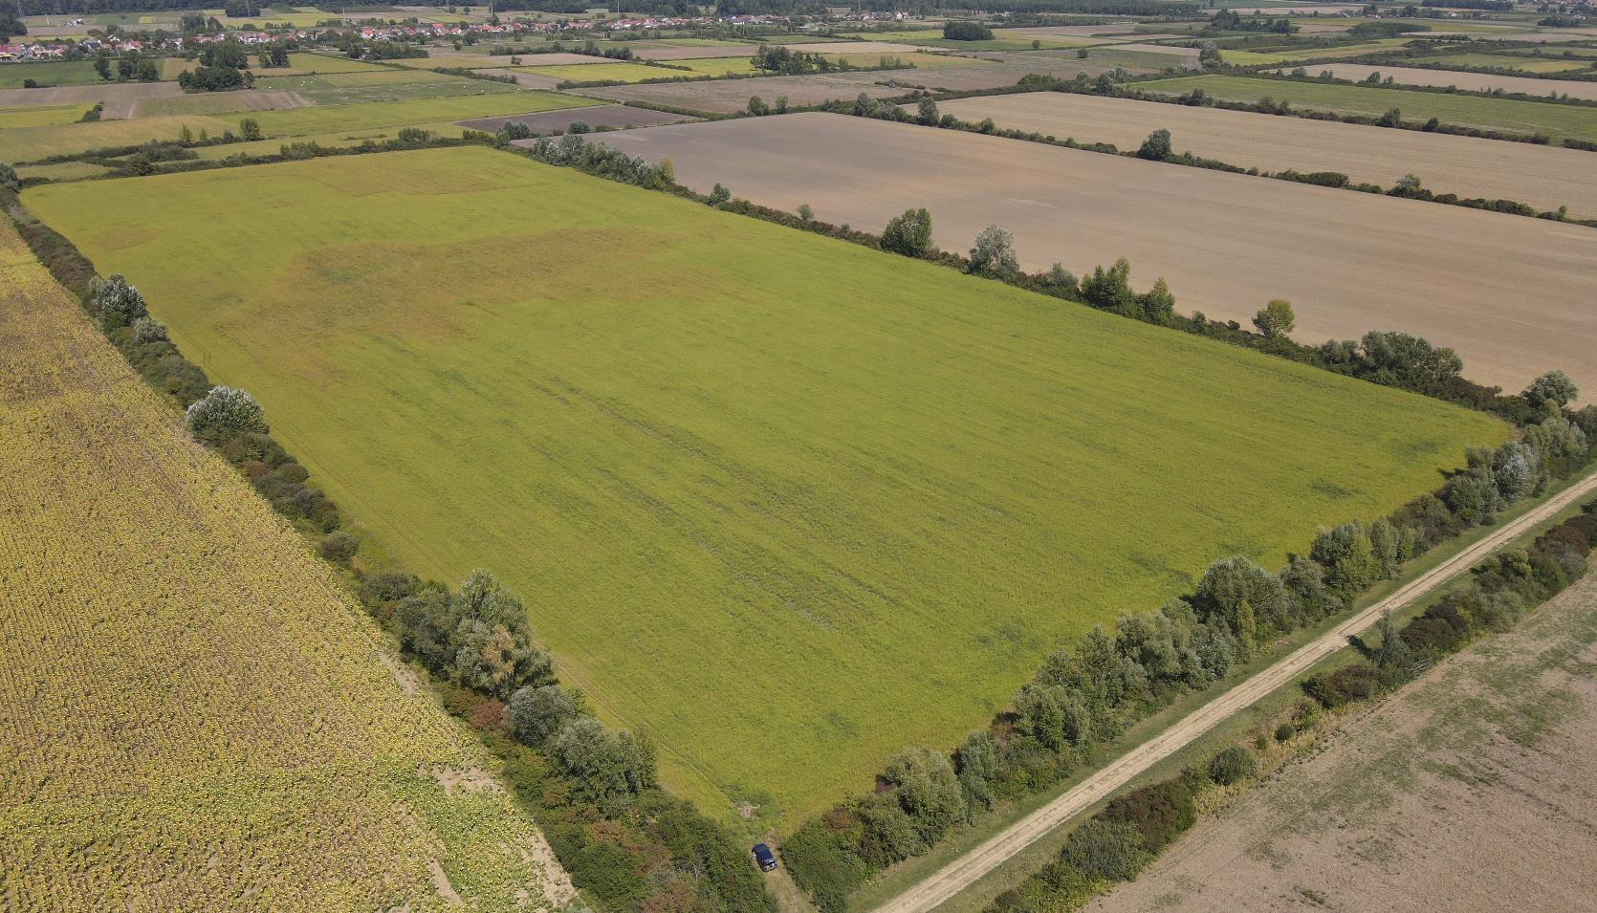
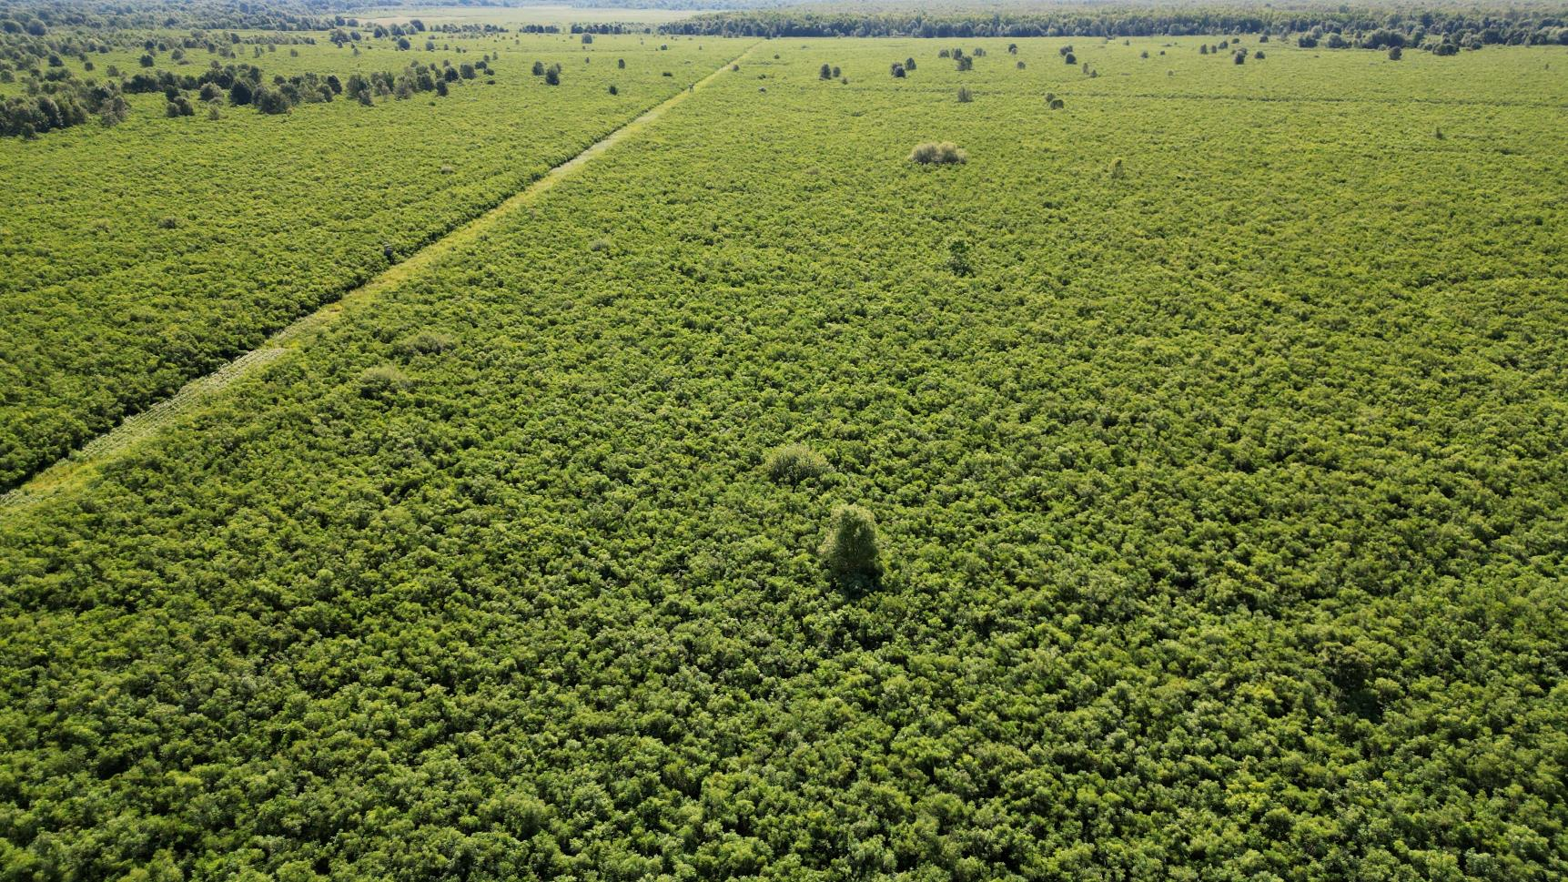
TWO TARGET SPECIES
Field covered with ragweed near Donji Andrijevci
False indigo bush in Turopolje
Common ragweed Ambrosia artemisiifolia
False indigo bush Amorpha fruticosa
Allergenic annual of fields and disturbed land
Shrub of floodplain lowlands, spread by flood water
Notes:
Two species with very different ecology. Ragweed is an allergenic annual of fields and disturbed land – here a field near Donji Andrijevci. False indigo bush spreads almost exclusively by flood water, which makes floodplains such as Kopački Rit the most exposed habitats – here a stand in Turopolje.

Slide 4
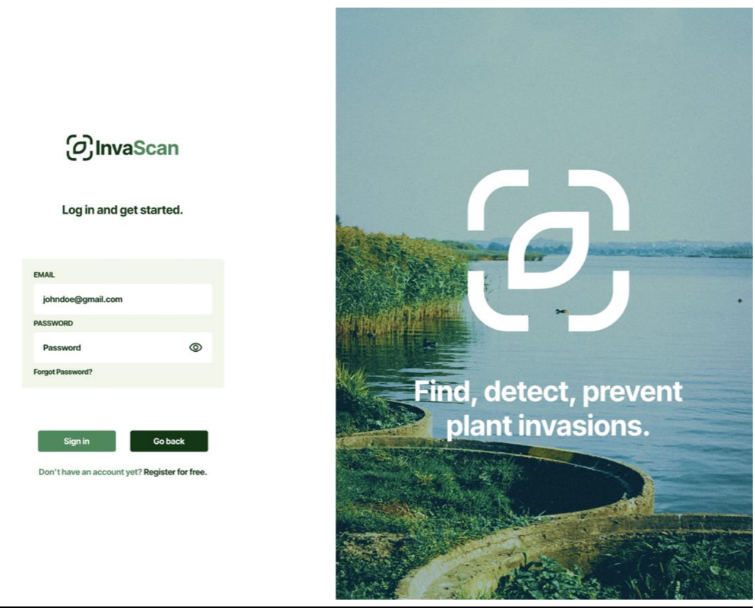
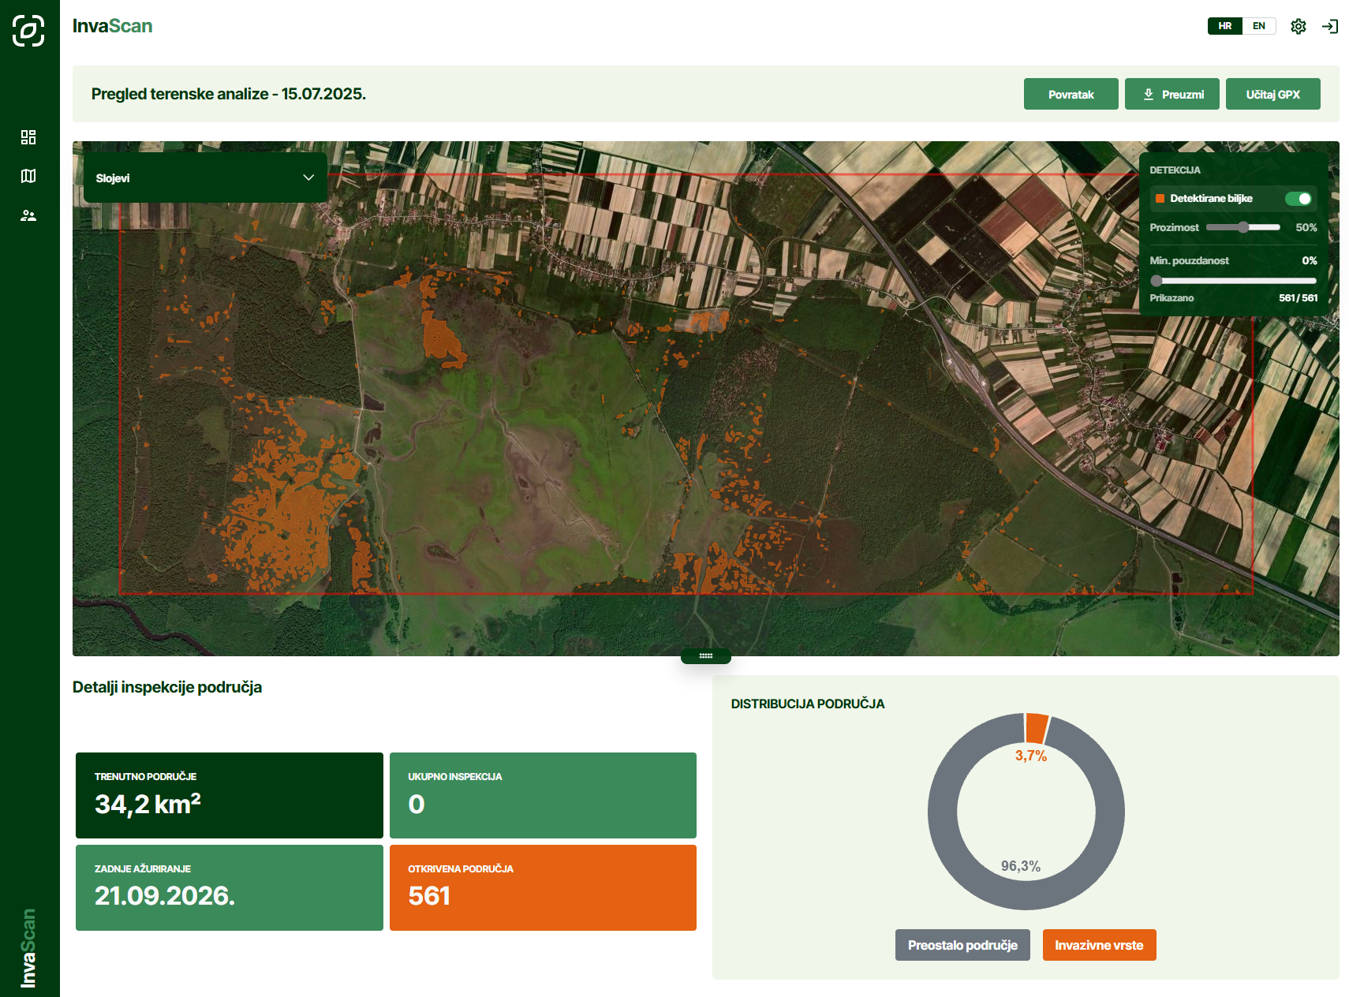
THE INVASCAN APPLICATION
User log-in
Area analysis: detection map, indicators and validation of findings
Notes:
This is the application itself. After logging in, the user sees the analysed area with the detection map, summary indicators and the tools for validating each finding.

Slide 5
HOW IT WORKS
1 DRAW
2 SELECT
3 RETRIEVE
4 DETECT
5 DOWNLOAD
Area of interest
Outline it in a web browser
Analysis settings
Species
Time range
Spatial detail
Automatic imagery
Sentinel-2 (10 m) or PlanetScope (3 m), preprocessed
Model inference
Classification model runs on the imagery
Results
Polygons with detection confidence, as shapefile
Single analysis or continuous monitoring of a set area at a set interval – same interface, no remote sensing expertise needed.
Notes:
The user draws an area of interest and chooses species, time range and spatial detail. The system retrieves and preprocesses Sentinel-2 or PlanetScope imagery, runs the model and returns polygons with a detection confidence, downloadable as a shapefile. Continuous monitoring is also supported.

Slide 6
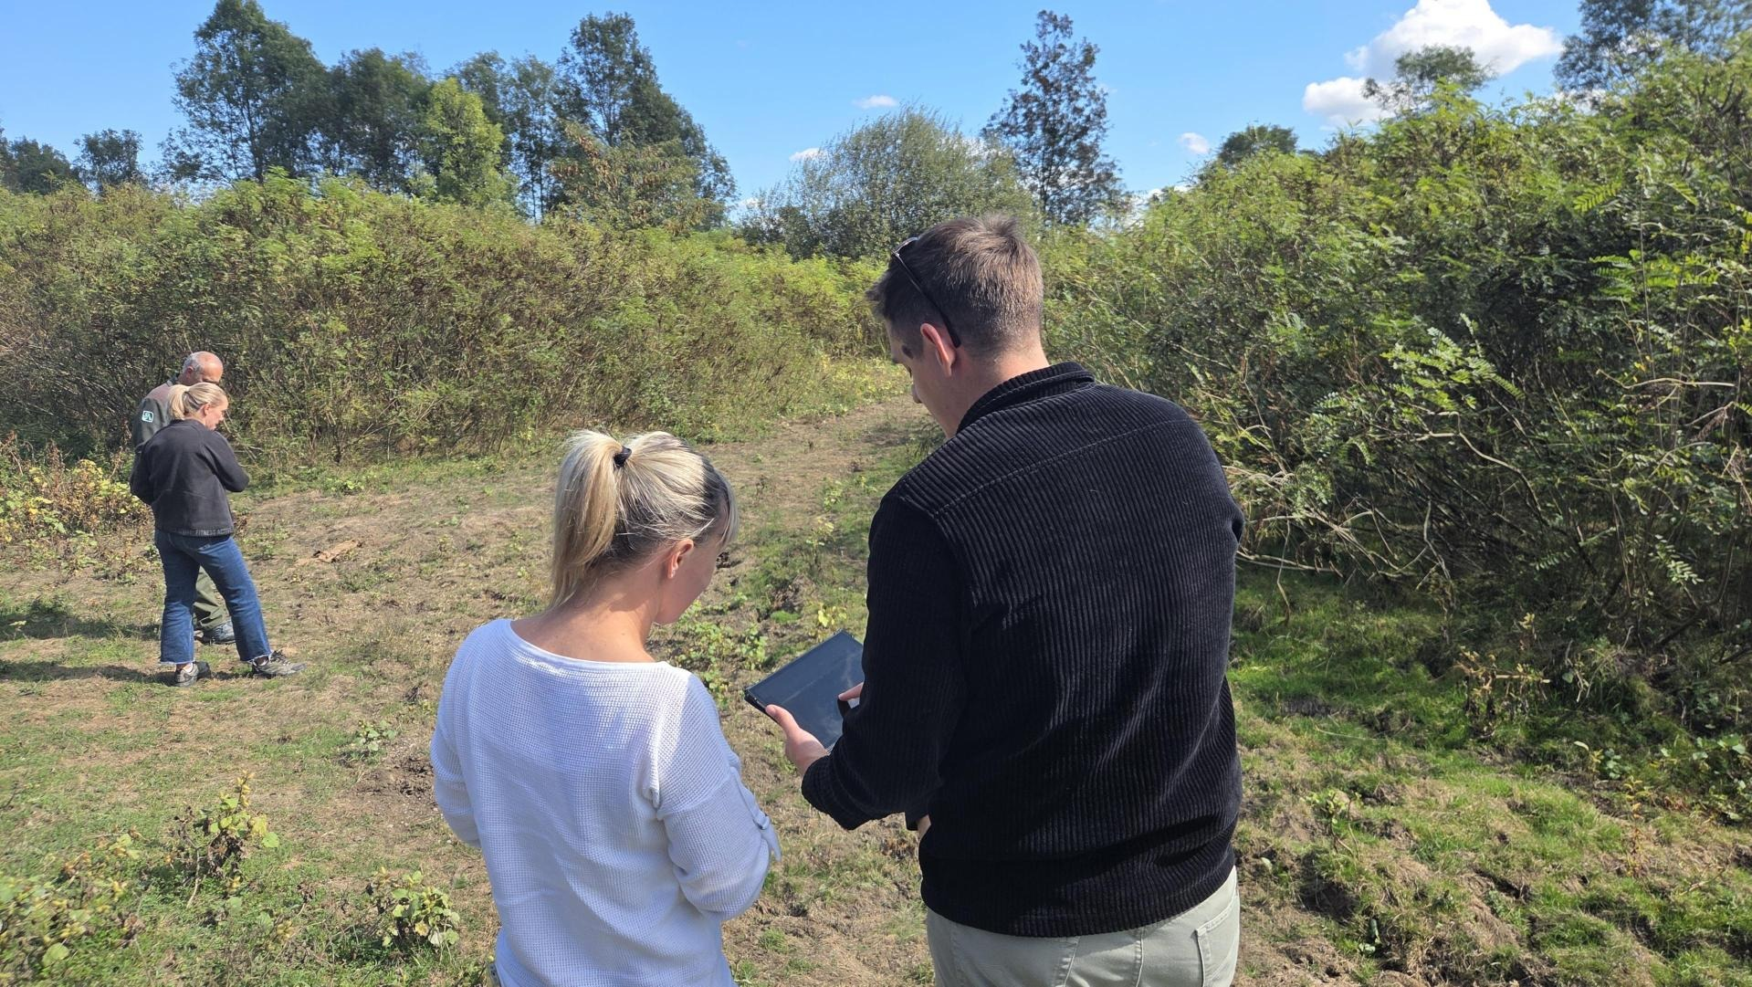
FIELD VALIDATION CLOSES THE LOOP
Detections are checked by field staff in the same interface.
DETECT
VERIFY
Satellite + model
Polygons + confidence
Field staff
Confirm / reject
Photos, GPX tracks
MONITOR
RETRAIN
Set interval
Repeat analysis of the area
Model update
Field evidence as training data
Field check next to a false indigo bush stand –
the app runs on tablets and phones
Notes:
Detections are confirmed or rejected in the same interface, with photographs and GPX tracks attached. This field evidence is used to retrain the models.

Slide 7
MODELS
INPUT
PRESTO
EMBEDDINGS
CLASSIFIER
Satellite time series
Sentinel-2
PlanetScope
Geospatial foundation model
Autoencoder trained on satellite time series
From the encoder only
Short numerical record per pixel
Multilayer perceptron
Species vs. background
+ random forest for some species
One model per species and per sensor. Presto compresses an image into a short numerical record and reconstructs it; only that record is taken from the encoder and used to train a per-pixel classifier.
Notes:
Na ulazu su satelitske vremenske serije iz Sentinela-2 i PlanetScopea, pa model vidi kako se vegetacija mijenja kroz godinu.
Te podatke obrađuje Presto, geoprostorni temeljni model, istreniran na satelitskim vremenskim serijama. Sažima ih u kratki numerički zapis, takozvani embedding.
Na embeddingima treniramo klasifikator, koji za svaki piksel odlučuje je li stanište vrste ili pozadina. Za neke vrste dodatno koristimo random forest.
Važno je da radimo zaseban model za svaku vrstu i za svaki senzor.

Slide 8
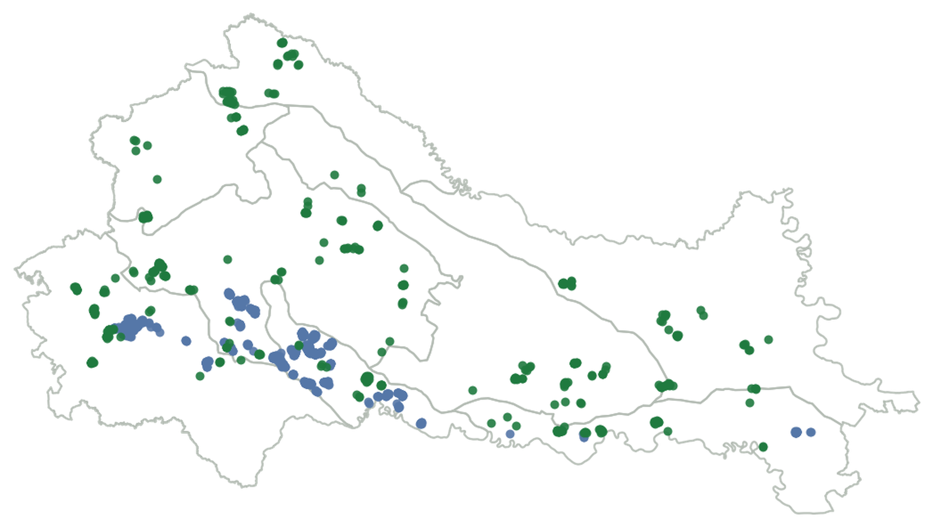
FIELD DATA
2022–2026
UAV field surveys
~25,000 km²
continental Croatia
10 m / 3 m
Sentinel-2 / PlanetScope
● Ambrosia 419 ● Amorpha 831 target-class polygons
Notes:
Field data were collected with drones between 2022 and 2026 across continental Croatia, about 25,000 square kilometres. The map shows the target-class training polygons: 419 for ragweed and 831 for false indigo bush.

Slide 9
RESULTS
SENTINEL-2 · 10 m
PLANETSCOPE · 3 m · false indigo bush
96.3 %
94.9 %
0.94
0.90
overall accuracy
overall accuracy
F1 score
IoU
common ragweed
false indigo bush
held-out test areas
held-out test areas
≈ 3 % false positive rate
Higher resolution captures smaller stands – at 3 m the false indigo bush model delineates stands with high overlap.
Notes:
On Sentinel-2 overall accuracy is 96.3 percent for ragweed and 94.9 percent for false indigo bush, with a false positive rate of about 3 percent. On PlanetScope at 3 metres the false indigo bush model reaches F1 0.94 and IoU 0.90 on held-out areas.

Slide 10
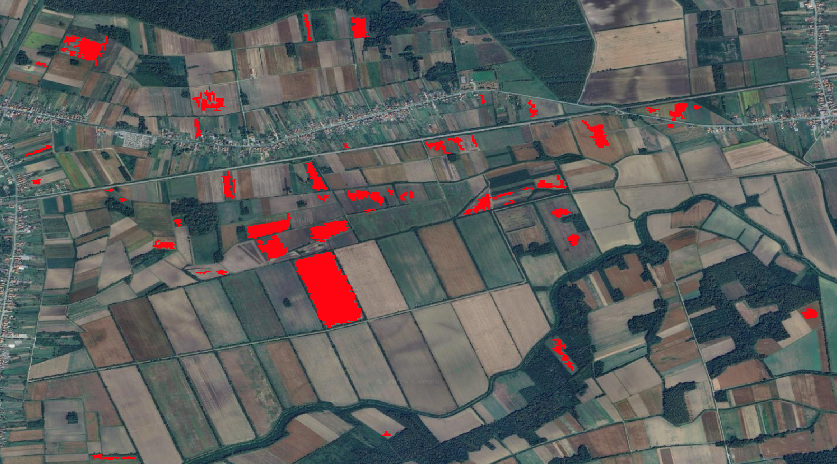
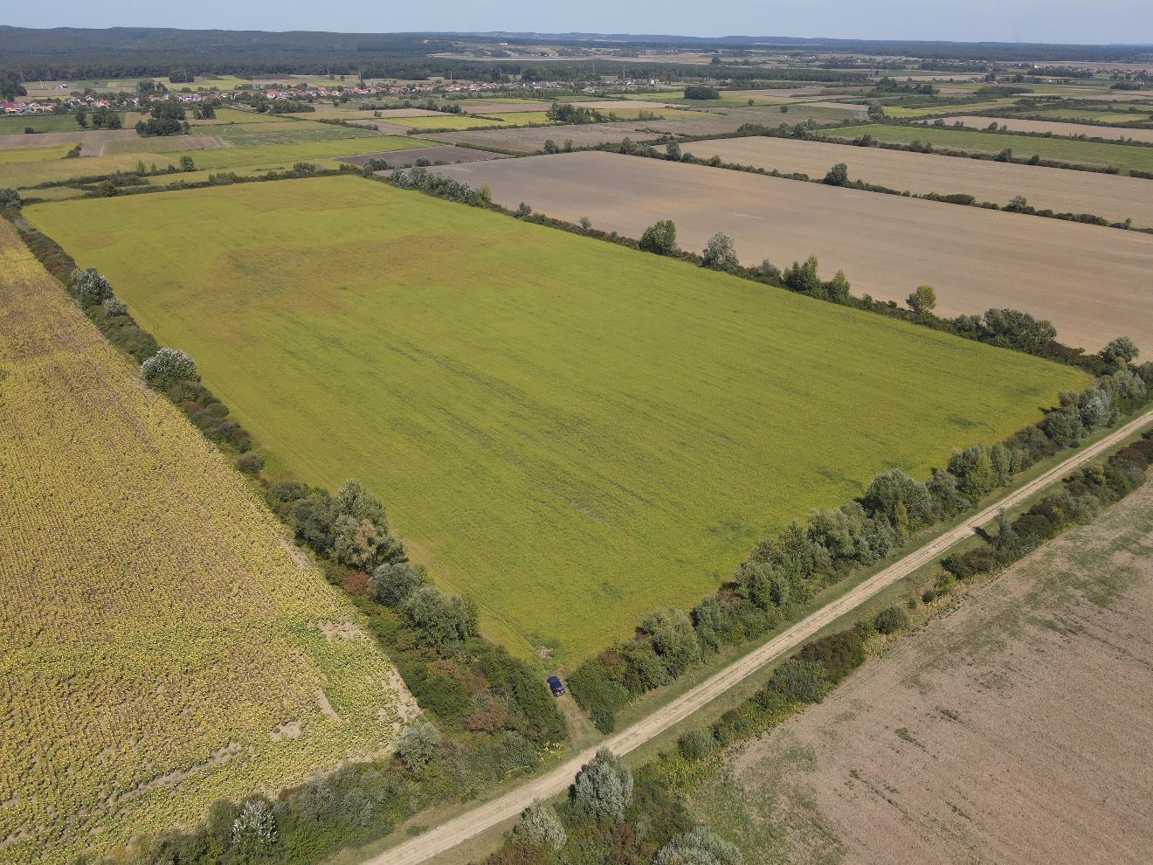
DETECTION IN PRACTICE
Detected ragweed (red) on a satellite basemap – Donji Andrijevci
Drone view of the same fields
Larger infested areas are exactly what the satellite detects reliably.
Notes:
An example from Donji Andrijevci: on the left the ragweed detected by the model in red, on the right the drone view of the same fields. Larger infested areas are what the satellite detects most reliably.

Slide 11
FIELD VERIFICATION IN KOPAČKI RIT
JULY 2026
WHY KOPAČKI RIT?
Kopački Rit Nature Park
• Field verification of model detections
• Small amounts of false indigo bush detected
Inside the model coverage
• Coverage spans all of continental Croatia
• One of the most important floodplains in the country
False indigo bush spreads almost exclusively by flood water and settles floodplain lowlands – floodplains like Kopački Rit are the most exposed areas and a priority for early detection.
Notes:
In July 2026 we carried out field verification in Kopački Rit Nature Park, where the model detected small amounts of false indigo bush. The area was included because the model covers all of continental Croatia and Kopački Rit is among the most important floodplains. Because false indigo spreads by flood water, floodplains are most exposed.

Slide 12
STATUS AND OUTLOOK
READY
LIMITATION
TRANSFERABLE
Operational
• Application is finished
• Runs over the whole coverage area
Where to be careful
• Young and fragmented stands
• Model stays conservative there
Next steps
• Other protected areas
• Additional species
• No interface changes needed
Interested in monitoring your protected area? Let’s talk after the session.
Notes:
The application is finished and runs over the whole coverage area. The remaining limitation is detection of young and fragmented stands, where the model is conservative. The system can be transferred to other protected areas and species without changes to the interface.

Slide 13






THANK YOU
Ivona Žiža
Oikon Ltd.
E iziza@oikon.hr
Oikon Ltd. – Institute of Applied Ecology
Trg senjskih uskoka 1-2
HR – 10020 Zagreb
T +385 1 5507 100
F +385 1 5507 101
E oikon@oikon.hr
W www.oikon.hr
We support and contribute to the Sustainable Development Goals
Notes:
Thank you. Questions are welcome.

