Slide 1
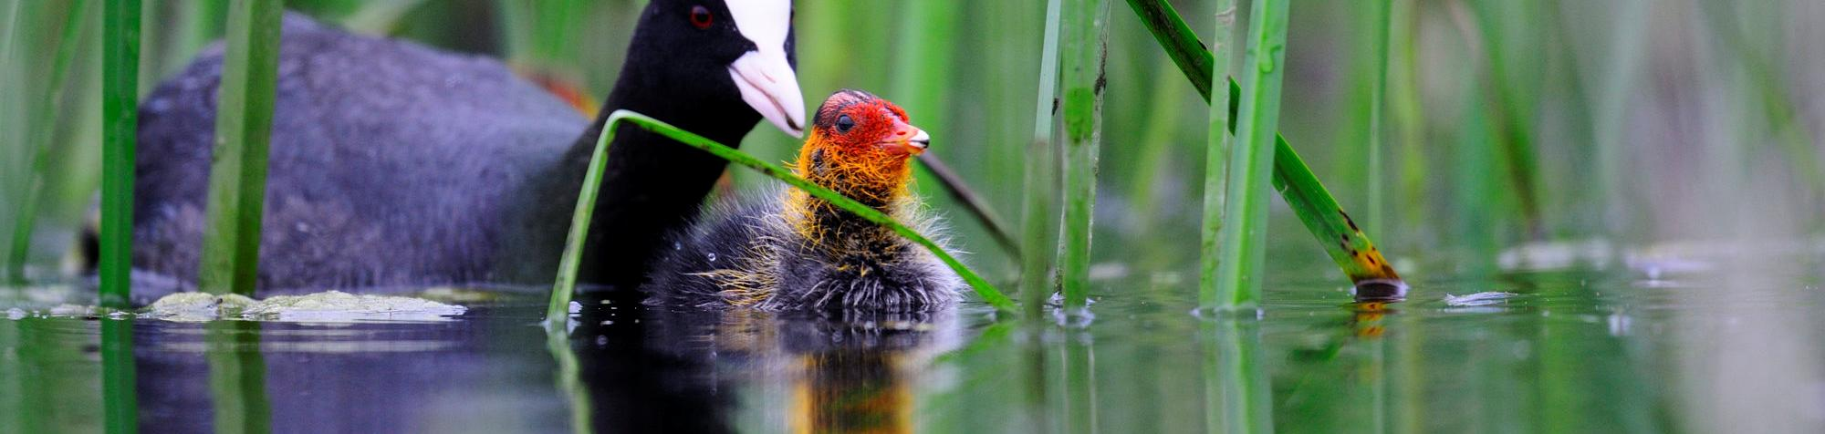








15TH INTERNATIONAL SYMPOSIUM
KOPAČKI RIT: PAST, PRESENT, FUTURE 2026
Fulica atra, Kopački rit
Bioacoustics Monitoring in the WatchOut Project as Support for Ornithofauna Monitoring in Kopački rit Nature Park
Vlatko Rožac, JUPP Kopački rit
October 2, 2026

Slide 2


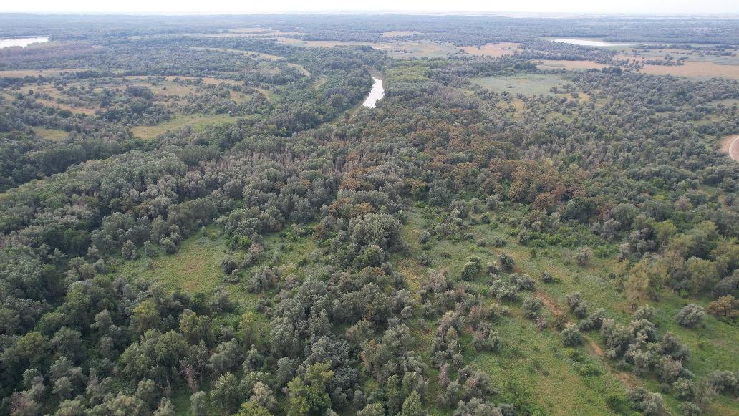
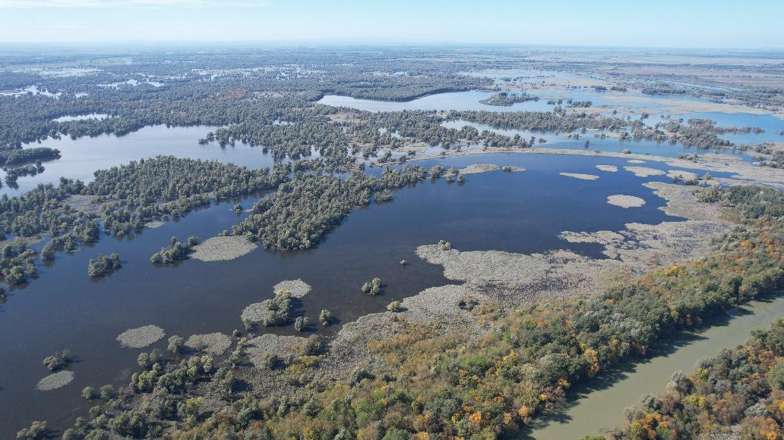
Kopački rit
big river floodplain
often periodic disturbances
high biodiversity
the most dynamic and endangered ecosystems

Slide 3
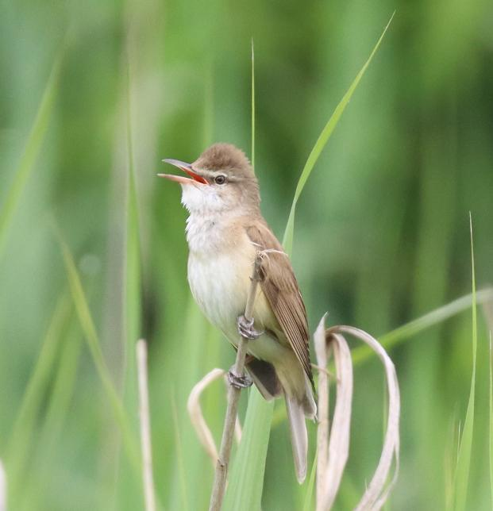
Kopački rit Management
Sustainability
Adaptability
  Surveillance
  Monitoring
Monitoring
Action
Decisions

Slide 4
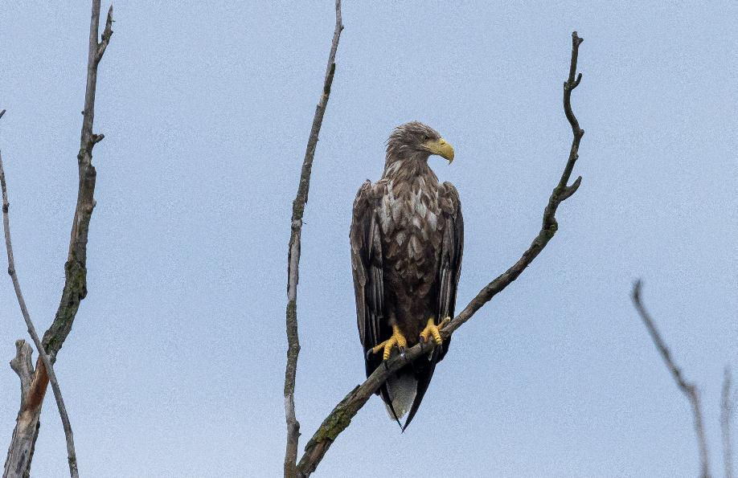
large area
high biodiversity
indicator taxon
birds
complex ecosystem relations
standard monitoring
bioacoustics monitoring
linear transect
Monitoring

Slide 5
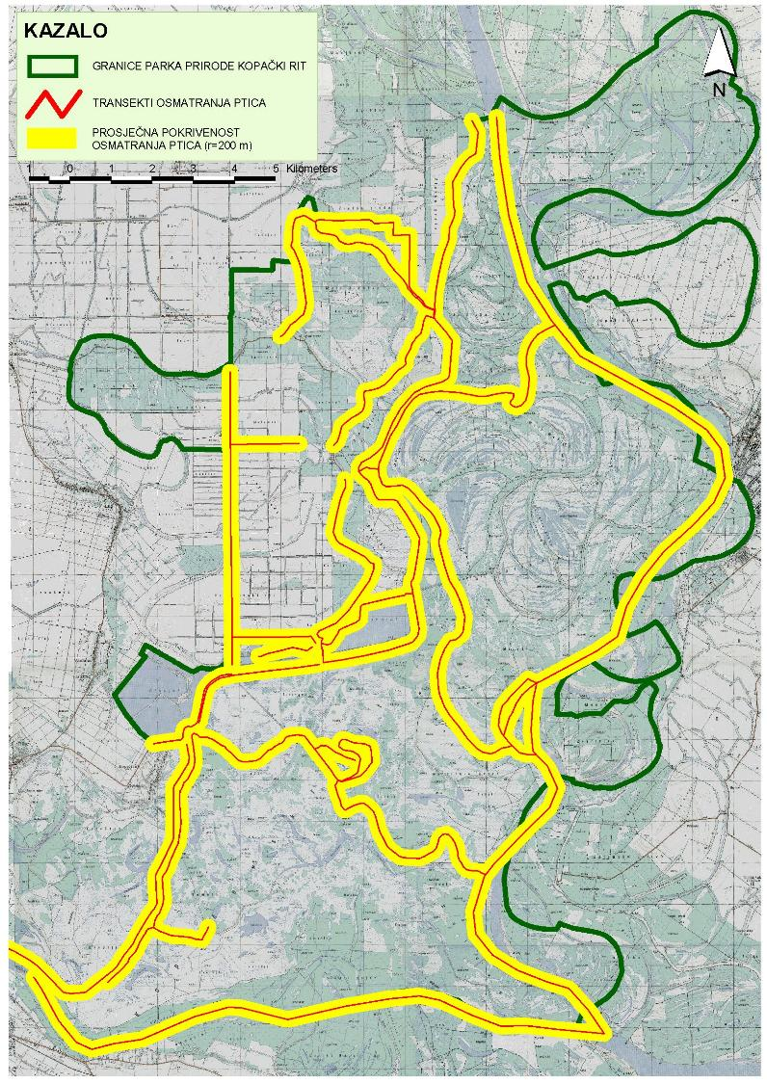
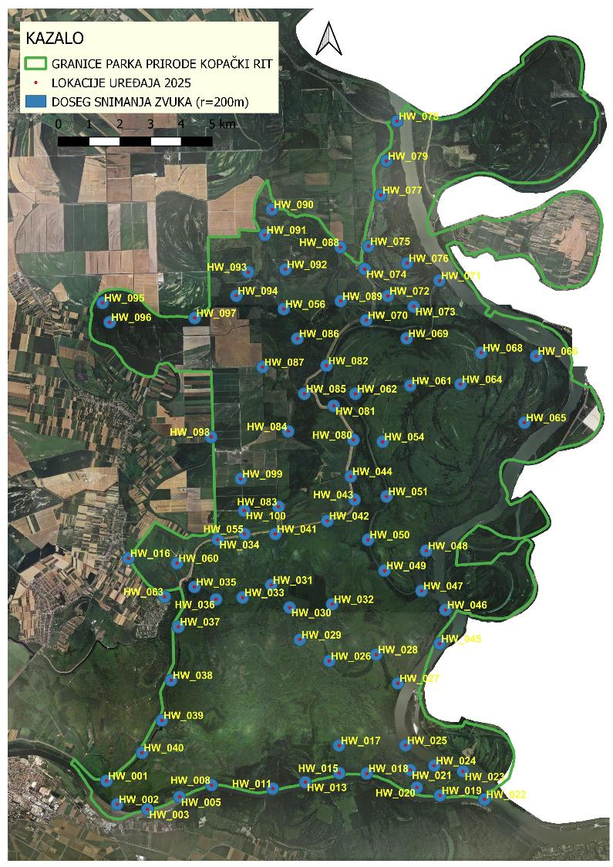

Monitoring Results
Linear transect in July – August 2025
2nd round of bioacoustics monitoring 2025

Slide 6
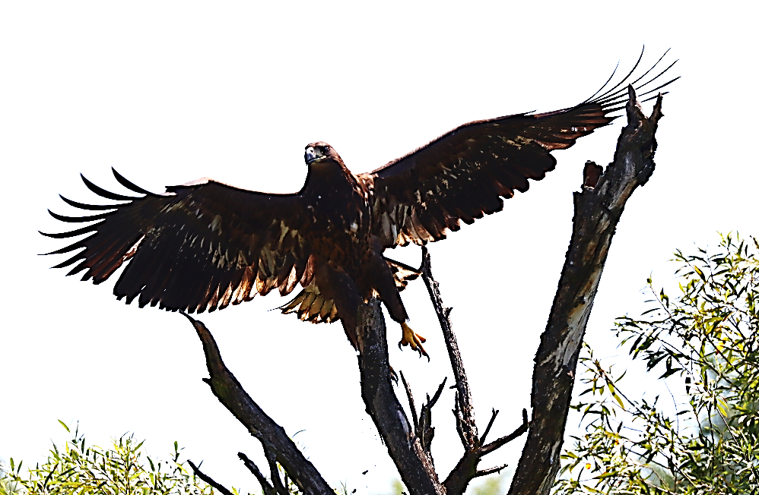
Monitoring Results
 | Standard monitoring | Bioacoustics monitoring
Detection | visual + acoustic | acoustic
Linear transect | 34/58
Spot |  | 85
Field effort (PD) | 24 | 42,5
Number of species | 84 | 224 (-35)
Duration (h) | 72 | 14.385,6
Surface (ha) | 5.891,708 | 1.092,72

Slide 7
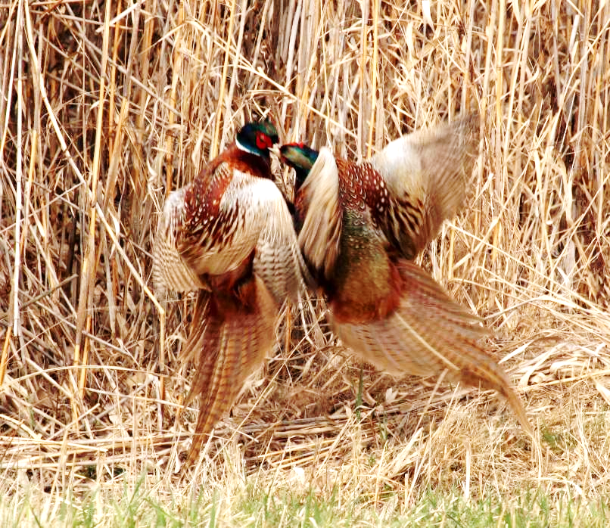
Conclusion
Bioacoustics monitoring data:
species presence,
distribution,
dispersion,
behaviour,
nesting & migration periods.
Improvements
Technical
efficiency
Data quality
abundance
density

Slide 8
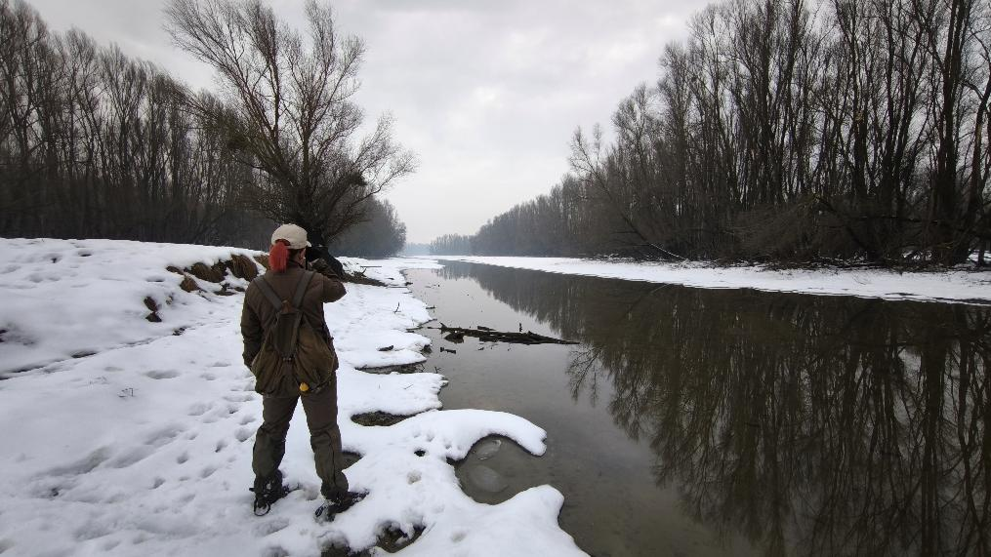
Conclusion
Purpose is not to replace standard monitoring, but to improve the efficiency and data quality to perform more precisely conclusions for the sustainable and adaptive protected area management.

Slide 9

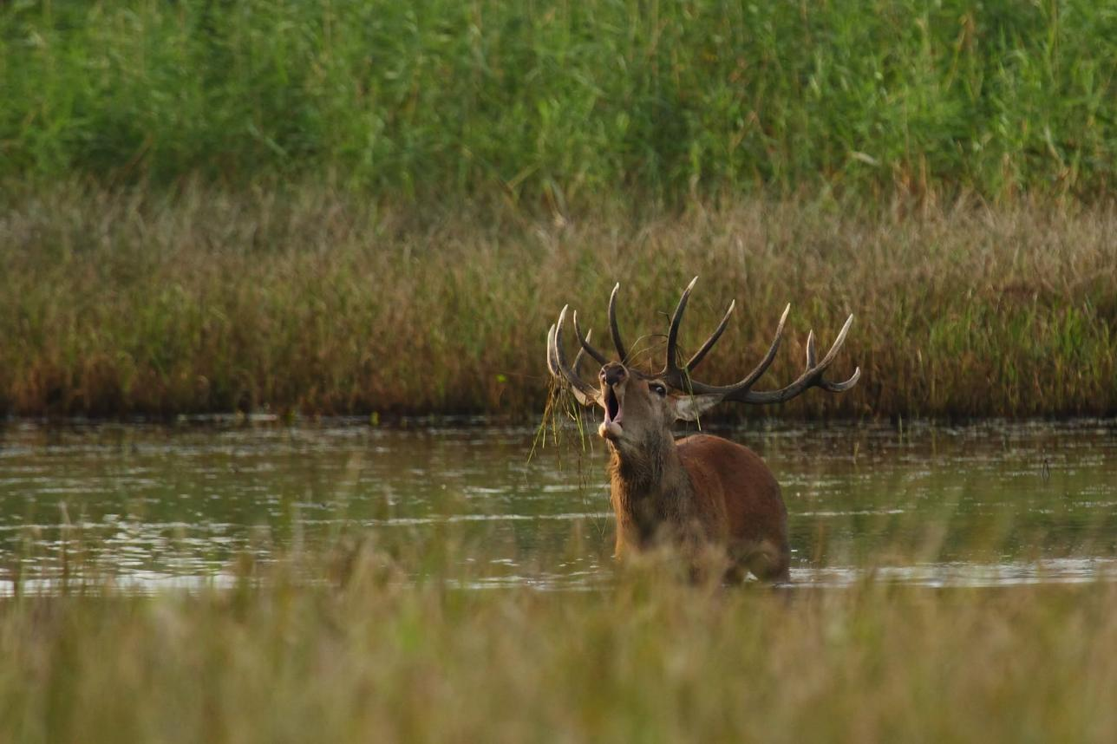



Acknowledgment
Thank you for your attention!
https://watchout.com.hr/

