Slide 1
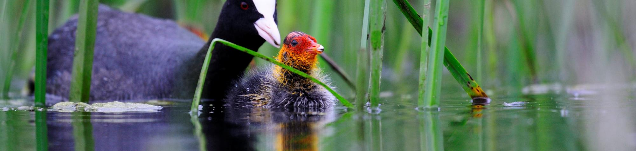








15TH INTERNATIONAL SYMPOSIUM
KOPAČKI RIT: PAST, PRESENT, FUTURE 2026
Fulica atra, Kopački rit
Achievements of standard biodiversity monitoring in
Kopački rit Nature Park during the implementation
of the "Watch Out" project
SINIŠA OZIMEC, IVANA MAJIĆ, TIHOMIR FLORIJANČIĆ, ANKICA SARAJLIĆ, IVAN PLAŠČAK,
DORIJAN RADOČAJ, DRAGAN PRLIĆ, MARIN ŠKORO, MARIJA VEREŠ, VLATKO ROŽAC
October 2, 2026

Slide 2


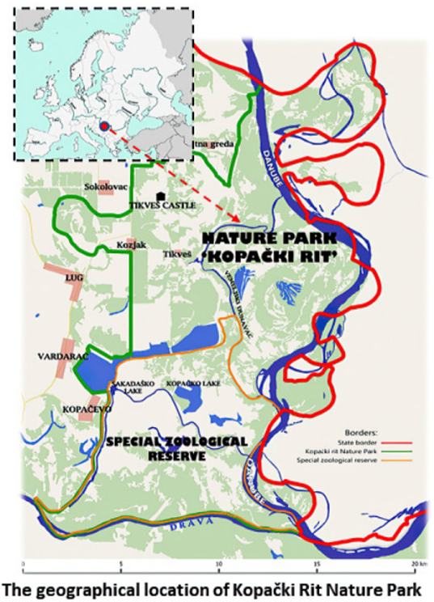
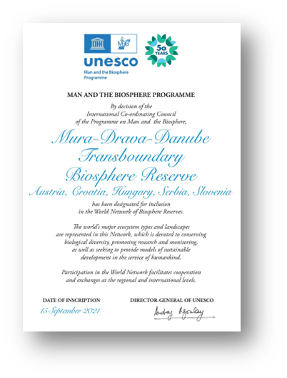

Nature conservation status:
Kopački rit Managed Nature Reserve (1967)
Kopački rit Special Zoological Reserve, and
Nature Park (1976)
Kopački rit Nature Park (1999)
List of Wetlands of International Importance
under the Ramsar Convention (No. 583/1992)
UNESCO’s Man and Biosphere Programme:
Mura-Drava-Danube Transboundary
Biosphere Reserve (Croatia-Hungary) (2012)
Mura-Drava-Danube 5-country
Transboundary Biosphere Reserve (Austria,
Croatia, Hungary, Serbia, Slovenia) (2021)
Ecological network Natura 2000:
SPA (Birds Directive)
HR1000016 Podunavlje i donje Podravlje
SAC (Habitats Directive)
HR2000394 Kopački rit

Slide 3
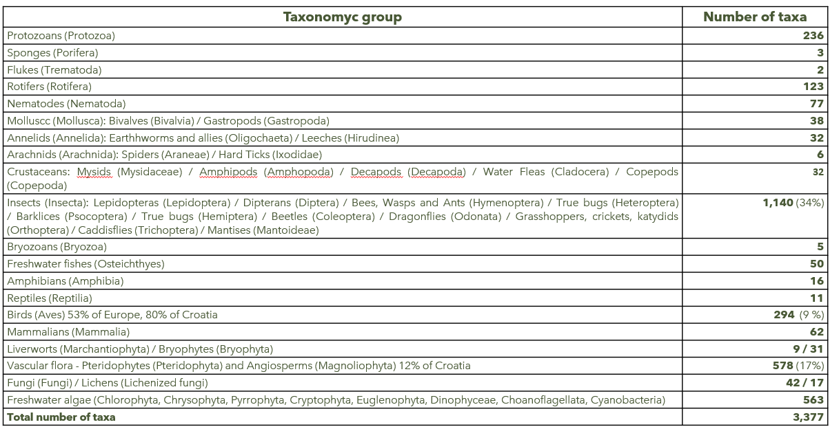
Biodiversity estimation for
Kopački rit Nature Park

Slide 4
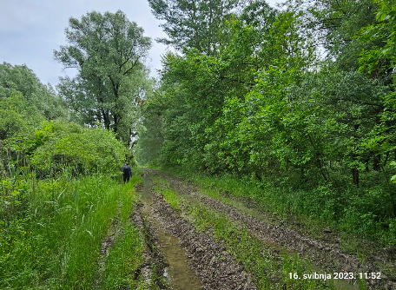
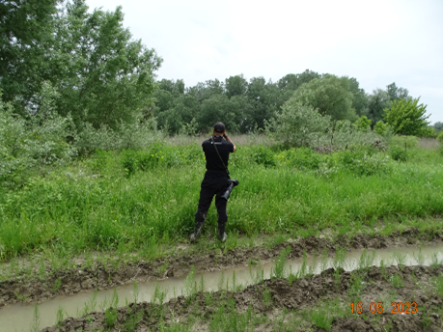
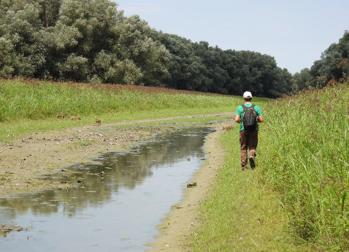
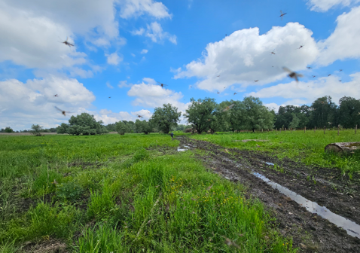
Standard monitoring of habitats, wild fauna and flora was done by researchers from the Faculty of Agrobiotechnical Sciences Osijek, and with partnership of employees of the Public Institution Kopački rit Nature Park, in the period April 2023 - September 2026.
Application of standard protocols for monitoring in wildlife biology for particular taxonomic groups, field observations, use of camera traps, recording and analyses of collected data.
Project results makes an important contribution to better knowledge on diversity of habitats, wild fauna, flora in Kopački rit Nature Park, especially of threatened, rare, strictly protected, and Natura 2000 target species.

Slide 5
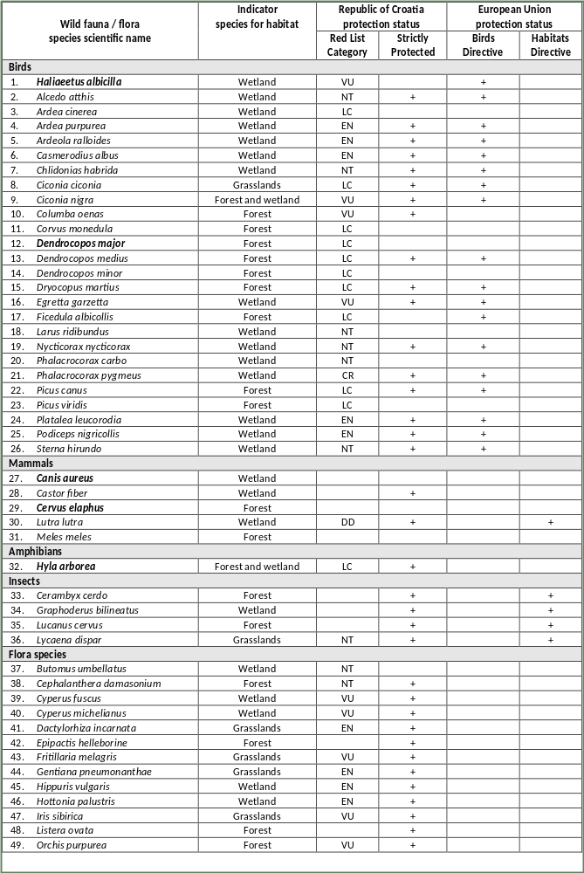
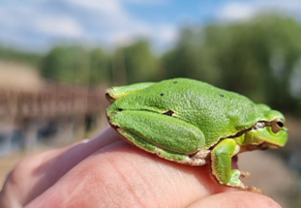
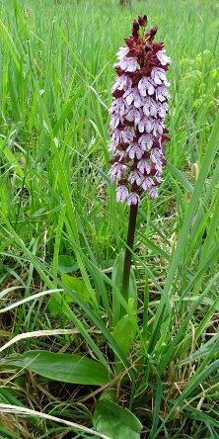
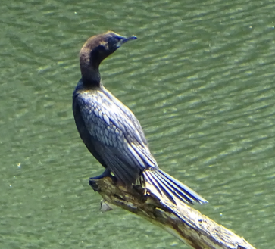
Priority for standard monitoring: 49 wild fauna
and flora species, selected as indicator species
of various habitats: aquatic and wetland,
forest, forest and wetland, and grassland habitats
Insects: 4 species
Amphibians: 1 species
Birds: 26 species
Mammals: 5 species
Flora: 13 species
Red List of Croatia: 40 species
Natura 2000 target species: 23 species

Slide 6
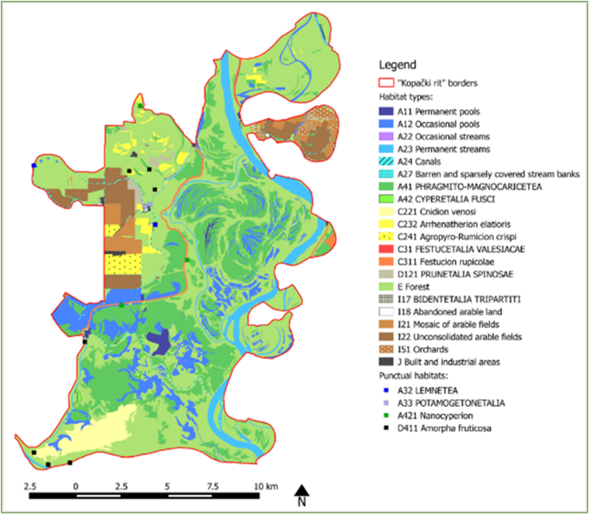
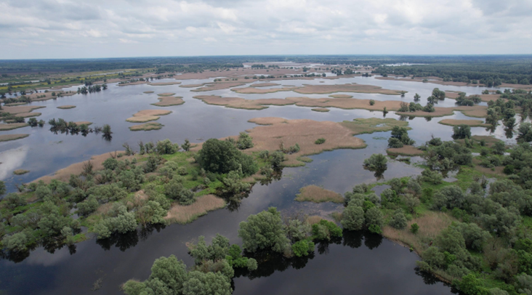
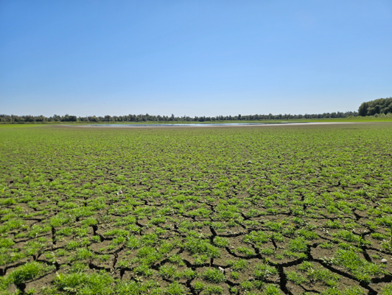

Habitat diversity consists of 89 habitat types, of which 49 (55%) are endangered at the national and European level.
Target habitat types and target wild fauna species for the Natura 2000 ecological network sites SPA HR1000016 and SAC HR2000394 Kopački rit, had been recorded.
The spatial distribution of terrestrial, aquatic and wetland habitat types is in permanent dynamic, depending on frequency, intensity and duration of floods (mainly the Danube River), as well as of drought periods.

Slide 7
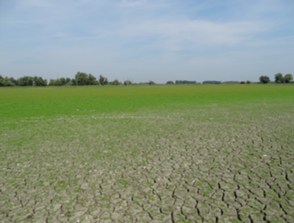
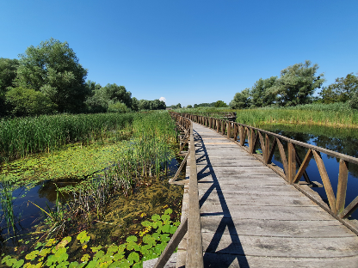
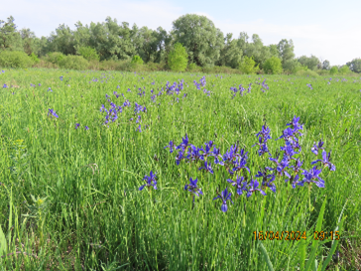
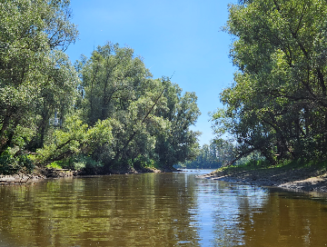
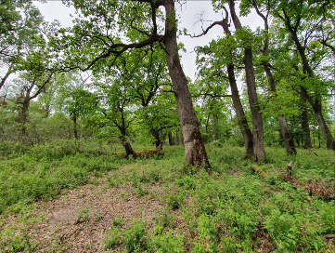
List of target and priority habitat types from Annex I
of the EU Habitats Directive, designated for
SAC HR2000394 Kopački rit:
3130 Oligotrophic to mesotrophic standing waters
with vegetation of the Littorelletea uniflorae and/or
the Isoëto-Nanojuncetea
3150 Natural eutrophic lakes with Magnopotamion
or Hydrocharition – type vegetation
6440 Alluvial meadows of river valleys of the
Cnidion dubii
91E0* Alluvial forests with Alnus glutinosa and
Fraxinus excelsior (Alno-Padion, Alnion incanae,
Salicion albae)
91F0 Riparian mixed forests of Quercus robur,
Ulmus laevis and Ulmus minor, Fraxinus excelsior
or Fraxinus angustifolia, along the great rivers
(Ulmenion minoris)

Slide 8
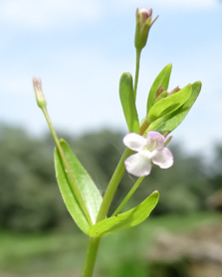
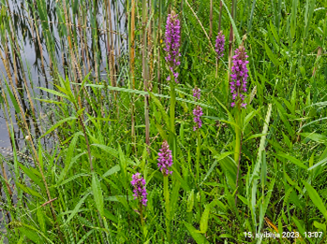
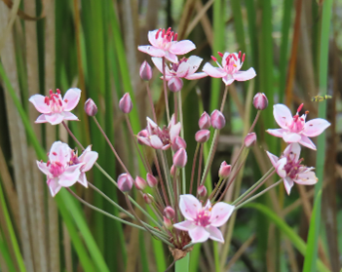

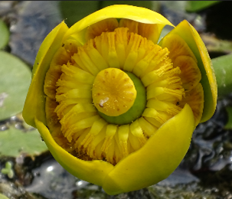

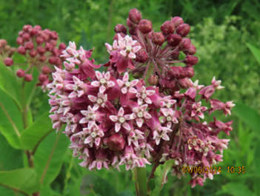
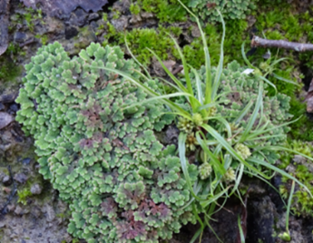
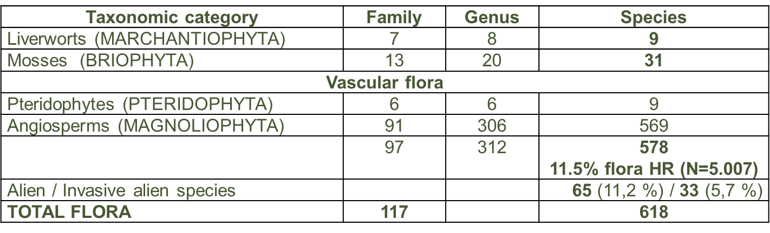
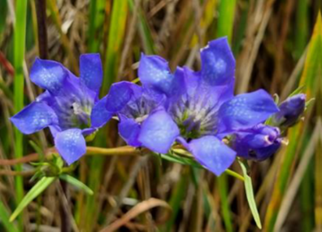
Flora diversity

Slide 9
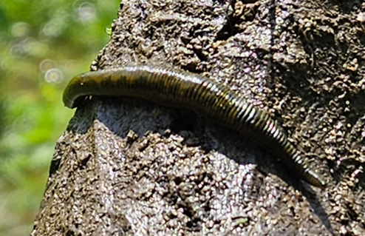
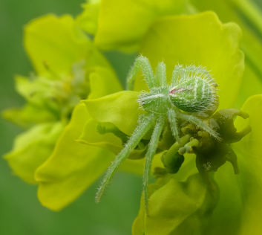
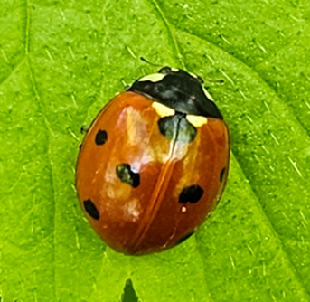
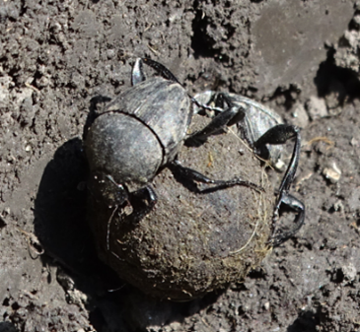
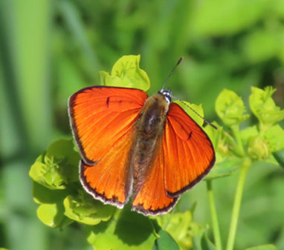
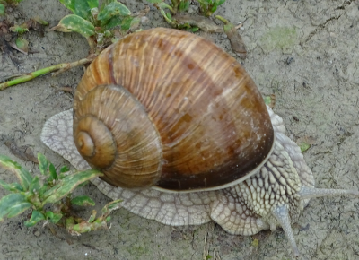
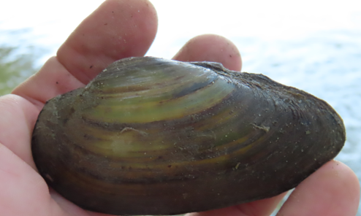
Invertebrate diversity
Wild fauna diversity from the taxonomic
groups of invertebrates: snails, bivalves,
leeches, arachnids, and insects, had been
recorded.
Insects with 1,138 species makes 34% of
total known biota; dominating groups:
Coleoptera (390 species), and Lepidoptera
(339 species). About 42 aquatic insects.
Lycaena dispar, Natura 2000 target species

Slide 10
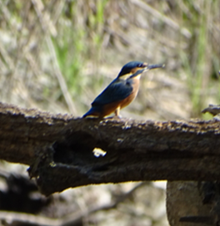
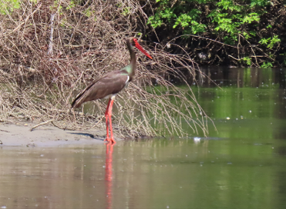
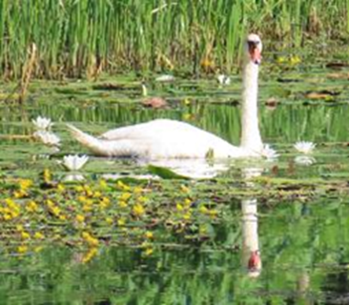
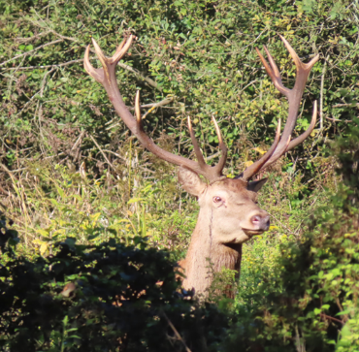
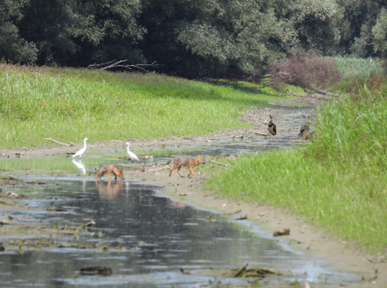
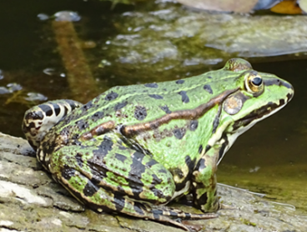
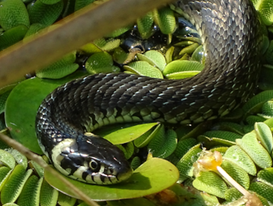
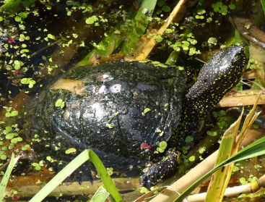
Vertebrate diversity
Freshwater fish fauna: 50 species 14 families
Amphibian fauna: 12 species of frogs and newts
Reptile fauna: 11 species, turtles and snakes
Bird fauna: 294 species (80% of total for
Croatia); wetland character of Kopački rit
provides optimal conditions for many marshland
and colonial waterbird species
Mammal fauna: 62 species (61% of total
for Croatia); dominating group are: rodents (20),
bats (19), and carnivores (11 species)

Slide 11
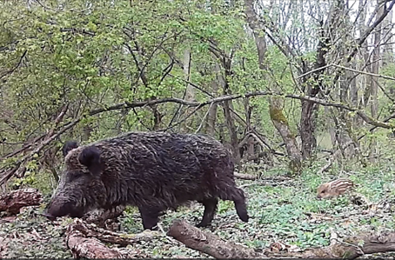
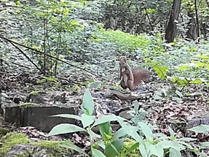
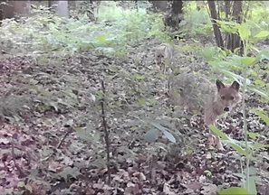
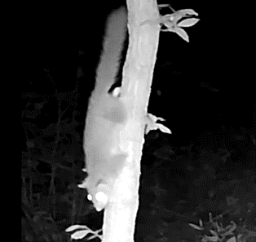
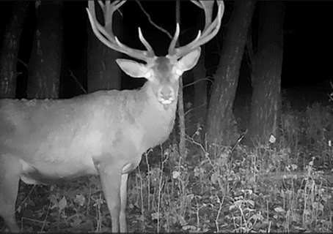
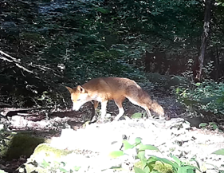
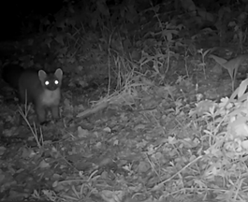

Camera traps are suitable tool for recording the presence and distribution of individuals of certain animal species, estimating the population size, monitoring behaviour and daily and seasonal activities. By analysing the camera traps records (photographs and video clips), a total of 22 animal species were recorded, 12 belongs to mammal fauna, and 10 to bird fauna.
According to number of recorded individuals, dominating species were: wild boar, red deer, red squirrel, pine marten, European badger and golden jackal.
Birds (Aves)
Buteo buteo (Linnaeus, 1758)
Corvus corone (Linnaeus, 1758)
Dryocopus martius (Linnaeus, 1758)
Garrulus glandarius (Linnaeus, 1758)
Parus major (Linnaeus, 1758)
Phasianus colchicus (Linnaeus, 1758)
Picus viridis (Linnaeus, 1758)
Sitta europaea (Linnaeus, 1758)
Troglodytes troglodytes (Linnaeus, 1758)
Turdus merula (Linnaeus, 1758)
Mammals (Mammalia)
Apodemus sp. (Kaup, 1829)
Canis aureus (Linnaeus, 1758)
Capreolus capreolus (Linnaeus, 1758)
Cervus elaphus (Linnaeus, 1758)
Felis silvestris (Schreber, 1775)
Glis glis (Linnaeus, 1766)
Lepus europaeus (Pallas, 1778)
Martes martes (Erxleben, 1758)
Meles meles (Linnaeus, 1758)
Sciurus vulgaris (Linnaeus, 1758)
Sus scrofa (Linnaeus, 1758)
Vulpes vulpes (Linnaeus, 1758)

Slide 12





Acknowledgment
Thank you for your attention!
https://watchout.com.hr/

