Slide 1



Sediment Management to Nature-Based River Training: Concept of an artificial Island at the Drava–Danube Confluence
Assoc. Prof. Gordon Gilja
Asst. Prof. Antonija Harasti
University of Zagreb Faculty of Civil Engineering
Laboratory for river and sediment dynamics (RISED)

Slide 2
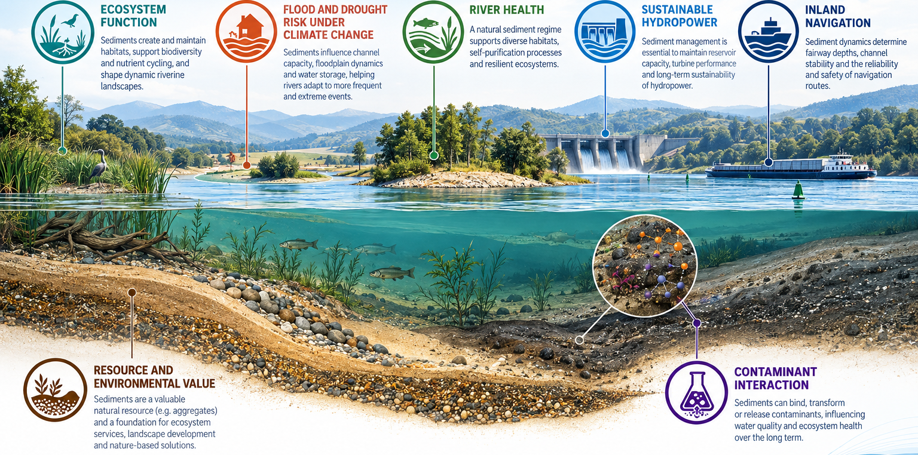
Sediments: the hidden key for healthy rivers
An increasing discrepancy between sediment surplus, e.g. reservoir sedimentation, and sediment deficit, e.g. river bed and coastal erosion, can be observed
This change of the sediment balance leads to an increase of flood risk, reduction of navigation possibilities and hydropower production and deterioration of the ecological conditions in the Danube River
INLAND NAVIGATION: Sediment balance supports fairway conditions

Slide 3
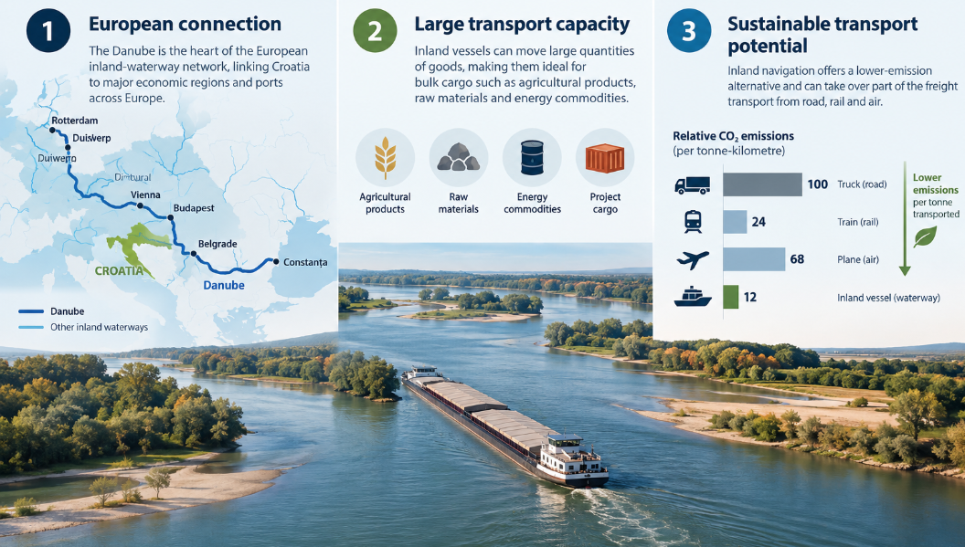
Why inland navigation matters in Croatia?

Slide 4
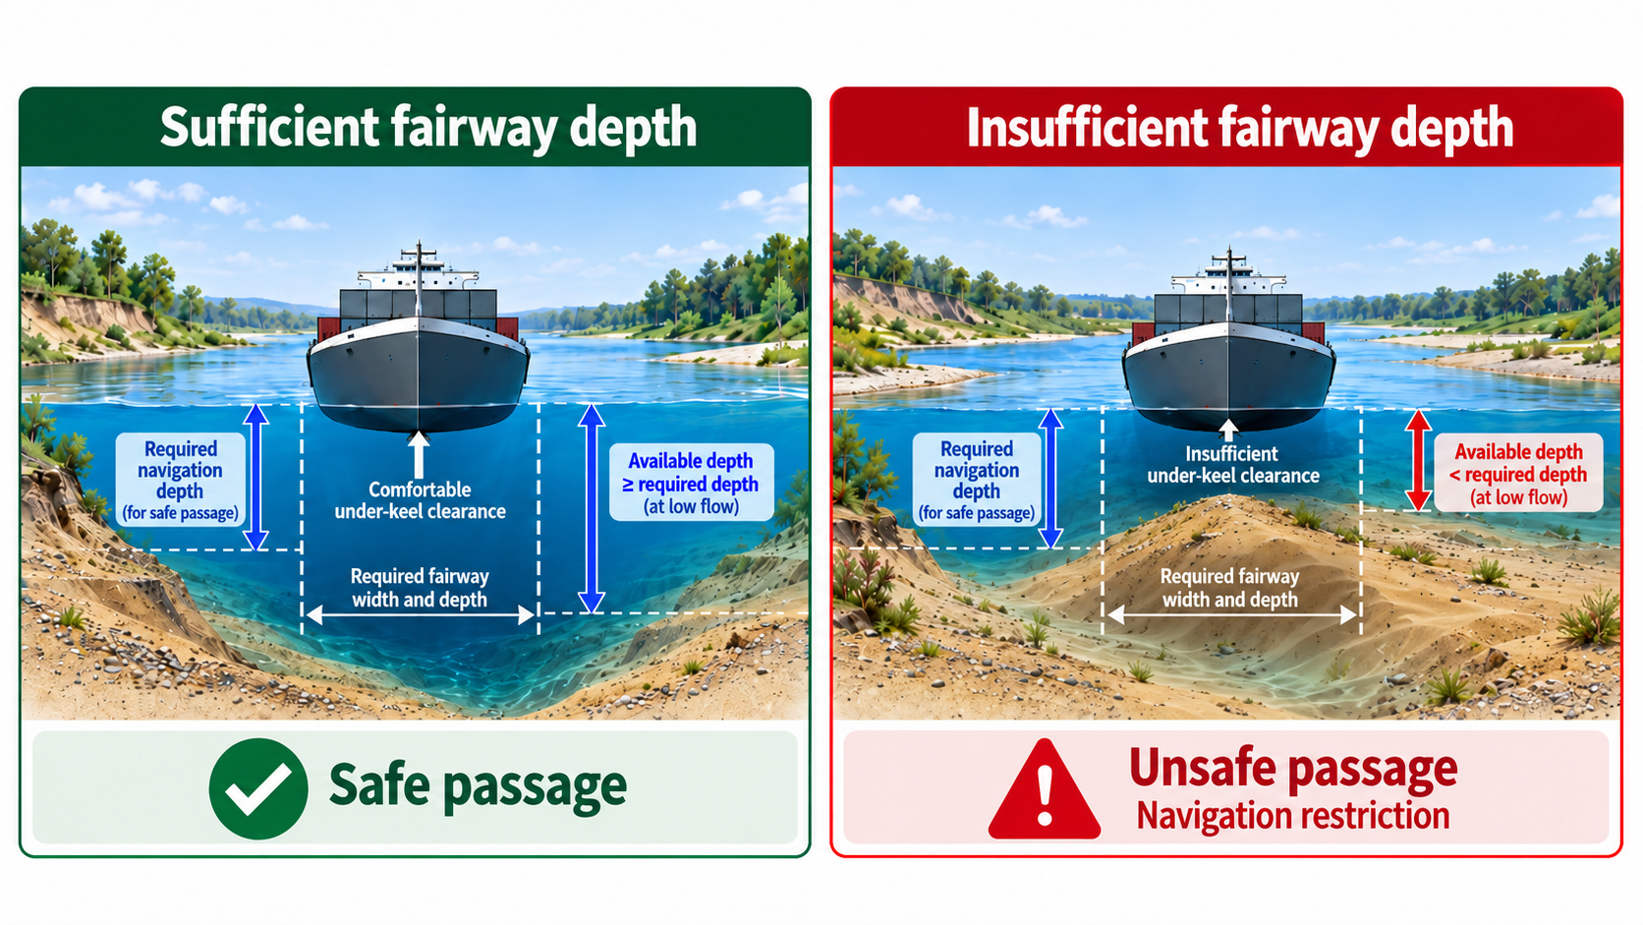
Why inland navigation matters in Croatia?
However, the potential is far from fully exploited
The Croatian 2022–2032 River Transport Strategy used a baseline in which inland waterways accounted for only 0.78% of total freight transport, while setting a strategic target of 3.05%
The strategy therefore identifies improved navigability and elimination of bottlenecks as one of the key conditions for increasing the competitiveness of inland navigation.
Navigation requires:
  sufficient water depth,
  a predictable fairway,
  manageable sediment deposition.
But rivers naturally erode, transport and deposit sediment

Slide 5
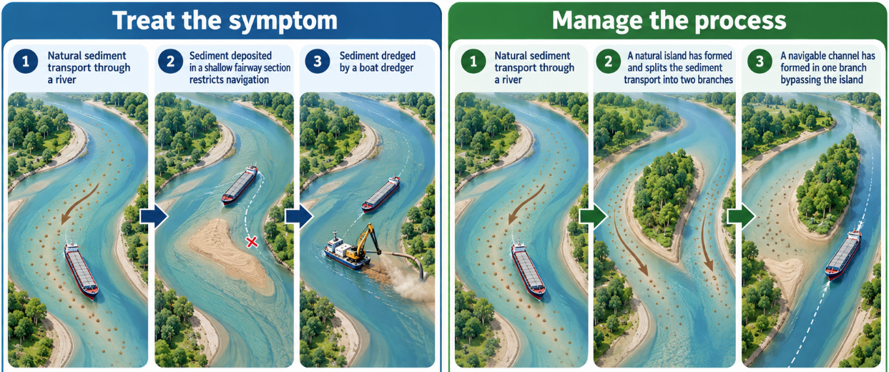
Traditional approach to fairway management
Treating the symptom
  Building river structures permanently locks river morphology and restricts natural development
  Dredging temporarily restores fairway depth but primarily treats the consequence of sedimentation as an emergency measure
The question is therefore not whether we can stop river morphology, but whether we can guide it in a useful direction?

Slide 6
Nature – based approach to fairway management
What if the river itself could help maintain the fairway?
  Current (treat the symptom)
    Sediment → deposition in fairway → dredging
  Alternative (manage the process)
    Sediment → controlled redistribution → navigable channel

Slide 7
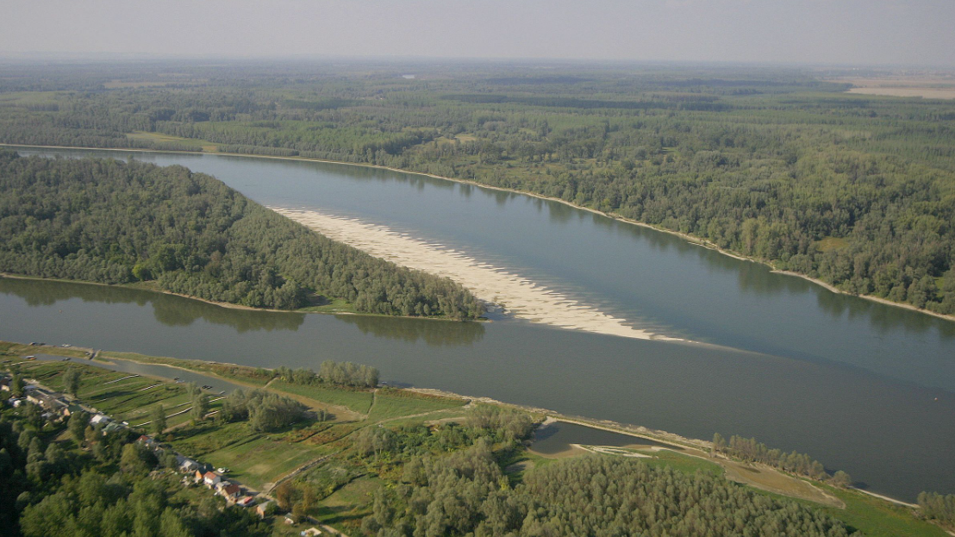
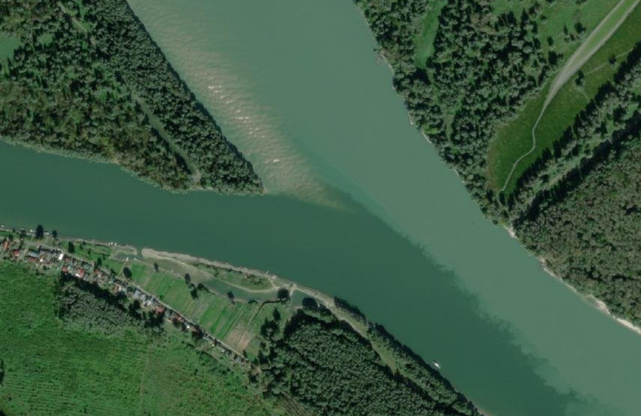
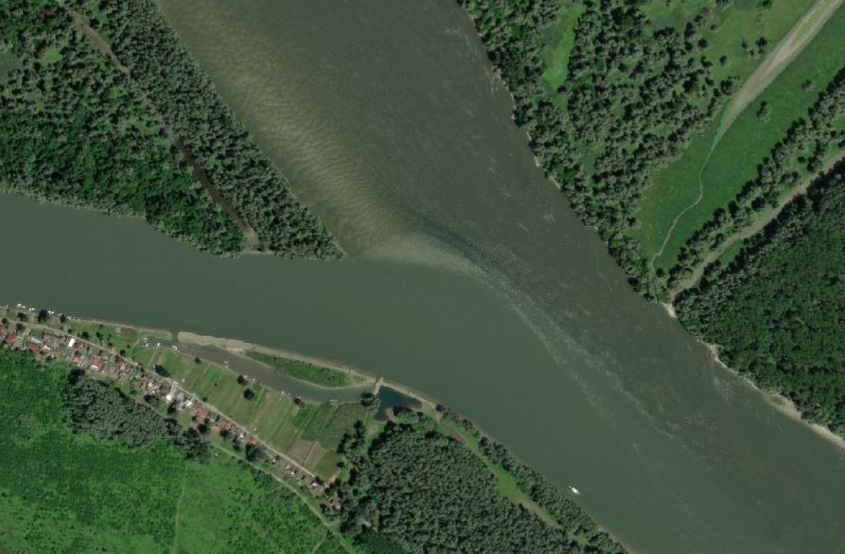
Photo by Mario Romulić
Demo site: Drava River confluence
Relative strength of Drava and Danube dominate sedimentation pattern at different times
  Danube pushes the sandbar into the confluence
  Drava flushes its sediment across the confluence

Slide 8
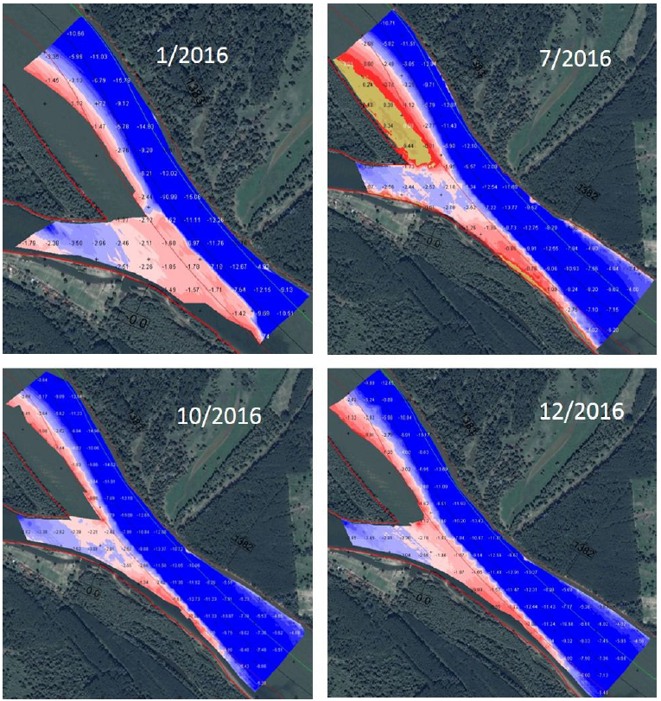
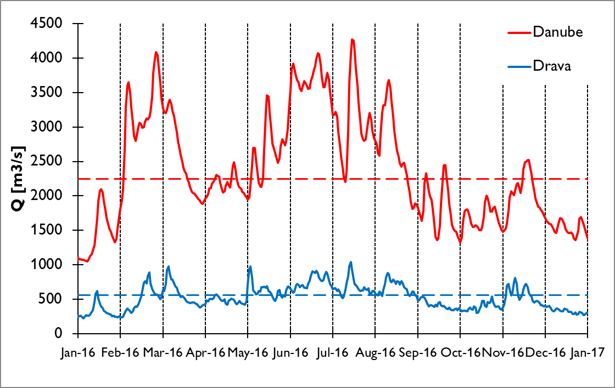
Demo site: Drava River confluence
Problems:
  Reduced sediment transport capacity
  Bed aggradation
  Sediment reallocation
1
1
2
3
2
3

Slide 9
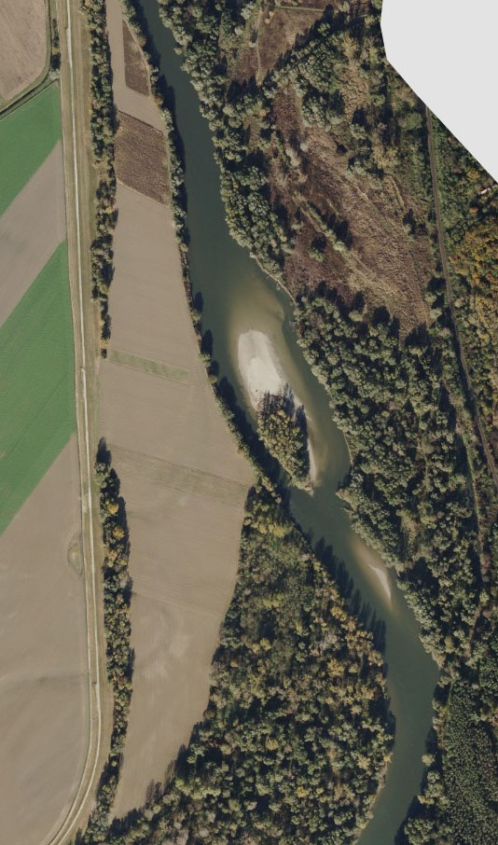
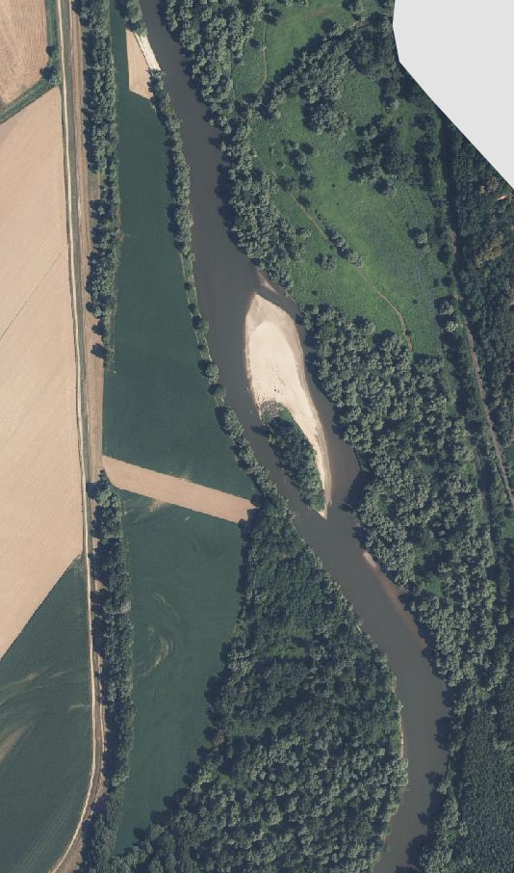
Improving sediment management solutions - NbS
The proposed concept
  Plan – to build on previous experience and replicate equilibrium observed in nature
  design NbS measure based on findings of the ongoing FAIRWAY project (replicate MIE)
  Optimization of fairway
  Increased conveyance
Why are river islands useful
  HYDRAULICS: They divide and concentrate flow
  MORPHOLOGY: They create different zones of erosion and deposition
  ECOLOGY: They increase hydraulic and morphological diversity
2011
2024

Slide 10
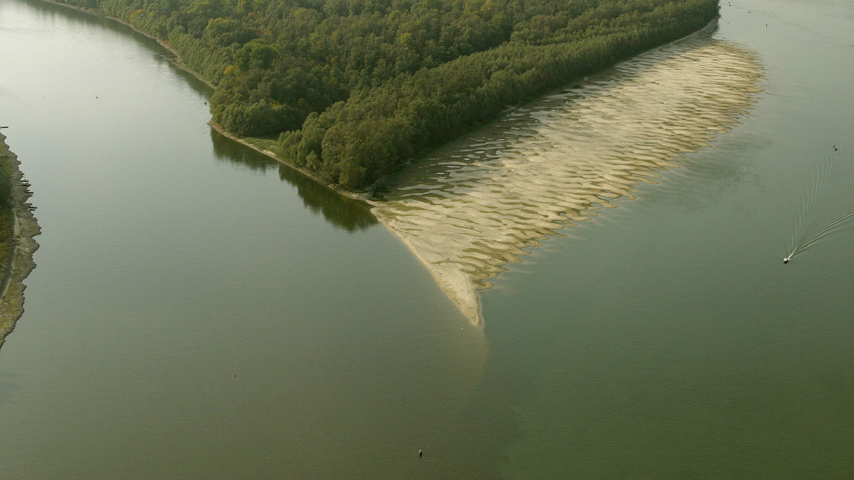
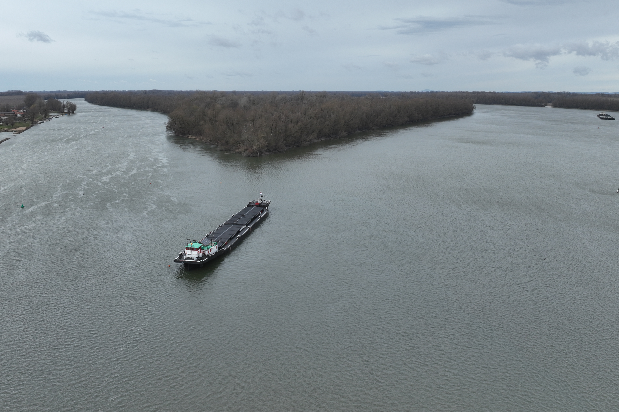
Improving sediment management solutions - NbS
The proposed concept: one island, two corridors
  Main channel
    Navigation corridor
    narrower effective flow width,
    higher velocity,
    increased sediment-transport capacity,
    targeted morphological deepening.
  Secondary channel
    Lower-energy corridor
    reduced velocity,
    greater potential for controlled deposition,
    hydraulic diversity,
    potential ecological function.
  Island
    Sediment-management structure
    occupies part of the existing shallow zone,
    directs flow,
    accommodates sediment,
    progressively stabilised with natural materials and vegetation.
Nature park „Kopački rit”
Drava
Danube
FAIRWAY
Drava
Danube

Slide 11
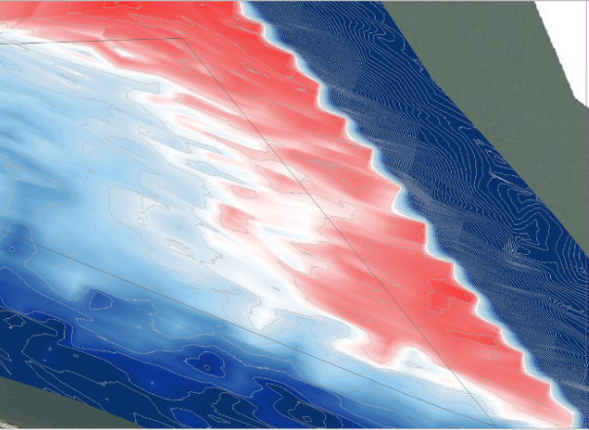
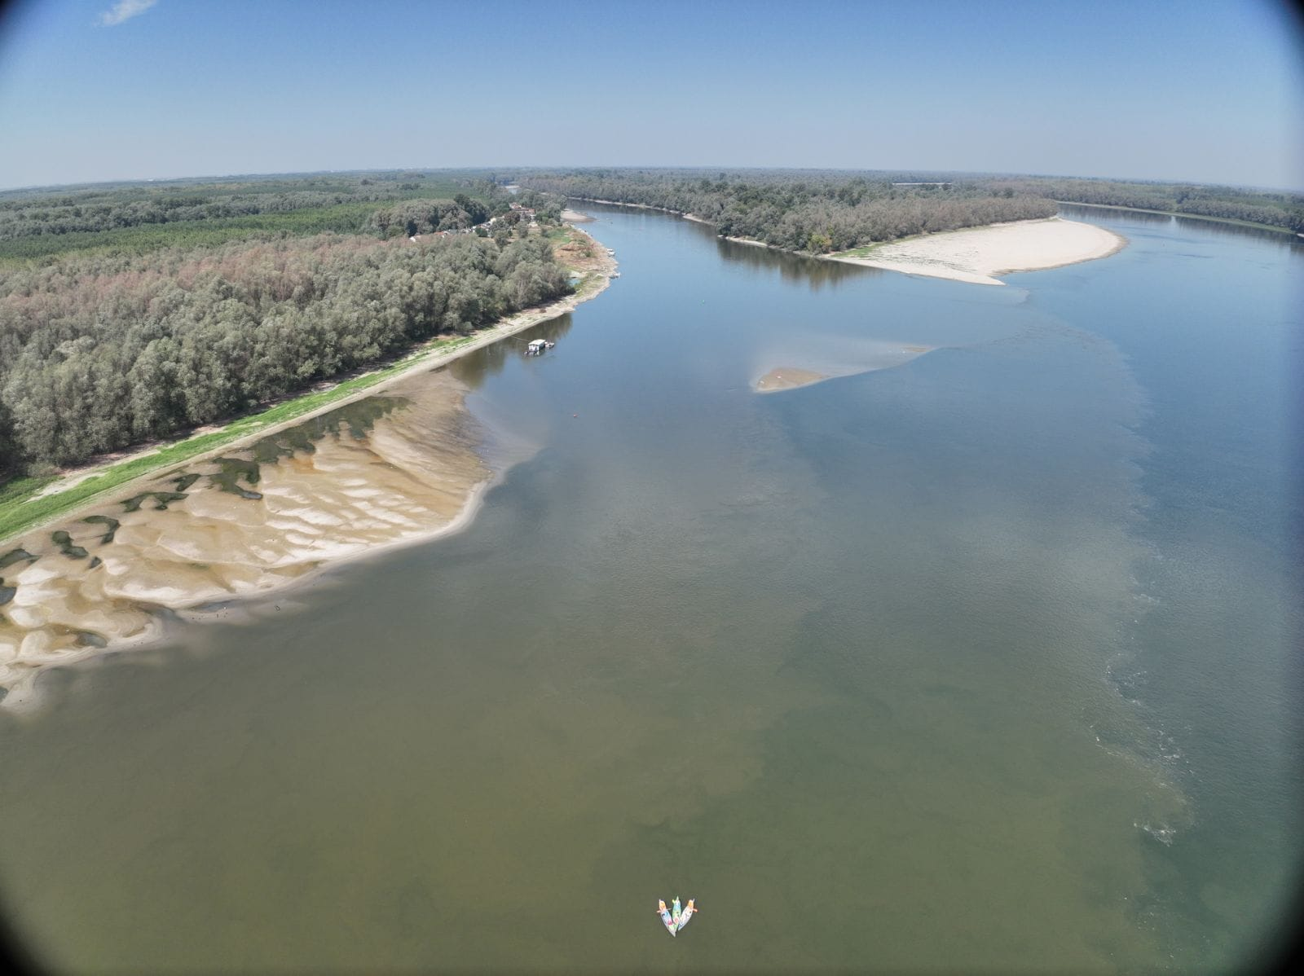
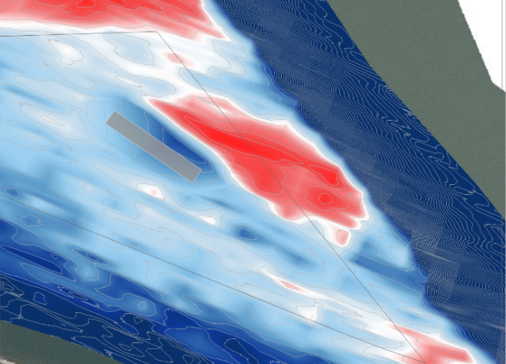
Improving sediment management solutions - NbS
Drava
Danube
before MIE implementation
after MIE implementation

Slide 12
Conclusions
The sediment itself is not the problem. The problem is where it deposits.
Goal is to redistribute the incoming sediment at the confluence, without disrupting its continuity
Drava supplies sediment
↓
Danube controls sediment continuity
↓
Island reorganizes the flow
↓
Erosion is encouraged in the fairway
↓
Deposition is redirected toward less critical areas
↓
Natural materials and vegetation progressively stabilize the intervention
Tne goal is not to make the river static, but to guide its natural dynamics so that navigation aligns with the natural river morphology

Slide 13



Follow the iNNO SED project advancement
Assoc. Prof. Gordon Gilja
innosedproject.substack.com/
instagram.com/innosed_eu
gordon.gilja@grad.unizg.hr
linkedin.com/company/inno-sed-project/
x.com/innosed_eu
youtube.com/@iNNOSED-eu

