Slide 1
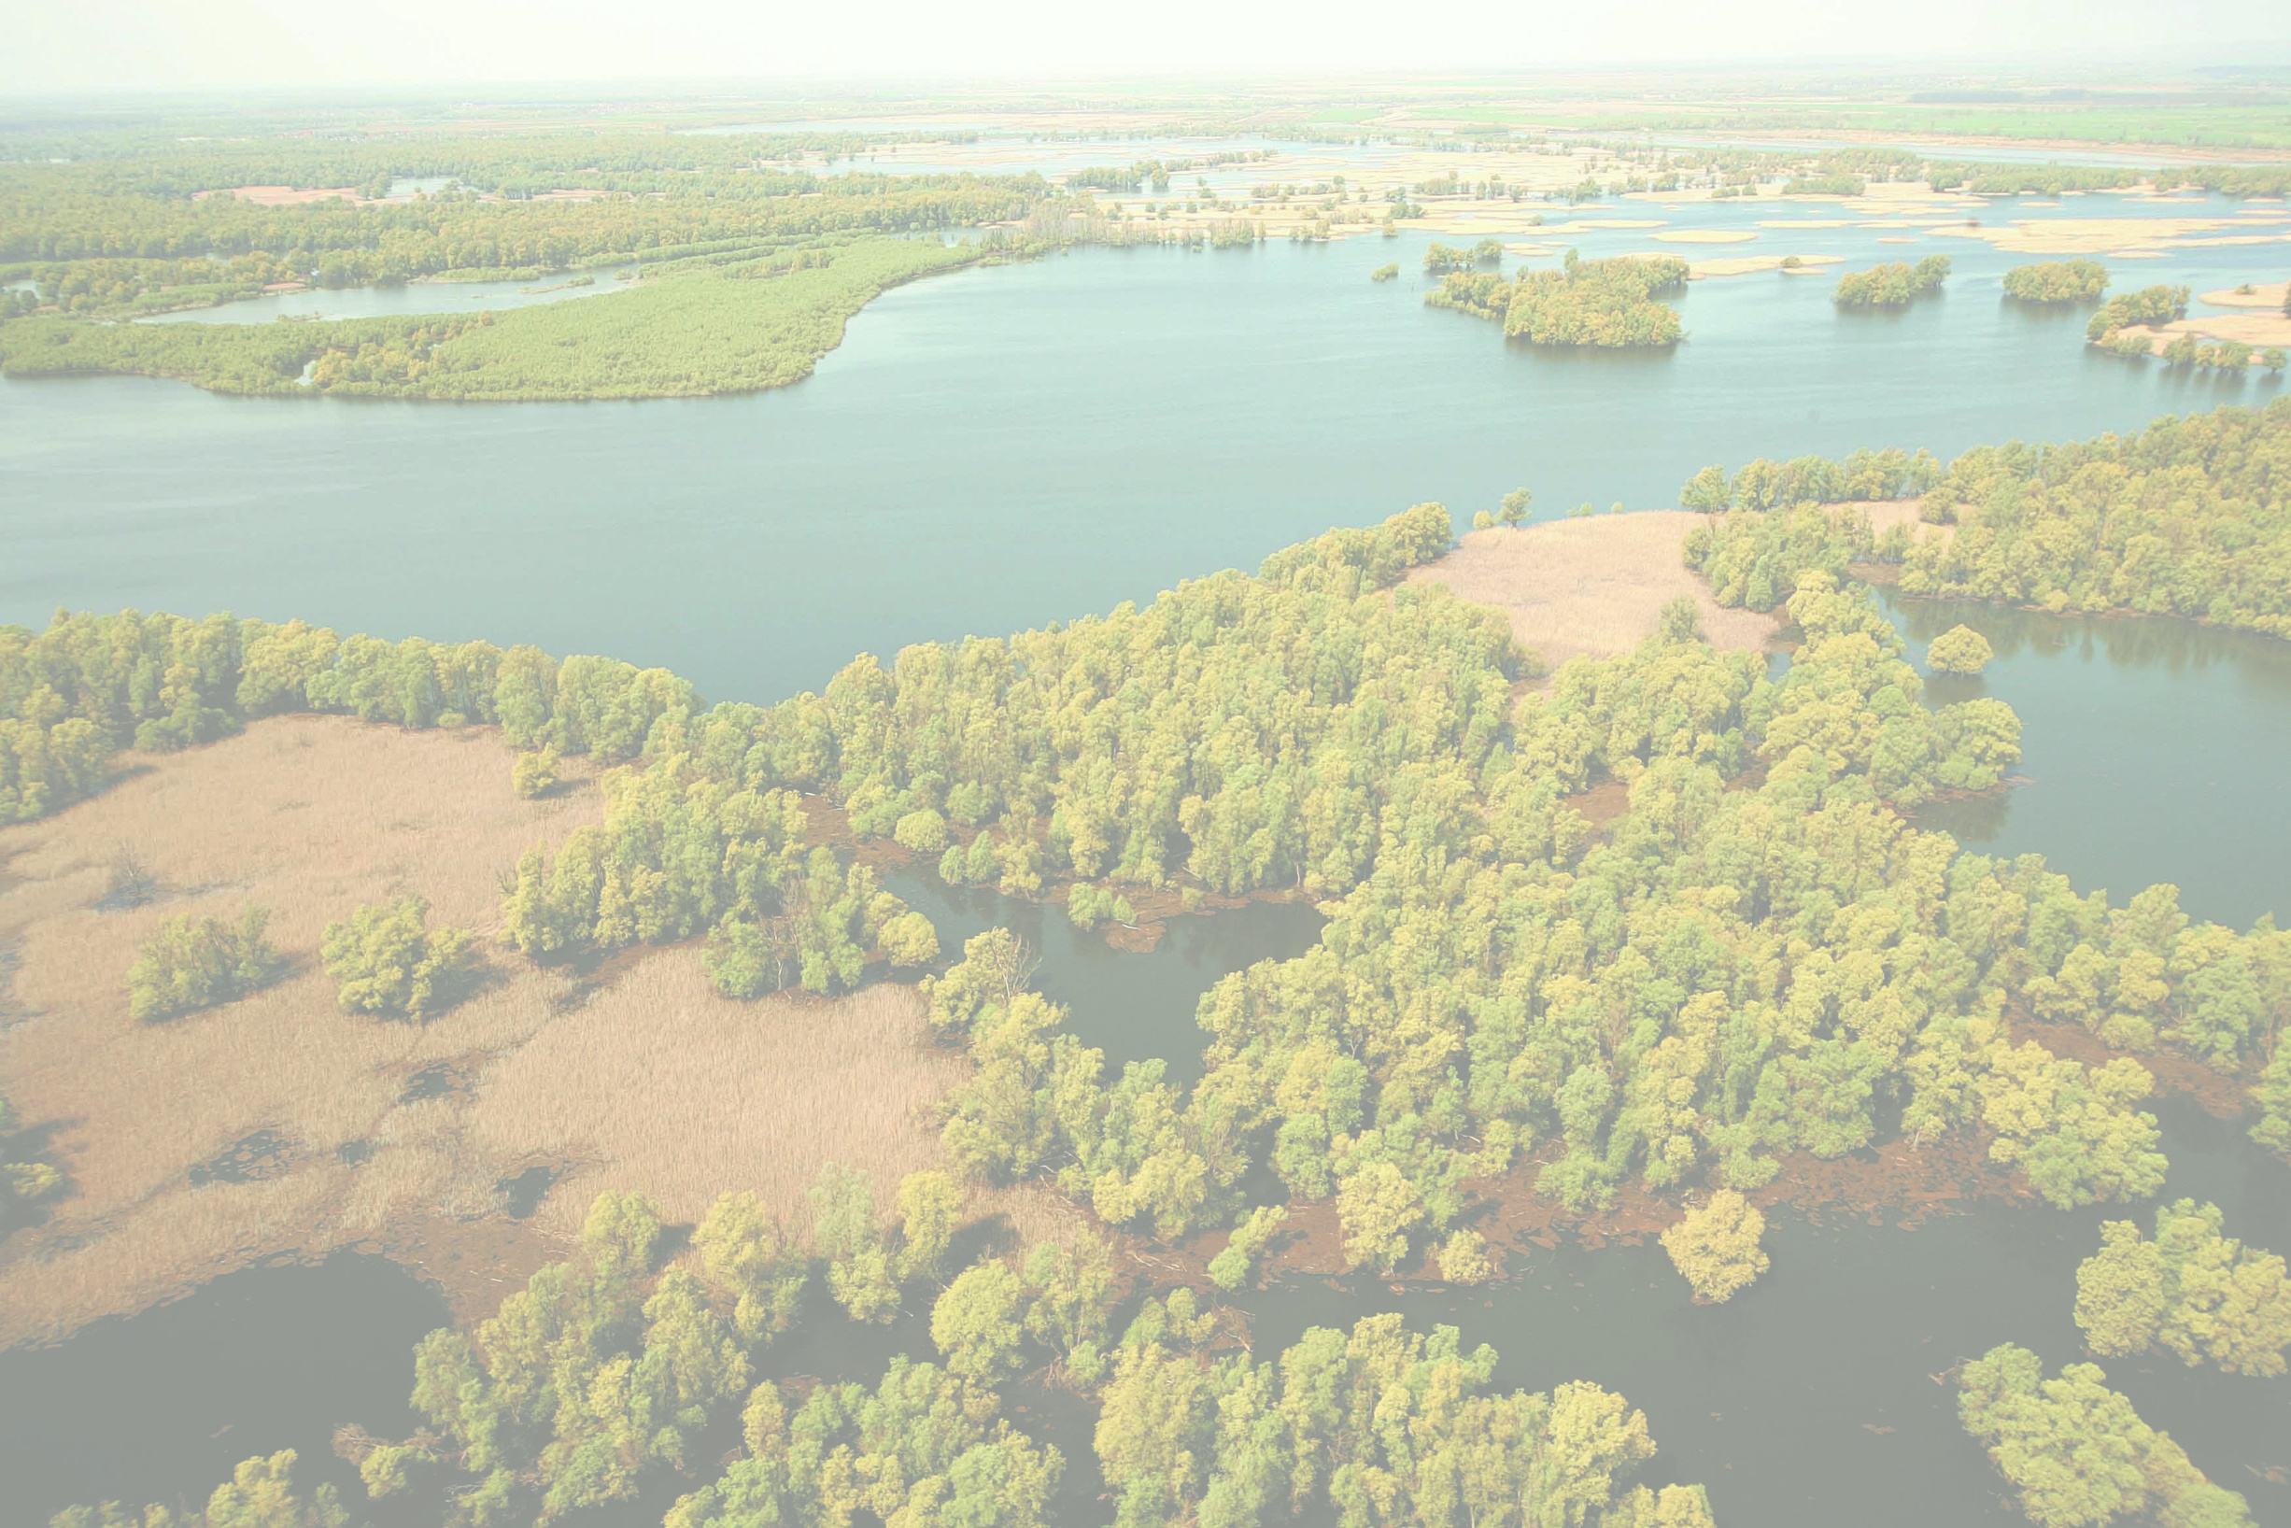
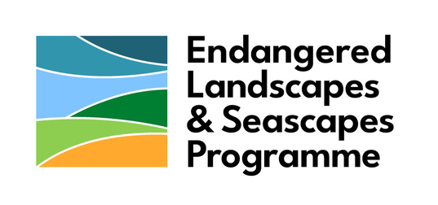
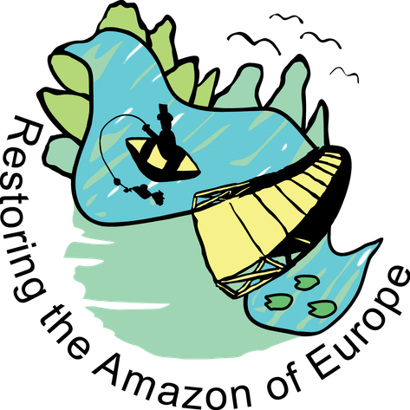
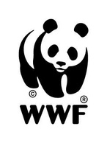


  Restoring the Amazon of Europe: Side Channel Restoration and Recovery of Hydrological Processes in Kopački Rit Nature Park
Marina Petrić¹, Vlatko Rožac², Ivan Vučković³, Ida Čarnohorski¹, Mladen Plantak³, Aleksandar Drobnjak¹
¹ WWF Adria
² Public Institution of NP Kopački rit
³ Elektroprojekt d.d.

Slide 2
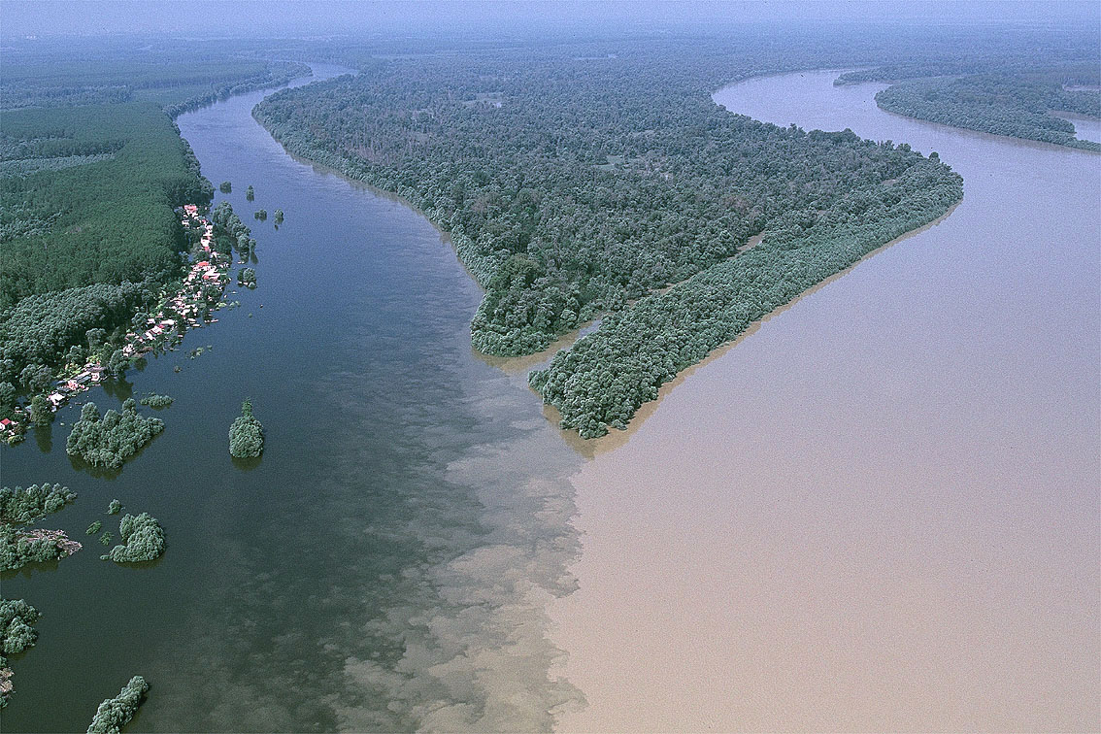
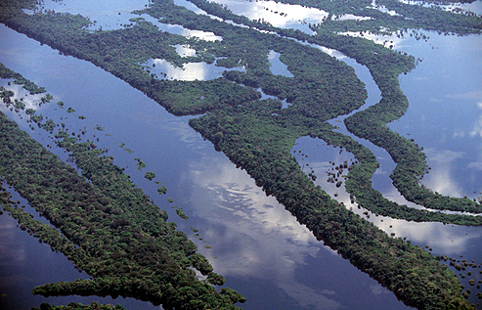
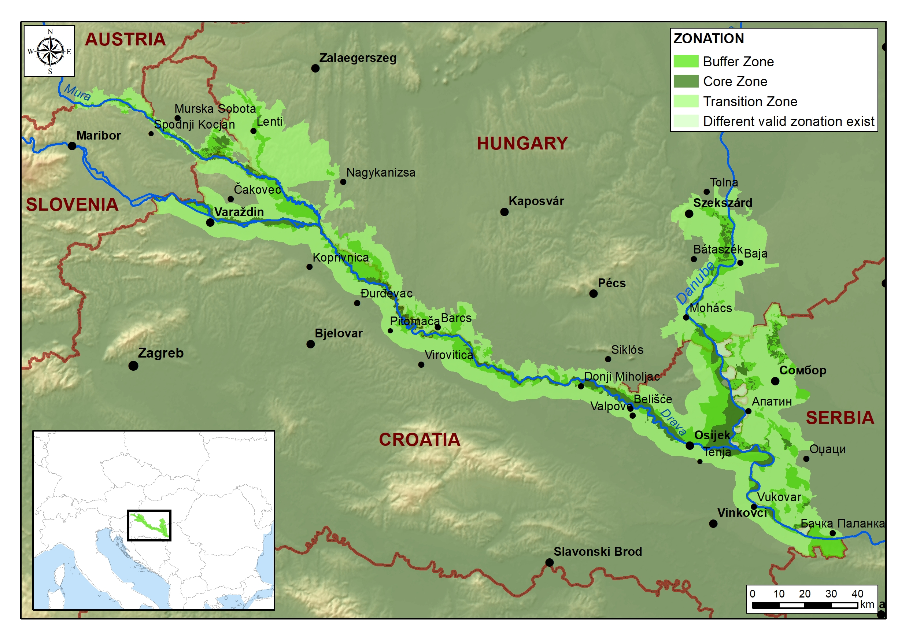
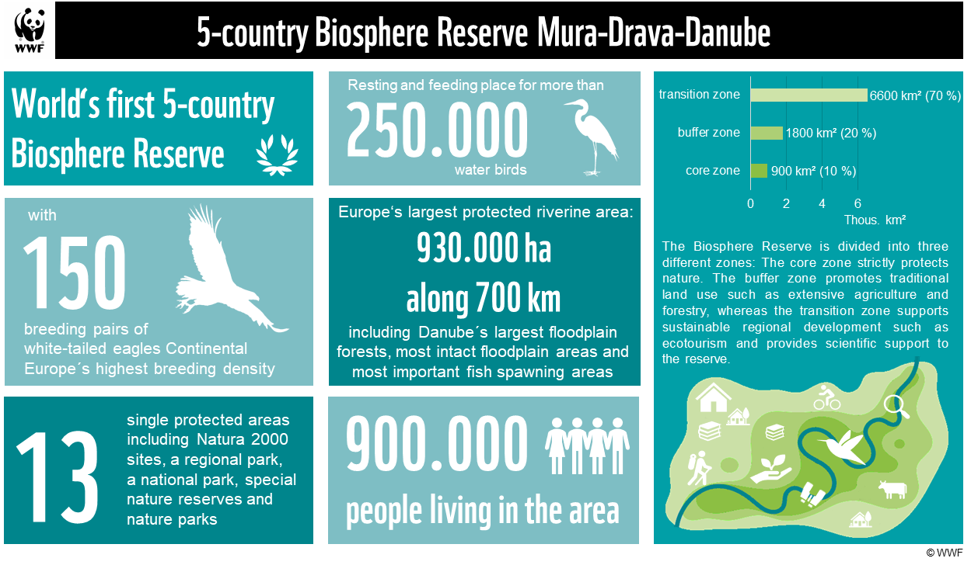
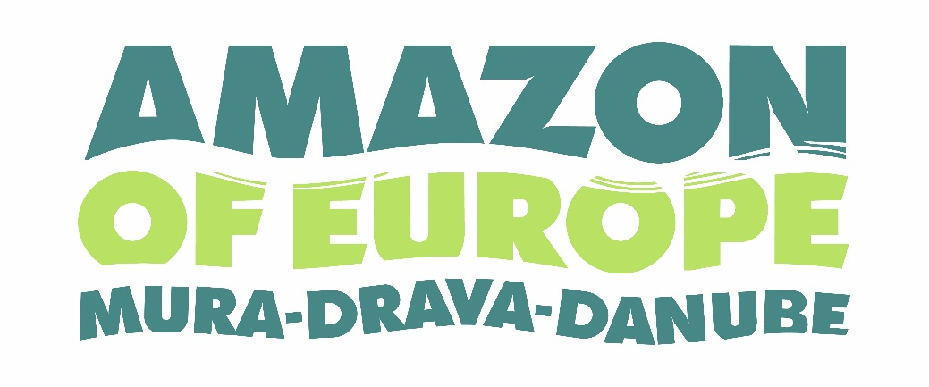
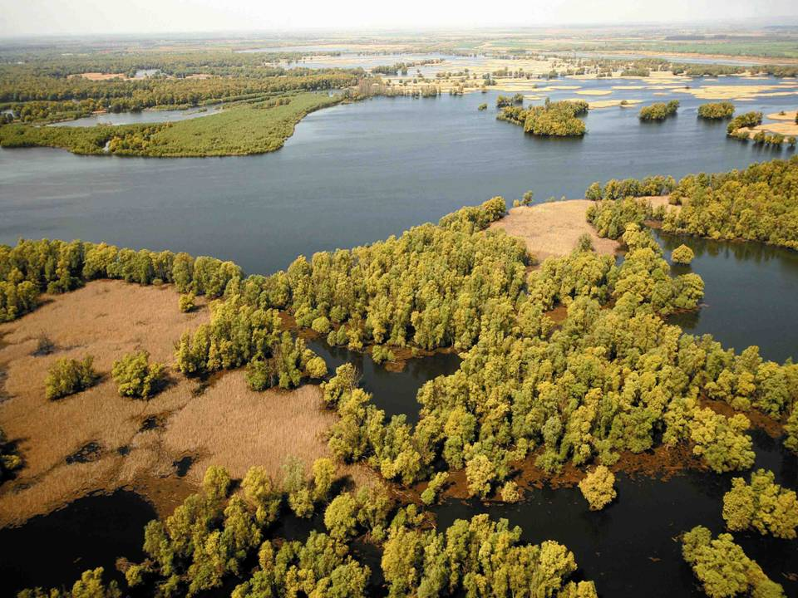
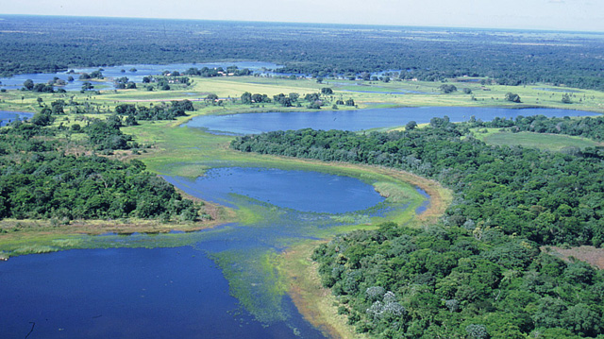
© Mario Romulic

Slide 3

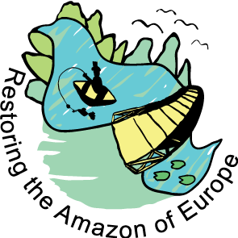

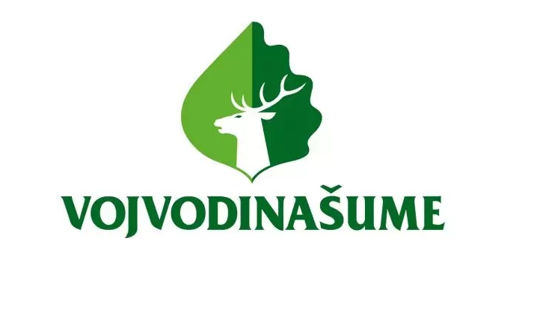

Obnova Europske Amazone: povezivanje riječnih staništa u prvom petodržavnom UNESCO-vom rezervatu biosphere
A resilient, ecologically connected Mura-Drava Danube Biosphere Reserve (TBR MDD) where nature restoration is systematically planned, widely supported, and effectively implemented across borders—contributing to biodiversity recovery, climate adaptation, and sustainable regional development.
Budgete | USD 4,6M
Duration | 12/2022 – 09/2028
Lead partner | WWF Adria
Partners | JU Park prirode Kopački rit, JP Vojvodinašume, WWF Austria, WWF Mađarska

Slide 4
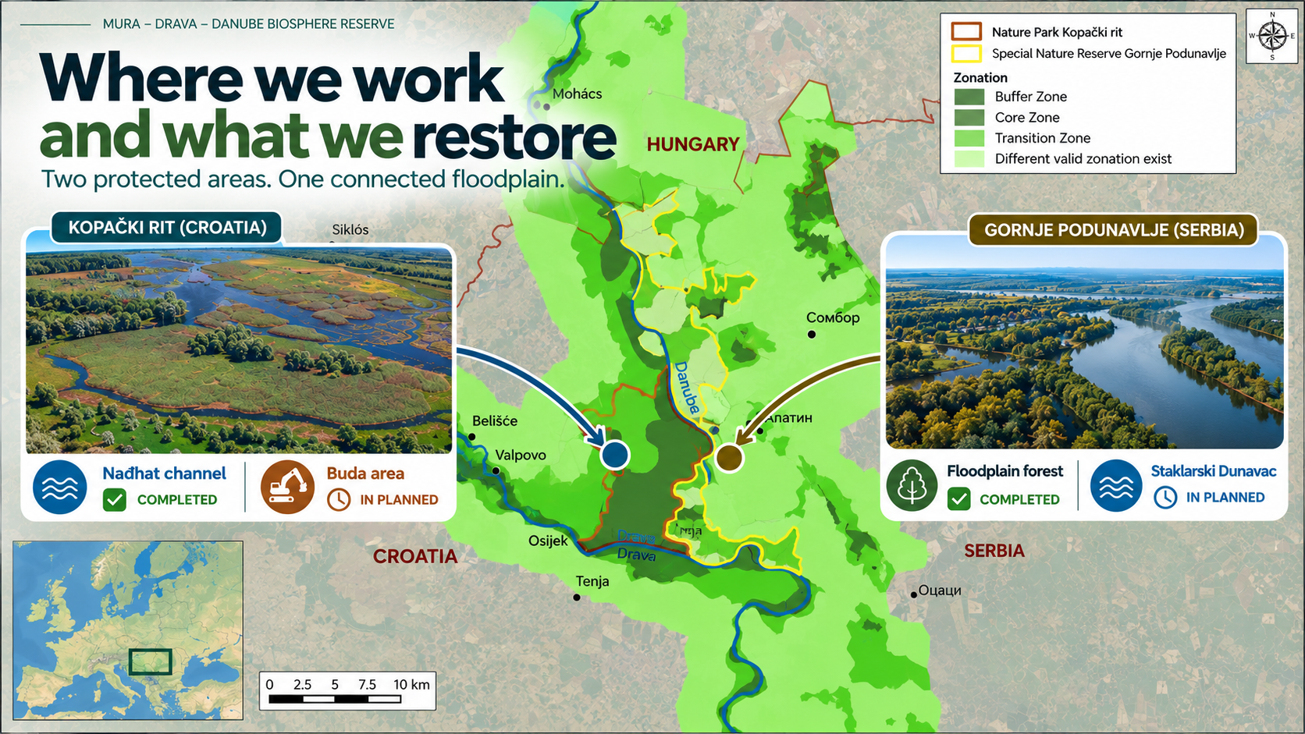
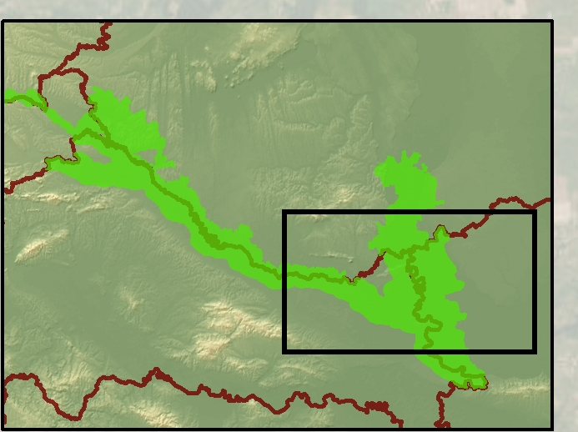

Slide 5
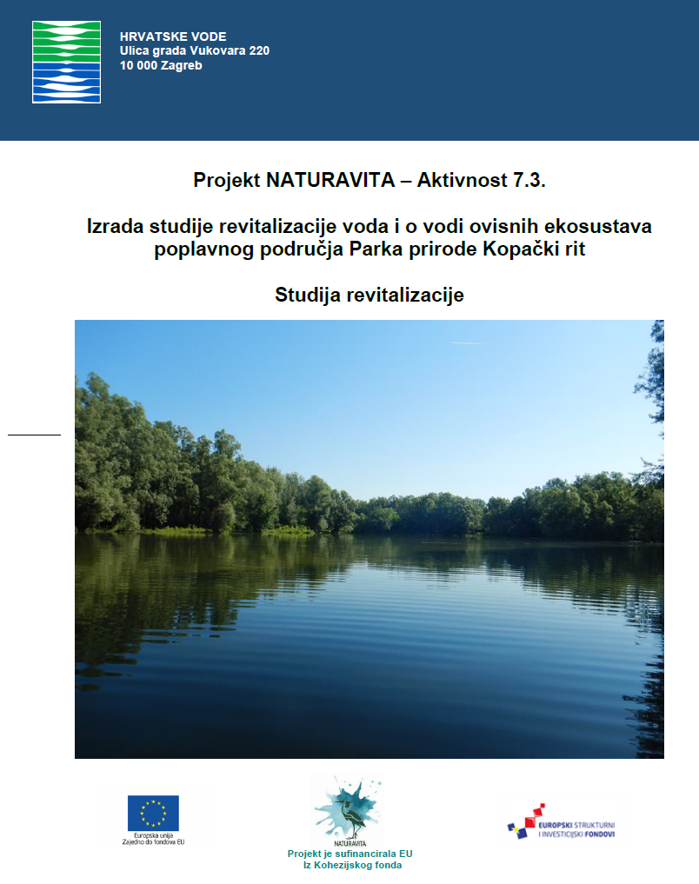
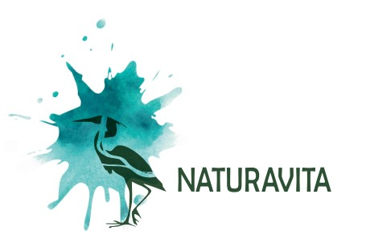

Slide 6
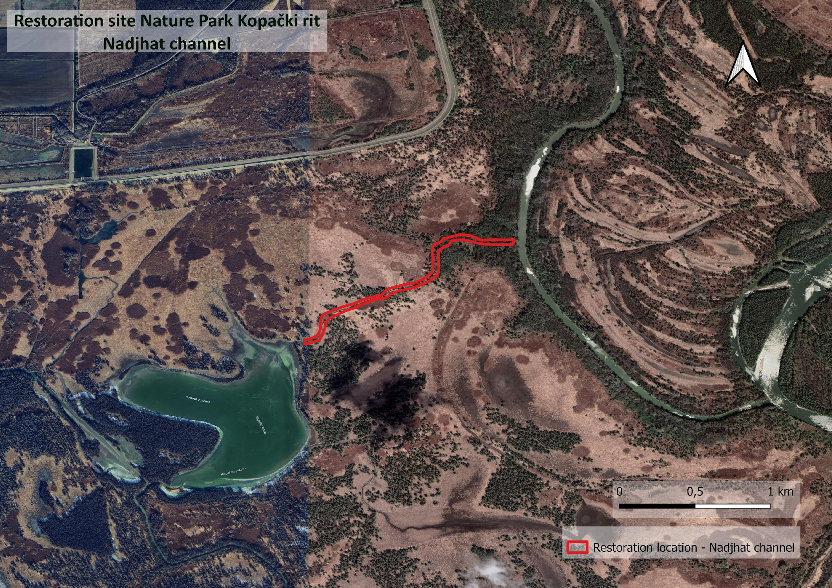
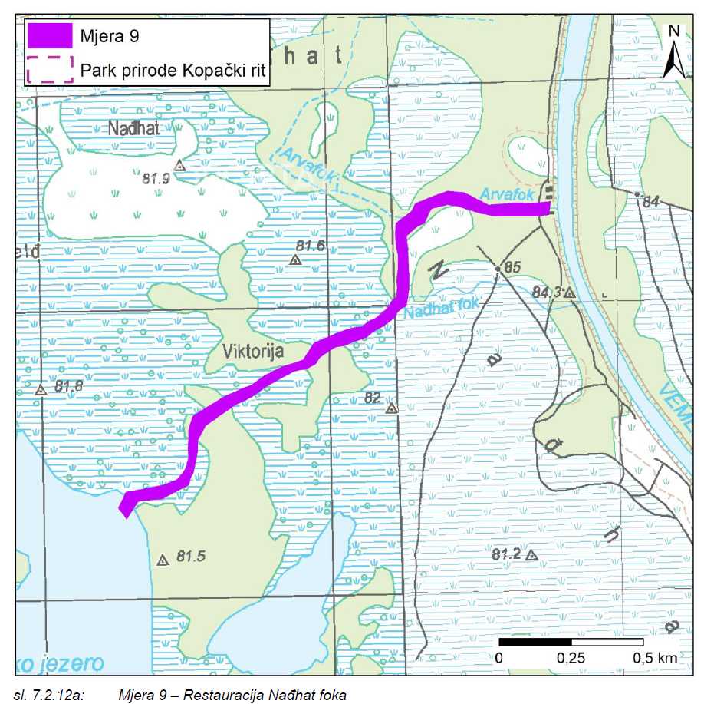
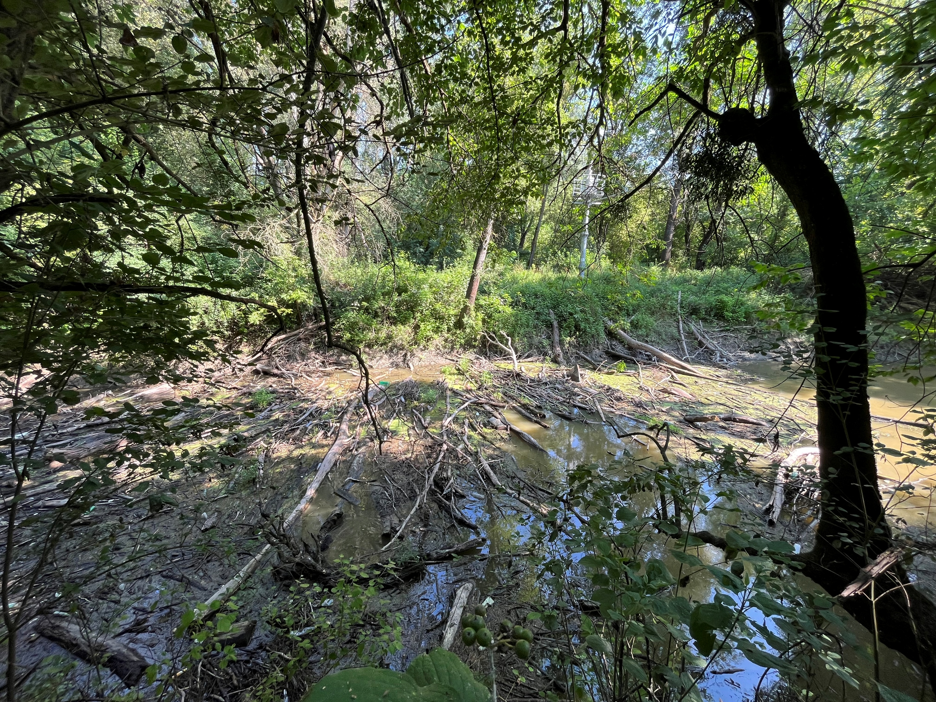

Restoration of the Nađhat Side Channel
Natural connection between Vemeljski Dunavac and Kopačko Lake
Reduced water flow due debris accumulation
Sedimentation

Slide 7
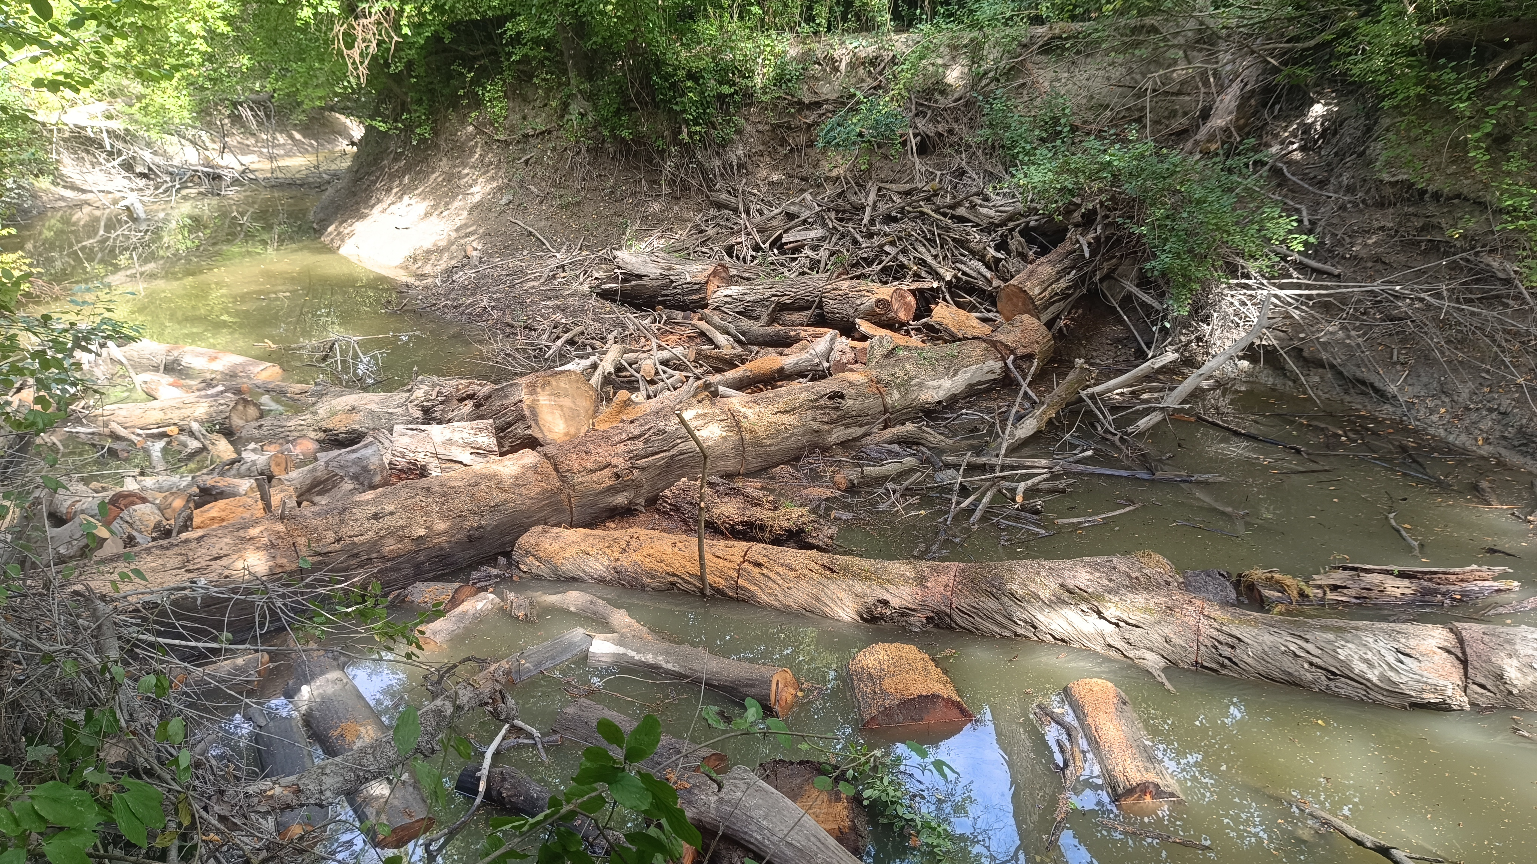
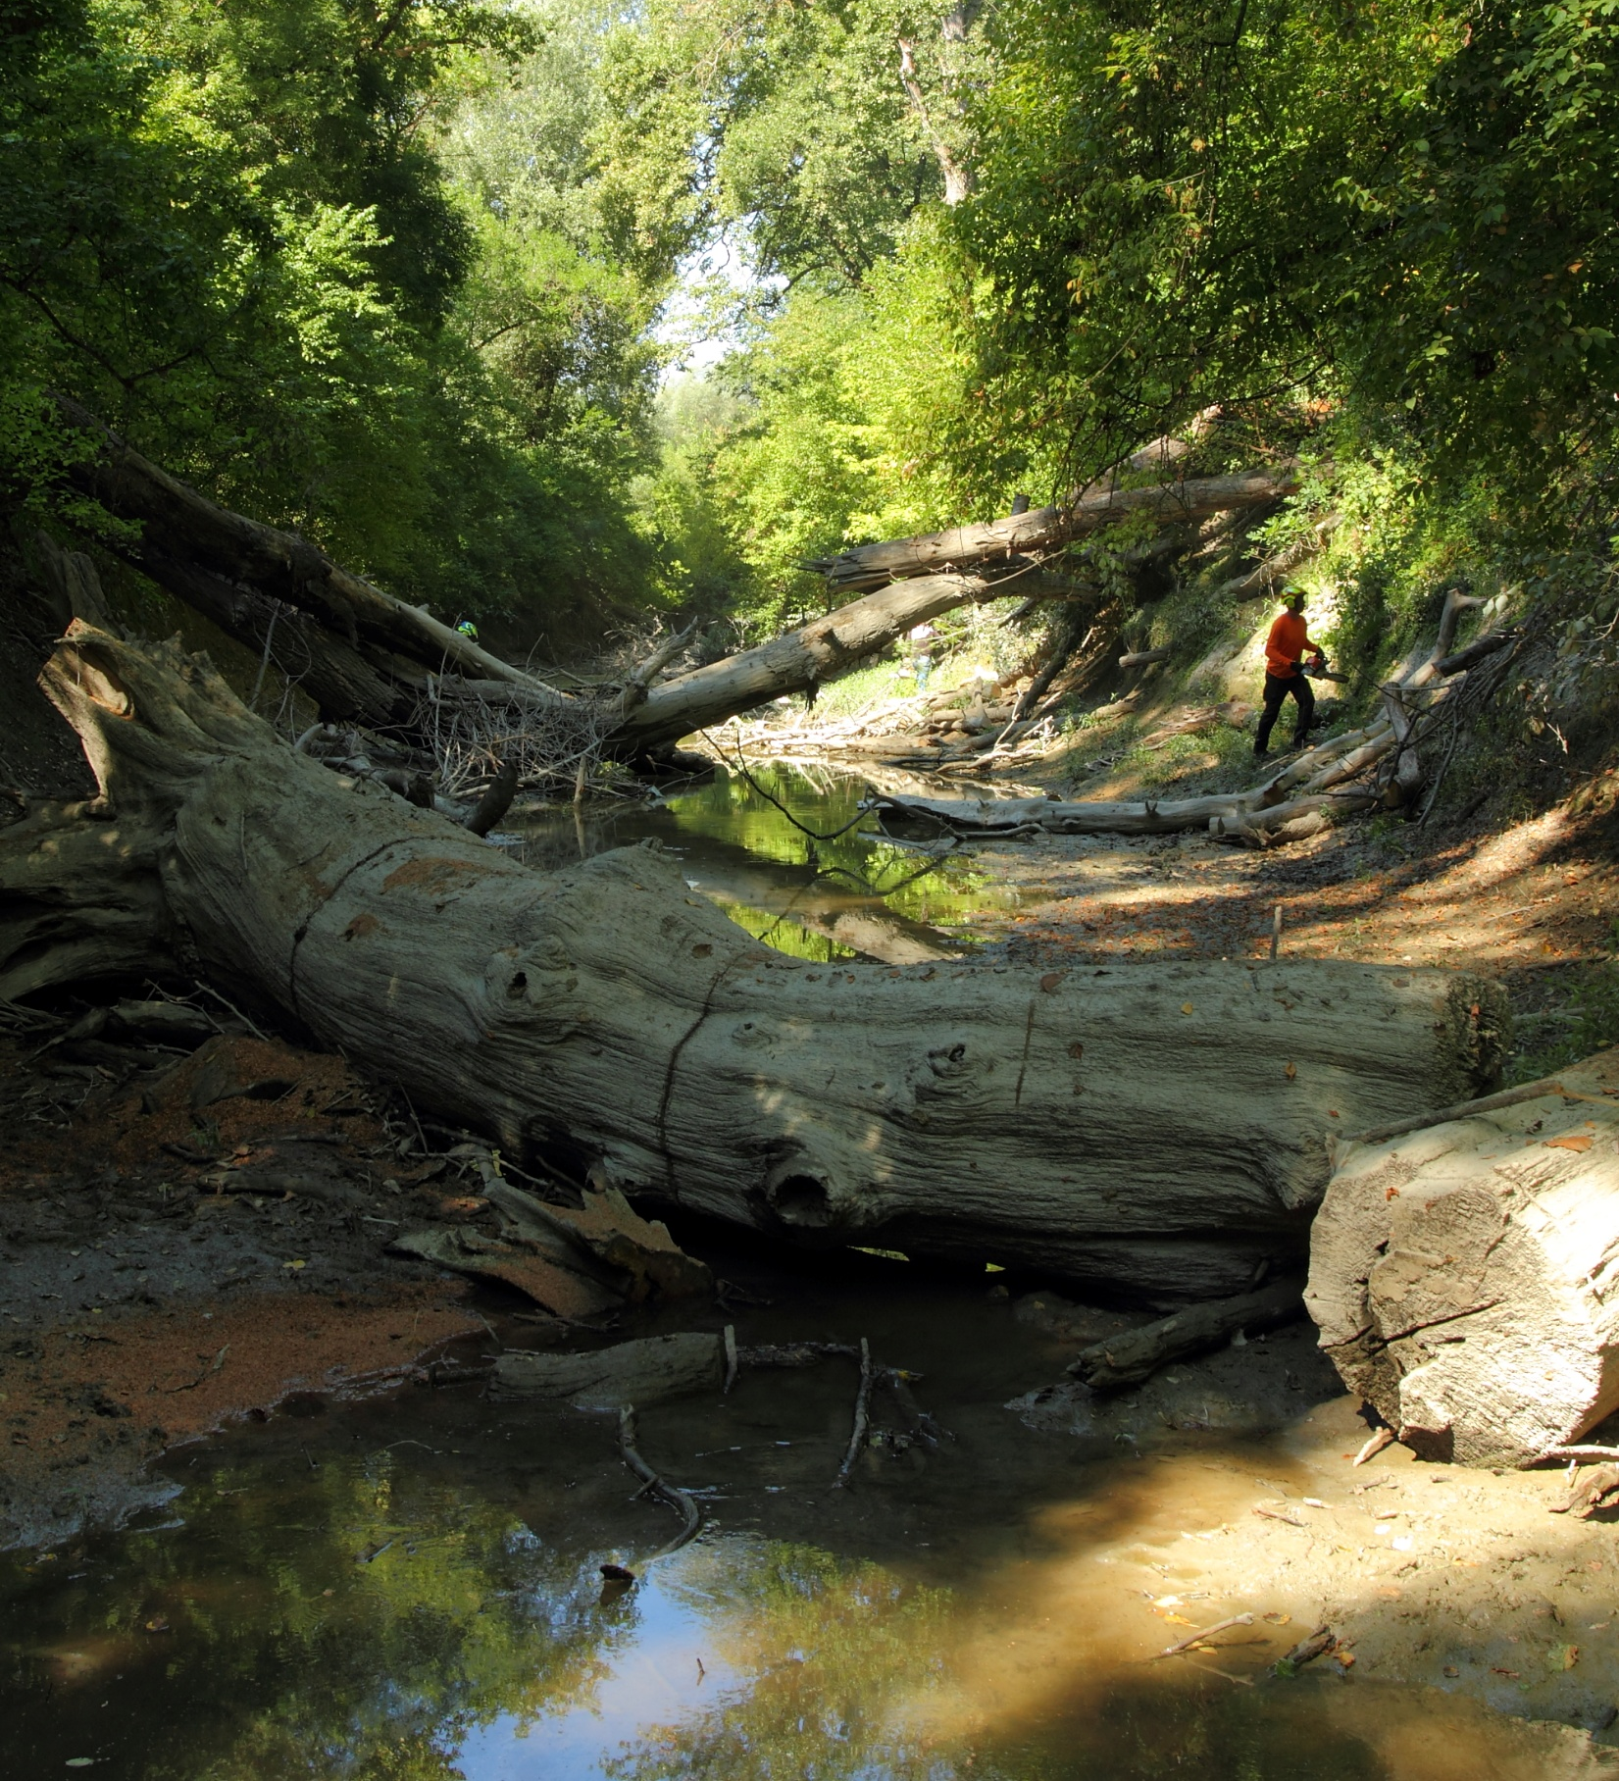
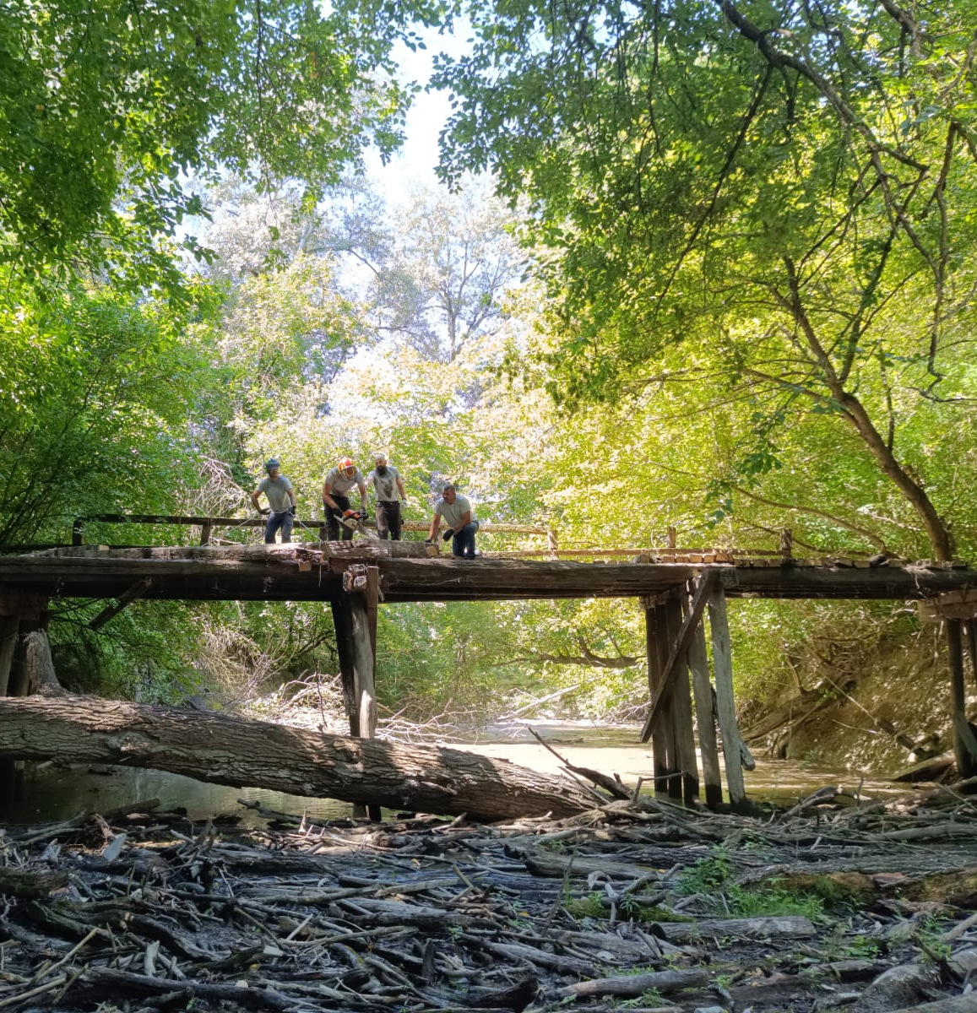
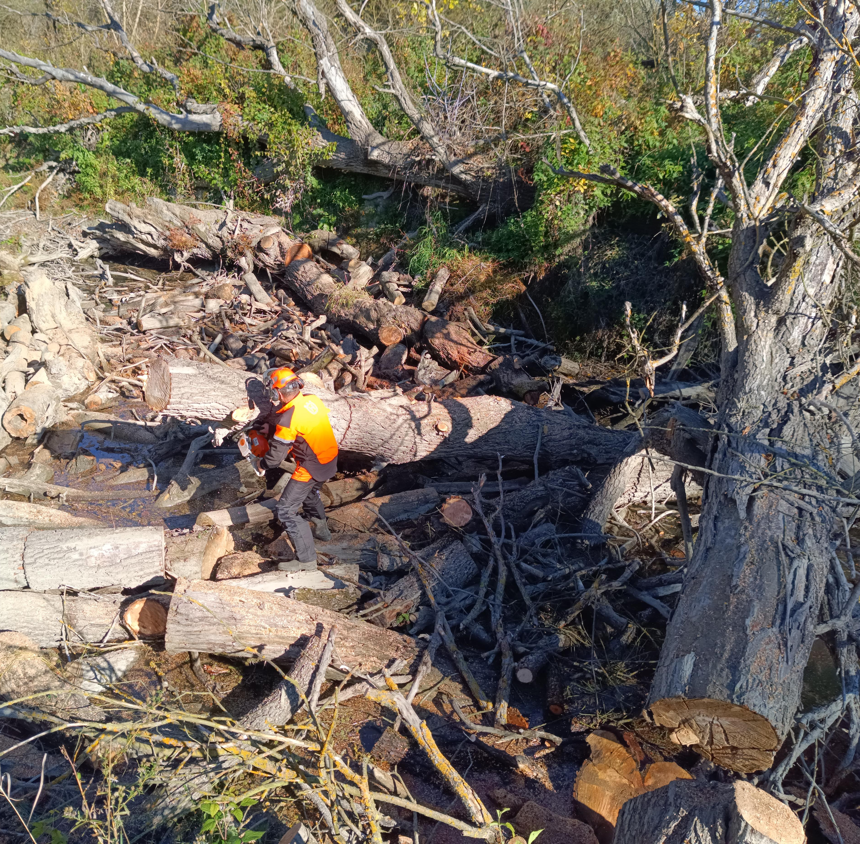
Photos by PI NP Kopački rit

Slide 8
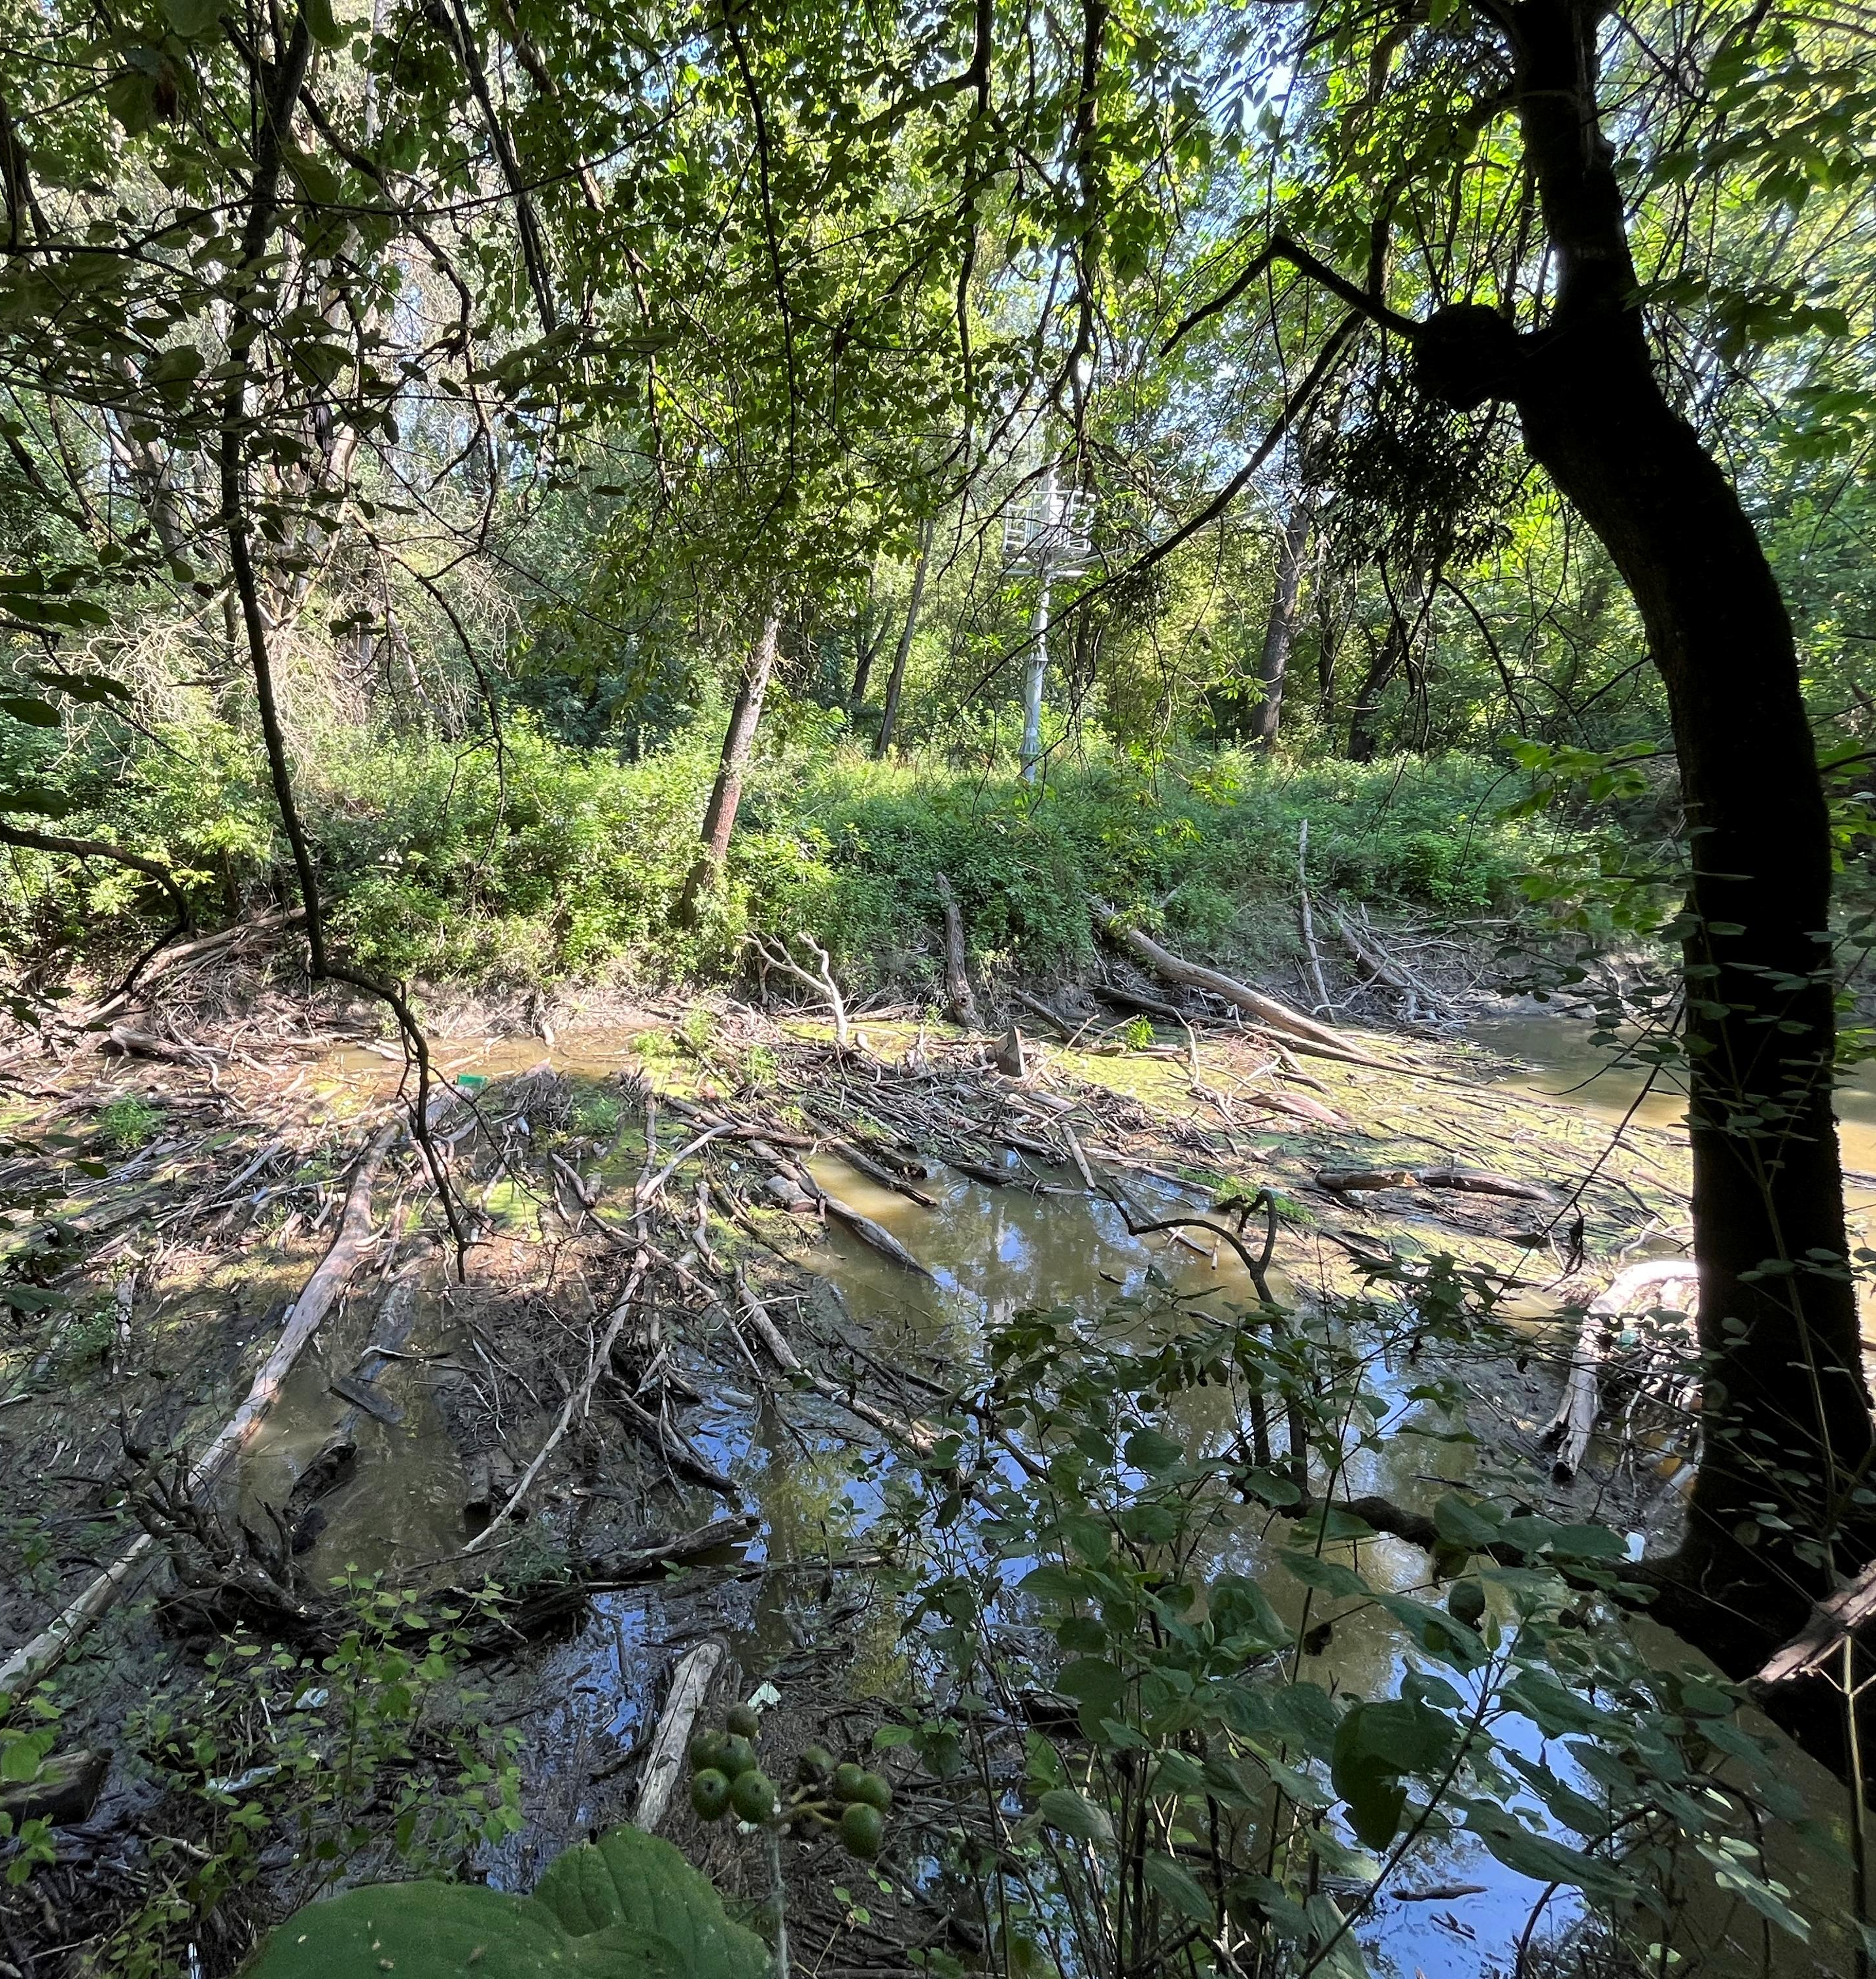
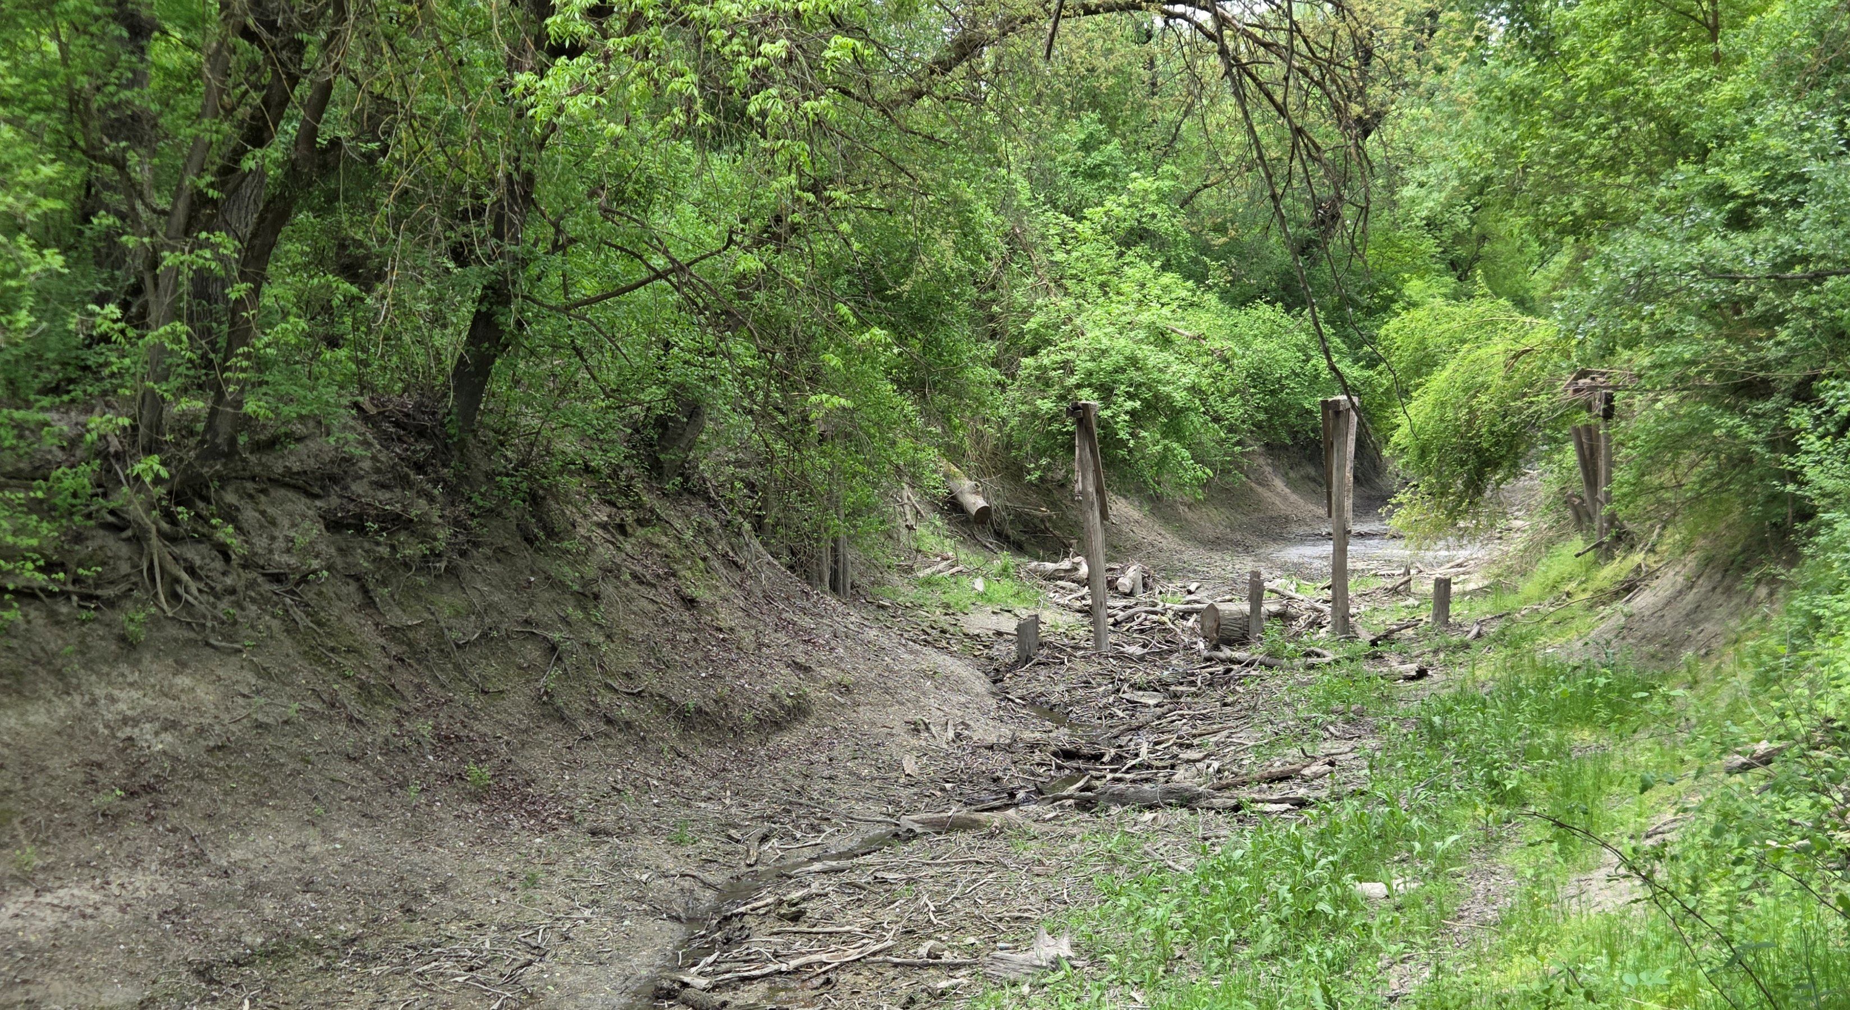
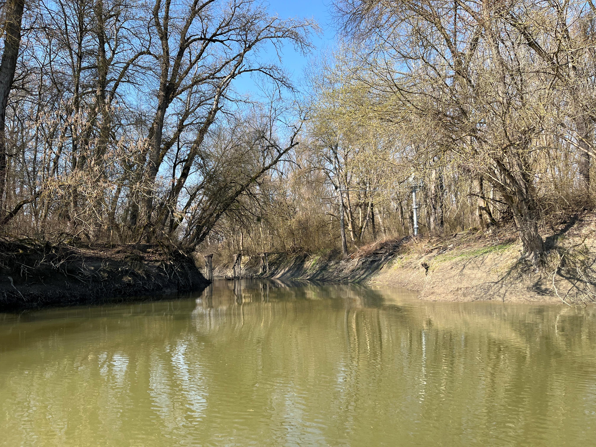

Slide 9
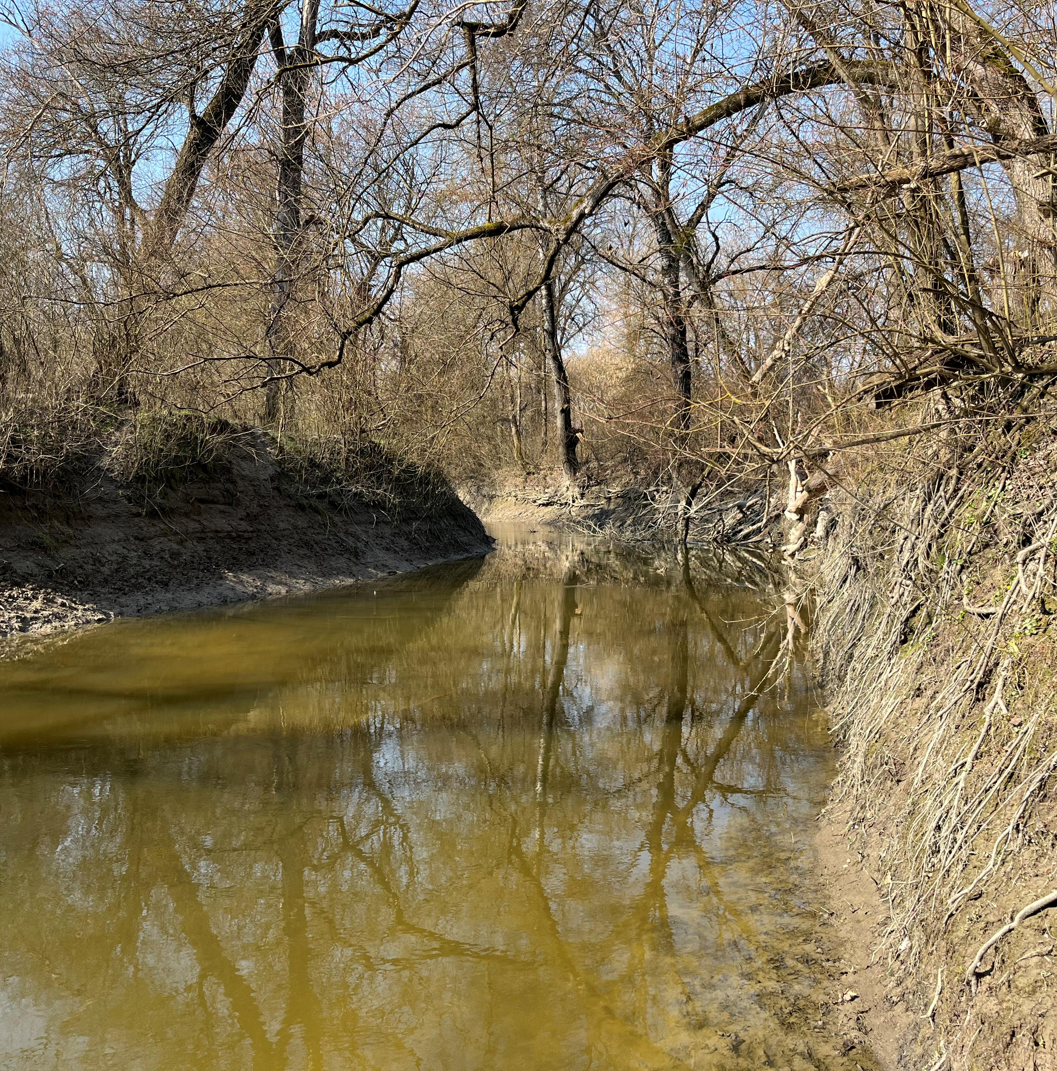
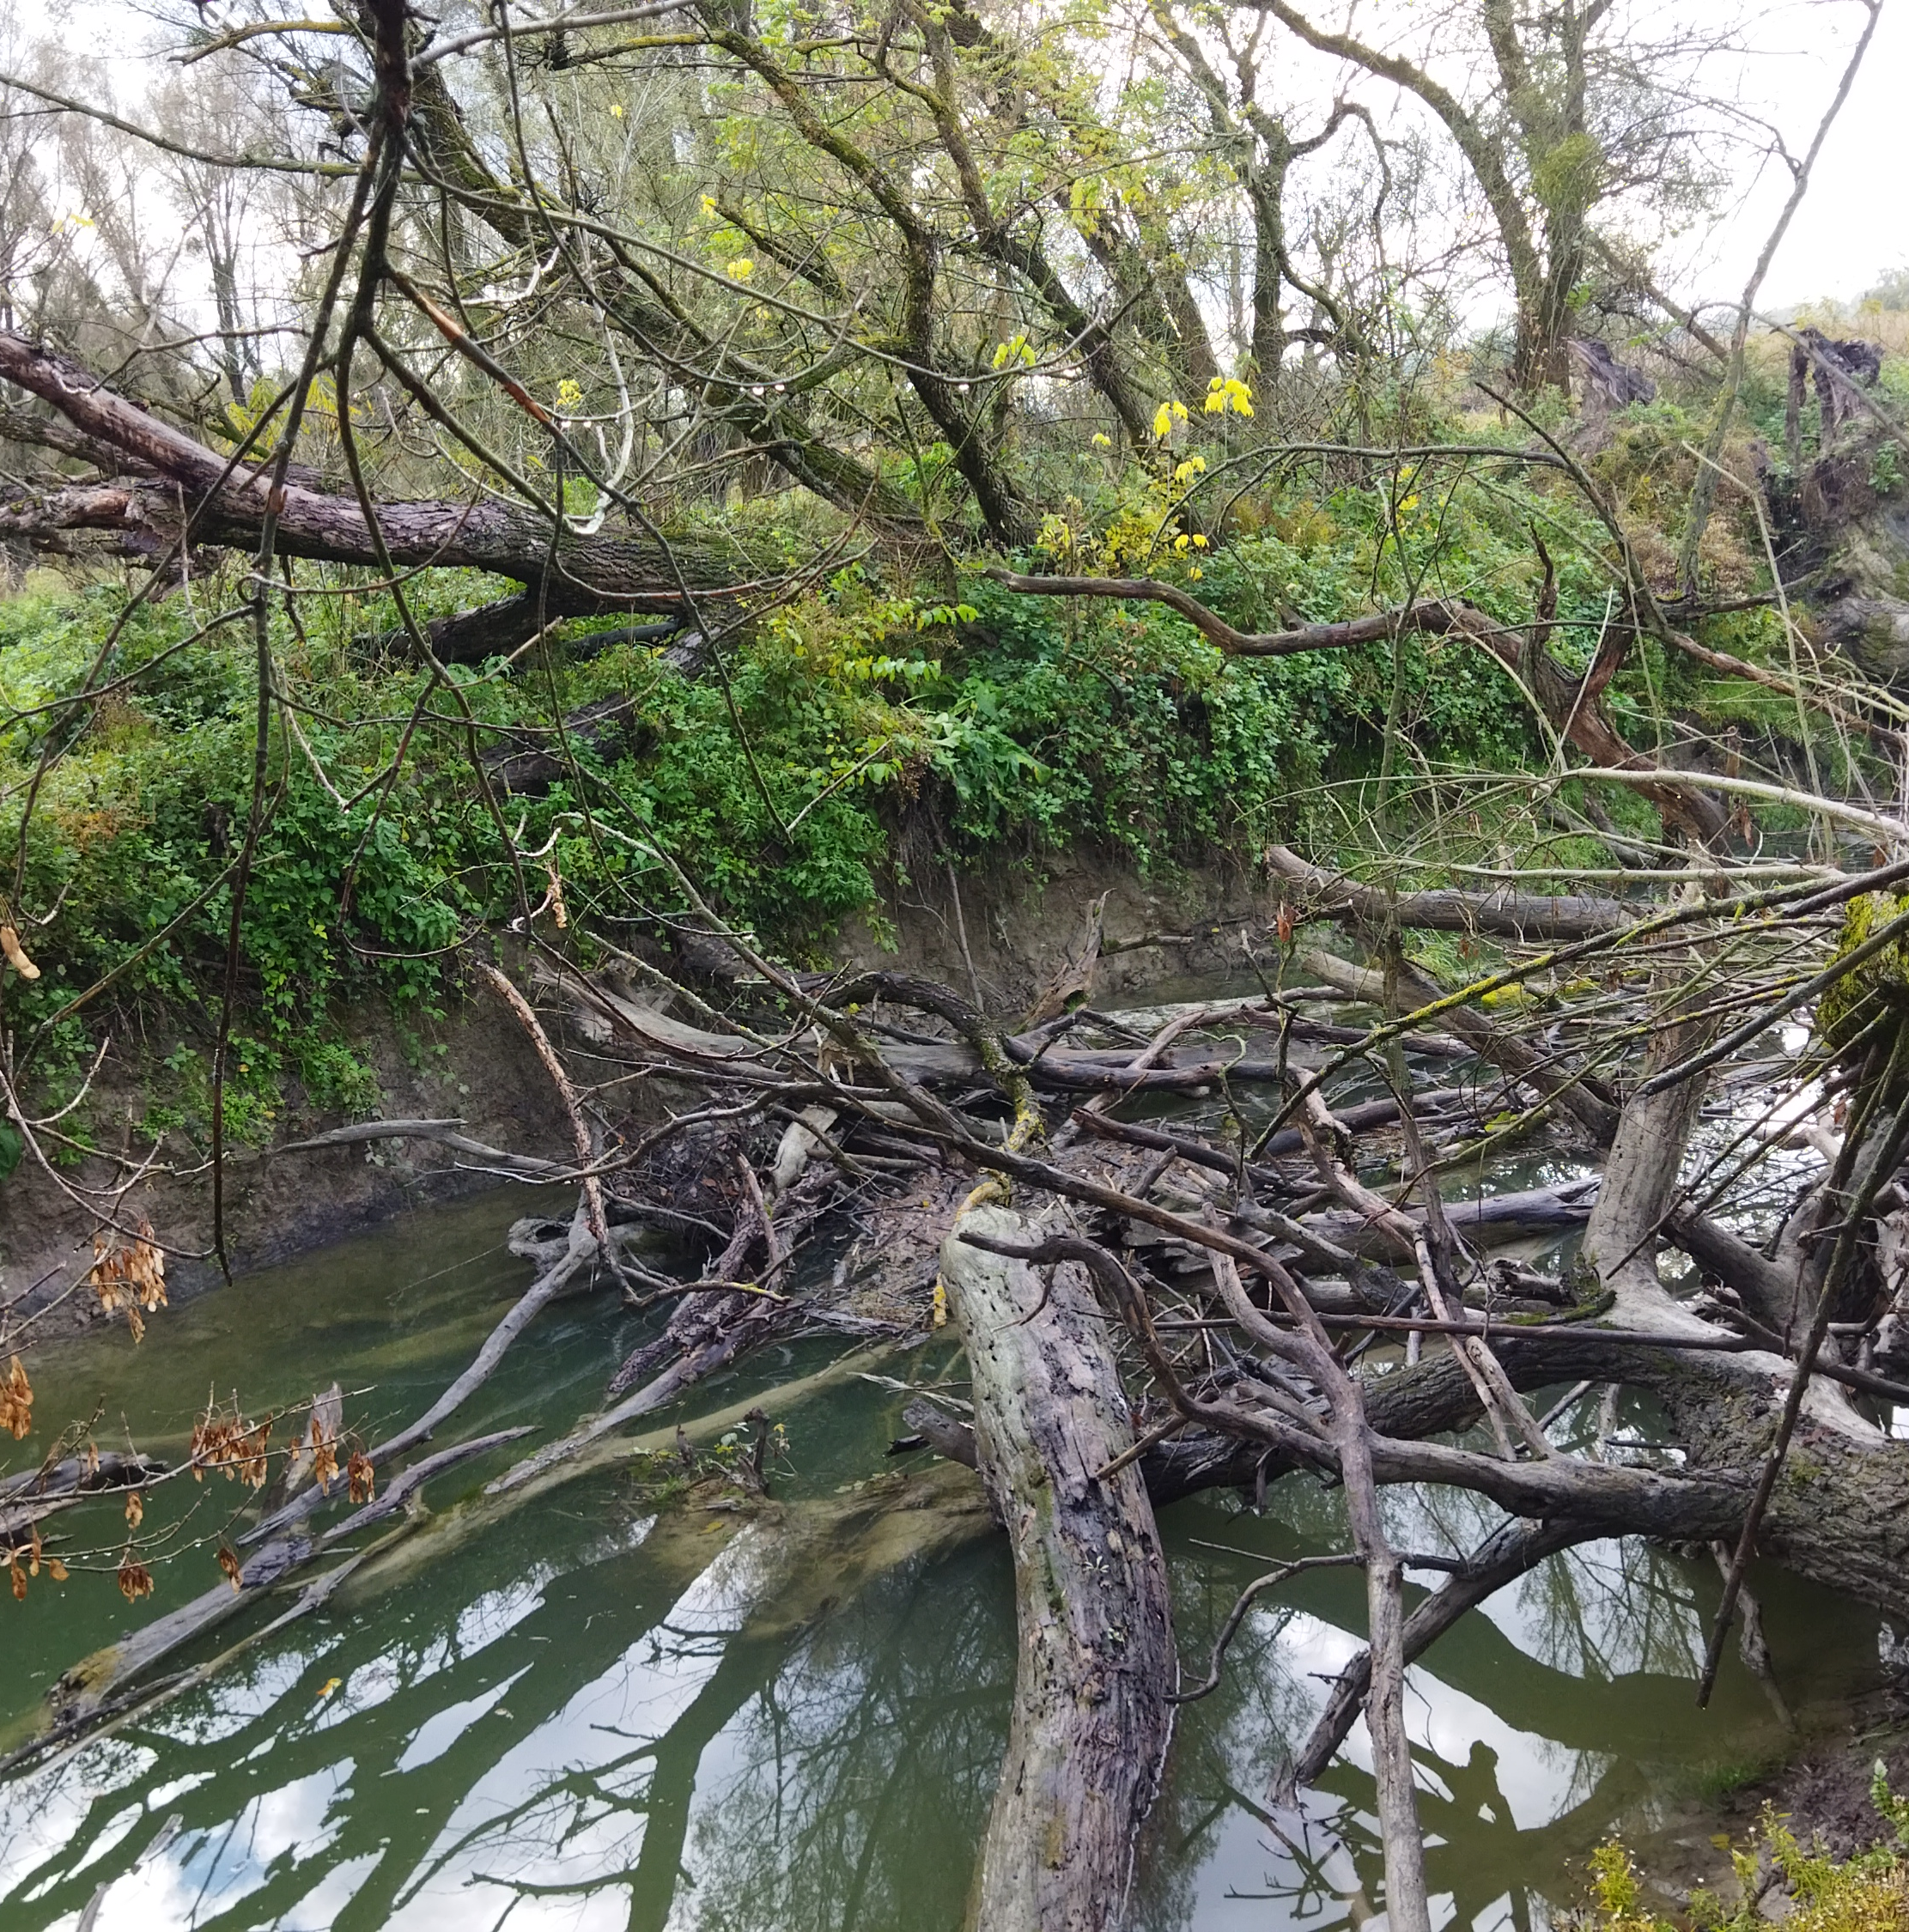
Photos by WWF Adria and PI NP Kopački rit

Slide 10
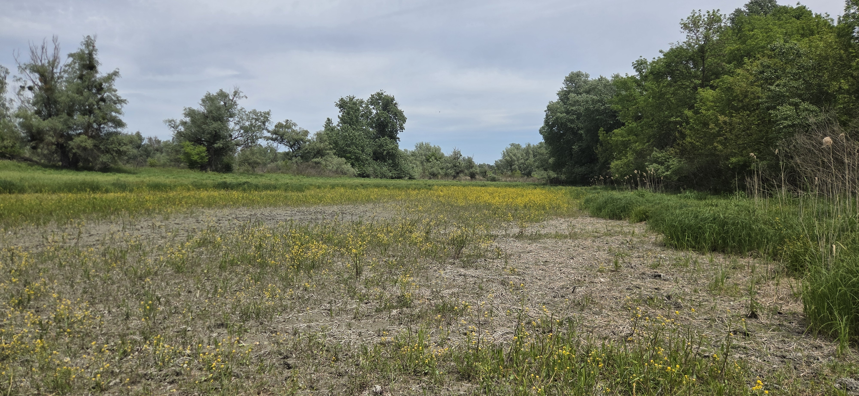
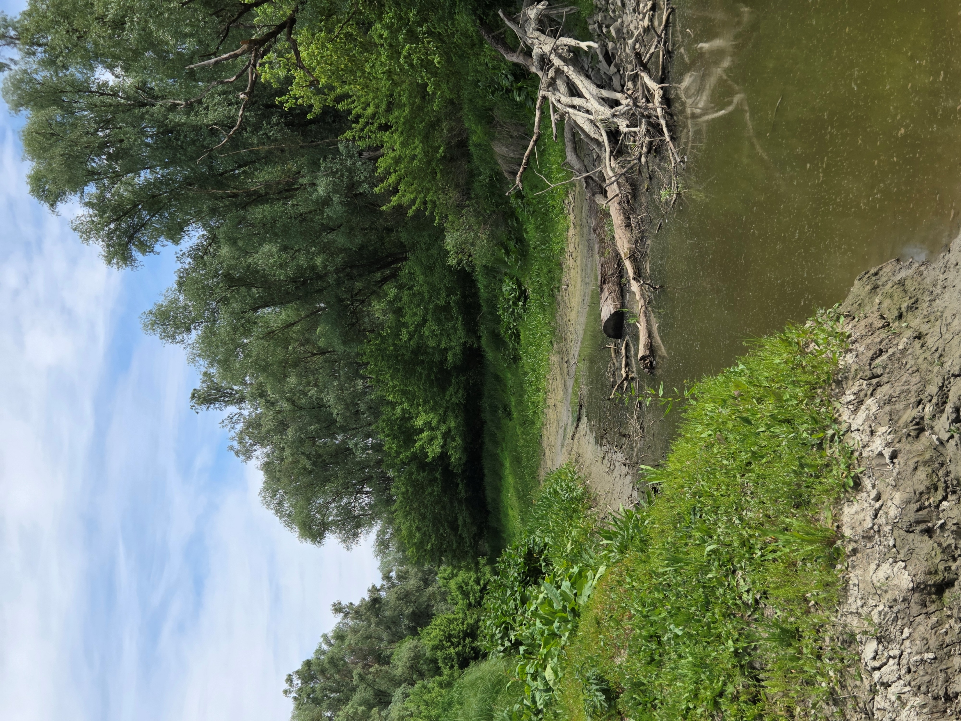
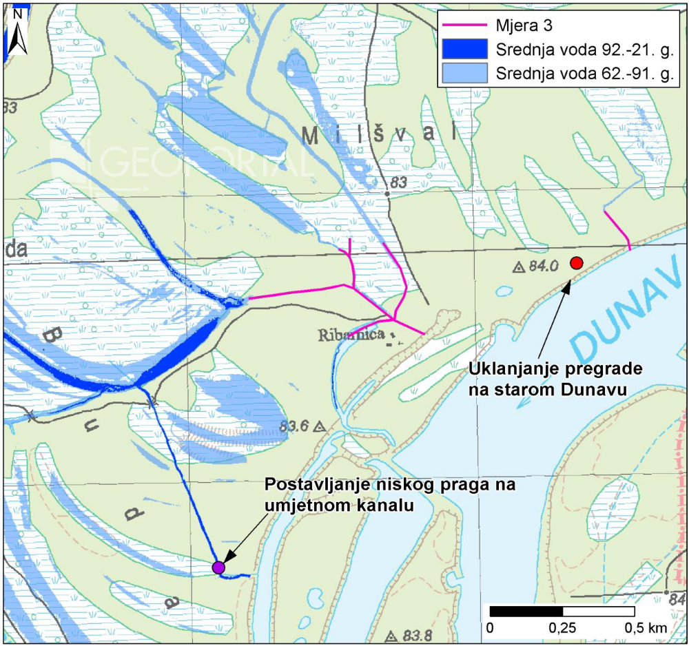
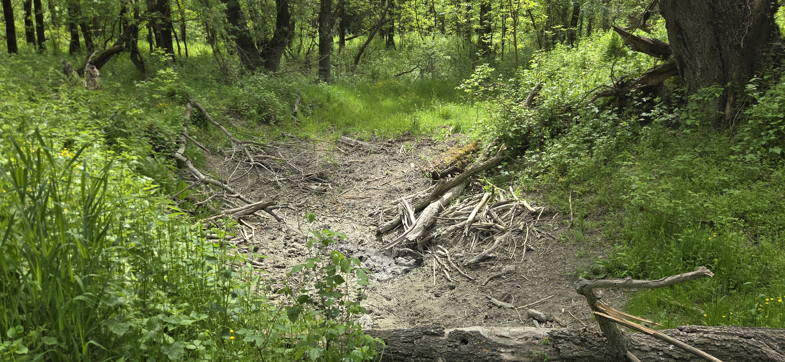
Restoration of the Buda Area
Reconnecting the Buda floodplain area with the Danube via the Ribarica side channel
Restoring longer and more frequent floodplain inundation
Improving habitat conditions for species
Implementation planned for 2027

Slide 11
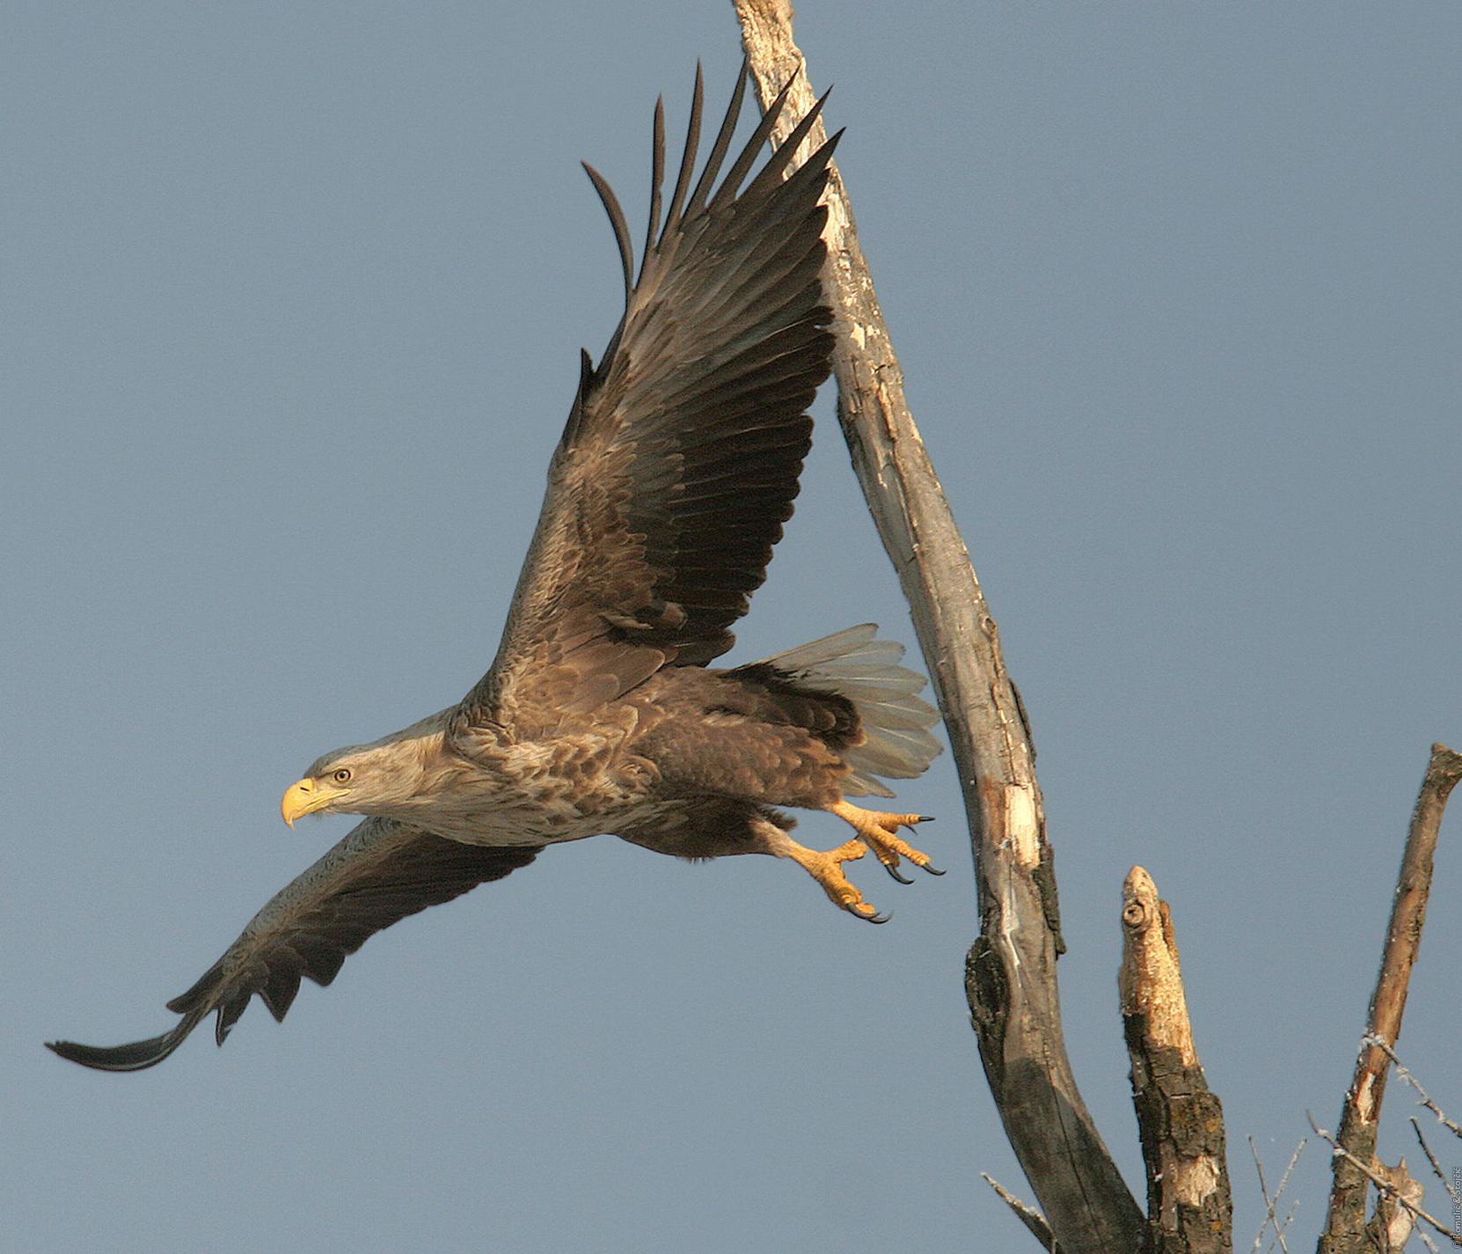
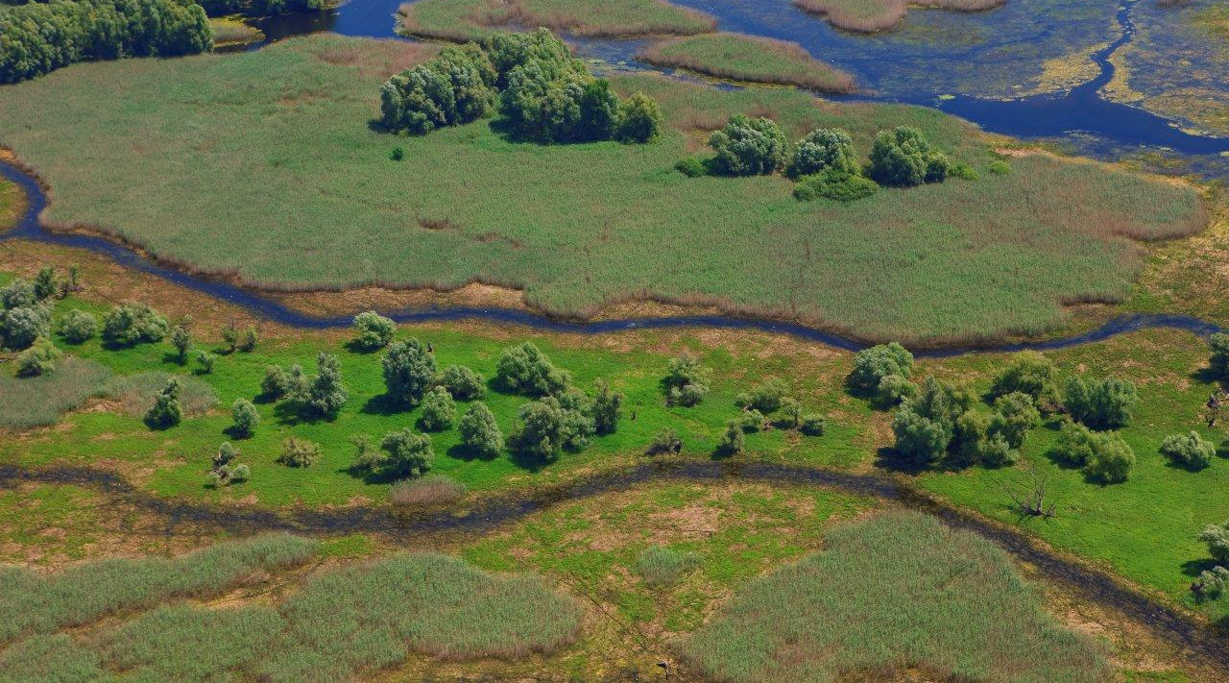
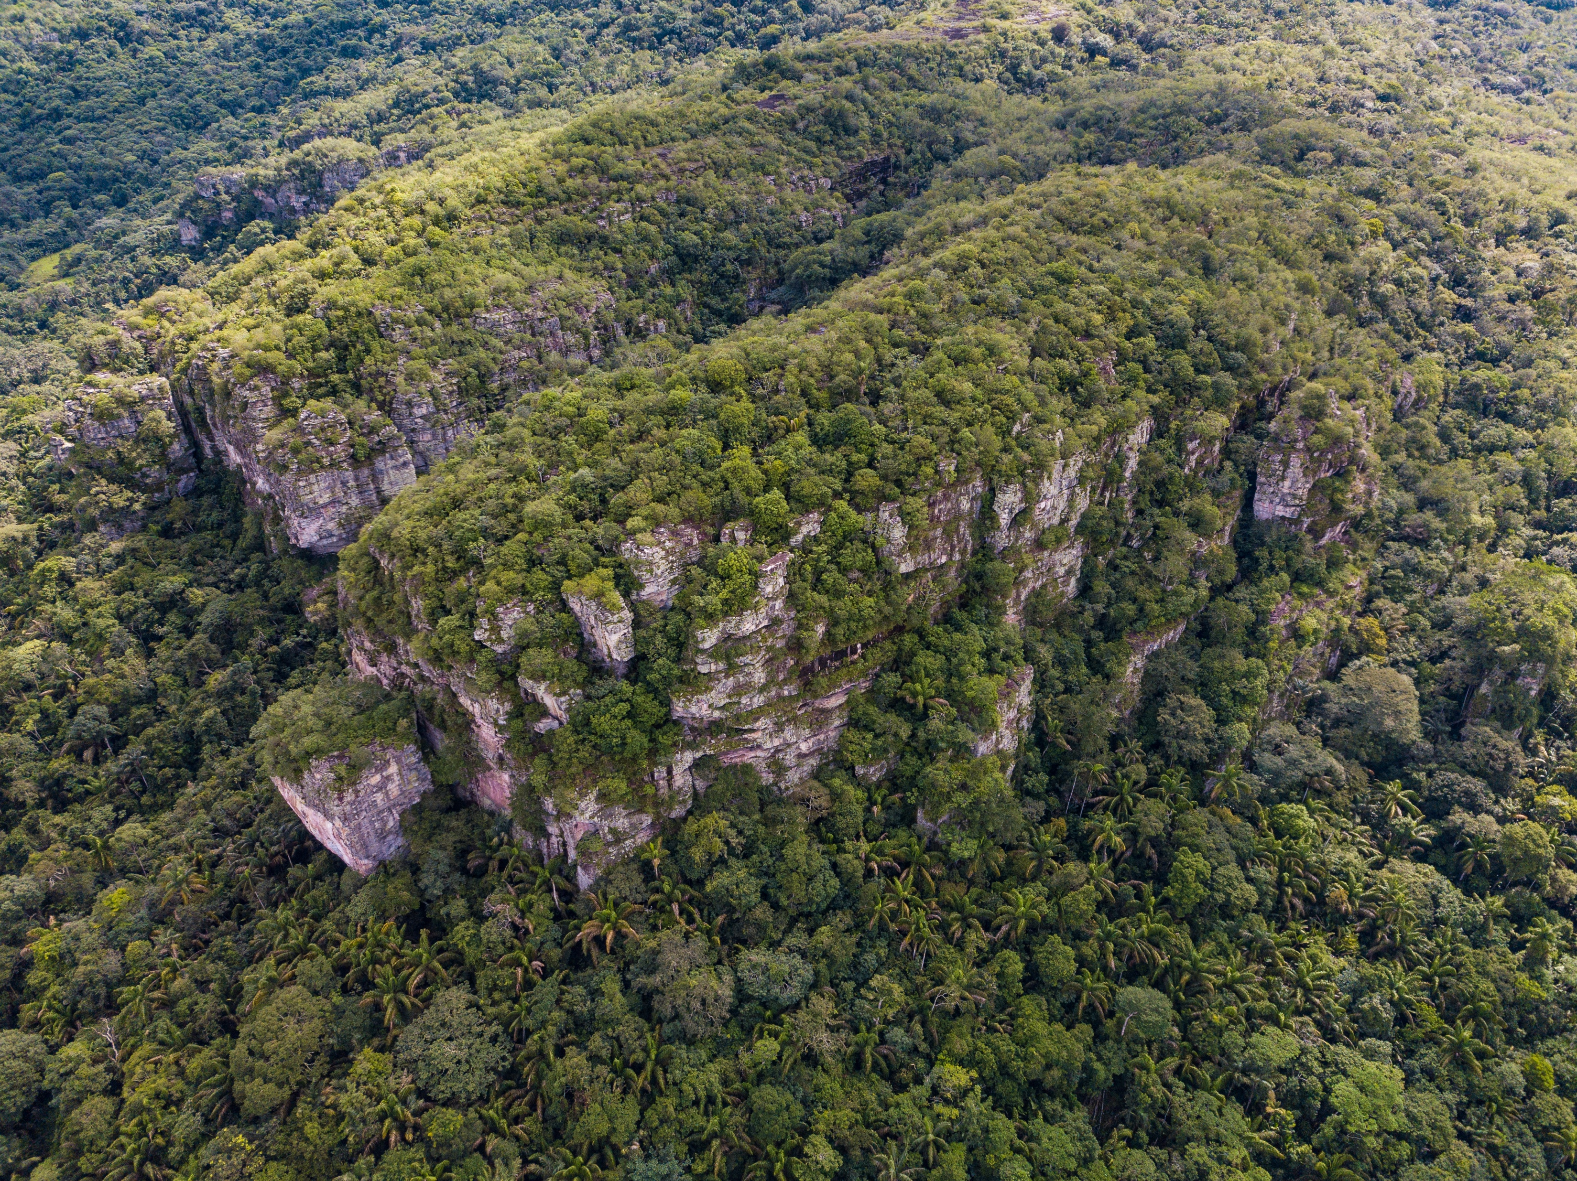
Thank you for the attention!

