Slide 1
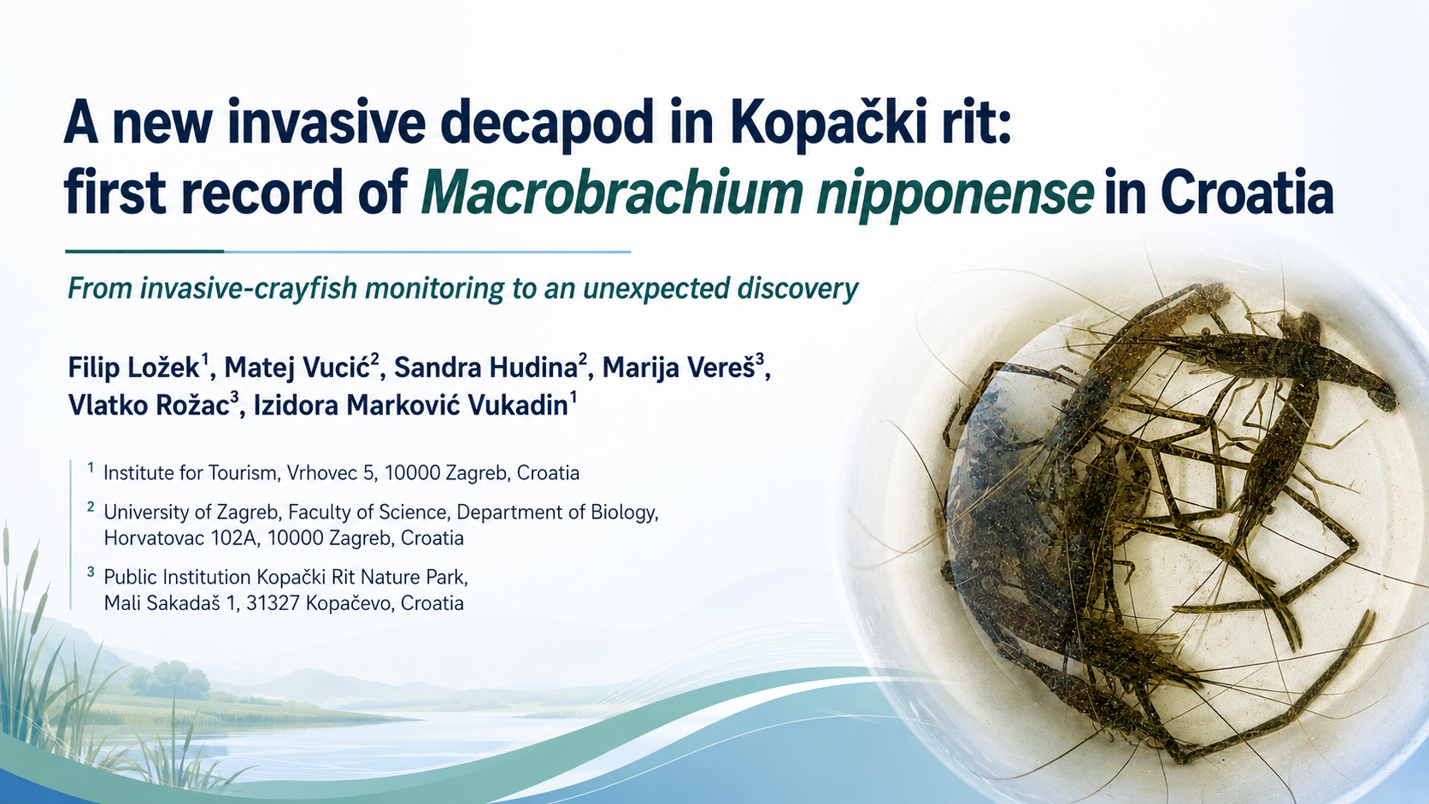
Notes:
“Today I will present the first confirmed record of Macrobrachium nipponense in Croatia, detected in Kopački rit Nature Park. The interesting part of this finding is that we were not actually searching for this species — it was discovered during monitoring focused on invasive crayfish. I will briefly show how it was detected, how we confirmed its identity, and what this finding may mean for Kopački rit and the wider Danube system.”
Transition: “First, it is important to understand the type of system in which we found it.”

Slide 2
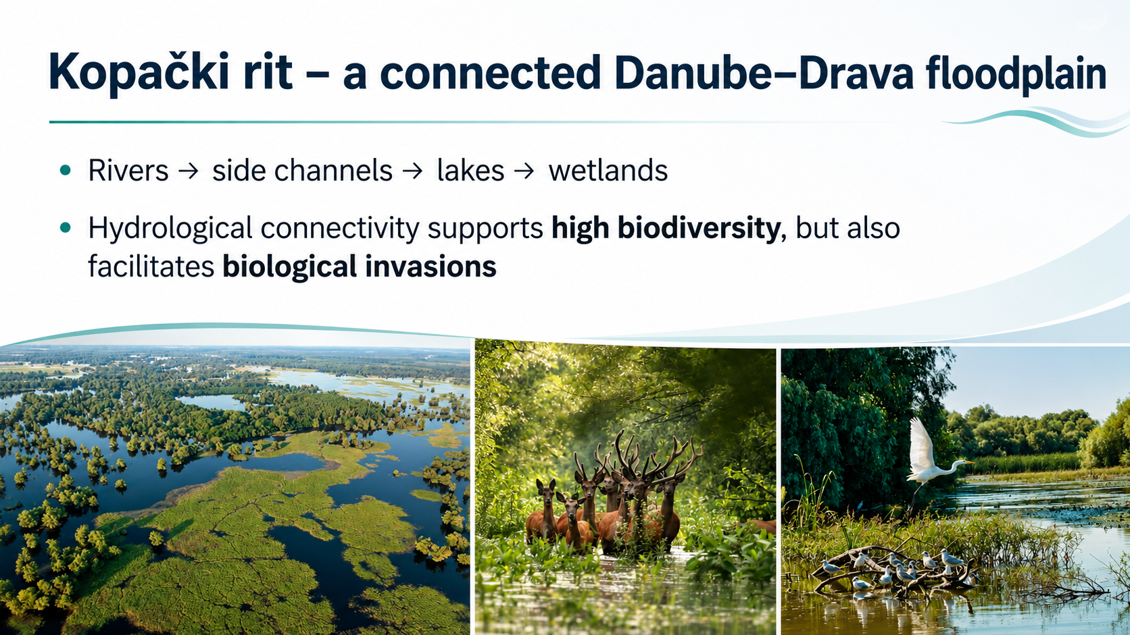
Notes:
“Kopački rit is a highly dynamic floodplain connected to both the Danube and the Drava. Rivers, side channels, lakes and wetlands become interconnected to different degrees depending on hydrological conditions. This connectivity is fundamental for the exceptional biodiversity of the area because it enables movement of organisms, nutrients and organic matter. But exactly the same connectivity can also facilitate the secondary spread of non-native aquatic species once they enter the river system.”
Transition: “And we already know this process from other decapods occurring in this region.”

Slide 3

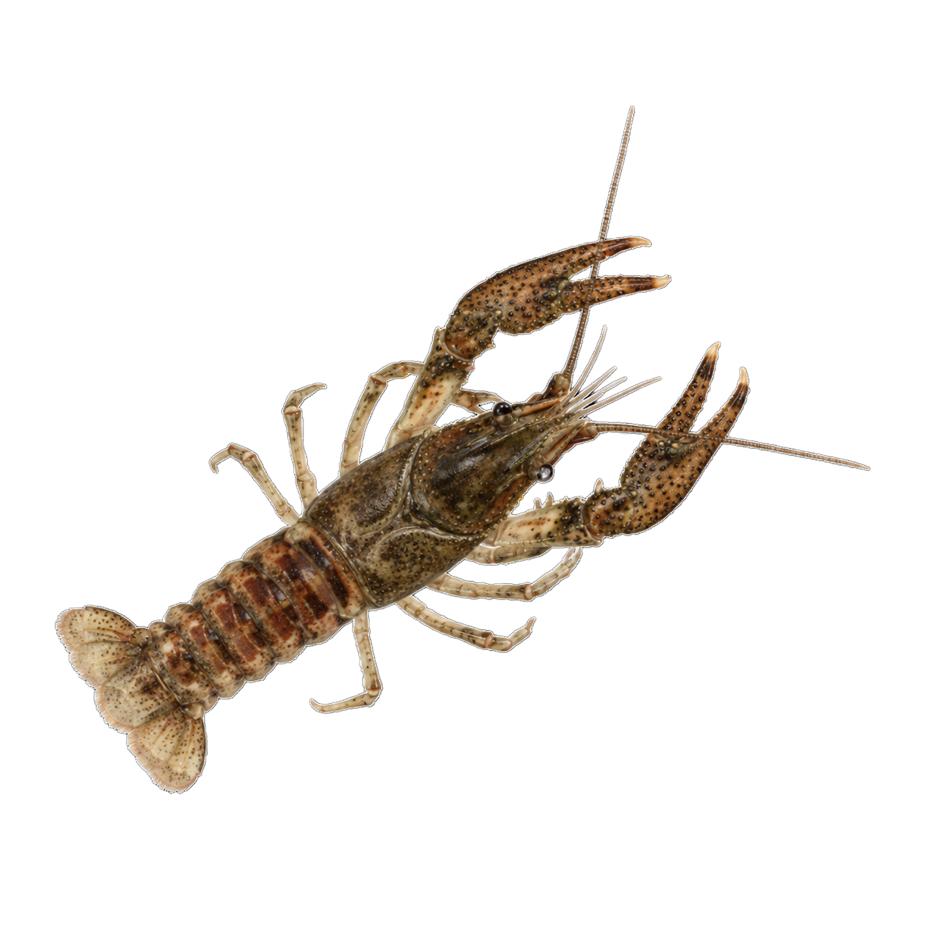
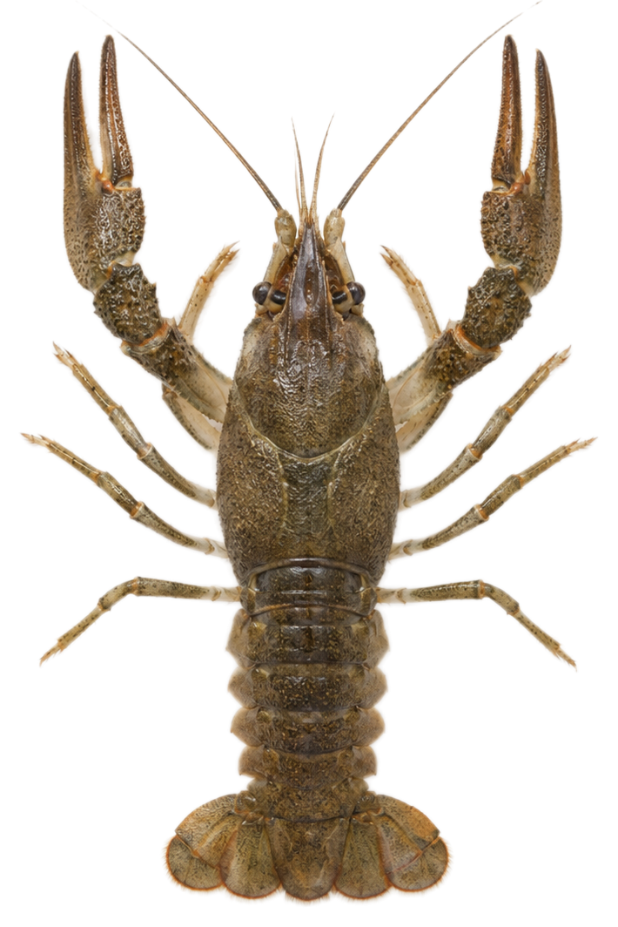
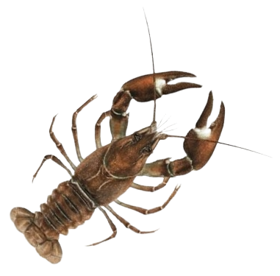
Decapods in the Danube and Drava
Narrow-clawed crayfish
Spiny-cheek crayfish
Signal crayfish
Pontastacus leptodactylus
Faxonius limosus
Pacifastacus leniusculus
NATIVE
INVASIVE
INVASIVE
Native to the Danube basin
First recorded in Kopački rit
in 2003 - Danube corridor
Reached the town of Belišće
by 2018 - Drava corridor
Notes:
“The local decapod community already contains both native and invasive crayfish. The narrow-clawed crayfish, Pontastacus leptodactylus, is native to the Danube basin, whereas Faxonius limosus and Pacifastacus leniusculus are non-native invasive species. F. limosus has been present in the Kopački rit area for more than two decades and is associated with the Danube invasion corridor, while signal crayfish has been spreading through the Drava system. So aquatic corridors have already demonstrated their importance for decapod invasions in this region.”
Transition: “This was actually the reason why we were conducting targeted decapod monitoring.”

Slide 4
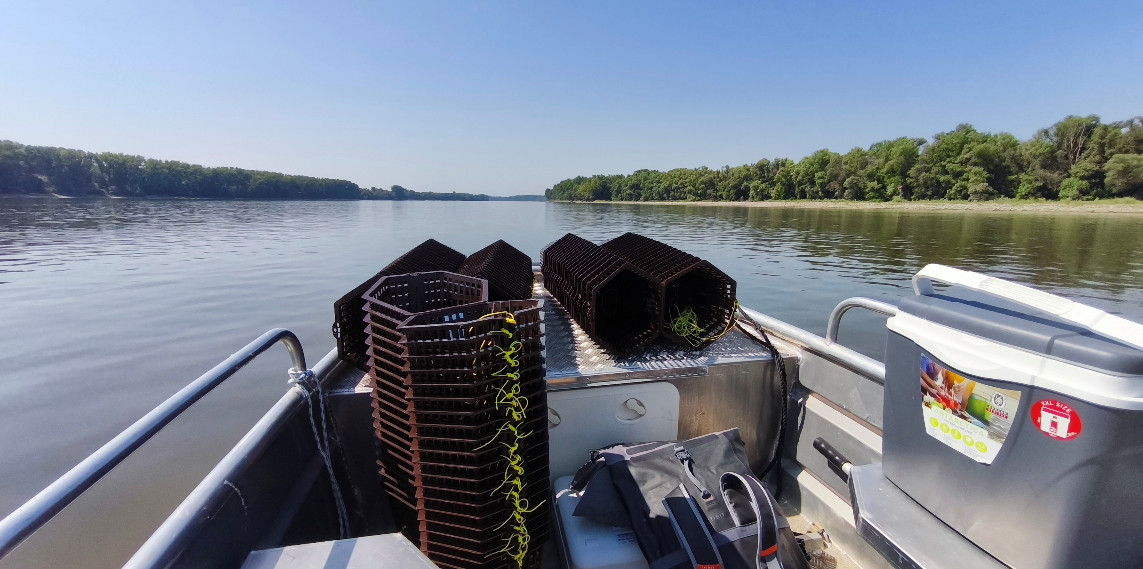
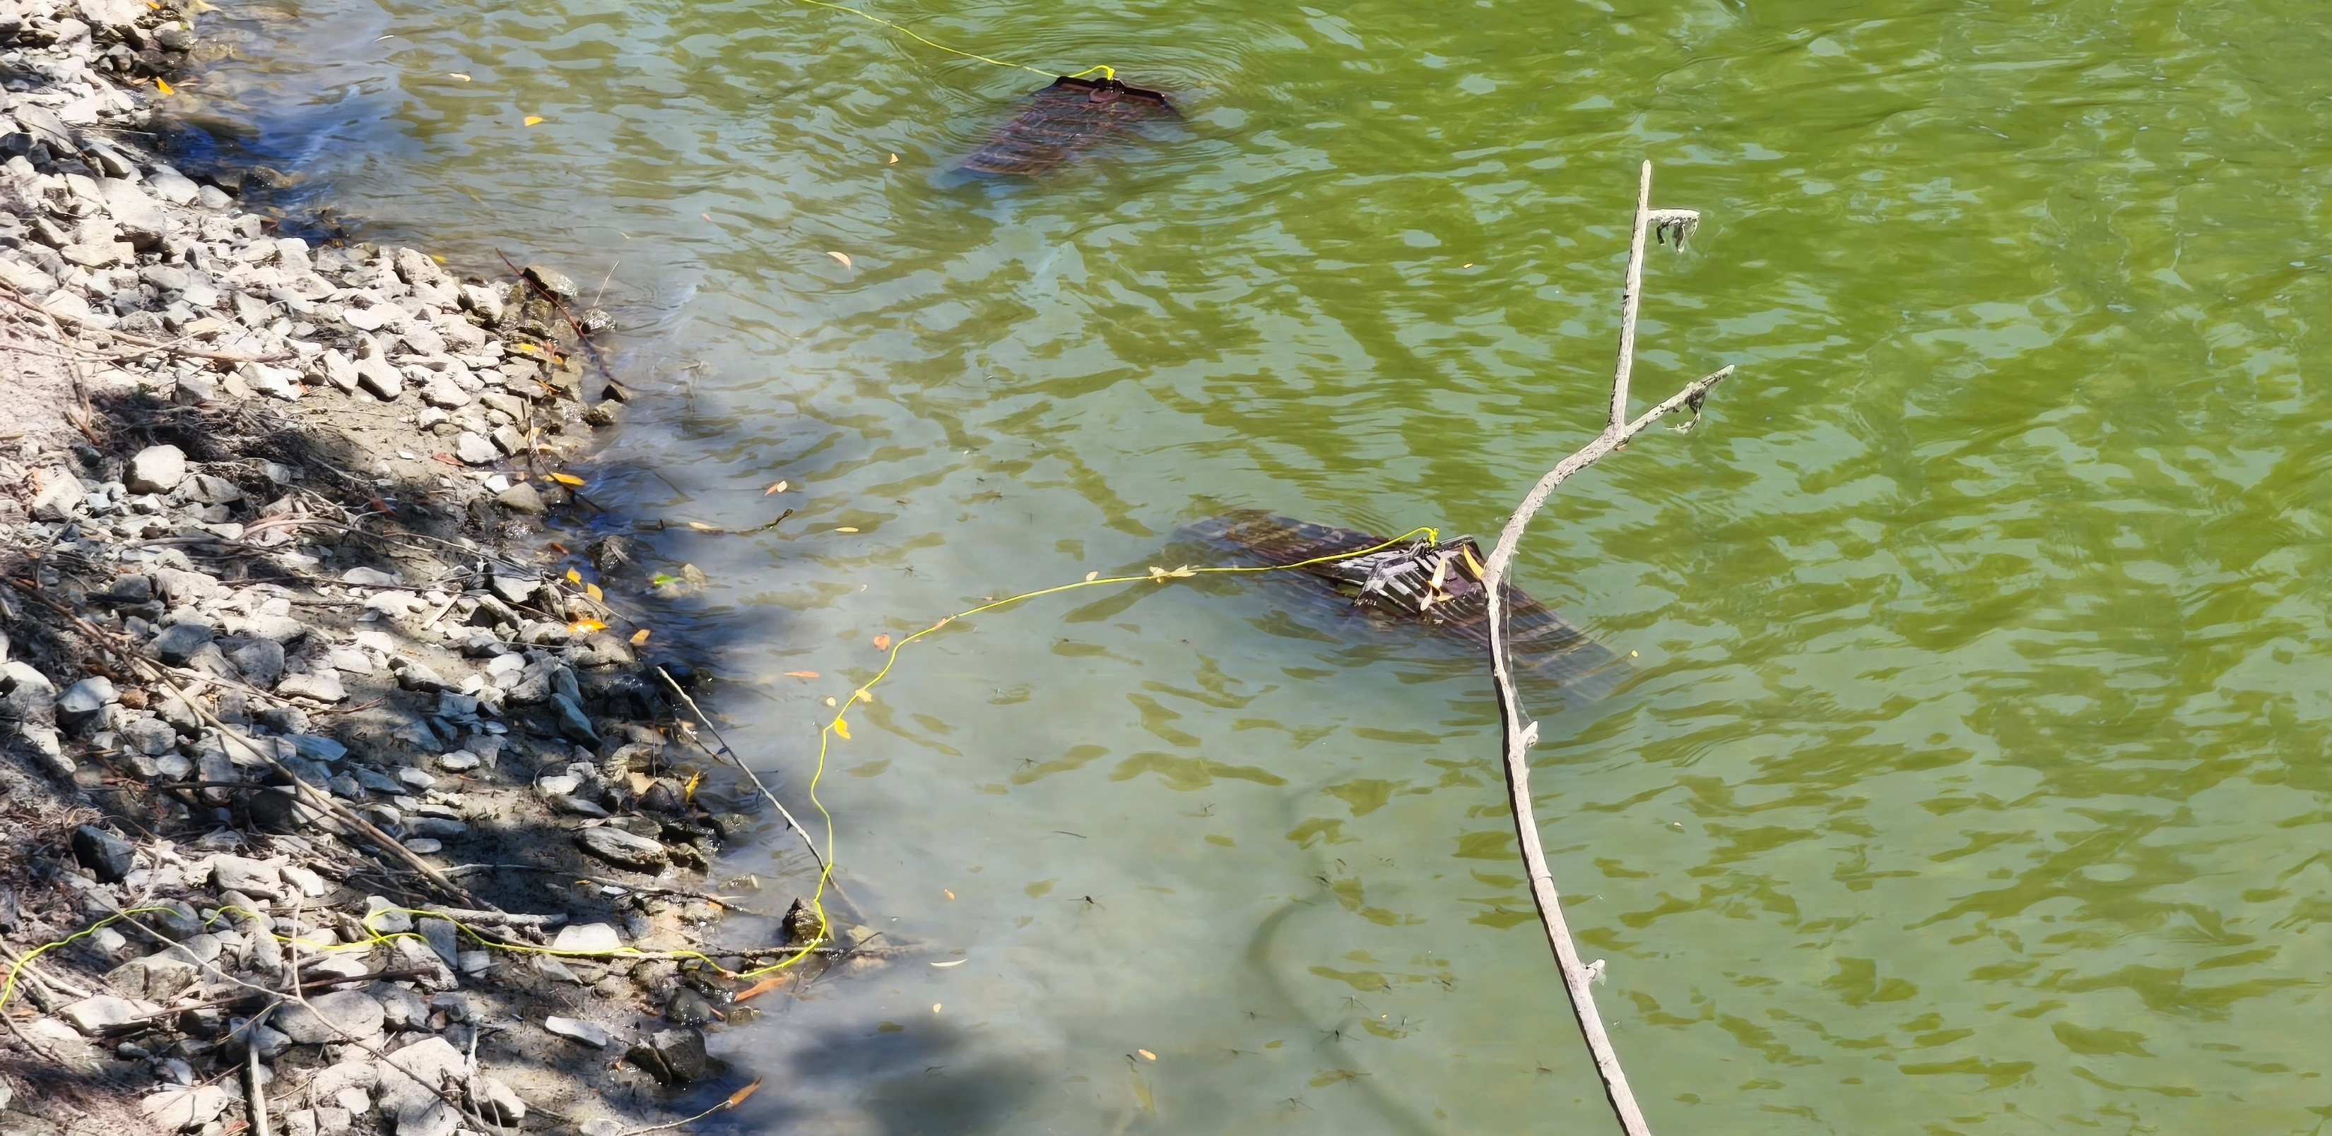
Targeted monitoring in Kopački rit
10
2
Overnight baited trapping
30 June–1 July
28–29 July 2026
localities
surveys in summer 2026
Notes:
“During summer 2026 we surveyed ten localities across Kopački rit in two sampling campaigns, at the end of June and again at the end of July. Our original objective was monitoring invasive crayfish. We used baited traps deployed overnight, so the sampling method was primarily designed for relatively large decapods. During this routine monitoring, however, we encountered something unexpected.”
Transition: “Five specimens clearly did not belong to any of the crayfish species we expected.”

Slide 5
Five shrimps captured at two localities
5
individuals
in total
Captured at
4
Hulovski Channel
Mouth
1
Vemeljski
Dunavac
Notes:
“In total, we captured five Macrobrachium individuals at two different localities. Four were found at the mouth of the Hulovski Channel, directly connected with the Danube, and one was found in Vemeljski Dunavac further inside the floodplain system. Finding specimens at two separate sites is important because this was not simply a single isolated animal caught at one location. At the same time, five individuals are still a very small sample, so we have to be careful when interpreting what this means for establishment.”
Transition: “The individuals themselves also showed considerable variation in size.”

Slide 6

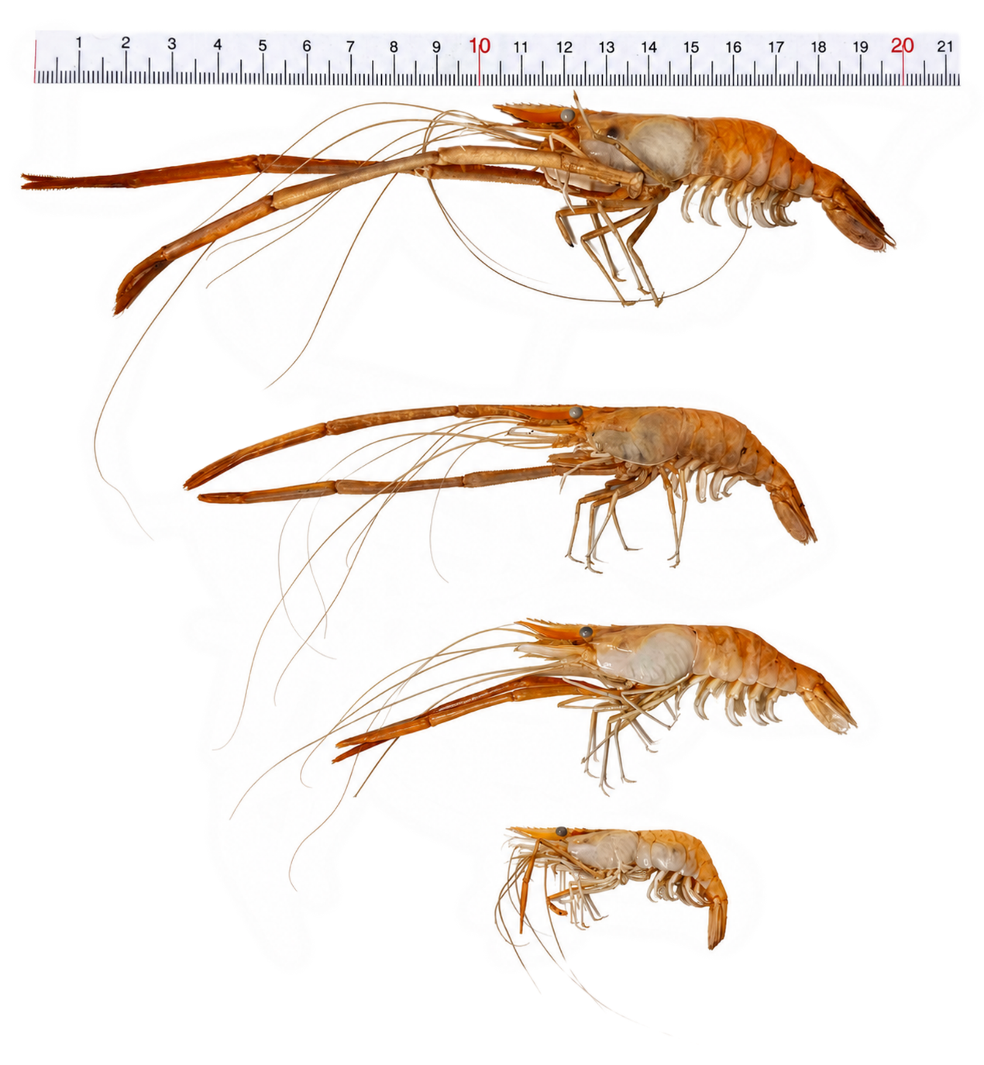
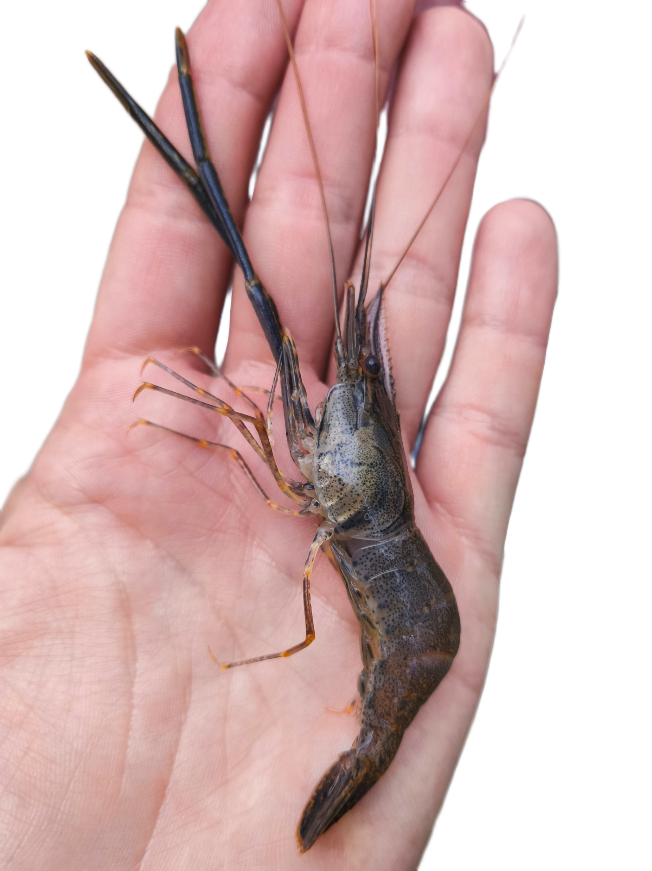
The captured specimens
4 ♂ + 1 ♀
sex composition
29.1–43.7
carapace length (mm)
3.5–12.5
body mass (g)
Notes:
“We captured four males and one female. The specimens ranged from 29.1 to 43.7 millimetres in carapace length and from 3.5 to 12.5 grams in body mass. So these were not tiny recently hatched individuals, but relatively well-developed animals of different sizes. However, we did not capture juveniles or an ovigerous female, which becomes important when we later discuss whether reproduction is occurring locally.”
Transition: “The next question was therefore straightforward: what exactly had we caught?”

Slide 7
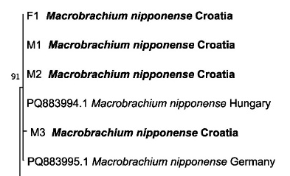
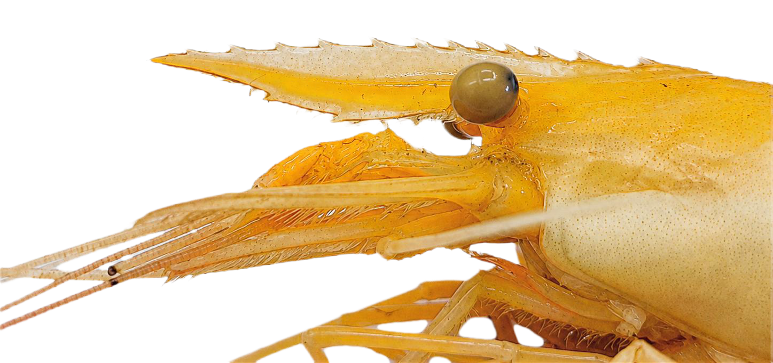
First confirmed record in Croatia
Morphological identification
Molecular identification
XII - XIV
II - IV
COI phylogenetic placement of Croatian specimens
Notes:
“We identified the specimens using two independent approaches. Morphologically, they showed the characteristic rostrum of Macrobrachium nipponense, including 12 to 14 dorsal and 2 to 4 ventral rostral teeth. We then sequenced the mitochondrial COI gene in four specimens, and all four clustered with confirmed European M. nipponense sequences. We detected two COI haplotypes: three Croatian individuals shared one sequence type closely matching the Hungarian material, while the fourth represented another sequence variant close to the German material. Together, the morphological and molecular evidence confirms the first record of M. nipponense in Croatia.”
Transition: “Once the identification was confirmed, the obvious next question was: how did it get here?”

Slide 8
How did it reach Kopački rit?
Danube corridor → secondary spread → Kopački rit
Adult movement
Planktonic larval
dispersal
Human-mediated
transport
Croatian specimens are genetically very similar to specimens from Hungarian and German part of the Danube.
This supports a Danubian invasion pathway, although the exact source
population cannot yet be determined (but in process).
Notes:
How did it reach Kopački rit?
“The most plausible broader scenario is secondary spread through the Danube invasion corridor, although our data cannot identify the precise source population. Several mechanisms could potentially contribute: movement of adults, dispersal of planktonic larvae, and human-mediated transport. The COI sequences of the Croatian specimens are very similar to sequences already reported from Danubian populations in Hungary and Germany, which is consistent with a Danubian pathway. But COI alone does not allow us to reconstruct the exact source or distinguish among these dispersal mechanisms.”
Transition: “The geographical pattern of European records provides additional context for this interpretation.”

Slide 9

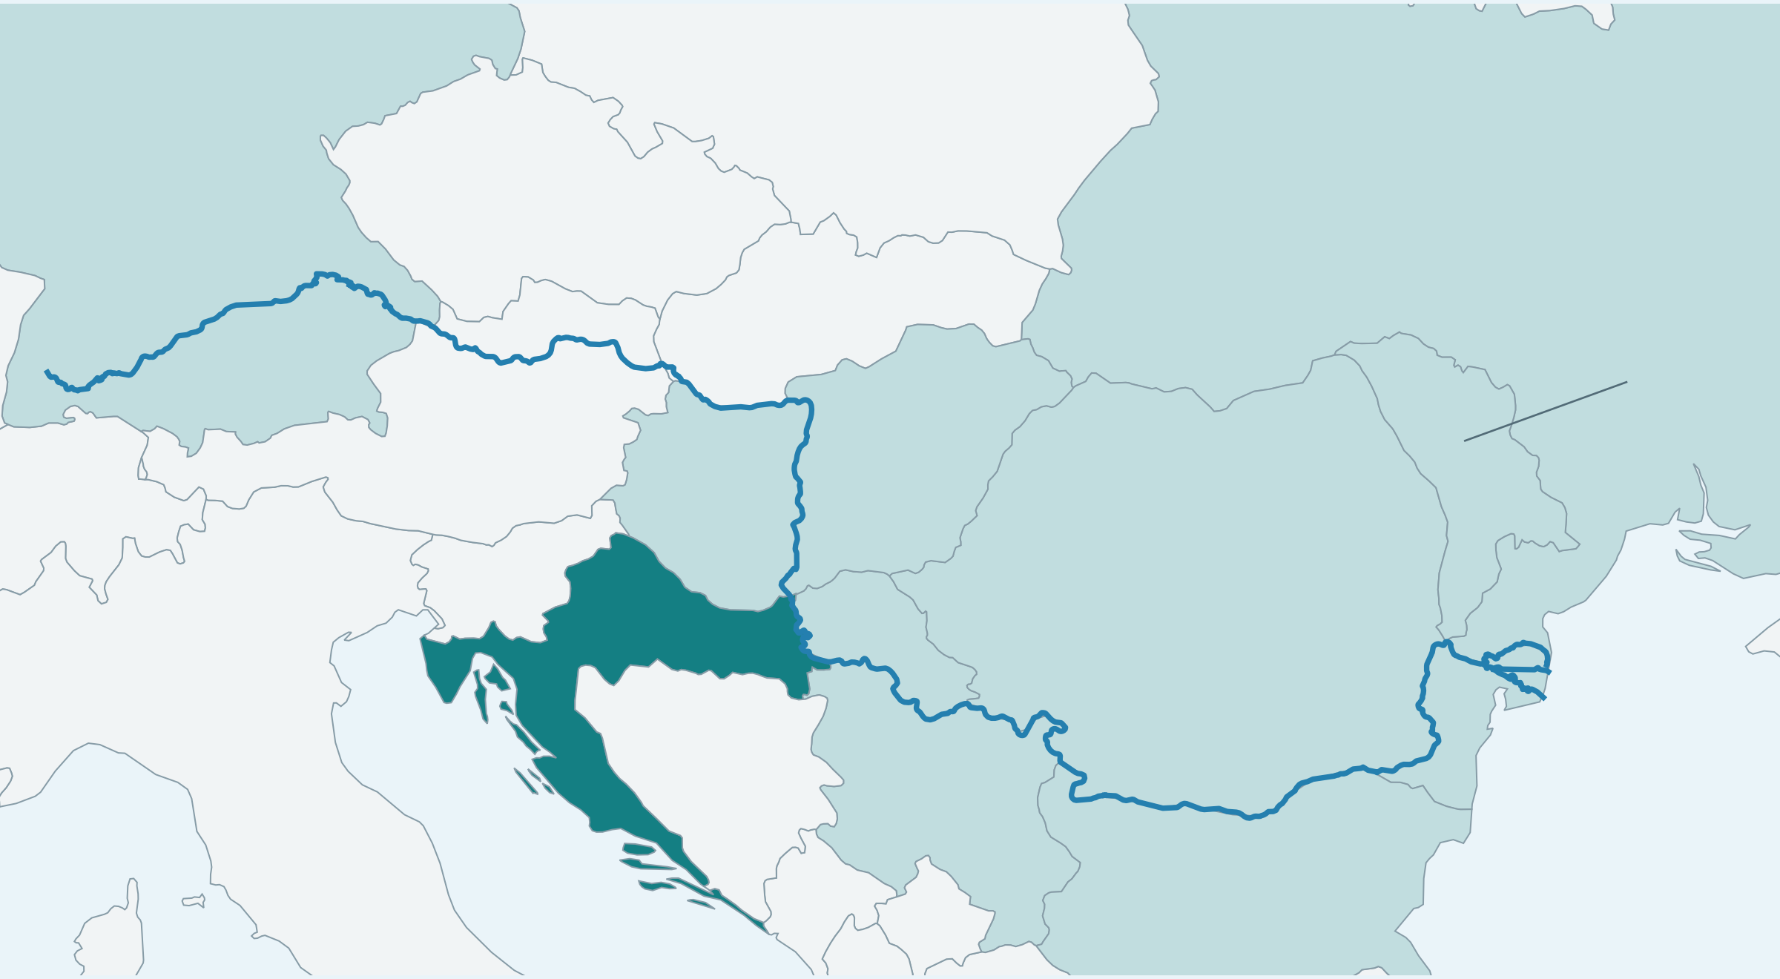
Records along the Danube corridor
Shading marks countries with selected records, not continuous occupancy.
Year of observation
Germany
2019
Ukraine (Danube Delta)
Czechia
Ukraine
2021
Romania
Moldova (lower Prut)
Slovakia
Moldova
Austria
2023
Germany, Hungary,
Bulgaria
Hungary
Croatia
Romania
2025
Serbia
Serbia
Danube
2026
Croatia
Black Sea
Bulgaria
Already recorded upstream and downstream of Croatia
Notes:
Records along the Danube corridor
“This map shows selected recent records associated with the Danube region; importantly, the shading does not imply continuous distribution. The species has now been recorded from several parts of the basin, including the lower Danube and more recently Germany, Hungary, Bulgaria and Serbia. Croatia therefore lies geographically between already documented populations upstream and downstream. The Croatian record fits a broader pattern of ongoing expansion through the Danube system rather than being geographically isolated.”
Transition: “But detecting the species is not the same as demonstrating that it has established a population.”

Slide 10
Is it established in Kopački rit?
Evidence so far
Evidence still missing
5
individuals captured
?
No juveniles detected
2
separate localities
?
No ovigerous females
4
?
Limited sampling with traps
not designed for small decapods
individuals at one site
Occurrence is confirmed, but establishment remains unconfirmed.
Notes:
Is it established in Kopački rit?
“At present, we can confidently confirm occurrence, but not establishment. Five individuals were found at two localities, including four animals at a single site, which suggests that the finding deserves attention. However, we did not detect juveniles or ovigerous females, and our sampling gear was designed for crayfish rather than small prawns, so reproductive stages could easily have been under-sampled. Therefore, the most defensible conclusion at this stage is that establishment remains unresolved.”
Transition: “And whether it establishes matters because its ecological role in European freshwater systems is still poorly understood.”

Slide 11
Potential ecological effects
Concerns for Kopački rit
Open questions
Faxonius limosus co-occurred with
M. nipponense at the sampling site.
What interspecific interactions occur?
Could the shrimp carry crayfish plague?
Predation on
fish eggs and fry
Predation on benthic
invertebrates
Changes to
the food web
Pathogen
interactions
Ecological impacts in European waters remain poorly understood.
Notes:
“At this stage, we cannot say what ecological impact Macrobrachium nipponense will have in Kopački rit, because its effects in European waters are still poorly understood. However, several mechanisms deserve attention: competition with other decapods, predation on benthic invertebrates, possible changes in food-web interactions, and interactions with pathogens. Interestingly, we captured Faxonius limosus at the same locality and during the same sampling period, showing that the two invasive decapods already co-occur. This raises questions about whether they compete, facilitate one another, or otherwise interact, and also whether M. nipponense could potentially participate in the transmission of crayfish-associated pathogens. These are therefore important priorities for future research rather than impacts that we can currently demonstrate.”

Slide 12
Next steps for monitoring
Methods
Priority habitats
Targeted trapping
01
Danube-connected channels
Adapt gear to capture specifically shrimps
Fine-mesh sampling
02
Side channels
Search for juveniles and ovigerous females
eDNA
03
Sakadaš Lake
Complement conventional sampling
04
Backwaters
Citizen science
Engage anglers and fishers
Notes:
Monitoring priorities from the supplied presentation: targeted trapping, fine-mesh sampling, environmental DNA, search for juveniles and ovigerous females, and citizen-science participation by anglers and fishers. Prioritise Danube-connected channels, followed by side channels, Sakadaš Lake and backwaters. Varying Danube water levels may redistribute larvae or juveniles through the floodplain network.

Slide 13
An opportunity to document an early invasion
01
02
03
First record
Establishment unknown
Future monitoring
Macrobrachium nipponense has been confirmed in Croatia for the first time.
Whether a population is established in Kopački rit remains unknown.
Repeated monitoring can document this invasion at an early stage.
Notes:
To conclude this presentation, we recorded M. nipponense for the first time in Croatia
Despite our record we don’t have support to say it is established here in Kopački rit
And most probably it is early invasion, which we should document by repeated monitoring efforts

Slide 14

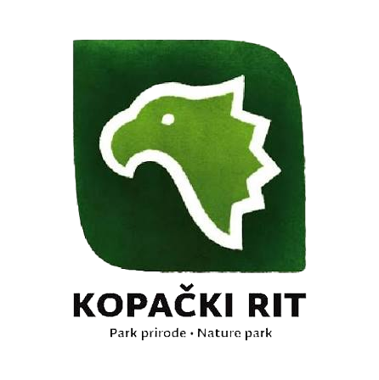


Acknowledgement
PACT-VIRA – IP-2024-05-9190 (HRZZ)
Organization of Kopački rit symposium
All colleagues who helped with realisation

Slide 15

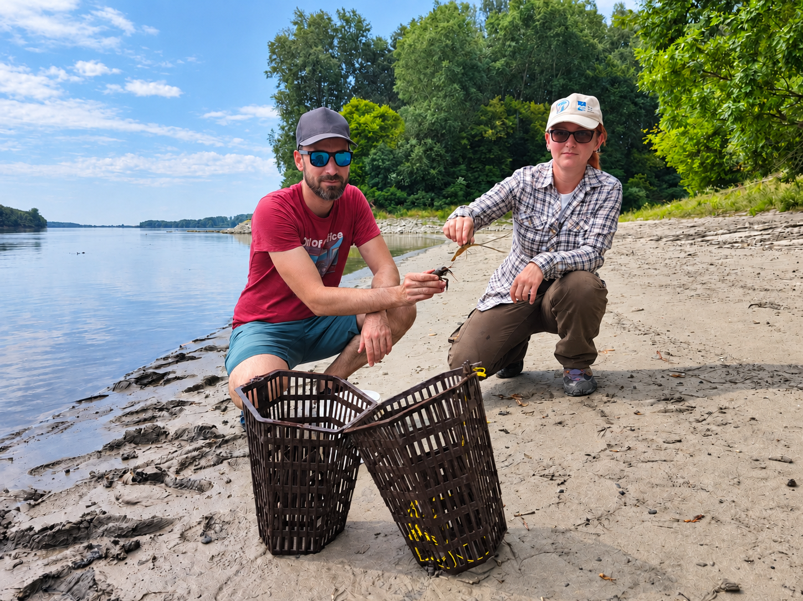
Thank you
?
Questions and discussion
?
?
?
?
?
?
?

