Slide 1

15th International Symposium “Kopački rit: Past, Present, Future 2026
Microwave-induced desiccation of Japanese knotweed (Reynoutria japonica Houtt.) rhizomes:
implications for disposal technique
Beata Grygierzec, Krzysztof Słowiński, Marta Kempf, Sylwester Tabor, Robert Witkowicz, Mateusz Krupa, Angelika Kliszcz, Janina Gospodarek, Stanisław Mazur, Piotr Kempf, Marin Lukačević, Agnieszka Synowiec
Osijek, Croatia
2nd-3rd October, 2026
Except where otherwise indicated, this presentation and its contents are licensed under the Creative Commons Attribution-NonCommercial-NoDerivatives 4.0 International License (CC BY-NC-ND 4.0)

Slide 2
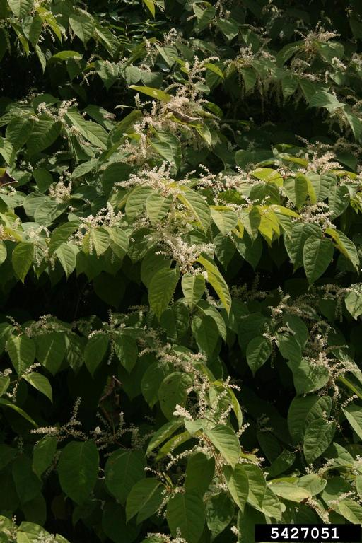
Introduction & problem context
Extreme management difficulty
eradication notoriously complex
Daunting disposal challenge
following manual or mechanical removal
Microwave radiation energy (MRE)
investigated to reduce rhizome moisture and viability
© Chris Evans, University of Illinois, Bugwood.org

Slide 3
?
Research objectives
Does moisture loss follow linear trend across increasing MRE durations?
How effectively does MRE dessicate R. japonica rhizomes?
Does MRE completely suppress rhizome viability and post-treatment resprouting?
What thermal changes occur within the treated rhizomes?

Slide 4
Materials and methods
?

Slide 5
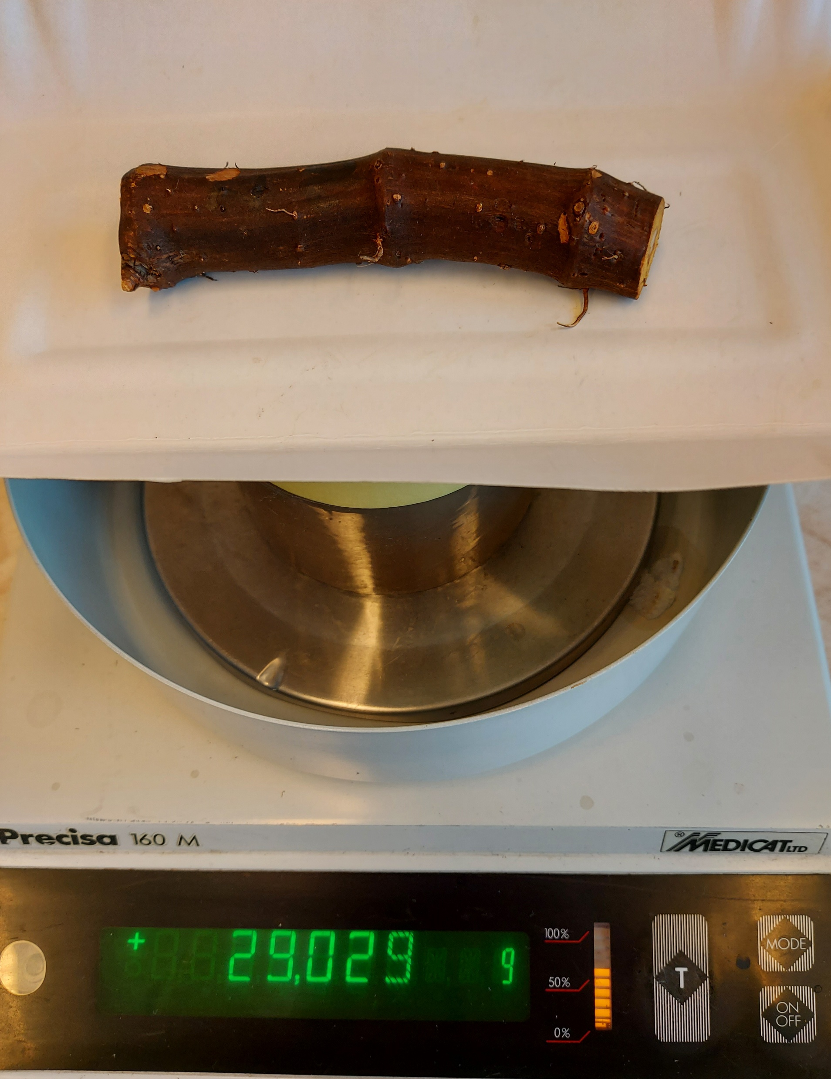
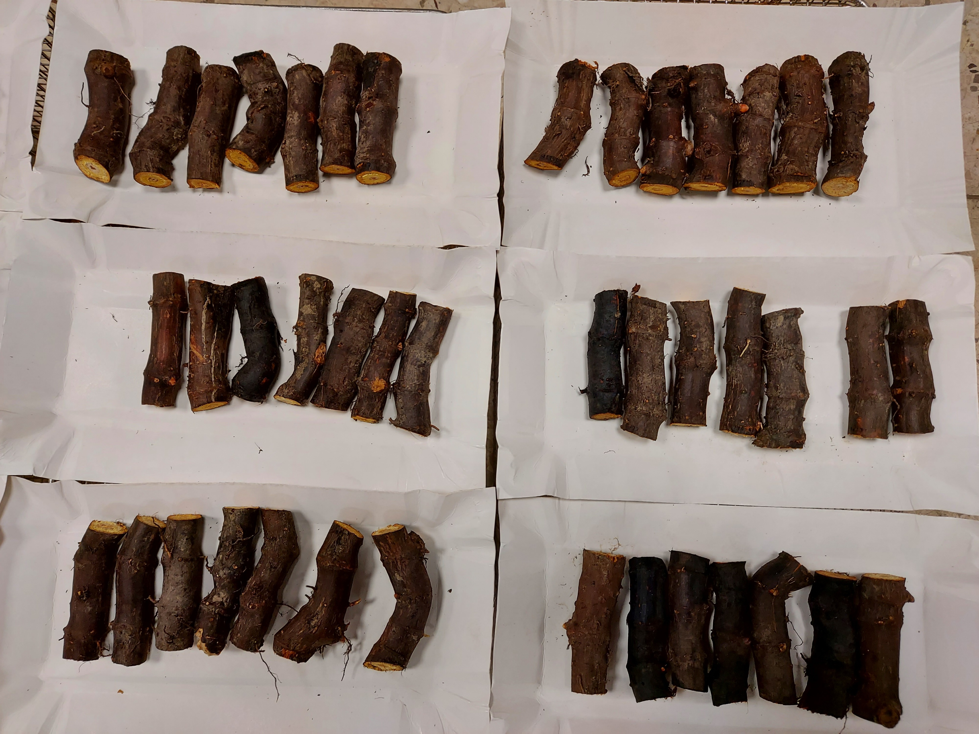
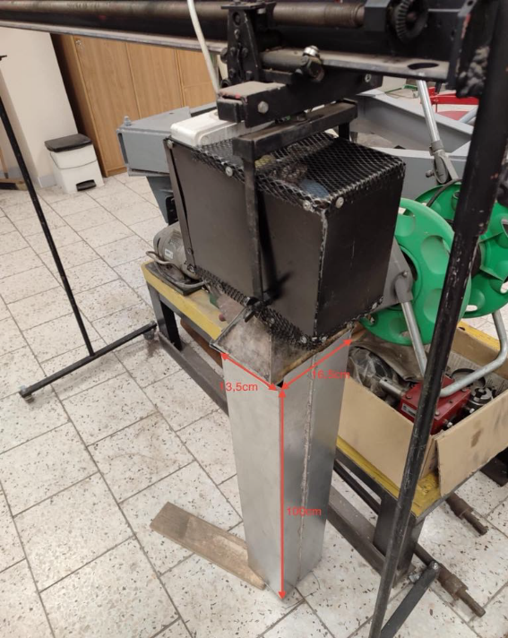
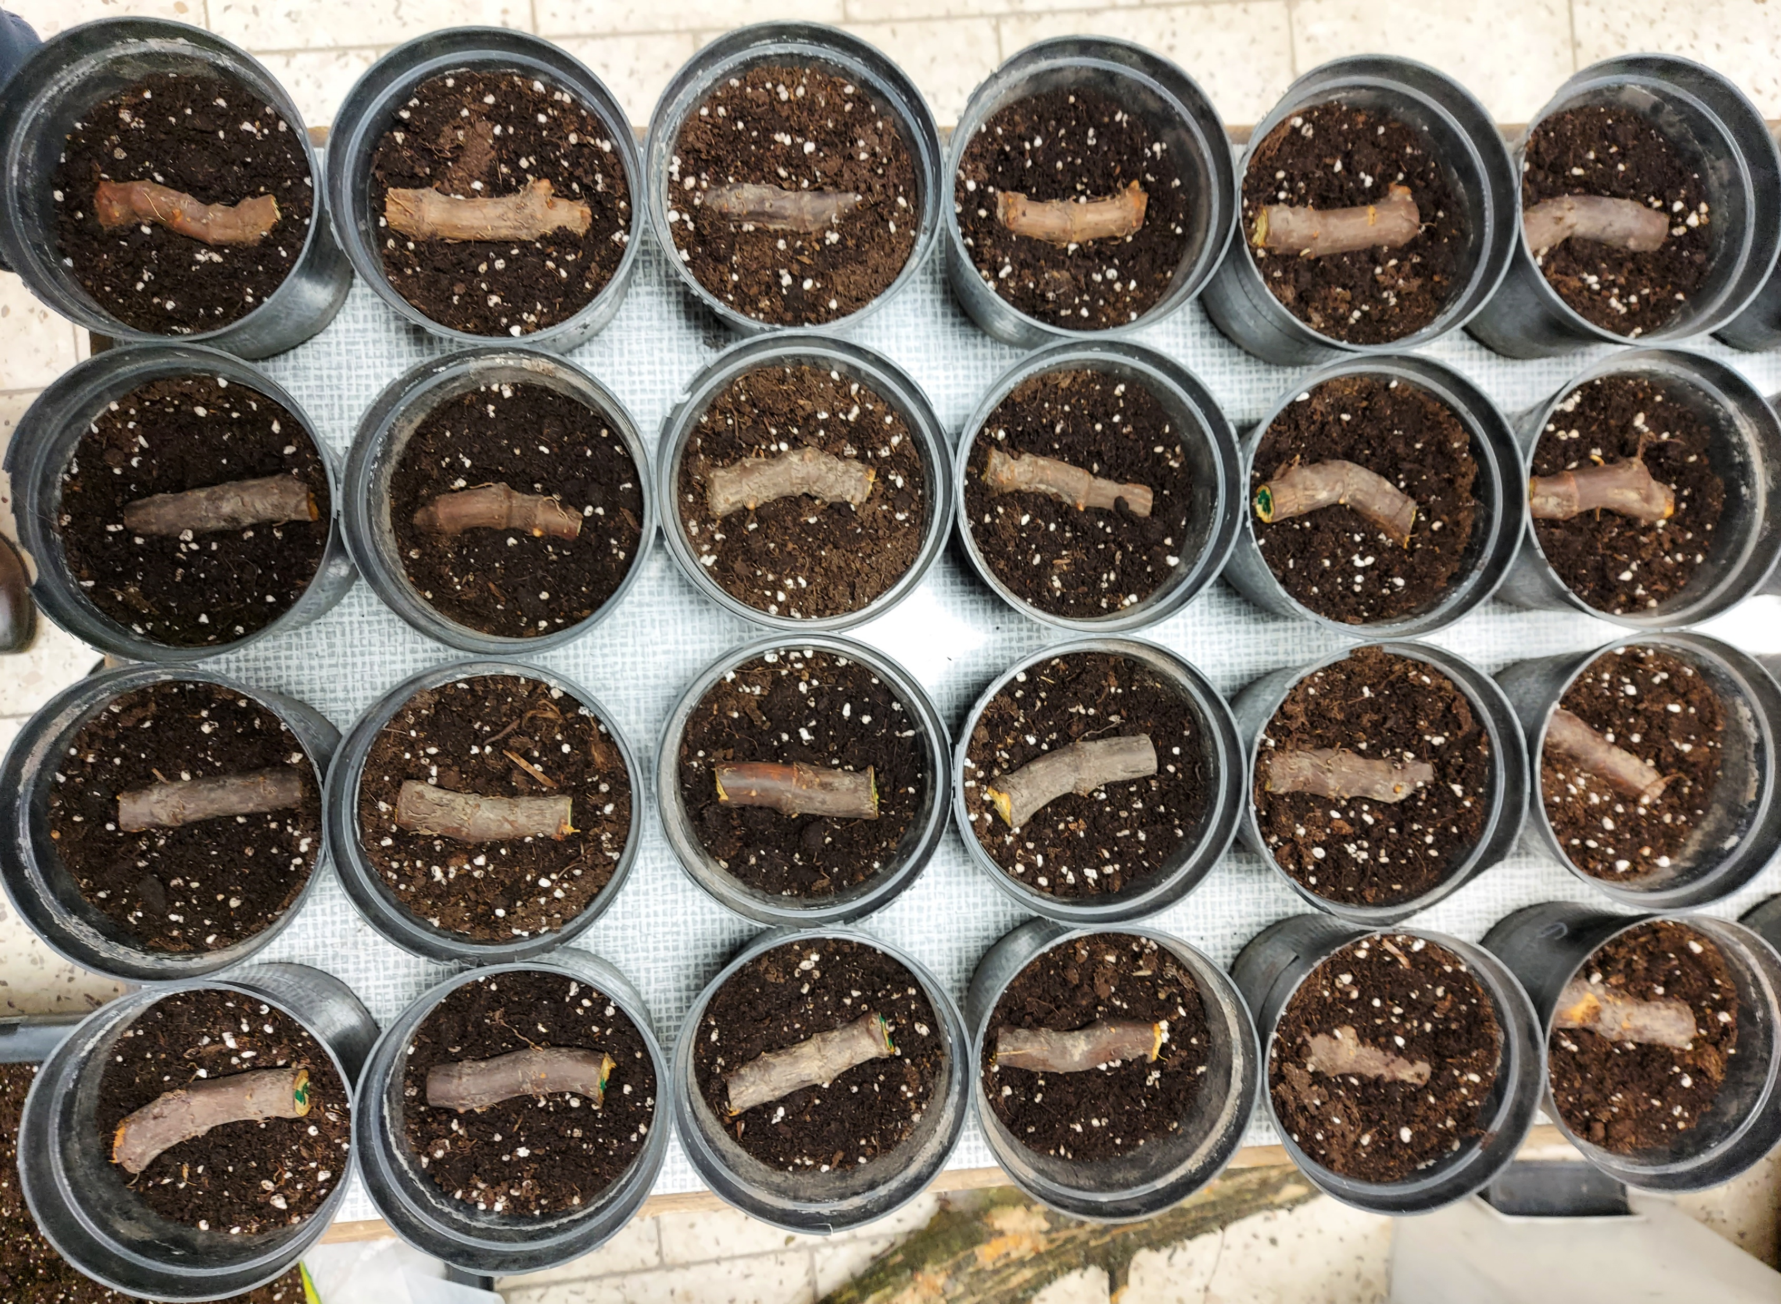
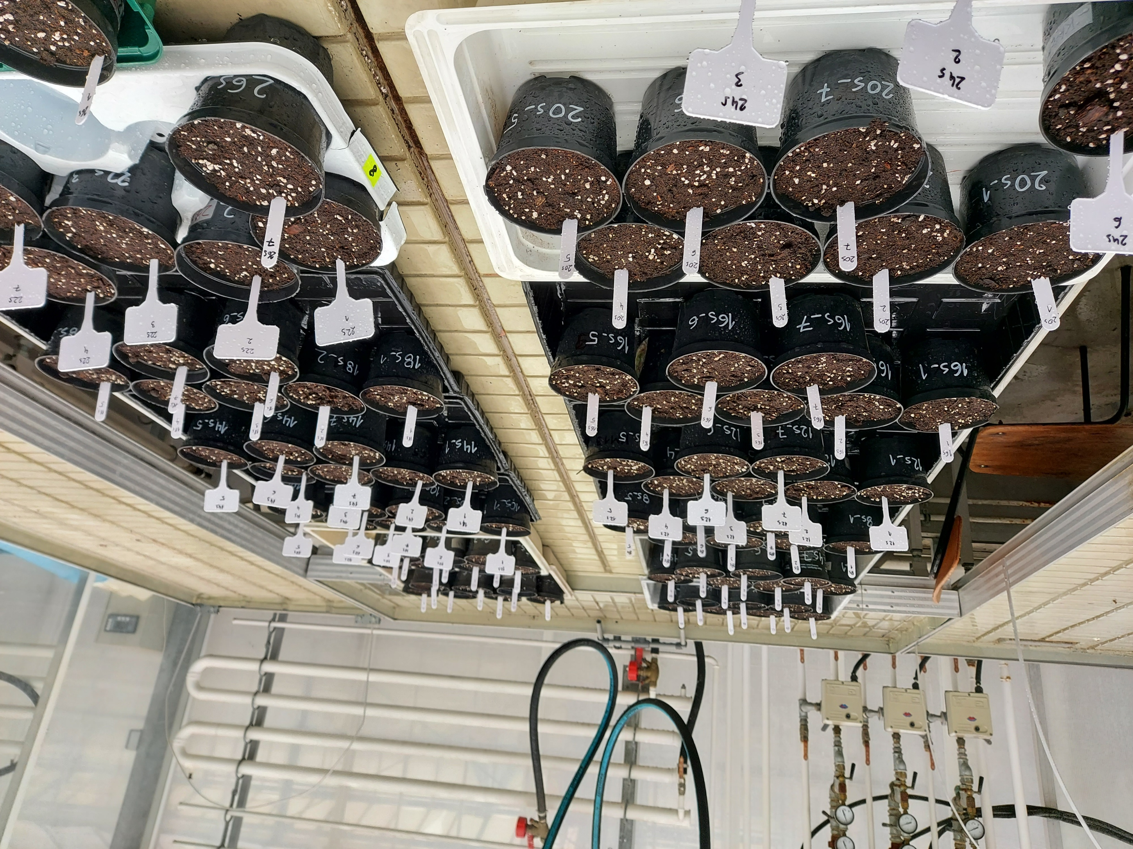
Materials and methods
MRE durations
0-30 s (2-s increments)

Slide 6
Influence of MRE on rhizome moisture loss
Welch’s ANOVA: F’’_{(14, 34.17)} = 43.508, p < 0.001; ω² = 0.92
Tamhane’s T2 test
(F = 325.445, p < 0.001)
Data represent the mean ± SE. Different letters indicate statistical significance according to the Games-Howell post-hoc test (p < 0.05).
The dashed red line illustrates Tamhane’s T2 trend test.

Slide 7
Influence of MRE on rhizome temperature
Data represent mean ± SE.

Slide 8
Concluding remarks
pronounced desiccation achieved driven by MRE time thermal spike → raising inner fragment temperature 64 °C viability not fully suppressed → few fragments resprouted further optimisation needed → lethal disposal threshold

Slide 9
Thank You for
your attention!
Thank you for your attention!

