Slide 1

15th International Symposium “Kopački rit: Past, Present, Future 2026
Effects of compressive force on American black cherry (Prunus serotina Ehrh.) endocarp fracture
Marin Lukačević, Krzysztof Słowiński, Beata Grygierzec, Łukasz Marcin Mateusiak,
Edita Štefanić, Agnieszka Synowiec, Sylwester Tabor, Michał Granisz
Osijek, Croatia
2nd-3rd October, 2026
Except where otherwise indicated, this presentation and its contents are licensed under the Creative Commons Attribution-NonCommercial-NoDerivatives 4.0 International License (CC BY-NC-ND 4.0)

Slide 2
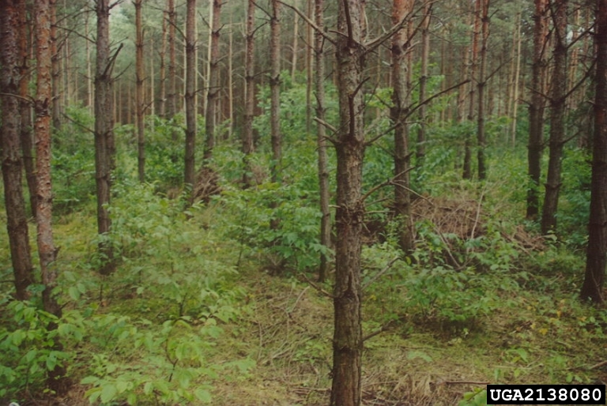
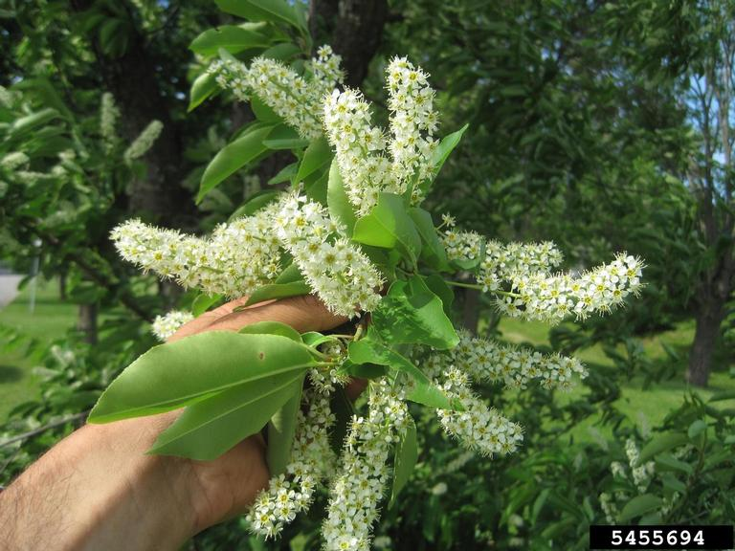
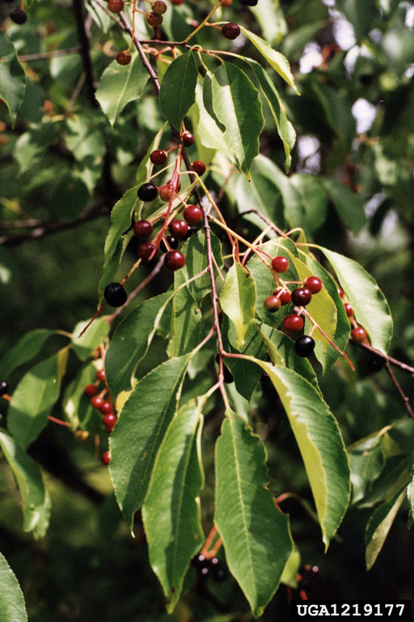
Introduction
fast-growing deciduous tree
(prevalent in Poland's forests
native to North America
(introduced to Europe in 17th century)
forest "transformer" species
(allelopathy – Pinus sylvestris L.)
prolific seed production
(≈7 000 seeds/tree)
long-distance seed dispersal
(birds & mammals up to 600 m)
vigorous resprouting capacity
(dense root suckers and stum sprouts)
© Barbara Tokarska-Guzik, University of Silesia, Bugwood.org (CC BY-NC)
© Rob Routledge, Sault College, Bugwood.org (CC BY-NC)
© Bill Cook, Michigan State University, Bugwood.org (CC BY-NC)

Slide 3
?
Research objectives
Does hydration state altering fracturing response of P. serotina?
How do CCFs affect P. serotina endocarp damage?
Can CCFs be utilised to deplete seed bank of P. serotina?
What is the correlation between increasing CCFs and the degree of damage?

Slide 4
Materials and methods
Force treatments:
1-115 N
116-135 N
136-145 N
146-155 N
156-165 N
>166 N

Slide 5
Visual classification and criteria for P. serotina endocarp damage
Category | Damage (%) | Classification criteria
UE | 0 | No visible mechanical damage, cracks, fissures, or structural deformation; the endocarp remains completely intact.
PDE | 1–50 | Cracking and fragmentation affect up to 50% of the endocarp, while the seed remains enclosed within the fractured endocarp.
CDE | 51–100 | Extensive fragmentation, splitting, or complete shattering of the endocarp results in complete exposure of the seed.

Slide 6
Influence of CCFs and hydration on endocarp fracturing
Asterisks denote statistically significant differences between hydration states according to Pearson’s chi-square or Fisher’s exact post-hoc tests
with the Holm–Bonferroni correction (*p < 0.05, **p < 0.01, *p < 0.001; NA – not applicable).

Slide 7
Influence of CCFs and hydration on endocarp fracturing
Asterisks denote statistically significant differences between hydration states according to Pearson’s chi-square or Fisher’s exact post-hoc tests
with the Holm–Bonferroni correction (*p < 0.05, **p < 0.01, *p < 0.001; NA – not applicable).

Slide 8
Influence of CCFs and hydration on endocarp fracturing
Note. Statistical significance thresholds: (n.s. – not significant, *p < 0.05, **p < 0.01, *p < 0.001.

Slide 9
Concluding remarks
distinct fracturing pattern observed based on hydration wet endocarps highly sensitive showing strong PDE dry endocarps resilient requiring higher CCFs for CDE field-scale validation → confirm seedbank depletion

Slide 10
Thank You for
your attention!
Thank you for your attention!

