Slide 1
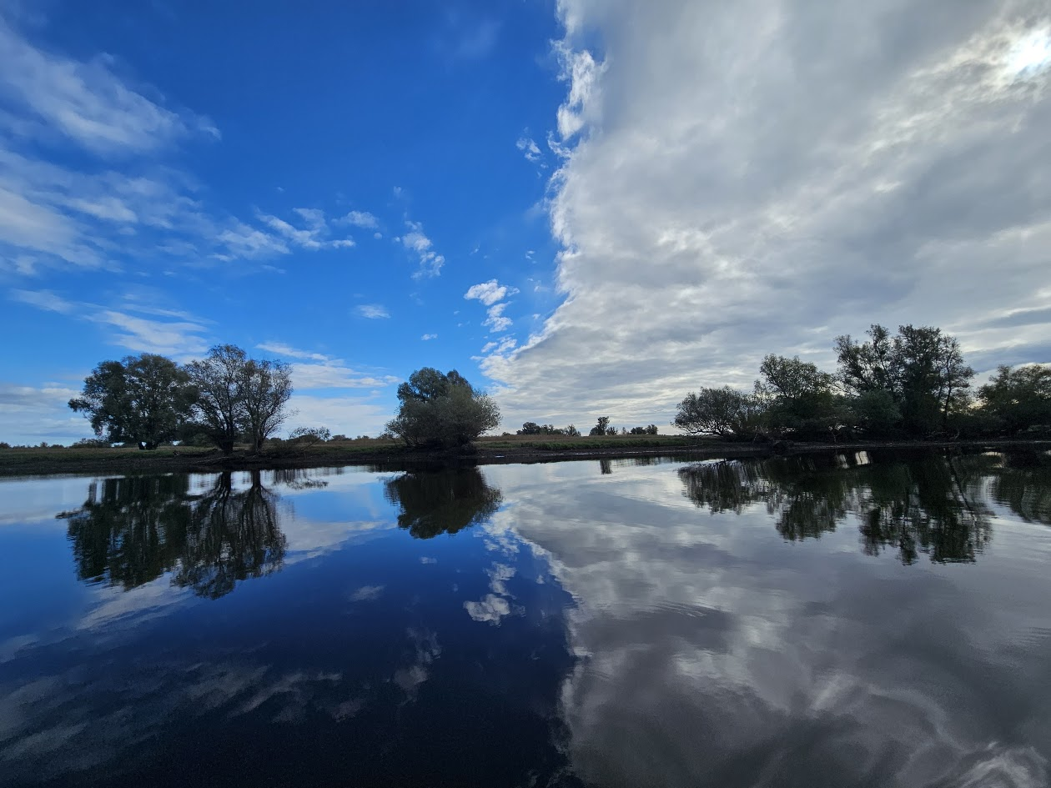









Challenges of integrating medium-resolution satellite data and bioacoustic monitoring in habitat occupancy modeling:
A case study in a dynamic floodplain ecosystem
Plaščak et al.
Notes:
Dear colleagues, when we talk about integrating acoustic and satellite data, we usually start from the assumption that more data is always better. Today, I will not be talking about how perfect this integration is. Instead, I will tell you what happens when high-resolution bioacoustics collides with static, medium-resolution satellite data, and what this 'methodological failure' teaches us about the future of remote sensing.

Slide 2

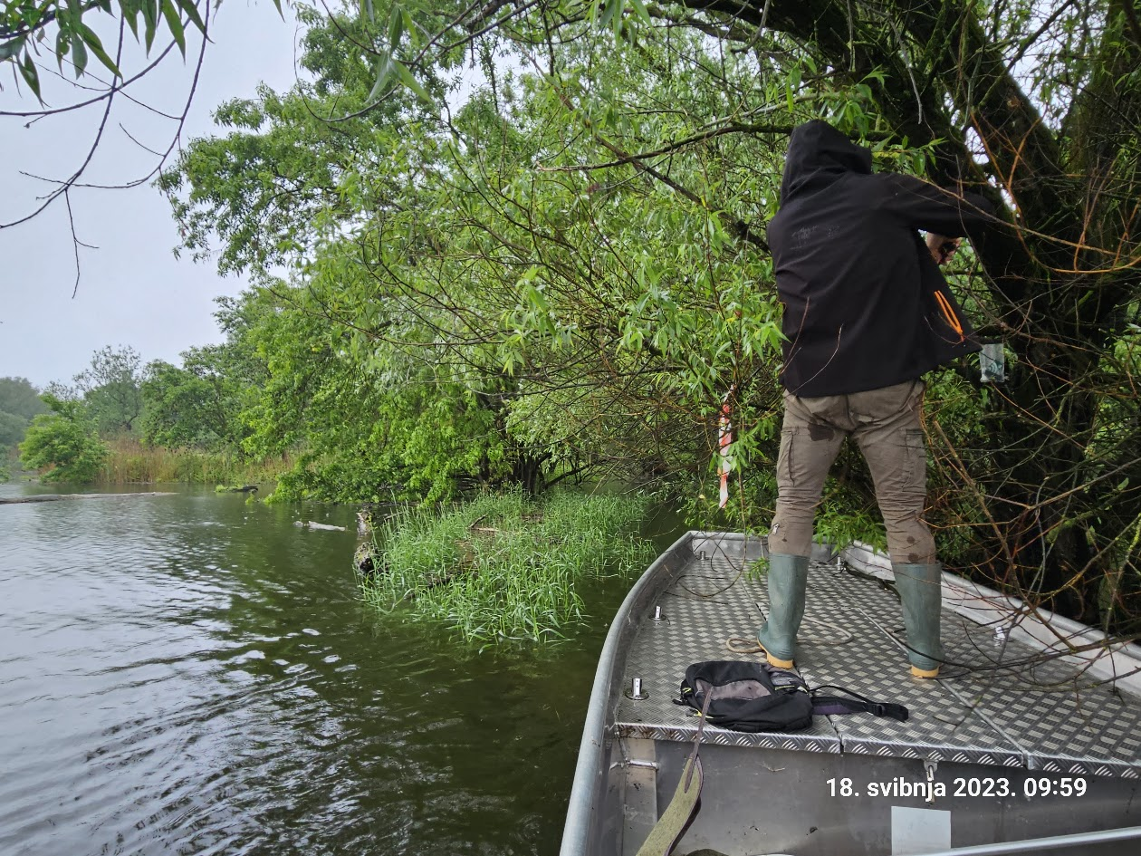
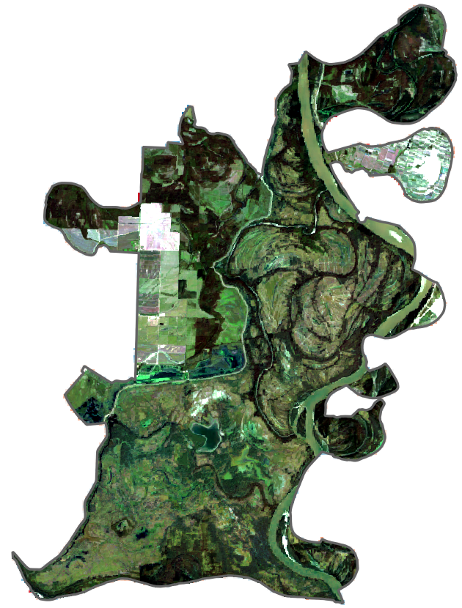
The Problem of Dynamic Ecosystems
Area: 231 km²
Floods last 64-249 days
Notes:
Kopački Rit is a European gem of fluvial marshes. Its key characteristic is hydrological dynamics—floods last anywhere from 2 to 8 months. Traditional wildlife monitoring, such as for red deer, is almost impossible here. That is why we turned to technology. Our goal was to integrate two powerful methods: passive acoustics, which tells us where and when the animal is, and satellite remote sensing, which tells us what the environment is like at that location.

Slide 3
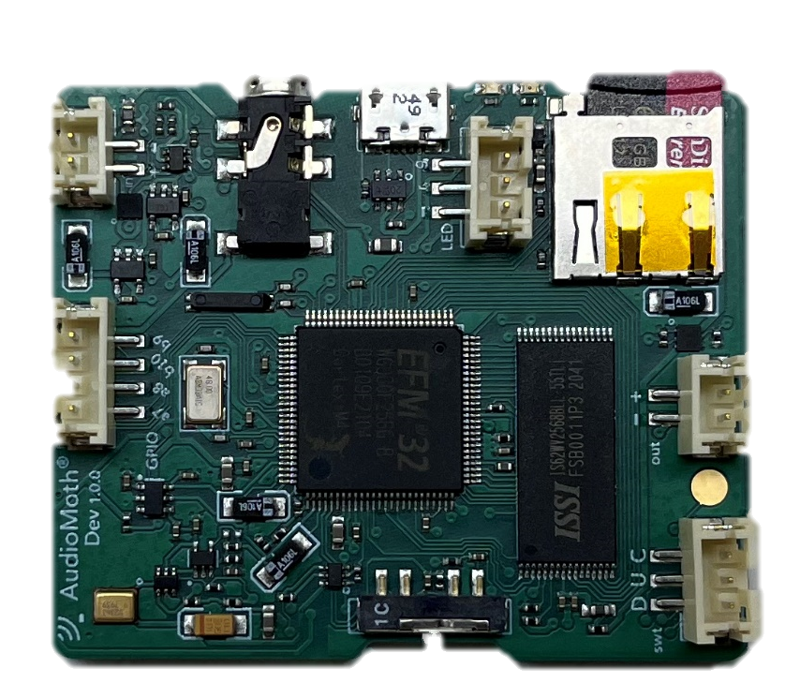
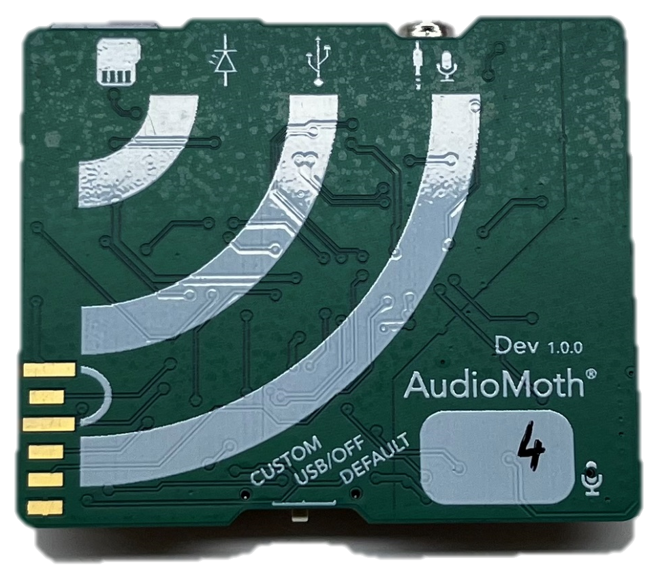
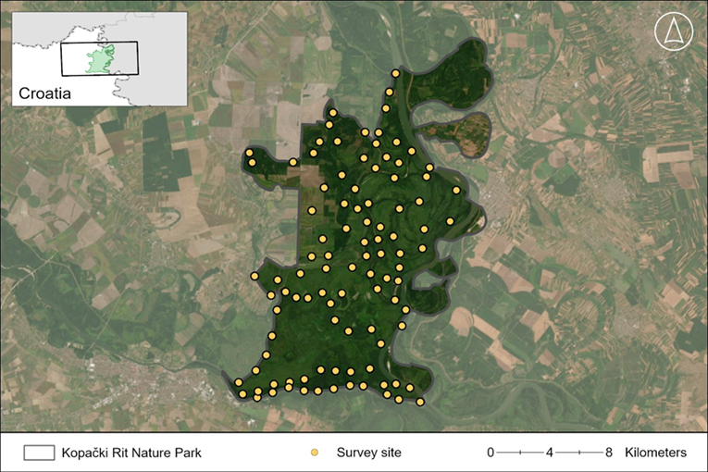
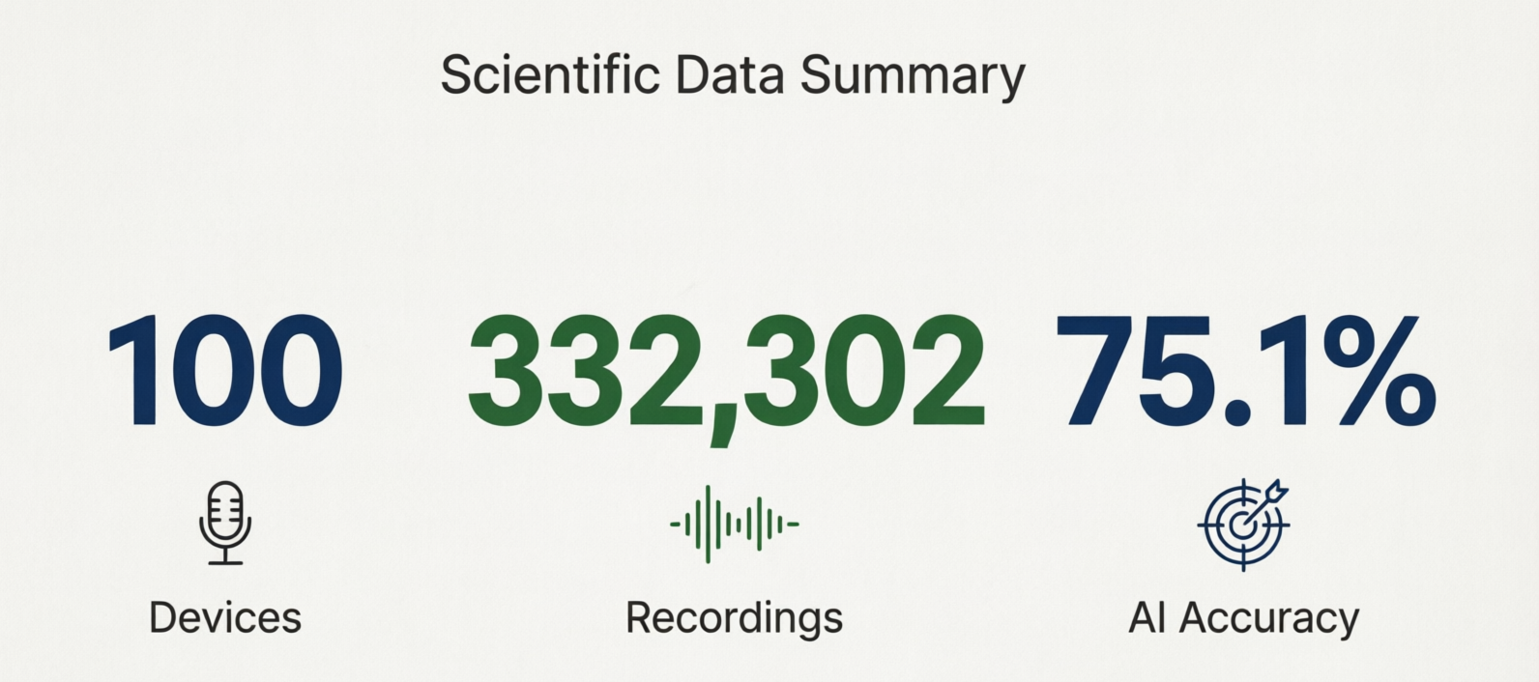
The Acoustic Component
High Resolution
Notes:
We deployed a network of ֍ 100 AudioMoth devices spaced 300 meters apart, following empirical knowledge on sound attenuation in dense vegetation. During a 10-day window at the peak of the rutting season in 2023 and 2024, ֍ we collected an impressive 332,302 recordings. Using a Random Forest model, we automated the detection of roars with an accuracy of 75.1%. We had a perfect spatiotemporal map of deer presence.

Slide 4
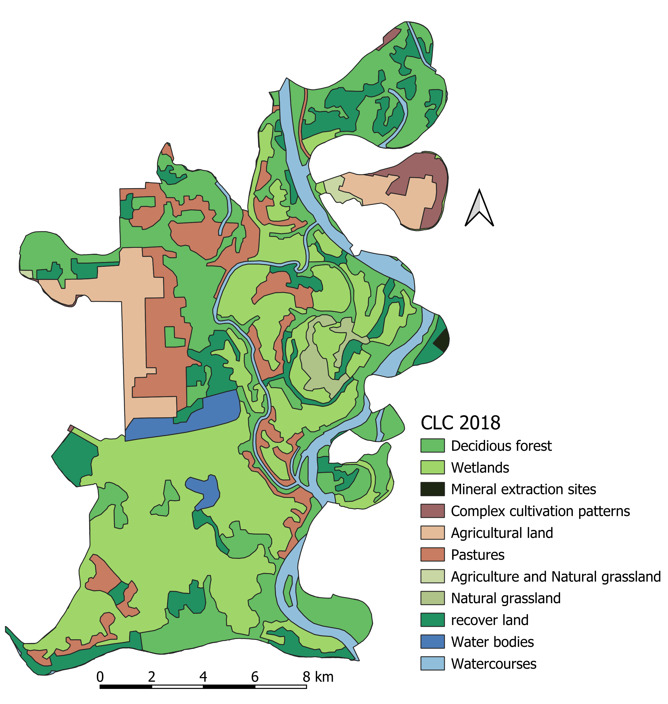
The Satellite Component
Static Resolution
Notes:
To explain why the deer are exactly there, we incorporated satellite covariates into our occupancy model using the R package unmarked. We used the ֍ CORINE land cover layer, plus the Euclidean distance to water. This is a standard, almost 'default' approach in landscape ecology. We combined the 'sound' and the 'pixel'.

Slide 5
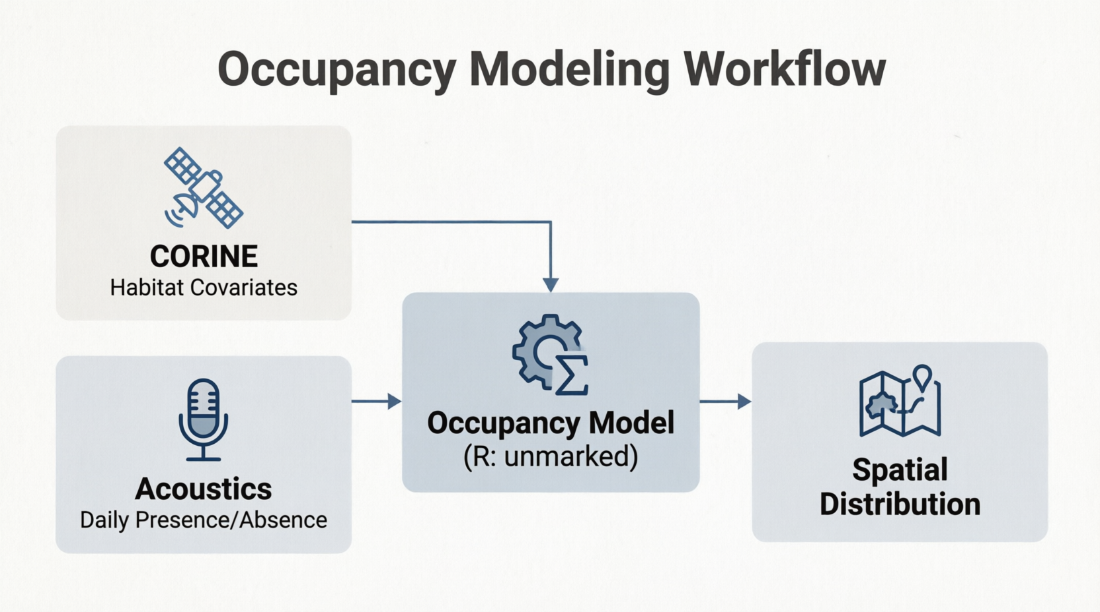
The Concept of Integration
Notes:
The model separated the probability of site occupancy from the probability of detection. We expected the satellite data to clearly show deer preferences for forest, wetland, or distance to water. However, the ecology of dynamic systems rarely respects our statistical assumptions.

Slide 6
What Did the Microphones Tell Us?
Notes:
First, let's look at what the microphones told us. ֍ The acoustic data clearly showed a drastic shift. ֍ In 2023, deer were concentrated in the southwestern and central parts. ֍ In 2024, the distribution became much more heterogeneous, almost uniform. The deer had obviously adapted to certain conditions. The question is: do the CORINE satellite data reflect this?

Slide 7
Occupancy Model Results
Year | Covariates | Estimate | SE | z | p
2023 | Deciduous forest | -2.263 | 1.584 | -1.428 | 0.153
 | Recover land | -0.938 | 1.380 | -0.680 | 0.497
 | Wetland | -1.125 | 1.586 | -0.709 | 0.478
 | Distance from water | 0.898 | 0.873 | 1.029 | 0.304
2024 | Deciduous forest | -0.786 | 0.517 | -1.520 | 0.129
 | Recover land | -0.520 | 0.446 | -1.164 | 0.244
 | Wetland | -0.480 | 0.526 | -0.912 | 0.362
 | Distance from water | 0.155 | 0.465 | 0.334 | 0.739
No static variable explains dynamic distribution (p > 0.05)
Notes:
Here we reach the core of the integration problem. ֍ When you look at the occupancy model results, you will see that none of the satellite covariates (neither forest, nor recover lan, nor wetland, nor distance to water) had a statistically significant effect. ֍ The p-values are all above 0.05. Although the coefficients went in the expected direction (e.g., a negative trend for forest), the model tells us that ֍ the land cover satellite data do not explain the distribution of red deer in Kopački Rit.

Slide 8
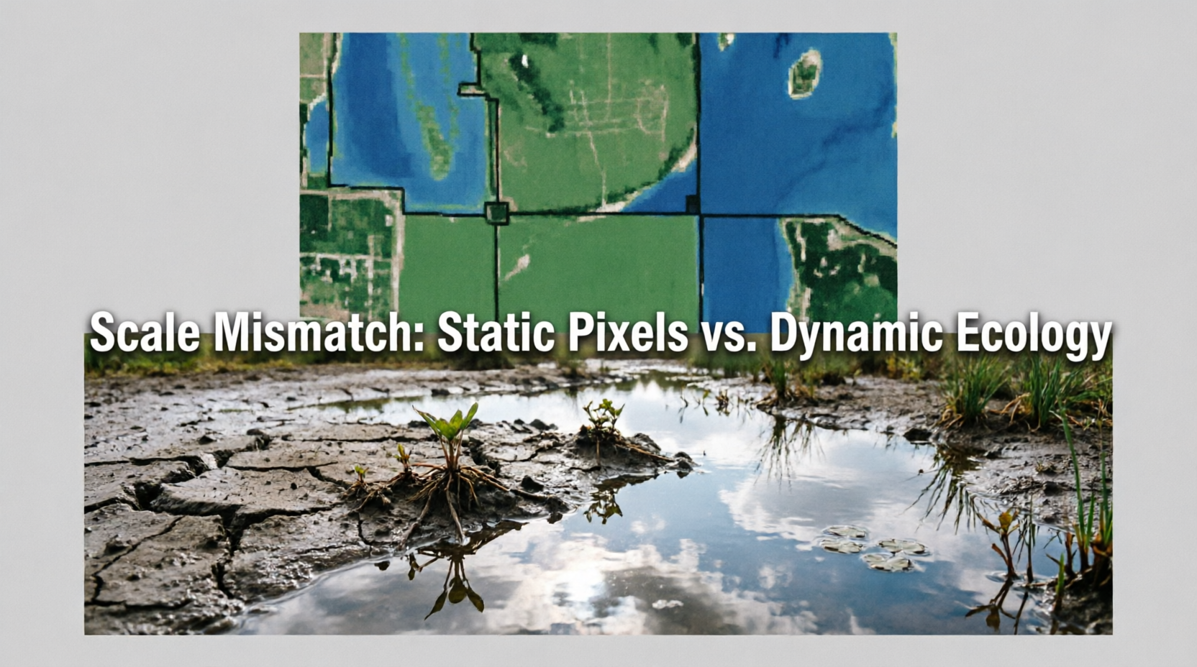

Why Did the Integration "Fail"
Notes:
Why did the integration fail? ֍ Because of a fundamental scale mismatch. CORINE is static. It categorizes land based on some average. But Kopački Rit is dynamic. A deer doesn't choose a habitat just because it is a 'wetland' on a map from 2018. A deer chooses a habitat depending on whether the ground is flooded by 50 centimeters today, or if it is dry. ֍ We tried to explain dynamic behavior with static data. It's like trying to predict traffic jams using only a map of paved roads, without any insight into current roadworks or accidents.

Slide 9
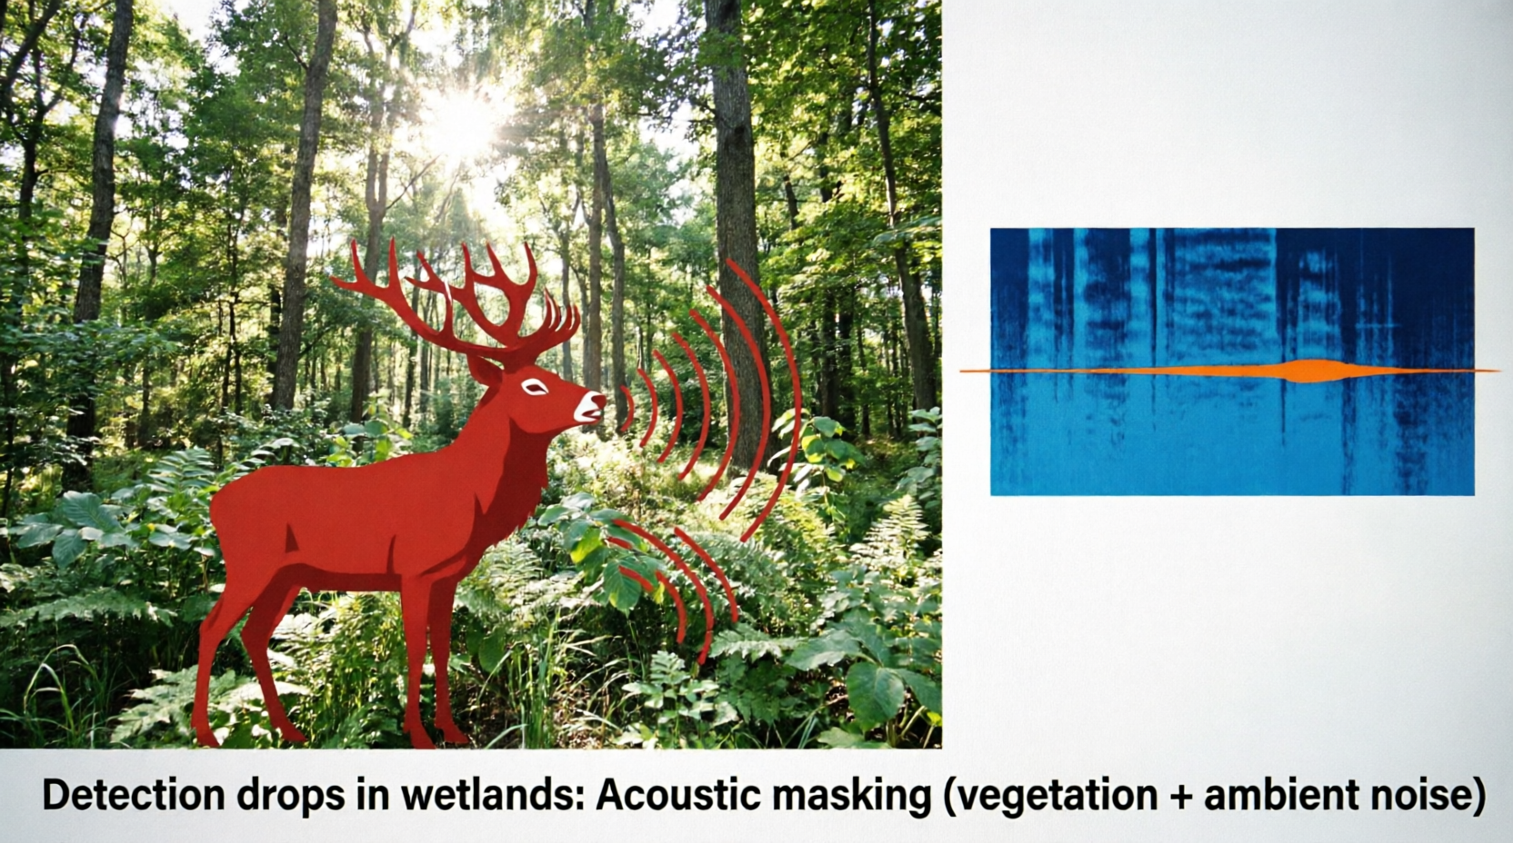
An Additional Problem: Acoustic Masking
Notes:
The second problem with integration lies in the detection itself. Our model showed that detection probability drops in wetlands. Why? Because of acoustic masking. ֍ Dense vegetation and ambient noise (wind, water flow) drown out the sound. The satellite sees the vegetation, but it doesn't see the acoustic resistance of that vegetation. That is why we need a more advanced approach.

Slide 10
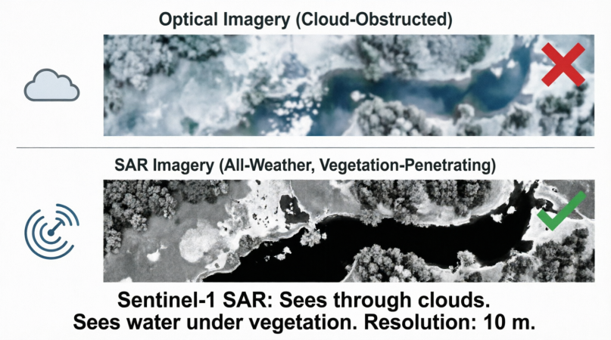
How to Fix the Integration?
Optical Imagery (Cloud-Obstructed)
SAR Imagery (All-Weather, Vegetation-Penetrating)
Sentinel -1SAR:
"sees" through clouds, "sees" water under vegetation. Resolution: 10 m
Notes:
So how do we integrate satellite data in such an environment? The answer is Sentinel-1 SAR (Synthetic Aperture Radar). ֍ Unlike optical satellites and CORINE, SAR actively sends microwaves. Water acts like a mirror and reflects the signal away from the satellite, which is why it appears completely black in the image—even if it is under sparse reeds or willows. Moreover, radar penetrates clouds, which are almost constant over Kopački Rit in autumn.

Slide 11
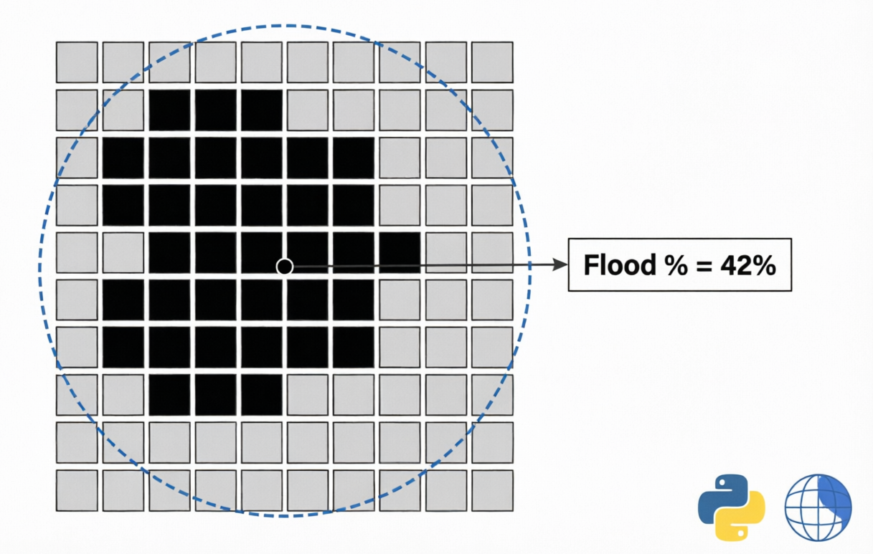
Conceptual Model of the Future
AudioMoth sensor
Water
Land
Notes:
Instead of the static variable 'distance to water', imagine that for each of our ֍ 100 microphones, and for every single day of recording, ֍ we calculate the exact percentage of flooded area within a 300-meter radius using 10-meter resolution Sentinel-1 images. We can do this every 6 days. This way, we transition from a static habitat class to the current ecological state. Today, this analysis can be performed in just a ֍ few lines of Python code via Google Earth Engine.

Slide 12
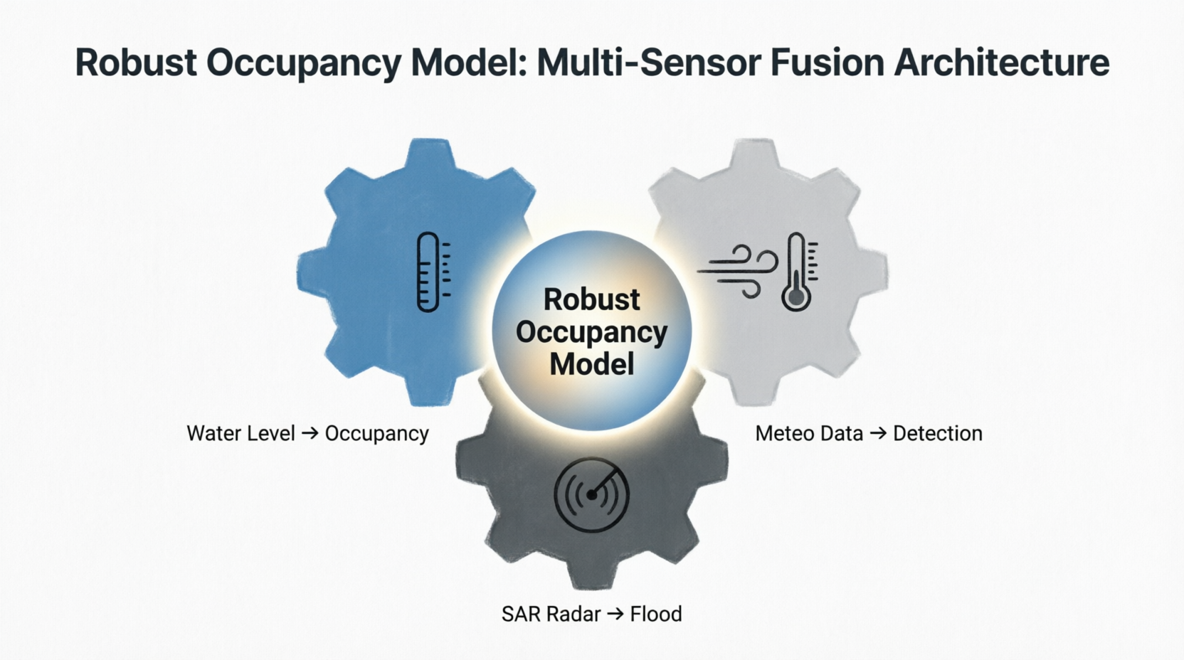
The Broader Context: Hydrology and Sound
Notes:
Alongside SAR, ֍ integration also requires the introduction of daily hydrological data (Danube water level at Batina) as covariates for occupancy, and meteorological data (wind speed) as covariates for detection. Only when we align the temporal and spatial resolution of all sensors—from microphones in the mud to radar in space—can we obtain a robust ecological model.

Slide 13
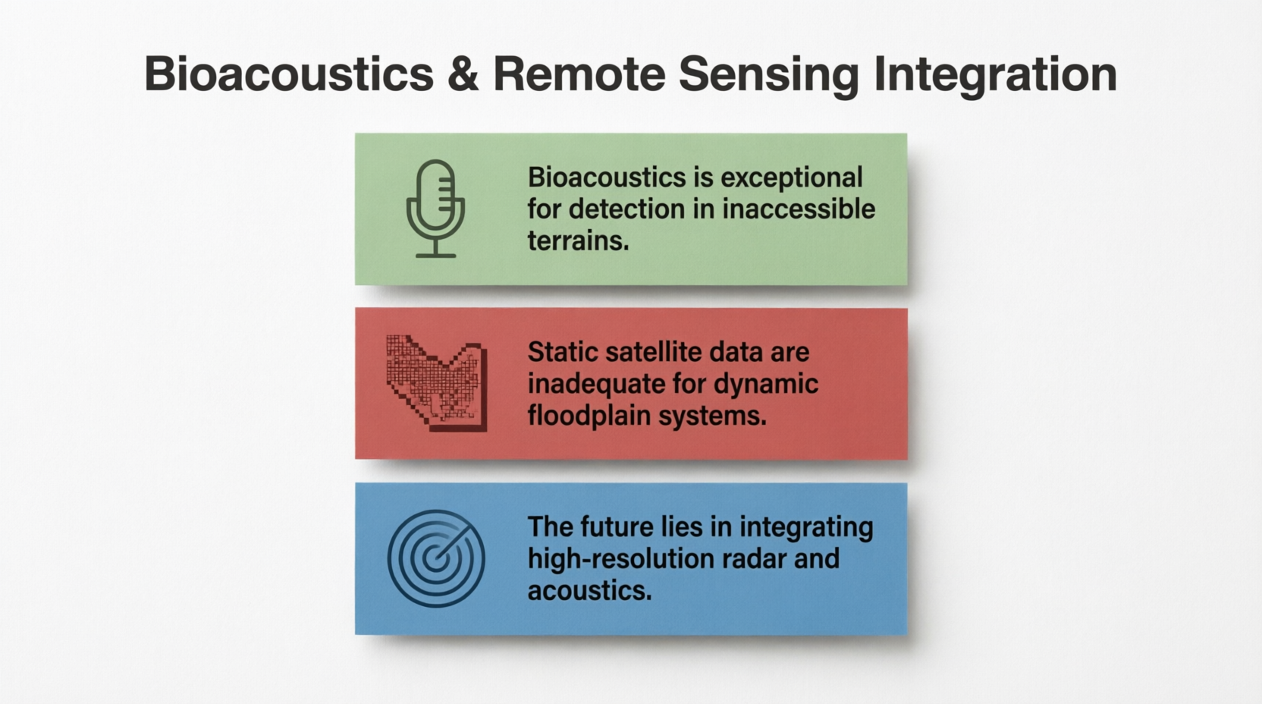
Take-Home Messages
Notes:
To conclude, three take-home messages. First, ֍ passive acoustics is an indispensable tool for monitoring in wetlands. Second, ֍ our 'failure' with CORINE data is actually a key scientific contribution—it proves that static, medium-resolution data cannot explain the dynamics of floodplain areas. And third, ֍ the future of integration lies in transitioning to dynamic, high-resolution radar data like Sentinel-1 SAR.

Slide 14

THANK YOU FOR YOUR ATTENTION
https://watchout.com.hr/
Notes:
Thank you for your attention. I look forward to your questions and to discussing how we can improve these integration models

