Slide 1
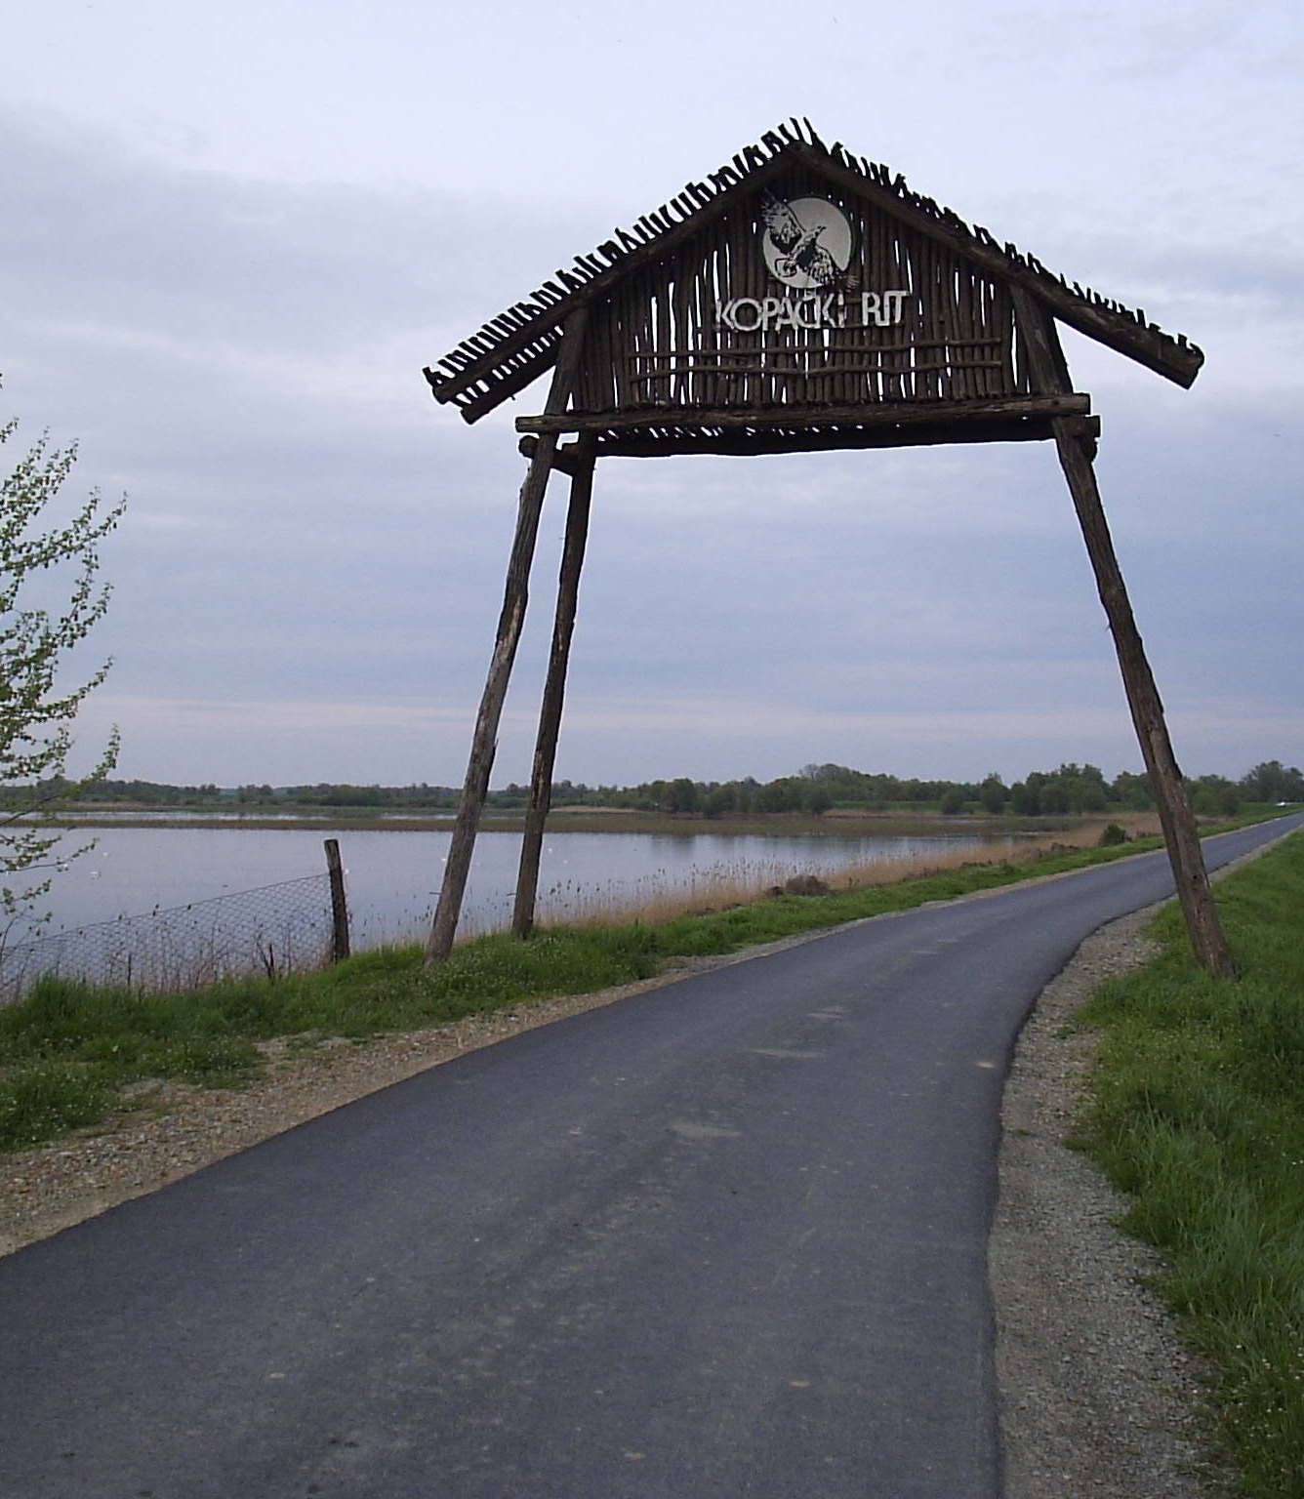
Digital tools and simulations for investigating climate change impacts on the
Kopački rit wetland ecosystem
15th International Symposium
„Kopački rit: Yesterday, Today, Tomorrow 2026”
Osijek, 1–2 October 2026
Andreja Dorić, Professor of Biology and Chemistry
Nataša Mesić Muharemi, Librarian
Tórizs István, CC BY-SA 3.0 <http://creativecommons.org/licenses/by-sa/3.0/>, via Wikimedia Commons

Slide 2
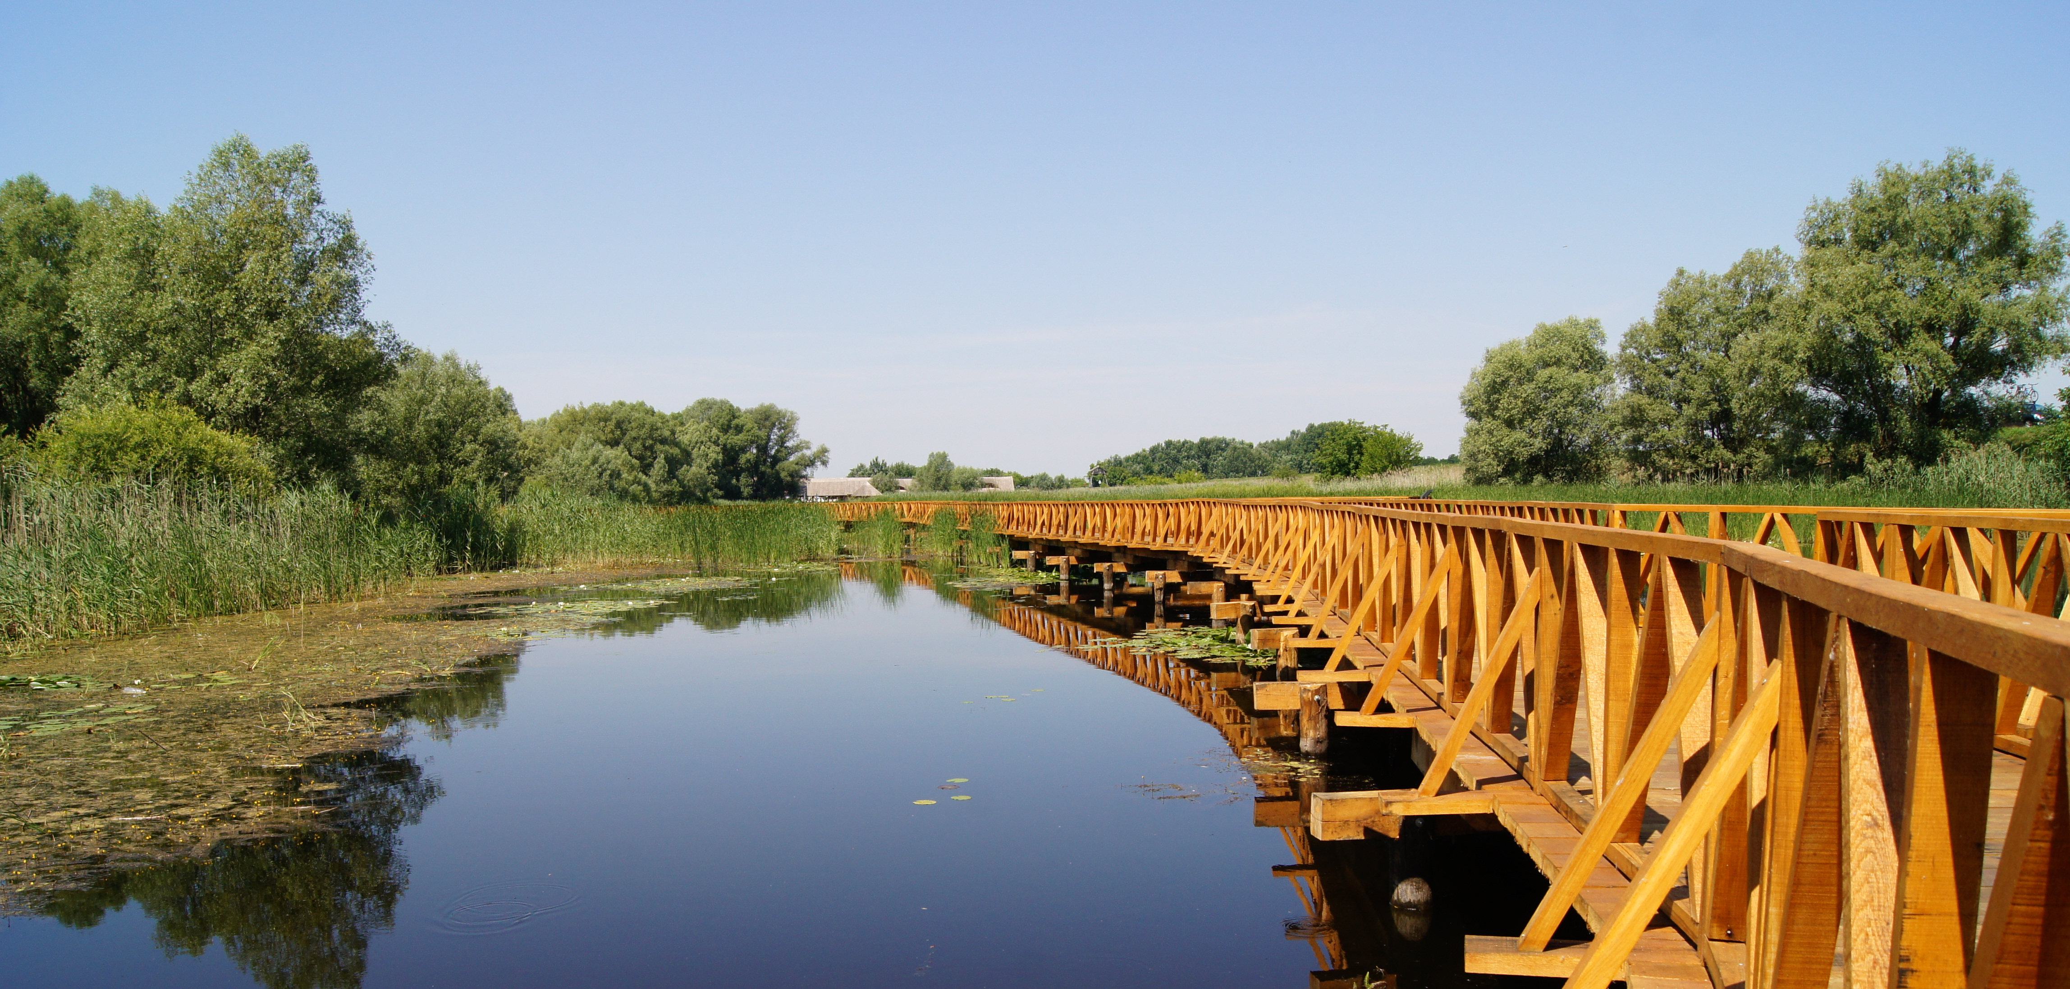
Climate Change – A Cross-Curricular Context
Science
nature, the environment, forms of energy
Biology
levels of organization, biodiversity, photosynthesis
Chemistry
substances, chemical reactions, greenhouse gases, the cycling of matter
Critical Thinking
Photo from the original presentation
claims, evidence, causes and effects
Why Connect Different Subjects?
Climate processes involve natural sciences, data, and interpretation at the same time.
The local example of Kopački Rit makes it possible to connect these concepts with a real and familiar environment.
Reading
understanding scientific and
popular science texts
MirNA butterfly, CC BY-SA 4.0 <https://creativecommons.org/licenses/by-sa/4.0>, via Wikimedia Commons
2

Slide 3
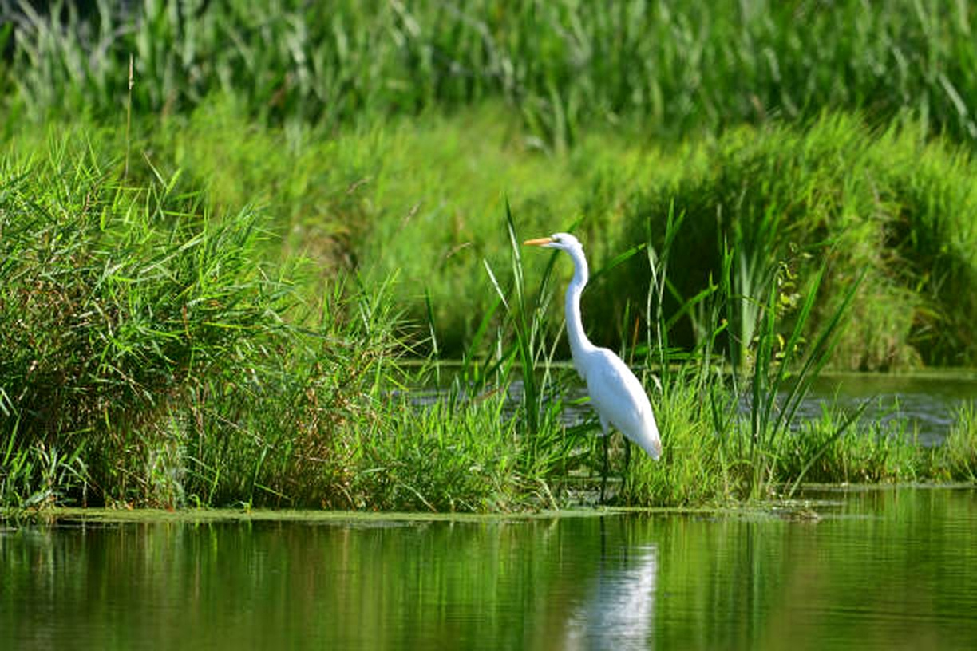
Kopački rit as a Local Research Environment
Kopački rit allows students to see climate change not as a distant and abstract problem, but as a process they can investigate in their own environment.
The local ecosystem becomes a setting for observation, measurement, modelling, and drawing conclusions.
AI@Green
3

Slide 4
Climate Change – A Complex, Interconnected Problem
CO₂ and temperature
changes in climate conditions
increased evaporation
greater water needs of organisms
→
→
→
Precipitation
changes in water availability
→
Water levels of the Drava and Danube
→
changes in the duration and extent of flooded habitats
Prolonged drought
reduction in available aquatic habitats
stress on fish, amphibians, aquatic invertebrates, and plants
→
→
Forest and other habitats
changes in microclimatic conditions
habitat loss or fragmentation
changes in community composition
→
→
→
Climate change does not only alter temperature – it changes the relationships between water, habitats, and living organisms.
AI@Green
4

Slide 5
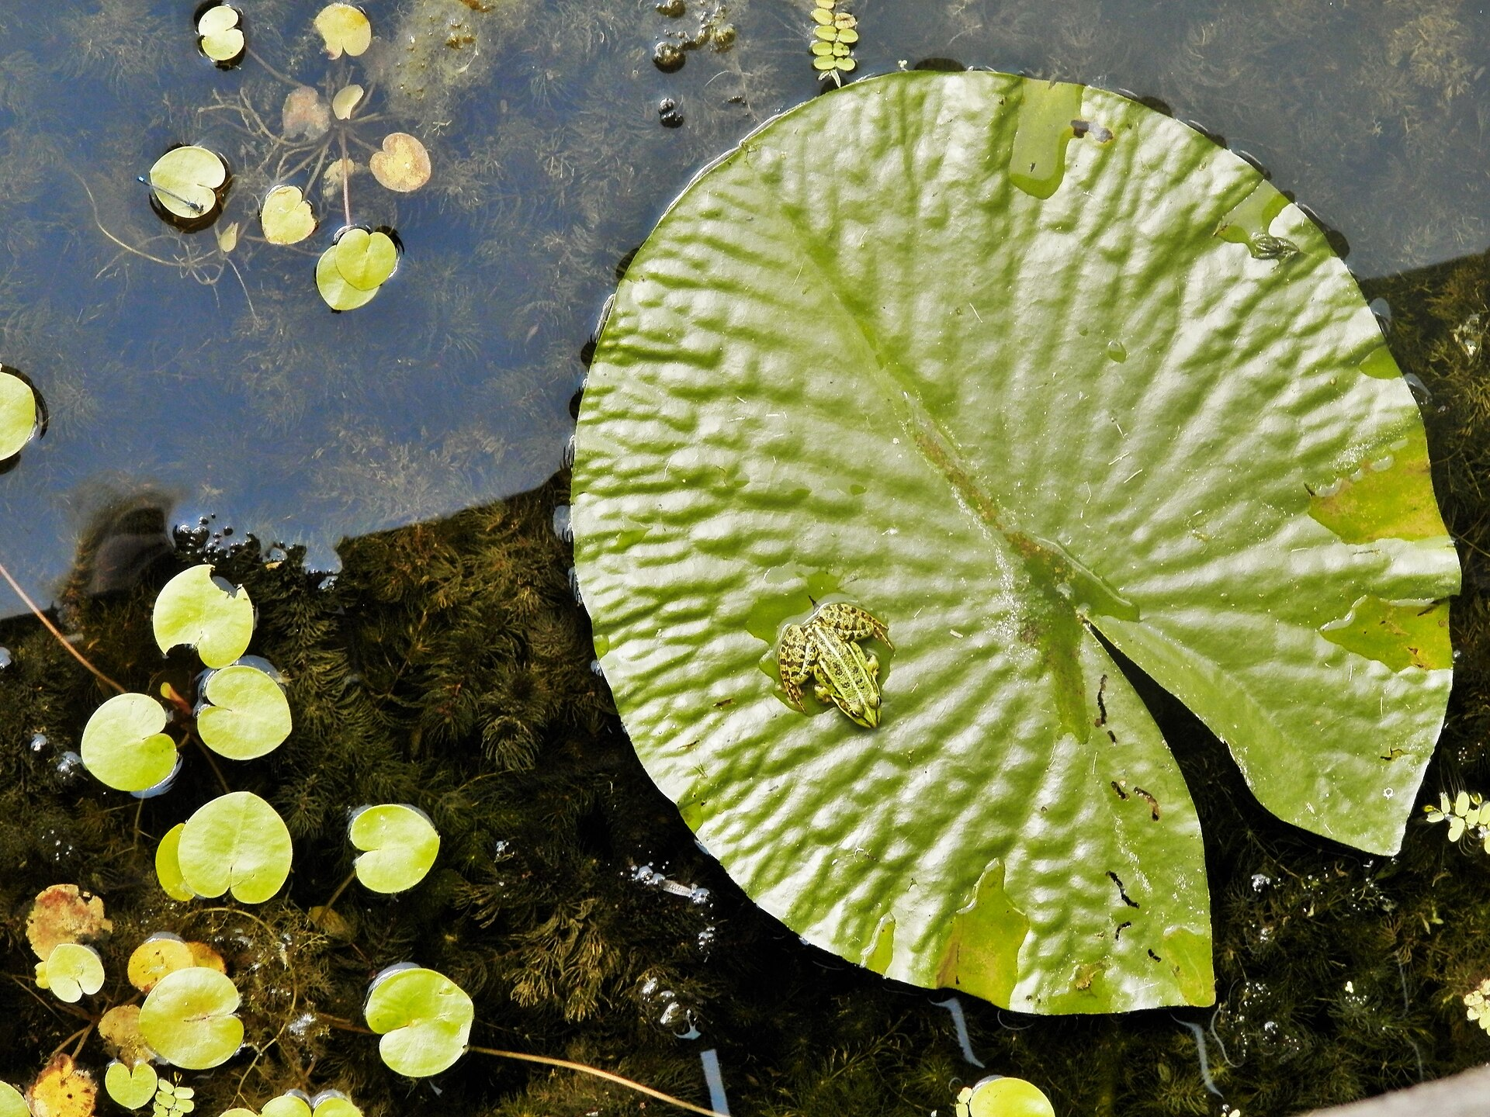
Kopački rit as a Learning Environment
OBSERVE
→
MEASURE
→
CONNECT
→
MODEL
→
SIMULATE
→
DRAW CONCLUSIONS
OBSERVE
MEASURE
CONNECT
changes in nature and habitats
temperature, precipitation, water levels, and other parameters
climate factors with the state of the ecosystem
MODEL
SIMULATE
DRAW CONCLUSIONS
relationships between different factors
possible changes in conditions
about possible impacts on biodiversity
AI@Green
Brigita Plander, CC BY-SA 4.0 <https://creativecommons.org/licenses/by-sa/4.0>, via Wikimedia Commons
5

Slide 6
How? Why?
CLIMATE CHANGE
→
TEMPERATURE • PRECIPITATION • EVAPORATION
→
WATER LEVELS AND FLOOD DURATION
→
HABITAT CHANGES
→
LIVING CONDITIONS
→
BIODIVERSITY
Climate change
Temperature • precipitation • evaporation
Water levels and flood duration
Habitat changes
Living conditions
→
→
→
→
change in input conditions
change in the water regime
habitat change
change in living conditions
changes in biodiversity
Question for students: Where in this chain can we observe, measure, and test assumptions?
AI@Green
6

Slide 7
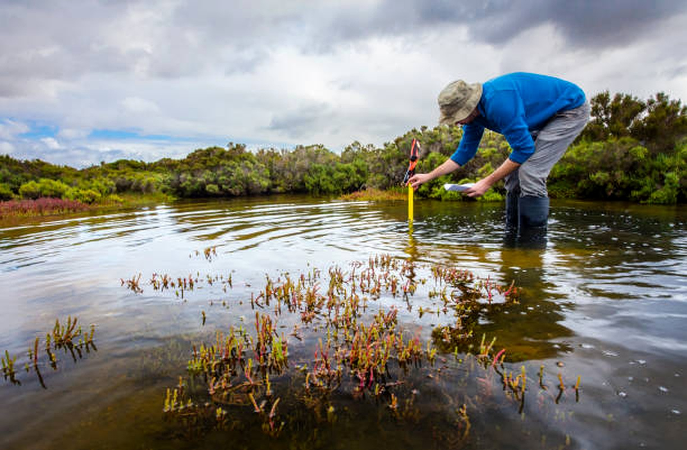
From the Real Ecosystem to a Student Simulation
STUDENT SIMULATION
changing conditions → observing the consequences → comparing scenarios
→
REAL ECOSYSTEM
What will happen …?
• What if the temperature increases?
• What if precipitation decreases?
• What if dry periods become longer?
• What if water levels change?
• What if floods last for shorter periods?
• How will habitats change?
• How could this affect biodiversity?
From reality to a model – without losing the research question.
AI@Green
7

Slide 8
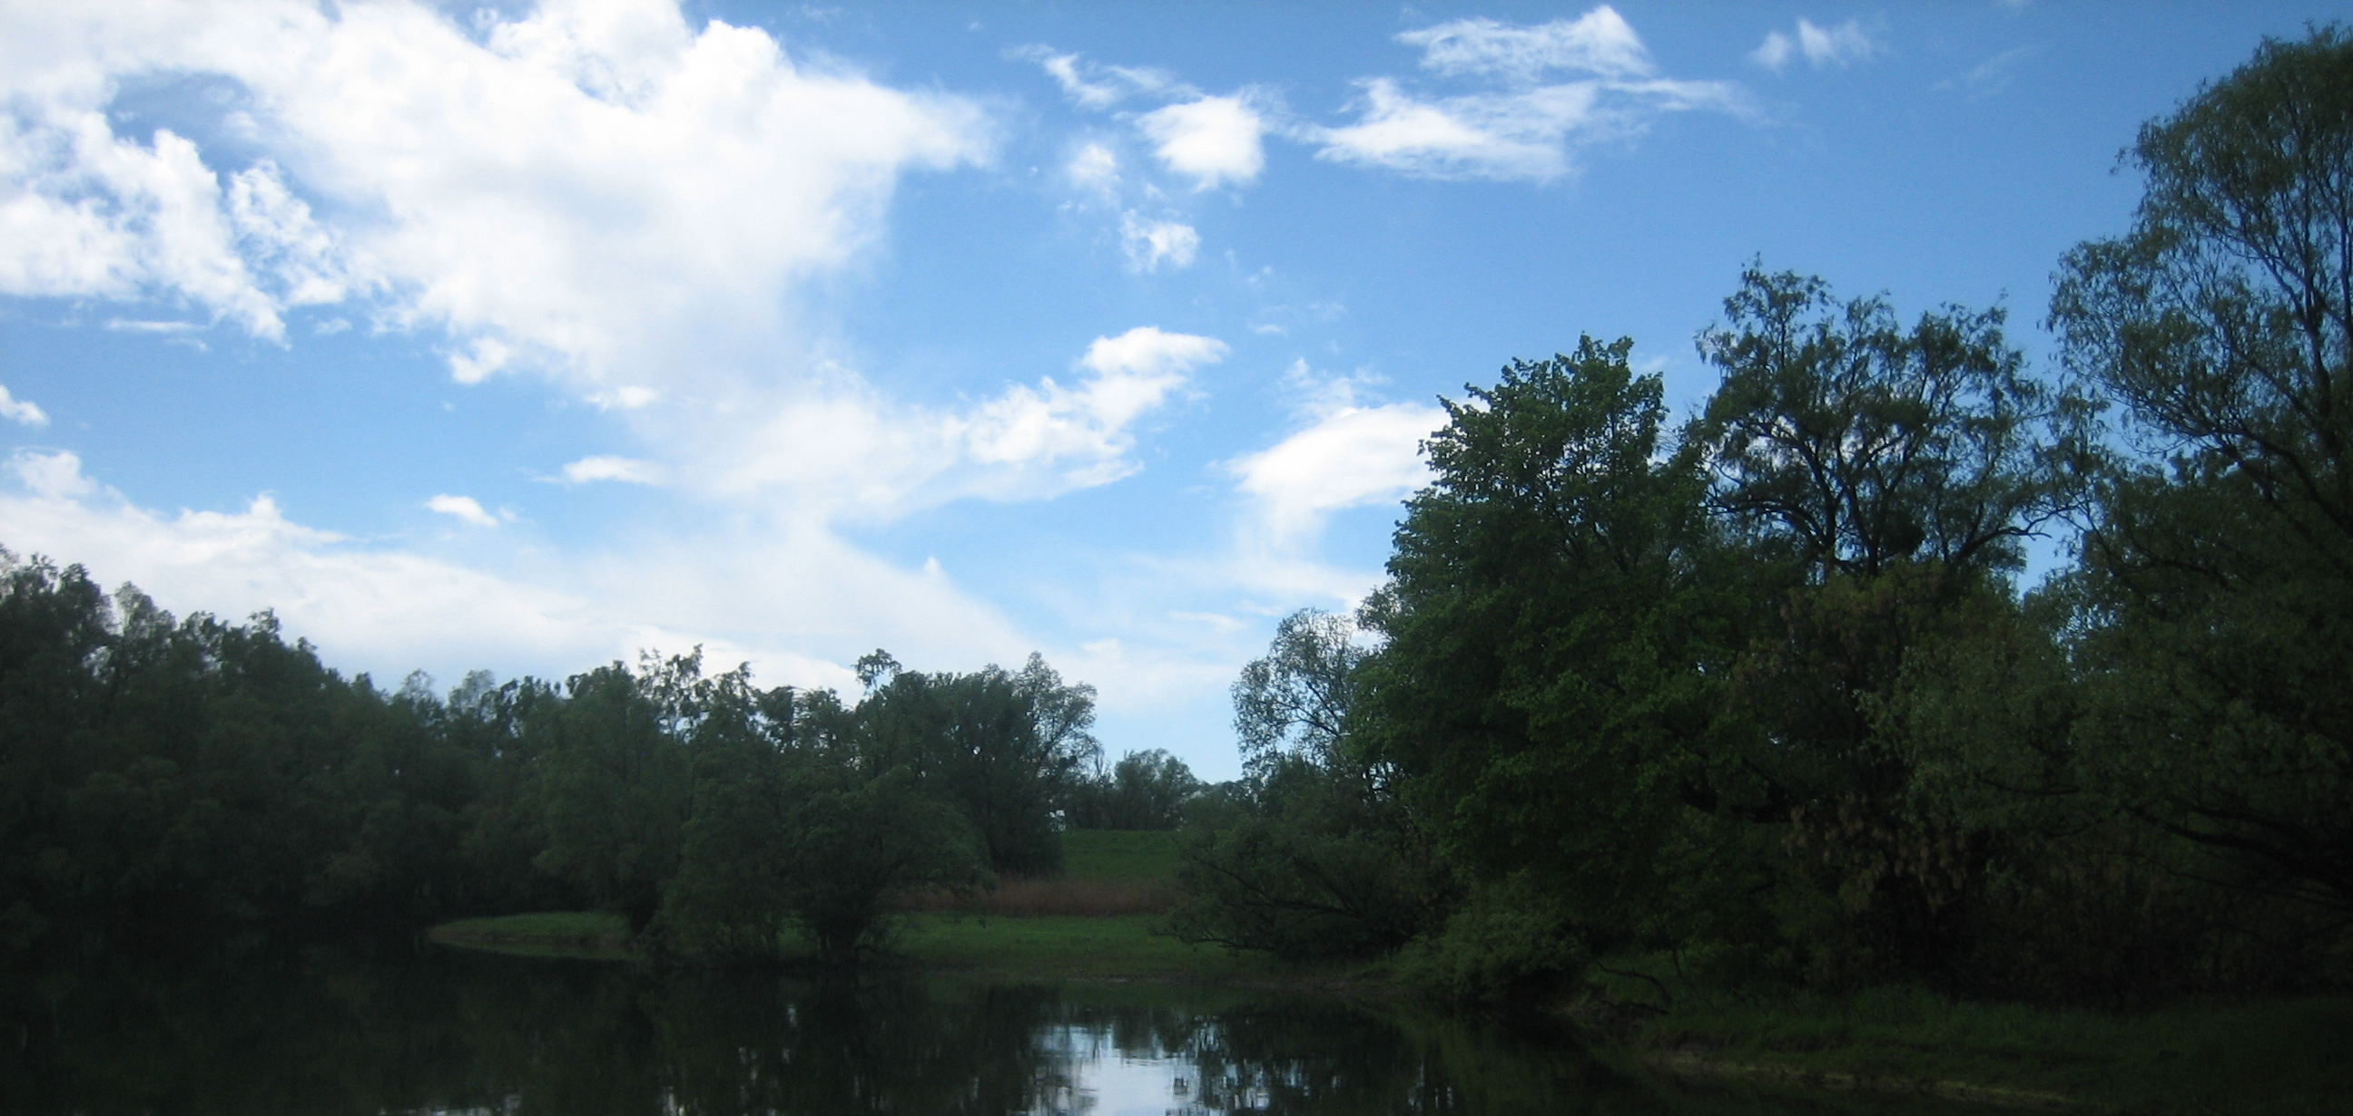
From Observation to Modelling and Simulation
OBSERVE
→
MEASURE
→
CONNECT
→
MODEL
→
SIMULATE
→
INTERPRET
THE MODEL AS A SIMPLIFICATION OF REALITY
• The model does not attempt to reproduce the entire ecosystem.
• It highlights relationships among selected factors and allows different scenarios to be explored.
A simulation does not predict the future – it allows us to explore possible outcomes under different assumptions.
AI@Green
Donatus Darko Tepert, CC BY-SA 3.0 <https://creativecommons.org/licenses/by-sa/3.0>, via Wikimedia Commons
8

Slide 9
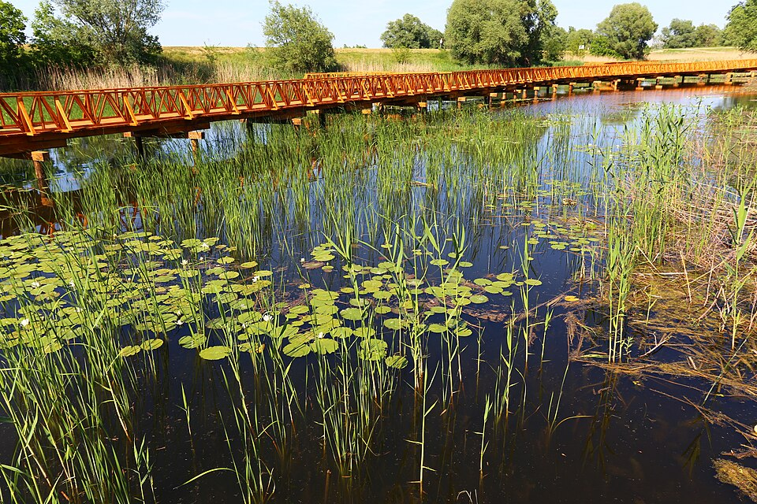
Why Simulate Climate Change?
COMPLEXITY
DYNAMICS
COLLABORATIVE LEARNING
A large number of interconnected factors. Simulations make these complex relationships visible and allow us to explore possible outcomes under different assumptions and scenarios.
By changing individual factors, we can immediately observe how the model results and climate projections change.
Simulations enable students to investigate together, compare scenarios, discuss possible consequences, and draw conclusions based on model results.
What if…?
Simulation models allow us to explore the consequences of different assumptions rather than simply describe them.
AI@Green
Misalalic, CC BY-SA 4.0 <https://creativecommons.org/licenses/by-sa/4.0>, via Wikimedia Commons
10

Slide 10
AI@Green – Digital Tools for Understanding Climate Change
IN THE PROJECT
OUR APPROACH
A digital tool is not an end in itself. We use it as a means to:
• artificial intelligence and interactive tools
• climate change and green skills
• inquiry-based and interdisciplinary learning
• connecting technology and the environment
• making complex relationships visible
• exploring scenarios
• connecting global processes with the local environment
• developing critical and inquiry-based thinking
AI@Green: Harnessing Artificial Intelligence and Interactive Tools for Climate Change Mitigation and Gaining Green Skills.
AI@Green
9

Slide 11
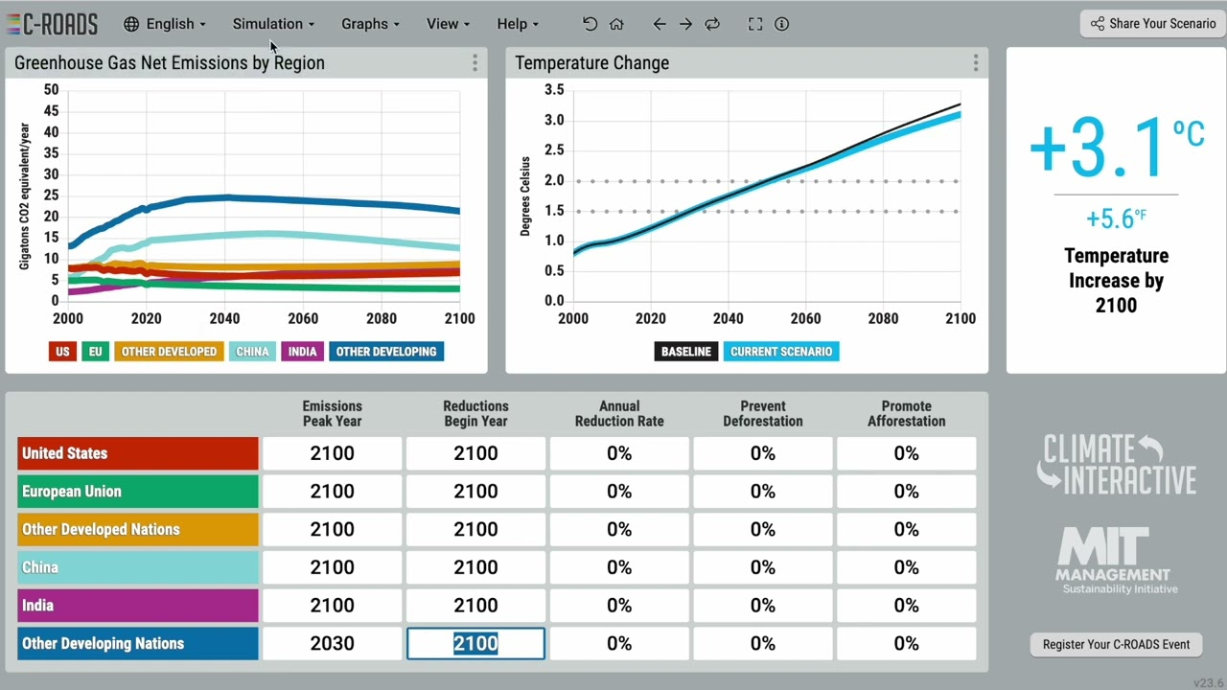
C-ROADS – Scenario Modelling of Climate Outcomes
WHAT DO WE CHANGE?
• regional / national emissions assumptions
• emissions reduction targets
• timing and level of action
C-ROADS interface
C-ROADS – Climate Interactive
From assumptions → through the model → to a possible climate outcome.
AI@Green
11

Slide 12
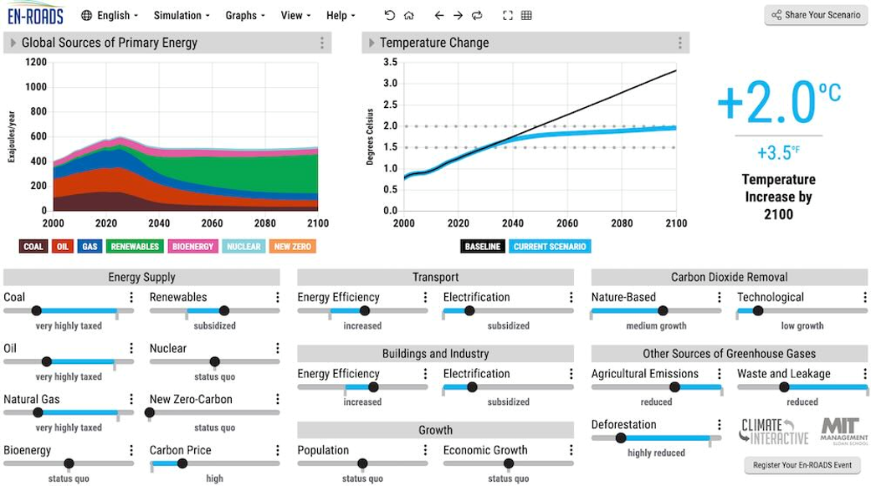
En-ROADS – Exploring Climate Policy Scenarios
EXAMPLE
• Changing an individual lever can affect:
• the energy system
• emissions
• greenhouse gas concentrations
• the temperature scenario
En-ROADS interface
En-ROADS focuses on global technological and economic policies (like carbon taxes or renewable subsidies), while C-ROADS focuses on regional and national emissions reduction pledges.
En-ROADS – Climate Interactive
AI@Green
12

Slide 13
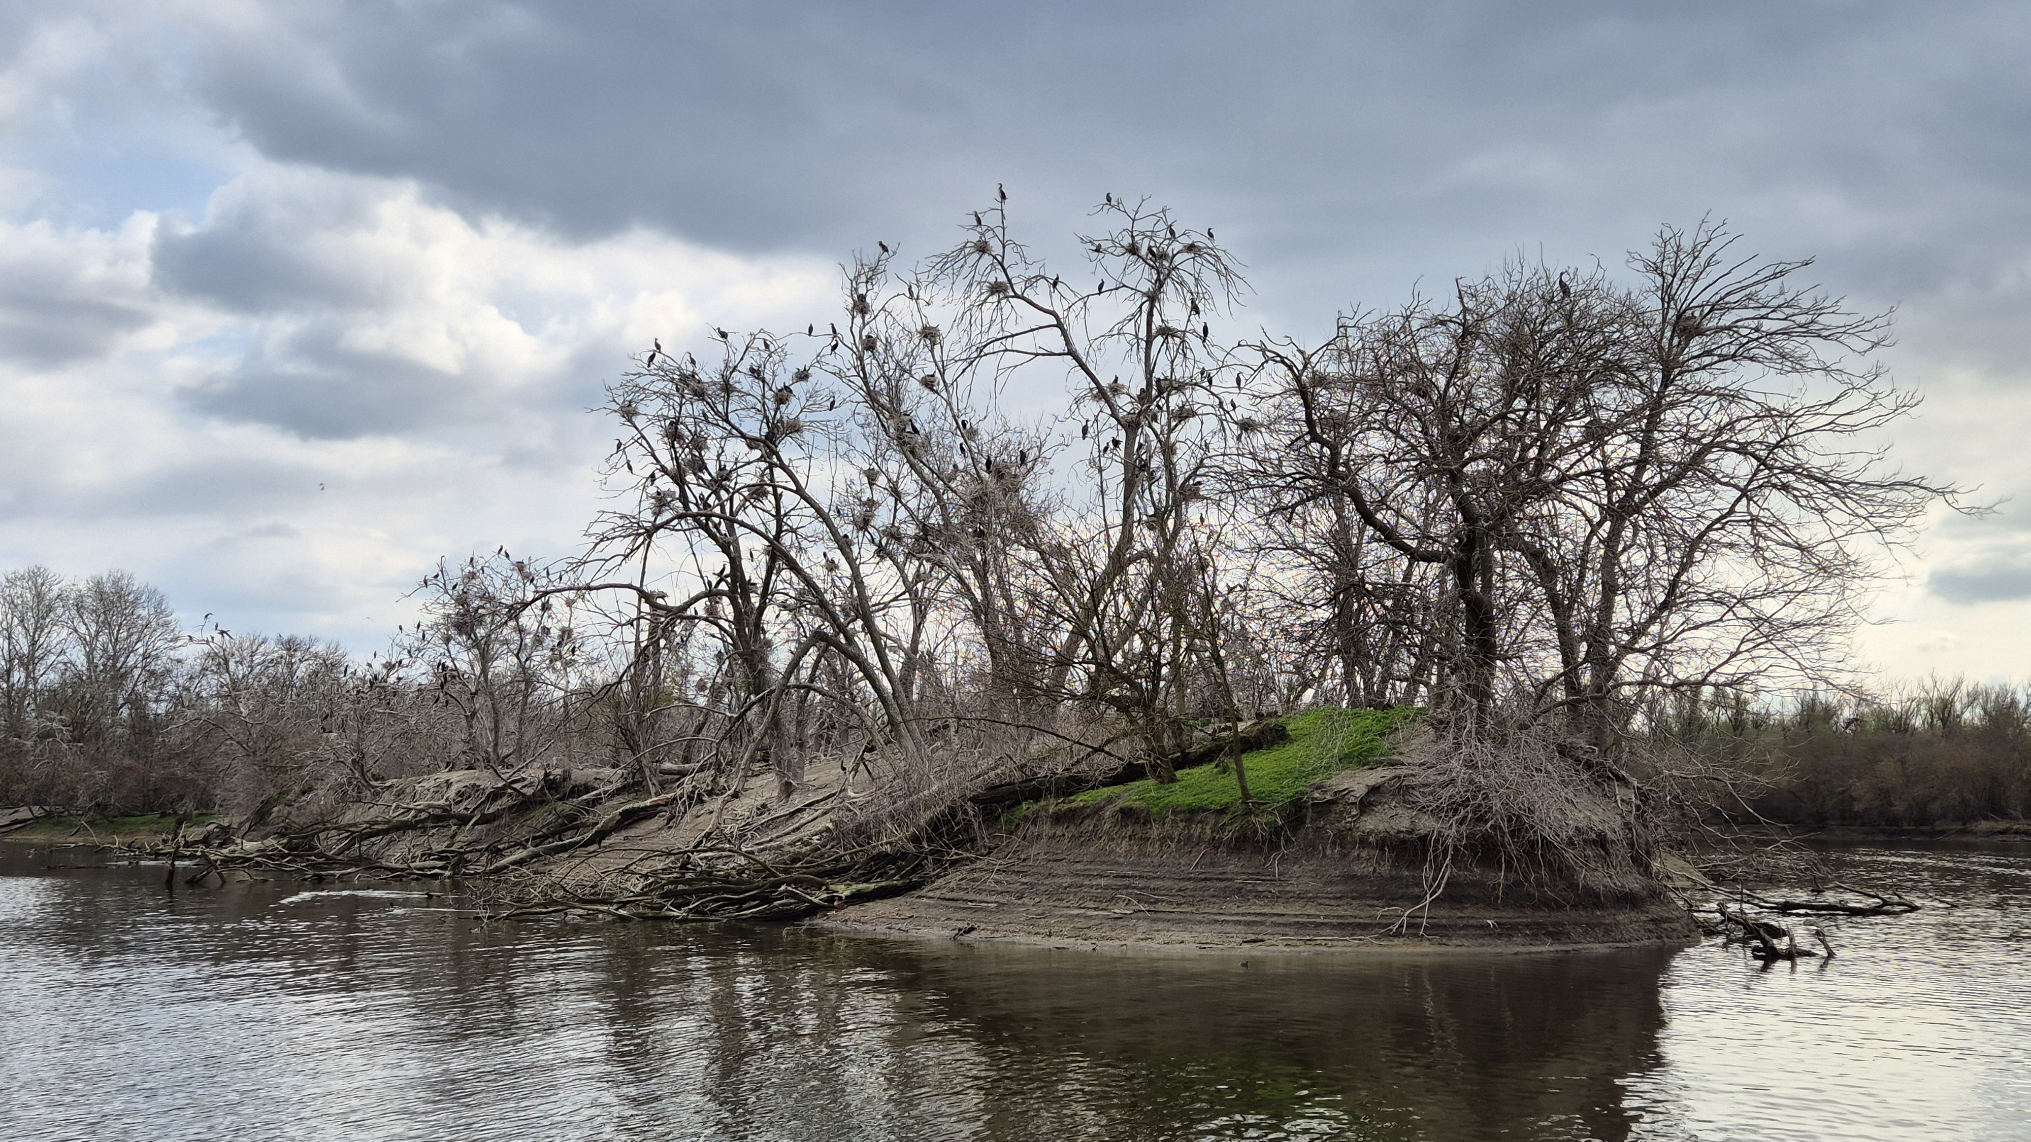
From a Global Model to a Local Ecosystem
GLOBAL CLIMATE SYSTEM
→
TEMPERATURE • PRECIPITATION • EVAPORATION
→
WATER REGIME
→
HABITATS
→
LIVING CONDITIONS
→
BIODIVERSITY
How does global climate change become a local ecosystem change?
Global model → climate conditions → water regime → habitats → living conditions → biodiversity
AI@Green
13

Slide 14
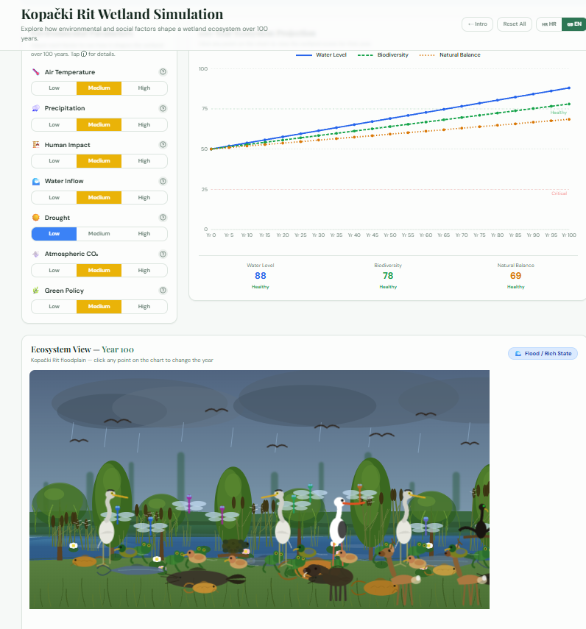
From the Real Ecosystem to a Student Simulation
REAL SYSTEM
In Kopački rit, we observe relationships among water, habitats, organisms, and biodiversity.
Climate Simulation
ecosimulate.com/climate-simulation/
https://rit-eco-flow.base44.app
RESEARCH QUESTIONS
What if…?
• the temperature increases?
• precipitation decreases?
• dry periods become longer?
• water levels change?
• floods last for shorter periods?
AI@Green
14

Slide 15
AI Green Hub – A Digital Tool for Learning About the Environment
An interactive web application connecting ecology, sustainability, and environmental science.
Interactive Learning
More Than a Quiz
eco-smart-sprout.base44.app
1
2
Students learn about ecology, sustainability, and environmental science through interactive content and activities.
AI Green Hub
The app brings together challenges, quizzes, learning content, fact-checking, and progress tracking.
Explore • Learn • Challenge
Challenges
Quiz
interactive challenges
knowledge checks
3
Exploring the Environment
4
Use in Teaching
The digital tool can be used for independent exploration, group work, and checking understanding.
Dedicated sections cover wetlands, the ocean, and climate topics.
Learn
Fake News
learning and exploration
identifying misinformation
Progress
Profile
THE DIGITAL TOOL AS A MEANS OF EXPLORATION
progress tracking
student profile
It does not replace direct experience of nature – it helps students connect information, ask questions, and better understand environmental processes.
Wetlands
Ocean
Climate
AI Green Hub • interactive educational tool

Slide 16
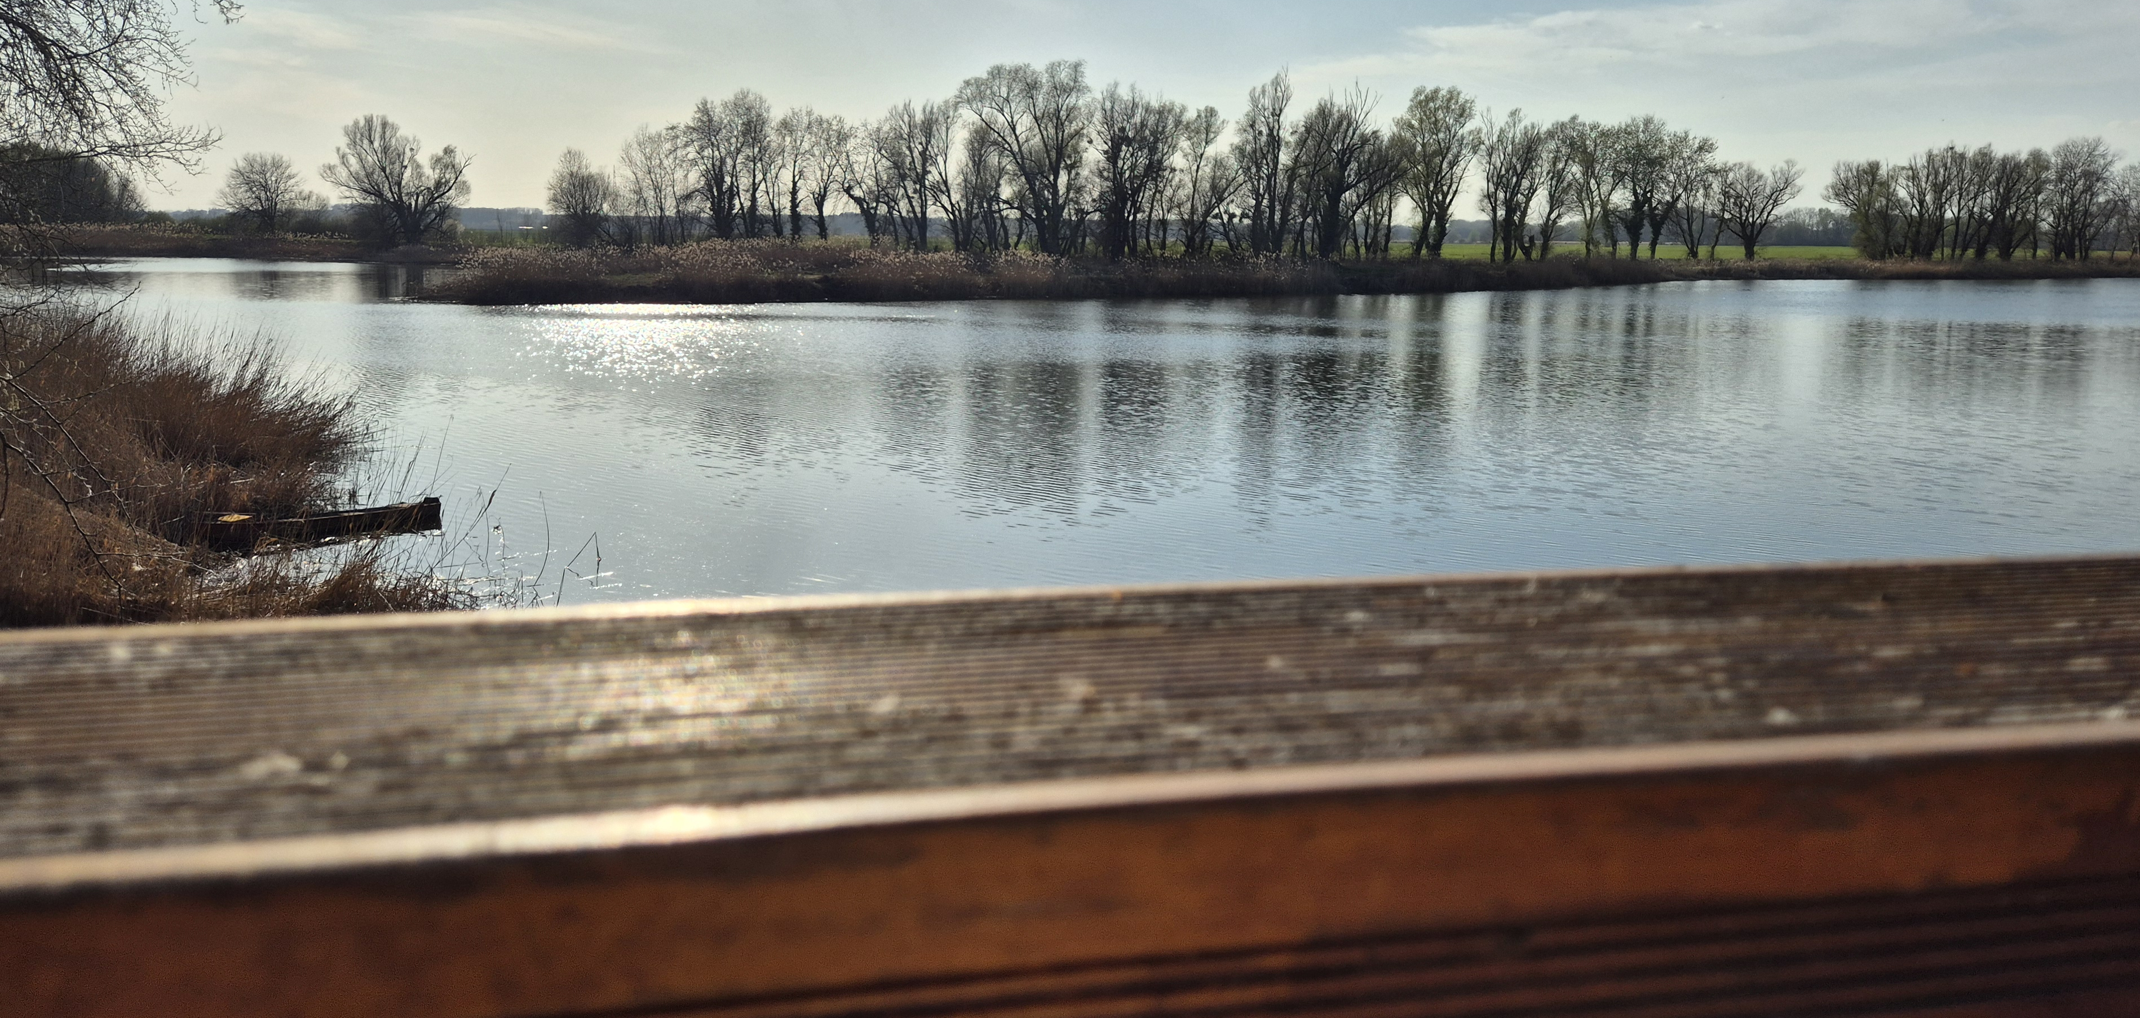
What Can a Simulation Do – and What Can’t It Do?
CAN
CANNOT
• simplify complex relationships
• enable scenario testing
• make cause-and-effect relationships visible
• encourage hypothesis generation
• enable comparison of different assumptions
• fully reproduce the complexity of an ecosystem
• predict a specific future event
• replace real-world measurements and observations
• account for every factor acting within an ecosystem
The value of a simulation is not in replacing reality, but in helping us understand it better.
16

Slide 17
From Data to Understanding
OBSERVE
→
MEASURE
→
CONNECT
→
MODEL
→
SIMULATE
→
INTERPRET
Simulations do not distance students from nature – they help them better understand the processes taking place in nature.
KEY MESSAGE
AI@Green
C-ROADS
En-ROADS
Kopački rit Simulation
AI Green Hub
AI@Green • local ecosystem • models • scenarios • inquiry-based learning
AI@Green
17

Slide 18
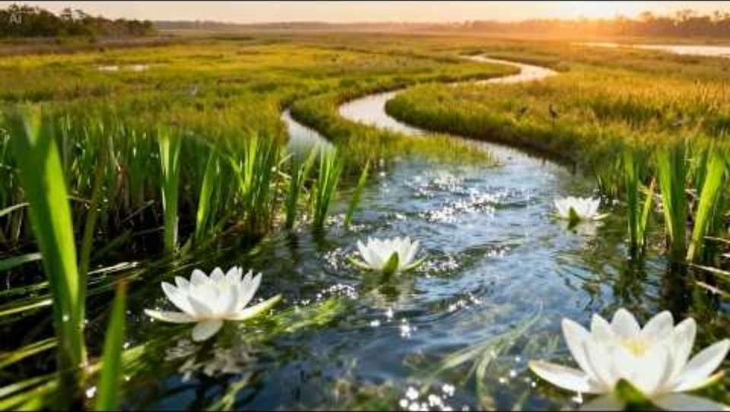
https://youtu.be/Ki5b1VQ7tMY
Video created with the help of artificial intelligence (AI)

Slide 19
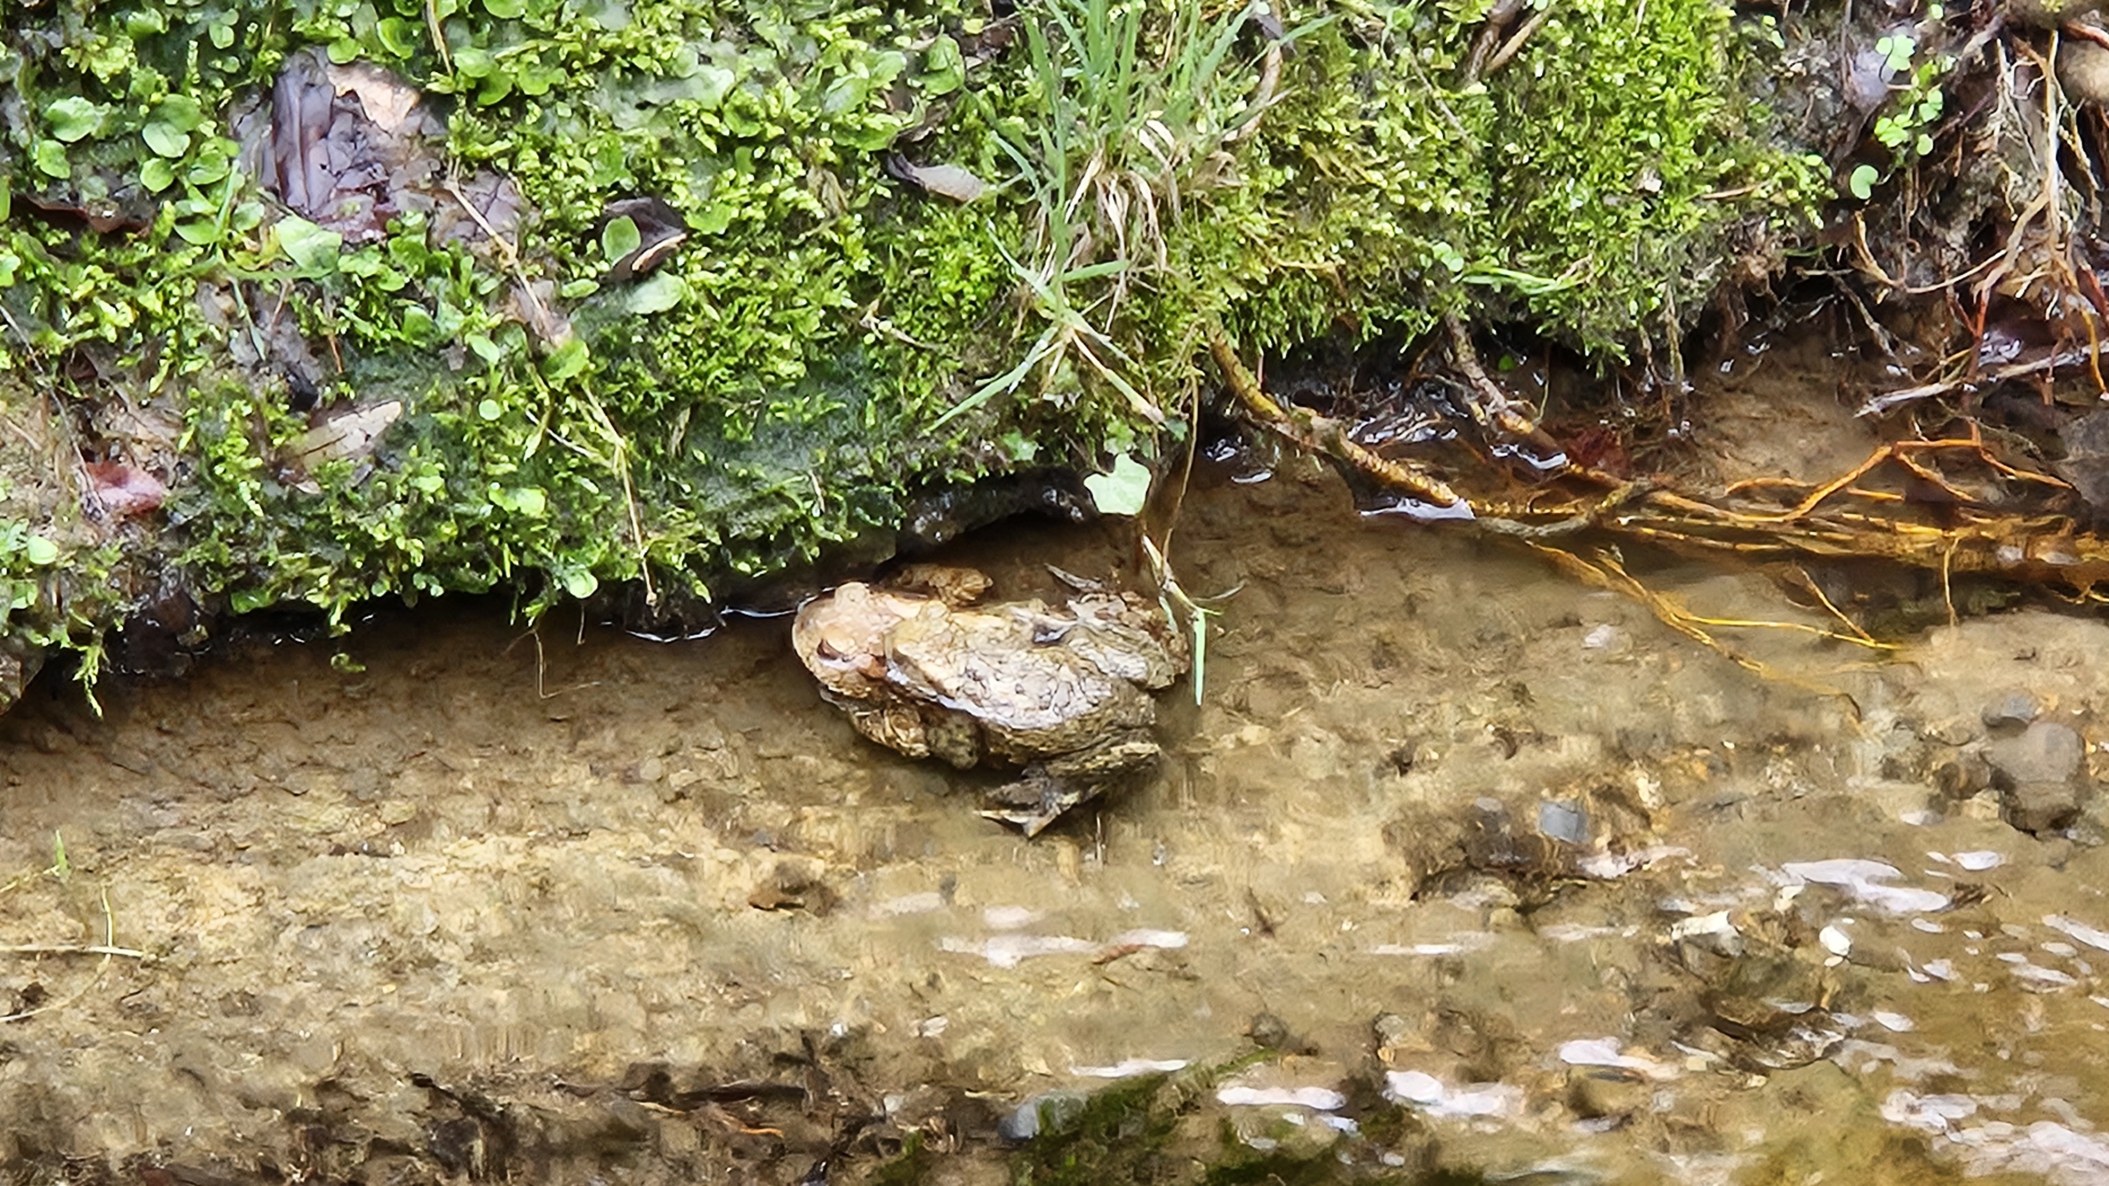
Thank you!

