Slide 1






No prescription for aquatic organisms: Non-stop exposure to pharmaceutical analgesics reveals emergence-altering effects on the non-biting midge Chironomus riparius Meigen, 1804
Bogumił Łosiewicz^{1,2,3}, Viktorija Ergović³, Predrag Simović⁴, Jelena Stanković Ristić⁵, Maciej Kamaszewski¹
¹Department of Animal Environment Biology, Faculty of Bioeconomy and Food Systems, Warsaw University of Life Sciences-SGGW, Poland
²Department of Genetic Engineering, The Kielanowski Institute of Animal Physiology and Nutrition, Polish Academy of Sciences, Poland
³Department of Biology, University of Osijek, Croatia
⁴Department of Biology and Ecology, Faculty of Science, University of Kragujevac, Serbia
⁵Institute for Biological Research “Siniša Stanković”, National Institute of the Republic of Serbia, University of Belgrade, Serbia
Osijek 02.10.2026

Slide 2

Paracetamol and Tramadol
Pharmaceuticals are emerging contaminants.
Paracetamol (PCM) and tramadol (TRA) are widely used analgesics.
Both compounds are detected in surface waters (PCM 0,1-100 µg/L; TRA 0,01-10 µg/L).
Their combined effects on aquatic organisms remain poorly understood.

Slide 3
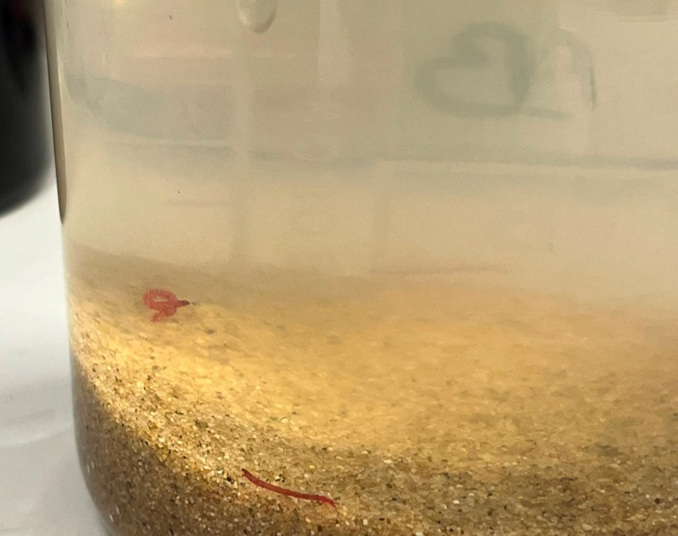
Animal model – Chironomus riparius
A multi-voltine, non-biting midge.
Widely distributed in the Holarctic region.
Short life cycle.
Easily distinguishable sex of imago.
Well established toxicity model organism.
Used in standardized OECD (Organisation for Economic Co-operation and Development) toxicity tests.
Photo by Predrag Simović

Slide 4
Aim of the study
To investigate the effects of environmentally relevant concentrations of PCM, TRA and their mixture on:
Emergence ratio,
Emergence time,
Life traits.

Slide 5
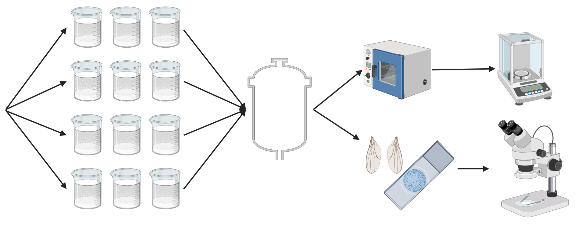
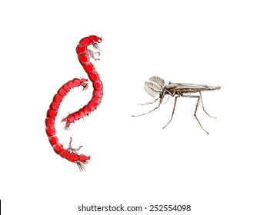
Methodology
n = 10 per beaker
Control
Measurement of dry weight
PCM
TRA
n = 480
MIX
Observations and adult fixation
Control group: 0 μg/L.
PCM groups: 0,1; 1; 10; 100; 1000 μg/L.
TRA groups: 0,1; 1; 10; 100; 1000 μg/L.
MIX groups: 0,1; 1; 10; 100; 1000 μg/L.
Slides from wings
Measurements of wing area and length
Scheme 1. Research methodology scheme (prepared with biorender.com)

Slide 6
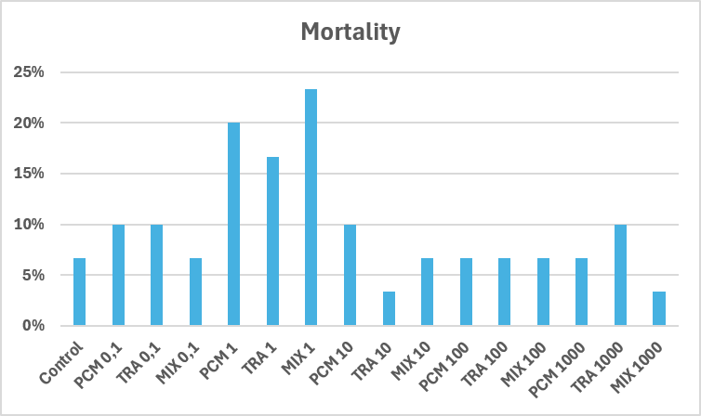
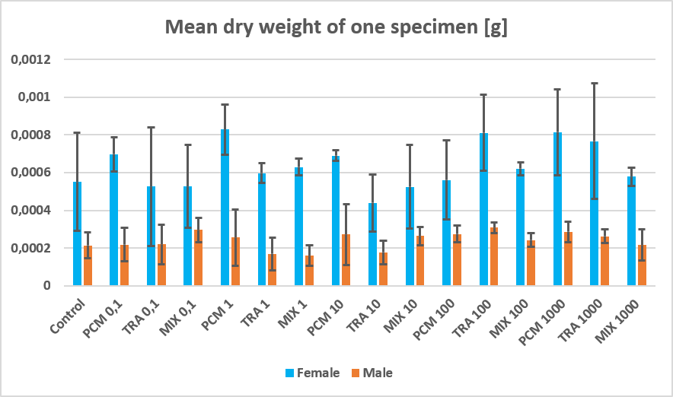
Mortality and weight
The highest mortality rates were observed in 1 μg/L groups.
Mortality in the rest of the groups did not exceed 10%.
There is no statistically significant differences in weight between groups.
Figure 1.

Slide 7
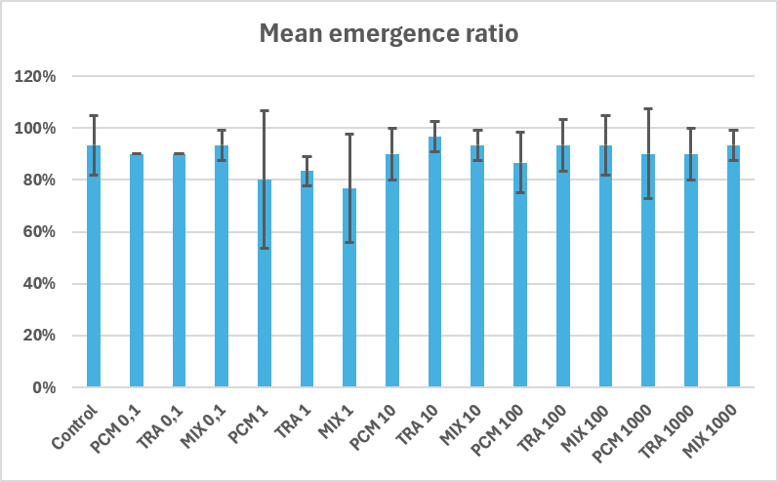
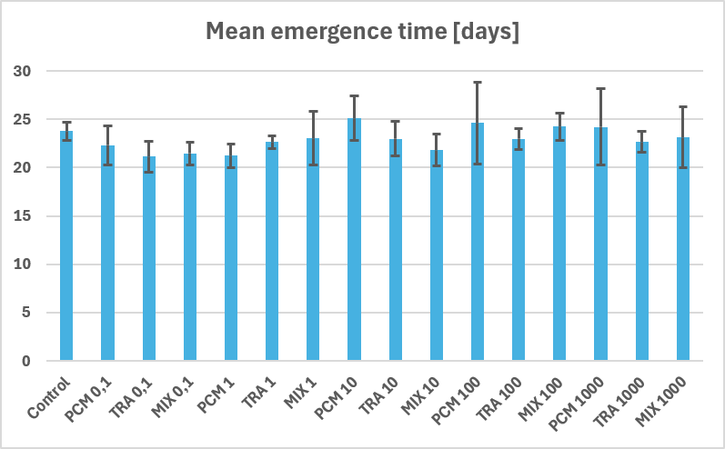
Combined emergence data
Almost all of the chironomids that survived the exposure emerged.
Differences in the emergence ratio mostly depend on the mortality.
No statistically sigificant differences were noted.
Low concentratios of pharmaceutics accelarated emergence.
High concentratios of pharmaceutics delayed emergence.
Figure 2.

Slide 8
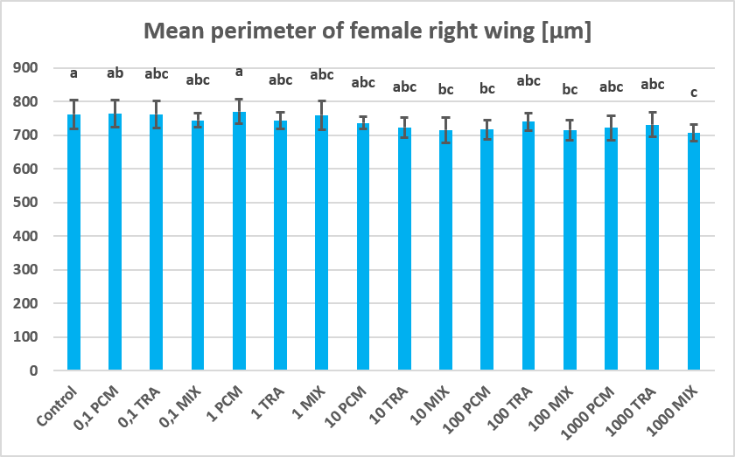
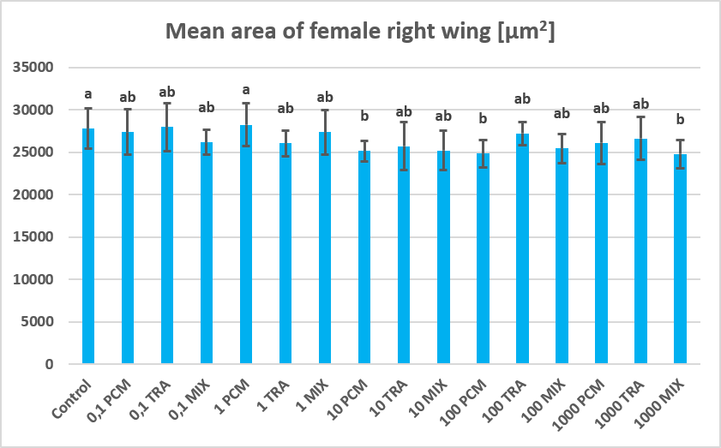
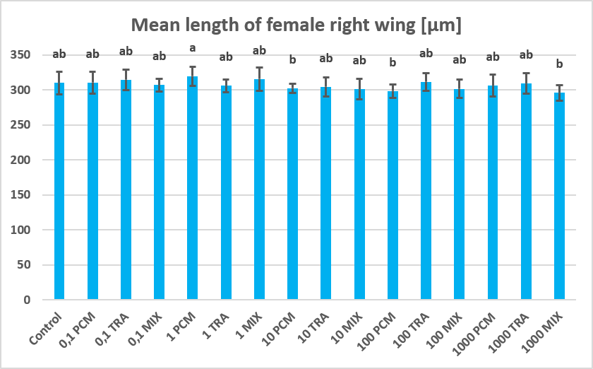
Wing measurements
Higher concentrations of pharmaceutics caused development of smaller wings.
Length of wings was not statistically significant affected by pharmaceutics.
Figure 3.

Slide 9
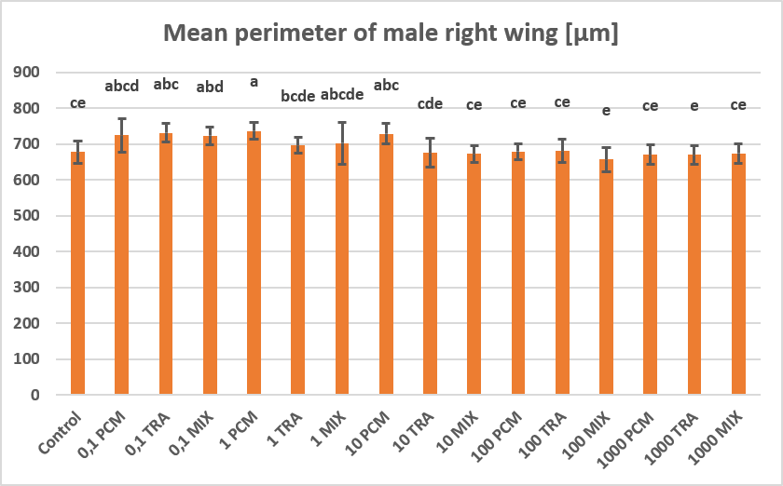
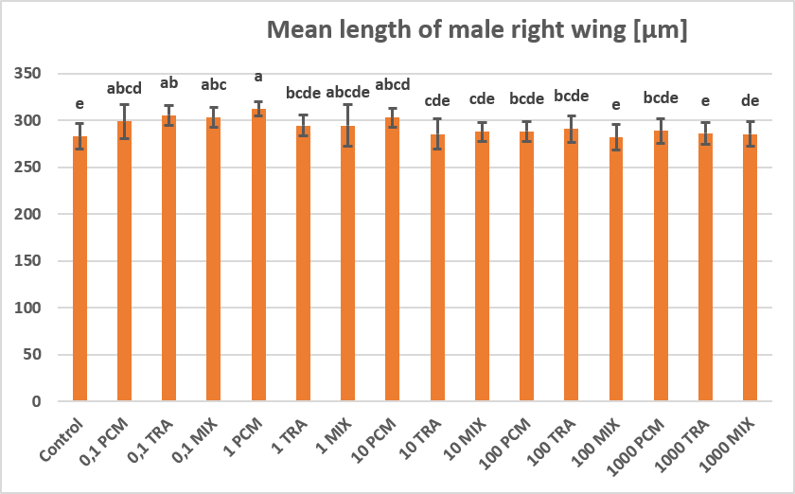
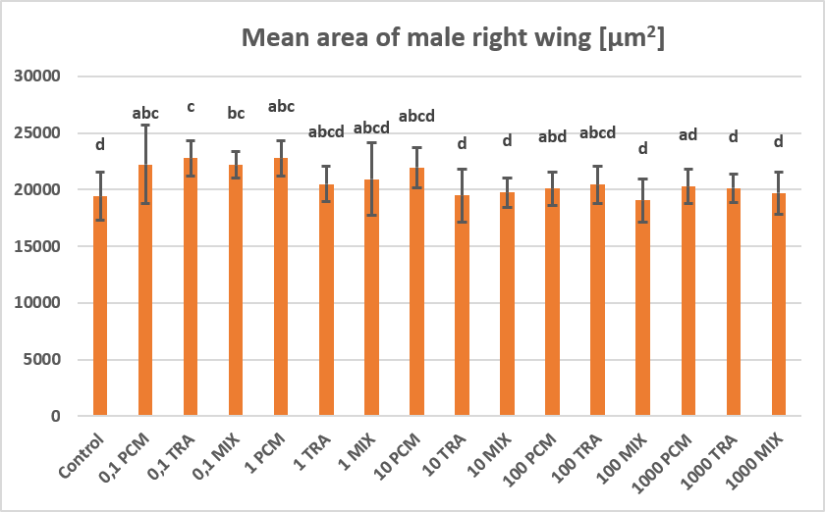
Wing measurements
Low concentrations of pharmaceutics caused an increase in the wing size.
Low concentrations also elongated wings.
Wings were smaller with the increase in the concentration.
Figure 4.

Slide 10
Summary
Environmentally relevant concentrations of PCM, TRA and their mixture impact development of C. riparius
Higher concentrations of pharmaceutics hinder wing size in both sexes.
More studies on environmentally relevant concentrations of emerging pollutants and their mixtures are needed.

Slide 11
Thank you for your attention!
Bibliography:
Diener, H. C., Schneider, R., & Aicher, B. (2008). Per-capita consumption of analgesics: a nine-country survey over 20 years. The Journal of Headache and Pain, 9(4), 225-231.
Jayawardana, S., Forman, R., Johnston-Webber, C., Campbell, A., Berterame, S., de Joncheere, C., ... & Mossialos, E. (2021). Global consumption of prescription opioid analgesics between 2009-2019: a country-level observational study. EClinicalMedicine, 42.
Kusari, S., Tatsimo, S. J. N., Zühlke, S., & Spiteller, M. (2016). Synthetic origin of tramadol in the environment. Angewandte Chemie, 128(1), 248-251.
Otoo, B. A., Amoabeng, I. A., Darko, G., & Borquaye, L. S. (2022). Antibiotic and analgesic residues in the environment–occurrence and ecological risk study from the Sunyani municipality, Ghana. Toxicology Reports, 9, 1491-1500.
OECD (2023), Test No. 219: Sediment-Water Chironomid Toxicity Using Spiked Water, OECD Guidelines for the Testing of Chemicals, Section 2, OECD Publishing, Paris
bogumil_losiewicz@sggw.edu.pl
maciej_kamaszewski@sggw.edu.pl
Osijek 02.10.2026

