Slide 1


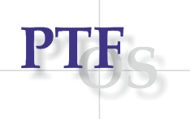


Novel food and alternative proteins in a sustainable food system
15th international symposium Kopački rit past, present, future 2026.
Osijek, 1. – 2. listopada 2026.
Nova hrana i alternativni proteini u održivom prehrambenom sustavu
Ana-Marija Klarić, Marina Tišma
Josip Juraj Strossmayer University of Osijek, Faculty of Food Technology Osijek, Franje Kuhača 18, 31000 Osijek, Croatia
This work was supported by the Croatian Science Foundation under the project (DOK-NPOO-2023-10) „Bioeconomy excellence alliance for stimulating innovative and inclusive green transition- BEAMING‟

Slide 2
Presentation content:
Novel food and alternative proteins in a sustainable food system
Introduction
Terminology
Food loss/food waste
Side streams
Upcycled food
Novel food
Regulation
Mycoproteins
Definition and features
Production technology
Case study: Sugar beet pulp valorisation with Ganoderma lucidum
The aim
Materials and methods
Results
Conclusions

Slide 3
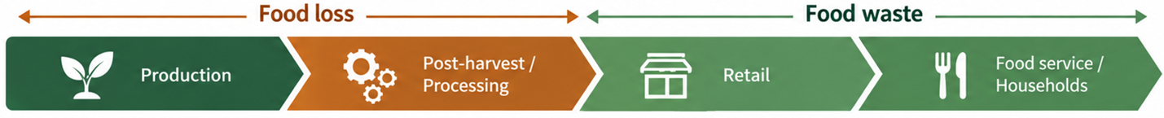
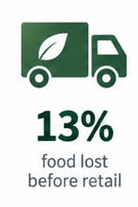
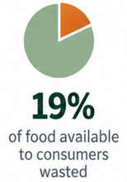
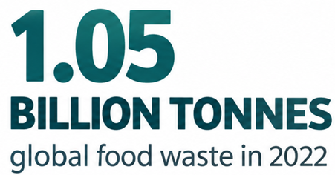
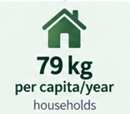

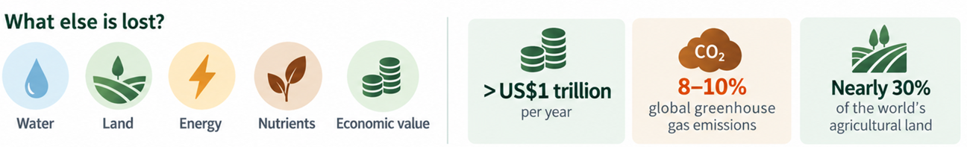
Food waste: a global challenge
Novel food and alternative proteins in a sustainable food system
United Nations Environment Programme (2024). Food Waste Index Report 2024. Nairobi.
Bangar et al. (2024). https://doi.org/10.1016/j.tifs.2023.104314

Slide 4
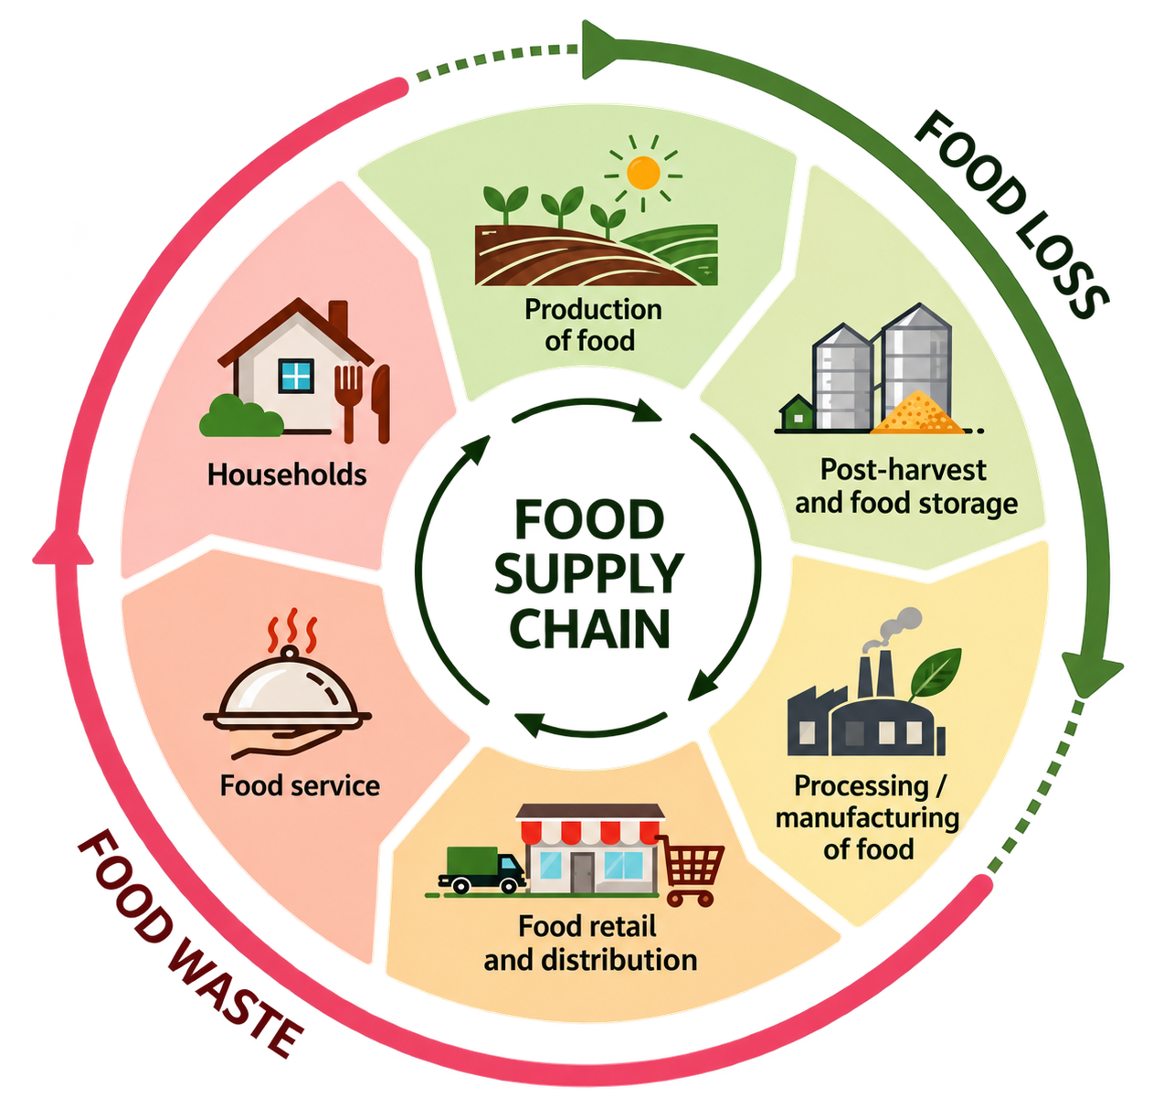
Food waste: a global challenge
Novel food and alternative proteins in a sustainable food system
Food loss: loss of inedible and edible food commodities occurring during production, post-harvest, storage, transportation, and processing, before the retail stage.
Edible food parts: food intended for human consumption.
Inedible food parts: associated parts not intended for consumption (bones, rinds and pits).
Food processing side streams: secondary material flows generated during food processing, including valuable by-products and processing residues.
Food waste: food and associated inedible parts removed from the food supply chain at the retail, food service and household levels.
United Nations Environment Programme (2024). Food Waste Index Report 2024. Nairobi.
Bangar et al. (2024). https://doi.org/10.1016/j.tifs.2023.104314

Slide 5
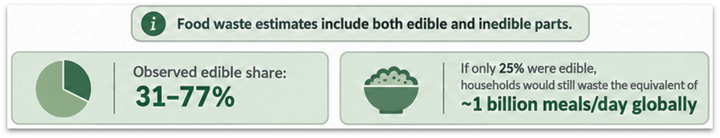
Food waste: a global challenge
Novel food and alternative proteins in a sustainable food system
United Nations Environment Programme (2024). Food Waste Index Report 2024. Nairobi.
Bangar et al. (2024). https://doi.org/10.1016/j.tifs.2023.104314

Slide 6
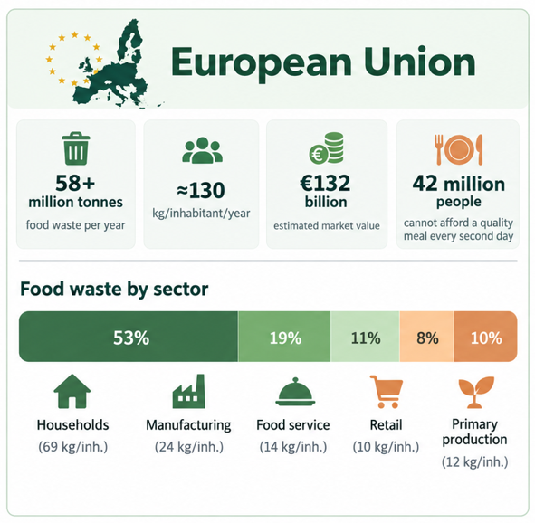
Food waste: a global challenge
Novel food and alternative proteins in a sustainable food system
https://ec.europa.eu/eurostat/statistics-explained/index.php?title=Food_waste_and_food_waste_prevention_-_estimates
https://otpadodhrane.haop.hr/

Slide 7
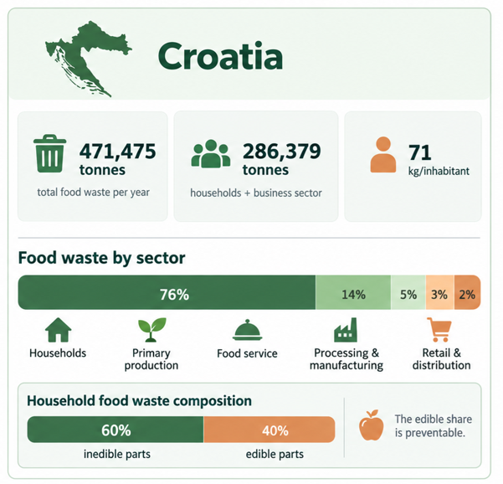
Food waste: a global challenge
Novel food and alternative proteins in a sustainable food system
https://ec.europa.eu/eurostat/statistics-explained/index.php?title=Food_waste_and_food_waste_prevention_-_estimates
https://otpadodhrane.haop.hr/

Slide 8

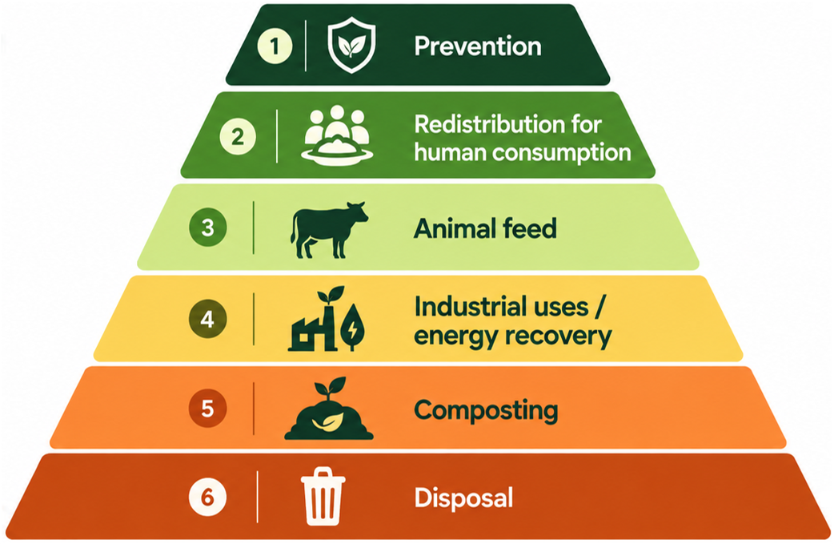
Food waste: prevention is not enough
Novel food and alternative proteins in a sustainable food system
Food waste prevention- top priority
general five stages waste management hierarchy
based on perspective – different food waste management strategies
Preferable
Source | Waste Management Hierarchy (from Most to Least Favorable Action) | Perspective
Zero Waste Europe | Source prevention, food redistribution, repurposing, anaerobic digestion and composting, mechanical biological mixed waste treatment and landfill/ incineration | Food waste policies
European Commission’s Knowledge Centre for Bioeconomy | Prevention, reuse for human consumption, reuse for animal consumption, reuse by-products and recycle food waste, recycle for nutrients recovery, energy recovery, disposal (landfill/ incineration/sewage) | Food waste valorisation
United Nations Environment Programme | Prevention, optimisation (redistribution to people and animal feed), recycling (anaerobic digestion and compost), energy recovery, disposal (landfill/incineration/sewage) | Guidance for governments, businesses and other organizations to develop food waste management strategies
Moshtaghian et al. (2021). https://doi.org/10.3390/foods10112874
Bangar et al. (2024). https://doi.org/10.1016/j.tifs.2023.104314
general five stages waste management hierarchy
based on perspective – different food waste management strategies
upcycled food production – a new strategy
incorporate upcycling to hierarchy

Slide 9
Food waste: prevention is not enough
Novel food and alternative proteins in a sustainable food system
agro-food systems generating side streams; by-products and residues
inedible food waste
Can these streams be transformed back into food?
Preferable
upcycling- new strategy; upcycled food/ingredients
Moshtaghian et al. (2021). https://doi.org/10.3390/foods10112874
Bangar et al. (2024). https://doi.org/10.1016/j.tifs.2023.104314

Slide 10
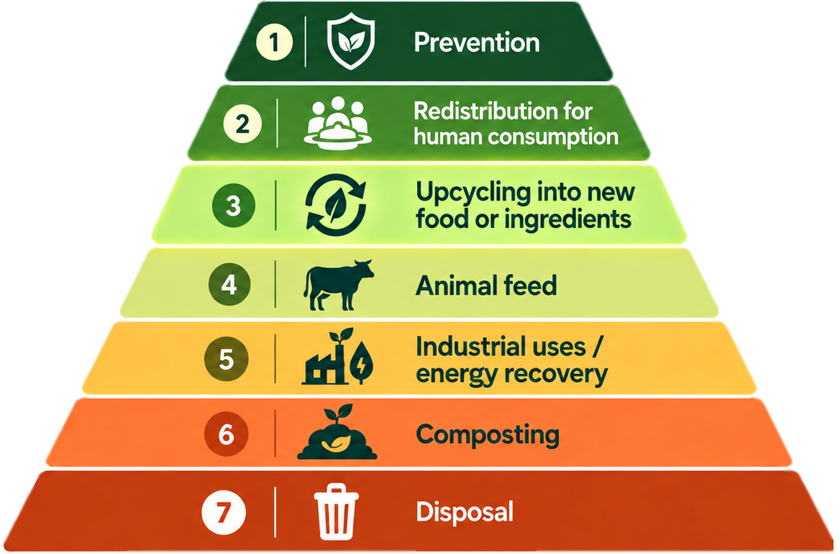
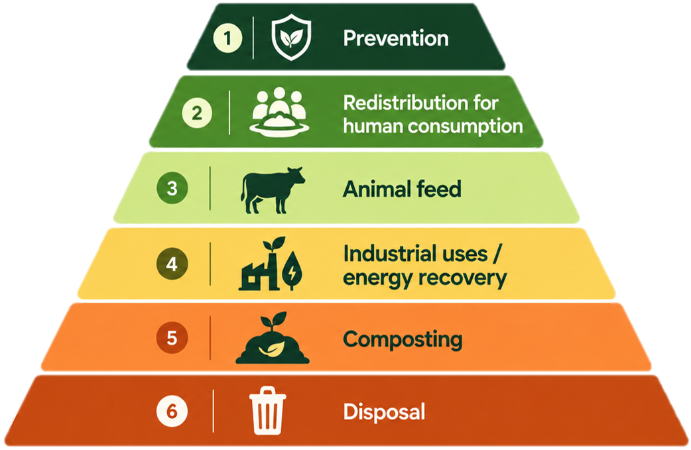
Food waste: prevention is not enough
Novel food and alternative proteins in a sustainable food system
Preferable
Moshtaghian et al. (2021). https://doi.org/10.3390/foods10112874
Bangar et al. (2024). https://doi.org/10.1016/j.tifs.2023.104314

Slide 11
Food waste: a global challenge
Novel food and alternative proteins in a sustainable food system
Upcycling: suitable and safe food waste or side streams are transformed into new food, ingredients or higher-value products.
Food loss: loss of inedible and edible food commodities occurring during production, post-harvest, storage, transportation, and processing, before the retail stage.
Edible food parts: food intended for human consumption.
Inedible food parts: associated parts not intended for consumption (bones, rinds and pits).
Food processing side streams: secondary material flows generated during food processing, including valuable by-products and processing residues.
Food waste: food and associated inedible parts removed from the food supply chain at the retail, food service and household levels.
United Nations Environment Programme (2024). Food Waste Index Report 2024. Nairobi.
Bangar et al. (2024). https://doi.org/10.1016/j.tifs.2023.104314

Slide 12
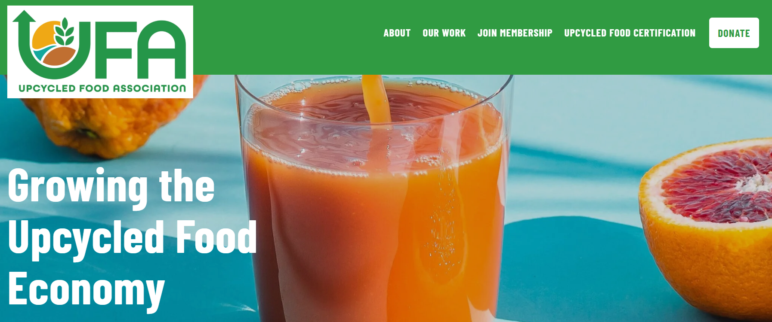
Upcycled food
Novel food and alternative proteins in a sustainable food system
Upcycled food
10% of upcycled ingredients by weight
auditable supply chain
declaration and labels
quality and safety
regulations
should include factors for their feasibility and acceptability
Upcycled food products use ingredients that otherwise would not have gone to human consumption, are procured and produced using verifiable supply chains, and have a positive impact on the environment.
Upcycled ingredients and food products elevate food that would otherwise be wasted to higher uses and have tangible benefits to the environment and society.
Upcycled food contain ingredients that would otherwise be diverted to other waste management destination and they classify as value-added products for human consumption.
Defining Upcycled Foods, (2020) THE UPCYCLED FOODS DEFINITION TASK FORCE
https://www.upcycledfood.org/

Slide 13






Upcycled food
Novel food and alternative proteins in a sustainable food system
Upcycled food
10% of upcycled ingredients by weight
auditable supply chain
declaration and labels
quality and safety
regulations
should include factors for their feasibility and acceptability
Upcycled food products use ingredients that otherwise would not have gone to human consumption, are procured and produced using verifiable supply chains, and have a positive impact on the environment.
Upcycled ingredients and food products elevate food that would otherwise be wasted to higher uses and have tangible benefits to the environment and society.
Upcycled food contain ingredients that would otherwise be diverted to other waste management destination and they classify as value-added products for human consumption.
Defining Upcycled Foods, (2020) THE UPCYCLED FOODS DEFINITION TASK FORCE
https://www.upcycledfood.org/

Slide 14
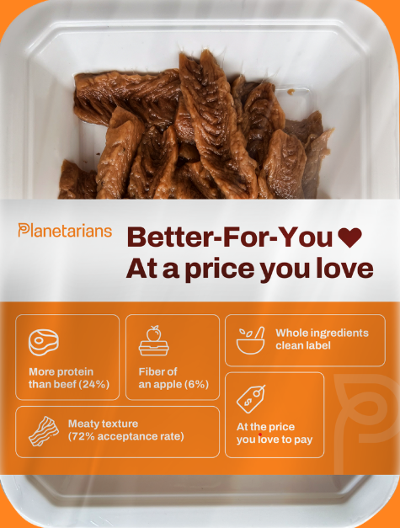
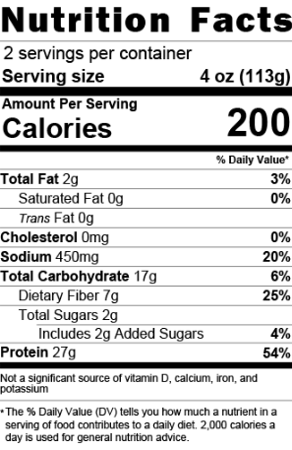
Upcycled food
Novel food and alternative proteins in a sustainable food system
Upcycled food products use ingredients that otherwise would not have gone to human consumption, are procured and produced using verifiable supply chains, and have a positive impact on the environment.
Upcycled ingredients and food products elevate food that would otherwise be wasted to higher uses and have tangible benefits to the environment and society.
Upcycled food contain ingredients that would otherwise be diverted to other waste management destination and they classify as value-added products for human consumption.
Ingredients:
Brewers spent yeast (water brewers yeast), soybean meal, 2% or less of brown sugar, sea salt, garlic powder, calcium chloride, onion powder and vegetable oil.
Contains: soy and gluten.
Defining Upcycled Foods, (2020) THE UPCYCLED FOODS DEFINITION TASK FORCE
https://www.upcycledfood.org/

Slide 15
Upcycled food: Regulations
Novel food and alternative proteins in a sustainable food system
Novel Food is defined as food that had not been consumed to a significant degree by humans in the EU before 15 May 1997, when the first Regulation on novel food came into force.
'Novel Food' can be newly developed, innovative food, food produced using new technologies and production processes, as well as food which is or has been traditionally eaten outside of the EU.
The underlying principles underpinning Novel Food in the European Union are that Novel Foods must be:
  Safe for consumers
  Properly labelled, so as not to mislead consumers
  If novel food is intended to replace another food, it must not differ in a way that the consumption of the Novel Food would be nutritionally disadvantageous for the consumer.
Pre-market authorization of Novel Foods on the basis of an evaluation in line with the above principles is necessary.
There are no dedicated EU-wide regulations specifically for upcycled food;
European Union Food Law and Safety Standards
Novel food regulations
European Food Safety Authority
HACCP
Food Labeling Requirements
Croatian National Regulations (NN 15/18, 114/18)
REGULATION (EU) 2015/2283 OF THE EUROPEAN PARLIAMENT AND OF THE COUNCIL of 25 November 2015 on novel foods, amending Regulation (EU) No 1169/2011 of the European Parliament and of the Council and repealing Regulation (EC) No 258/97 of the European Parliament and of the Council and Commission Regulation (EC) No 1852/2001; Official Journal of the European Union

Slide 16
Upcycled food: Public acceptability
Novel food and alternative proteins in a sustainable food system
Depends on various factors which relate to food quality characteristics and consumer beliefs
Based on consumers perception whether the product is edible or not
Nutritional, safety, environmental factors; sensory appeal, price, familiarity, ethical concern…
Consumers recognize advantages, but still hesitate to consume
Three categories of key factors influencing consumers acceptance of upcycled food
Sociodemographic characteristics
Psychographic characteristics
Product characteristics
Age
Gender
Educational Level
Income
Household size
Country of origin
Neophobia
Lifestyle
Knowledge
Environmental Awareness
Other factors
Product Category
Taste
Product Quality
Price
Products origin
Brand
Information
Logos, labels and certifications
Lu et al. (2024) https://doi.org/10.1016/j.foodqual.2023.105098
Moshtaghian et al. (2021) https://doi.org/10.3390/foods10112874

Slide 17



Mycoproteins
Novel food and alternative proteins in a sustainable food system
Why proteins?
Definition of mycoprotein
Features of mycoprotein
high nutritional value
essential for human health
growing demand for alternative protein sources
potential recovery from agro-food side streams
supports more sustainable food production
Alternative protein source produced through the fermentation of fungal biomass.
Protein-rich food ingredient derived from cultivated fungal mycelium, offering a suitable substitutes for traditional and plant-based proteins.
high protein and fiber content
low total and saturated fat content
high protein quality with all the essential amino acids
ideal protein bioavailability (0.996)
safe, nutritious and palatable
Majmuder et al. (2024). https://doi.org/10.1039/d3fb00169e
Finnigan et al. (2025). https://doi.org/10.1146/annurev-food-111523-121802

Slide 18





Novel food and alternative proteins in a sustainable food system
Mycoproteins: Production technology
Culture and inoculum preparation
Submerged fermentation (SmF)
Solid-state fermentation (SSF)
Cultivation of pure culture in a liquid growth medium- inoculum preparation
Medium optimization
Fermentation phase in controlled bioreactors or fermentation vessels - biosynthesis of biomass enriched with mycoprotein
With desired level of mycoprotein, fermentation is terminated
Centrifugation or filtration (isolation of fungal biomass)
Additional processing steps (enhancement)
Preparation of solid substrate and inoculum
Inoculation with chosen fungal strain
Incubation phase in bioreactors (regulated enviroment) - biosynthesis of mycelial biomass and mycoprotein
With desired level of mycoprotein, end of the incubation time!
Additional processing steps (enhancement)
SmF culture
Scale up-
SmF bioreactor
Filtration/ Centrifugation
Mycoprotein biomass
Majmuder et al. (2024). https://doi.org/10.1039/d3fb00169e
Finnigan et al. (2025). https://doi.org/10.1146/annurev-food-111523-121802

Slide 19

Novel food and alternative proteins in a sustainable food system
Mycoproteins: Production technology
Culture and inoculum preparation
Submerged fermentation (SmF)
Solid-state fermentation (SSF)
Cultivation of pure culture in a liquid growth medium- inoculum preparation
Medium optimization
Fermentation phase in controlled bioreactors or fermentation vessels - biosynthesis of biomass enriched with mycoprotein
With desired level of mycoprotein, fermentation is terminated
Centrifugation or filtration (isolation of fungal biomass)
Additional processing steps (enhancement)
Preparation of solid substrate and inoculum
Inoculation with chosen fungal strain
Incubation phase in bioreactors (regulated enviroment) - biosynthesis of mycelial biomass and mycoprotein
With desired level of mycoprotein, end of the incubation time!
Additional processing steps (enhancement)
SSF culture
Scale up-
SSF bioreactor
Mycoprotein biomass (solid substrate and fungal biomass)
Majmuder et al. (2024). https://doi.org/10.1039/d3fb00169e
Finnigan et al. (2025). https://doi.org/10.1146/annurev-food-111523-121802

Slide 20

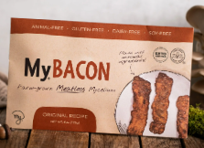
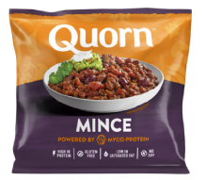
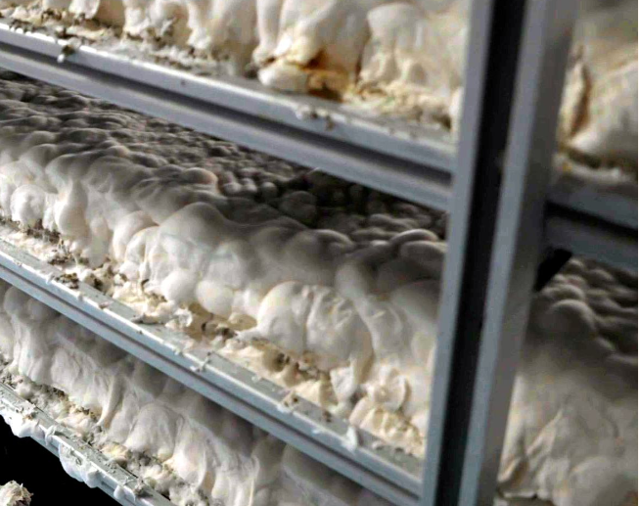
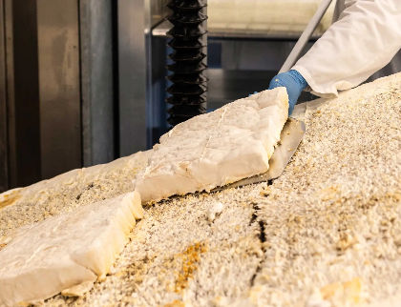
Novel food and alternative proteins in a sustainable food system
Mycoproteins: Production technology
  Marlow Foods’ Quorn mycoprotein
cultivated through submerged fermentation, Fusarium venenatum A3/5
cultivated through solid-state fermentation fermentation, Pleurotus ostreatus
https://www.quorn.co.uk/
https://myforestfoods.com/

Slide 21



Case study: Sugar beet pulp valorisation with Ganoderma lucidum
Novel food and alternative proteins in a sustainable food system
Aim and objectives of research
Materials and methods
Results

Slide 22
Case study: Sugar beet pulp valorisation with Ganoderma lucidum
Novel food and alternative proteins in a sustainable food system
Aim and objectives of research
Can a sugar-industry side stream become a nutritionally improved food ingredient through fungal fermentation?
Research aim
Development of a biotechnological process for the production of fermented sugar beet pulp enriched with mycoproteins from Ganoderma lucidum.
Research specific objectives
Optimization of the biotechnological process of cultivating Ganoderma lucidum on beet pulp with the aim of increasing the protein content.
Conduction of the detailed chemical and nutritional characterization of beet pulp, fermented beet pulp.
Assess the microbiological safety and quality of fermented beet pulp.

Slide 23
Case study: Sugar beet pulp valorisation with Ganoderma lucidum
Novel food and alternative proteins in a sustainable food system
Substrate
Microorganism
Process
Materials and methods

Slide 24
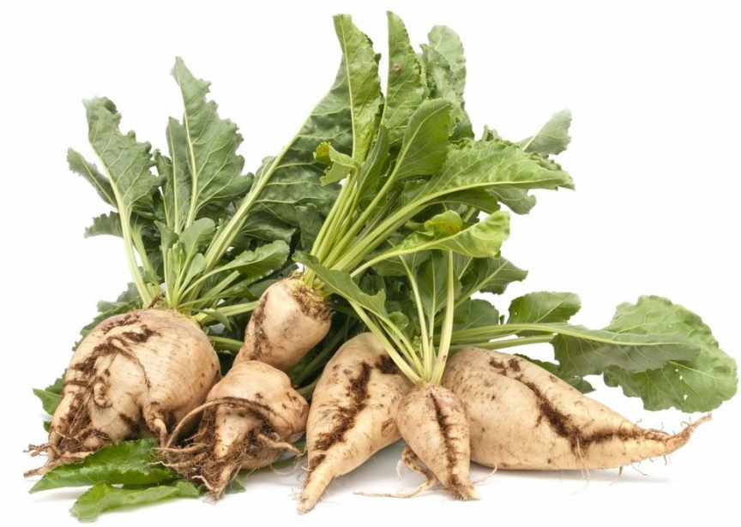
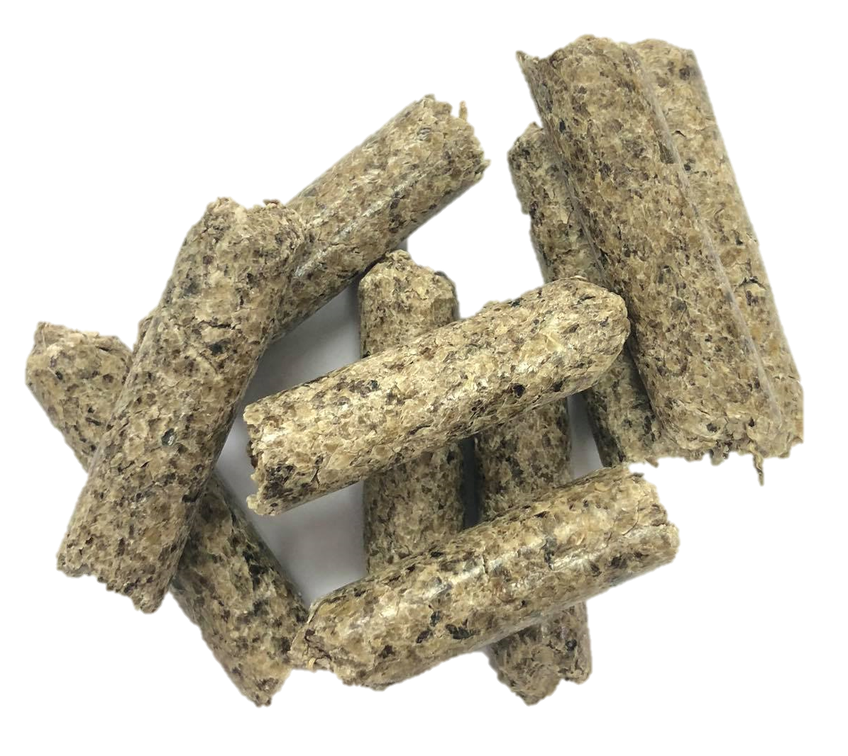
Case study: Sugar beet pulp valorisation with Ganoderma lucidum
Novel food and alternative proteins in a sustainable food system
Substrate
Substrate
Microorganism
Process
Sugar beet pulp (SBP)
lignocellulosic by-product of sugar industry
about 10.4 million tons produced annually in the European Union
potential use in: fuels, polymers, waste water treatment, value-added products (chemicals…), feed and food
Materials and methods

Slide 25
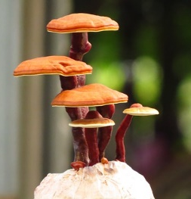
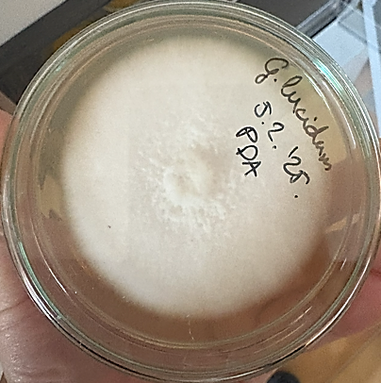
Case study: Sugar beet pulp valorisation with Ganoderma lucidum
Novel food and alternative proteins in a sustainable food system
Substrate
Microorganism
Process
Sugar beet pulp (SBP)
Ganoderma lucidum
lignocellulosic by-product of sugar industry
about 10.4 million tons produced annually in the European Union
potential use in: fuels, polymers, waste water treatment, value-added products (chemicals…), feed and food
filamentous fungi; medicinal mushroom (Reishi/ Lingzi )
bioactive components: triterpenoids (ganoderic acid), polysaccharides (B-D- glucans), proteins (ganodermin), phenols
Materials and methods

Slide 26
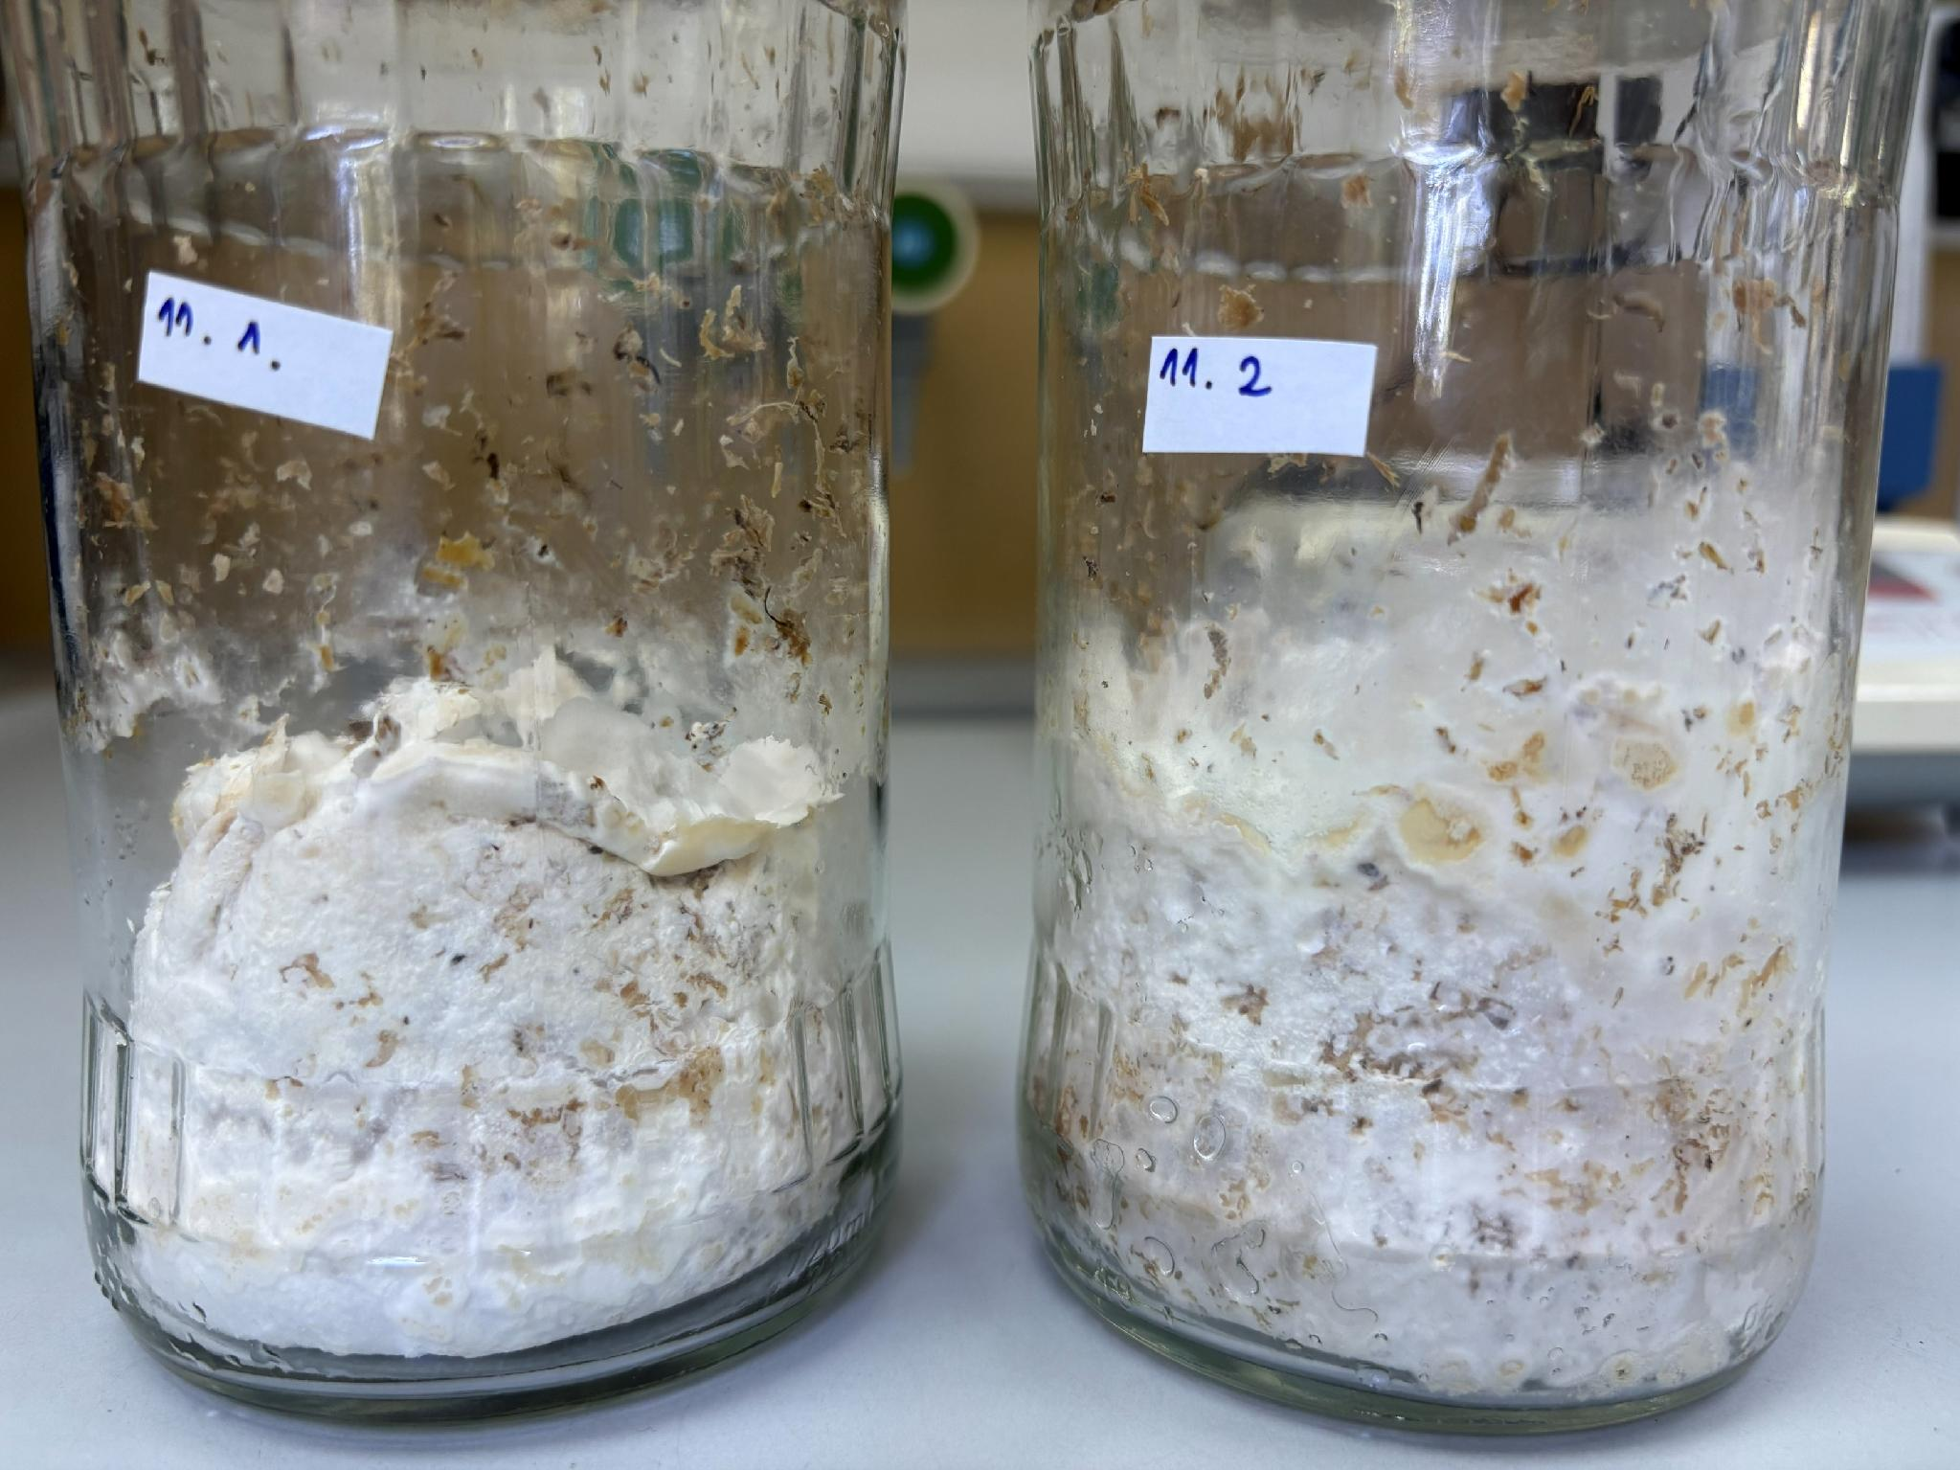
Case study: Sugar beet pulp valorisation with Ganoderma lucidum
Novel food and alternative proteins in a sustainable food system
Substrate
Microorganism
Process
Sugar beet pulp (SBP)
Ganoderma lucidum
Solid-state fermentation (SSF)
lignocellulosic by-product of sugar industry
about 10.4 million tons produced annually in the European Union
potential use in: fuels, polymers, waste water treatment, value-added products (chemicals…), feed and food
filamentous fungi; medicinal mushroom (Reishi/ Lingzi )
bioactive components: triterpenoids (ganoderic acid), polysaccharides (B-D- glucans), proteins (ganodermin), phenols
biological degradation method
cultivation of microorganisms on solid substrates without the presence of free water
complex enzymatic system for depolymerization and degradation of the lignocellulosic biomass
Materials and methods

Slide 27
Case study: Sugar beet pulp valorisation with Ganoderma lucidum
Novel food and alternative proteins in a sustainable food system
Results

Slide 28
Case study: Sugar beet pulp valorisation with Ganoderma lucidum
Novel food and alternative proteins in a sustainable food system
Optimisation
Chemical composition analysis
Safety analysis
optimisation of the SSF process
optimisation of post-fermentation processing method
protein content
amino acid profile
dietary fiber
sugars
fats
ash
heavy metals
toxins
polycyclic aromatic hydrocarbons (PAHs)
polychlorinated biphenyls (PCBs)
ergot and tropane alkaloids
Results

Slide 29
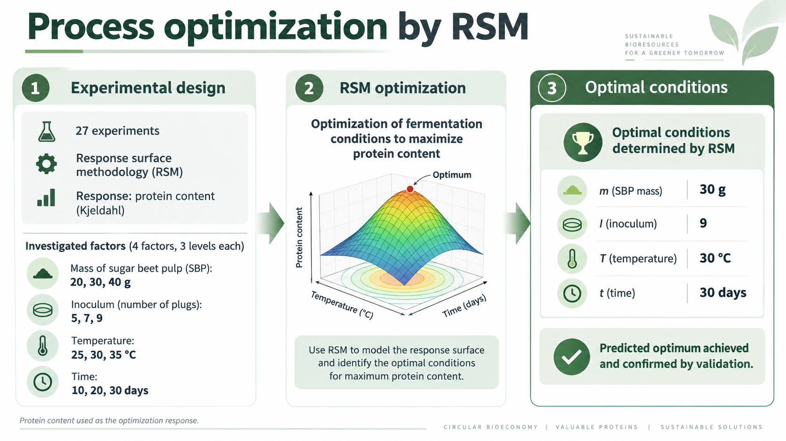
Case study: Sugar beet pulp valorisation with Ganoderma lucidum
Novel food and alternative proteins in a sustainable food system
Chemical composition analysis
Optimisation
Safety analysis
Optimisation of the SSF process

Slide 30
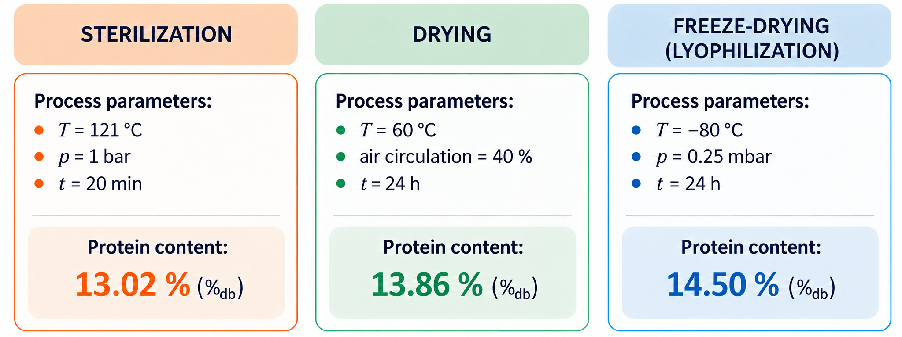
Case study: Sugar beet pulp valorisation with Ganoderma lucidum
Novel food and alternative proteins in a sustainable food system
Chemical composition analysis
Optimisation
Safety analysis
Optimisation of post-fermentation processing method

Slide 31
Case study: Sugar beet pulp valorisation with Ganoderma lucidum
Novel food and alternative proteins in a sustainable food system
Chemical composition analysis
Optimisation
Safety analysis
Chemical composition analysis
Compound | RAW SBP | ST | D | L
Protein [%_{db}] | 9.14 | 13.02 | 13.86 | 14.50
Fats [%_{db}] | 0.600 | 0.610 | 0.694 | 0.766
Dietary fiber (%)
Total | 72,49 | 43,98 | 48,82 | 46,02
Insoluble | 55,75 | 27,50 | 28,03 | 27,78
Soluble | 16,73 | 16,49 | 20,79 | 18,24
Reducing sugars [mg glucose/g_{db}] | 5.879 | 225.324 | 182.814 | 244.687
Ash [%_{db}] | 5.095 | 6.379 | 6.502 | 6.054
Table 1. Chemical composition of sugar beet pulp before and after SSF
RAW SBP- untreated SBP
ST- sterilised fermented SBP
D- dried fermented SBP
L- lyophilised fermented SBP

Slide 32
Case study: Sugar beet pulp valorisation with Ganoderma lucidum
Novel food and alternative proteins in a sustainable food system
Chemical composition analysis
Optimisation
Safety analysis
Chemical composition analysis
Table 2. Content of free amino acids [ng/mg]
Sample | Lys | His | Cys | Arg | Gly | Ser | Asp | Ala | Glu | Pro | Val | Met | Ile | Leu | Tyr | Phe | Thr
RAW SBP | 1.258 | 0.531 | ND | 2.774 | ND | 0.673 | 0.569 | 2.24 | 1.385 | 0.346 | 0.694 | ND | 0.753 | 1.012 | 2.173 | 0.37 | 0.456
ST | 3.799 | 0.155 | ND | 7.898 | 6.67 | 3.652 | 4.154 | 4.361 | 16.495 | 2.272 | 1.655 | 0.291 | 1.224 | 2.989 | 2.476 | 1.816 | 2.371
D | 13.786 | 3.173 | ND | 24.2 | 11.14 | 15.961 | 28.553 | 25.425 | 32.634 | 14.58 | 11.171 | 6.914 | 12.715 | 46.639 | 21.226 | 24.493 | 32.629
L | 25.345 | 5.158 | ND | 41.028 | 11.052 | 19.131 | 27.983 | 24.554 | 48.225 | 11.106 | 11.722 | 10.492 | 12.352 | 152.867 | 28.038 | 32.105 | 44.339

Slide 33
Case study: Sugar beet pulp valorisation with Ganoderma lucidum
Novel food and alternative proteins in a sustainable food system
Chemical composition analysis
Optimisation
Safety analysis
Safety analysis
Table 3. Evaluation of quality and health safety of unfermented and fermented SBP
Parameter | RAW SBP | ST | D | L
Gross energy, kJ/kg | 16913 | 15375 | 16358 | 16531
Lead, mg/kg | 1.1 | 1.3 | 1.3 | 1.4
Cadmium, mg/kg | 0.49 | 0.74 | 0.67 | 0.70
Arsen, mg/kg | 0.13 | 0.15 | 0.16 | 0.13
Phosphorus, % | 0.0088 | 0.11 | 0.12 | 0.11
Iron, mg/kg | 589 | 484 | 678 | 490
Calcium, % | 0.72 | 1.1 | 1.2 | 1.1
Potassium, mg/kg | 1428 | 1895 | 1979 | 2033
Parameter | RAW SBP | ST | D | L
PAHs, mg/kg | < 0.005 | < 0.005 | < 0.005 | < 0.005
PCBs, mg/kg | < 0.005 | < 0.005 | < 0.005 | < 0.005
Aflatoxins, mg/kg | < 0.003 | < 0.003 | < 0.003 | < 0.003
Fumonisins, mg/kg | < 0.30 | < 0.30 | < 0.30 | < 0.30
Zearalenone, mg/kg | < 0.030 | < 0.030 | < 0.030 | < 0.030
Deoxynivalenol, mg/kg | < 0.20 | < 0.20 | < 0.20 | < 0.20
Ochratoxin A, mg/kg | < 0.001 | < 0.001 | < 0.001 | < 0.001
Ergot alkaloids µg/kg | < 48.0 | < 48.0 | < 48.0 | < 48.0
Tropane alkaloids µg/kg | < 2 | < 2 | < 2 | < 2
Notes:
Chemical safety assessment showed no detectable levels of PAHs, PCBs, mycotoxins, ergot alkaloids or tropane alkaloids in either raw or fermented SBP. Heavy metals were detected in all samples and remained at comparable levels after processing, while mineral concentrations generally increased. But compliance with food-specific regulatory limits must be confirmed before considering food application.

Slide 34
Conclusions
Novel food and alternative proteins in a sustainable food system
Food side streams should increasingly be considered as resources rather than waste.
Mycoprotein production can connect alternative proteins, food upcycling and circular bioeconomy.
Filamentous fungi can convert low-value substrates into protein-enriched biomass and nutritionally improved ingredients.
The real potential depends on safety, digestibility, consumer acceptance, scalability and demonstrated environmental benefits.
SBP was successfully valorised
through SSF with G.lucidum.
Optimised fermentation increased protein content by 1.57 times compared with untreated SBP.
Fermentation markedly improved the amino acid profile, particularly lysine, leucine and phenylalanine.
The results demonstrate the potential of fungal fermentation to transform a sugar-industry side stream into a nutritionally improved, protein-enriched ingredient for further food applications.

Slide 35


