Slide 1
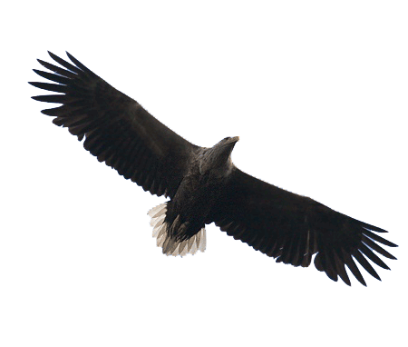

What White-tailed Eagles tell us about Kopački rit after 147 years of research?
Tibor Mikuska
Croatian Society for Birds and Nature Protection
Kopački rit – Jučer, Danas, Sutra, Osijek, 01-02 October 2026

Slide 2
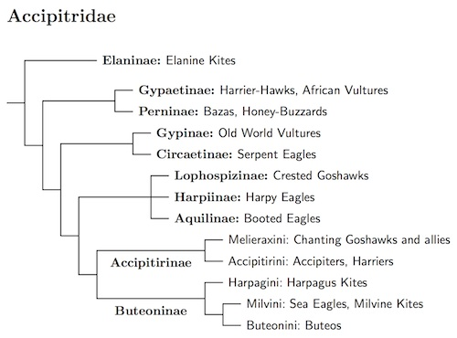
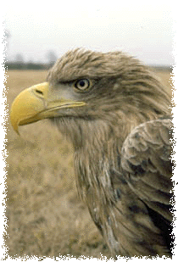
Eagle that is not an eagle!
The latest raptor phylogenies based on DNA are clear!
The Sea-Eagles are most closely related to Kites, then Buzzards, then Goshawk, and only then the "true" Eagles!
Retrieved in 2024 from: http://jboyd.net/Taxo/List9.html
Notes:
First fossil record of Haliaeetus genus – 16-28 mil years ago

Slide 3
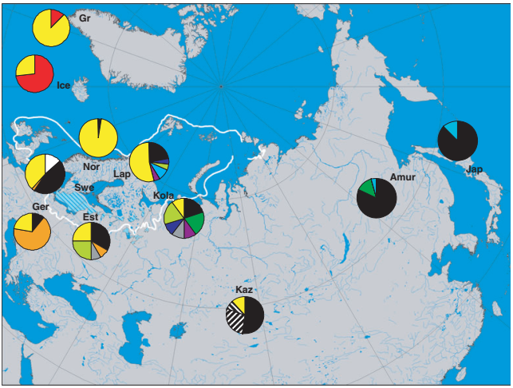
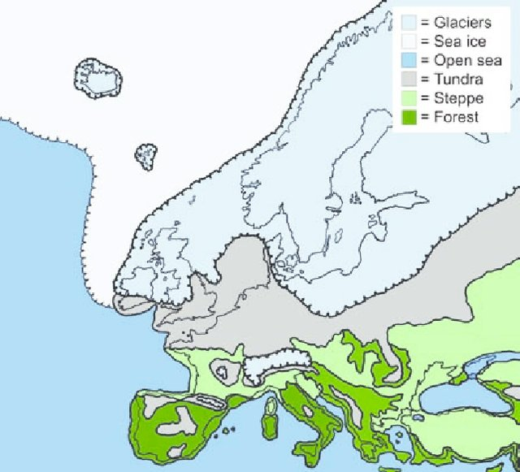
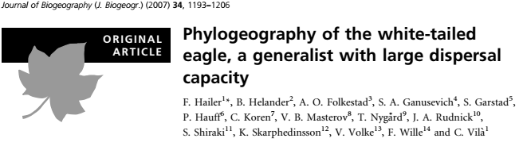
Halldórsson, Guðmundur & Oddsdottir, Edda & Sigurdsson, Bjarni. (Eds.) (2008) AFFORNORD Effects of afforestation on ecosystems, landscape and rural development. Nordic Council of Ministers, Copenhagen

Slide 4
Main breeding requirements of eagles?
Large (old), massive trees for nest support
Spacious alluvial wetlands:
hydro-morphological features of large rivers and floods
Availability of prey and food supply
Disturbance-free sites (particularly during breeding) and protection from human impact

Slide 5
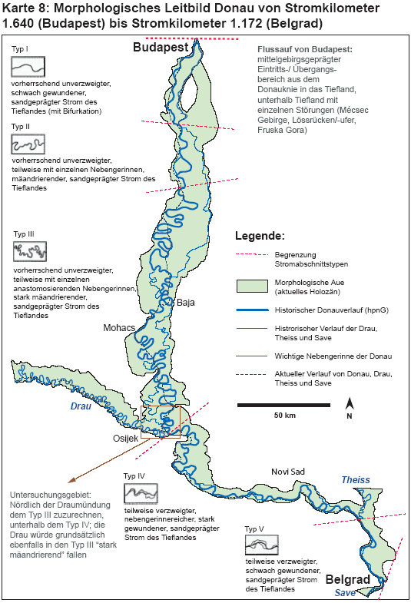
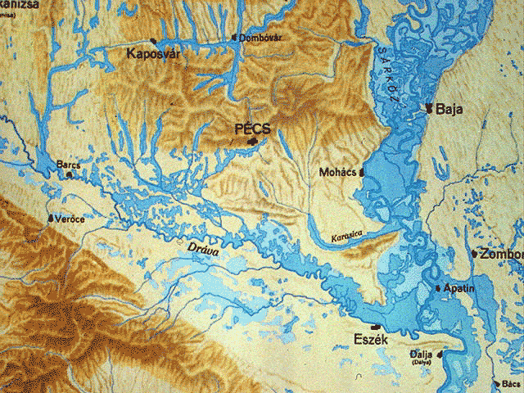
Notes:
Dunav prije 250 Godina

Slide 6
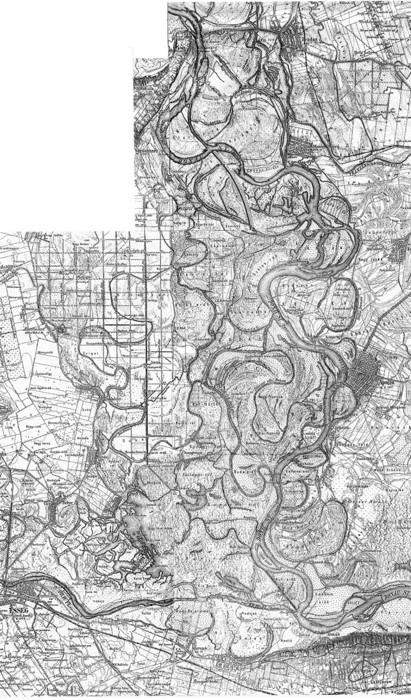
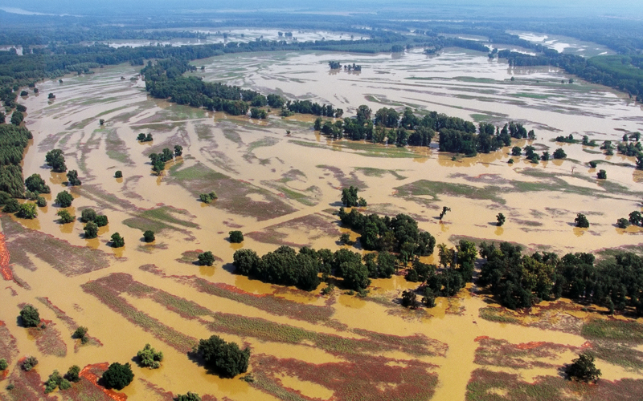

Slide 7
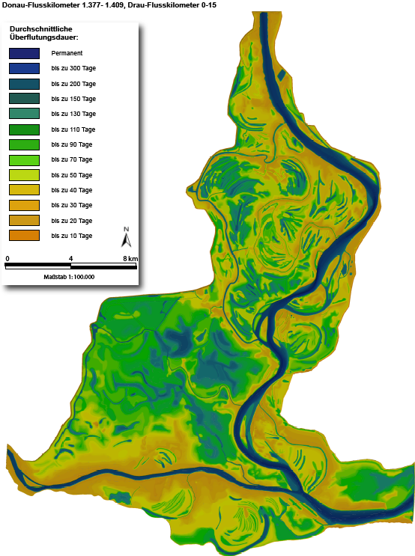
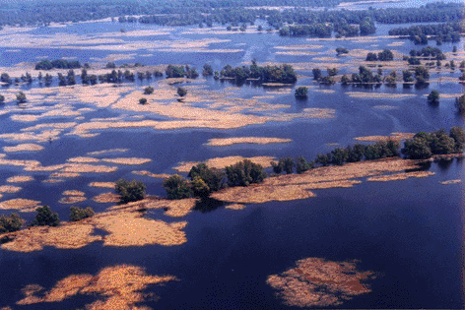
Regular annual phenomenon driven by snowmelt and rainfall
Different duration due to relief
Floods provide food for eagles!
Formerly in late spring/early summer

Slide 8
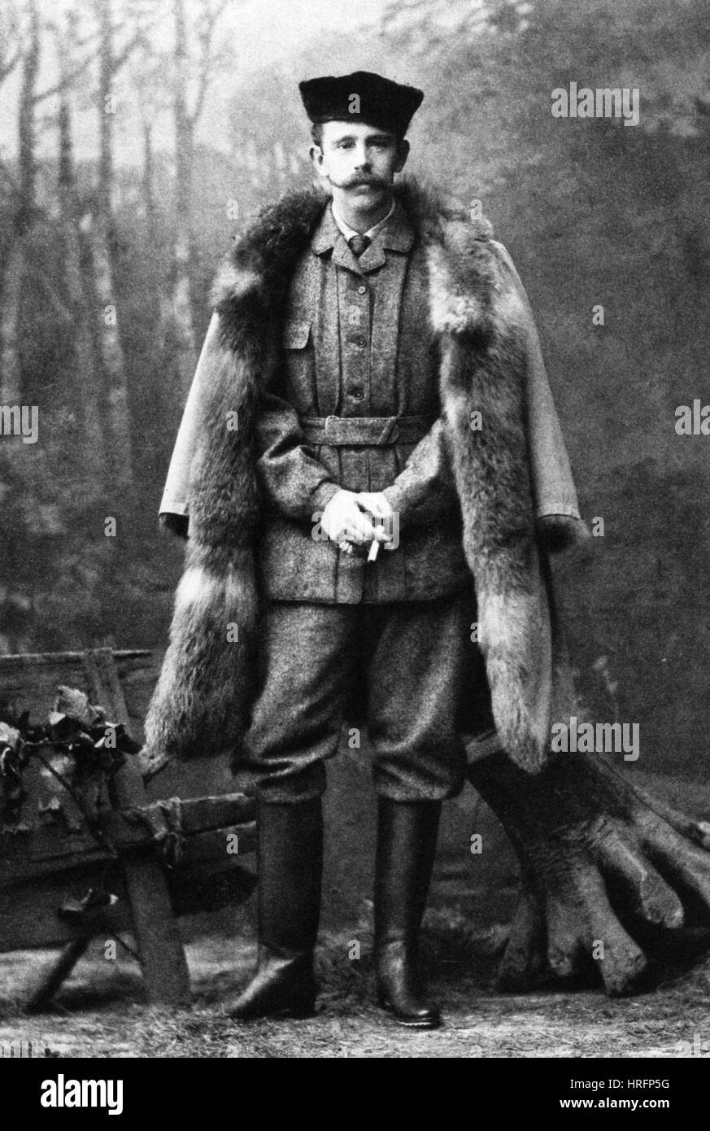
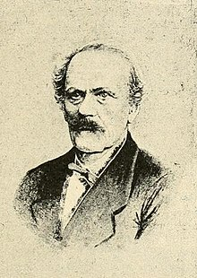
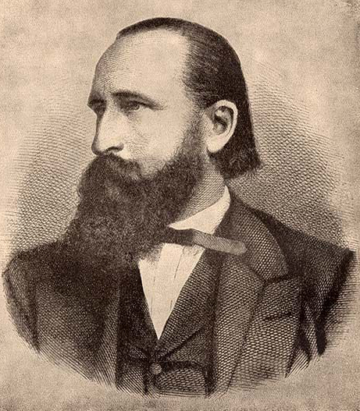
„ ……20 breeding pairs of White-tailed eagles......”
RUDOLF VON ÖSTERREICH, HOMEYER E.F. & BREHM A. (1879): Zwölf Frühlingstage an der mittleren Donau.
Journal für Ornithologie 27: 1–83.
Notes:
Alfred Edmund Brehm (German pronunciation: [ˈalfʁeːt ˈʔɛtmʊnt ˈbʁeːm]; 2 February 1829 – 11 November 1884) was a German zoologist, writer, director of zoological gardens and the son of Christian Ludwig Brehm, a famous pastor and ornithologist.; 147 Godina (od 2026)

Slide 9
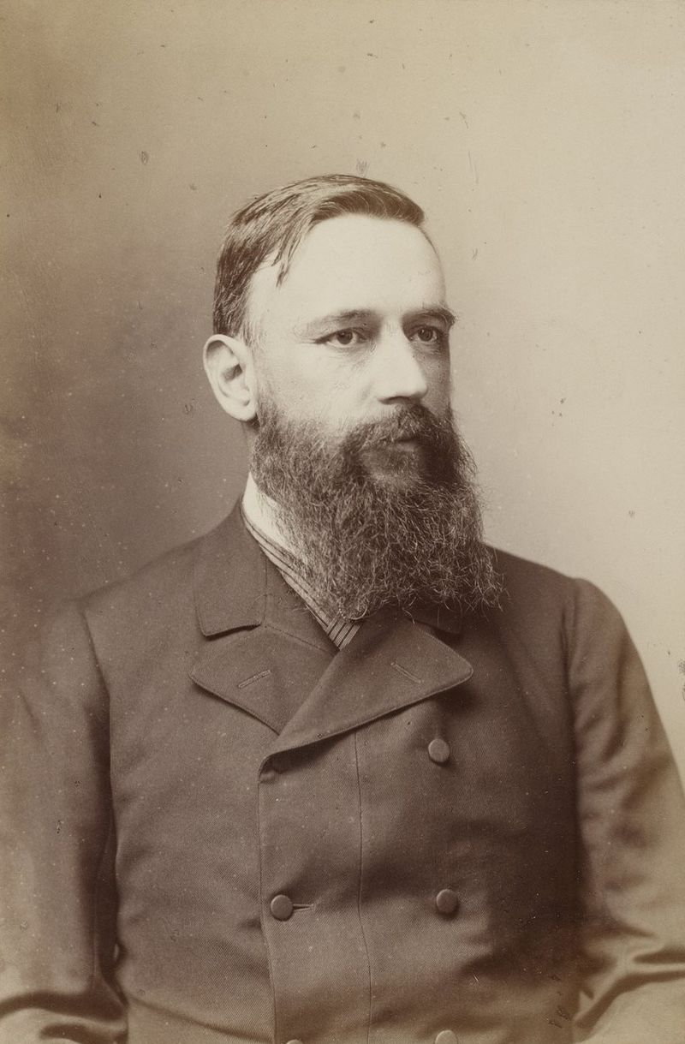
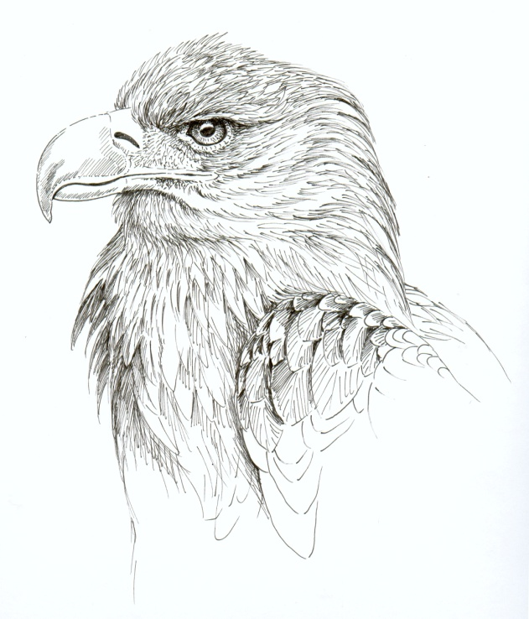
(1879 -1892)
10 articles on bird fauna of the area
„ ……20 breeding pairs of White-tailed eagles......”
MOJSISOVICS A. (1886): Biologische und faunistische Beobachtungen über Vögel und Säugethiere Südungarns und Slavoniens in der Jahren 1884 and 1885. — Mitt. Naturwiss. Ver. Steiermark 22: 109–204.
Notes:
Radio 12 godina Graz, (1879 -1892) – 10 published articles about bird fauna of this area

Slide 10
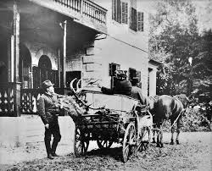
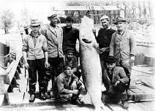
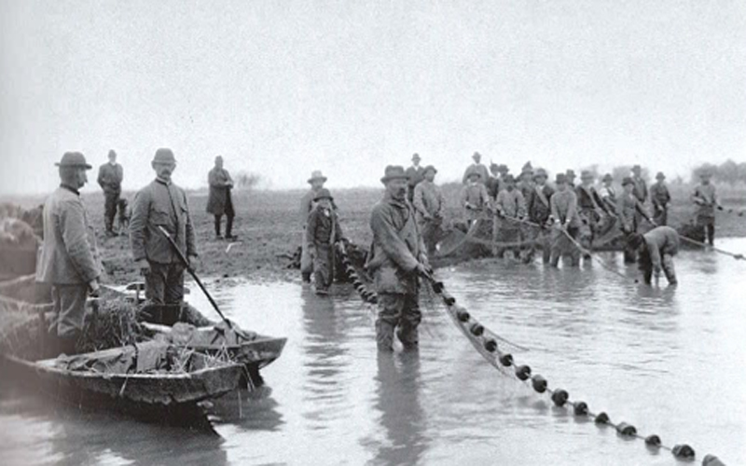
Why was a breeding population limited in 19 century?
Area was primarily managed as hunting/fishing ground
Predators were persecuted
  Last wolf killed in 1879
  Eagles and large raptors killed as predators, for fun & scientific collections
  Fishing was a big business

Slide 11
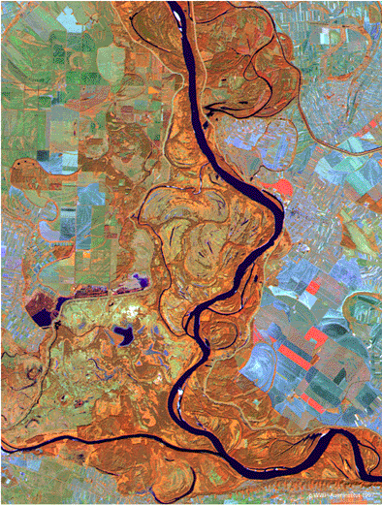
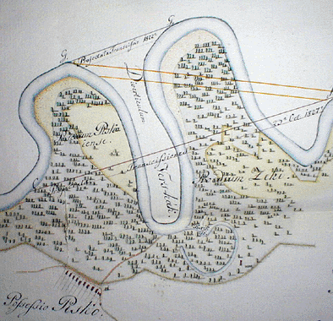
Changes in the floodplain in 19th and 20th century
Dike construction
Land reclamation and wetland habitat loss (70% of active floodplain loss)
Cutting through meanders for navigation purposes

Slide 12
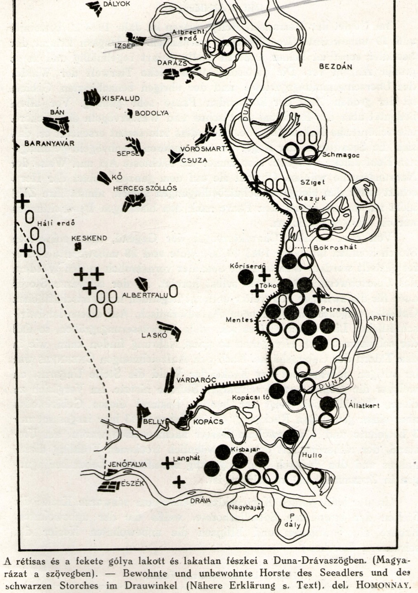
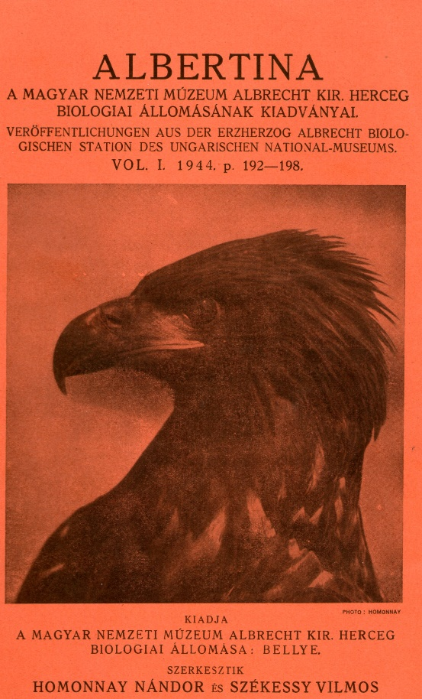
Nándor Homonnay (1912-1976) born in Apatin, ornithologist
Homonnay N. (1944) “Distribution of White-tailed eagle and Black stork population on Belye lordship”, Albertina, 1: 192-198.
“… (in 1943) ..22 occupied nest and 19 empty White-tailed eagle nests on the Belye lordship property…”
(note: 19 occupied nests on the map = black circles + additional 14 empty nests = white circles)

Slide 13
Changes in the floodplain primary use in 20th century
State hunting ground for trophy animals (Red deer) – highest priority in former Yugoslavia
Deer population raised to 4000 animals (14 deer/100 ha) – viscera after hunting left in field
Fishponds (570 ha) constructed in late 60-ties
Fishing in open waters outlawed – rivers taken over by sport anglers, limited illegal fishing in the floodplain
Intensive forestry continued in the former floodplain

Slide 14
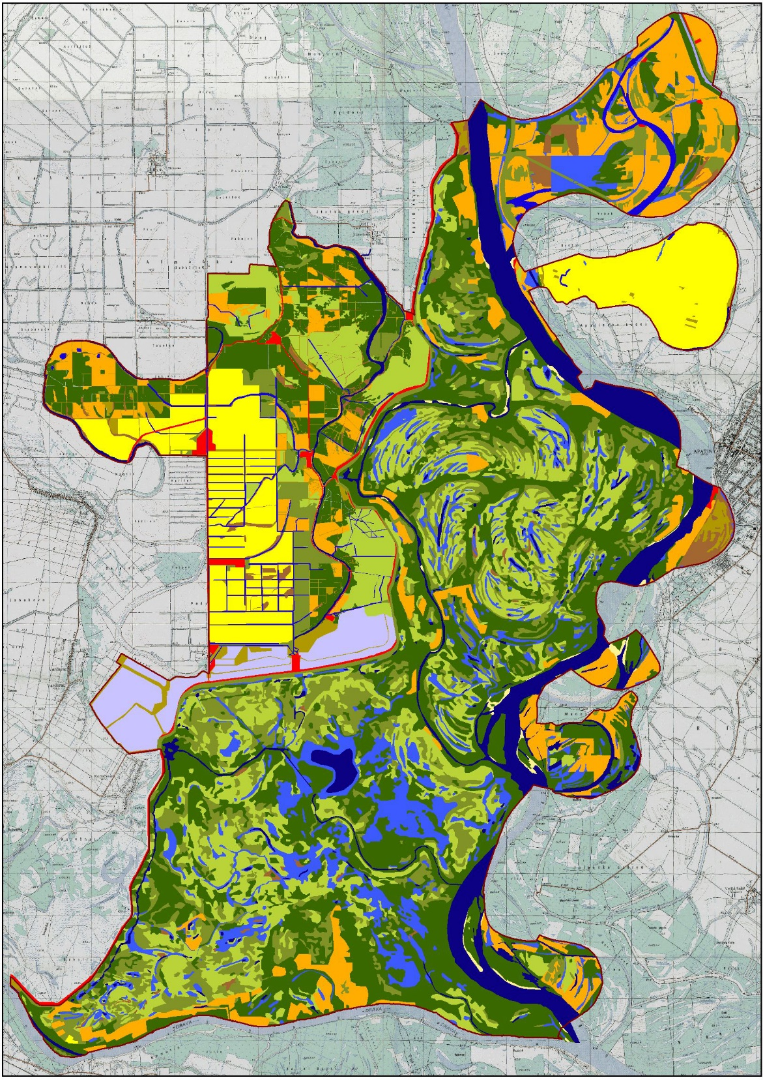
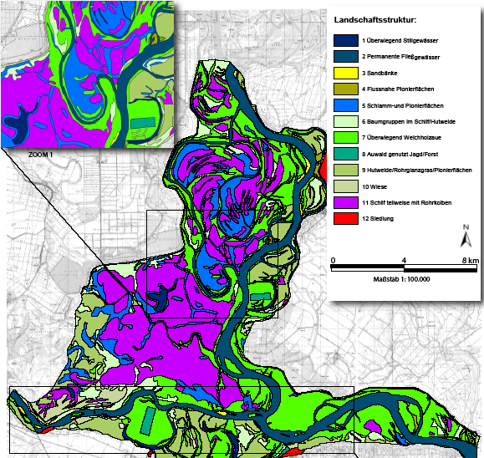

Slide 15
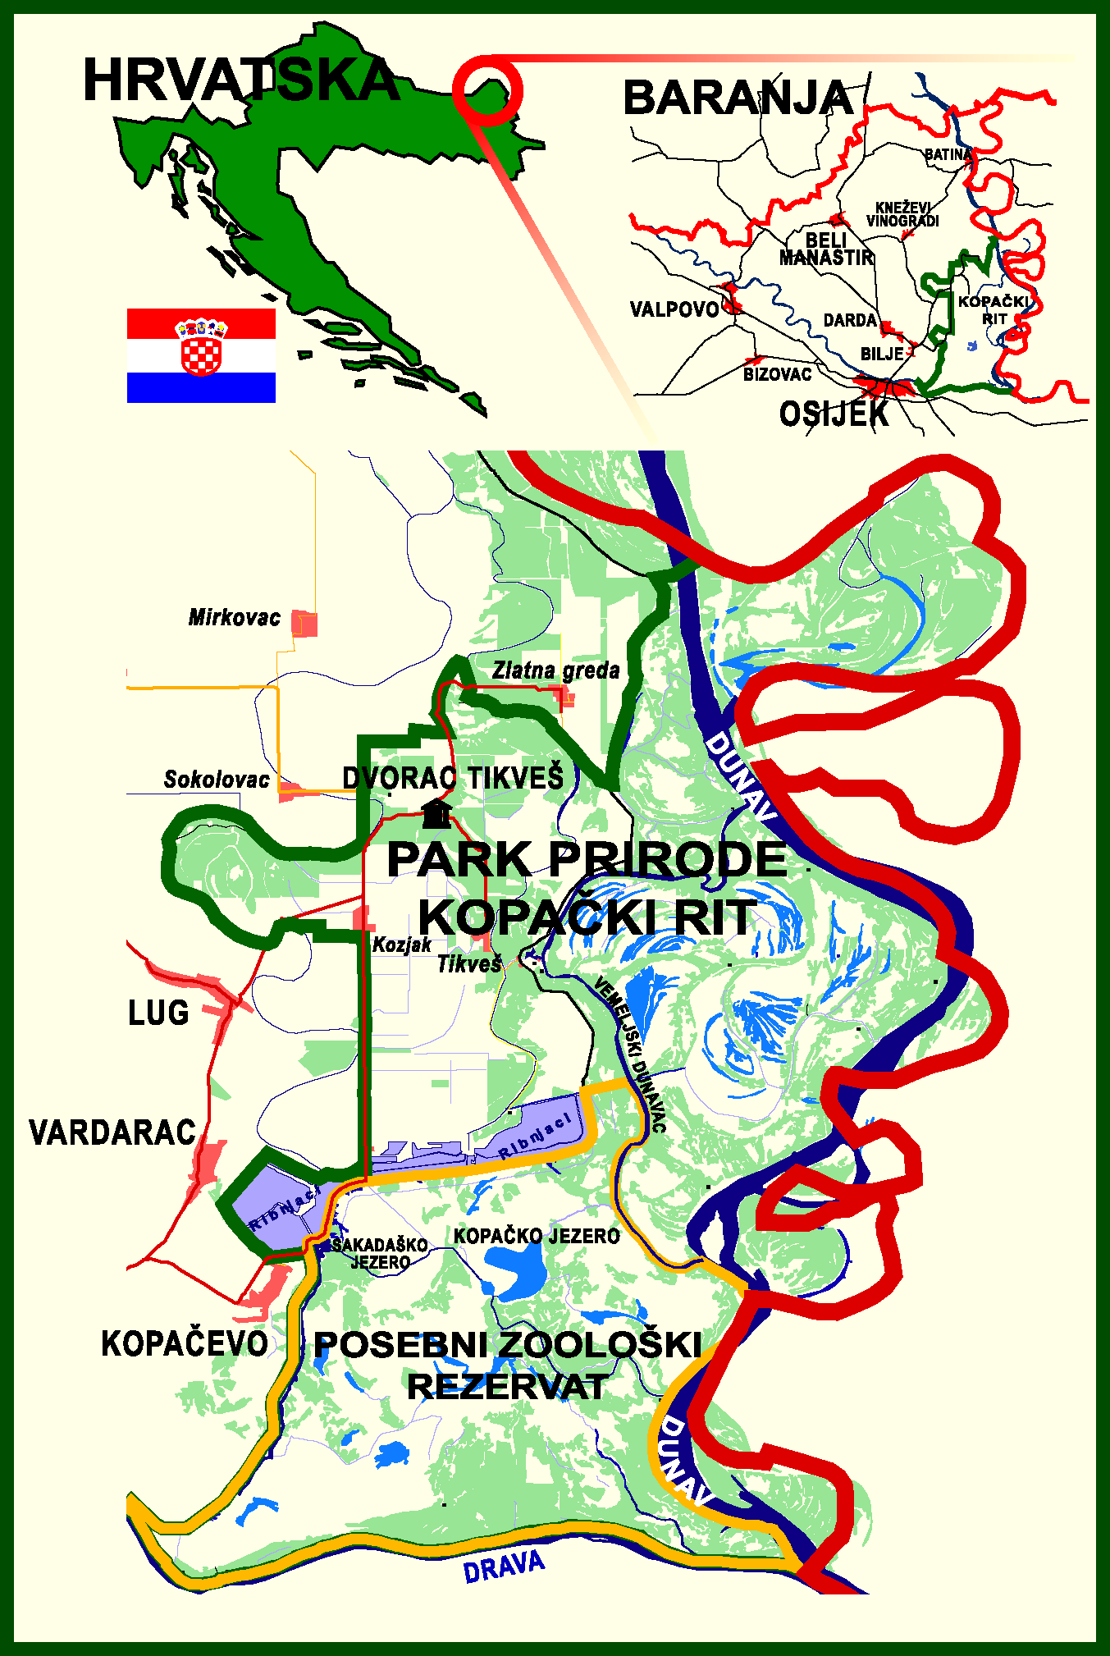
Protection efforts since late 1960-ties
Area protected in 1967 – two protection categories
Nature park and Special zoological reserve formally designated in 1974
Listed as IBA in 1986
Ramsar site in 1995
Nature park Management Office in 1997
Biosphere reserve in 2012
Natura 2000 sites in 2013

Slide 16
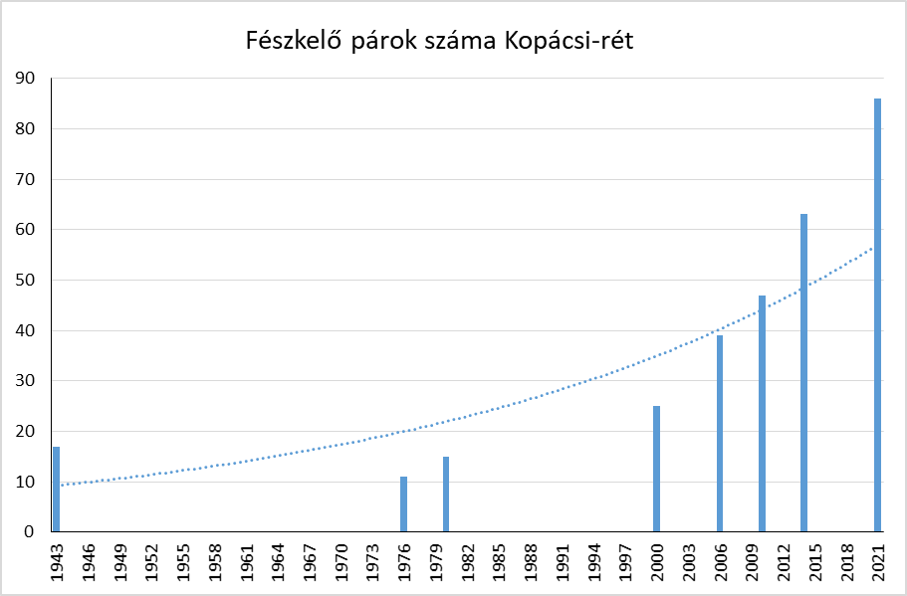
White-tailed Eagle breeding population in Kopački rit
Mikuska (1979) – 11 pairs
Mikuska & Mikuska (1981) – 15 pairs
Ham, Mikuska, Gec, Fištrović &Schneider (1988) – 20 + 3 potential pairs
Ham, Mikuska, Gec (1991, unpubl.) – 25 pairs + 7 potential pairs
Špoljarić (2001) – 25 pairs*
Mikuska & Mikuska (2006, unpubl.) -39 pairs
Radović & Mikuska (2009) – 42-45 pairs
Mikuska et al. (2023) – 86 pairs

Slide 17
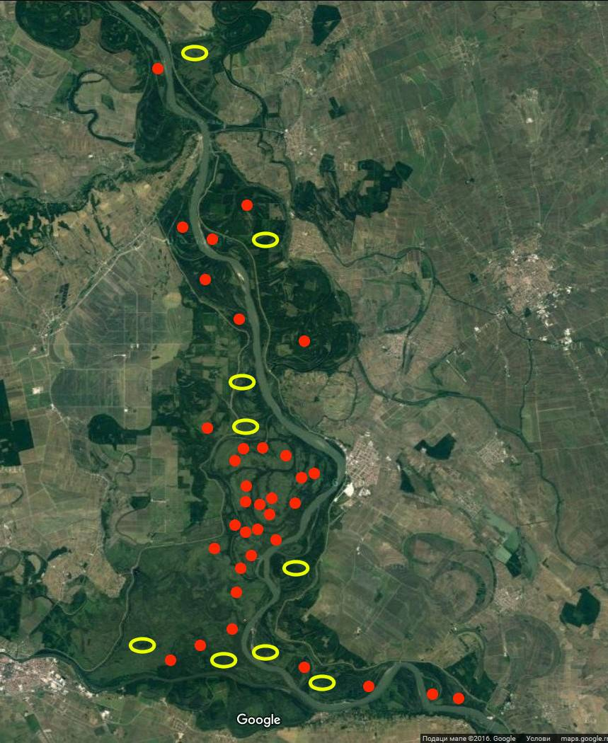
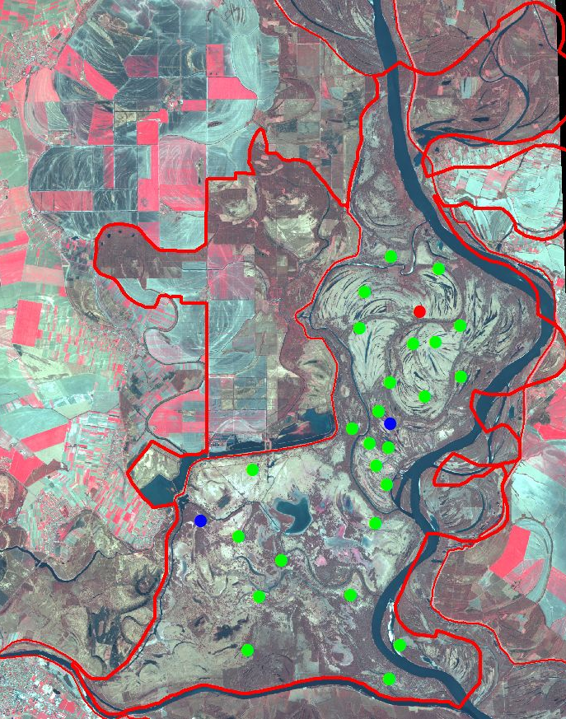
1943
1991
2000

Slide 18
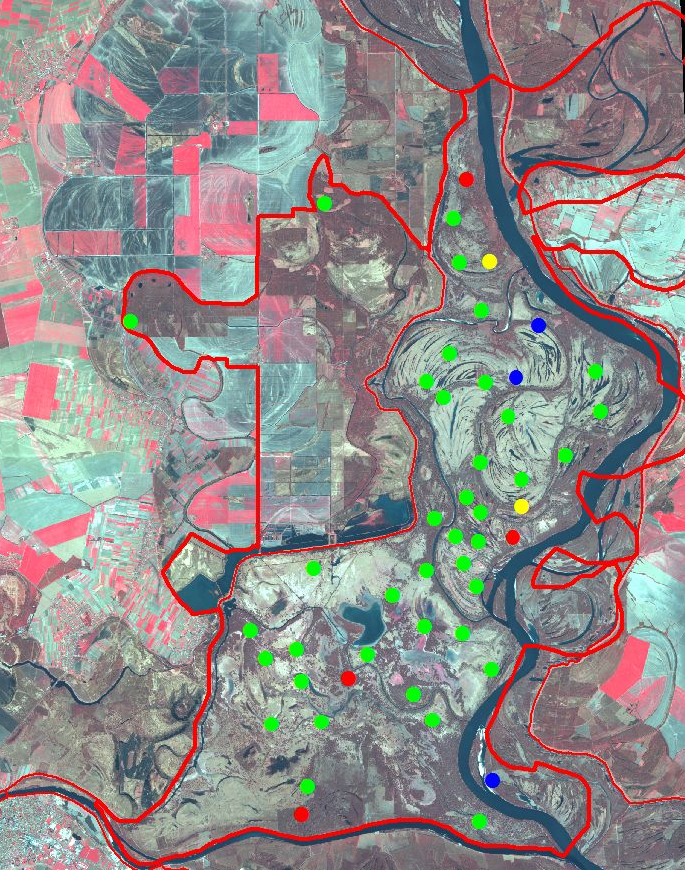
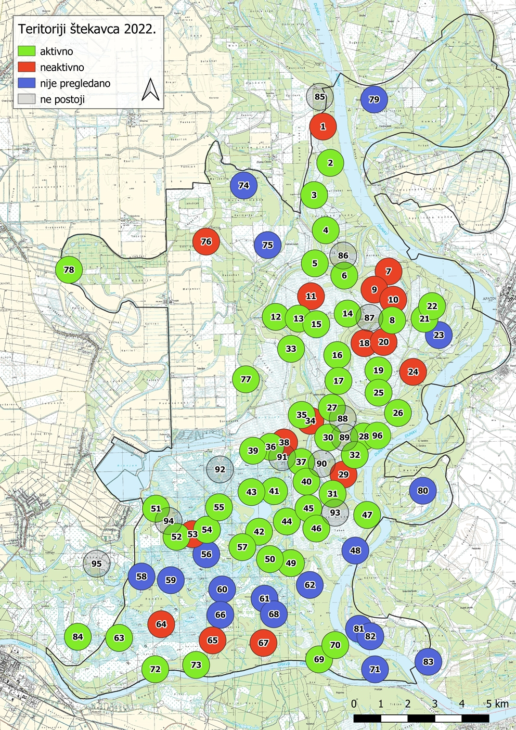
2006

Slide 19
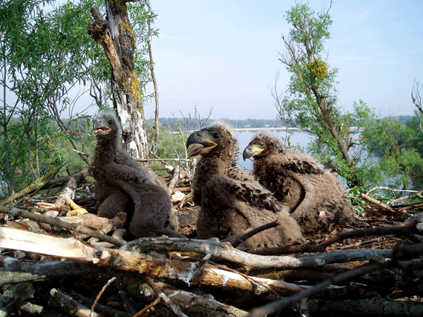
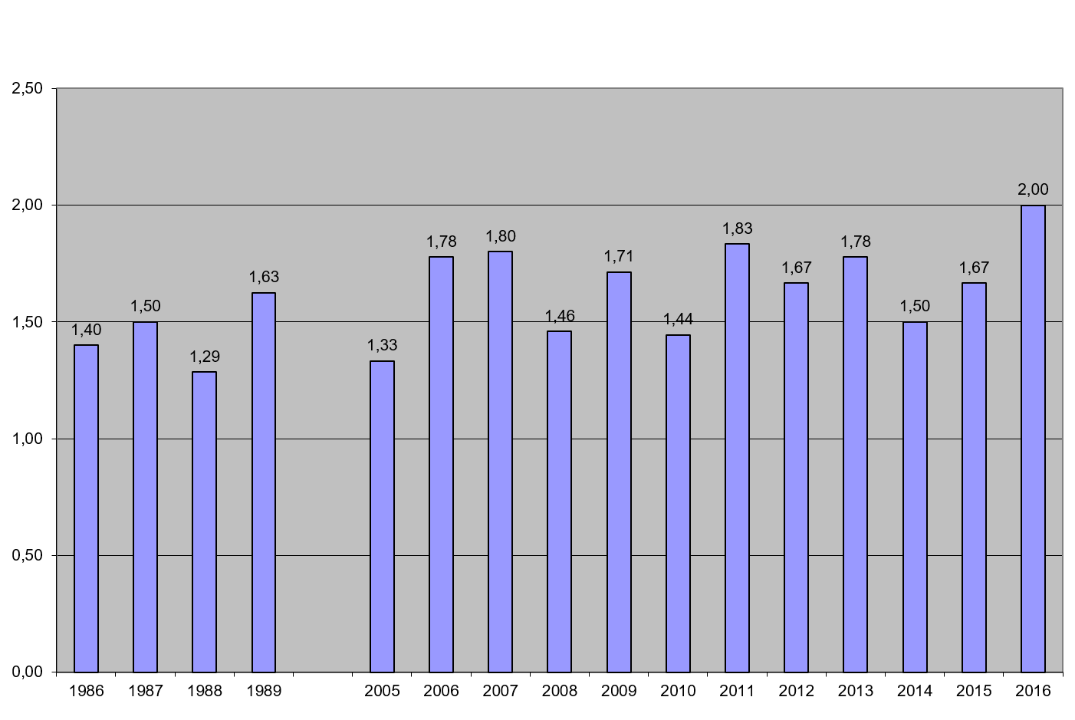
Increase of breeding success
1986-1989 – Ham,Mikuska, Gec, unpubl.
2005-2016 – Mikuska (2009)
Mikuska (2009) Denisia

Slide 20
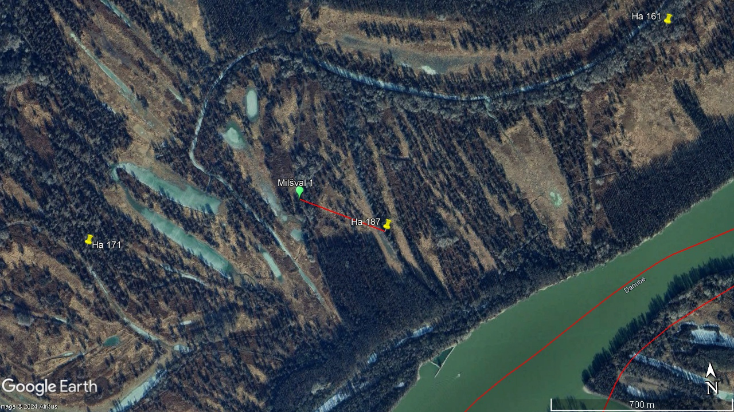
Increase of breeding density from 0,062 pairs/km² (1976.) to 0,412 pairs/km² (2021.) – 6,65 times higher
Decrease in breeding territory size from 1906 ha/pair to 242 ha/pair.
Decrease of minimal distance between two neighbouring pairs from 1100 m to 895 m (minimum 350 m)

Slide 21
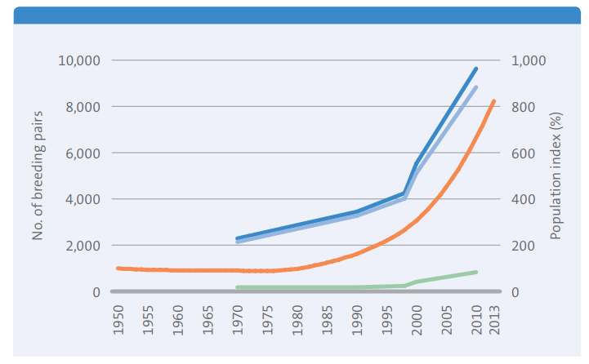
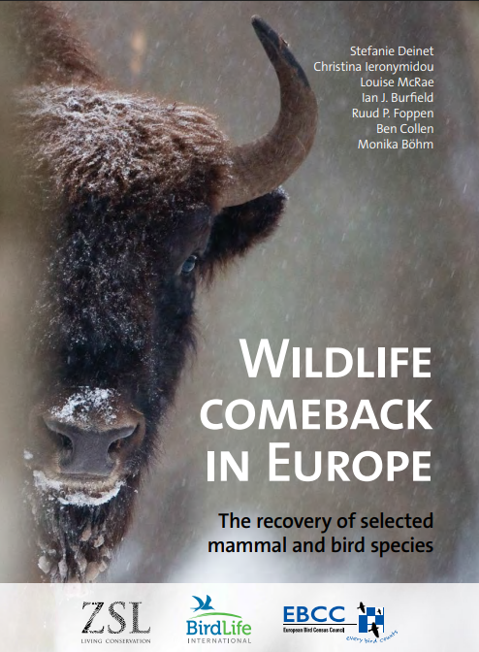
White-tailed Eagle recovery since 1970-ties
Global population – 34.600 individuals (2021)
European population – 12.500 pairs (2020)
Trend 1970-2018 - +445 %
Notes:
Report from 2013

Slide 22
Changes in the floodplain primary use in 21th century
Hunting banned in Special Zoological reserve in 1997
During the last war deer population reduced to ¼ of former numbers – natural forest succession commenced
Abandonment of fish production in the fishponds in 2008
Expansion of Jackal population in early 2000 – increase of poisoning cases with carbofuran
destruction of floodplain habitats continue
river regulation projects continue (on smaller scale but still important)
Intensive forestry and agricultural practises continue

Slide 23
What can we expect next – is the population safe?
Within the active floodplain – very few available areas on the south, formation of new territories upstream and downstream direction
Further colonisation of former floodplain – under the assumption that human disturbance / habitat destruction can be prevented

Slide 24
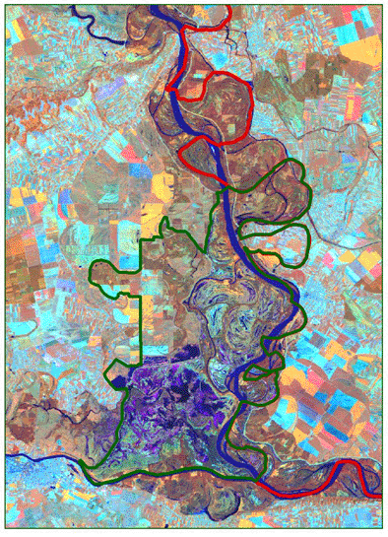
Looming threat – lack of proper floods
59 dams have been built along the Danube’s first 1,000 kilometres
Lack of sediment transport = river bed erosion, further increased by river channelisation for navigation purposes
In average years reservoirs control the river discharge = lack of floods = lack of food
Climate change – more rainfall in winter = winter floods; dry & hot summers = no floods for spawning of fish and other water dependent organisms

Slide 25
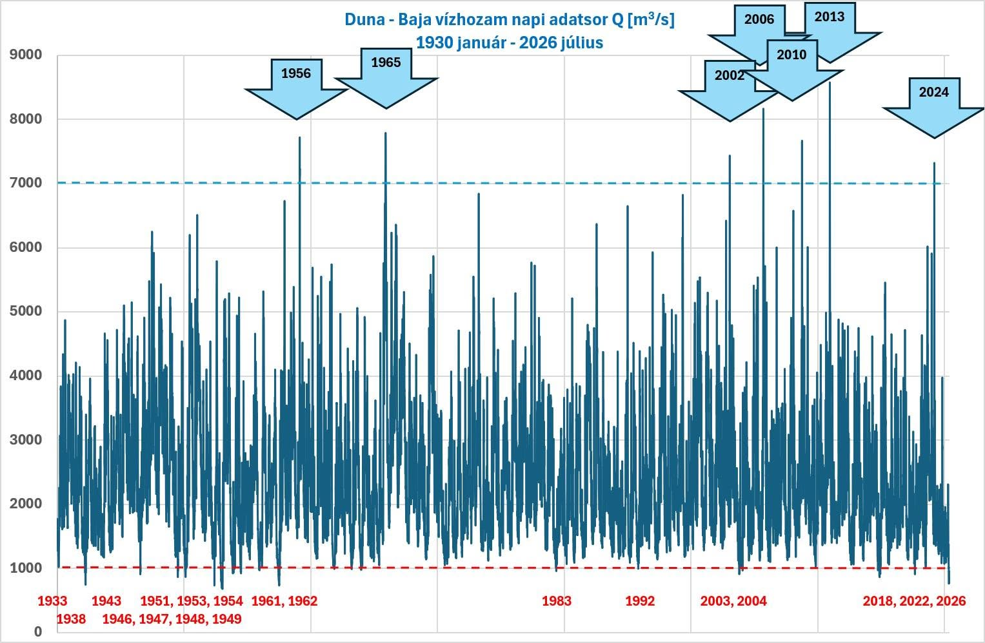

Slide 26
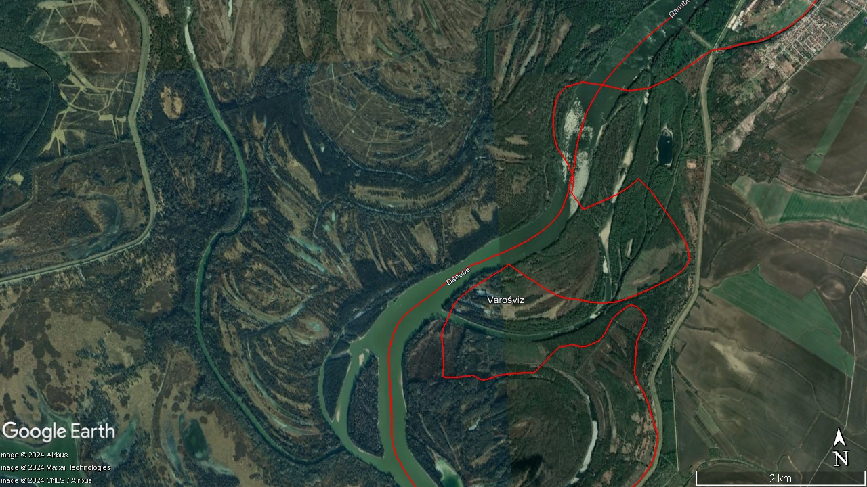
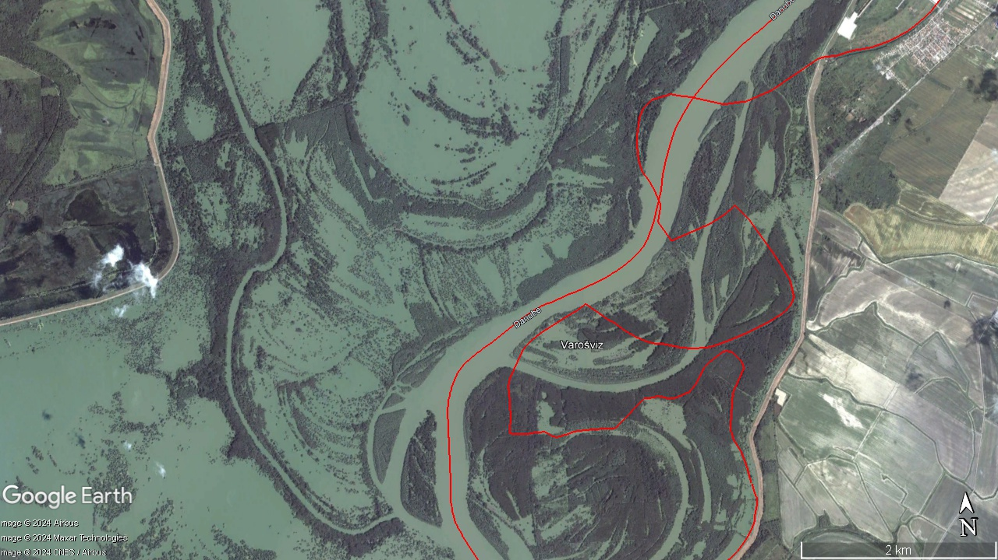

Slide 27
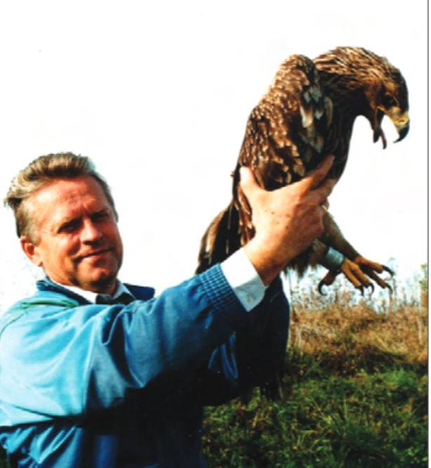
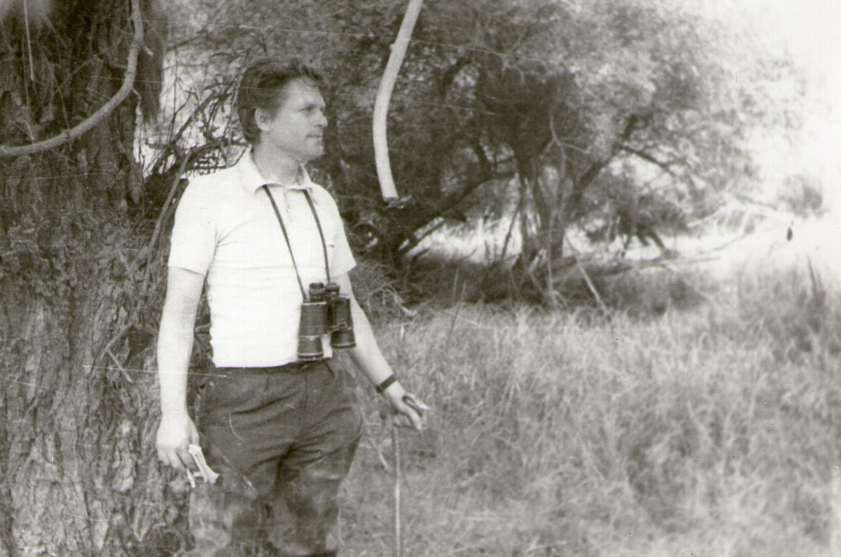
Prof. dr. József Mikuska (1943-2006)

Slide 28
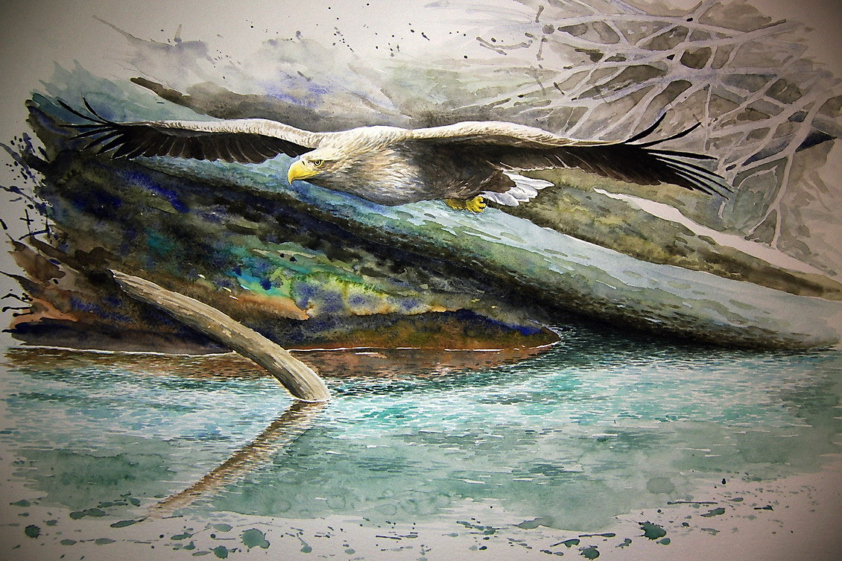
Thank you for your attention!

