Slide 1



Effects of Silver Nanoparticles and Silver Ions on Developmental and Morphological Abnormalities in Juvenile Guppies (Poecilia reticulata)
Kacper Kawalski¹, Maciej Kamaszewski¹, Jakub Martynow¹, Hubert Szudrowicz¹,
Dobrochna Adamek-Urbańska¹, Wiktoria Cieśla¹, Bogumił Łosiewicz^{1,2}
¹Warsaw University of Life Sciences, Faculty of Bioeconomy and Food Systems, Department of Animal Environment Biology, Ciszewskiego 8, 02-786 Warsaw, Poland
²The Kielanowski Institute of Animal Physiology and Nutrition, Polish Academy of Sciences, Department of Genetic Engineering, Instytucka 3, 05-110 Jabłonna, Poland

Slide 2
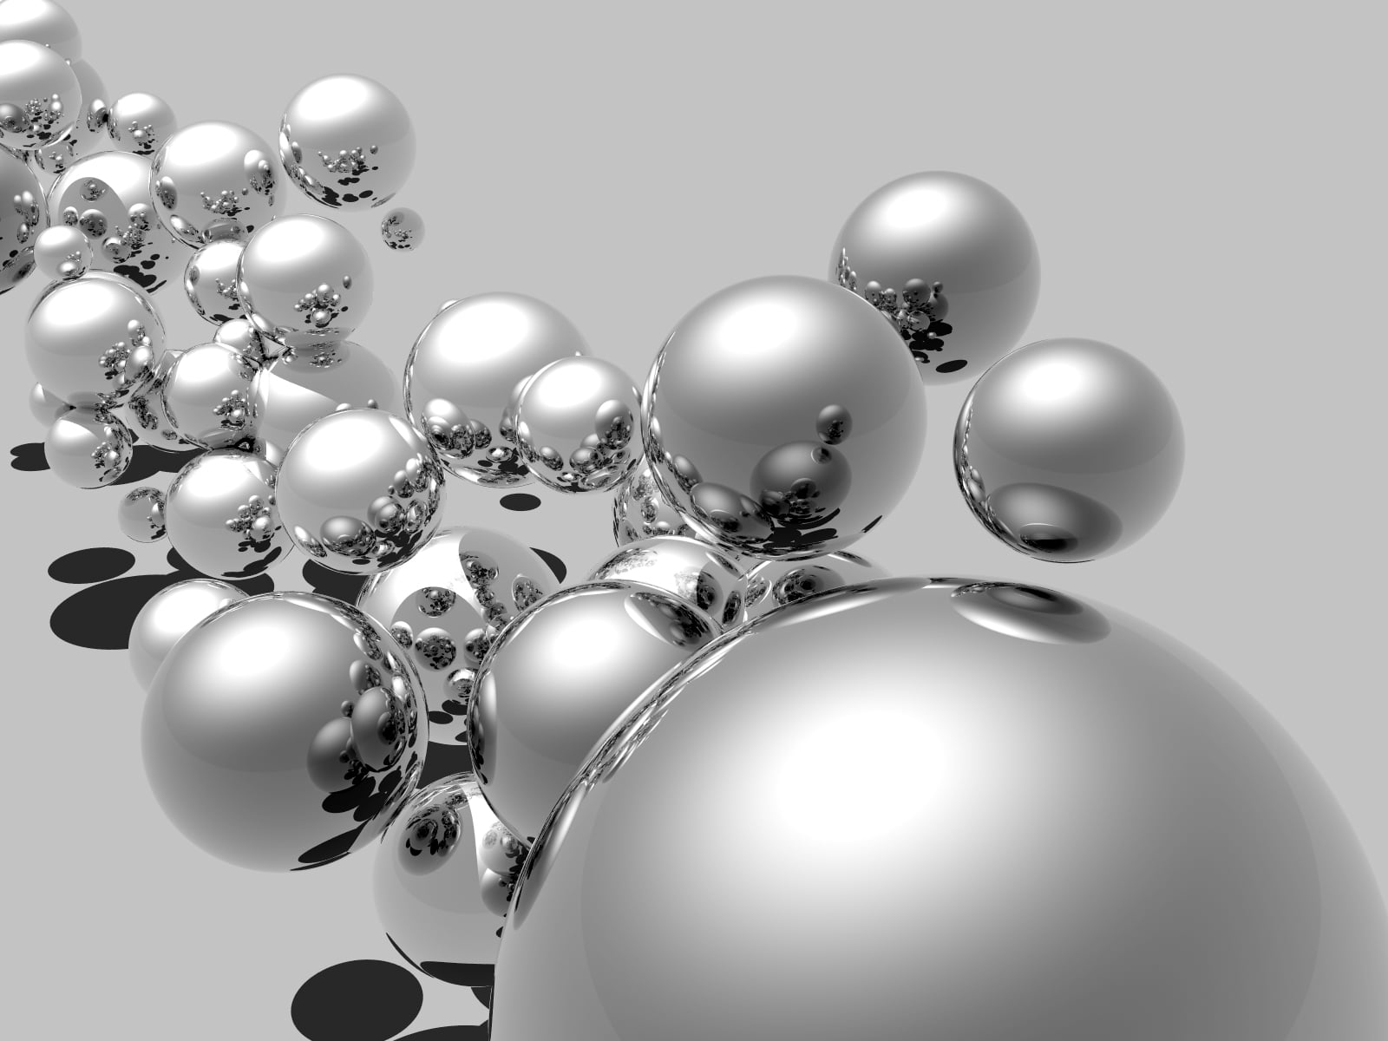
Silver nanoparticles – AgNPs
Used since the 20th century, and their use is steadily rising.
Used in production and medicine, known for cytotoxic and antimicrobial properties.
Found in wastewater and natural aquatic environments (Dumont et al. 2015).
May disturb growth, sexual maturation and damage digestive tract (Kamaszewski et al. 2023).
Thus, there is a growing need to study their effects on living models.
https://www.elgalabwater.com/blog/research-silver-nanoparticles

Slide 3
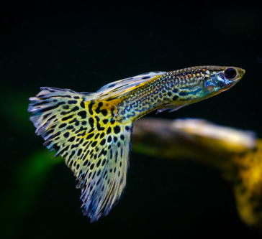
Animal model - guppy
Native to northern South America, but spread worldwide; invasive in some regions.
Easy to maintain in captivity.
A potential biomarker species.
Presence of X and Y sex chromosomes.
External sex traits are visible from about the 60th day of life (Kamaszewski et al. 2020).
Lecithotrophic, live-bearing (ovoviviparous) species. Few studies examine the effect of AgNPs on such animals.
https://www.inaturalist.org/photos/84707391?fbclid=IwZXh0bgNhZW0CMTAAAR2fZnHWcxmejGVxmRWnfeJx9KNQCGehOOxHe-s4MjsoiHTQ5s4e4TU2xkI_aem_AaBXEz8LAE2K2A1S_NlU7SlyvBsW78uUNWWE4BXy7CJBXo6HibXRGwlEwBhMB595FmBUS9bbmpflDbO0uuMq83pZ

Slide 4
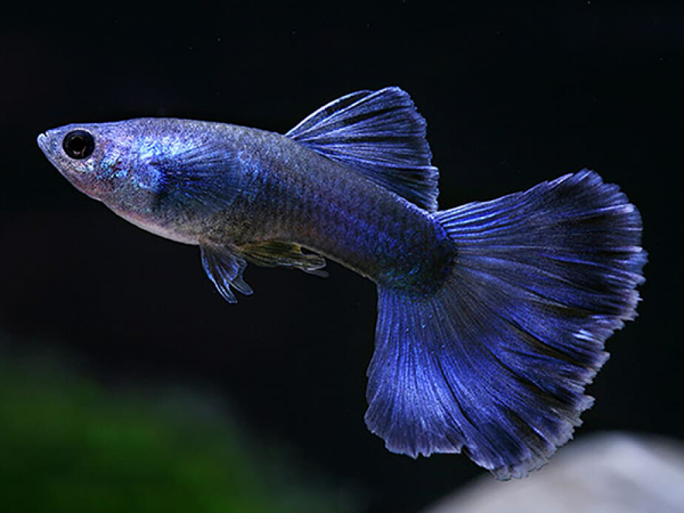
Aim of the study
To examine the impact of silver nanoparticles and ions on:
digestive tract
growth and development from the day of birth
development of sexual maturation
https://www.indiamart.com/proddetail/moscow-blue-guppy-fish-23254364591.html

Slide 5
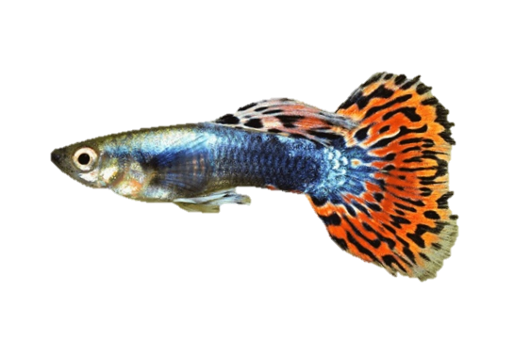

Methodology
Analysis of scans with focus on ovaries, liver and intestine
60 days
Scanning slides
Control
AgNPs 0.05ppm
AgNPs 1ppm
Body measurements
AgNPs 0.01ppm
AgNPs 0.1ppm
Ag+ 0.01ppm
H&E Staining
Fixation
6 μm
Paraffin embedding
Sectioning into slices

Slide 6
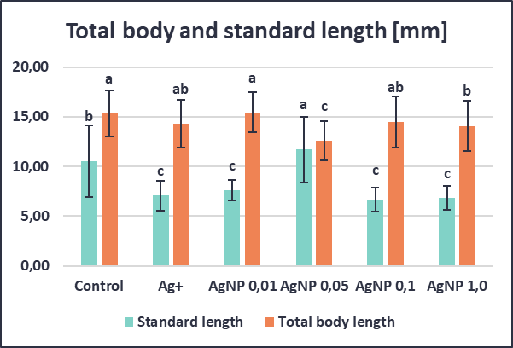
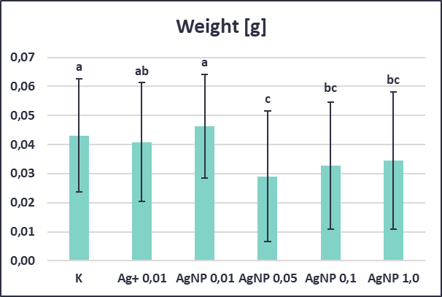
Body measurements and mortality rate
Mortality was higher in all treated groups than in the control, with the highest values in the Ag+ (39%) and AgNP 1 ppm (37%) groups.
AgNPs 0.05, 0.1 and 1 ppm groups were the lightest, with the lowest value of 0.029 (± 0.023) g in the AgNPs 0.05 group.
The AgNPs 0.05 group had the largest standard length (11.68 ± 3.31 mm) but the smallest total body length (12.59 ± 2.00 mm).
Almost all treated groups were lighter and/or shorter than the control.
A
B
C
The graphs present mortality rate [A] and fish body parameters [B–C]. X-axis shows experimental group. Letters a, b and c indicate homogeneous groups (Tukey's test, p<0.05, n=27–33). Bars show mean ± SD.

Slide 7
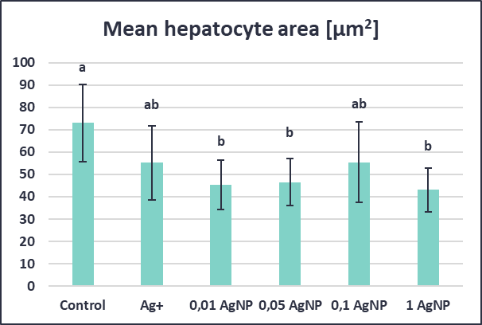
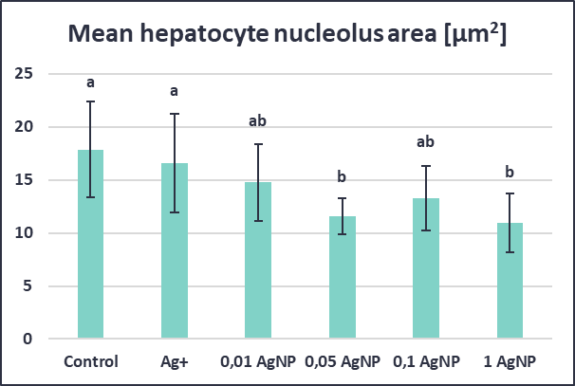
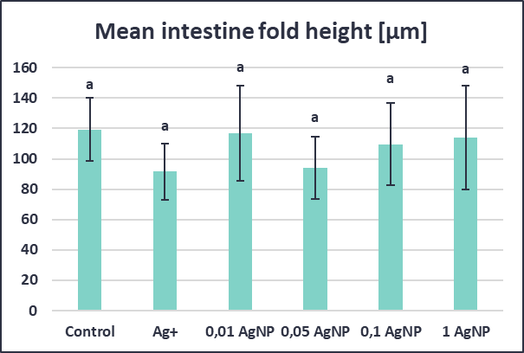
Measurements of digestive tract
Hepatocyte area was significantly smaller than in the control in the AgNP 0.01, 0.05 and 1 ppm groups (Ag+ and AgNP 0.1 ppm did not differ significantly).
Hepatocyte nucleolus area was significantly smaller than in the control in the AgNP 0.05 and 1 ppm groups.
Intestinal fold height did not differ significantly between groups (the highest mean value was in the control group).
A
B
The graphs present cell measurements [A-C]. X-axis shows experimental group. Letters a and b indicate belonging to homogeneous groups as determined by Tukey's test (p<0.05, n=8-14 for hepatocytes and n=9-17 for intestine). Bars show mean ± SD.
C

Slide 8
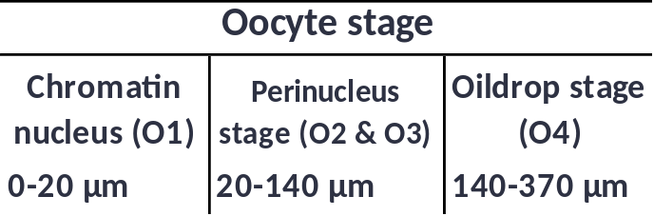
Sex distribution and ovary measurements
A
Sex was determined on the basis of external sex traits.
AgNPs and Ag+ delayed the appearance of external sex characteristics. The proportion of unidentified fish was highest in the AgNP 0.1 ppm group (79%), followed by AgNP 0.05 and 1 ppm (73% and 72%).
More females than males were identified in the Ag+, AgNP 0.05 and AgNP 1 ppm groups. In the AgNP 0.01 group the numbers were equal, and in the AgNP 0.1 group males prevailed.
In all exposed groups, O1 oocytes predominated over O2–O3 oocytes (83–100%).
Oocytes at stage O4 were observed only in the control group.
Table 1. Oocyte development stages (modified Lambert 1970).
B
The graphs present sex distribution [A] and oocyte size distribution [B]. Y-axis shows experimental group.

Slide 9
Summary
Silver nanoparticles delayed sexual maturation and may impair growth.
AgNPs may exert hepatotoxic effects (reduced hepatocyte size).
The effect of AgNPs on the intestine cannot be clearly determined from the obtained results.
The lack of a clear concentration – response relationship may be explained by aggregation of nanoparticles at higher concentrations.
Individual differences in resistance to AgNPs may also contribute.

Slide 10
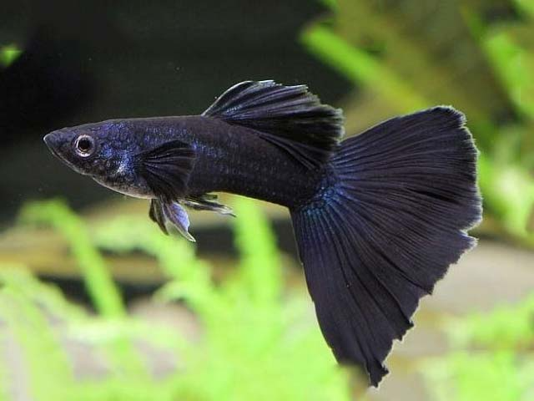
Thank you for your attention!
Bibliography:
Dumont, E., Johnson, A. C., Keller, V. D., & Williams, R. J. (2015). Nano silver and nano zinc-oxide in surface waters–Exposure estimation for Europe at high spatial and temporal resolution. Environmental pollution, 196, 341-349.
Kamaszewski, M., Kawalski, K., Wiechetek, W., Szudrowicz, H., Martynow, J., Adamek-Urbańska, D., ... & Aksakal, E. (2023). The Effect of Silver Nanoparticles on the Digestive System, Gonad Morphology, and Physiology of Butterfly Splitfin (Ameca splendens). International Journal of Molecular Sciences, 24(19), 14598.
Kamaszewski, M., Skrobisz, M., Wójcik, M., Kawalski, K., Szczepański, A., Bujarski, P., ... & Martynow, J. (2020). The role of transcription factors in gonad development and sex differentiation of a teleost model Fish—Guppy (Poecilia reticulata). Animals, 10(12), 2401.
Lambert, J. G. D. (1970). The ovary of the guppy Poecilia reticulata: the granulosa cells as sites of steroid biosynthesis. General and Comparative endocrinology, 15(3), 464-476.
https://fish-guppy.com/different-types-of-guppy-fish-guppies-with-pictures/

