Slide 1


Gajna as an Example of Sustainable Floodplain Pasture Management
15th International Symposium “Kopački rit: Yesterday, Today, Tomorrow 2026”
Osijek, 1–2 October 2026
Traditional Grazing, Native Breeds and Biodiversity
Zoran Komesarović, mag. prim. educ.
Faculty of Education, Osijek

Slide 2
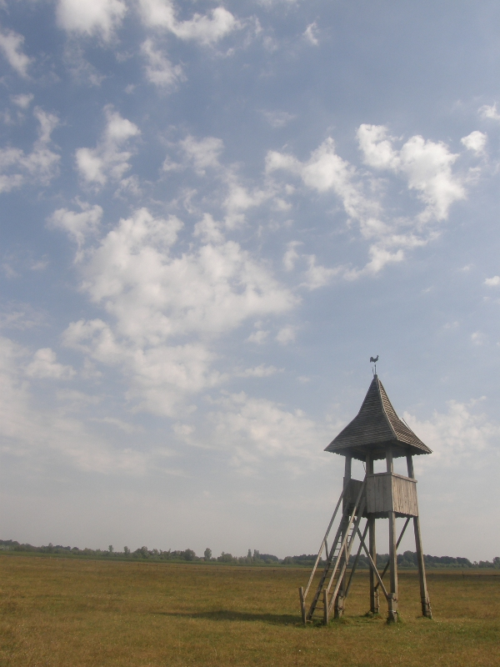
The aim
to present Gajna as an example of an area in which environmental protection, biodiversity conservation and the sustainable use of natural resources are linked through traditional grazing, water management and the maintenance of open habitats
based on available scientific sources and official documents of the Ministry of Environmental Protection and Green Transition

Slide 3
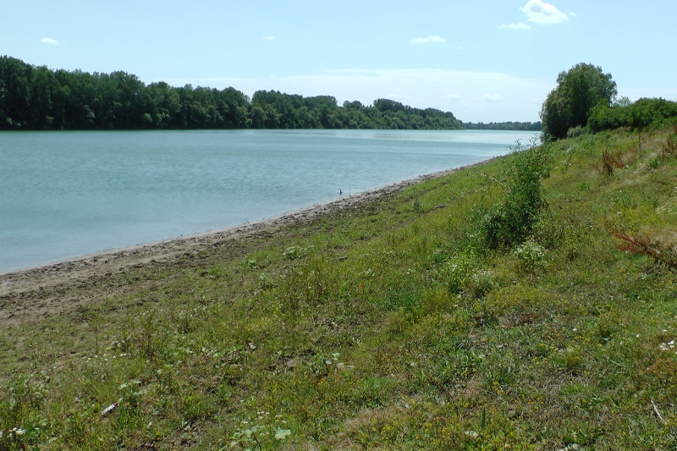
Gajna - A Significant Landscape
designated as a protected Significant Landscape by the Decision of the Assembly of the Municipality of Slavonski Brod in 1990
According to the Nature Protection Act, a Significant Landscape is defined as “a natural or cultivated area of high landscape value and biodiversity and/or geodiversity, or a landscape with preserved unique features characteristic of a particular area.”

Slide 4
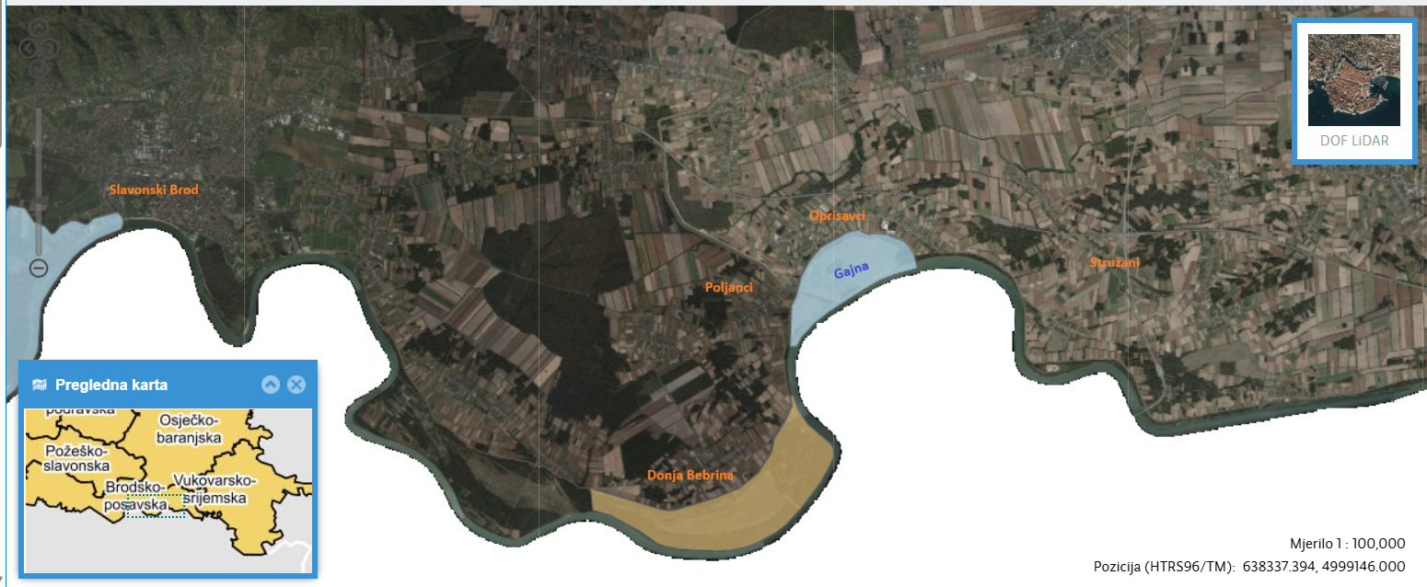
LOCATION
semi-natural floodplain pasture along the Sava River
399.89 ha as a Significant Landscape; 425.70 ha as the wider Natura 2000 site
Brod–Posavina County, near the villages of Oprisavci and Poljanci

Slide 5
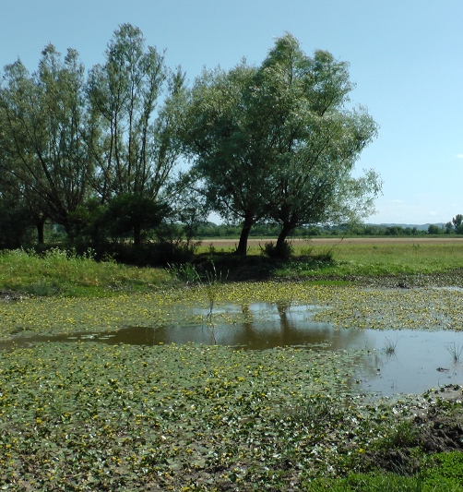
Part of the Natura 2000 ecological network
To support the protection and management of Gajna (and other protected areas in the region), the PU 021 Management Plan was adopted to conserve and promote:
  floodplain pastures
  aquatic and grassland habitats
  target species of the ecological network
  sustainable land use
Source: PU 021 Management Plan, 2024–2033.
Photo source: Natura Slavonica, Significant Landscape Gajna, accessed 27 September 2026.

Slide 6
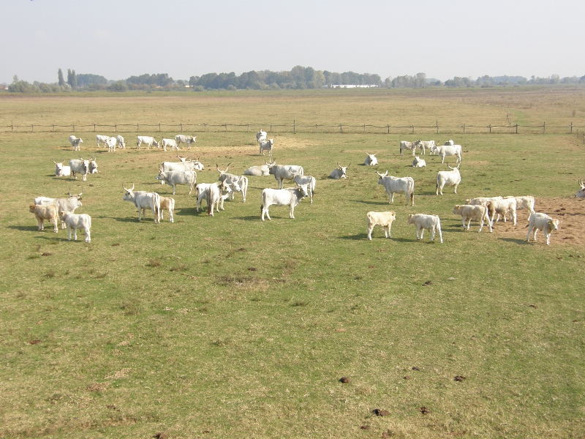
Floodplain pasture
typical Slavonian floodplain pasture shaped by the Sava River
open wet grassland (as the dominant land type) with marsh flora and fauna
old river arms, ponds and alluvial depressions
seasonal water retention after winter, spring and autumn floods
water regulation through the lateral canal during dry periods
habitat maintained through active management, especially grazing and mowing
sensitive to abandonment, succession and invasive plant spread
Source: PU 021 Management Plan, 2024–2033; Antunović et al., 2021; Mandir & Tomičić, 2022; Zingstra et al., 2009.
Photo source: Natura Slavonica, Significant Landscape Gajna, accessed 27 September 2026.

Slide 7
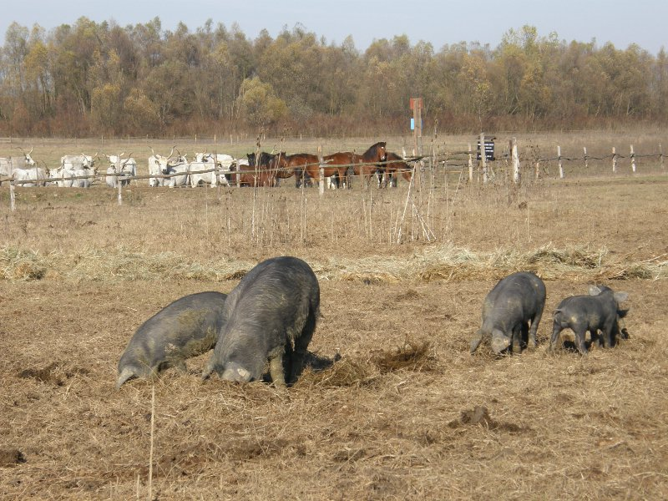
traditional grazing and the autochthonous Croatian breeds
Traditional grazing in Gajna
  a form of land use,
  an important management practice for maintaining landscape
  example of linking nature conservation with traditional rural practices
Regular grazing, meadow mowing and occasional water regulation help maintain biodiversity, prevent natural succession and limit the spread of alien and invasive plant species
The presence of native Croatian breeds connects the ecological value of Gajna with the cultural and agricultural heritage of the Sava floodplain
  the Black Slavonian pig, Turopolje pig, Posavina horse, Cigaja sheep and Croatian Sheepdog
Source: PU 021 Management Plan, 2024–2033; Rules of Internal Order in Gajna Significant Landscape, 2011; National Programme for the Conservation of Native and Protected Breeds, 2010.
Photo source: Natura Slavonica, Significant Landscape Gajna, accessed 27 September 2026.

Slide 8
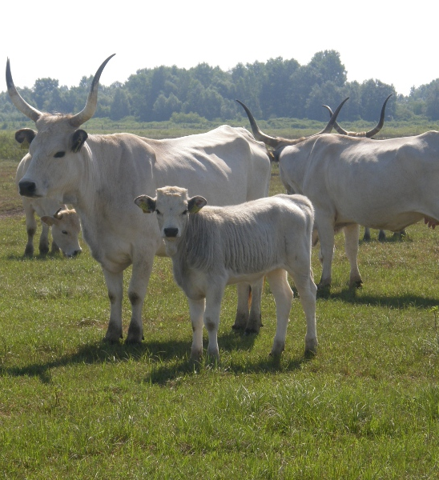
Slavonian-Syrmian Podolian cattle
The Slavonian-Syrmian Podolian cattle
  an old native cattle breed strongly connected with the lowland landscapes of Slavonia, Syrmia and Baranja
  modest nutritional requirements, resilience and adaptability,
  suitable for extensive grazing in open floodplain pastures.
Their grazing helps prevent the overgrowth of pastures by shrubs and supports the preservation of open floodplain habitats.
Responsible for conserving endangered habitats and species in protected floodplain areas such as Gajna.
  linked with the control of invasive false indigo bush (Amorpha fruticosa) and the recovery of native pasture flora.
Source: Gavran et al., 2022; Mijić et al., 2015; Antunović et al., 2021; PU 021 Management Plan, 2024–2033.
Photo source: Natura Slavonica, Significant Landscape Gajna, accessed 27 September 2026.

Slide 9
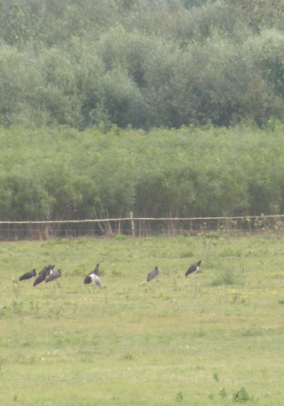
Gajna as a mosaic of habitats
Wet grasslands, old river arms, ponds and alluvial depressions
As part of the Natura 2000 ecological network, Gajna includes target habitat types linked to amphibious vegetation and natural eutrophic waters.
The area is especially valuable because of seasonal flooding and water retention
Ornithological research recorded 117 bird species on Gajna pasture during monthly field visits in 2021
  Of these, 25 are included in the Croatian Red List of Birds, including critically endangered, endangered and vulnerable species
Source: PU 021 Management Plan, 2024–2033; Mandir & Tomičić, 2022.
Photo source: Natura Slavonica, Significant Landscape Gajna, accessed 27 September 2026.

Slide 10
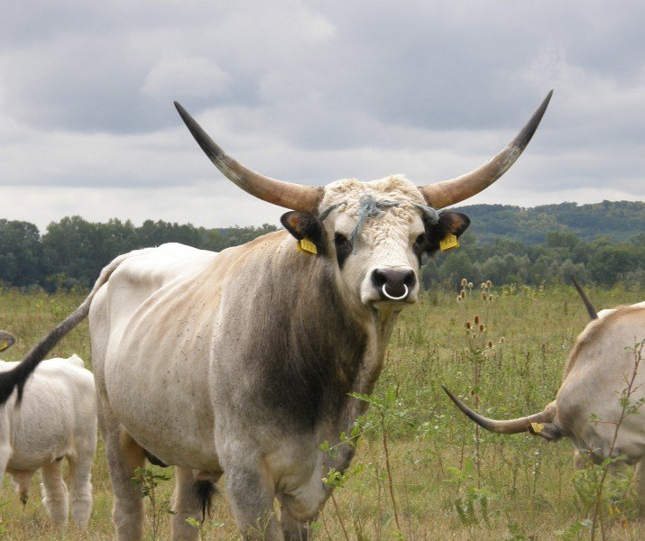
conclusion
Gajna shows how nature conservation and traditional land use can support each other
Flood dynamics, grazing, mowing and water management help maintain open habitats
Native Croatian breeds are part of both biodiversity conservation and rural heritage
The future of Gajna depends on active management, local cooperation and continuous habitat maintenance
Photo source: Natura Slavonica, Significant Landscape Gajna, accessed 27 September 2026.

Slide 11
references
Antunović, S., Živković, J., Božić-Ostojić, Lj., Štefanić, E., Mirosavljević, K., Benković, R., & Čuljak, A. (2021). Invazivne biljne vrste na području značajnog krajobraza Gajna [Invasive plant species in the area of the Significant Landscape Gajna]. Agronomski glasnik, 83(4), 203–218. https://doi.org/10.33128/ag.83.4.4
Gavran, M., Turalija, A., & Gantner, V. (2022). Potencijal slavonsko-srijemskog podolca za uzgoj u Slavoniji i Baranji [Breeding potential of Slavonian-Syrmian Podolian cattle in Slavonia and Baranja]. Radovi Zavoda za znanstveni i umjetnički rad u Požegi, 11, 97–106. https://doi.org/10.21857/ydkx2co6e9
Javna ustanova Natura Slavonica. (n.d.). Značajni krajobraz Gajna. Retrieved September 27, 2026, from https://natura-slavonica.hr/znacajni-krajobraz-gajna/
Javna ustanova za upravljanje zaštićenim dijelovima prirode Brodsko-posavske županije – Natura Slavonica. (2023). Plan upravljanja područjima ekološke mreže Gajna, Dvorina, Jelas polje s ribnjacima i Jelas polje te posebnim rezervatima Bara Dvorina i Jelas ribnjaci (dio) i značajnim krajobrazima Gajna i Jelas polje (PU 021), 2024.–2033. Slavonski Brod.
Javna ustanova za upravljanje zaštićenim prirodnim vrijednostima Brodsko-posavske županije. (2011). Pravilnik o unutarnjem redu u Značajnom krajobrazu Gajna. Službeni vjesnik Brodsko-posavske županije, 2/2011.
Mandir, T., & Tomičić, D. (2022). The comparison of the ornithofauna of Bara Dvorina and Gajna – the Sava River floodplains in eastern Croatia. Larus, 57, 61–84. https://doi.org/10.21857/yvjrdcv71y
Mijić, P., Pavičić, M., Beneš, I., Ivkić, Z., Burazović, Ž., Vučković, G., & Špehar, M. (2015). Breeding of Slavonian-Syrmian Podolian on Gajna grassland and its role in preservation of tradition and biodiversity. In 26th International DAGENE Symposium 2015: Proceedings (pp. 93–100).
Ministarstvo poljoprivrede, ribarstva i ruralnog razvoja. (2010). Nacionalni program očuvanja izvornih i zaštićenih pasmina domaćih životinja u Republici Hrvatskoj.
Zavod za zaštitu okoliša i prirode. (n.d.). Bioportal – Informacijski sustav zaštite prirode. Ministarstvo zaštite okoliša i zelene tranzicije. Retrieved September 27, 2026, from https://bioportal.hr/
Zingstra, H., Kis, A., Ribaric, A., Bakovic, D., Ilijas, I., Jeremic, J., Galambos, L., Szabados, K., Vukelic, M., & Predic, T. (2009). The relevance of farming and farmland for maintaining the landscape and biodiversity of the Sava floodplains: Final report of Task C of the Life 3rd countries project Protection of Biodiversity of the Sava River Basin Floodplains. Wageningen International.

Slide 12
Thank you for your attention!

