Slide 1




OCCURRENCE OF AFRICAN SWINE FEVER
IN WILD BOAR IN KOPAČKI RIT NATURE PARK
Tihomir Florijančić¹, Ivo Bašić², Vlatko Rožac²
¹ Josip Juraj Strossmayer University of Osijek, Faculty of Agrobiotechnical Sciencse Osijek, Vladimira Preloga 1, Osijek, Croatia
² Public Institution “Nature Park Kopački rit“, Mali Sakadaš 1, Kopačevo – Bilje

Slide 2
AFRICAN SWINE FEVER (ASF)
a contagious viral disease affecting domestic and wild pigs
manifests as hemorrhagic fever
(very similar to classical swine fever)
mortality rate of up to 100%
disease that affects pigs of all age groups
no risk to humans or other animals
notifiable disease
listed by the World Organisation for Animal Health (WOAH, formerly OIE)
potential to spread very rapidly across national borders

Slide 3
has serious socioeconomic and public health consequences
is of major importance for the international trade in animals and products of animal origin
has caused economic losses of several billion euros in Europe to date
is controlled in domestic pig holdings by culling pigs on infected premises
requires strict control measures within 3 km and 10 km zones
(including a movement ban lasting at least 45 days)
is very difficult to eradicate in wild boar populations
no vaccine is currently available

Slide 4

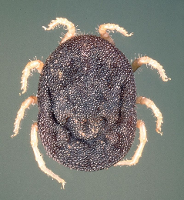
AFRICAN SWINE FEVER (ASF)
CAUSATIVE AGENT
enveloped DNA virus belonging to the genus Asfivirus within the family Asfarviridae
DNA arbovirus capable of infecting both invertebrates (ticks of the genus Ornithodoros) and vertebrates (family Suidae)

Slide 5
CAUSATIVE AGENT
the virus is shed through saliva, ocular and nasal discharge, urine, feces, and reproductive tract secretions
blood contains high concentrations of the virus
in the external environment, the virus can survive for prolonged periods when present in protein-rich materials such as meat, blood, feces, and bone marrow

Slide 6
TRANSMISSION
pigs become infected through contact with infected pigs
contaminated feed, water, and bedding
the virus can be spread over long distances by vehicles and people
pigs can become infected through indirect contact via fomites
mechanical transmission can occur via insects, rats, and humans (e.g. through non-sterile veterinary instruments)
virus transmission via aerosols has been reported only among pigs in close contact

Slide 7
TRANSMISSION
The occurrence of ASF in pig farms is usually associated with:
contact between domestic and wild pigs
the introduction of new pigs into the farm
feeding pigs with contaminated swill that has not been adequately heat-treated
the movement of vehicles and people

Slide 8
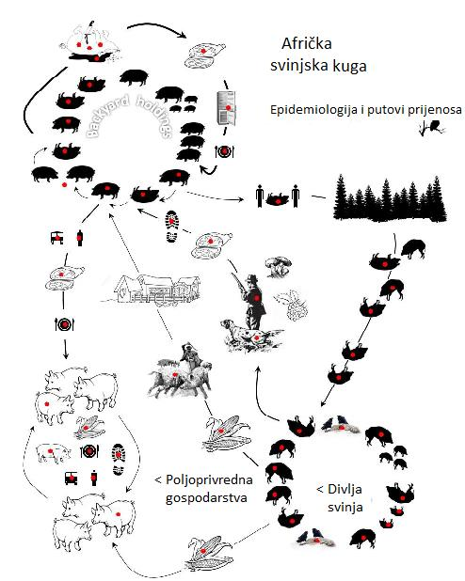
A group of epidemiological factors and transmission routes involved in maintaining the endemicity and geographical spread of ASF virus in Eastern Europe
AFRICAN SWINE FEVER
Epidemiology and Transmission
Agricultural holding
Wild boar
Source: http://www.veterinarstvo.hr/UserDocsImages/ASK/Priru%C4%8Dnik%20ASK.pdf

Slide 9
MAIN CLINICAL SIGNS
an incubation period of 5–15 days
a rapid disease course, with death occurring only a few days after the onset of clinical signs
an elevated body temperature (above 40–42°C)
clustering together
loss of appetite
incoordination
lethargy, depression, and recumbency
nasal and ocular discharge
bleeding from body orifices
hemorrhages of the skin (ears and extremities) and mucous membranes
vomiting and bloody diarrhea
abortion

Slide 10
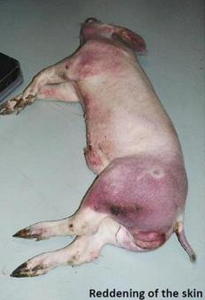
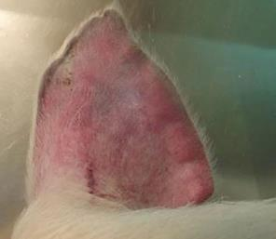
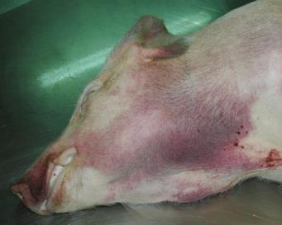
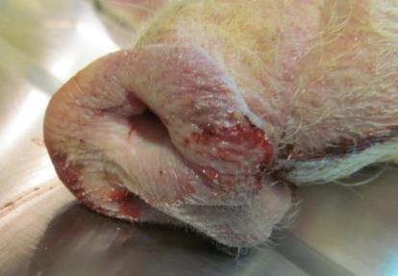
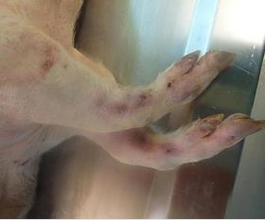
Clinical signs
Izvor: https://www.hpa.hr/wp-content/uploads/2018/10/africka-svinjska-kuga.pdf

Slide 11
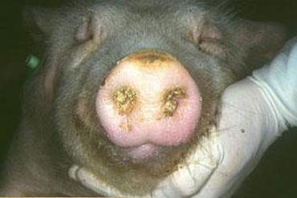
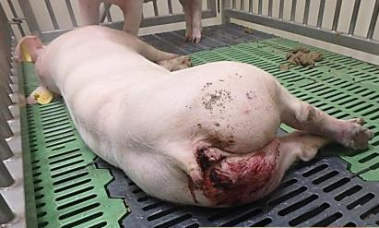
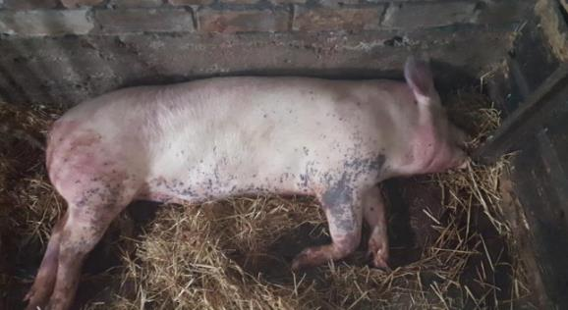
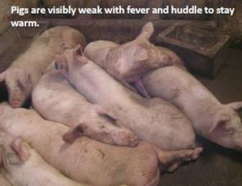
Izvor: https://ec.europa.eu/food/sites/food/files/animals/docs/ad_cm_asf_btsf-asf_20181106_pres-01.pdf

Slide 12
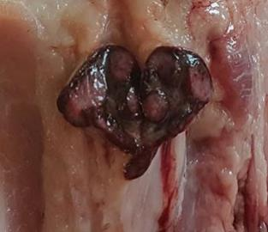
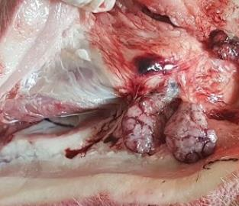
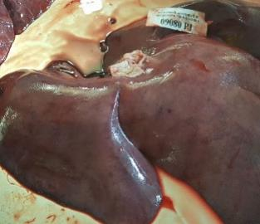
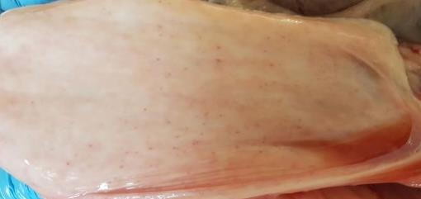
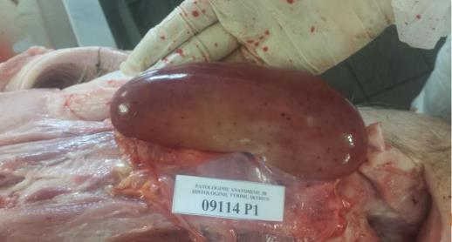
Promjene post mortem
Izvor: https://ec.europa.eu/food/sites/food/files/animals/docs/ad_cm_asf_btsf-asf_20181106_pres-01.pdf

Slide 13

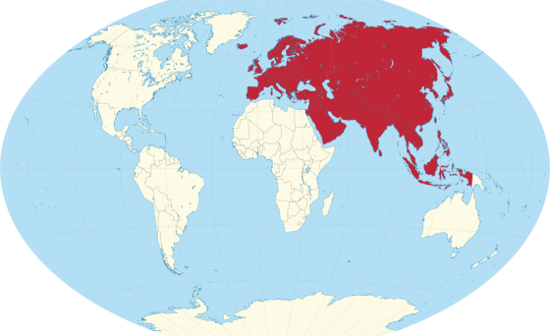
DISTRIBUTION IN AFRICA
The first epizootic occurred in 1907, but the disease was first described in Kenya in 1921
DISTRIBUTION IN EURASIA
the first spread of the disease outside Africa occurred in Europe (Portugal) in 1957 (the disease remained endemic on the Iberian Peninsula until the mid-1990s)
ASF outbreaks were reported and eradicated in several European countries during the 20th century, including Malta (1978), Italy (1967, 1980), France (1964, 1967, 1977), Belgium (1985), and the Netherlands (1986), with the exception of Sardinia, where the disease has persisted since 1978
the second transcontinental introduction from Africa was reported in Georgia (Caucasus) in 2007, after which the disease spread to Armenia, Azerbaijan, Iran, Russia, and Belarus

Slide 14
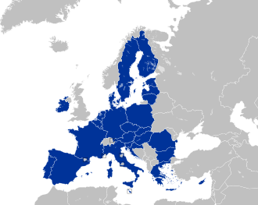
DISTRIBUTION IN THE EU
ASF was confirmed in the European Union (EU) in 2014, in Lithuania, Latvia, Estonia, Poland, the Czech Republic, Romania, and Bulgaria, followed by Belgium
in July 2017, ASF was confirmed in wild boar in the Czech Republic, followed by cases in non-commercial backyard domestic pig holdings in Romania, close to the border with Hungary
in the Czech Republic, the implementation of strict measures targeting wild boar in the infected and at-risk areas prevented the spread of ASF to domestic pig holdings
in Romania, new outbreaks were confirmed in domestic pigs in early 2018, particularly in holdings with inadequate biosecurity measures
in 2023, the Animal Disease Information System (ADIS) recorded 4,513 ASF cases in domestic pigs across 16 countries and 7,903 cases in wild boar across 20 countries in the EU

Slide 15

DISTRIBUTION IN CROATIA
the first cases in Croatia were confirmed on 26 June 2023 in domestic pigs from two holdings in the area of Posavski Podgajci, Vukovar-Srijem County (two small holdings where pigs were kept outdoors)
the first case of ASF in wild boar was confirmed on 5 July 2023 in the same county
according to ADIS data, by the end of 2023, ASF had been confirmed in 1,124 domestic pigs in Croatia
(25% of all positive cases reported in domestic pigs across the 16 countries registered in ADIS) and in 11 wild boar
(0.14% of all positive cases reported in wild boar across the 20 countries registered in ADIS)
the last ASF case in 2023 was recorded in domestic pigs on 4 December and in wild boar on 22 December

Slide 16
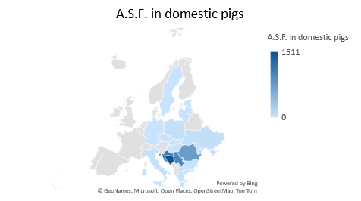
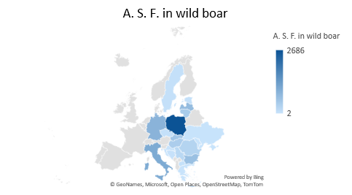
2023
Izvor: https://webgate.ec.europa.eu/tracesnt/adis/public/notification/outbreaks-weekly-report

Slide 17
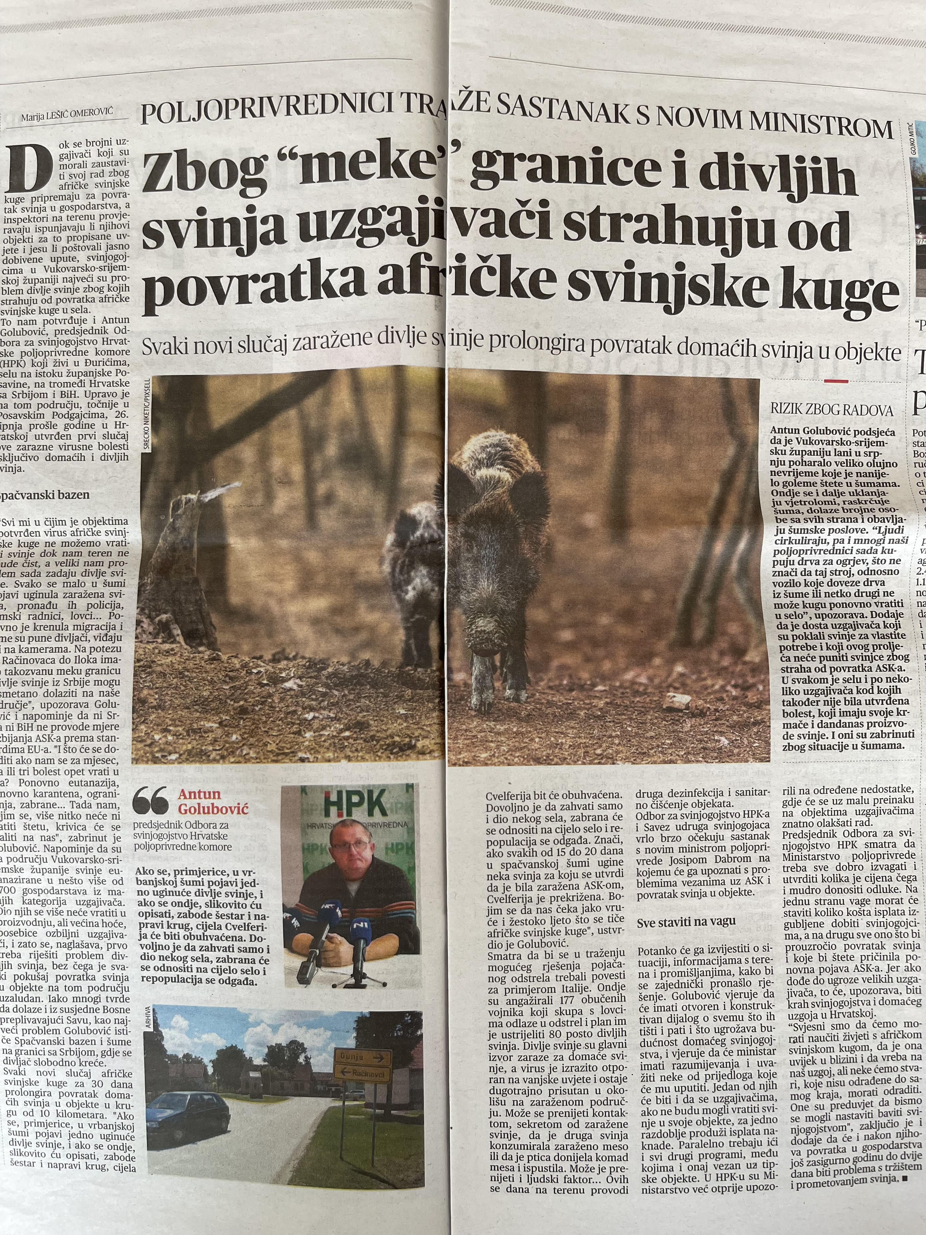
Foto: Tihomir Florijančić

Slide 18
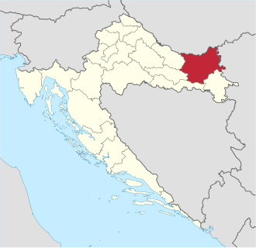
DISTRIBUTION IN Osijek-Baranja County
during 2025, a renewed intensification of disease spread was recorded
following the initial spread in Vukovar-Srijem County, the epicenter of the epidemic shifted towards Osijek-Baranja County
by the end of October 2025, 353 ASF-positive wild boar and 44 positive holdings with domestic pigs had been confirmed
ASF was officially confirmed at Sokolovac Farm on 20 September 2025 (by 30 September, 9,827 fattening pigs had been euthanized - estimated economic loss cca €2.5 million)
positive wild boar were also detected within Kopački rit Nature Park and in the surrounding hunting grounds along the Danube

Slide 19
DISTRIBUTION IN KOPAČKI RIT
Kopački rit represents a specific epidemiological area due to its extensive and interconnected wetland habitat, which provides highly suitable conditions for wild boar, as well as its location along the Danube and the state border with Serbia
in July 2025, an Order on the Reduction of Game Population Numbers was adopted, requiring the removal of wild boar in Restriction Zone III, while outside this zone the population was to be reduced to 10% of the breeding stock
these measures also included hunting grounds within the Park, while hunting in the Special Zoological Reserve was exceptionally permitted under the Wildlife Protection Programme

Slide 20
DISTRIBUTION IN KOPAČKI RIT
since the implementation of these measures, a total of 53 wild boar have been shooted, of which 6 tested positive for ASF virus, while 15 dead wild boar were found, all of which tested positive
during 2025, Kopački rit and the surrounding hunting grounds represented one of the areas with the occurrence of ASF in the wild boar population in Osijek-Baranja County
the specific ecological and spatial characteristics of the area require continuous surveillance, timely diagnosis, and coordinated implementation of wildlife management, nature conservation, and veterinary control measures

Slide 21



Slide 22
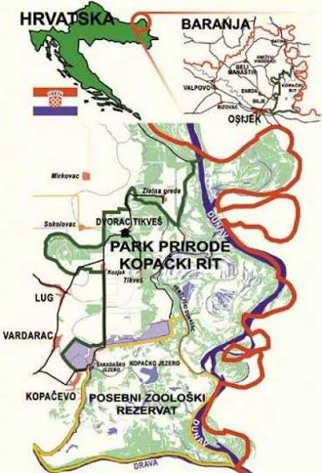
DISTRIBUTION IN KOPAČKI RIT

Slide 23


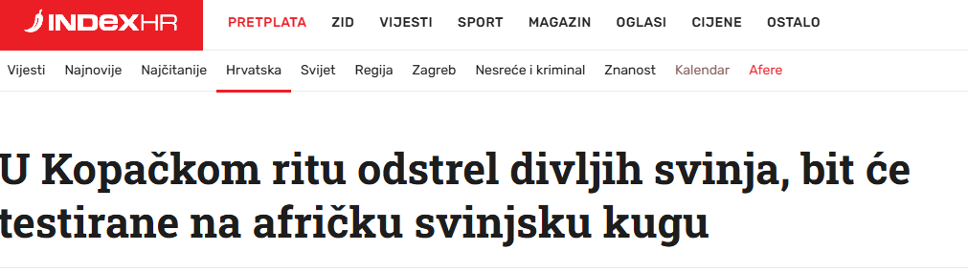


Slide 24
PREVENTION (What can be done to prevent ASF?)
prevention in disease-free countries depends on appropriate import policies and the implementation of effective BIOSECURITY measures
during outbreaks and in affected countries, ASF control can be challenging and must be adapted to the specific epidemiological situation
strict biosecurity measures on farms
good knowledge and management of wild boar populations, together with close coordination between veterinary services and hunting authorities, are essential
depending on the epidemiological situation, ticks should also be considered as part of control programs

Slide 25
!
IMPLEMENT BIOSAFETY MEASURES
!
REPORT ANY SUSPICION OF DISEASE TO A VETERINARIAN OR VETERINARY INSPECTOR

