Slide 1


ARCHAEOLOGICAL RESEARCH AT THE OLD TOWN VOĆIN
Srđan Đuričić
Valentina Šljivac

Slide 2
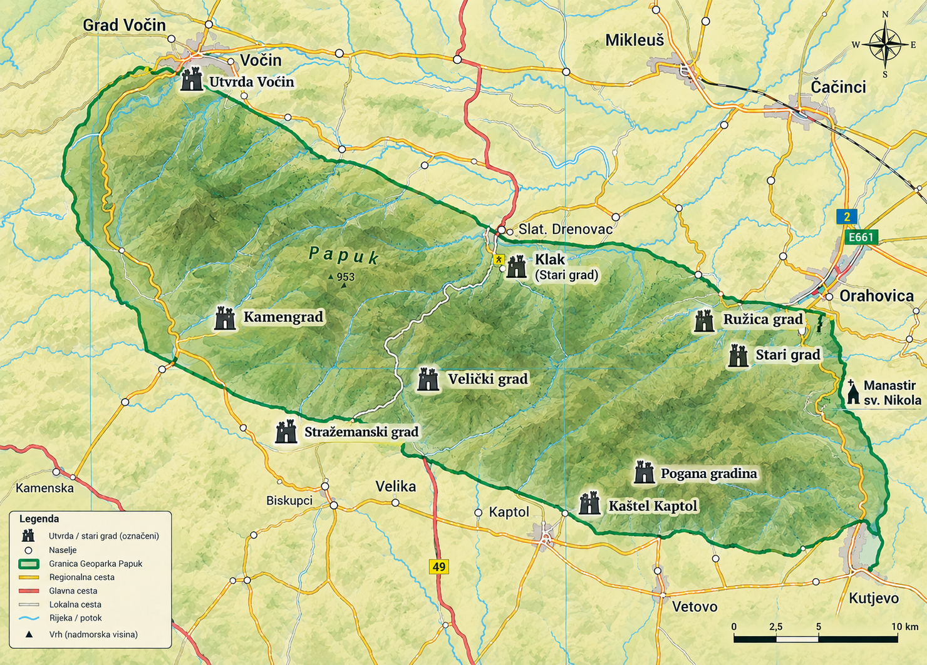

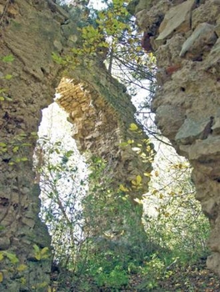
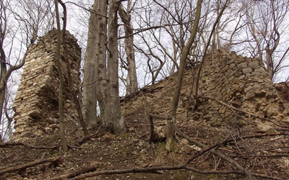
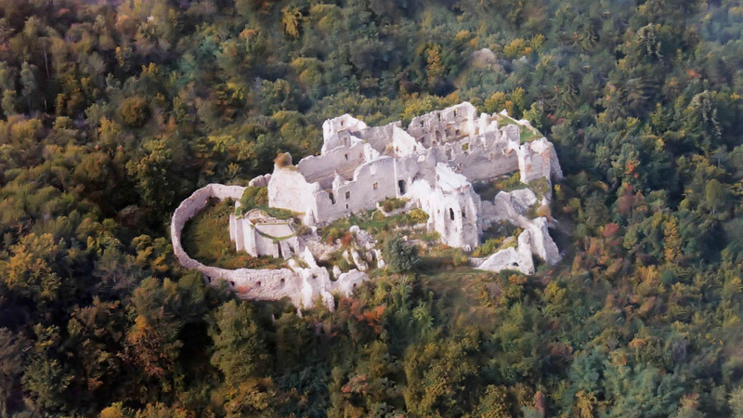
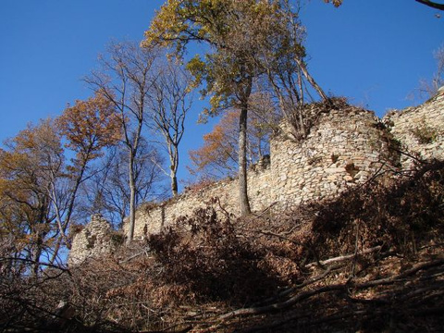
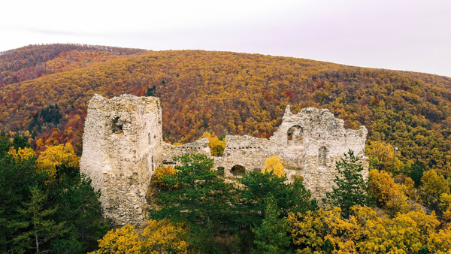
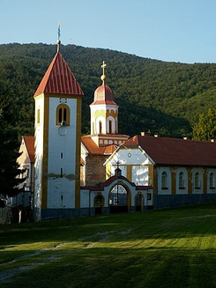
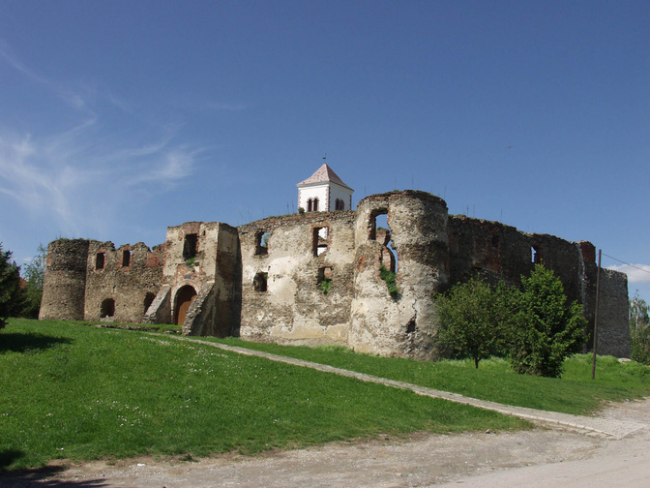
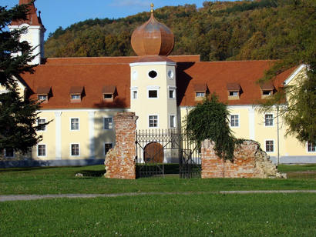

Slide 3
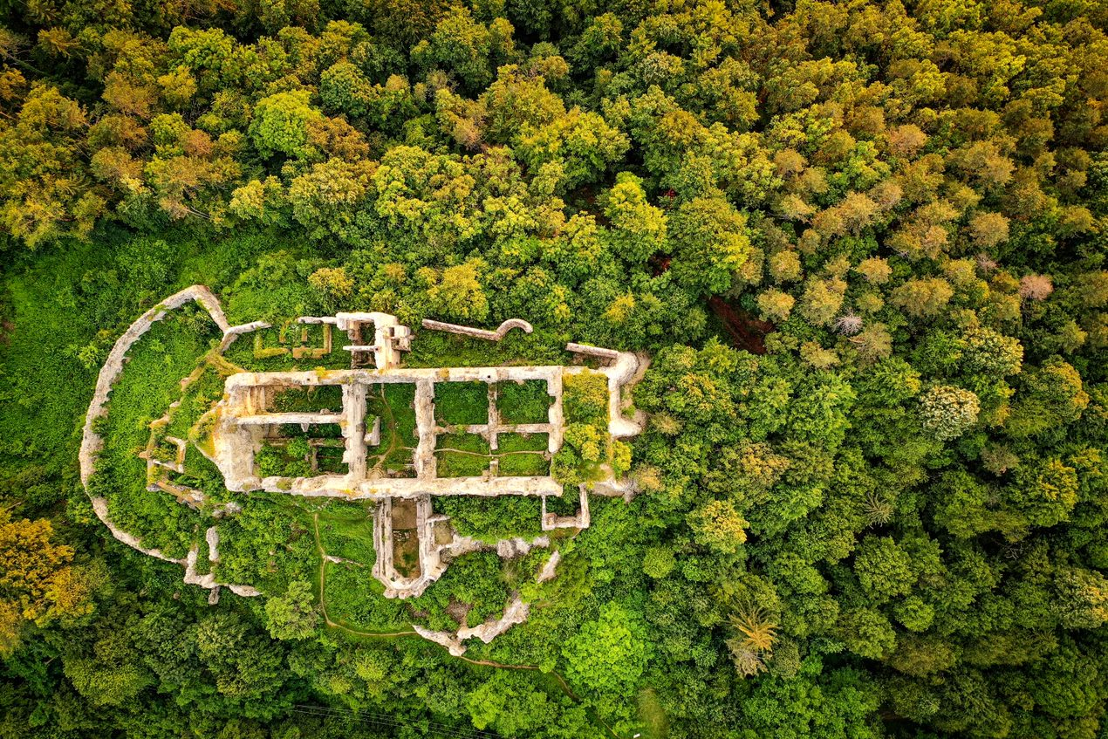
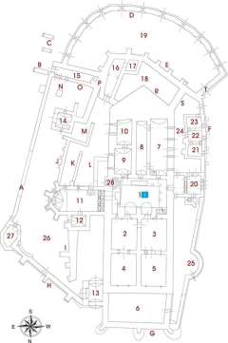

Slide 4
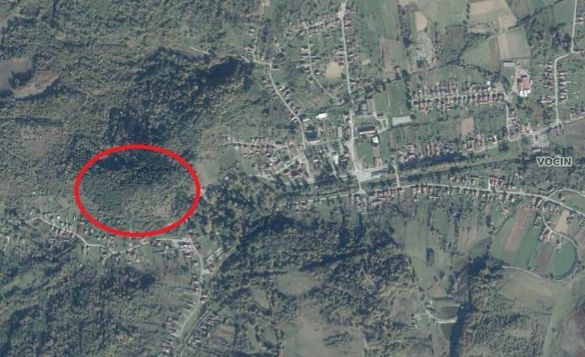
FORT POSITION
  300 meters above sea level
  Voćin is the largest and most populous settlement in the municipality of the same name (which comprises 21 settlements and covers an area of ​​nearly 300 km²)
  Natural valleys and watercourses facilitated movement toward surrounding areas
  An important junction of transport routes leading to Požega, Daruvar, Slatina, and Orahovica
  A fortress—situated on a commanding elevation—offering a clear view of the surrounding area and serving a vital defensive and strategic control function

Slide 5
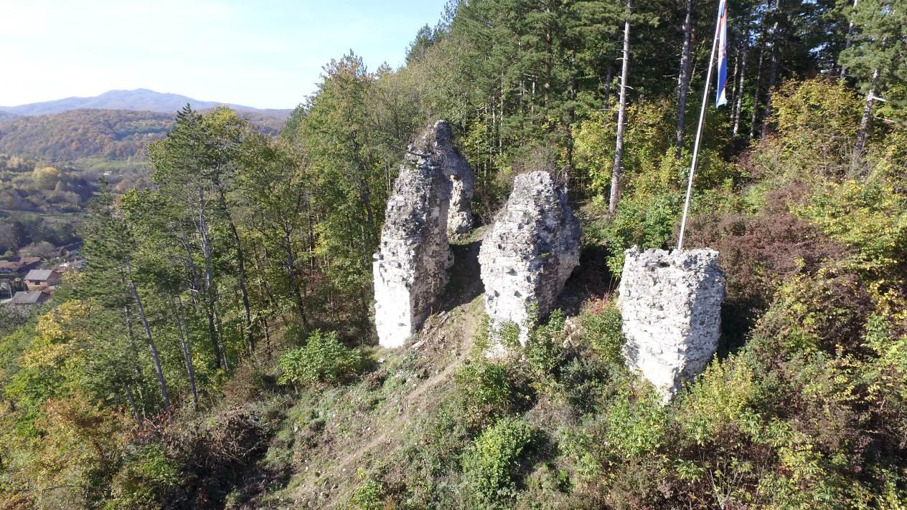
WHAT IS PRESERVED?
Part of the tower and buttresses (photo: Marijo Kokorić)

Slide 6
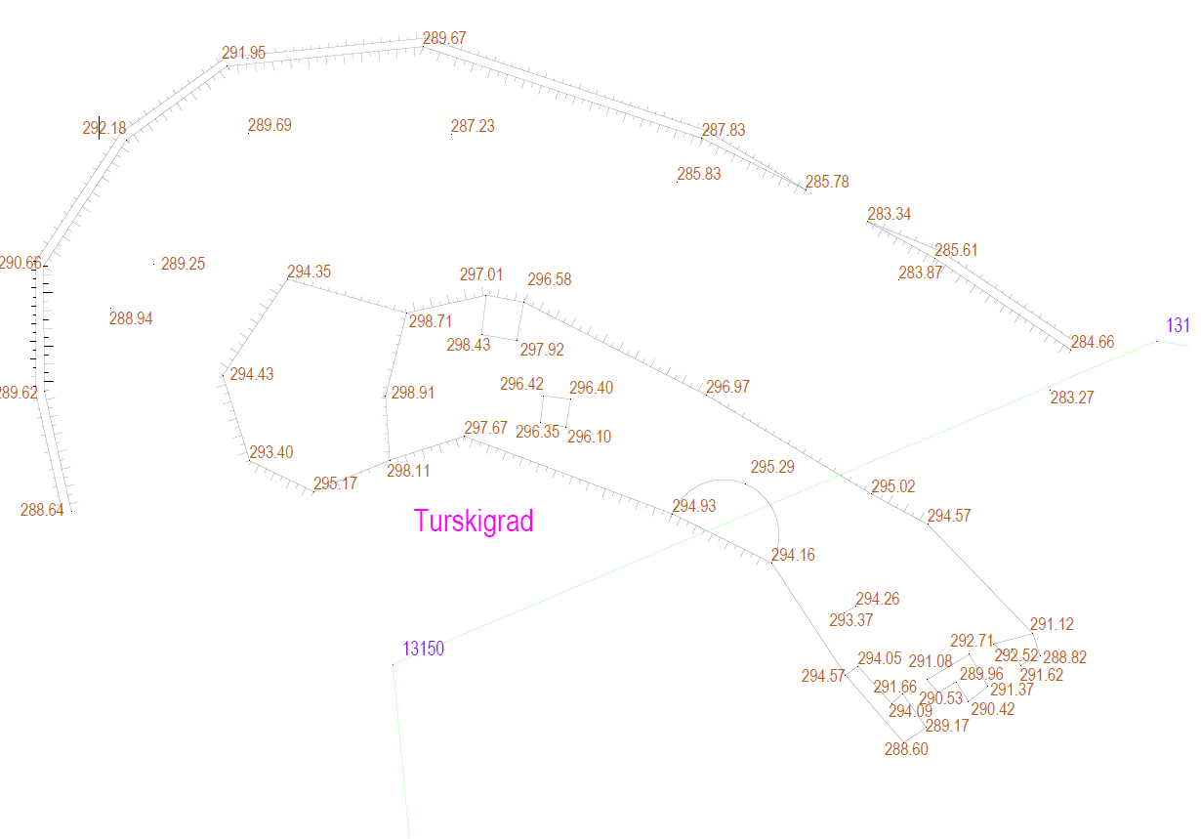

Slide 7
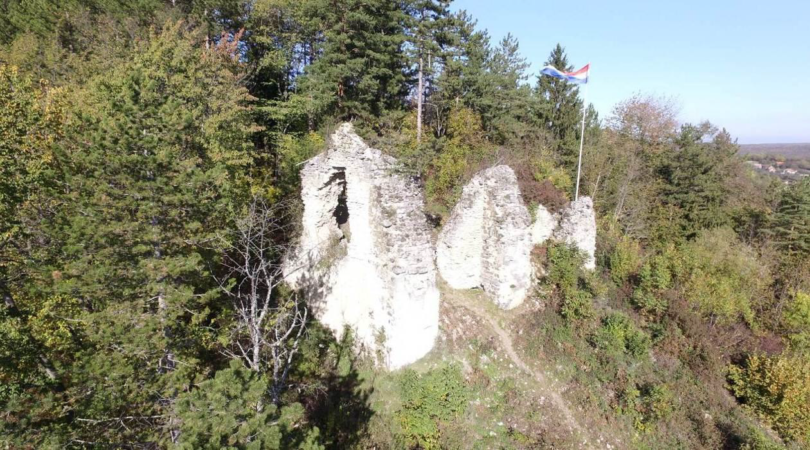
Remains of the Voćin fortress – part of the tower and buttresses (photo: Marijo Kokorić)

Slide 8
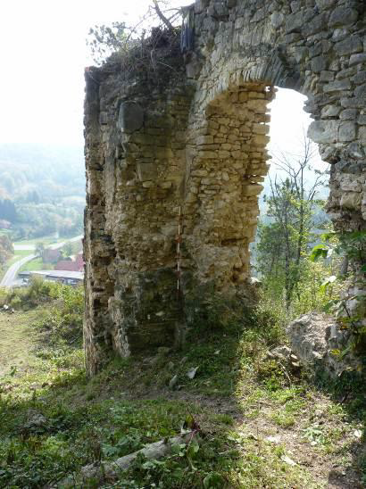
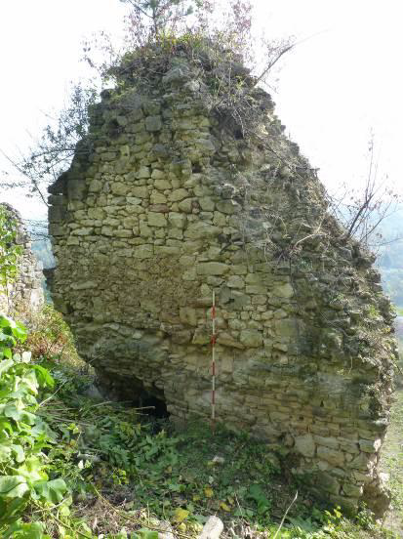
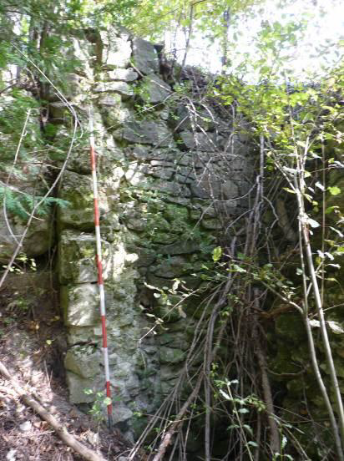
TOWER
  two-story and vaulted. Parts of the eastern and southern walls are particularly visible. On the western part of the site, the outlines of possible ramparts or palisades (approximately 60 meters in length) are visible.
  Elements of the central tower – an arched opening, a lintel, and a recess at the southwest corner
(photo: Srđan Đuričić)

Slide 9
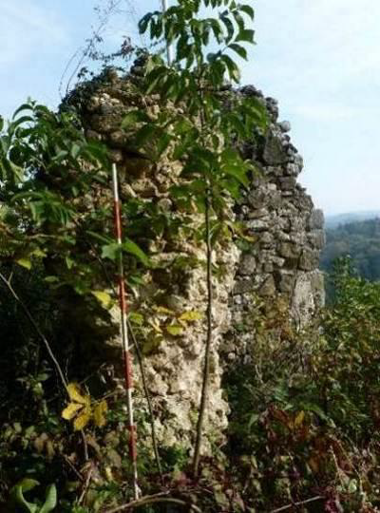
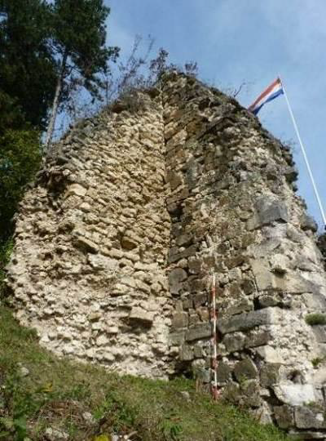
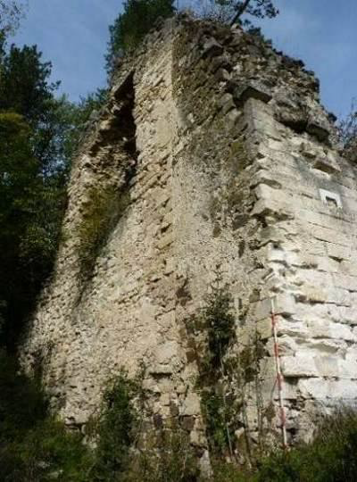
BUTTRESS
  They are constructed of volcanic rock, sandstone, and limestone.
  The best-preserved element is the southeastern buttress (comprising two construction phases): the first was a smaller supporting buttress, likely built to stabilize a damaged section of the tower, while the massive buttress visible today was added later.
  This demonstrates that the fortress was not built all at once, but rather evolved and adapted to changing needs over time
Photographs of the buttresses (photographed by Srđan Đuričić)

Slide 10
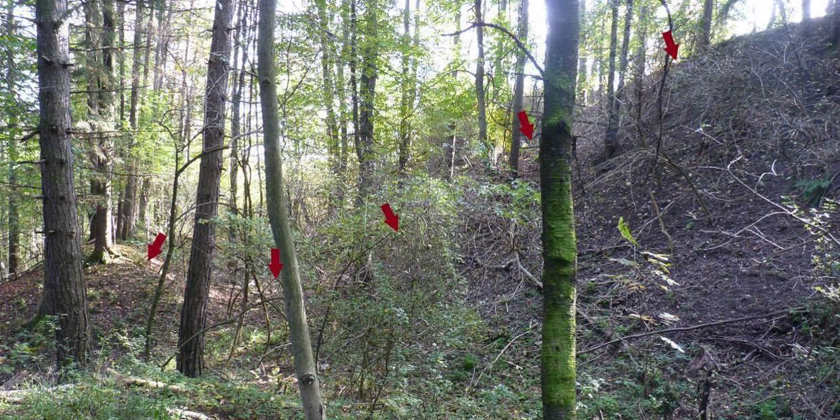
MOAT
  MOAT The fortress was surrounded by a moat ranging from 24 to 26 meters in width. Its depth is not uniform along its entire length—it varies from approximately 12 meters on the eastern side to 5 meters on the western side.

Slide 11
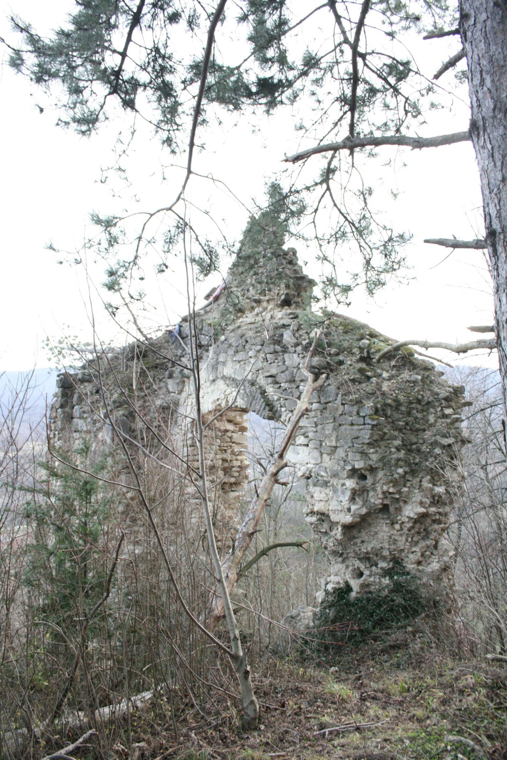
HISTORY OF VOĆIN AND THE FORTRESS
  The settlement of Voćin is first mentioned in the 13th century under the name Ogona (an estate of the Mojslav/Moslavinski clan)
  Ownership changed hands over the centuries: starting with the Aba clan in the early 14th century (held by the Aba/Voćinski family)
  15th century – the Gorjanski family
  Owners of the estate: Katarina and Eufrozina Iločki, daughters of Nikola Iločki
  In 1490, the Voćin fortress is explicitly mentioned in historical sources within an agreement between Vladislaus II Jagiellon and Ivaniš Korvin
STARI GRAD KAPTOL

Slide 12
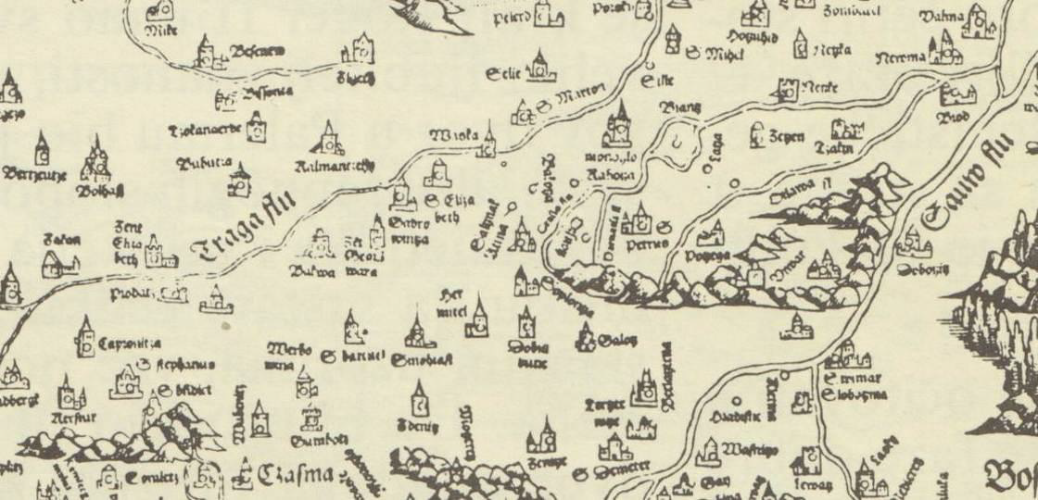
OTTOMANS
THE EARLIEST CARTOGRAPHIC VIEW OF VOĆIN FORTRESS - A MAP of Hungary from 1528 by Lazarus (Mirko Marković: Descriptio Croatiae – Croatian lands on geographical maps from the oldest times to the appearance of the first topographic maps
  In 1543, the Ottomans conquered Voćin. Under Ottoman rule, Voćin became part of the Sanjak of Požega
  religious and ethnic composition of the population changed
  Evliya Çelebi’s description characterizes Voćin as a fortified town with stone walls, a captain, 50 soldiers, and several small cannons

Slide 13
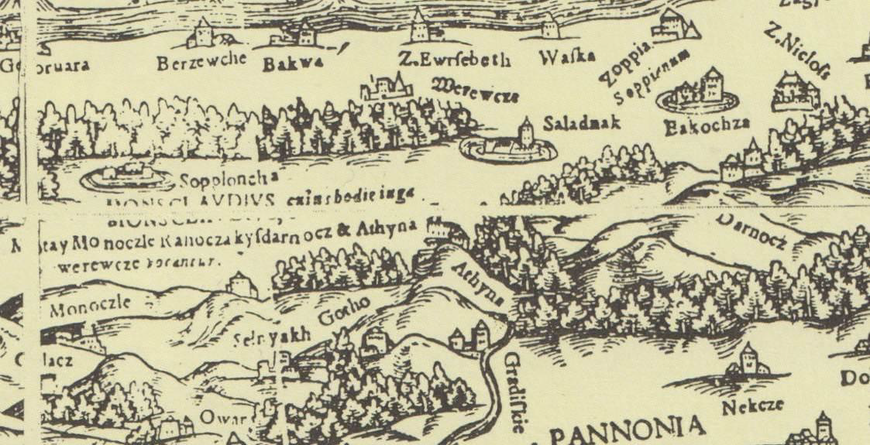
  Detail from a map of Croatia and Hungary by Wolfgang Lazius, 1556
(Mirko Marković 1993; p. 51)

Slide 14
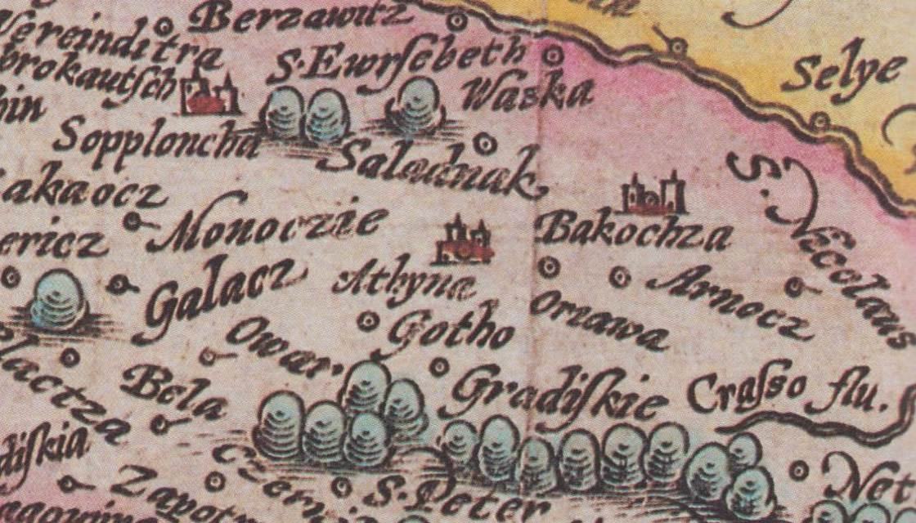
  Detail of a map by Johann Bussemacher from 1592 (Mirko Marković 1993; pp. 52–53).

Slide 15
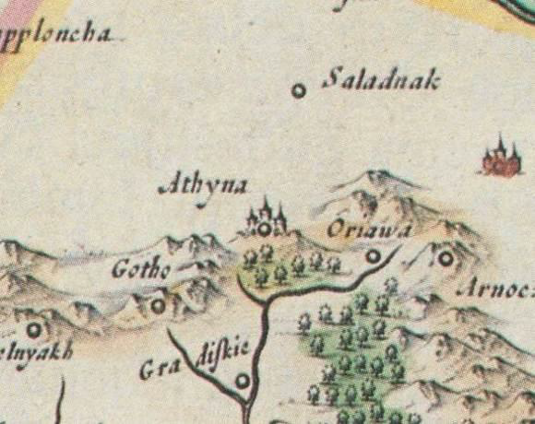
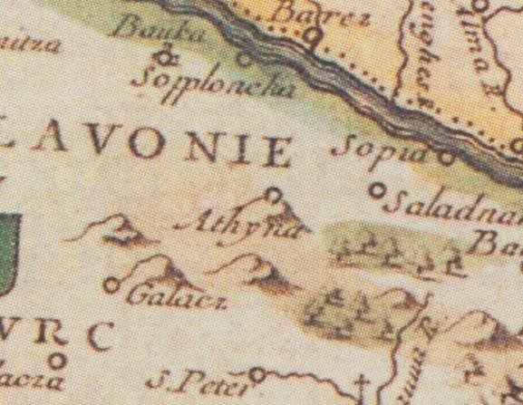
A section of Blaeu's map from 1640
(Mirko Marković 1993; pp. 68–69))
Voćin on Du Val's map from 1663
(Mirko Marković 1993; p. 121)

Slide 16
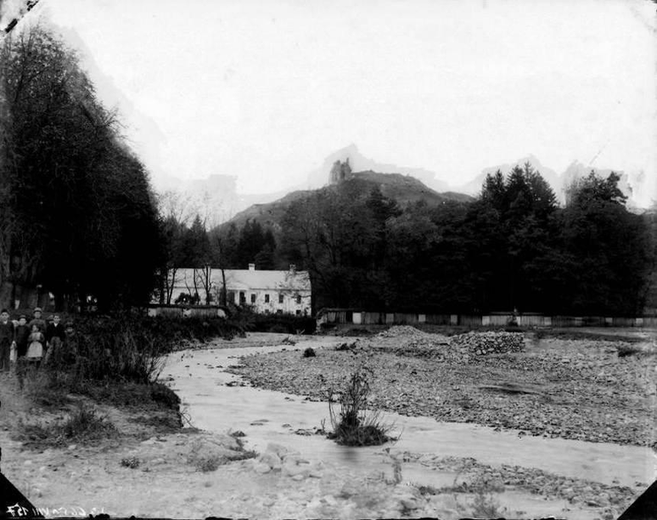
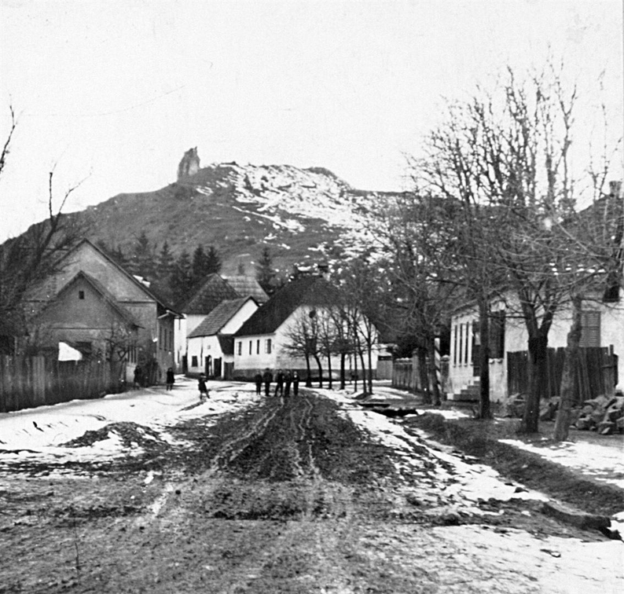
Voćin Old Town, photographed from the park in the village center, 1885 – inv. no. FKB-6650
(sourced from: https://fototeka.min-kulture.hr/hr/Predmet/21154/3)
View with the Old Town, inv. no. FKB-6649
(retrieved from: https://fototeka.min-kulture.hr/hr/Predmet/21156/3)

Slide 17
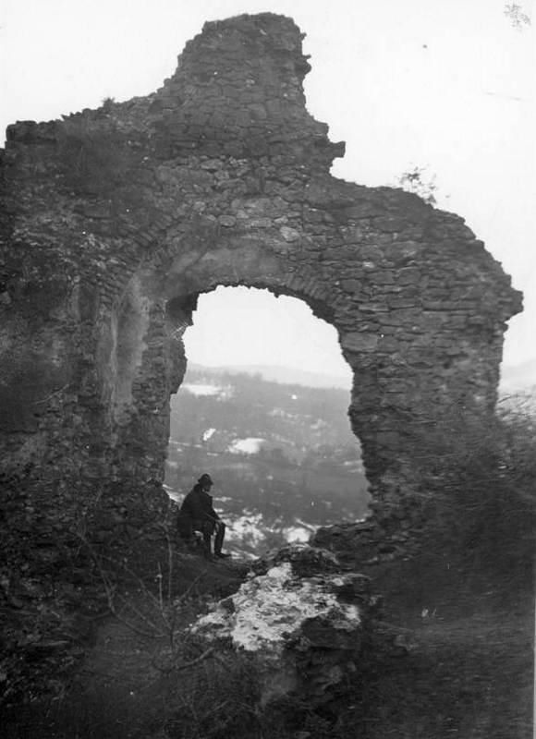
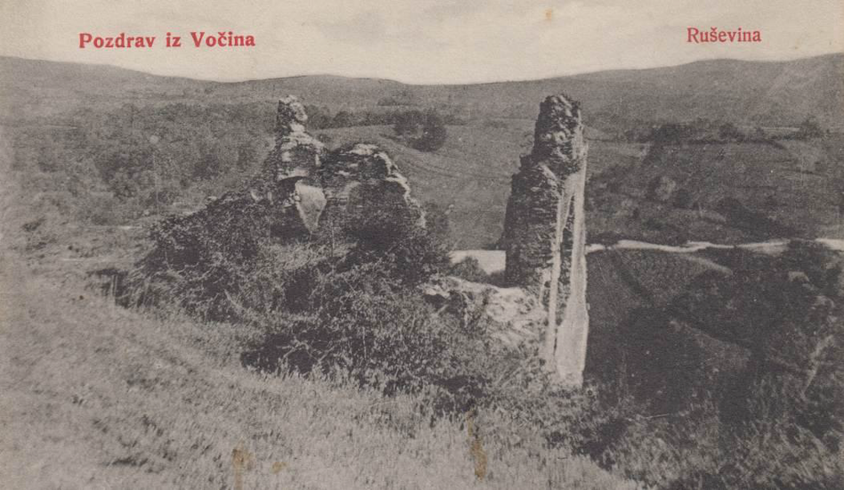
Postcard from the publisher Ed. Bauer dating from 1907, depicting the Old Town (ZMS 1013)
The earliest known photograph dates to around 1885 and is attributed to Gjuro Szabo

Slide 18
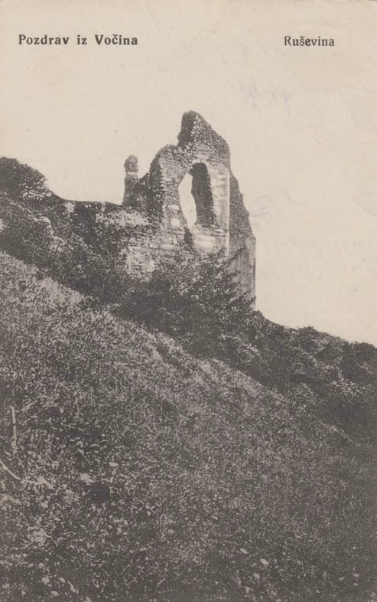
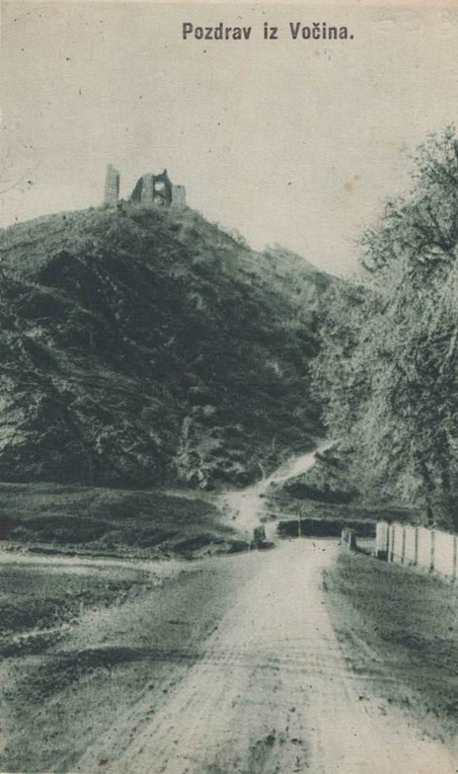
PROTECTION OF THE OLD TOWN
  The site has been protected since 1969
  The importance of protection comes to the fore especially when we look at old photos and the state of the site today
  Photos from the first half of the 20th century show parts of the fort that no longer exist today
Postcards depicting the Old Town
(ZMS 991 and ZMS 638)

Slide 19
Gjuro Szabo at the Old Town
(Source: Photo Archive of the Ministry of Culture and Media)

Slide 20
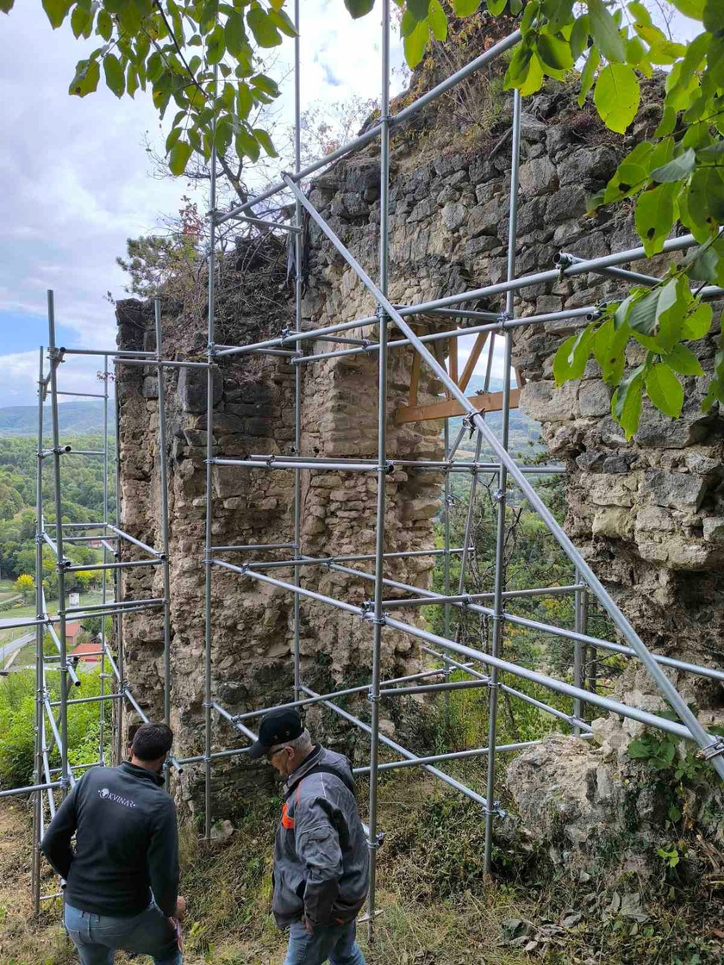
PROTECTION OF THE OLD TOWN
  County Museum of Slatina, Public Institution Papuk Nature Park and the Municipality of Voćin
  Public Call for Proposals for Public Cultural Needs in the Republic of Croatia for 2024 (Ministry of Culture and Media of the Republic of Croatia)
  Initial investigations were conducted in 2024, when two archaeological test trenches were opened
Investigations are continuing in 2025 and are currently underway in 2026, involving conservation and restoration work on the preserved sections of the fortress

Slide 22
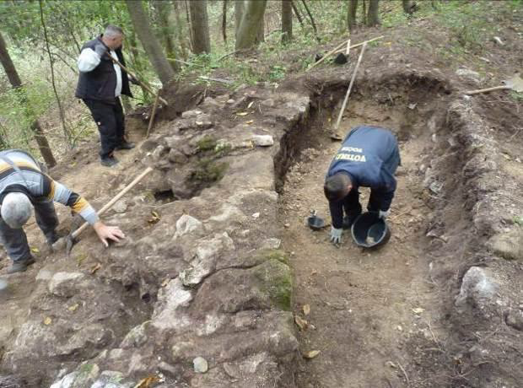
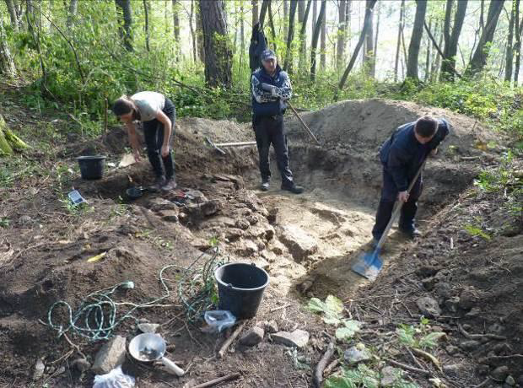
ARCHAEOLOGICAL EXCAVATIONS
  Test trench 1 was positioned at the edge of the fortification, at the junction of the plateau and the ditch. The aim was to determine whether a defensive element, such as a stone rampart or a wooden palisade, existed at that location.
TWO ARCHAEOLOGICAL HORIZONS
  Test trench 2 was positioned in the central part of the plateau, approximately 7 meters southeast of test trench 1, to investigate the spatial layout and check for the presence of stone structures and buildings

Slide 23
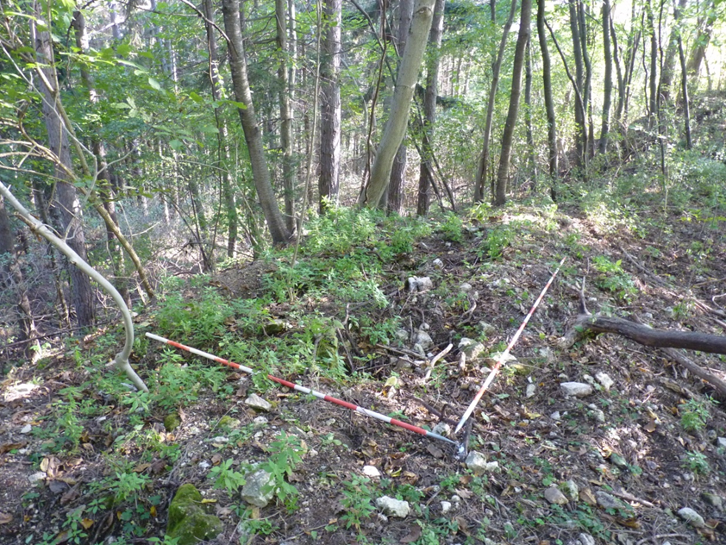
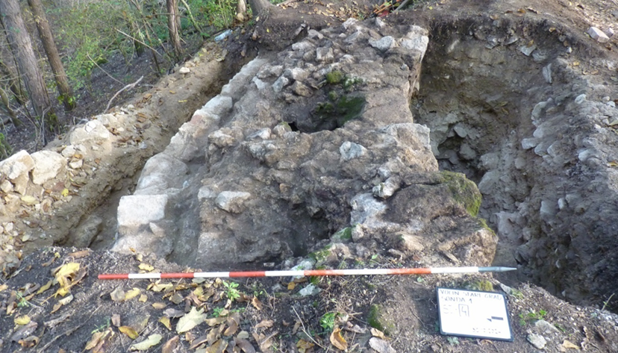
TRACES OF DEFENSE AND FIRE
  Defensive wall - approximately 4 meters long and 2.20 to 2.40 meters wide
  massive quarried and dressed stones. The outer face was built of larger stone blocks, while the core was filled with smaller stones bonded with lime mortar
  The defensive wall dates to the Ottoman period (materials from the medieval fortress were partially reused)
  A layer of rubble
  likely occurred shortly after the fortress ceased to function or during its capture by the Habsburg army in 1687

Slide 24
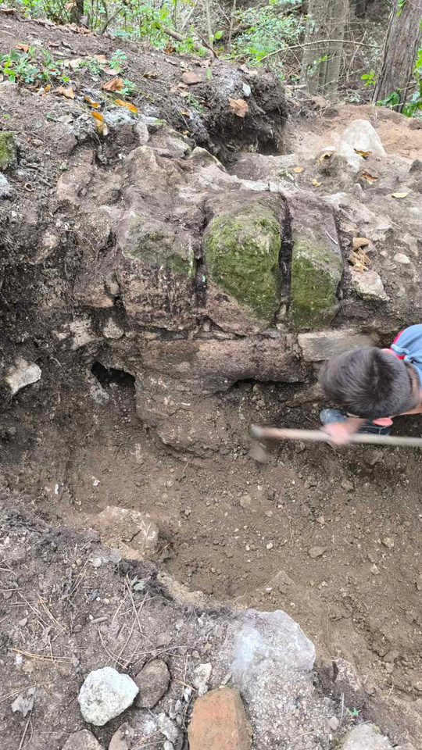
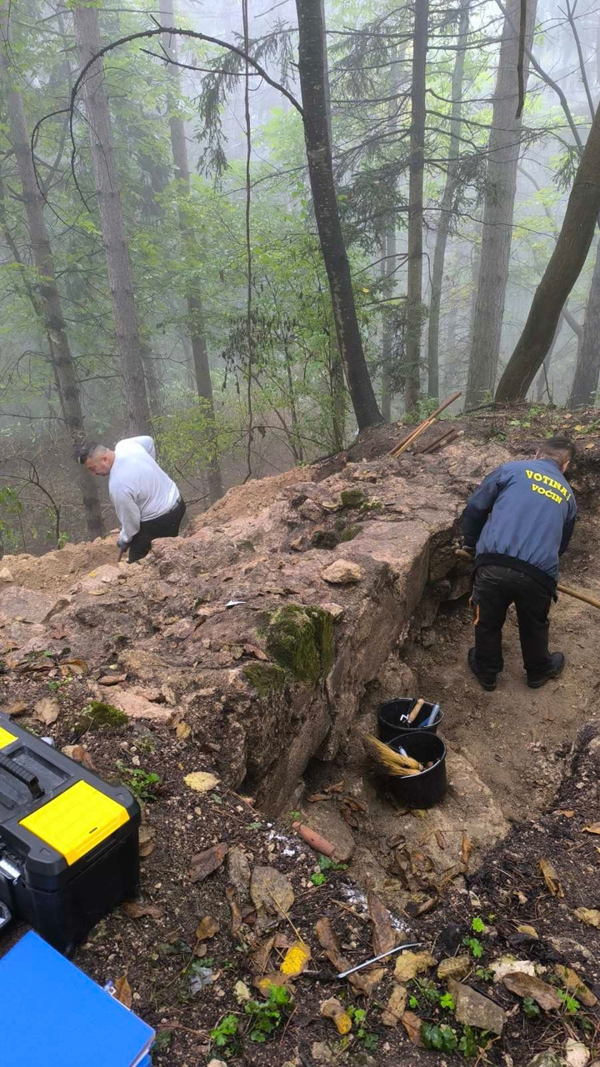
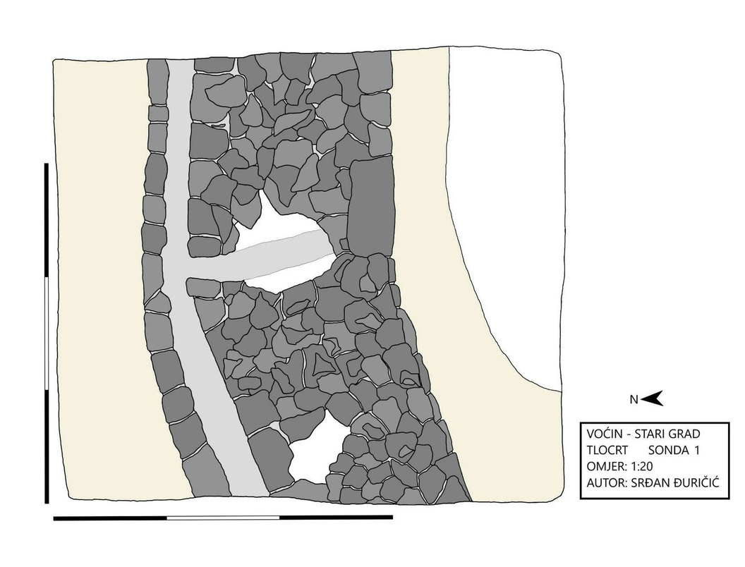
DRAINAGE SYSTEM
  A well-preserved stormwater drainage system was also discovered alongside the defensive wall
  Two channels perpendicular to the defensive wall were documented; they terminate in an elongated channel that runs parallel to the outer face of the wall and extends towards the east

Slide 25
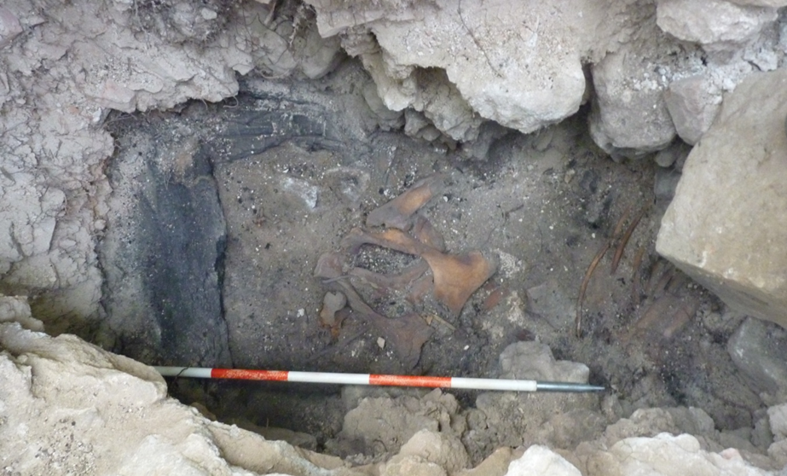
  Traces of earlier structures were found in the underlying layers. Large quantities of broken stone, mortar, and brick, along with signs of burning, indicate the demolition of a structure
  Remains of charred wooden beams and a nearly complete horse skeleton were found in layers SJ 8–11
  It was impossible to determine exactly which structure the remains belonged to or whether all the layers were part of the same structure
  Violent destruction and traces of fire—linked to the Ottoman siege of 1543
  The findings point to a situation of urgency

Slide 26
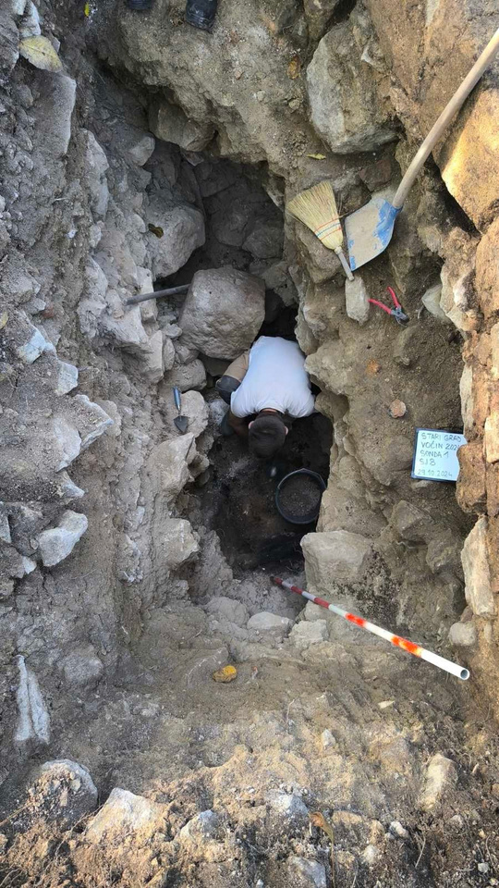
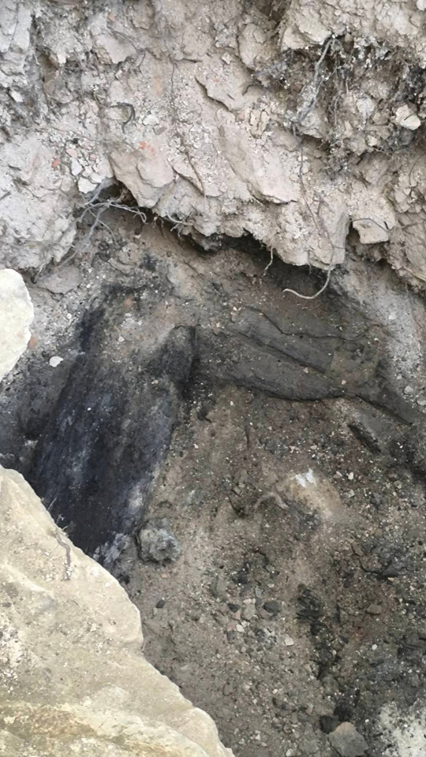
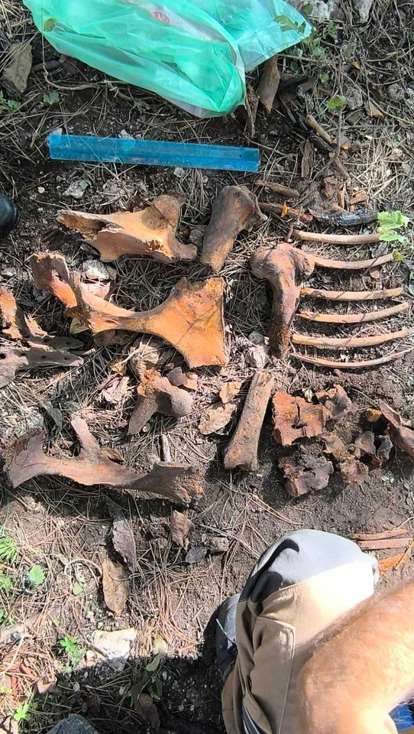
Remains of wooden beams and skeleton

Slide 27
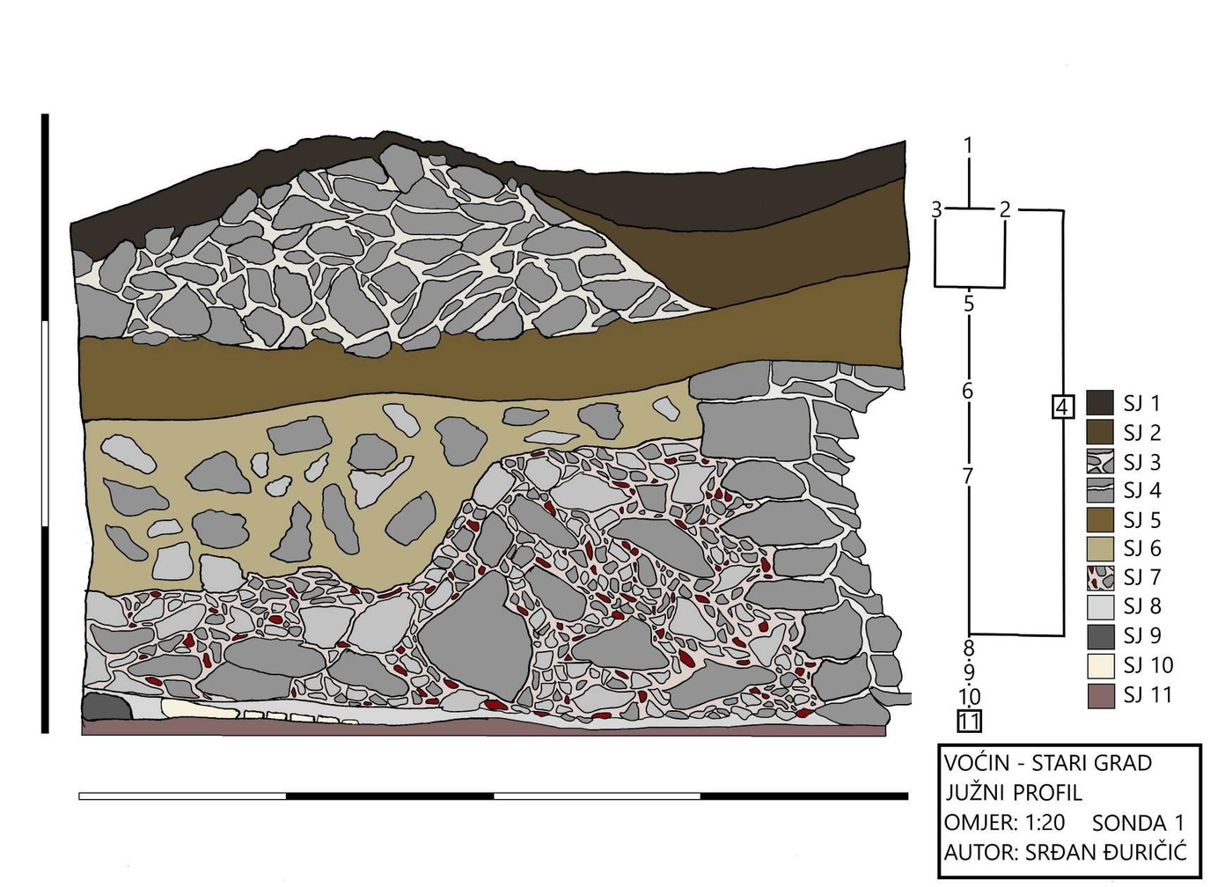

Slide 28
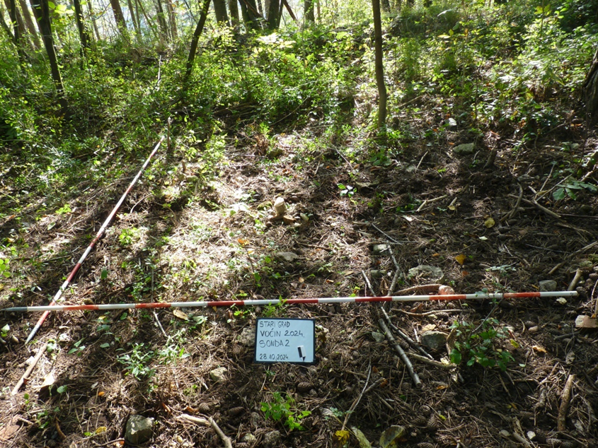
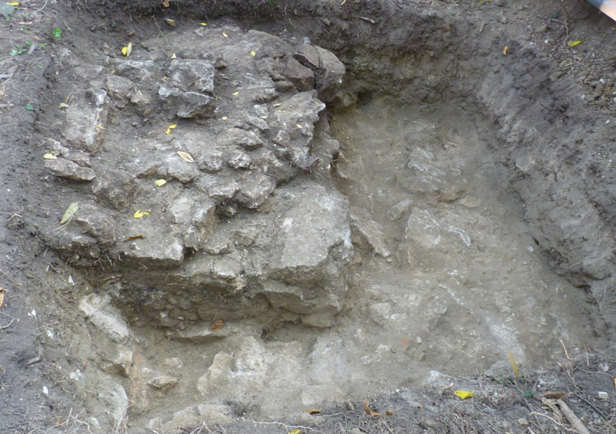
WHAT HAPPENED INSIDE THE FORTRESS?
TEST TRENCH 2
  The initial dimensions of the test trench were 3 × 3 meters; it was further expanded in 2025 and 2026
  A masonry structure made of rubble stone bonded with lime mortar was discovered in the northeast corner. Its function was uncertain at the time, but its dimensions suggested it was part of a larger structure
  Nine stratigraphic units were defined during the initial investigation. Numerous portable finds (animal bones and pottery fragments) were recovered from the archaeological layer

Slide 29
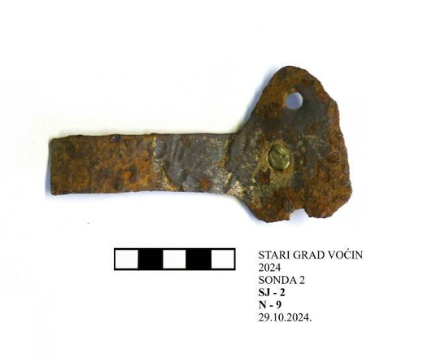


WHAT HAPPENED INSIDE THE FORTRESS?
TEST TRENCH 2
  Numerous portable finds (animal bones and pottery fragments) were recovered from the archaeological layer
  The osteological material is particularly interesting - mostly bones of ruminants and game (wild boar).
  Traces of cutting and cutting

Slide 30




Datable finds, such as a crossbow bolt head – a *vereton* – and grey Turkish pottery
(16th century)

Slide 31


WHAT HAPPENED INSIDE THE FORTRESS?
TEST TRENCH 2
  The limestone bedrock (SU 14) beneath the archaeological layers
  Traces of working and finishing are visible on the limestone (traces of small channels used for detaching or leveling the rock were also observed)
  Two circular depressions—approximately 20 centimeters in diameter and 30 centimeters deep—were also found next to the structure (SU 3)
  In 2024, the investigation concluded at a layer of mortar and stones interpreted as a floor surface

Slide 32



  Building materials, stone fragments, lime mortar, plaster, and brick were found in the excavated layers. Fragments of profiled stone and a significant quantity of osteological material are particularly noteworthy
  A millstone was also found at the bottom of Trench 2; one half of it extends beneath the western profile

Slide 33


WHAT HAPPENED INSIDE THE FORTRESS?
TEST TRENCH 2
  Thickness and quantity of archaeological layers
  Fragments of profiled stone suggest the possible existence of a more luxurious structure featuring profiled wall openings
  a complex life, and the space did not serve only for defense
Excavations 2026.

Slide 34



CONCLUSION
  The old town of Voćin is not just a ruin on top of a hill
  The statics of the fort, atmospheric conditions, historical damage and recent deterioration endanger the preserved structures
  plan long-term remediation
  considering the possibility of presenting the site to visitors
Conservation and restoration works 2026.

