Slide 1
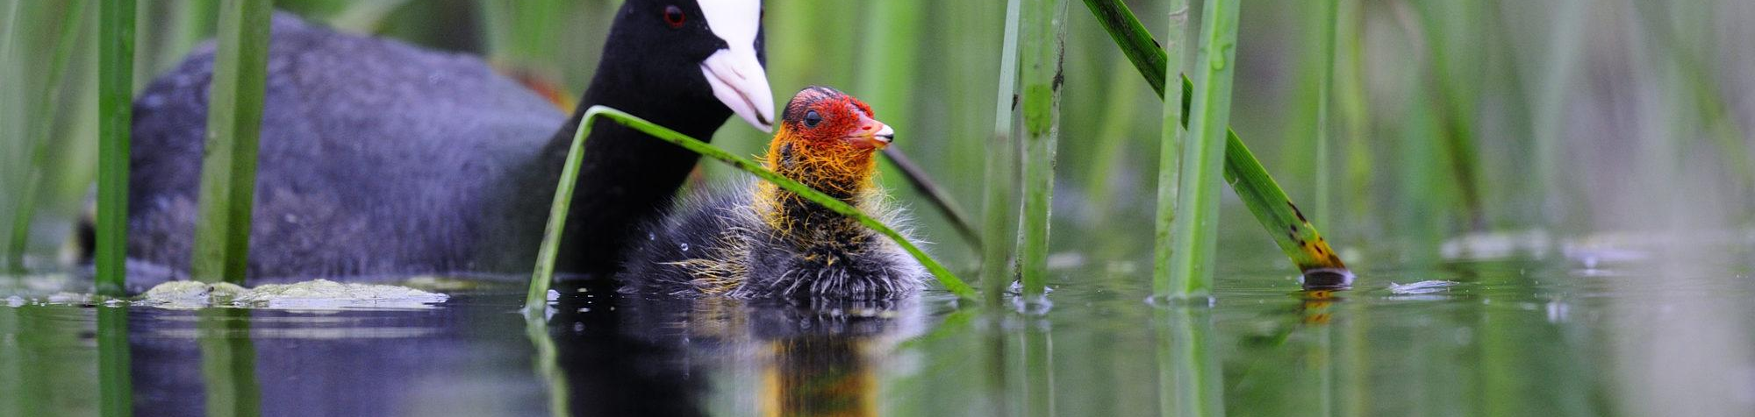





Fulica atra, Kopački rit
Listening to Kopački rit: Ecoacoustic insights from the WatchOut project
José W. Ribeiro Jr
Quantitative Ecology Lead
josewribeiro@wildmon.ai
Notes:
Good morning. I'm José Ribeiro, from WildMon. Today I want to take you on a short listening trip through Kopački rit. This work is a partnership between Huawei, our partners at the University of Osiék, the Nature Park, and WildMon. Our team has another talk about the technology behind its TOMORROW, when you have the chance to see a demo how to analyze acoustic data. Today I will focus on what we heard, and what it tells us about the park.

Slide 2
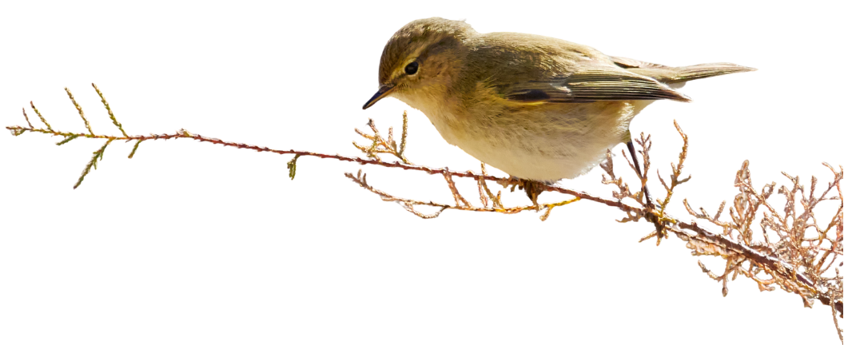
Project Goal
1
2
3
Where does it live?
What are the drivers?
Is it changing?
Establish a scientific baseline for species distributions in Kopački rit Park
Vegetation and water as habitat drivers
Occupancy trends for birds, mammals, and amphibians, 2023–2025
4
Notes:
We came with three simple questions. First: where do species live in the park? Second: what shapes where they live, the vegetation or the water? And third: is anything changing from one year to the next? To answer them, we listened to the park from 2023 to 2025.

Slide 3
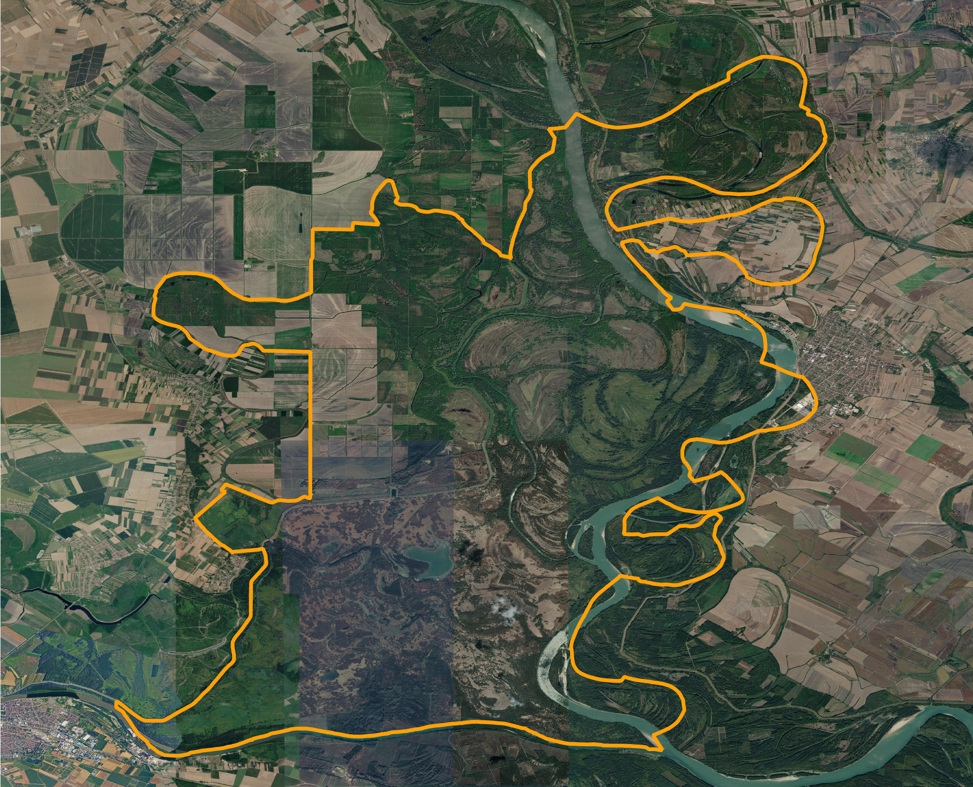
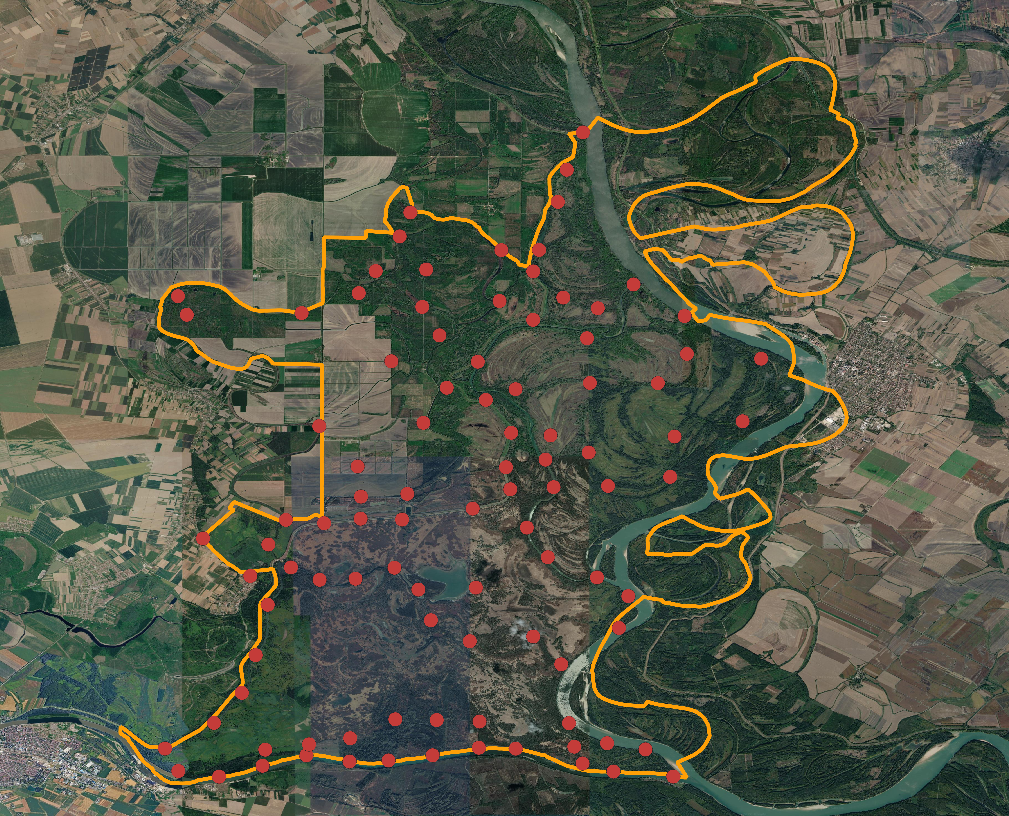
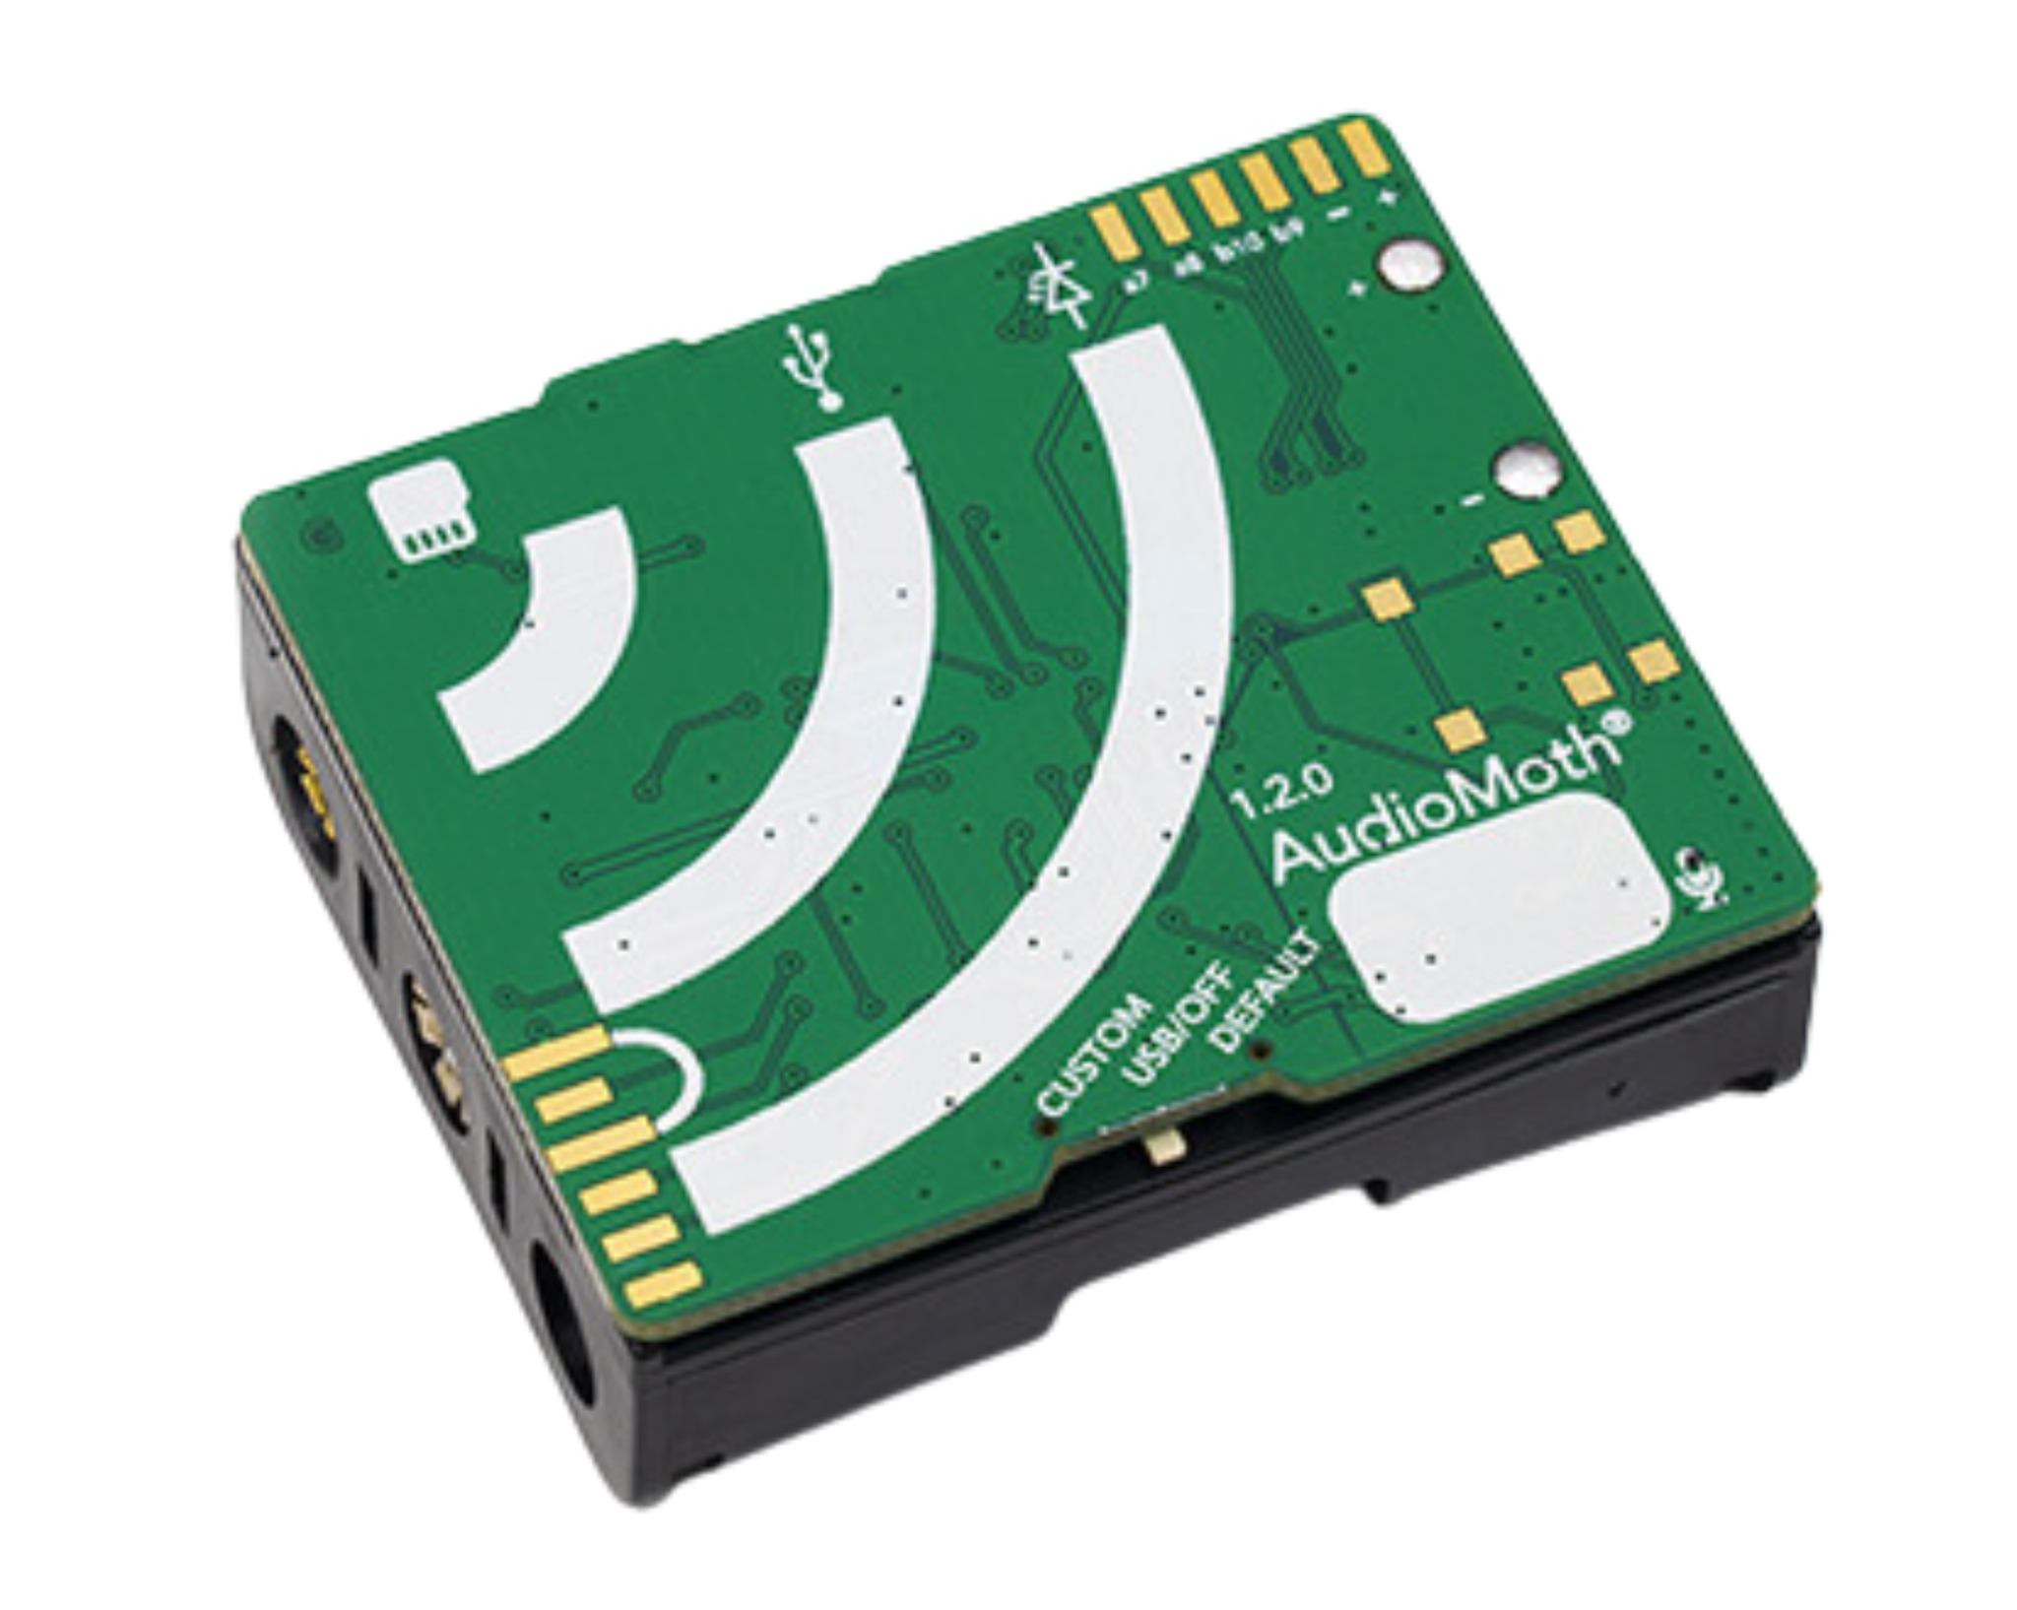
Study area
Kopački rit Nature Park
98 sampling sites
3 Years (2023–2025)
AudioMoth recorders
Notes:
The Park is a wetland where water and forest meet. This mix of habitats is exactly why it is such a good place to listen. We placed small audio recorders, called AudioMoths, at 98 sites across the park. Each one recorded one minute of sound every five minutes, day and night, from spring to autumn. We did this for three years. The red dot is one recorder. None of this would be possible without our local partners, who took the recorders into the field.

Slide 4


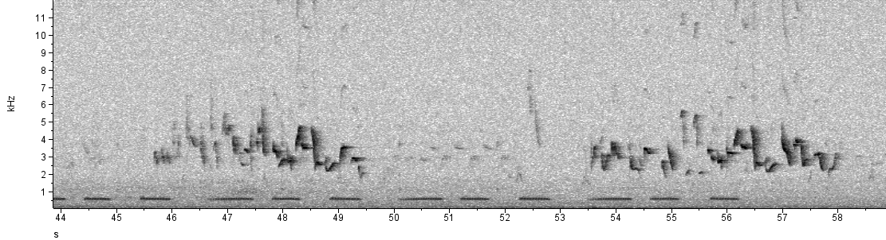
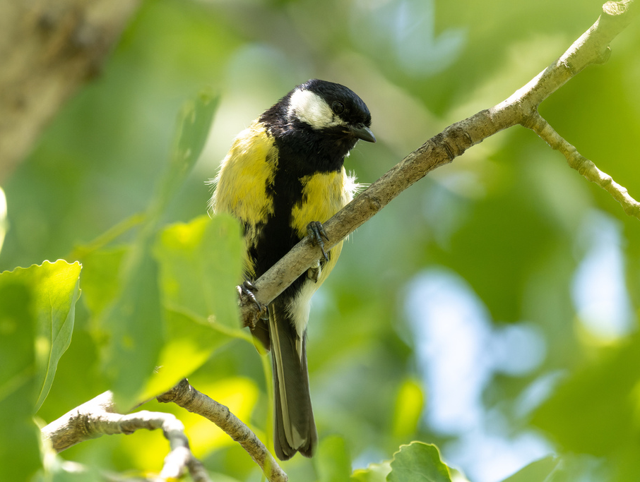
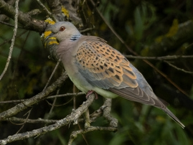
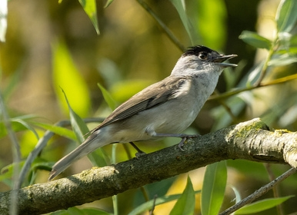
Data Analysis - Acoustic
What are we measuring?
Acoustic Monitoring
Frequency (kHz)
Time (s)
Time (s)
Power
Eurasian blackcap
Great tit
European turtle dove
Notes:
This is what a recording looks like. Time runs from left to right, and pitch from bottom to top. Each species leaves its own shape. In just 15 seconds, we have a Eurasian blackcap, a great tit, and the soft, low call of the turtle dove, a Vulnerable species

Slide 5
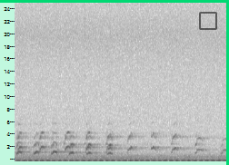
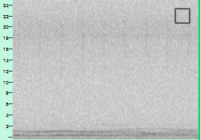
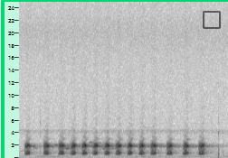
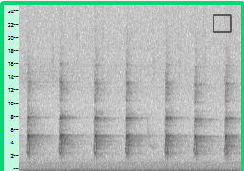
Data Analysis - Acoustic
Why Passive Acoustic Monitoring?
Acoustic Monitoring
great spotted woodpecker
white-tailed eagle
golden Jackal
common tree frog
Each focal species leaves a distinct acoustic signature in the soundscape
Notes:
Together with the university team, we followed some focal species. Each one has its own voice: the white-tailed eagle, the golden jackal, the common tree frog, and the great spotted woodpecker. We can see for their spectrogram very distinct vocalizations

Slide 6
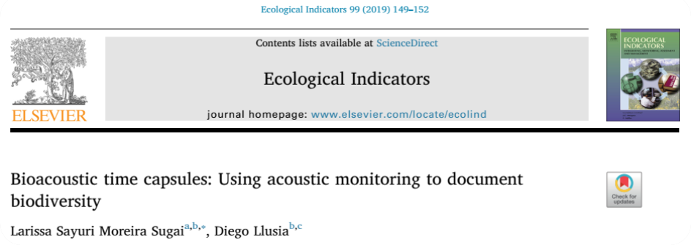
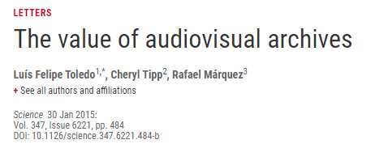
Data Analysis - Acoustic
Why Passive Acoustic Monitoring?
Acoustic Monitoring
Non-invasive
Listens in all directions, about 100–200 m
Many sites and species at the same time
Long, continuous time frames
Permanent record (audio archive)
Notes:
Why listen, instead of just looking? First, listening does not disturb the animals: we don't need to see them or catch them. One recorder listens in all directions, and we can cover many sites and many species at the same time, day and night, for months. And every recording becomes a permanent archive. Researchers call these recordings time capsules: in ten years, anyone can go back and listen again.

Slide 7
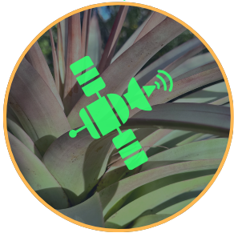
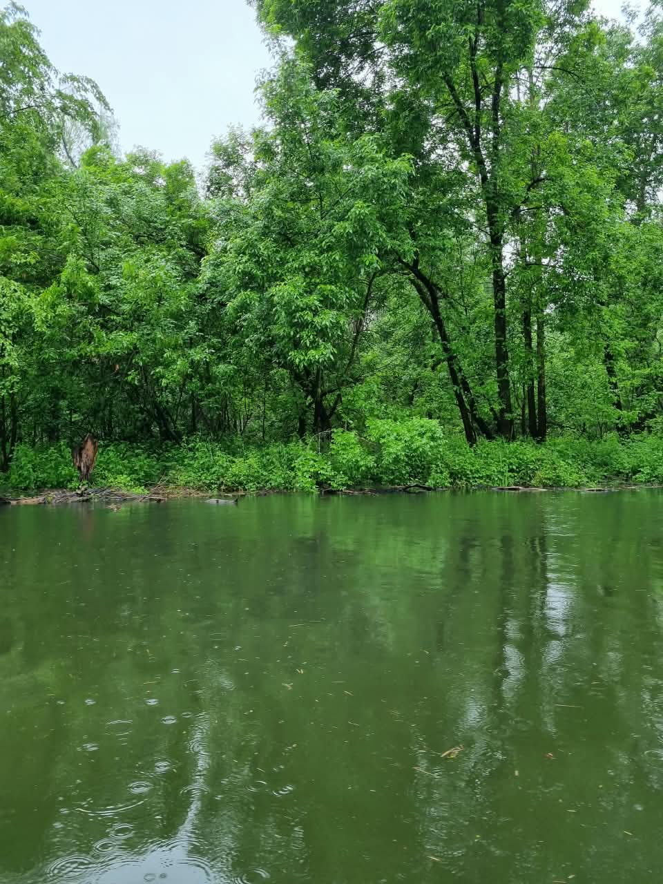
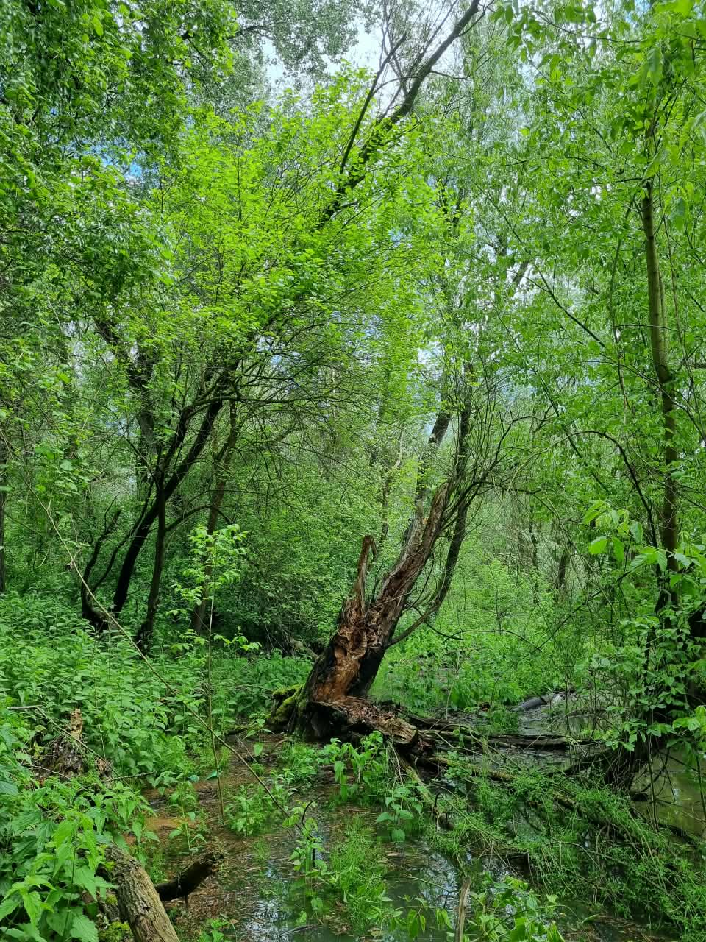
Data Analysis
Environmental variables
Satellite
belogorica — % of Belogorica cover
Kndvi_mean — Mean Kernel Normalized Difference Vegetation Index (March-August)
ch_gedi_std — canopy height variation (standard deviation) from GEDI satellite
mndwi - Modified Normalized Difference Water Index (March-August)
  twi - Terrain Wetness Index
Notes:
To understand why a species lives in one place and not in another, we used satellite data about the landscape around each device: how much Belogorica forest there is, how green the vegetation is, how much the tree height changes, how much surface water there is, and how wet the ground is. Basically, we are trying to capture two important habitats in a wetland: vegetation and water.

Slide 8
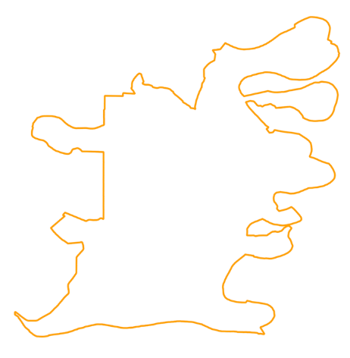
Data Analysis
Ecological modeling
Multi-species, multi-season occupancy models (imperfect detection)
Species with fewer than 10 detections were excluded
  Occupancy model 136 species (126 birds, 5 mammals, 5 amphibians)
Occupancy (Ψ) = 0.6
4
Notes:
Then we used occupancy models. The idea is simple. Imagine ten sites. We hear this frog at six of them, so we say its occupancy is 0.6. But sometimes the frog is there and stays quiet, and we miss it. The model corrects for that. We modeled 136 species: most of them birds, 5 mammals and 5 frogs and toads.

Slide 9
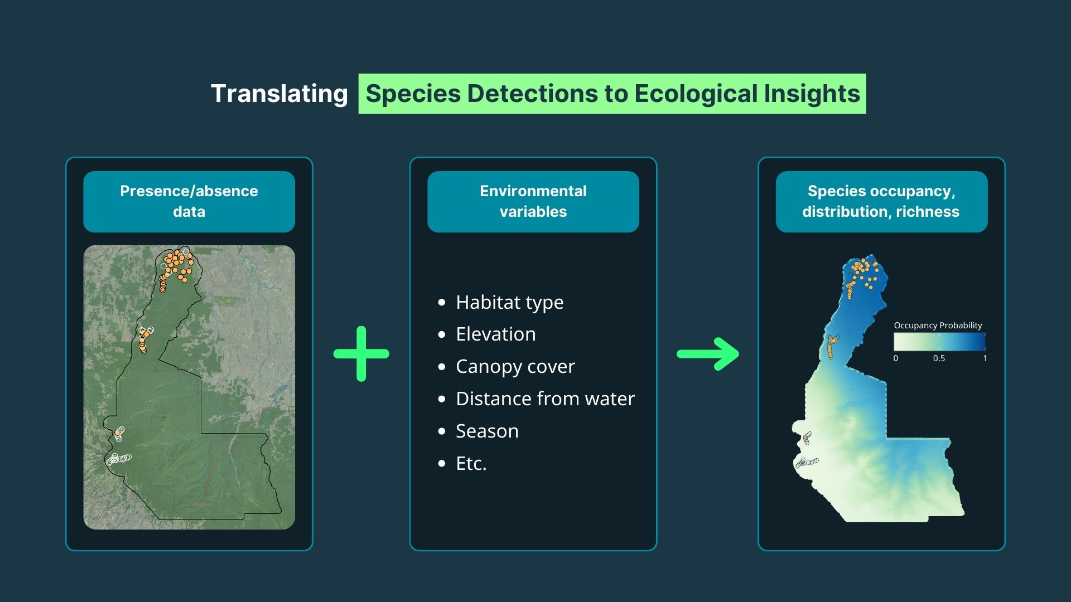
Data Analysis
Ecological modeling
Notes:
In short: we combine where we detected each species with the landscape data. This is what allows us to go beyond just record and hearing species and actually understand the ecological patterns driving where wildlife occurs — and to predict biodiversity across the full study area.

Slide 10
RESULTS
Notes:
So, what did we listen?

Slide 11




Project Numbers
164
4,442,539
4,442,539
species: 154 birds, 5 mammals, 5 amphibians
one-minute recordings
5
8.5 years
species of conservation concern
of continuous sound (~74,000 hours)
Every species record was validated by experts before modeling
Notes:
Three years of listening gave us almost four and a half million one-minute recordings. That is about eight and a half years of sound if you listened non-stop. No team of people could listen to all of that, and that is why we use AI. In these recordings we found 164 species: 154 birds, 5 mammals and 5 amphibians. Every record was checked by our experts. Five of them are species at risk: the turtle dove, which is Vulnerable, and four Near Threatened species
: the Eurasian curlew, the northern lapwing, the ferruginous duck and the European otter.

Slide 12


Results
AI model
154 classes (species)
Average precision across all classes = 0.989
150 of 154 classes at 0.90 or higher; lowest 0.81
Model performs well, ready to be run over new data
https://watchout.com.hr/
https://watchout.com.hr/
Notes:
With these validated recordings, we trained our own AI model for the sounds of this park. It recognizes 154 species, with an average precision of about 0.99. For 150 of those species, precision is above 0.9. So the model is ready to listen to new recordings from the park. Tomorrow, Tomaz will explain how to apply this kind of model in the other talk.

Slide 13
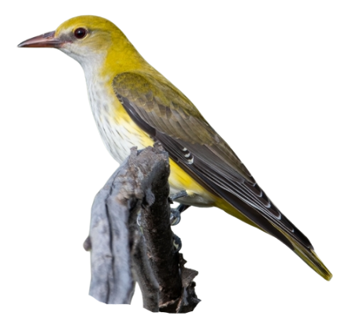
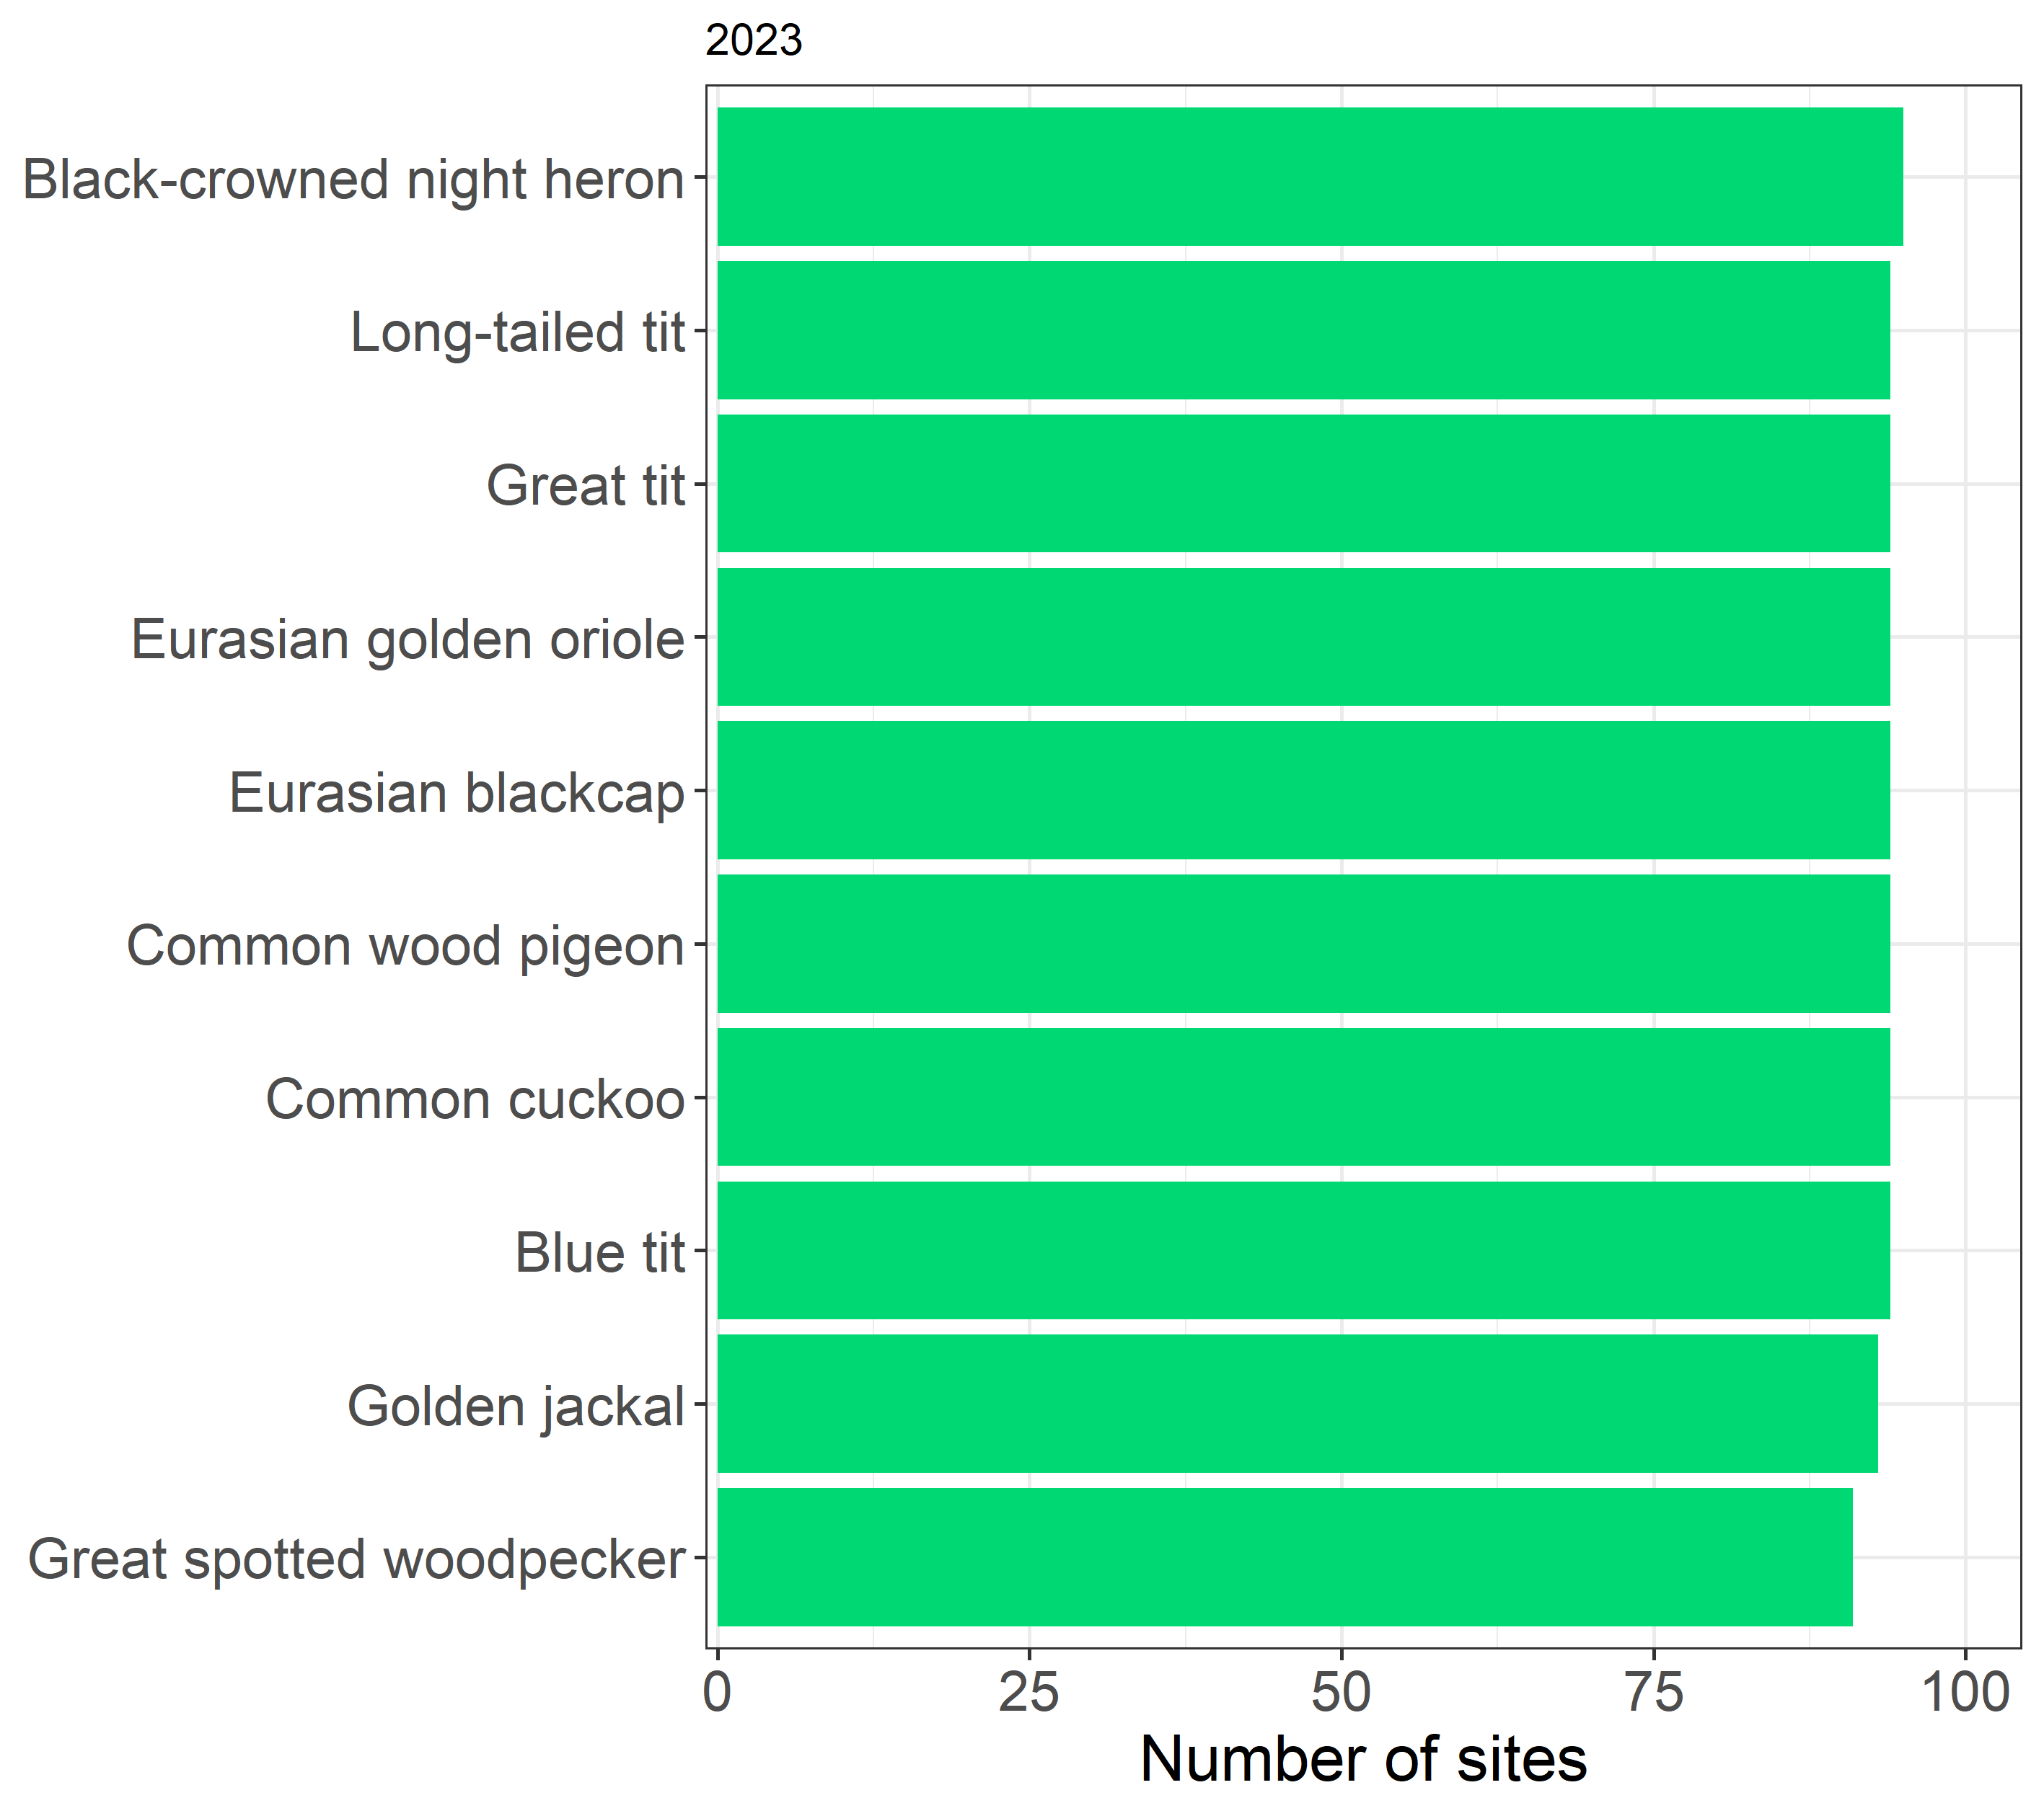
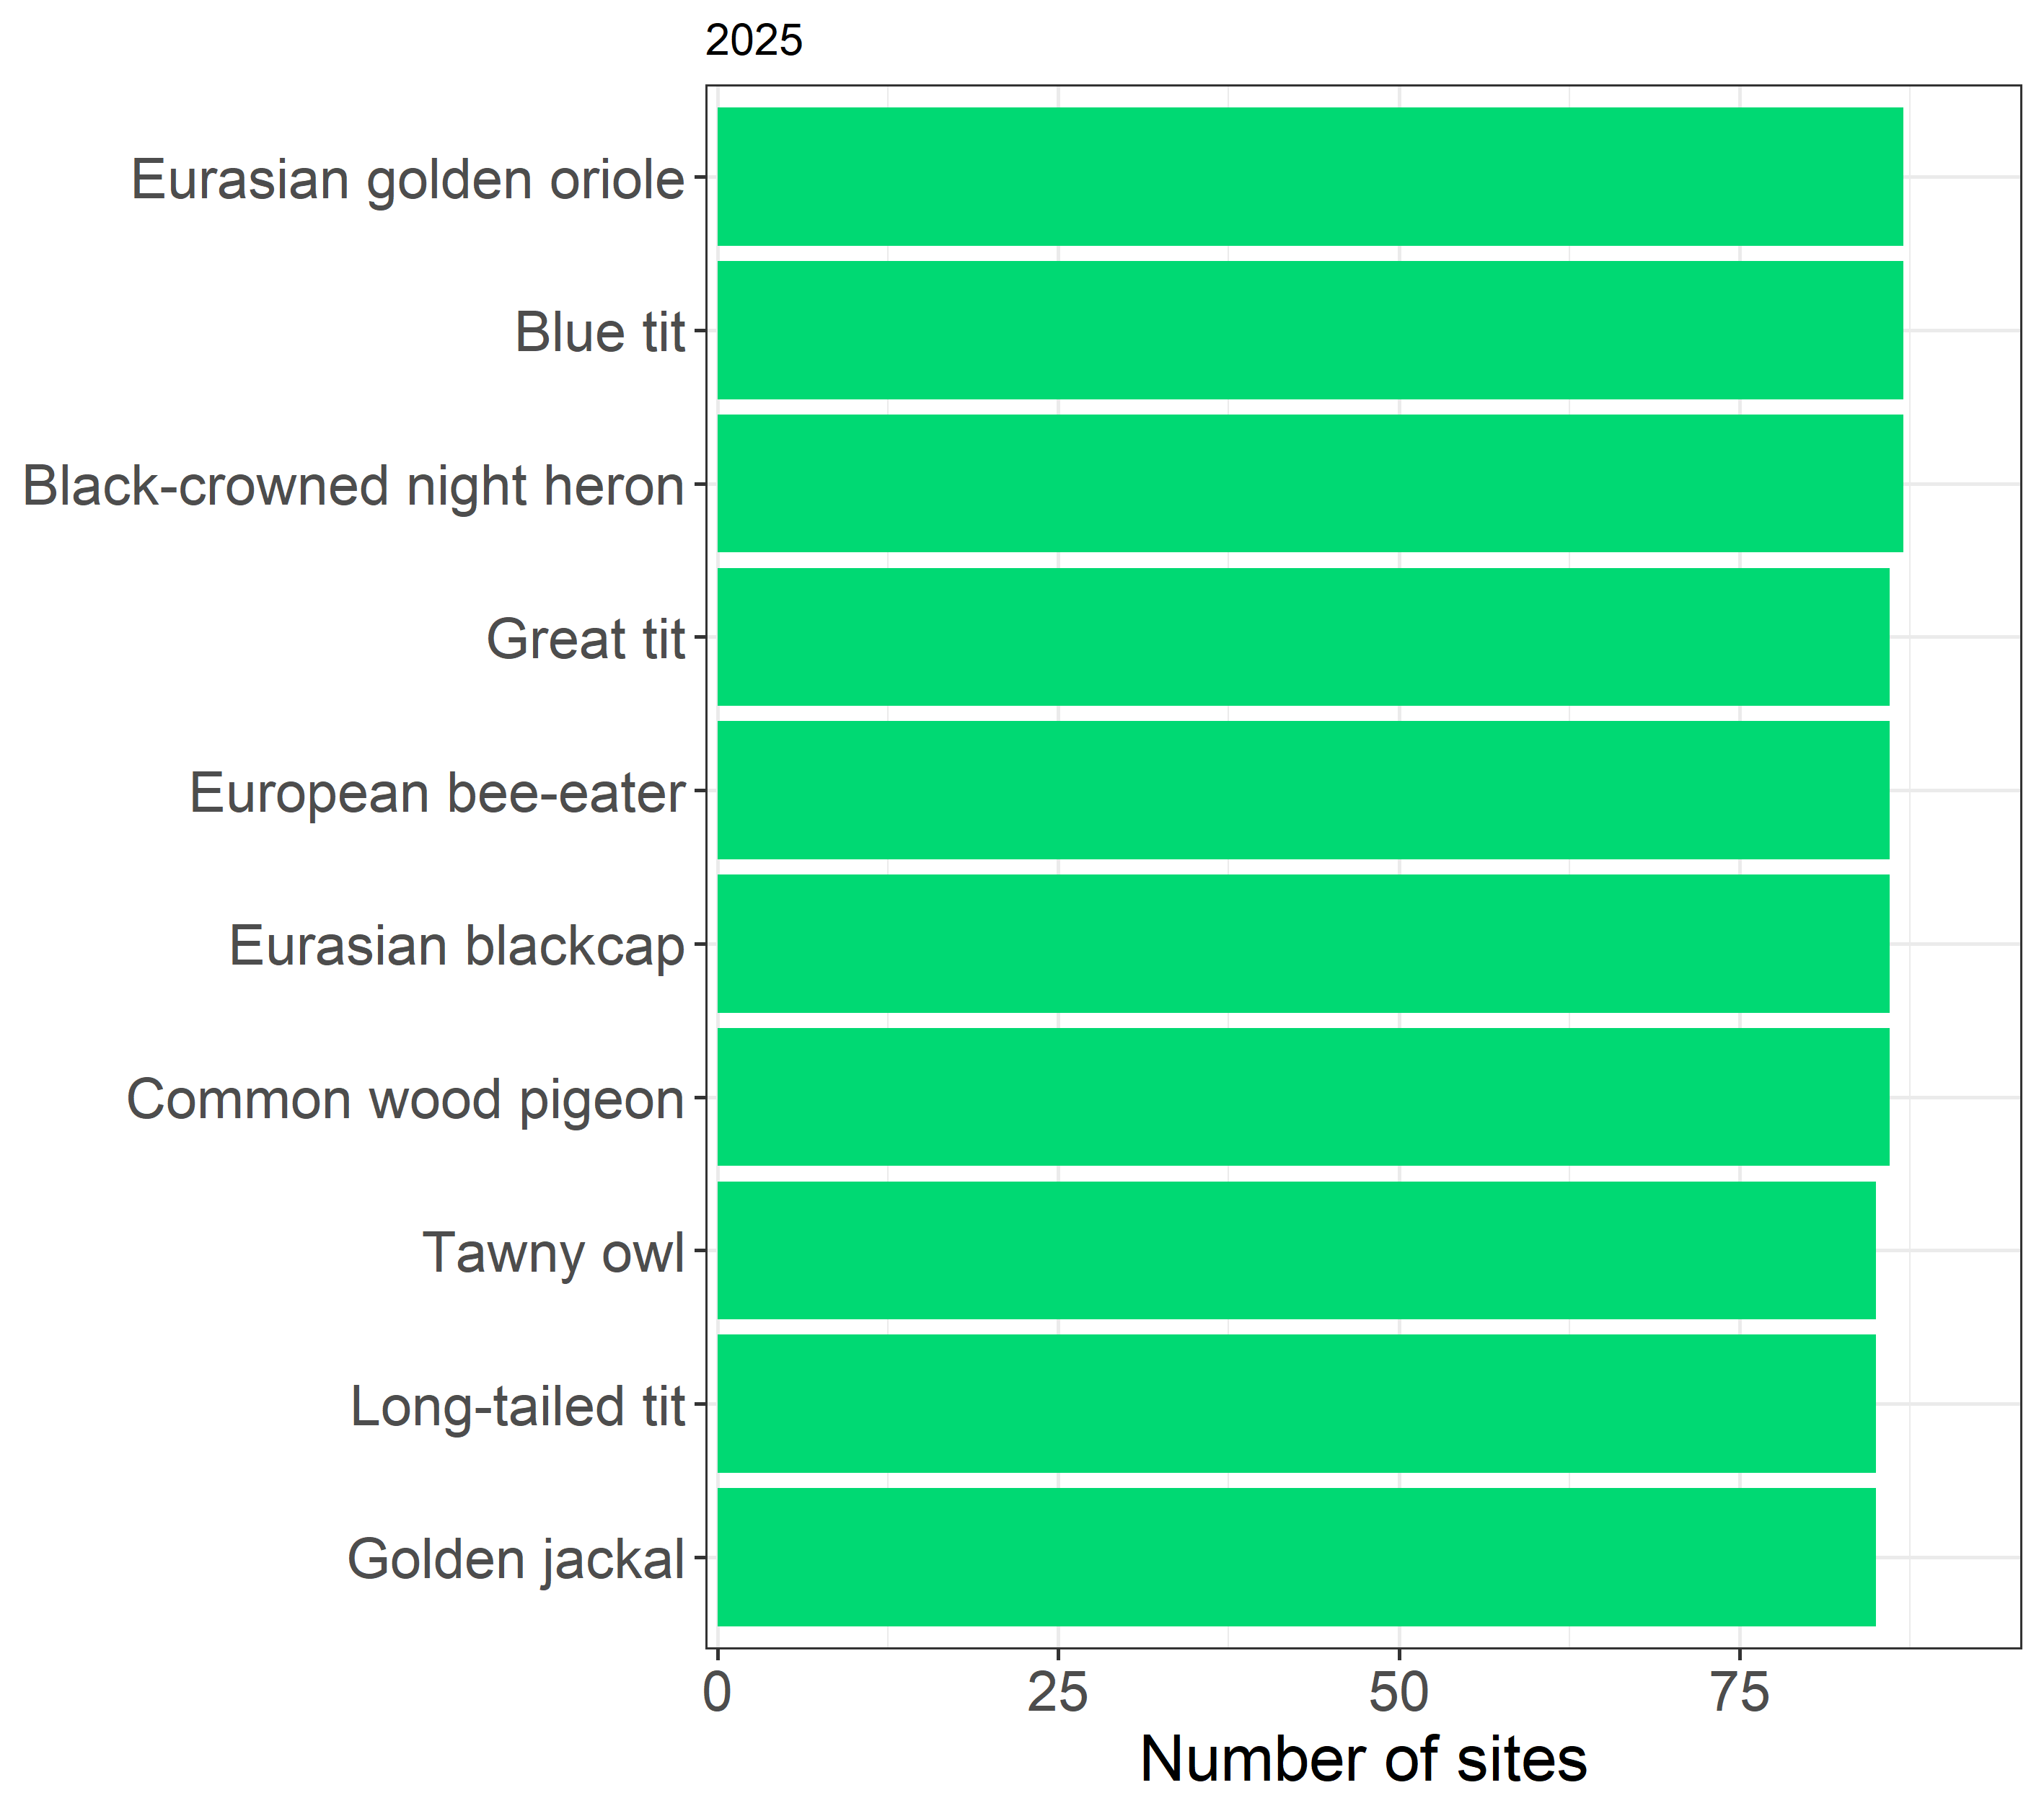
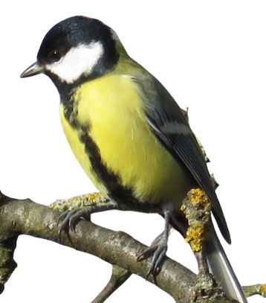
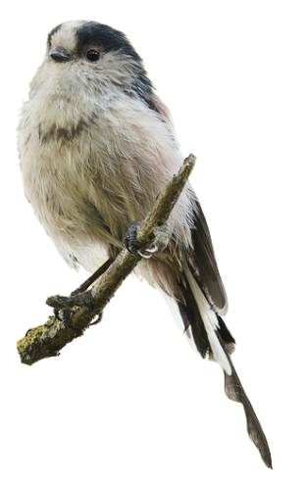
Results
Most detected species
Notes:
These are the species we heard at the most sites. In both 2023 and 2025, the top ten were heard at almost every site: the golden oriole, the blue tit, the great tit, and even the golden jackal. We can see a high number of species widely distributed

Slide 14
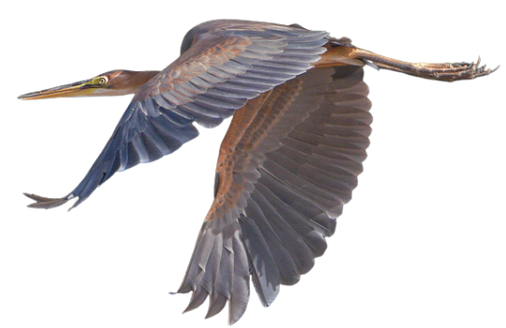
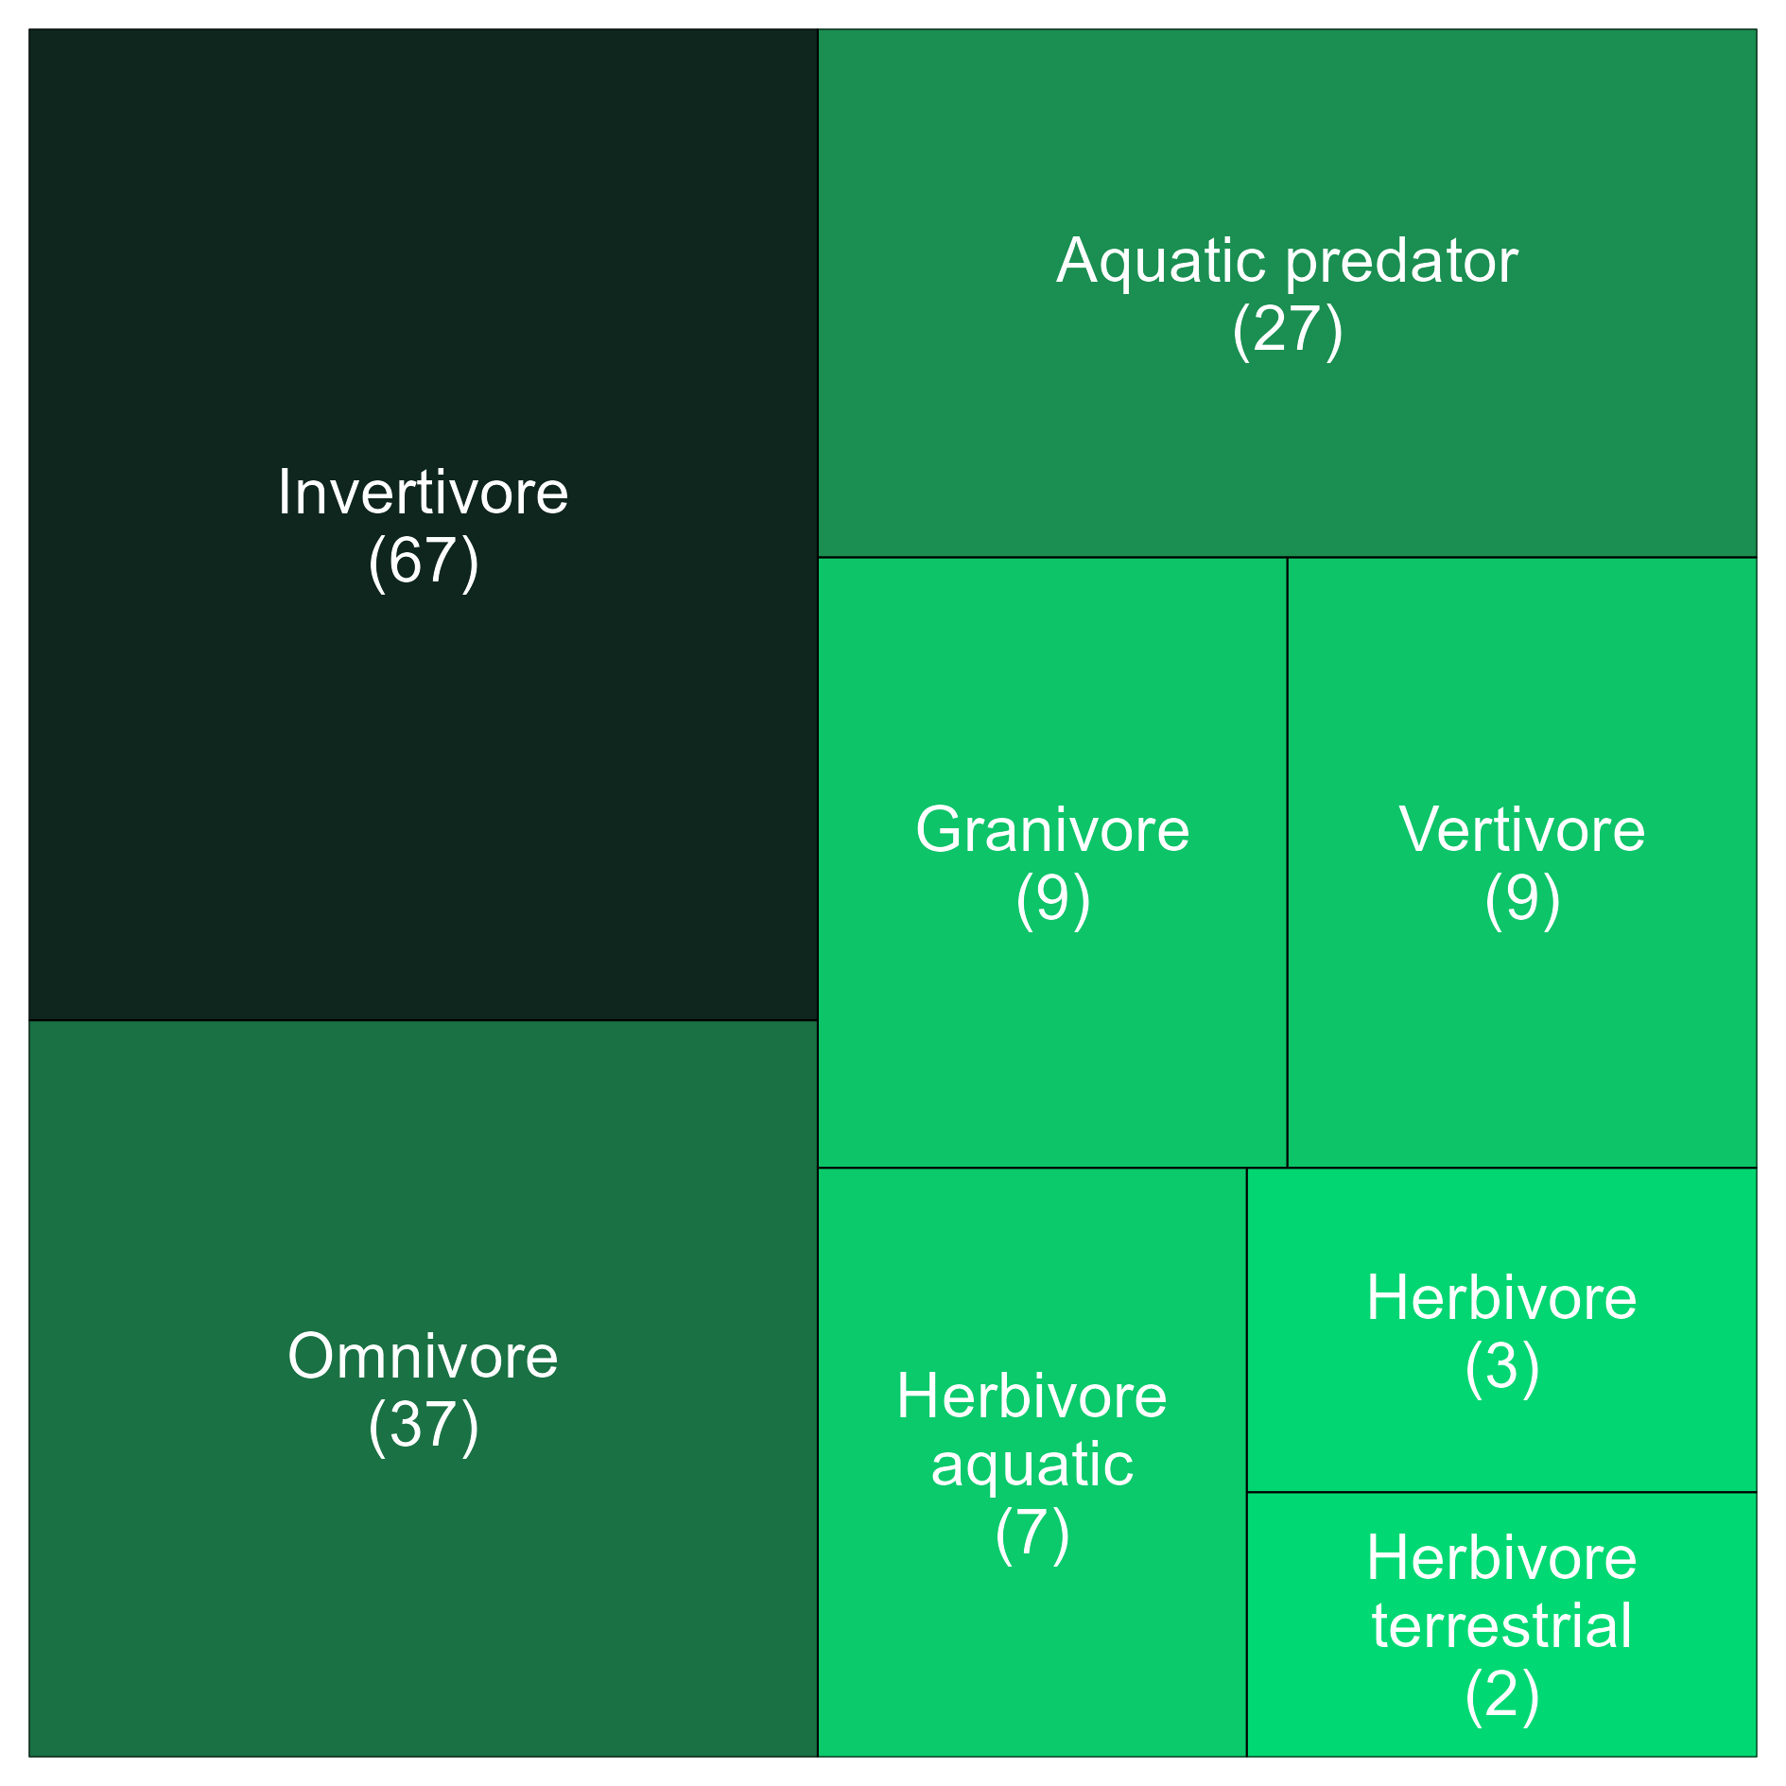
Species
Composition
By Diet
1 in 5 species feeds in or near water
Notes:
When we group the species by what they eat, the largest group eats insects and other small animals. But look at this block: 27 species are water hunters, like herons and kingfishers. Together with the water-plant eaters, about one in five species feeds in or near the water. That is the signature of a wetland. We don’t see this incredible number of water associated species in other systems

Slide 15
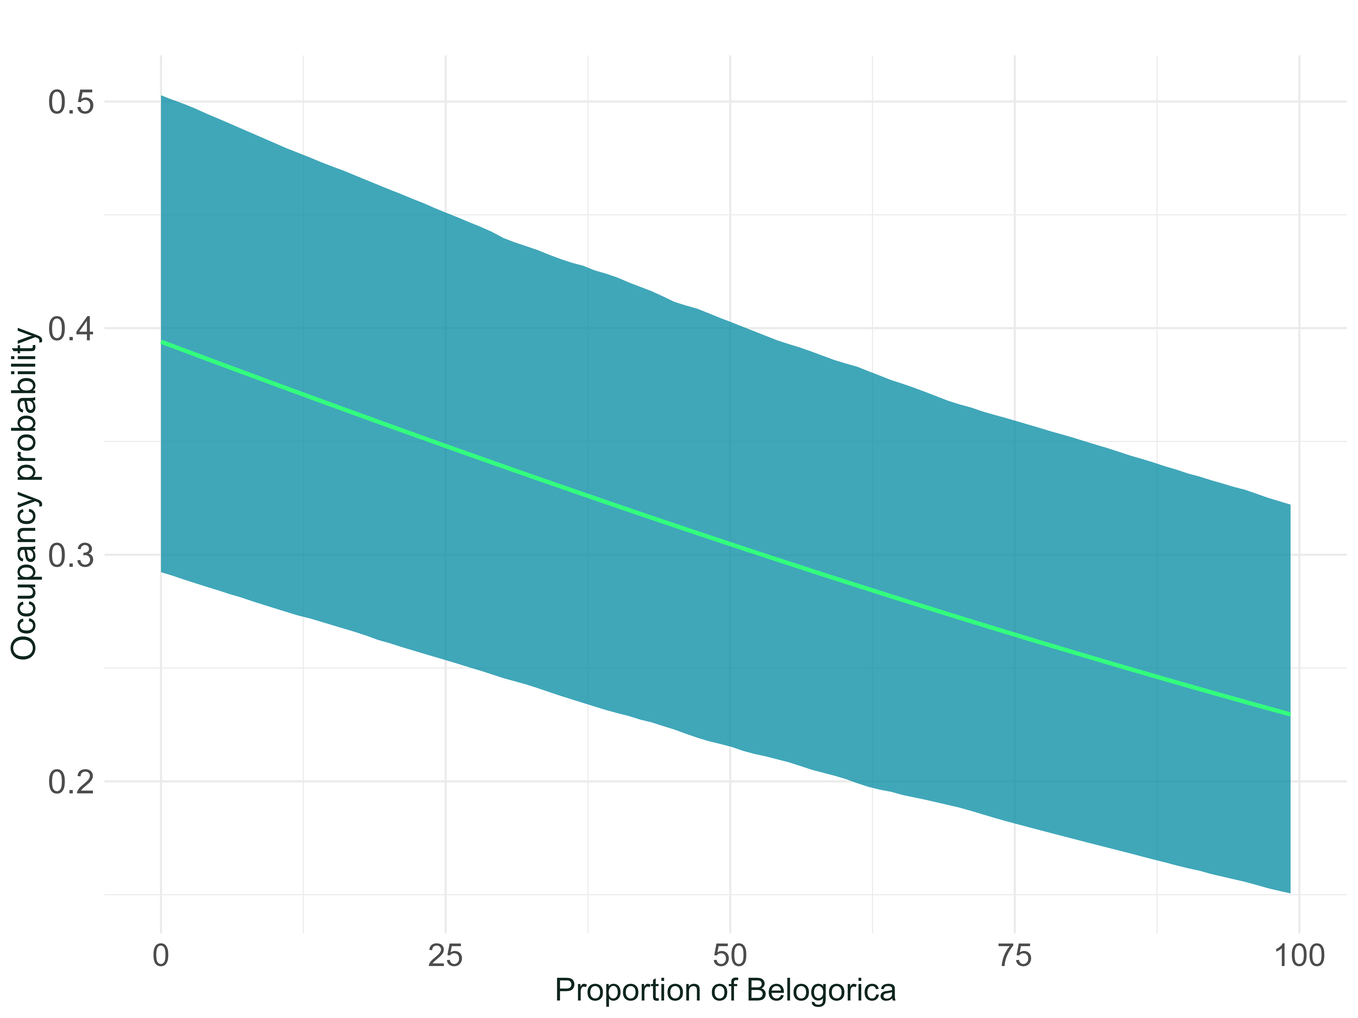
Results
Species occupancy
Bird community
Mammals: no response to any habitat variable (some species used the whole park)
Amphibians: fewer occupied sites where Belogorica dominates
Birds: also had a negative response to Belogorica, and positive to water ground
Notes:
Now, where do species live? For mammals, we found no clear link with any habitat. They move a lot, and some, like the golden jackal, use almost the whole park. For frogs and toads, and for most birds, the chance of finding them was lower where there is more Belogorica forest cover. You can see it in this graph: as Belogorica goes up, bird occupancy goes down. But about ten forest birds, like the robin and the jay, show the opposite: they prefer this forest. Birds were also more common on wetter ground. So the type of forest, and water, sort the species.
European Otter

Slide 16
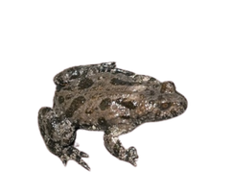
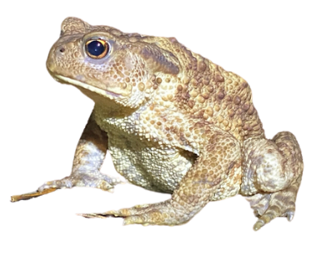
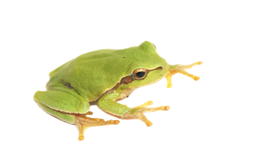
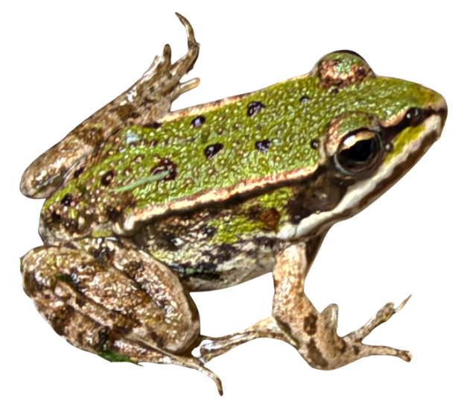
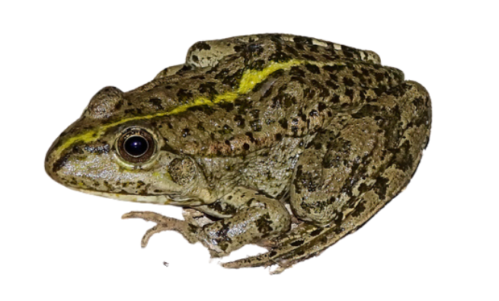
Results
Trends
Birds and mammals are stable
Amphibians declined ~ 38% of occupancy
What led to this trend? Dry seasons? Will they recover?
Notes:
And is anything changing? For birds and mammals, the answer is no: from 2023 to 2025, their communities stayed stable. But frogs and toads are different. On average, their occupancy fell by 38% in 2024, and in 2025 it was still about 30% below 2023. The common toad fell the most. The fire-bellied toad and the tree frog dropped and then partly recovered. And two species, the pool frog and the marsh frog, actually increased. So the big question is: why? Was it the weather, the flooding, or just a very good year in 2023? With only three years, we cannot say yet. Many of you may know what happened in the park in those years, and I would love to discuss it.
Birds and mammals held steady from 2023 to 2025, but amphibian occupancy fell by 38%
Birds (126 spp.): 1.02 in 2024, 0.99 in 2025
Mammals (5): 1.10 and 1.01, wide uncertainty
Amphibians (5): 0.62, then 0.70; still ~30% below 2023

Slide 17
CONCLUSIONS
Notes:
Let me finish with what this means

Slide 18
Limitations & Future Recommendations
No local climate data
Water effects unresolved
Temperature, rainfall, and flood levels could explain the amphibian drop, but were not available
Satellite water indices gave counterintuitive results; field measures of flooded area and flood pulses are needed
Short time series
Turnover not modeled
Distinguishing cycles from directional change needs 5–10 years
Stable totals can hide local extinctions and colonizations
Notes:
First, some honest limits. We did not have local climate data, like temperature, rain and flood levels, and these could explain the drop in frogs and toads. The satellite water data gave surprising results, so we need to link with field measures of flooding to understand better. Three years is short: we need five to ten years to see real trends. And a stable total can hide local losses and gains, we didn't model local extinctions and colonizations directly (the mechanisms of changes)

Slide 19
Overall key project takeaways…
The acoustic baseline is ready to support new research
A baseline for the park
Forest type sorts species
Birds and mammals are stable
Amphibians need attention
1
2
3
4
164 species from 4.4 million minutes at 98 sites, including 5 of conservation concern
164 species (4.4 million minutes), including 5 of conservation concern + 5 focal species
Belogorica cover separates forest specialists from wetland and open-habitat species
Community occupancy stayed near 2023 levels through 2004 and 2025
Occupancy fell 38% in 2024; Why (hydrology, climate)? Longer monitoring can explain why
Notes:
So, I leave you four key messages. One: we now have an acoustic baseline for the park, with 164 species monitored, five of them at risk. Two: the type of forest sorts the species. Three: birds and mammals were stable. Four: frogs and toads need attention.

Slide 20
Technology should not be a substitute for humans, but a powerful tool that can help us listen to and understand wildlife
I hope this project inspires us to keep the voices of the animals alive in Kopački rit Nature Park, so that future generations can continue to hear them
https://watchout.com.hr/
Notes:
Technology should not replace people. It is a tool that helps us listen to wildlife and understand it. I hope this project inspires us to keep the voices of PARK alive, so that future generations can continue to hear them.

Slide 21






Acknowledgment
Notes:
This project was carried out by many hands and many organizations. I thank everyone for their collaboration. Thank you all. I'm happy to take your questions

Slide 22


Q&A session

Slide 23



Slide 24

Listening to Kopački rit: Ecoacoustic insights from the WatchOut project
José W. Ribeiro Jr
Quantitative Ecology Lead
josewribeiro@wildmon.ai

Slide 25
Data Analysis
Ecological modeling
great spotted woodpecker
white-tailed eagle
golden Jackal
common tree frog

Slide 26
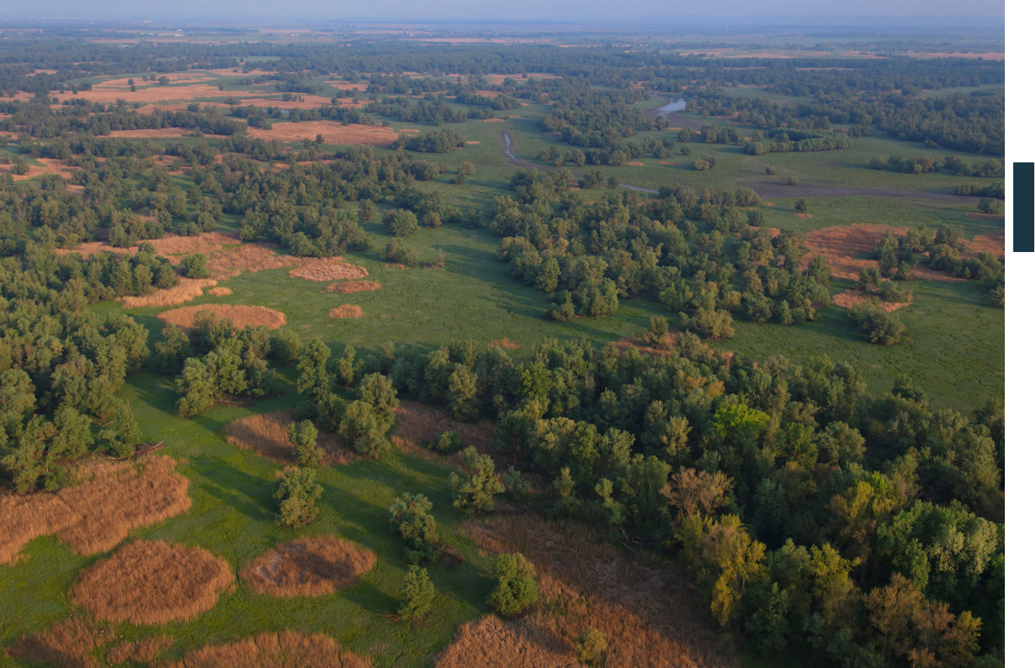
Study area
Kopački rit Nature Park, Croatia
4
Notes:
Danube–Drava floodplain, eastern Croatia. open water, wetlands, meadows, and deciduous forest. Aereial view of Kopački rit in Spring before the floods @gettyimages

Slide 27
Study area
Kopački rit Park, Croatia
4
Notes:
Danube–Drava floodplain, eastern Croatia. open water, wetlands, meadows, and deciduous forest. Aereial view of Kopački rit in Spring before the floods @gettyimages

