Slide 1





AQUATIC INSECT ASSEMBLAGES
IN MOUNTAIN STREAMS IN THE SLAVONIAN MOUNTAINS DURING THE WINTER SEASON
..
Sastav zajednice vodenih kukaca u gorsko-planinskim potocima područja Slavonskog gorja tijekom zimske sezone
.
Matea Dent^{1*,} Viktorija Ergović¹, Miran Koh¹, Predrag Simović^{1,2,}
Bogumił Łosiewicz^{1,3,4}, Barbara Vlaičević¹
2.10.2026.

Slide 2
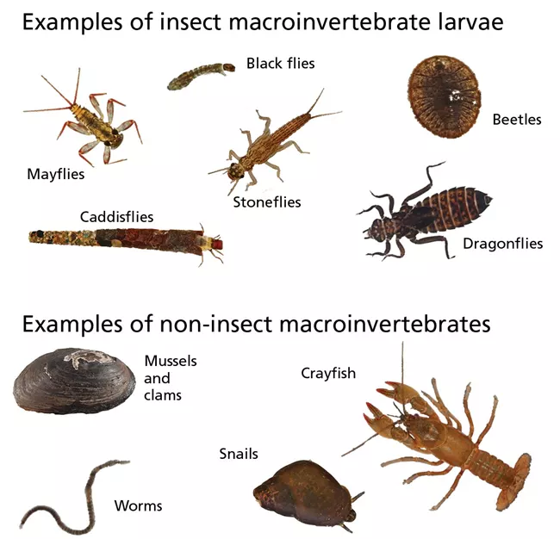
Benthic macroinvertebrates
Macrozoobenthos: invertebrates living on or in the bottom, larger than 500 µm
  Ephemeroptera, Plecoptera, Trichoptera, Coleoptera, Odonata, Diptera, Gastropoda, Bivalvia, Hirudinea (Hirudinida), Crustacea, Oligochaeta and Platyhelminthes (Turbellaria)
Slow-moving with long life cycles, community change reflects water quality
A biological quality element for stream status under the Water Framework Directive (2000/60/EC)
Limiting factors: dissolved oxygen, temperature, pH, nutrients, suitable microhabitat

Slide 3
Ephemeroptera (mayflies), Plecoptera (stoneflies), Trichoptera (caddisflies) groups (EPT)
Dominant fauna of mountain streams
Merolimnic: larvae in water, adults on land, linking aquatic and terrestrial habitats
Secondary producers: food for other predators
Sensitive to changes in environmental conditions

Slide 4
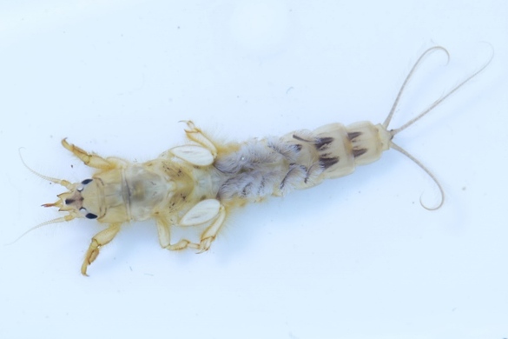
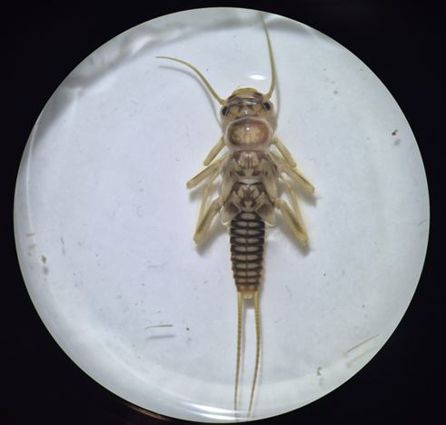
Ephemeroptera: Ephemera danica Müller, 1764
Plecoptera: Perla sp.

Slide 5
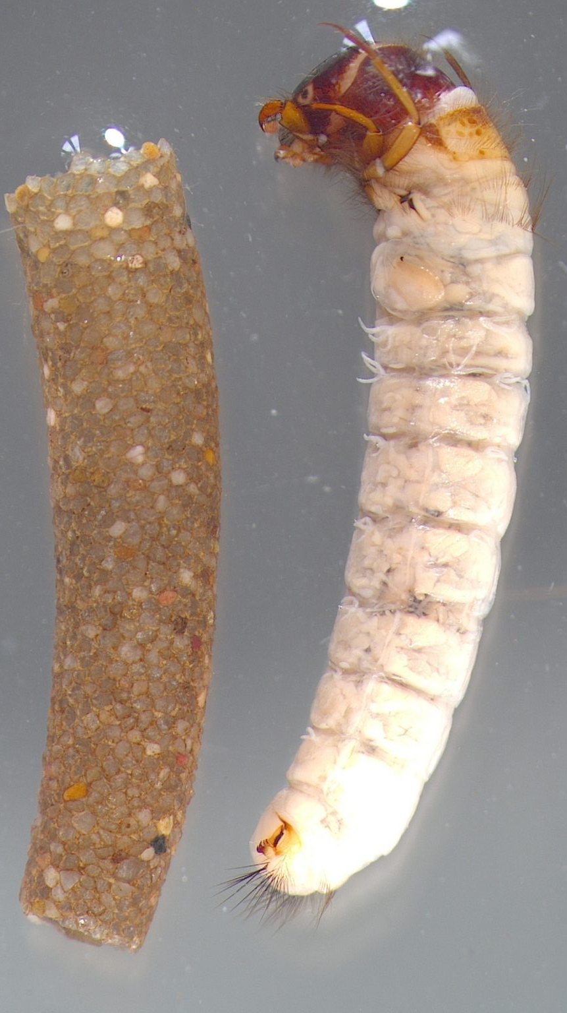
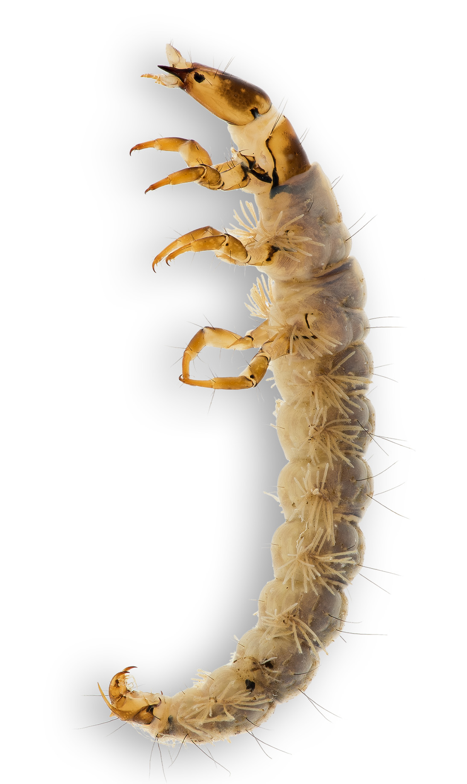
Trichoptera: Sericostoma sp. (left) Rhyacophila sp. (right)

Slide 6
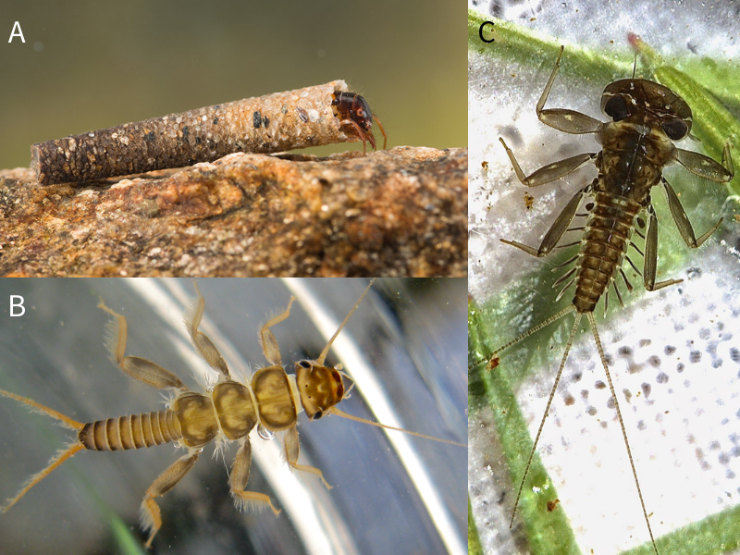
Adaptations to fast-flowing water
Ephemeroptera
  dorsoventrally flattened body reduces drag; enlarged femur (Ecdyonurus); single claw and three cerci grip stones
Plecoptera
  very similar adaptations; no lateral gills on the body; two claws and two cerci
Trichoptera
  case-less species anchor with silk (Hydropsyche); mineral cases as a barrier to current (Drusus sp.); strong muscular body
Caddisfly larvae, Trichoptera (A); Stonefly nymph, Plecoptera (B); mayfly nymph, Ephemeroptera (C)

Slide 7
Microhabitats - substrate types
Lithal: stone and rock (lithobionts)
Akal and psammal: gravel (akobionts) and sand (psammobionts)
Pelal and phytal: mud (pelobionts); macrophytes and moss (phytobionts)
Flow velocity determines substrate composition, which defines the microhabitat
At higher altitudes fine sediment is washed out and stones of various sizes remain

Slide 8
Mountain streams features
Lotic systems: one-way flow, physical and chemical conditions change from source to mouth
Mostly forested, with low and stable water temperature and high dissolved oxygen
Heterogeneous substrate
  cobbles (6-20 cm), pebbles (2-6 cm), gravel (0.2-2 cm)
Altitude limit for mountain streams: 500 m
Shaped by floods, erosion, ice cover, precipitation and climate change

Slide 9
Study area - Papuk and Psunj
Papuk
  Nature Park (1999), first Croatian Geopark (2007)
  Highest peak 953 m; protected area 336 km² (with part of Krndija)
  Older granitoid rocks, schists and limestone (karst elements)
  Network of over 100 streams; watershed between the Sava (south) and the Drava (north)
  About 95% forest: beech, oak and fir

Slide 10
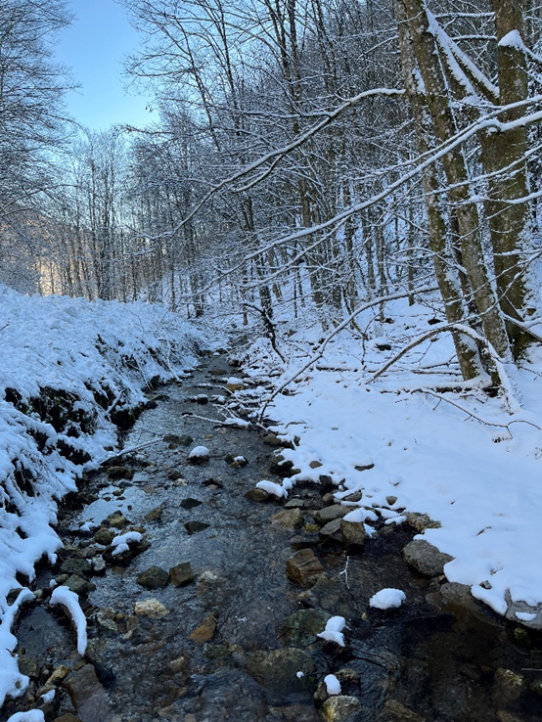
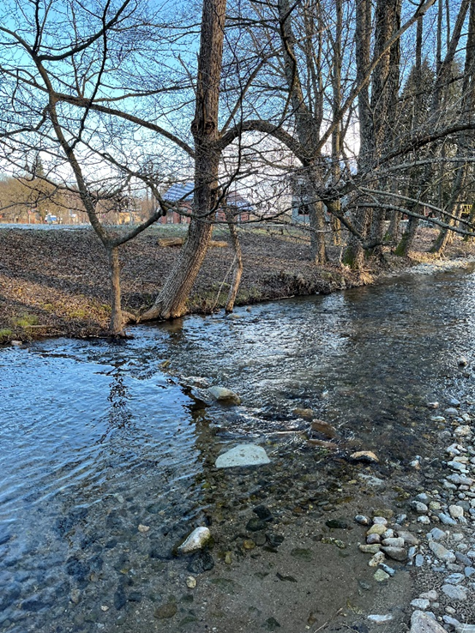
Kovačica viša (left) Kovačica niža (right) - Papuk)

Slide 11
Psunj
  Highest of the Slavonian mountains, not protected
  Highest peak Brezovo polje, 984 m
  Oldest rock complex in Croatia (Precambrian metamorphism): schists, gneisses, marble, metagabbro
  Similar geology to Papuk
  Lies south-west of Papuk
  Both are remnants of islands of the Paratethys (Pannonian) Sea, in eastern Croatia
  Brzaja rises on Papuk and flows down to Psunj

Slide 12
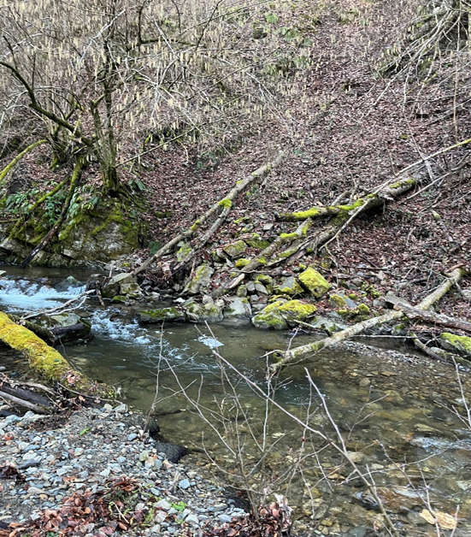
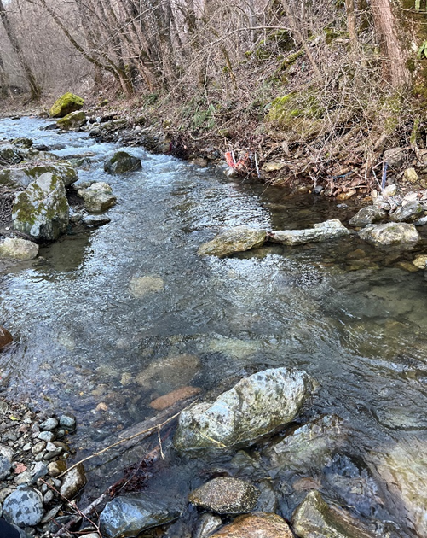
Sivornica viša (left) Sivornica niža (right) - Papuk)

Slide 13
Study area and sampling design
Streams: Kovačica, Bijela and Brzaja (Papuk) Cikotska, Sivornica and Brzaja (Psunj)
10 sites: one below and one above 500 m a.s.l. in each stream (216-765 m)
Sampled February to early March 2025, adapted AQEM method, hand net 25 x 25 cm, 500 µm mesh
3 dominant microhabitats x 3 replicates = 9 samples per site, 90 samples in total
Samples fixed in 96% ethanol; EPT identified to the lowest possible taxon

Slide 14
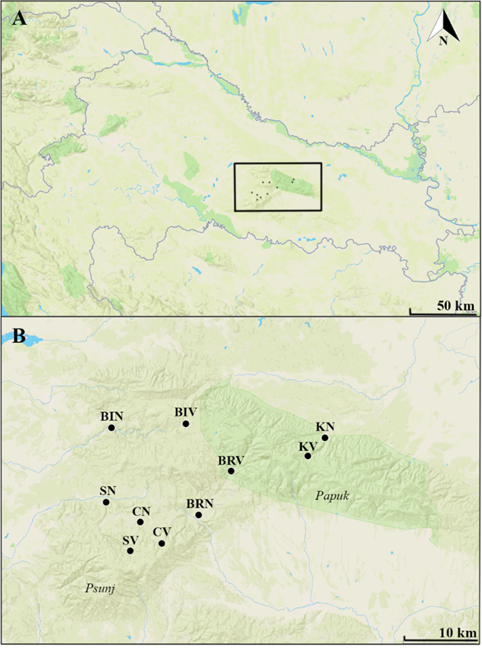
Study area – Papuk and Psunj
A – study area, central and eastern Croatia, the square marks the sites shown in B – sampling sites on Papuk and Psunj

Slide 15
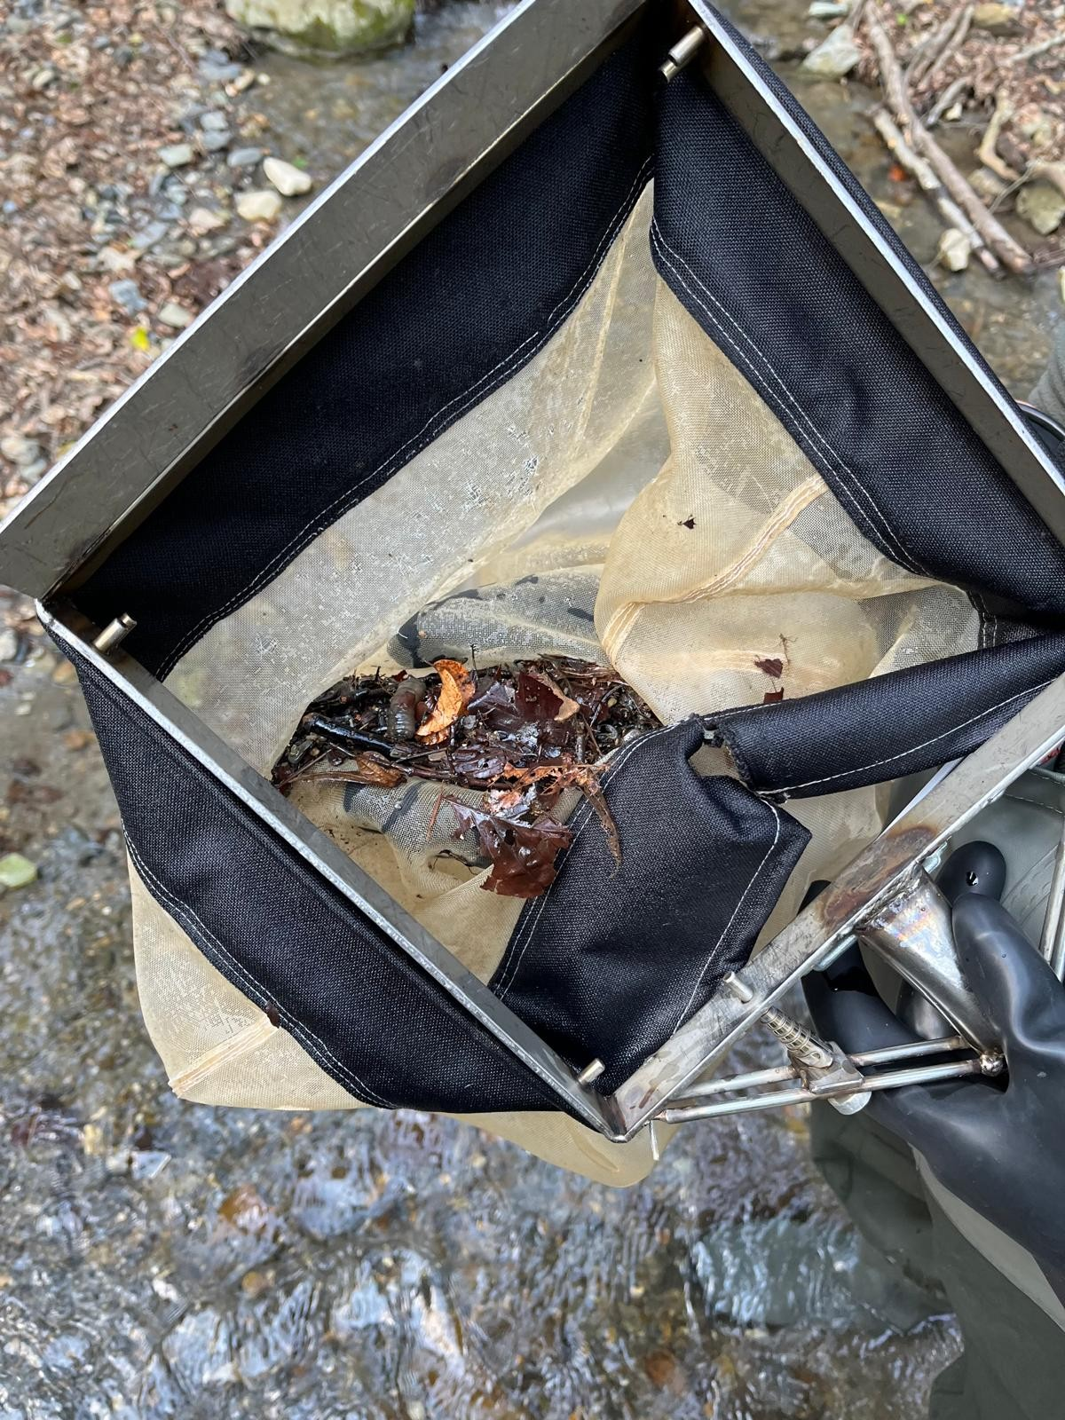
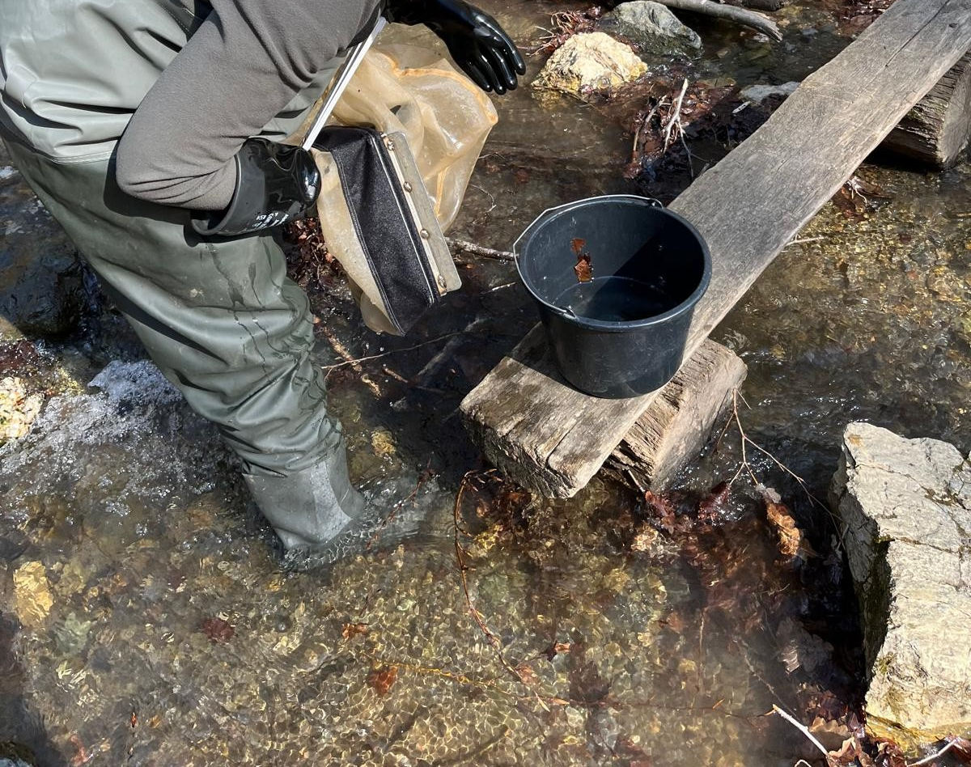
A
B
Macrozoobenthos sampling process (A, B)

Slide 16
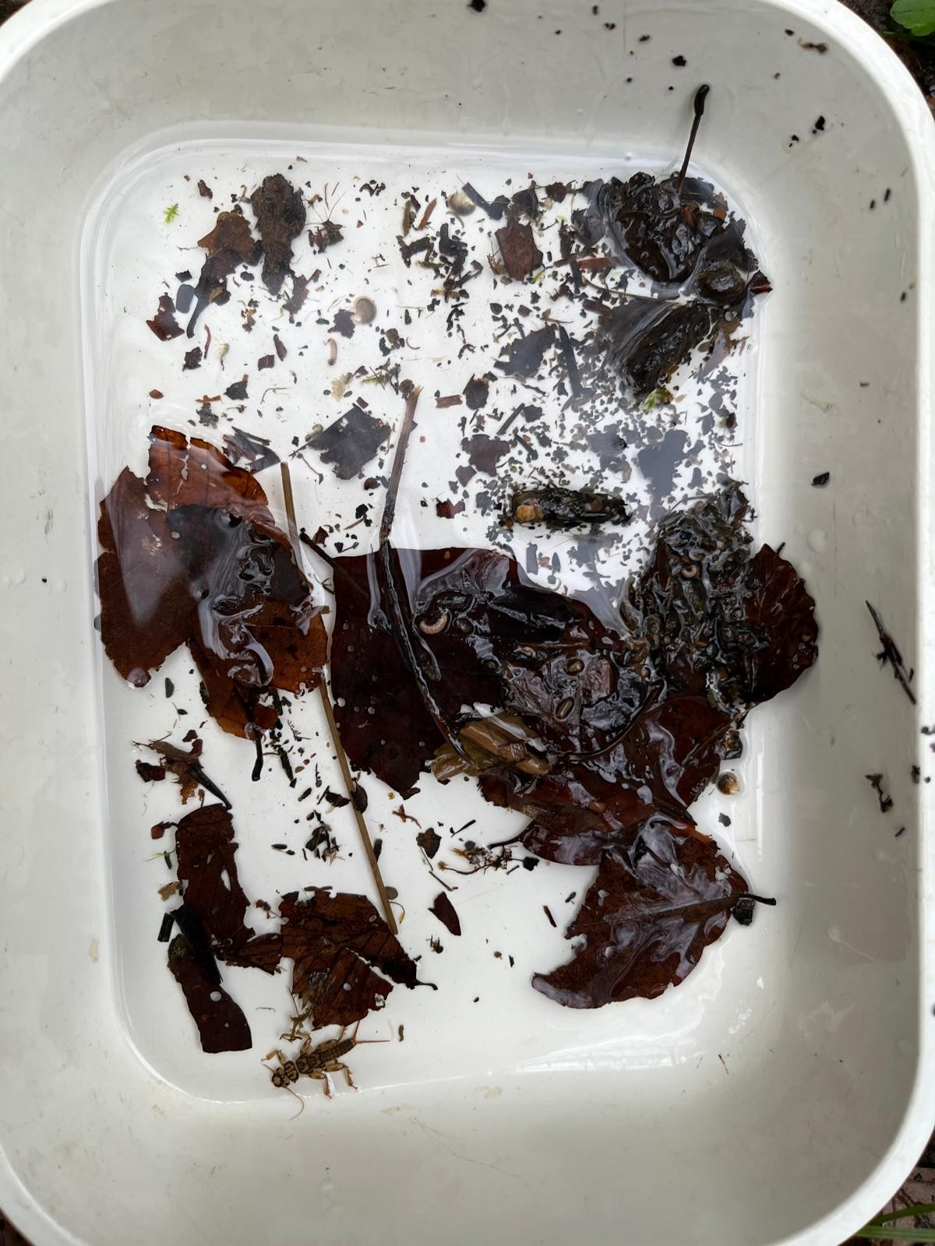
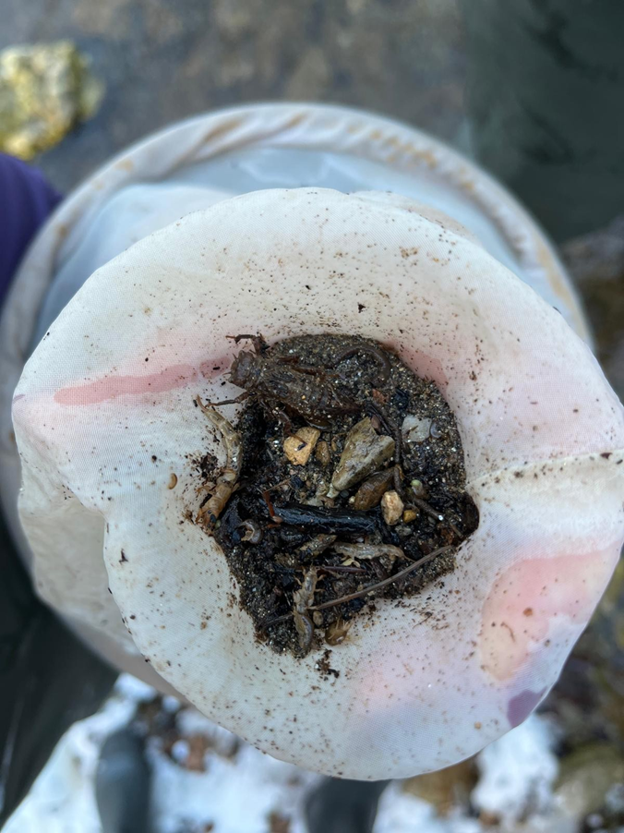
C
D
Macrozoobenthos sample (C, D)

Slide 17
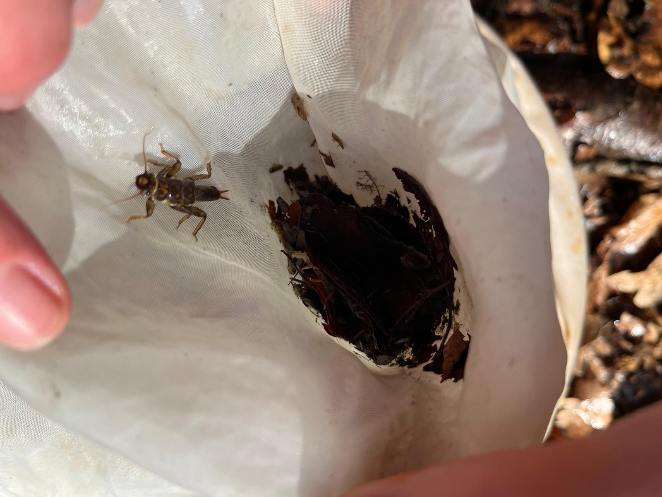
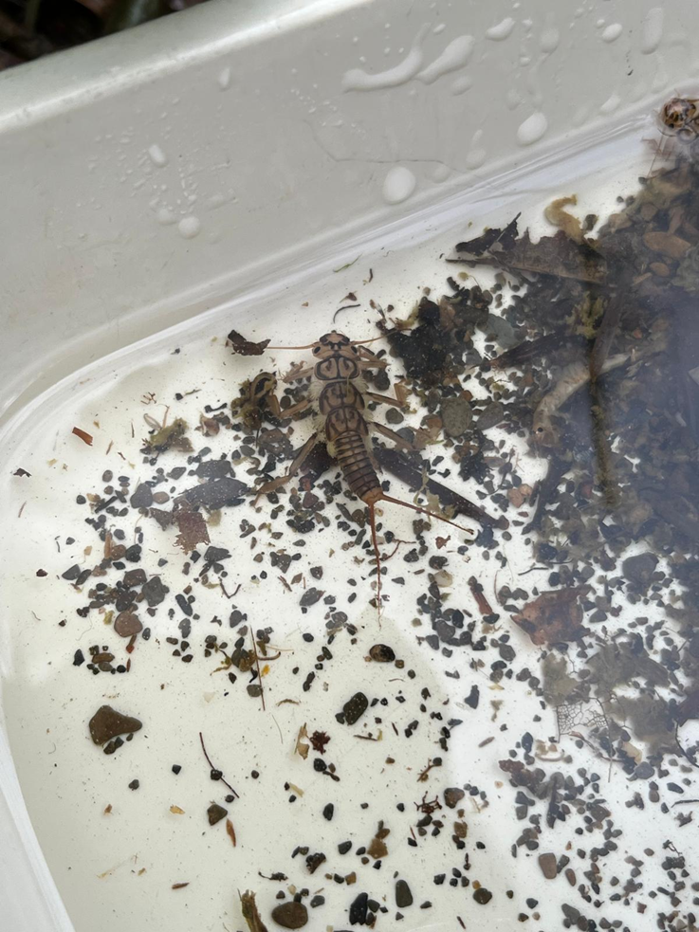
Macrozoobenthos sample in the net (left), Plecoptera sp. (right)

Slide 18
Results
90 macrozoobenthos samples were analysed from 10 sites on Papuk and Psunj, with Diptera dominant at five sites (up to 59.43% at Cikotska niža)
Baetis rhodani and Brachyptera risi were the most abundant EPT species (up to 1095 and 1049 ind./m²), while among Trichoptera Glossosoma (up to 366 ind./m²) and Stenophylax (up to 809 ind./m²) dominated
according to the Shannon index, the highest diversity was recorded at Cikotska niža (H' = 2.542) and the lowest at Sivornica niža (H' = 1.265)
bed width (F = 10.34), pH and altitude were the strongest factors (RDA, p = 0.001), and indicator species were linked to akal, microlithal and megalithal substrates

Slide 19
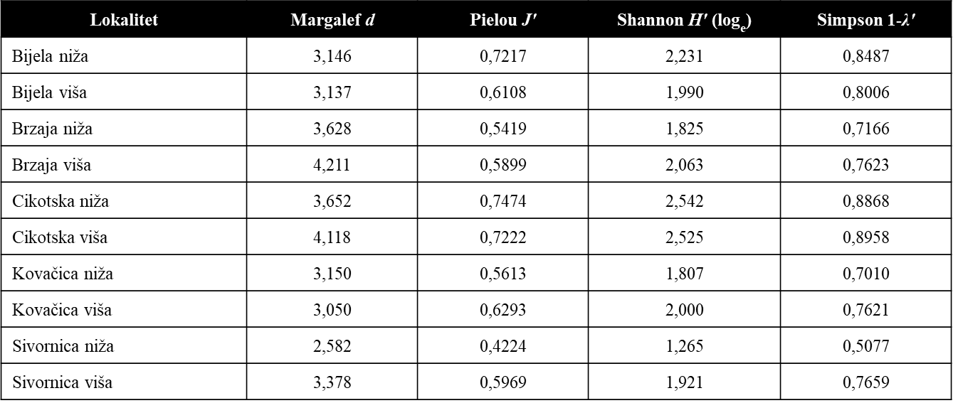
Diversity and evenness indices at the studied sites

Slide 20
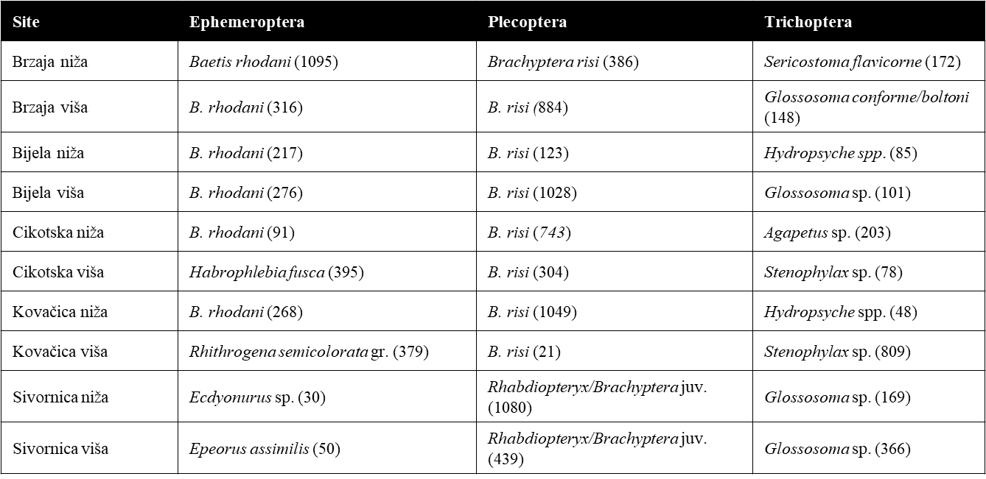
Dominant EPT taxa per site (ind./m2)

Slide 21
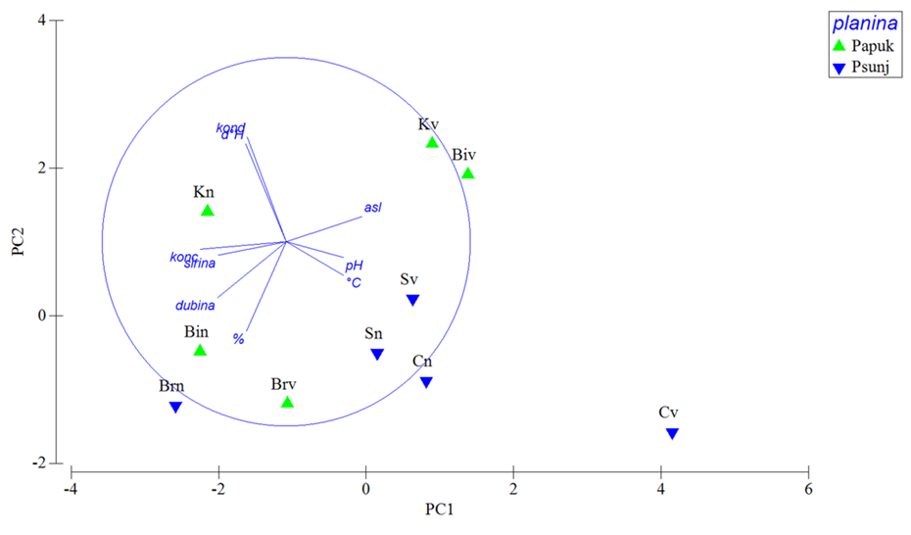
PCA analysis (Principal component analysis)
PCA: the first two axes explain 69.4% of variance
PC1 is driven by dissolved oxygen and altitude, PC2 by conductivity and hardness, and PC3 by pH

Slide 22
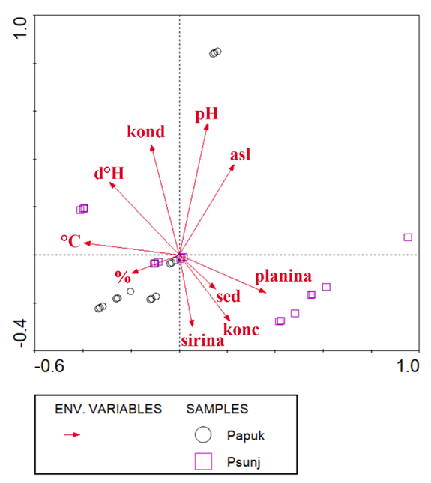
RDA analysis (Redundancy analysis)
All factors were significant except sampling depth
The strongest were bed width (F = 10.34), pH (F = 6.607) and altitude (F = 6.409), all p = 0.001

Slide 23
BEST analysis (Biota-environment matching)
Hardness, altitude, substrate type, bed width and mountain best explain the EPT community (ρ = 0.291 (p = 0.001))

Slide 24
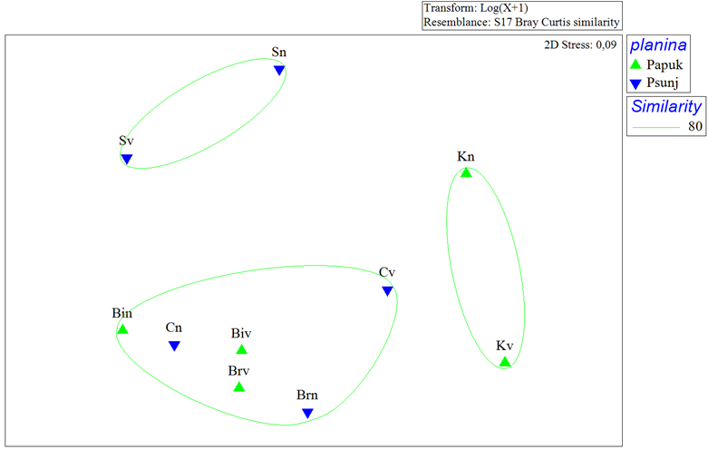
NMDS of macrozoobenthos
Sites grouped by mountain at 80% similarity
Sivornica viša and niža are most similar to each other; likewise, Kovačica viša and niža
Bijela, Brzaja, and Cikotska sites form a third group

Slide 25
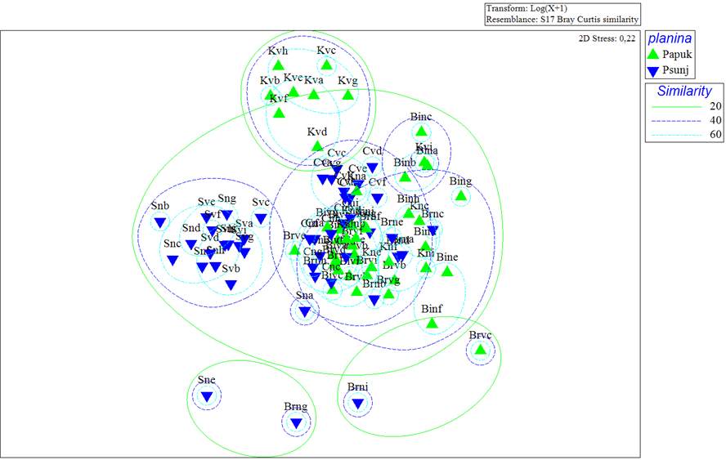
NMDS of the EPT community
Similarity of 20 to 60% between samples grouped by mountain
As with macrozoobenthos, Sivornica and Kovačica samples are the most similar within their groups

Slide 26
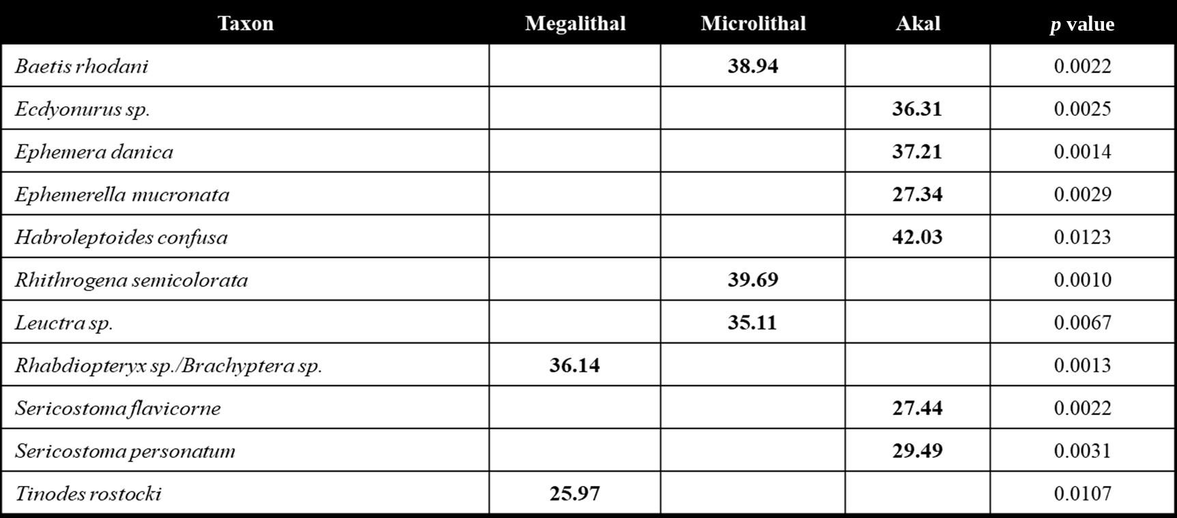
IndVal (Indicator species by microhabitat)

Slide 27
Conclusion
Dominant taxa: Baetis rhodani, Brachyptera risi, Glossosoma sp, and Stenophylax sp.; likely adapted to cold winter conditions and able to use varied microhabitats
Diversity was highest at Cikotska niža and viša and lowest at Sivornica sites (all on Psunj), reflecting differences in substrate structure and bed width
Indicator taxa were tied to akal, microlithal and megalithal substrates, so substrate type shapes EPT communities
In winter, stream morphology influenced EPT communities more than single physical and chemical water factors
For assessment and protection of mountain streams, consider bed characteristics, substrate heterogeneity and habitat structure alongside abiotic factors

Slide 28
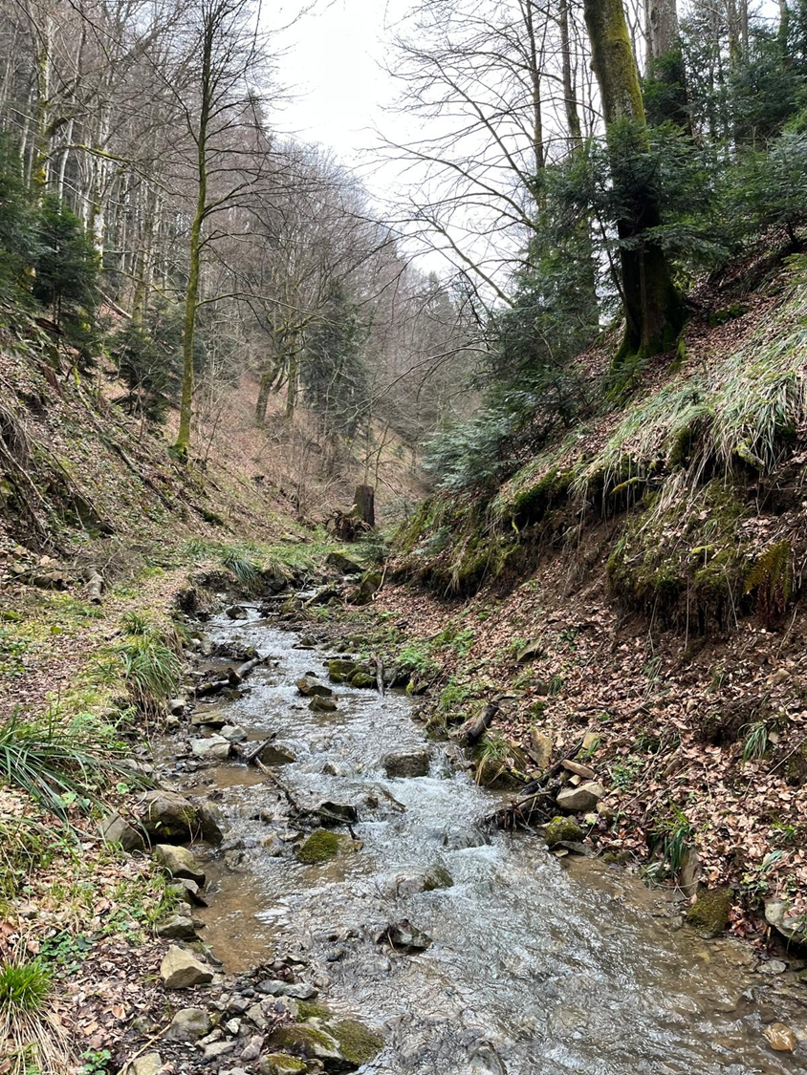
Thank you for your attention!☺

