Slide 1
GPS tracking of animals – what have we learned?
Lessons from developing and deploying a LoRa GPS tracker.
Dorian Tepić, Marko Augustinović
Kopački rit, 1. 10. 2026.

Slide 2
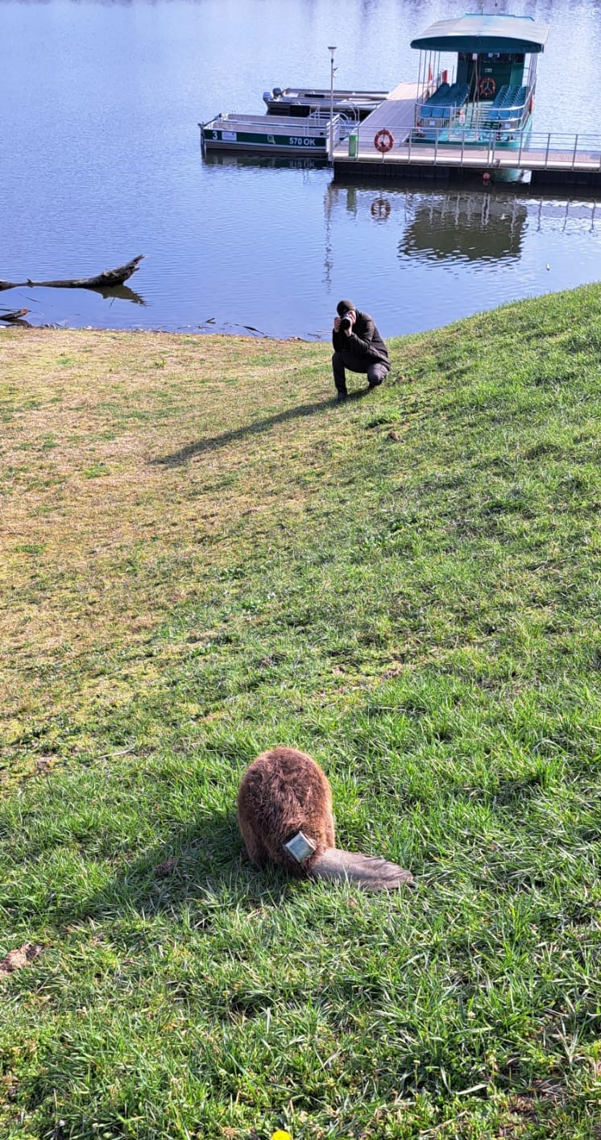
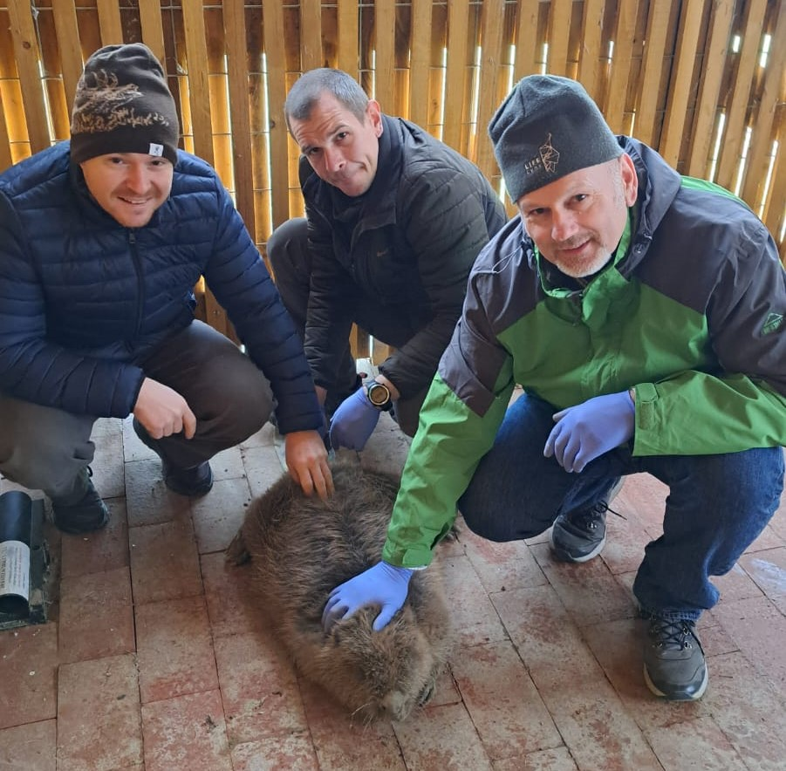
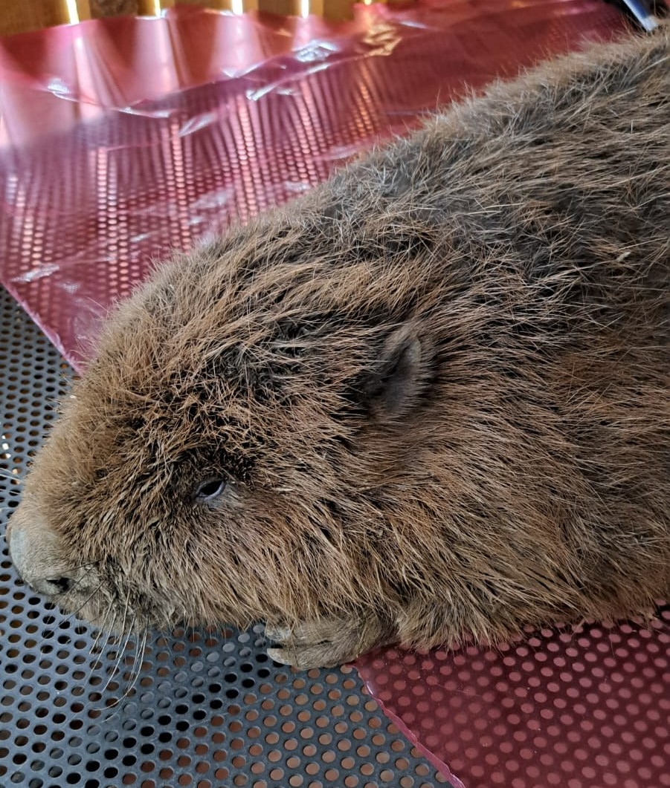
Where did it all started?
Project „Naturavita” Nature Park Kopački Rit in 2021.
Tracker bought in Osijek

Slide 3
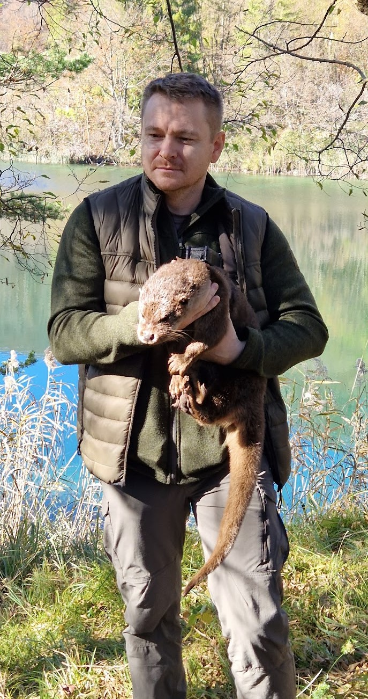
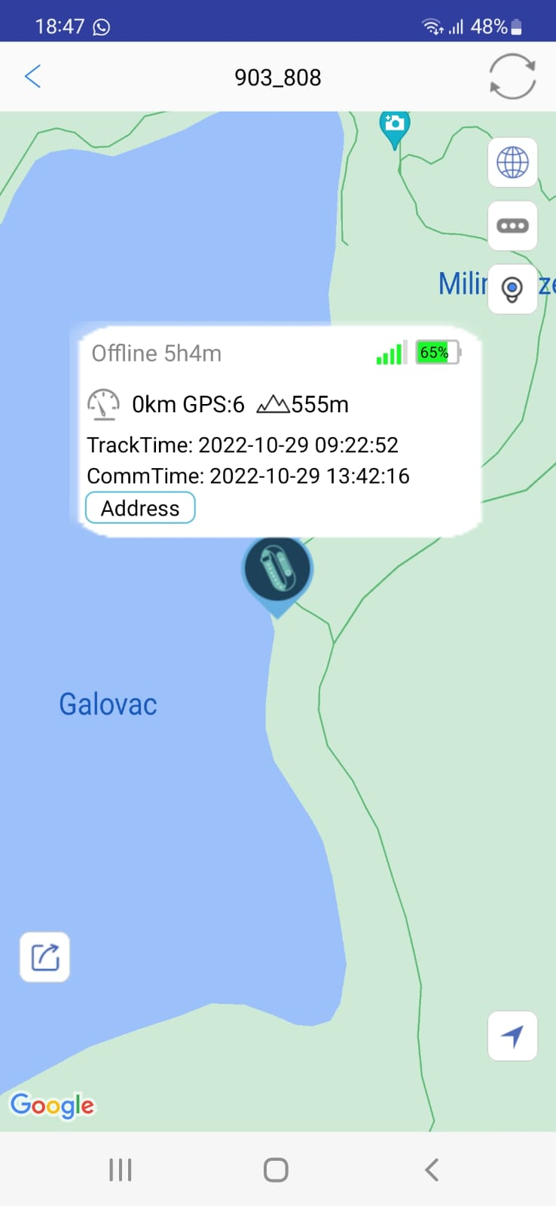
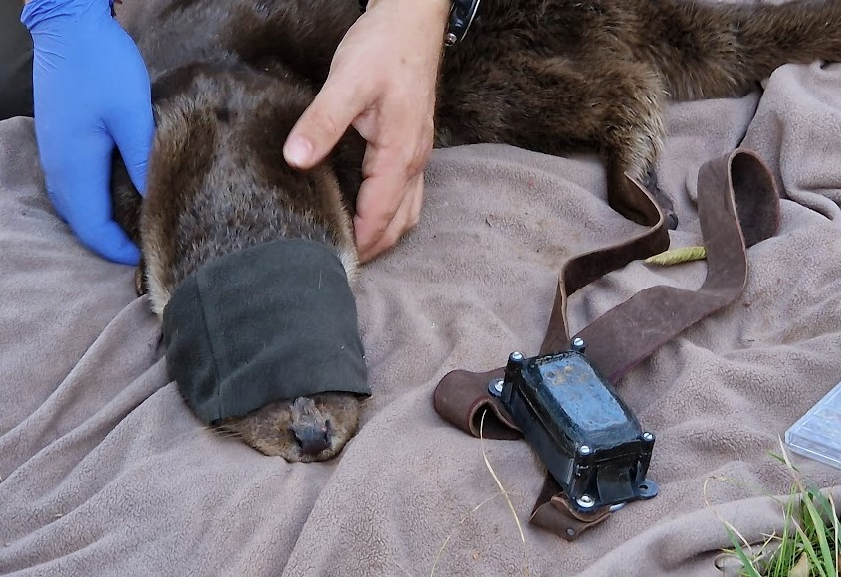
Where did it all started?
Otter in Plitvice Lakes National Park in late October 2022.
Tracker bought on eBay for a few euros
Lasted for several days and gave only a few locations

Slide 4
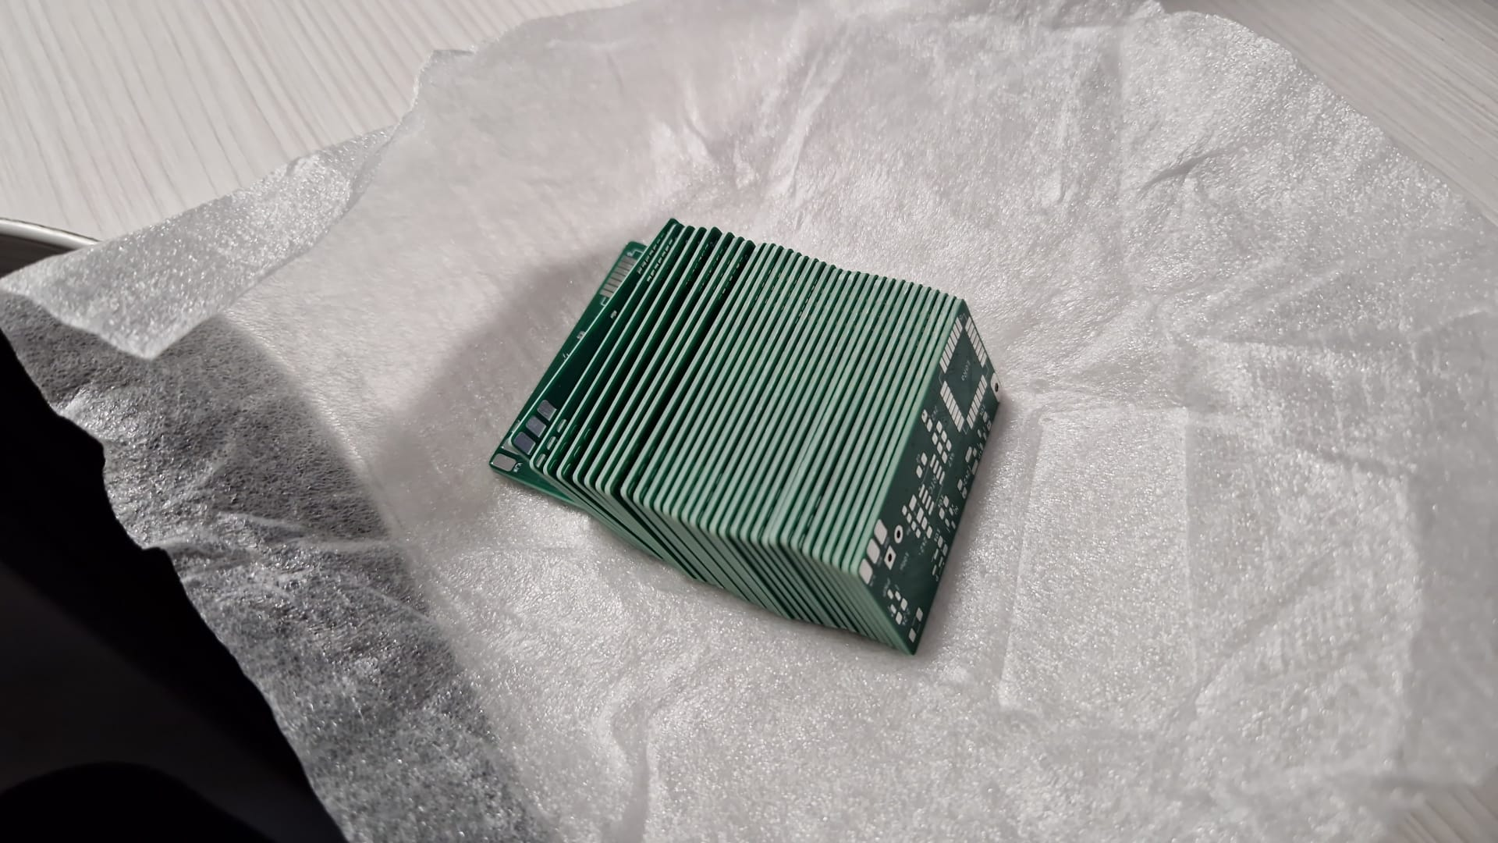
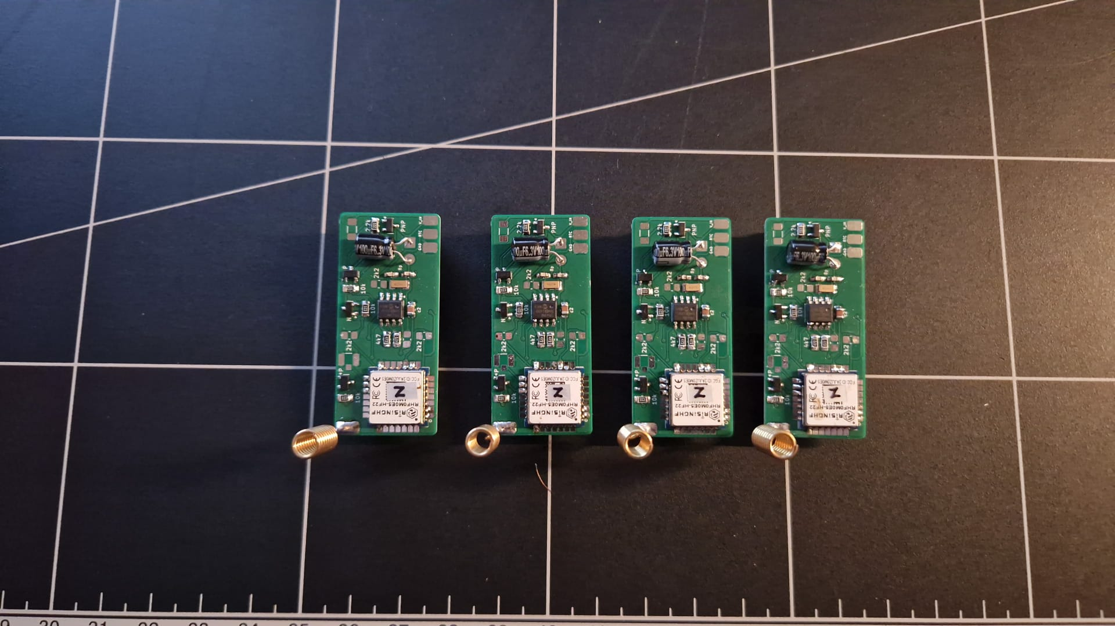
An idea was formed – "Let's build our own trackers!"
Version 1
Research & development consisted of:
  Market research
  PCB (electronics) design & manufacturing
  Programming
  Enclosure design & development
  Laboratory & field testing
The tracker featured:
  GPS module, LoRa module & a microcontroller
  3D printed housing and leather harness
  One A-size battery (3,600 mAh)

Slide 5
How does it work? – LoRa tracker & base stations
Version 1
LoRa (Long Range) technology:
  A radio technology built for sending small amounts of data over long distances
  Uses the licence-free 868 MHz band in Europe
  Range is several kilometres in open terrain, but drops significantly with obstacles, dense vegetation and bad weather
  Uses very little power, which means longer battery life than GSM or satellite trackers
Base stations (Oikon Gateways):
  Receive the signals from all trackers within range
  Forward the data over the mobile network to a server, where users can see the locations
  Oikon's private network is independent of public LoRaWAN coverage, which is very sparse in Croatia
  Can be placed or moved to follow the animals' home ranges

Slide 6
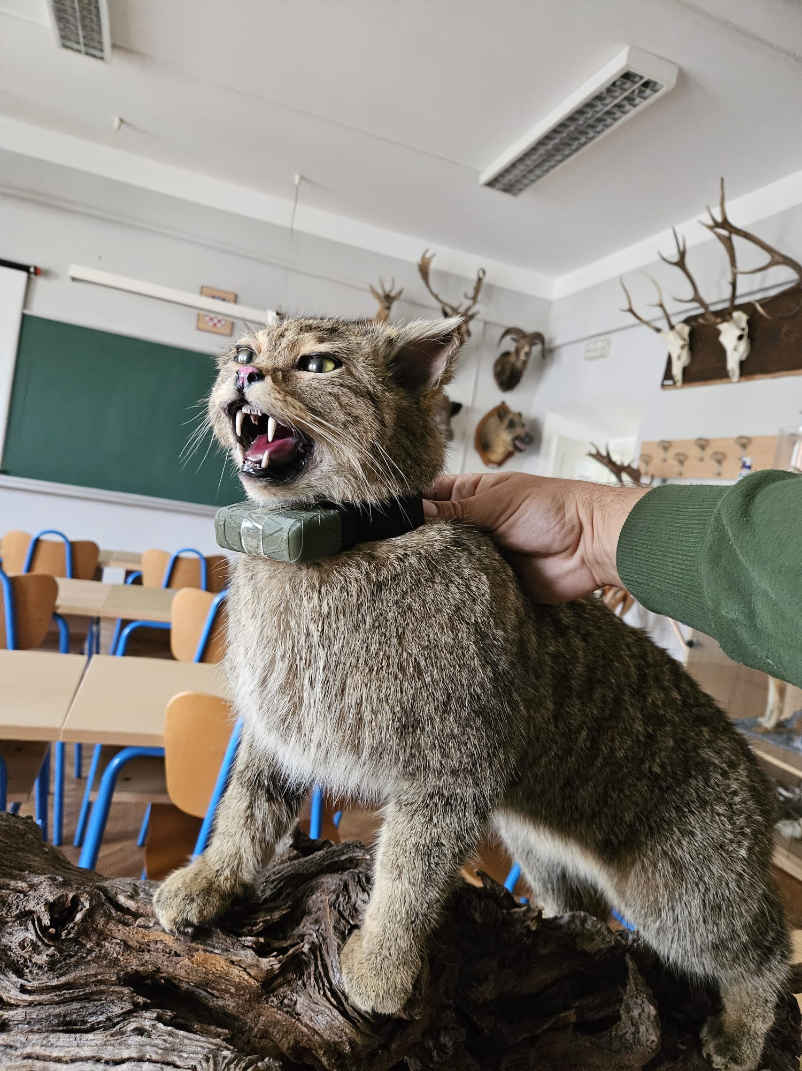
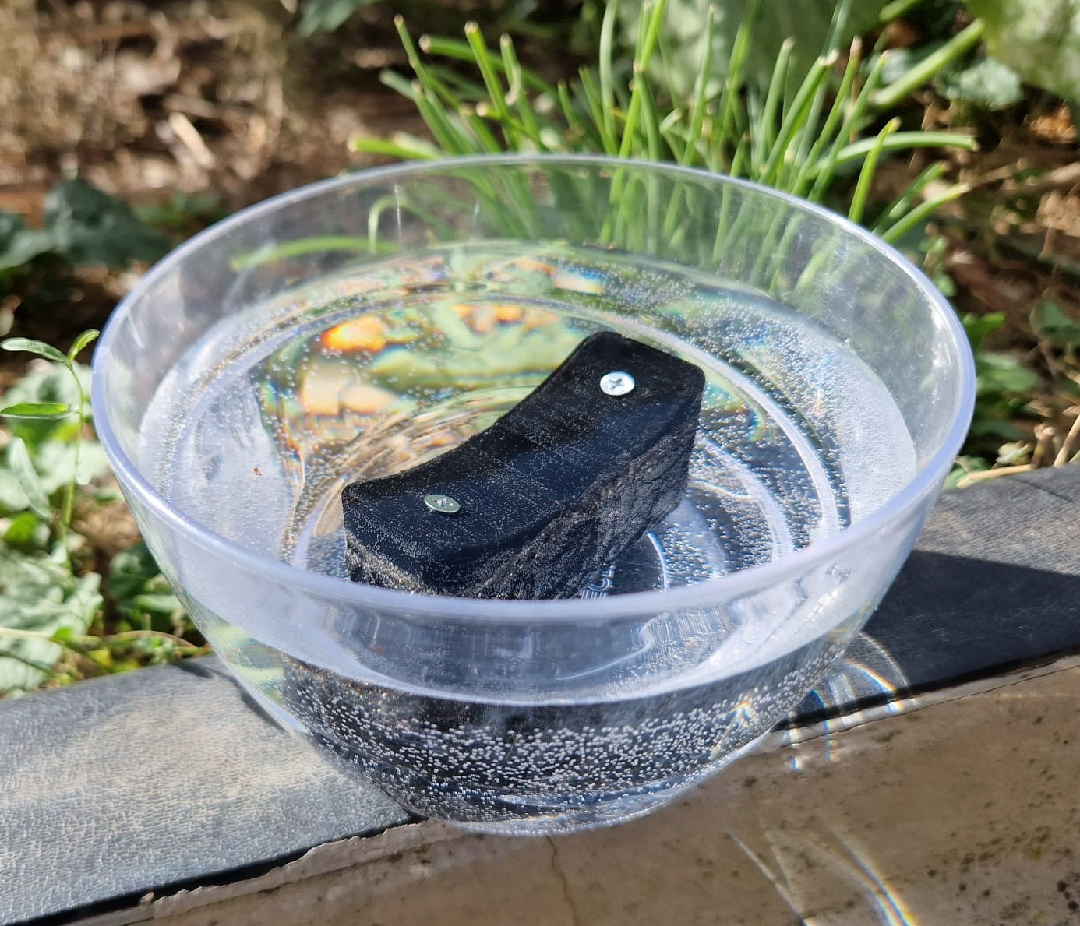
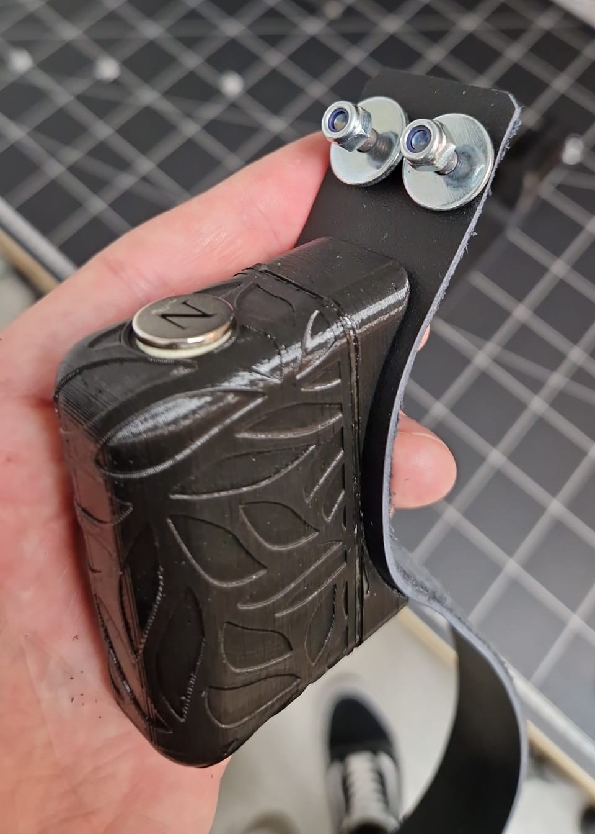
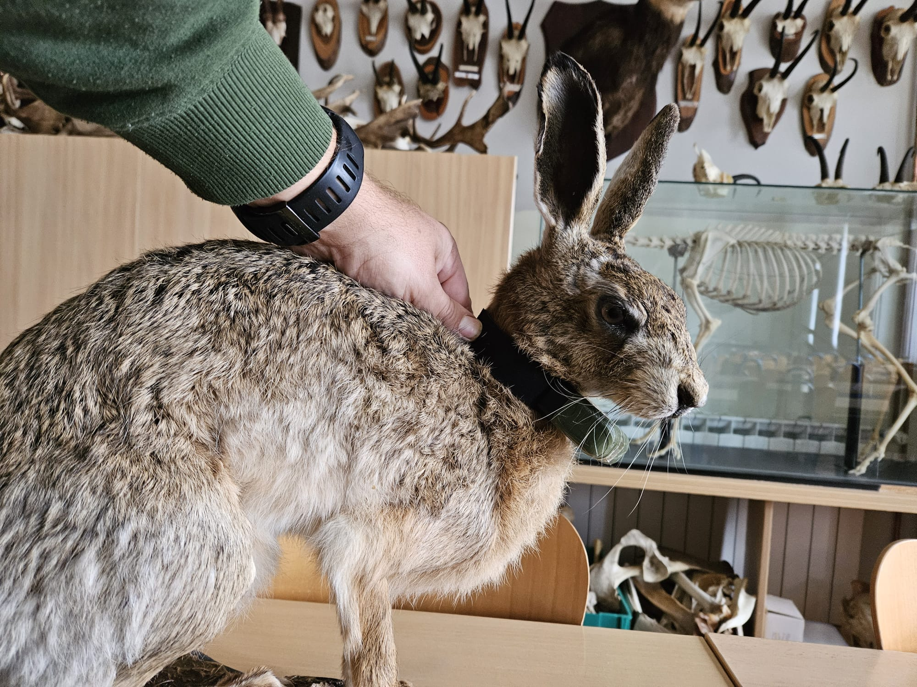
Initial laboratory & field testing
Version 1

Slide 7
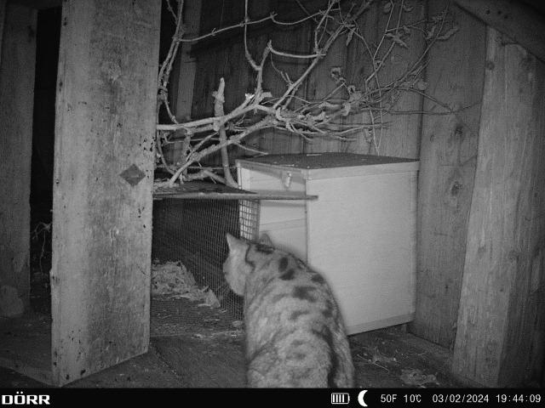
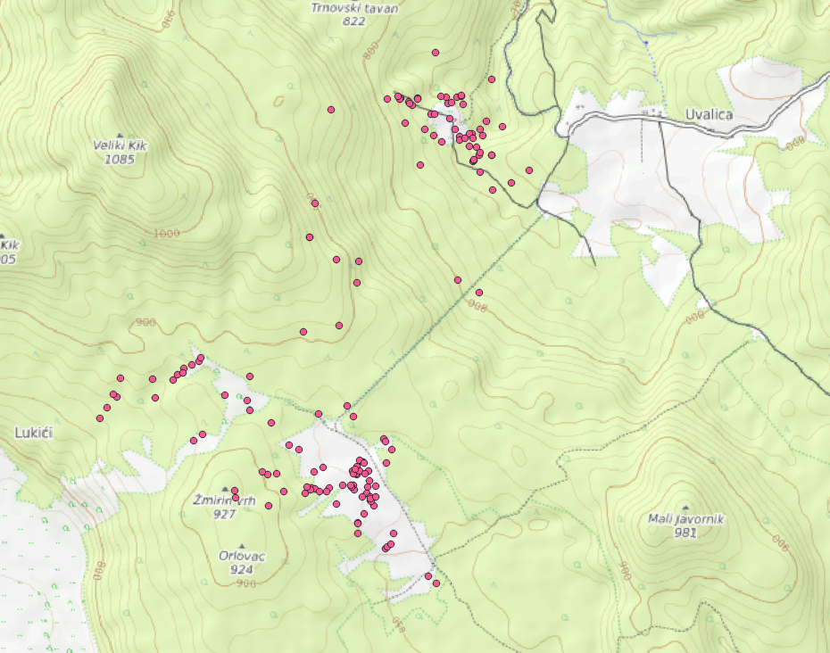
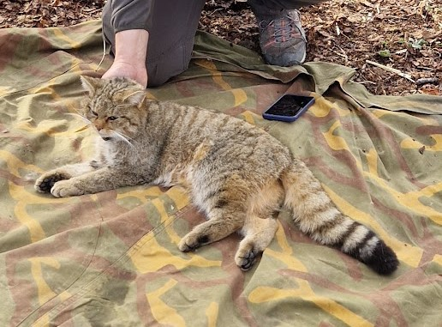
First animal marked with Oikon’s tracker
Version 1
Wildcat ”Brigita” in Plitvice Lakes National Park in early 2023.
We managed to get around 300 locations across several months

Slide 8


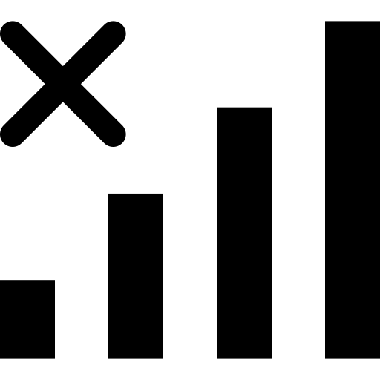
Notes about version 1
Version 1
Poor battery life - high power consumption
Not waterproof enough – water tends to leak inside the enclosure
Insufficient LoRaWAN coverage – the network is very sparse

Slide 9
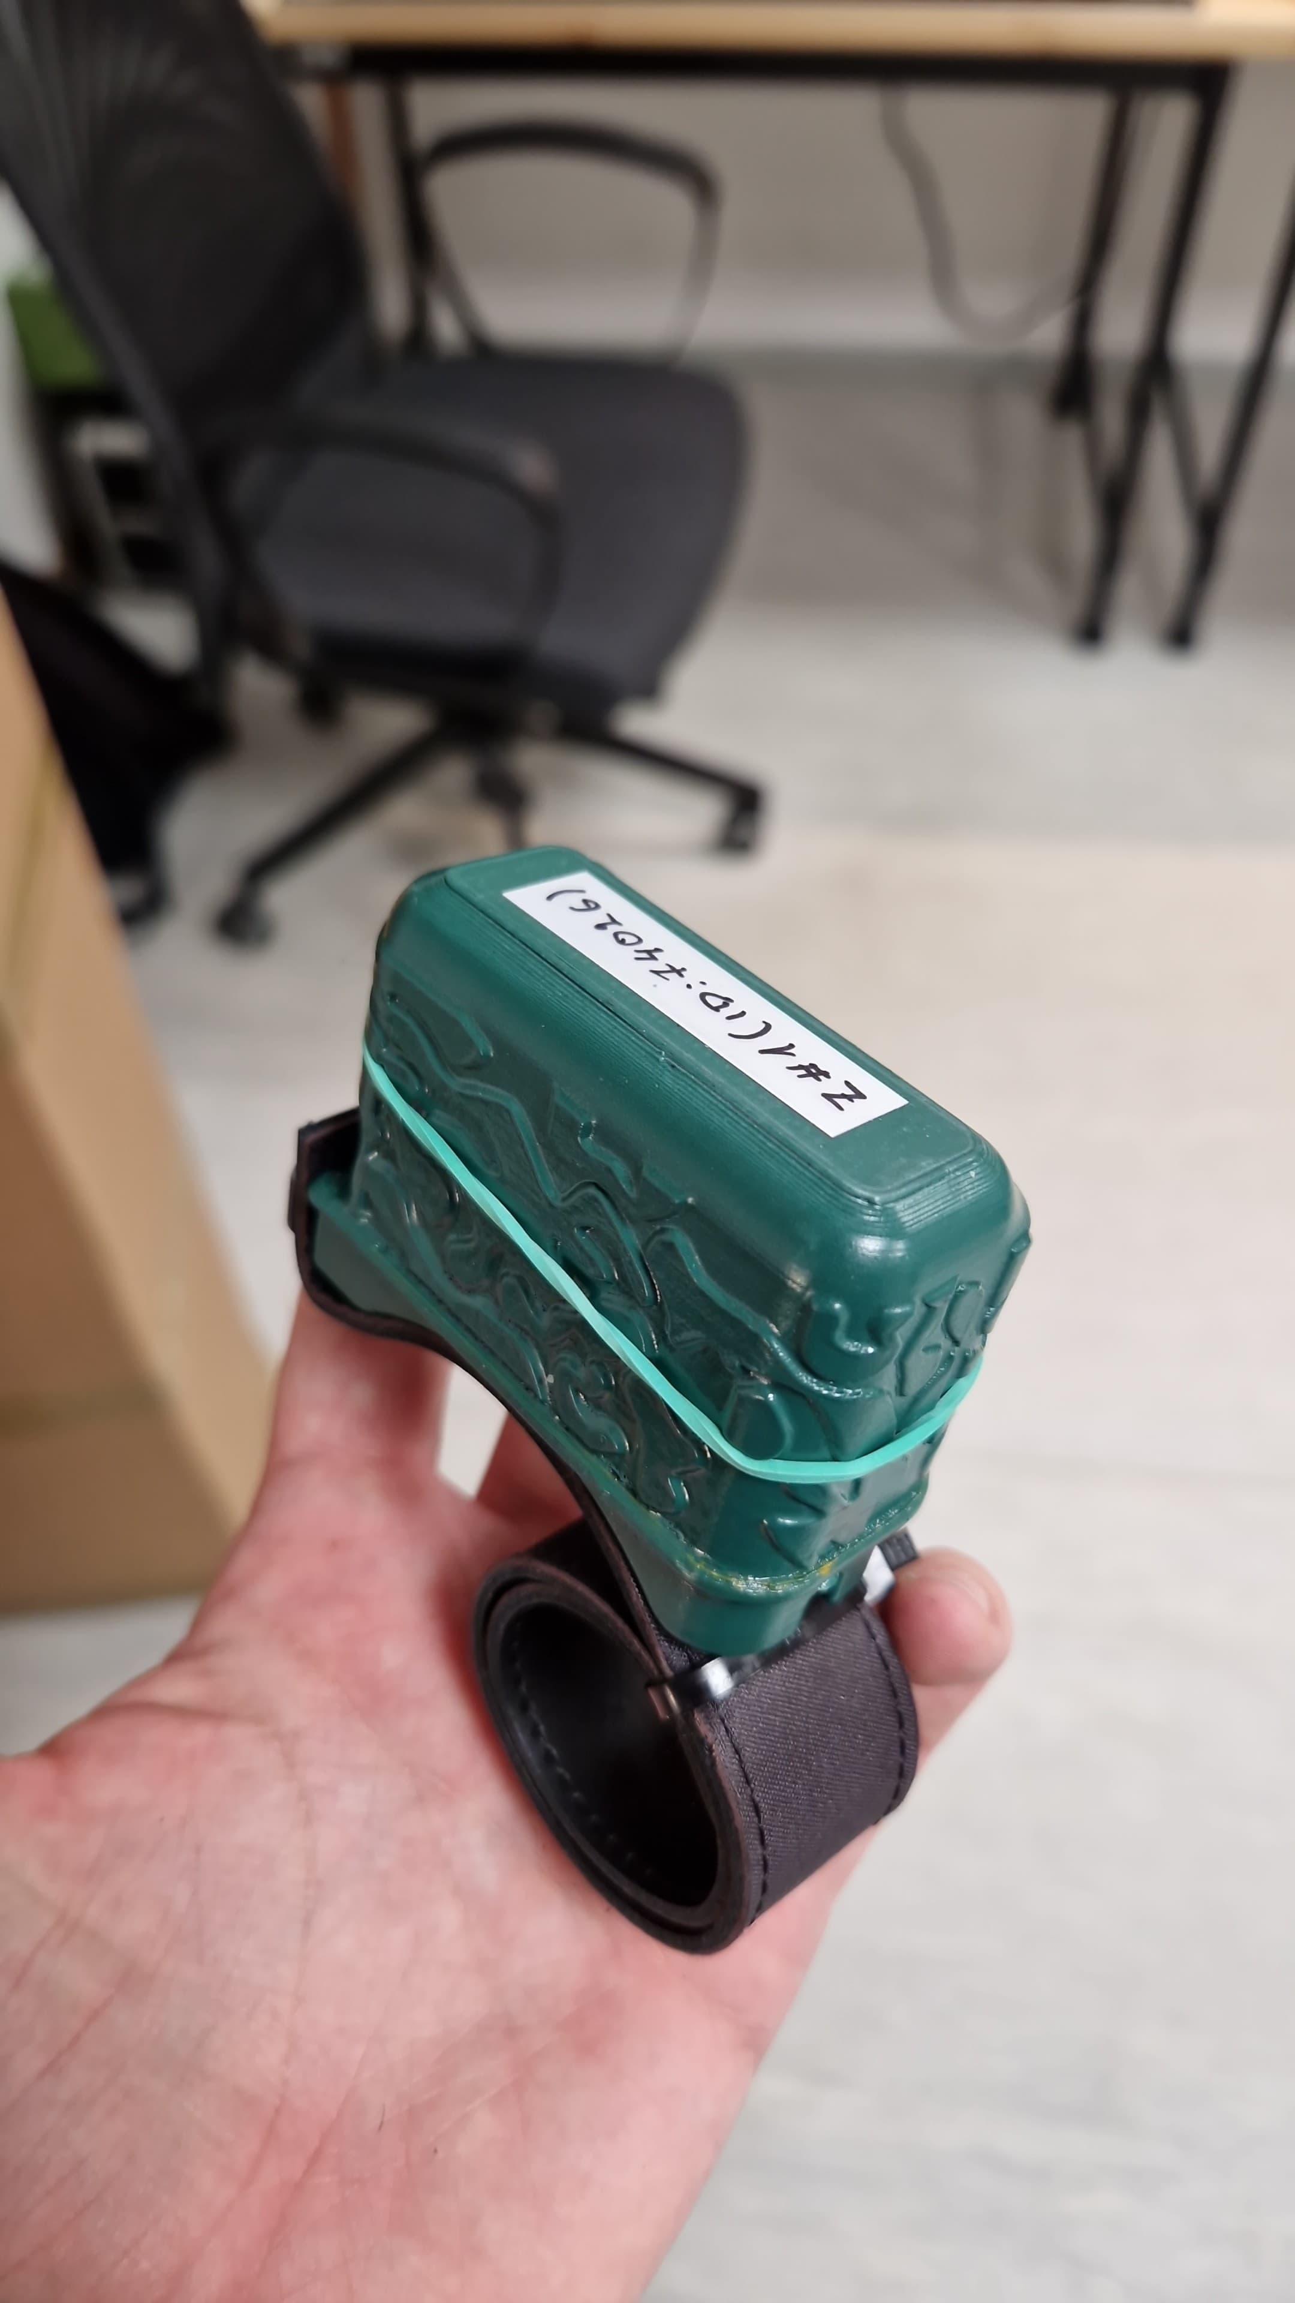
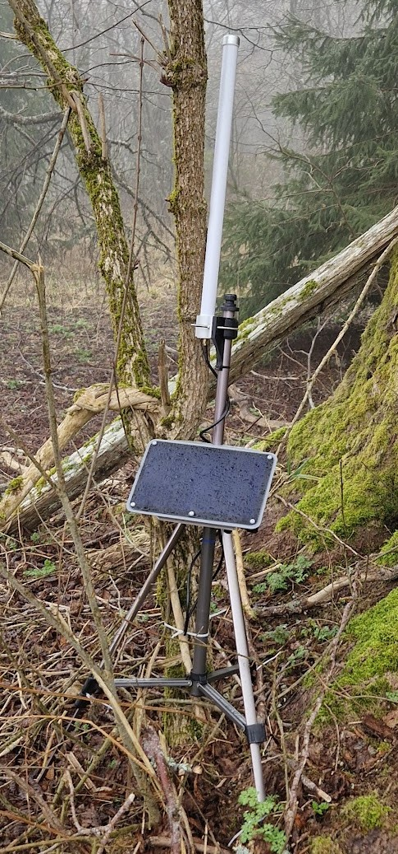
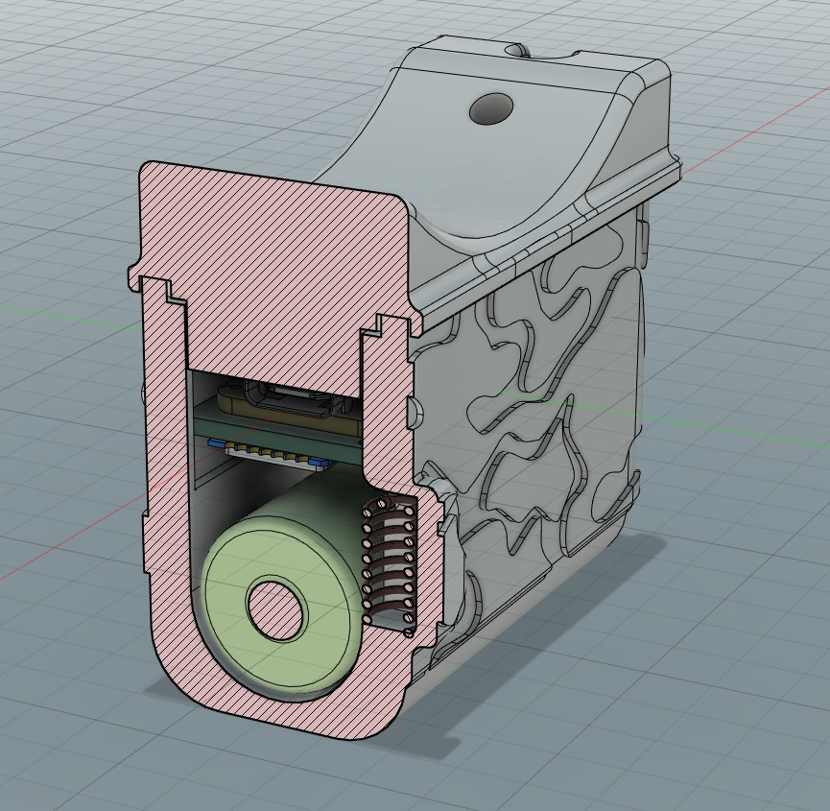
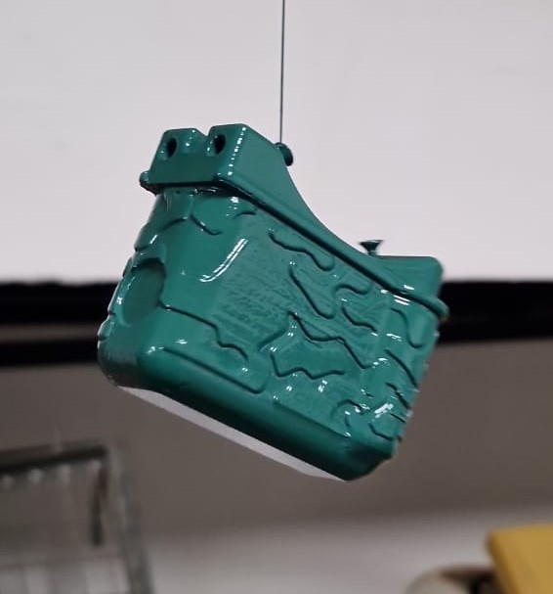
Moving from version 1 to version 2
New PCB (electronics) with new GPS and microcontroller
Introducing Oikon’s own private LoRa network infrastructure (Oikon Gateways)
New waterproof enclosure

Slide 10
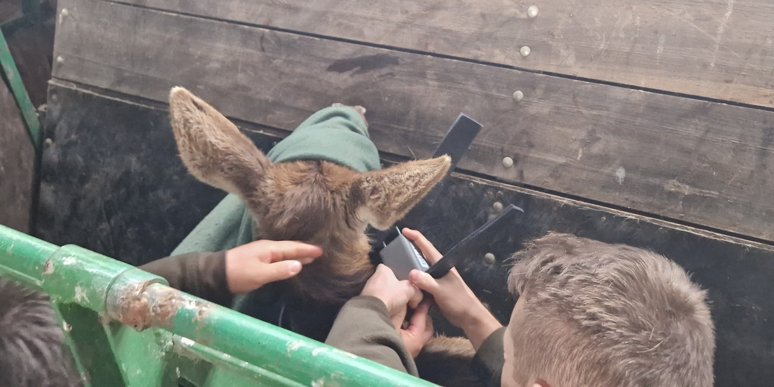
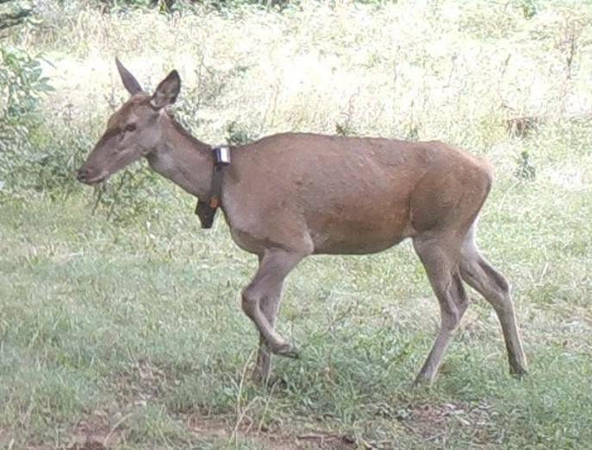
Animals marked with version 2
Version 2
In 2023./2024. 10 deer were marked near the city Senj
A few of them still work to this day and have given us more than 2,000 locations

Slide 11
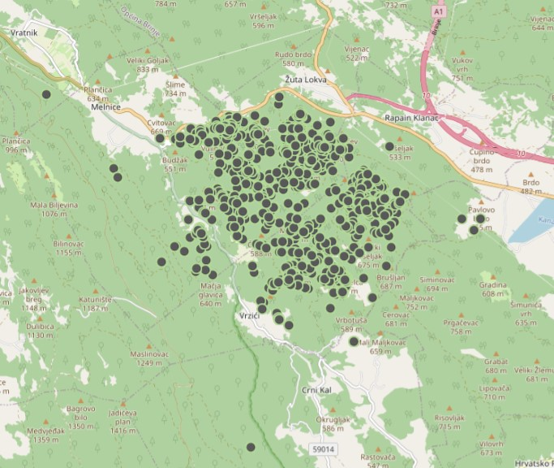
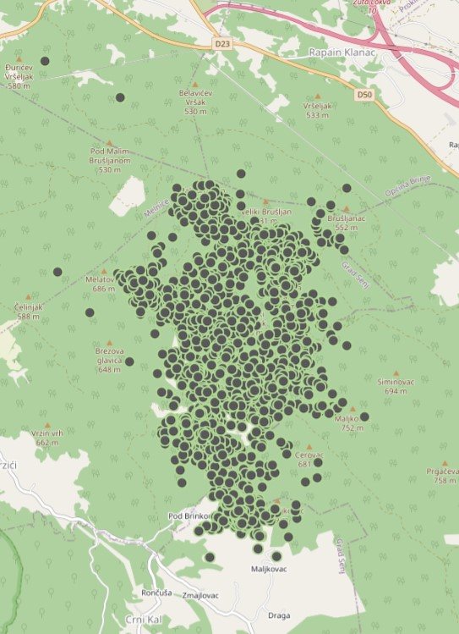
Version 2

Slide 12
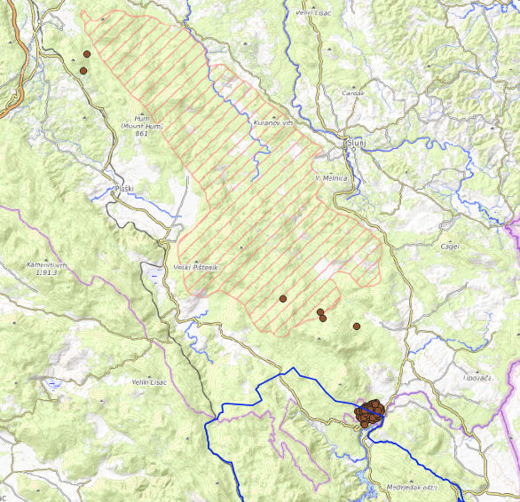
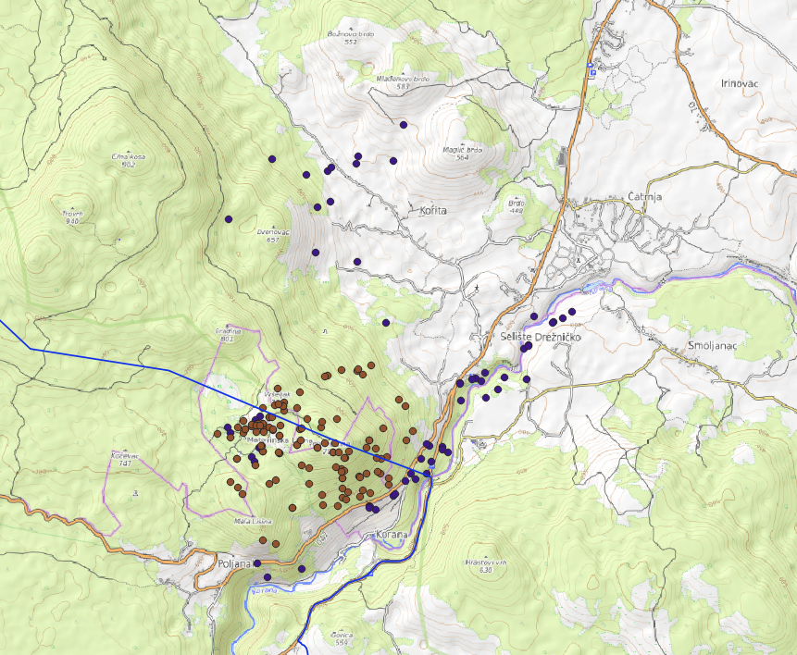
Animals marked with version 2
Version 2
Four more wildcats were marked in 2024.

Slide 13


Notes about version 2
Version 2
Not robust enough – tends to break with time as the animal moves
Not enough memory storage
Magnetic switch-on not reliable enough – sometimes the device doesn't start
Still not satisfied with the battery life!

Slide 14
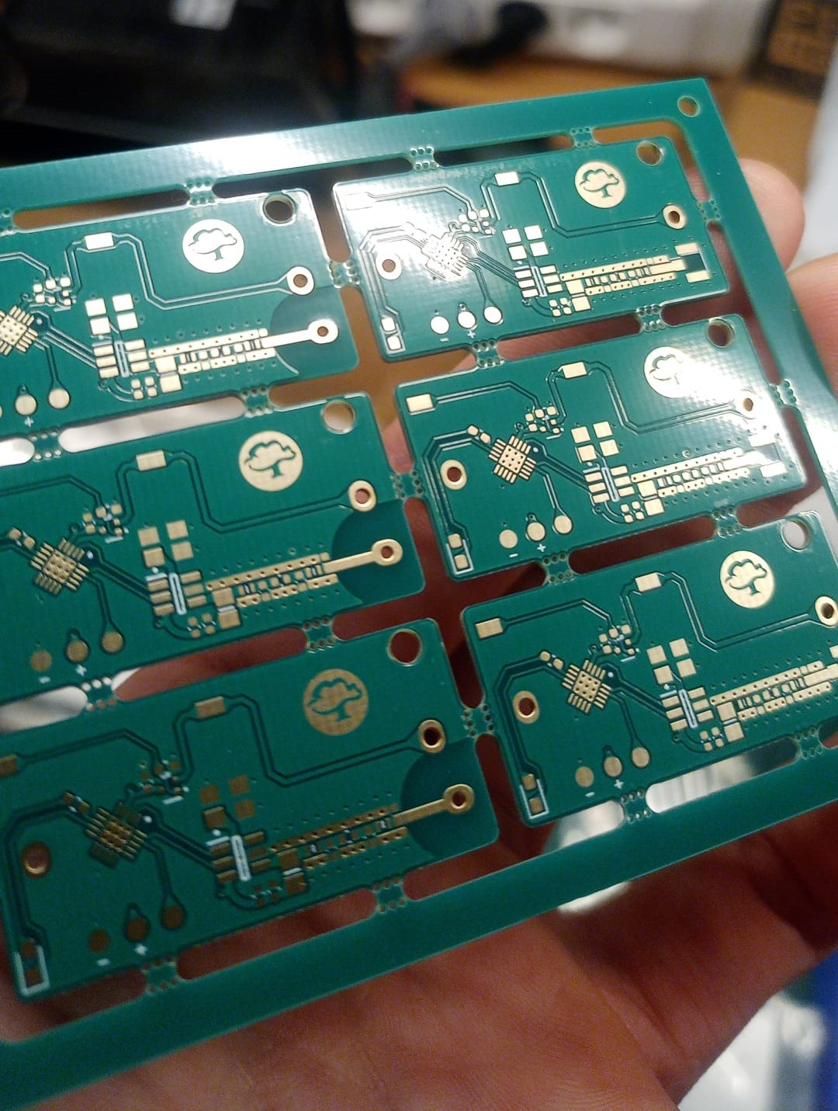
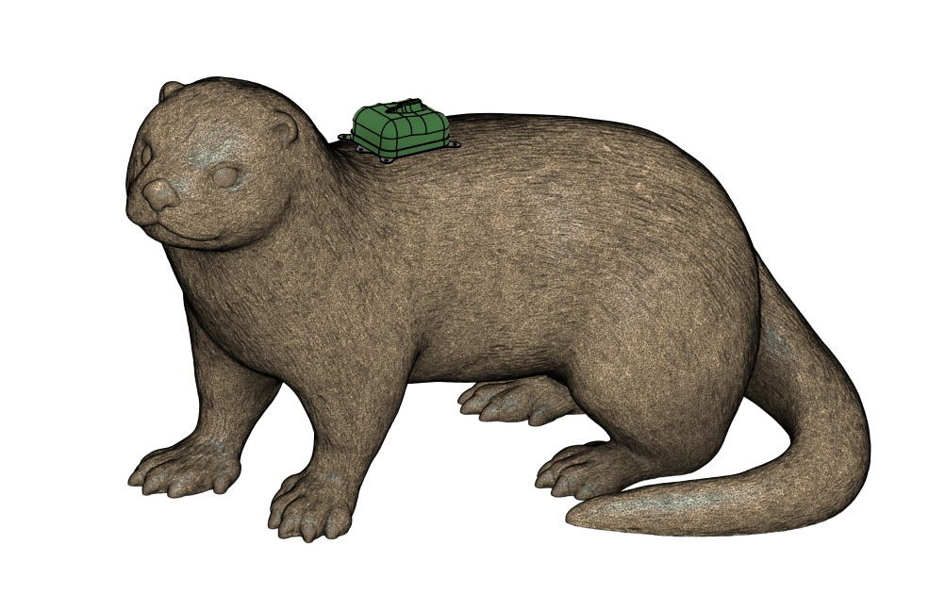
Moving from version 2 to version 3
New PCB (electronics) with more storage
A sturdier enclosure
New magnetic switch-on solution
Introducing a fully waterproof tracker (rated to 40 m of depth)

Slide 15
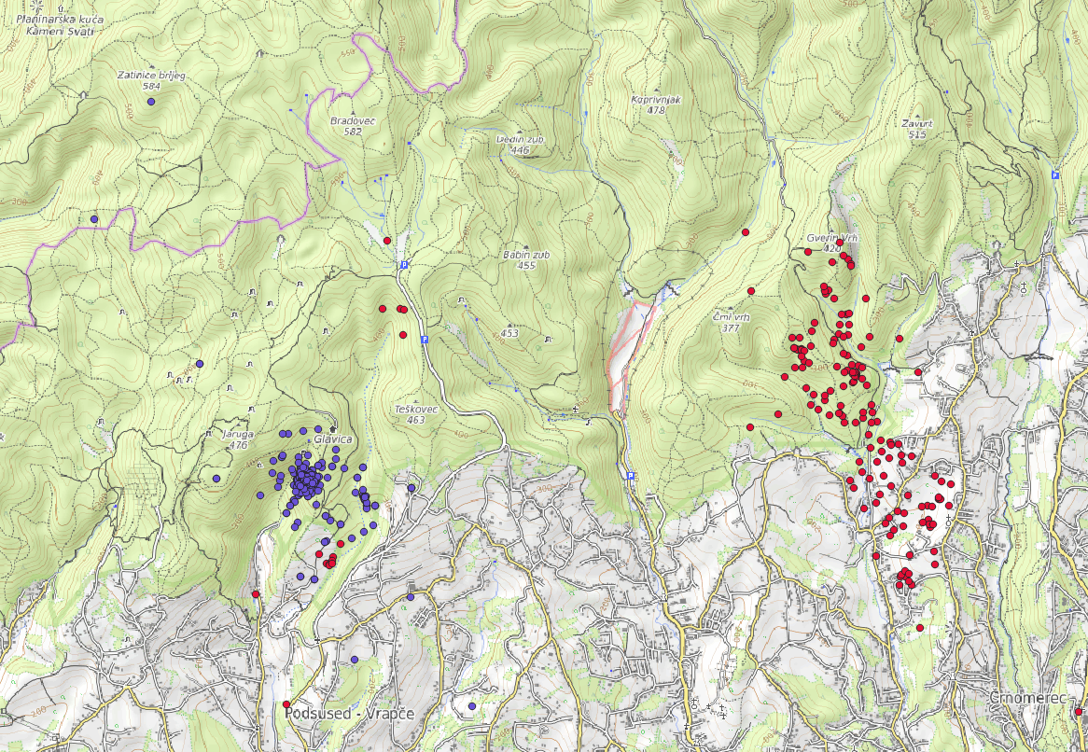
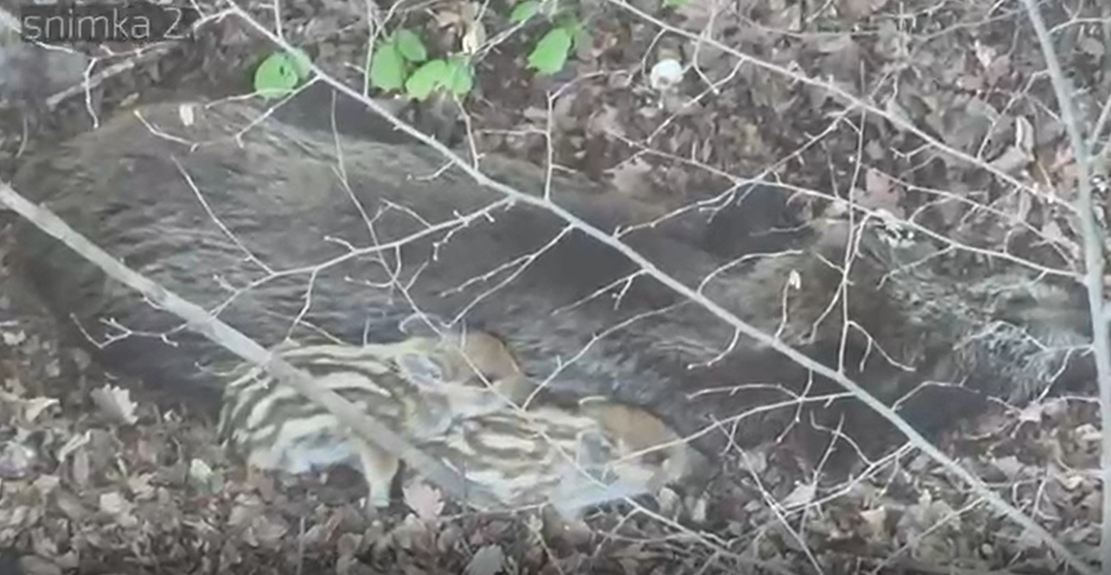
Animals marked with version 3
Version 3
In early 2026, two wild boars were marked near the city of Zagreb
The tracker showed that one of the wild boars had recently had piglets

Slide 16
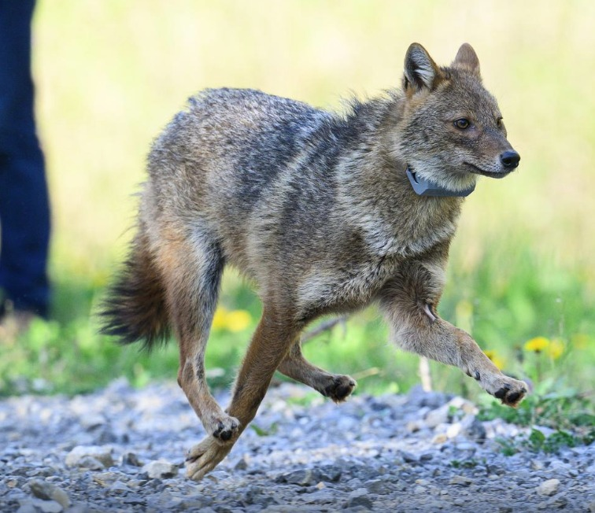
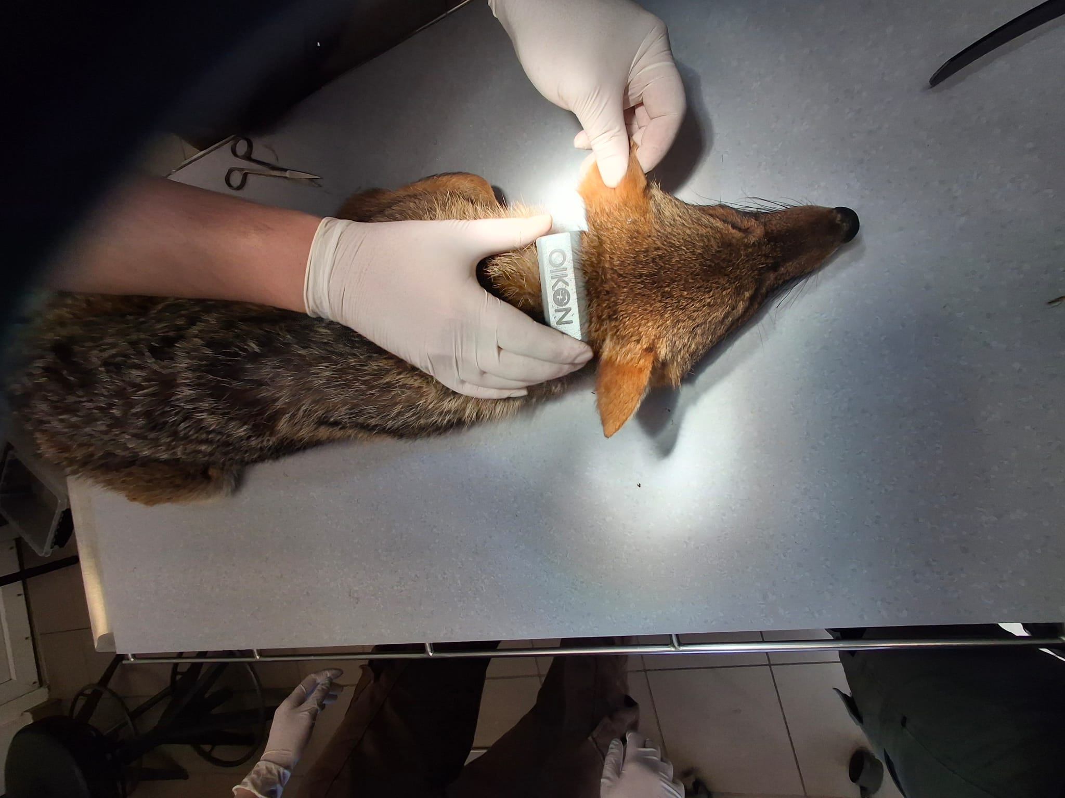
Animals marked with version 3
Version 3
In early 2026, one jackal was also marked near the city of Zagreb

Slide 17
History of tracking
Animal | Date of marking | Tracker version | End of tracking | Cause of tracking end | Did the tracker do its job?
Wildcat- Brigita | 17.2.2024. | 1 | 13.4.2024. | Drained battery | Partially
Wildcat - Željko | 11.5.2024. | 1 | 22.6.2024. | Drained battery | Partially
Wildcat - Maja | 16.3.2025. | 1 | 17.6.2025. | Drained battery | Partially
Wildcat - Speedy | 14.3.2025. | 1 | 23.8.2025. | Drained battery | Yes
Wildcat - Petka | 15.6.2025. | 1 | 8.10.2025. | Drained battery | Yes
Hare - Mima | 6.3.2026. | 2 | 28.3.2026. | Unknown | Partially
Deer #1 | 3.3.2022. | 1 | 10.3.2022. | Animal died? | N/A
Deer #2 | 3.3.2022. | 1 | 20.4.2022. | Animal died? | N/A
Deer #3 | 3.3.2022. | 1 | 10.3.2022. | Animal died? | N/A
Deer #4 | 3.3.2022. | 1 | 3.10.2022. | Unknown | Yes
Deer #5 | 23.1.2024. | 2 | 12.5.2024. | Unknown | Yes
Deer #6 | 23.1.2024. | 2 | 4.4.2025. | Unknown | Yes

Slide 18
History of tracking
Animal | Date of marking | Tracker version | End of tracking | Cause of tracking end | Did the tracker do its job?
Deer #10 | 1.3.2025. | 2 | 4.4.2025. | Enclosure failure | Yes
Deer #11 | 1.3.2025. | 2 | 11.9.2025. | Enclosure failure | Yes
Deer #12 | 1.3.2025. | 2 | Still working | / | Yes
Deer #13 | 1.3.2025. | 2 | 14.10.2025. | Enclosure failure | Yes
Deer #14 | 1.3.2025. | 2 | Still working | / | Yes
Jackal #1 | 8.4.2026. | 3 | 8.4.2026. | Out of range | No
Wild boar #1 | 26.3.2026. | 3 | 21.5.2026. | Tracker fell off | Yes
Wild boar #2 | 27.5.2026. | 3 | 10.6.2026. | Did not work properly; boar shot, collar and data recovered | Partially

Slide 19
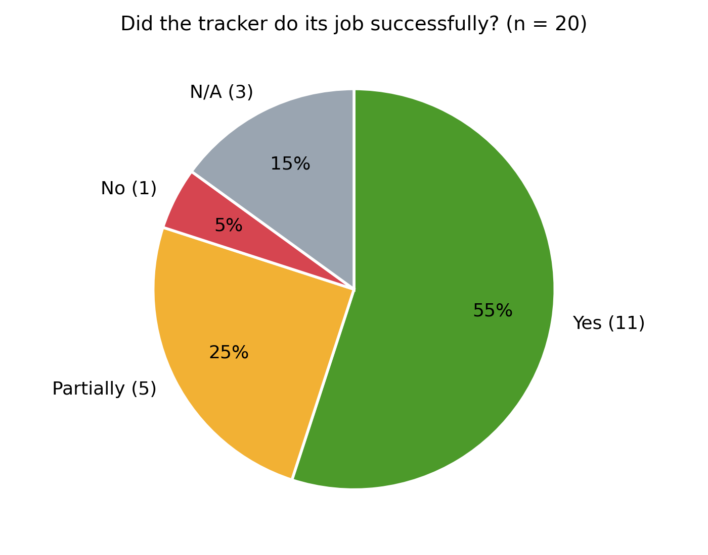

Slide 20



What are the main drawbacks of LoRa technology? What have we learned?
Not satisfied with the communication range. Range significantly decreases because of obstacles, dense vegetation, fog and rain.
Battery consumption varies depending on the operating mode – we solve that!
Animals with a small home range – a problem if the animal is in an area not covered by LoRa signal – hope we will solve that!
Requires user involvement during tracking – gateways must be relocated – relocate gateway.
We were losing data due to lack of memory – we also solved that!

Slide 21
What we offer now?
Three types of terrestrial trackers:
  Type „S” – The smallest tracker for animals like wildcat, hare or jackal
  Type „M” – The medium sized tracker for animals like wild boar or deer
  Type „L” – The largest tracker for animals such as bear
One type of marine/freshwater tracker:
  Type „W” – Waterproof tracker rated for 40 meters of depth
Custom solutions – We are open for discussion about special solutions

Slide 22
Future plans – mid-2027.
The next version, currently in development, will have:
  Hybrid communication technology (LoRa + Satellite)
  Further improved battery life
  Even more durable enclosure
  Geofence
  Different operation modes that user can change easily

Slide 23


THANK YOU
Oikon Ltd. – Institute of Applied Ecology
Trg senjskih uskoka 1-2
HR – 10020 Zagreb
T +385 1 5507 100
F +385 1 5507 101
E oikon@oikon.hr
W www.oikon.hr
Marko Augustinović, mag. ing. silv., CE
T +385 1 5507100
M +385 98 891801
E maugustinovic@oikon.hr
We support and contribute to the Sustainable Development Goals

