Slide 1

BZVZ: Budrovci residents for a cheerful homeland – from research to action
(Budrovčani za vedriji zavičaj)
International Symposium
Kopački rit: Yesterday, Today, Tomorrow
Osijek, 1–2 October 2026
Marija Kušić, mathematics and physics teacher
Budrovci Primary School
Notes:
BZVZ stands for “Budrovci for a Brighter Community”. Original logos and documentary photographs are retained.

Slide 2

Project: BZVZ – Budrovci residents for a cheerful homeland
Who: Young Scientists, pupils in 7th and 8th grade
Where: Budrovci Primary School, B1 extracurricular activity
Aim: Explore the environment and contribute to our community through useful work.
Notes:
BZVZ stands for “Budrovci for a Brighter Community”. Original logos and documentary photographs are retained.

Slide 3
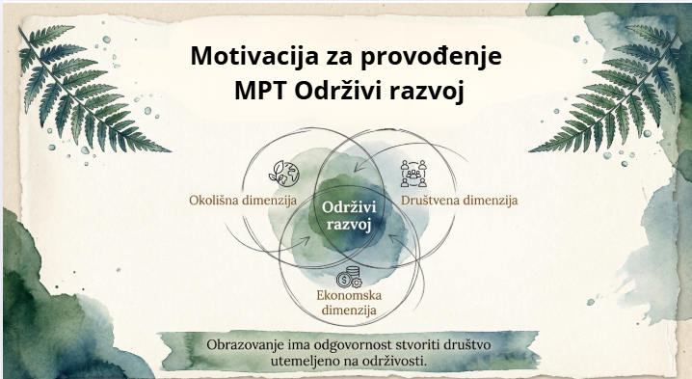
Why Teach Sustainable Development
as a Cross-Curricular Theme?
Environmental Dimension
Sustainable
Development
Social Dimension
Economic
Dimension
Education has a responsibility to build
a society founded on sustainability.
2
Notes:
BZVZ stands for “Budrovci for a Brighter Community”. Original logos and documentary photographs are retained.

Slide 4
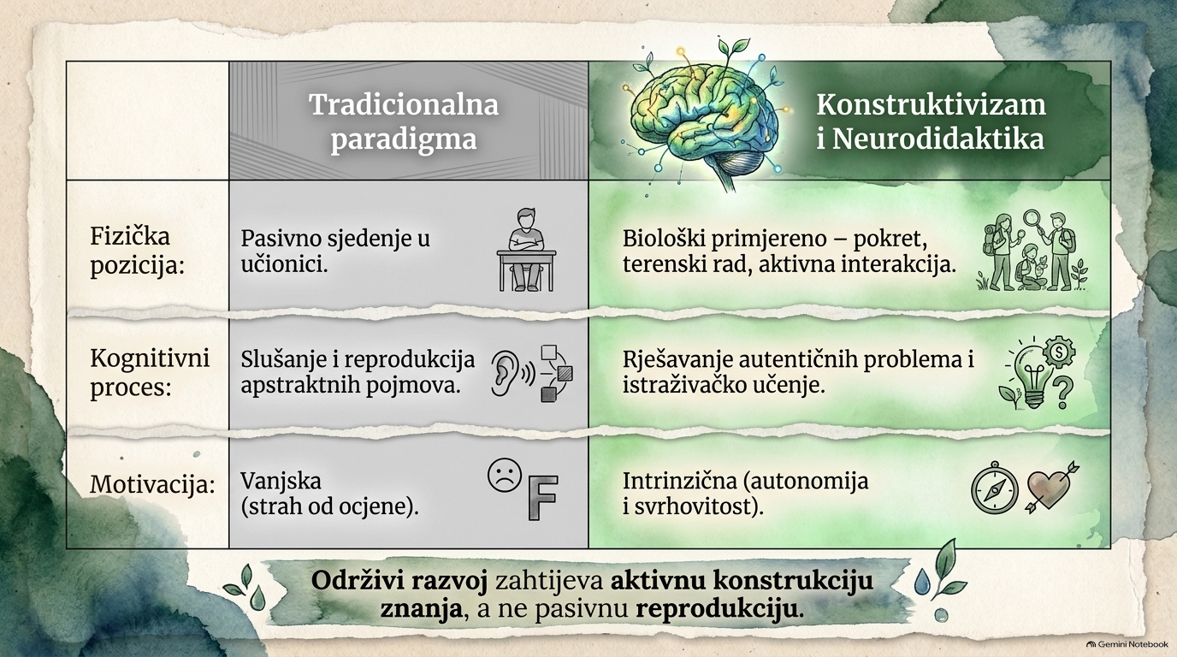
Traditional
Paradigm
Constructivism
Physical
Position
Passive sitting
in the classroom.
Movement, fieldwork
and active interaction.
Cognitive
Process
Listening and reproducing
abstract concepts.
Solving real problems
and learning through inquiry.
Motivation
Extrinsic
(fear of grades).
Intrinsic
(autonomy and purpose).
Sustainable development requires actively building
knowledge rather than passively reproducing it.
Notes:
BZVZ stands for “Budrovci for a Brighter Community”. Original logos and documentary photographs are retained.

Slide 5
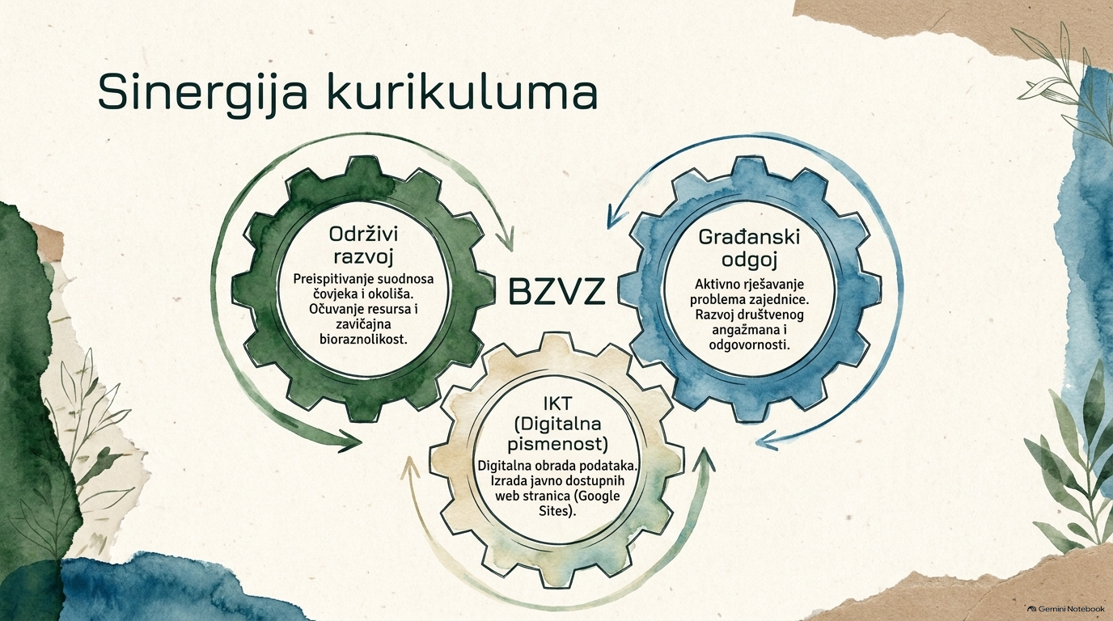
Curriculum Synergy
Sustainable
Development
Citizenship
Education
Examining the relationship between people and the environment. Conserving resources and local biodiversity.
Actively solving community problems. Developing social engagement and responsibility.
ICT
(Digital Literacy)
Digital data processing. Creating publicly accessible websites (Google Sites).
Notes:
BZVZ stands for “Budrovci for a Brighter Community”. Original logos and documentary photographs are retained.

Slide 6
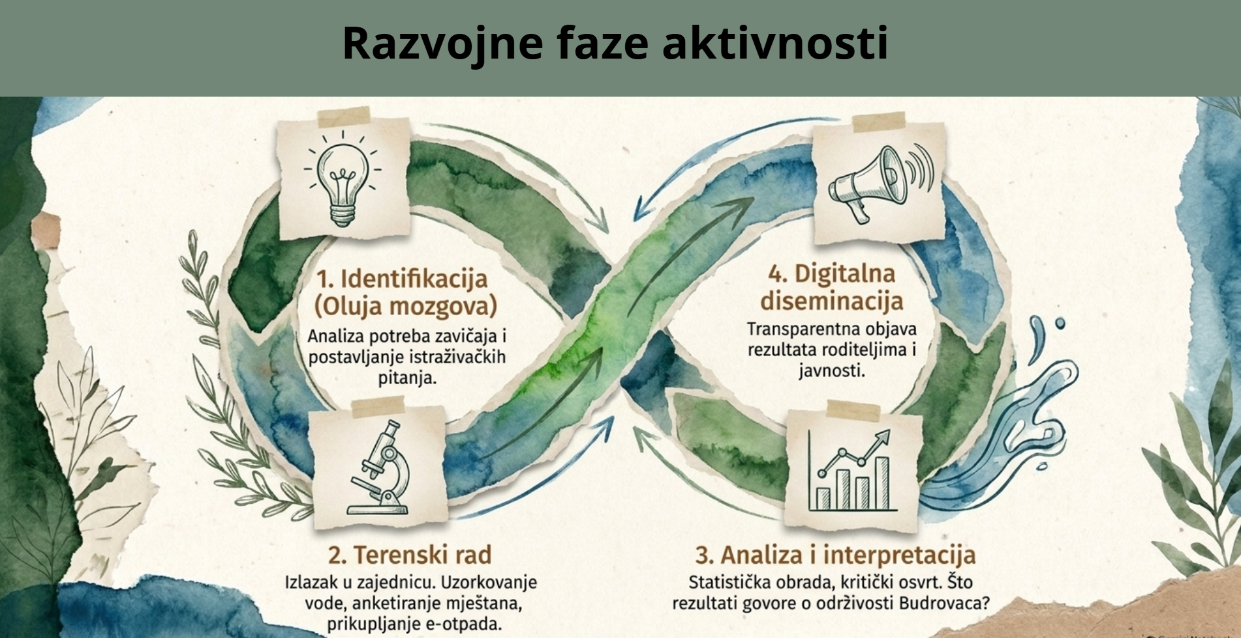
Stages of Activity Development
1. Identification
(Brainstorming)
4. Digital
Dissemination
Analysing local needs and formulating research questions.
Sharing results openly with parents and the public.
2. Fieldwork
Community visits. Water sampling, resident surveys and e-waste collection.
3. Analysis and Interpretation
Statistical analysis and critical reflection. What do the results tell us about sustainability in Budrovci?
Notes:
BZVZ stands for “Budrovci for a Brighter Community”. Original logos and documentary photographs are retained.

Slide 7
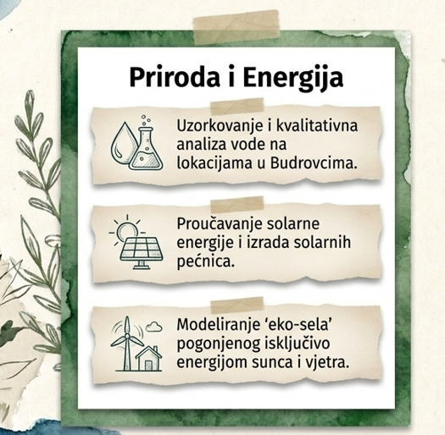
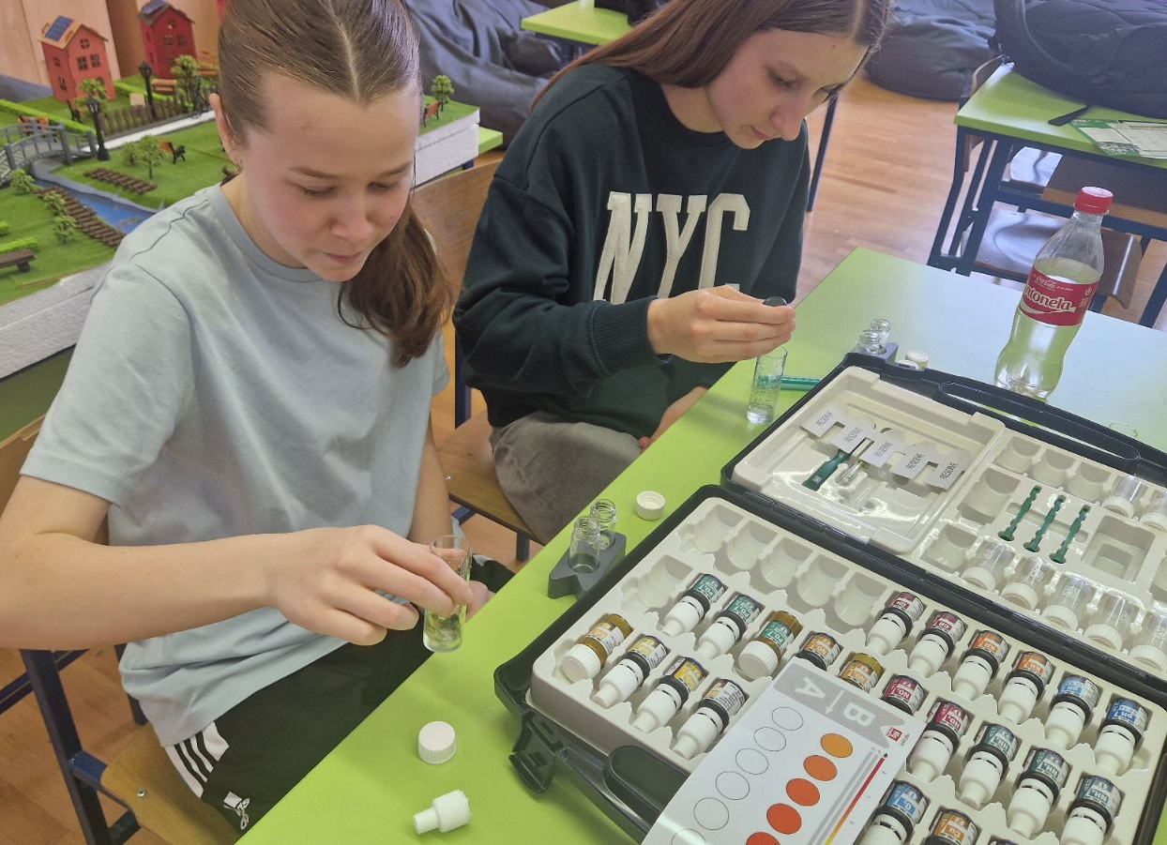
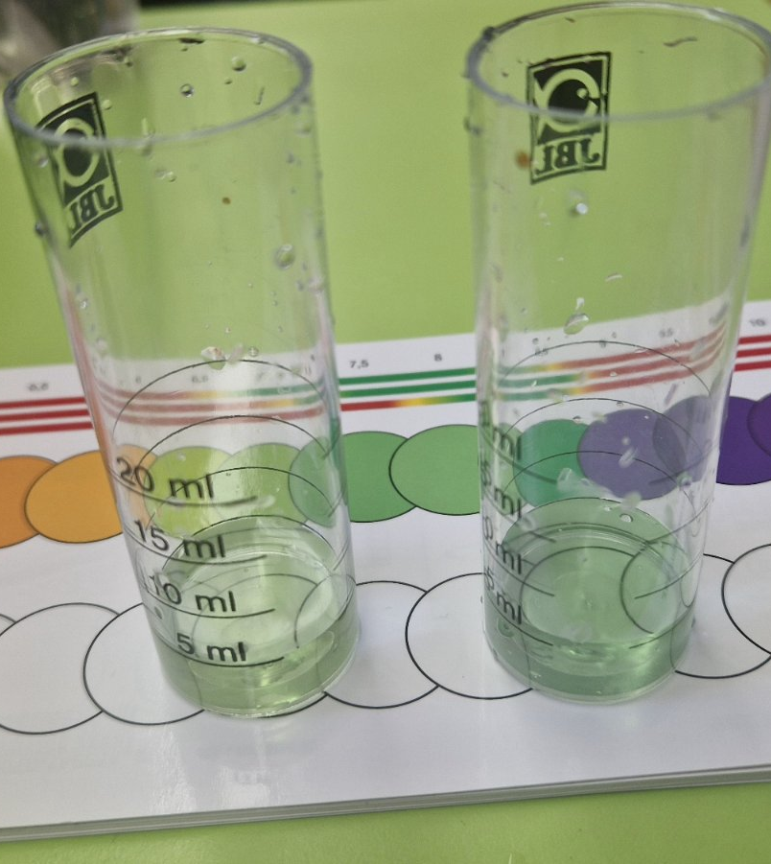
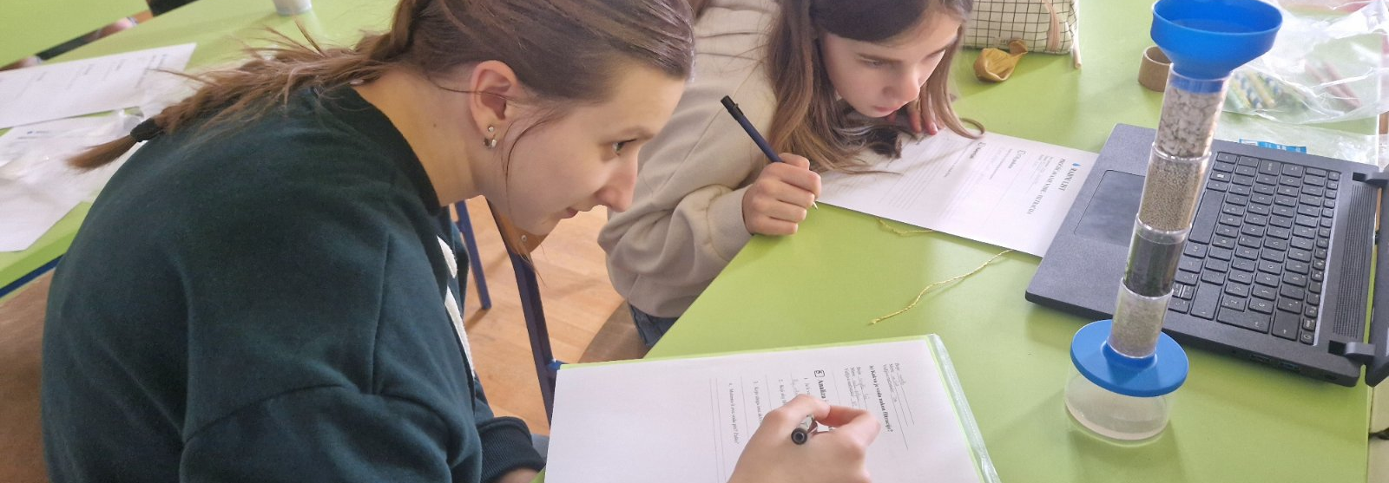
Some of Our Activities
Water sampling and qualitative analysis at locations in Budrovci.
Studying solar energy and building solar ovens.
Modelling an eco-village powered entirely by solar and wind energy.
5
Notes:
BZVZ stands for “Budrovci for a Brighter Community”. Original logos and documentary photographs are retained.

Slide 8
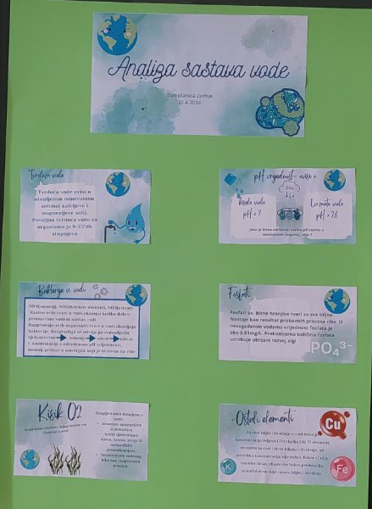
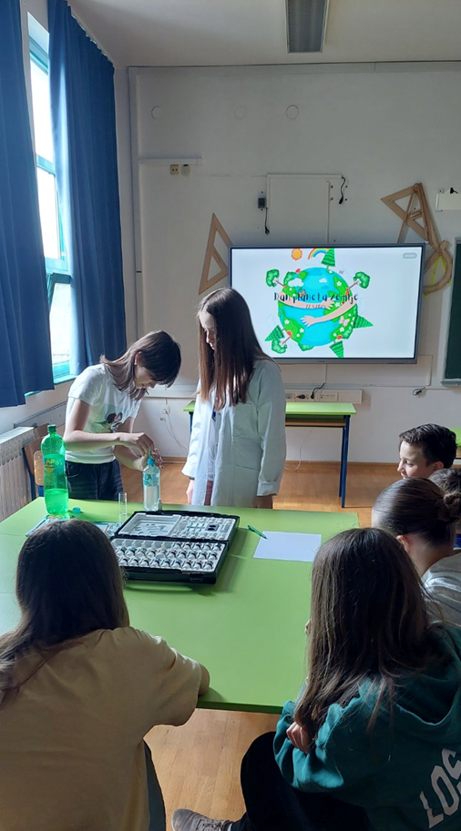
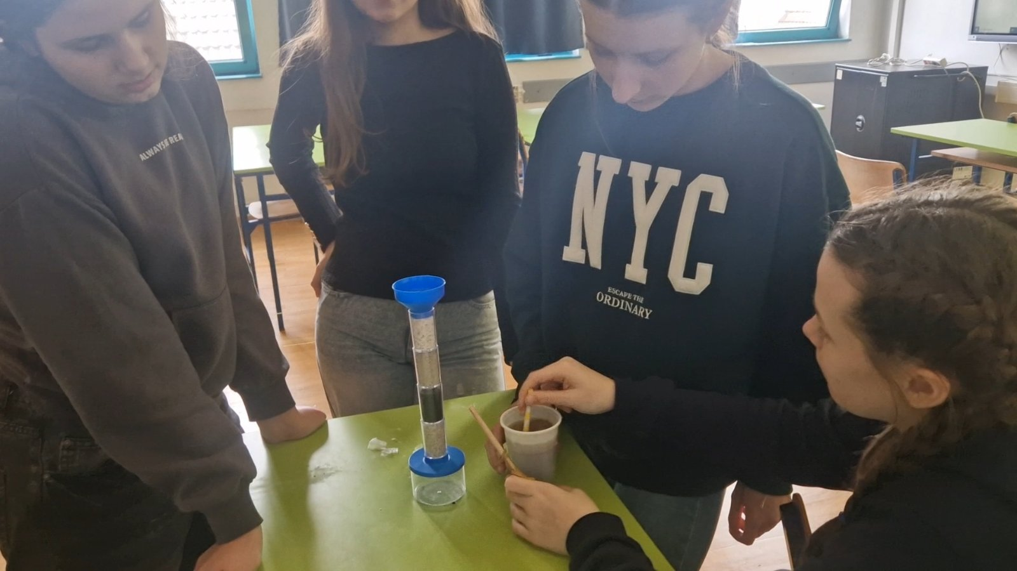
Water Analysis
Notes:
BZVZ stands for “Budrovci for a Brighter Community”. Original logos and documentary photographs are retained.

Slide 9
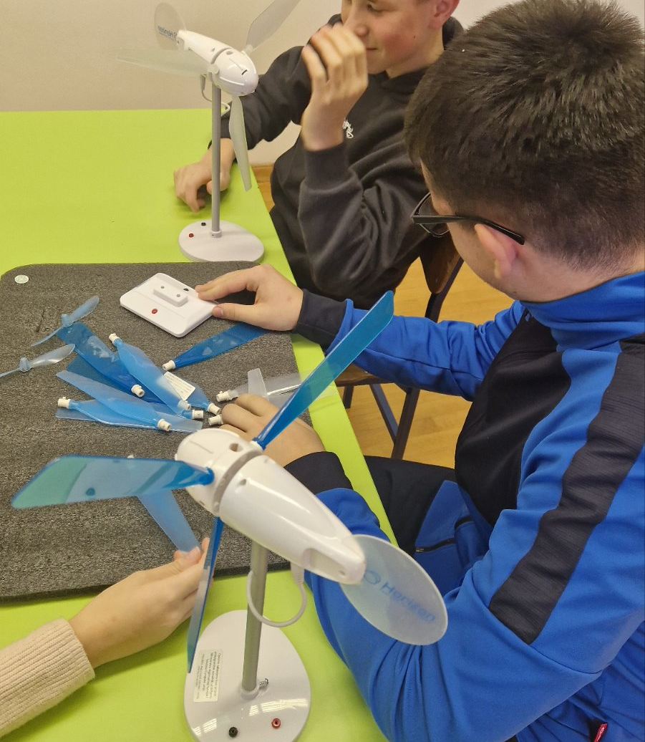
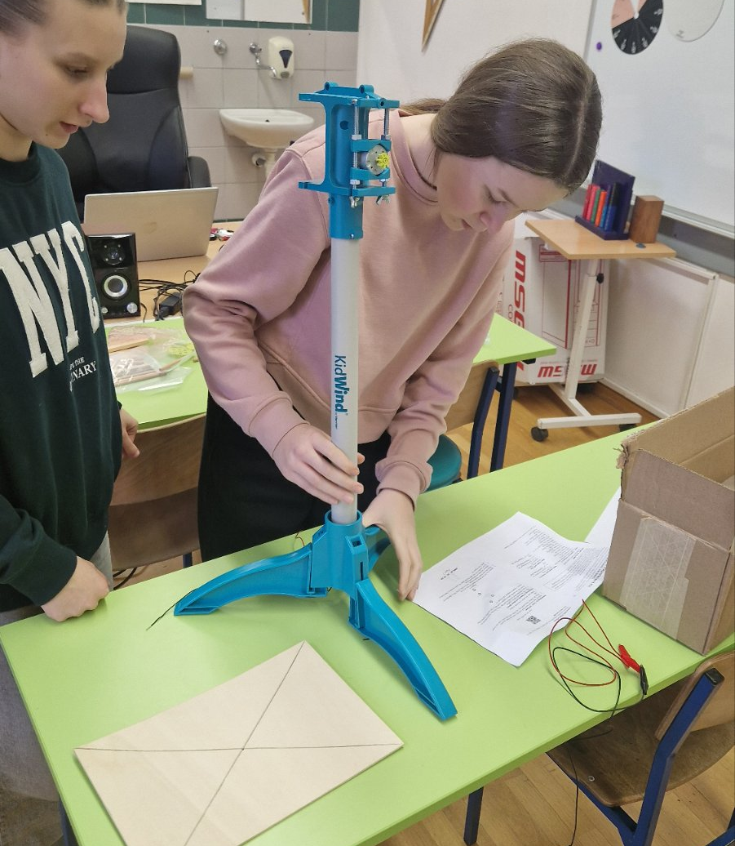
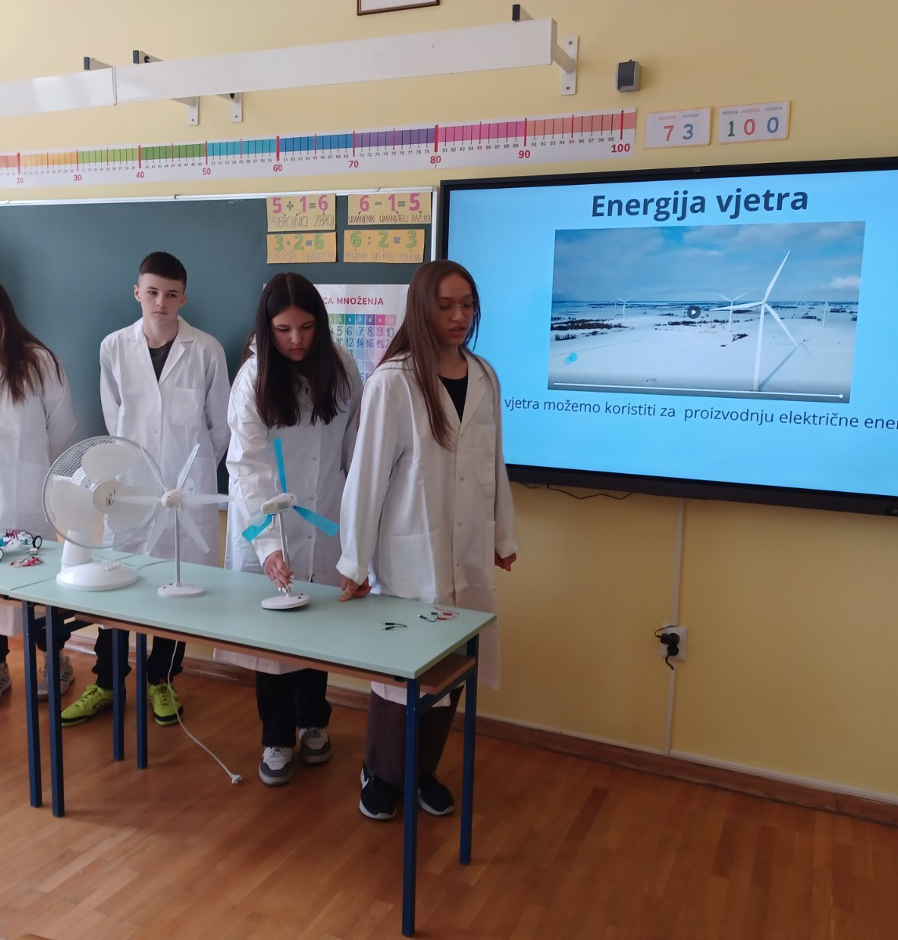
Renewable Energy Sources: Wind Energy
9
Notes:
BZVZ stands for “Budrovci for a Brighter Community”. Original logos and documentary photographs are retained.

Slide 10
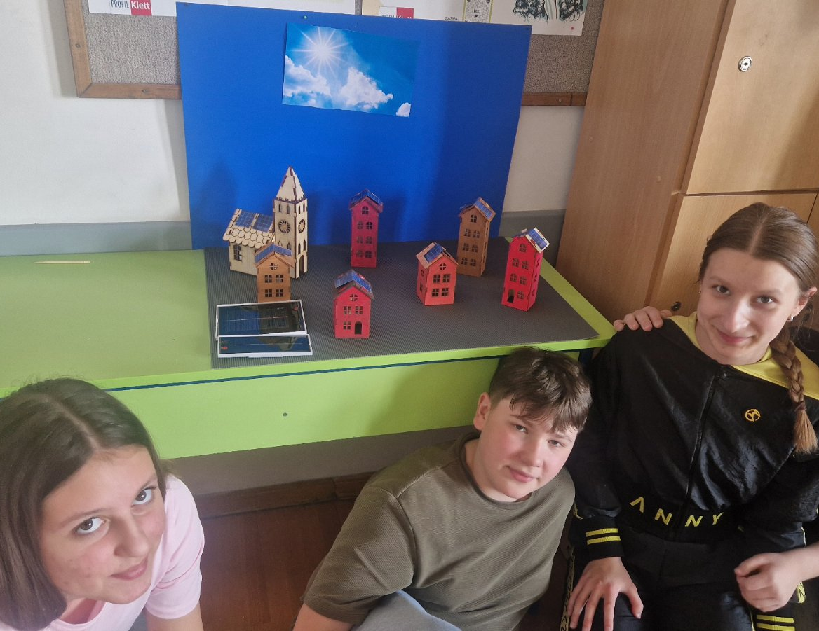
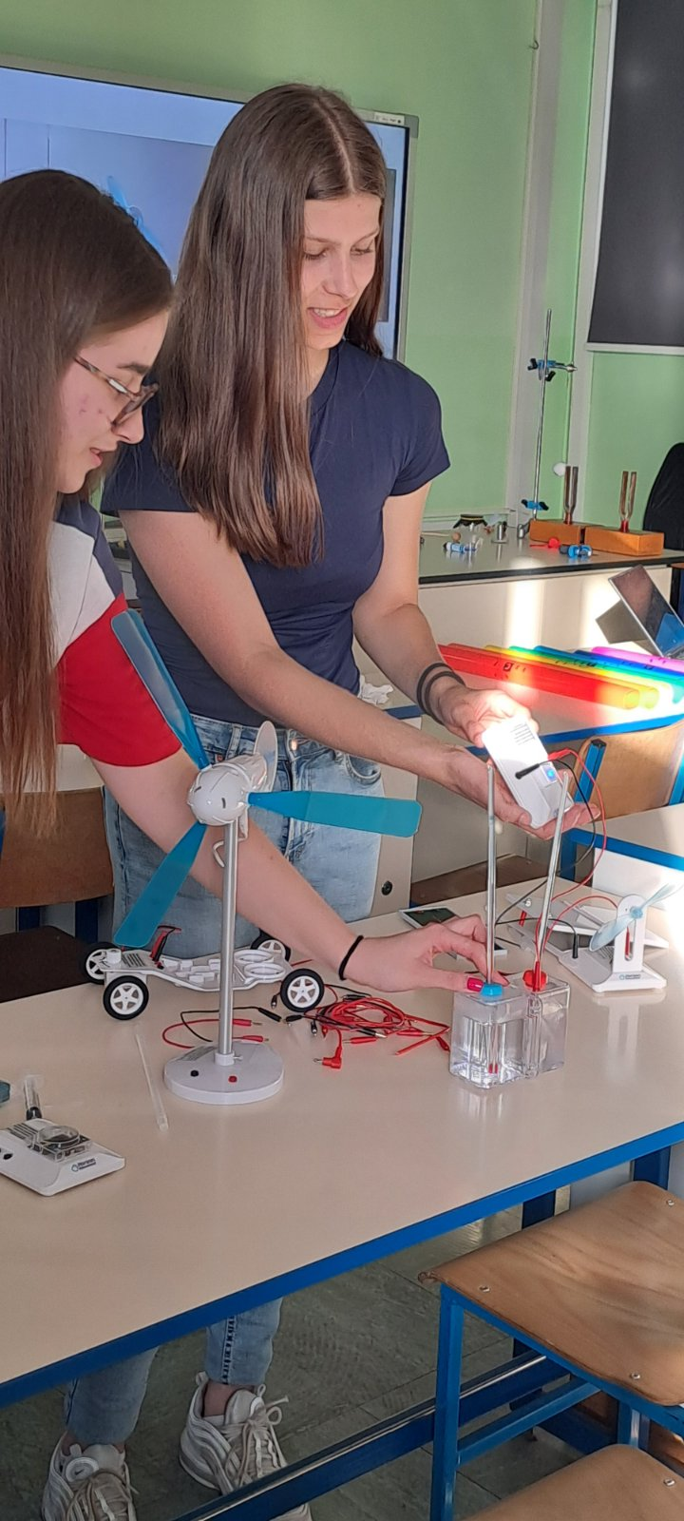
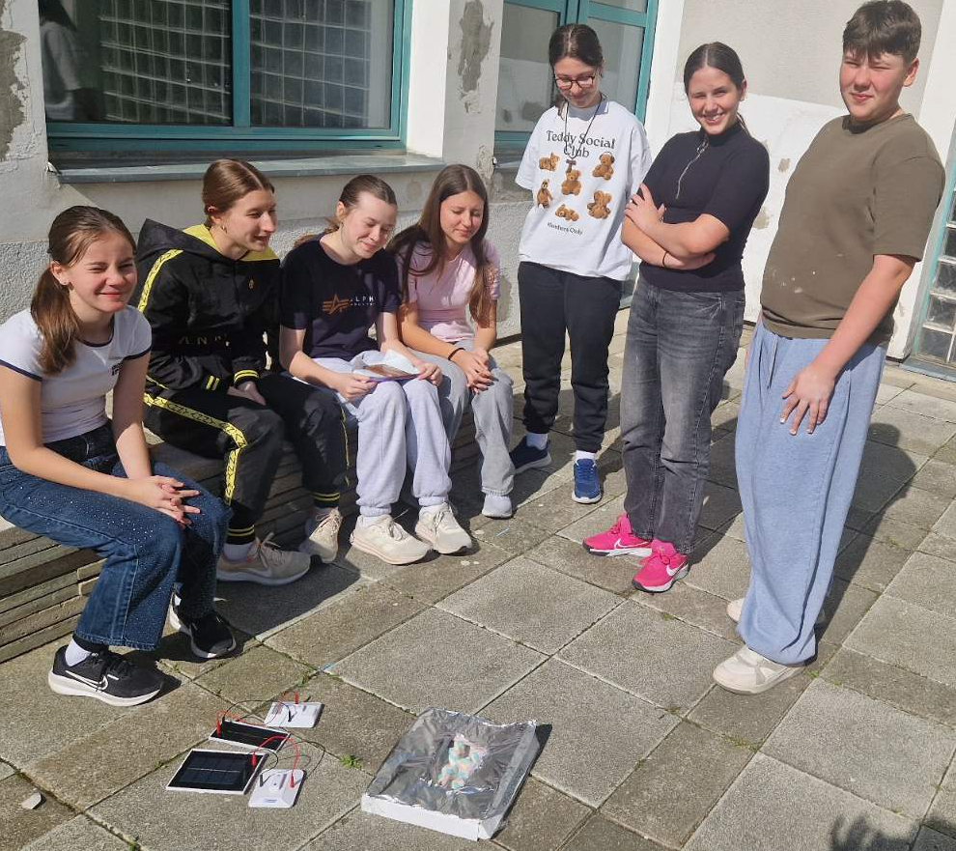
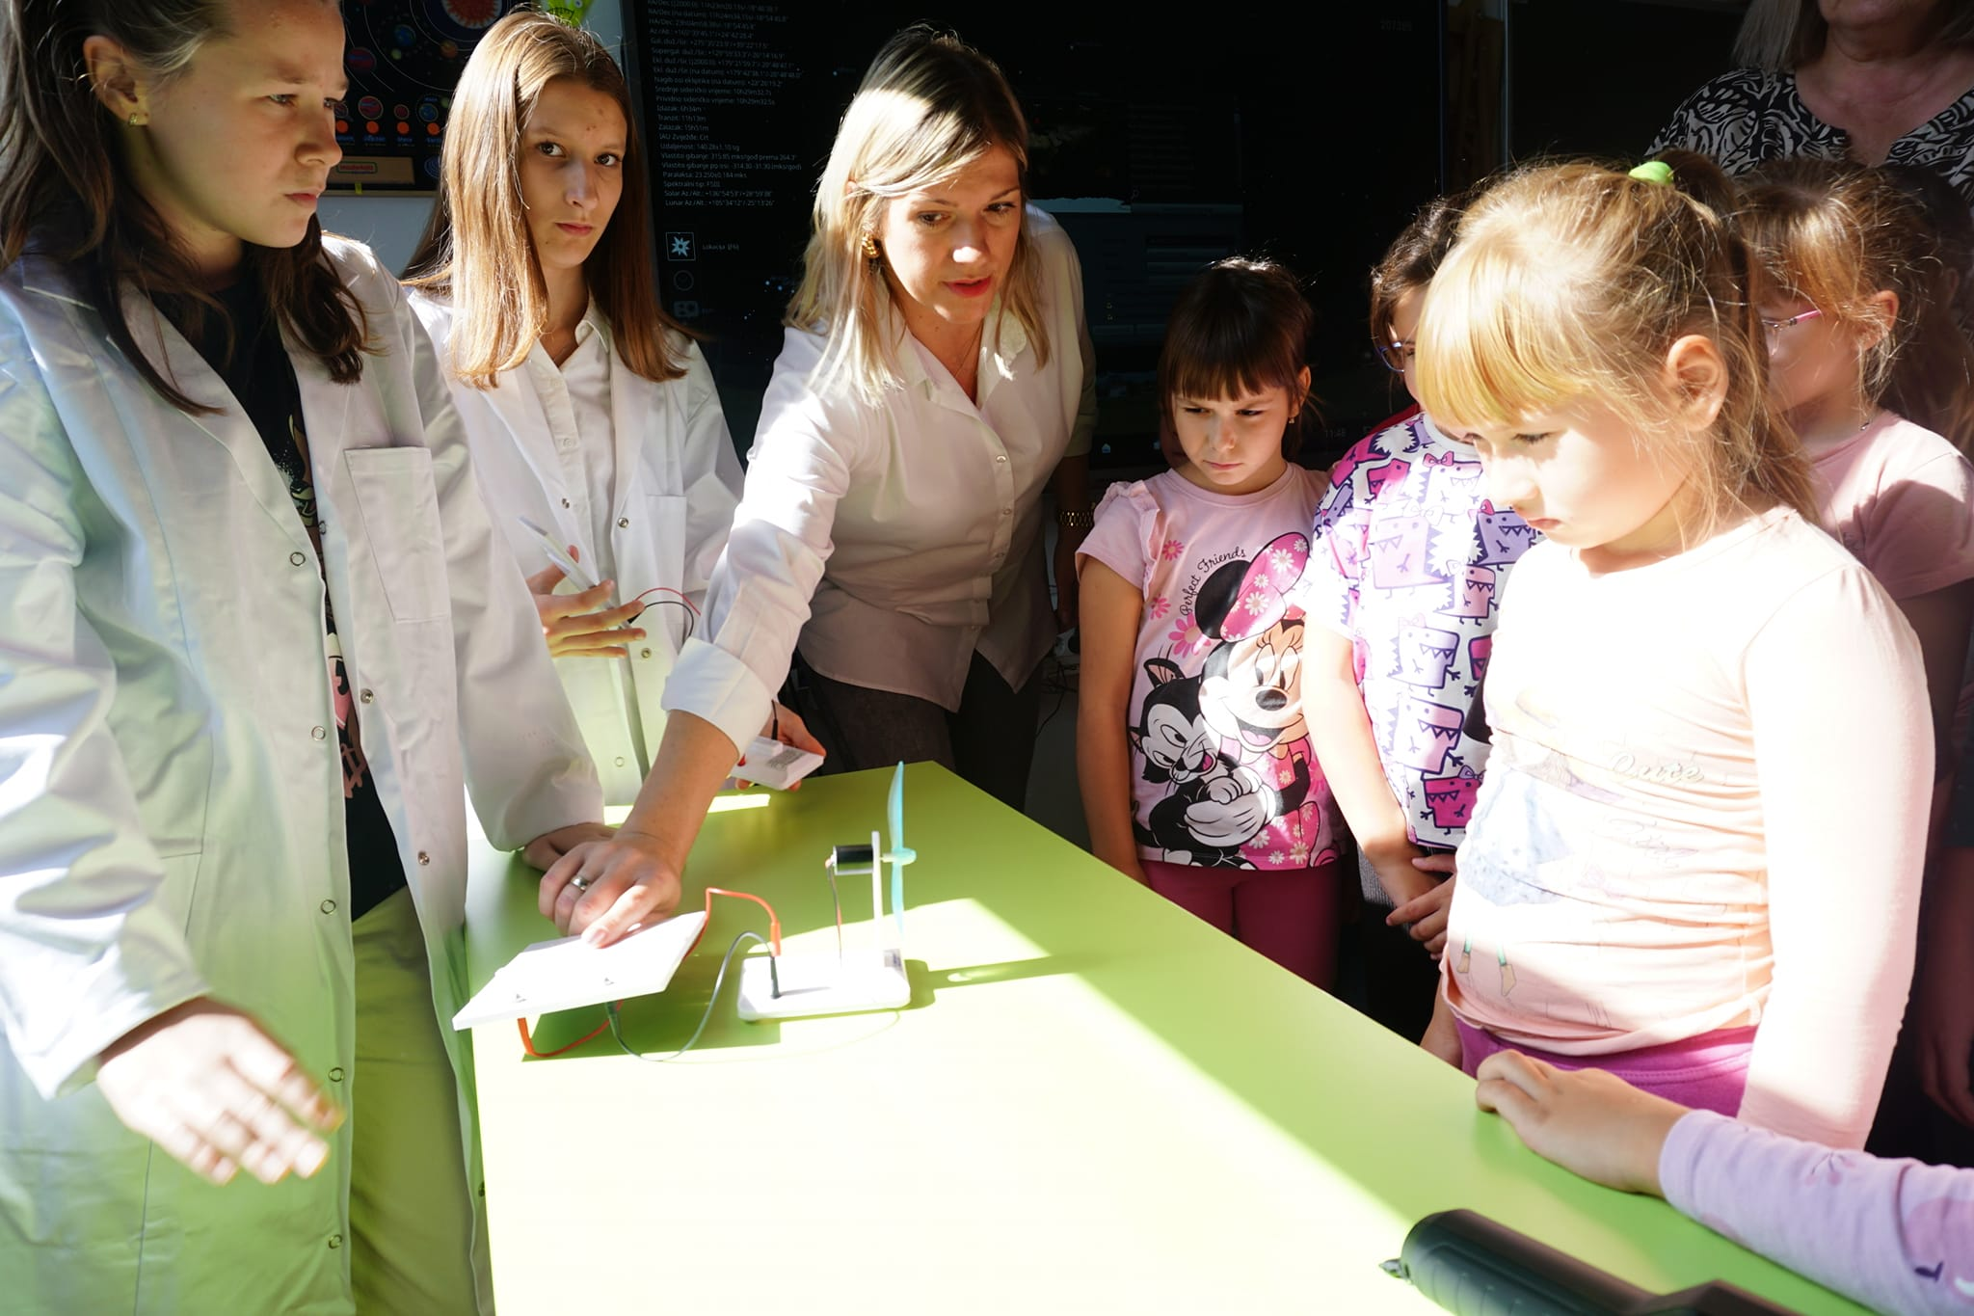
Solar Energy
4
Notes:
BZVZ stands for “Budrovci for a Brighter Community”. Original logos and documentary photographs are retained.

Slide 11
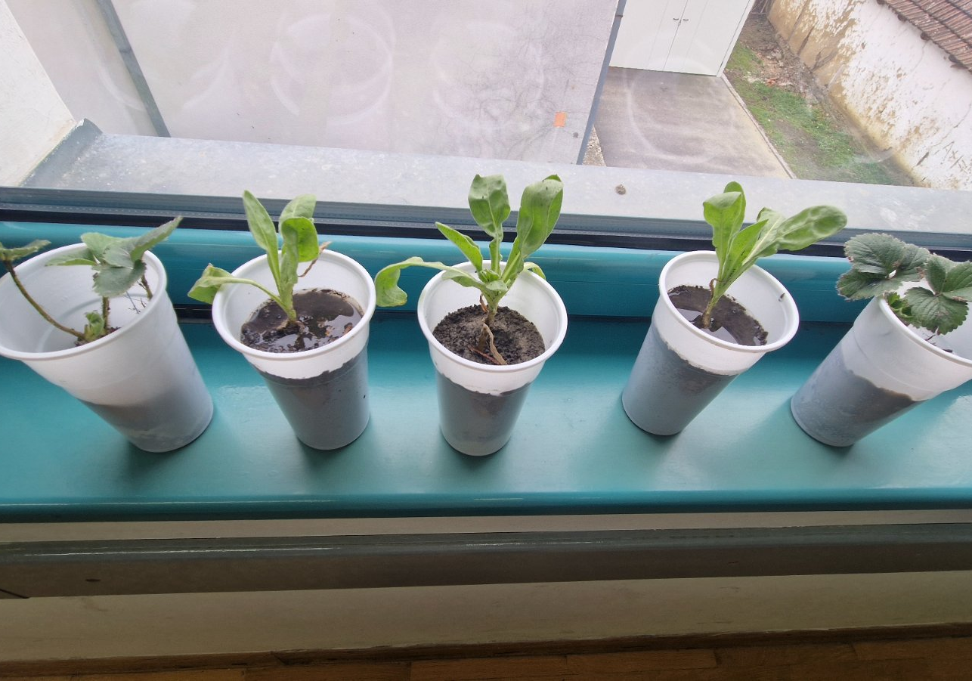
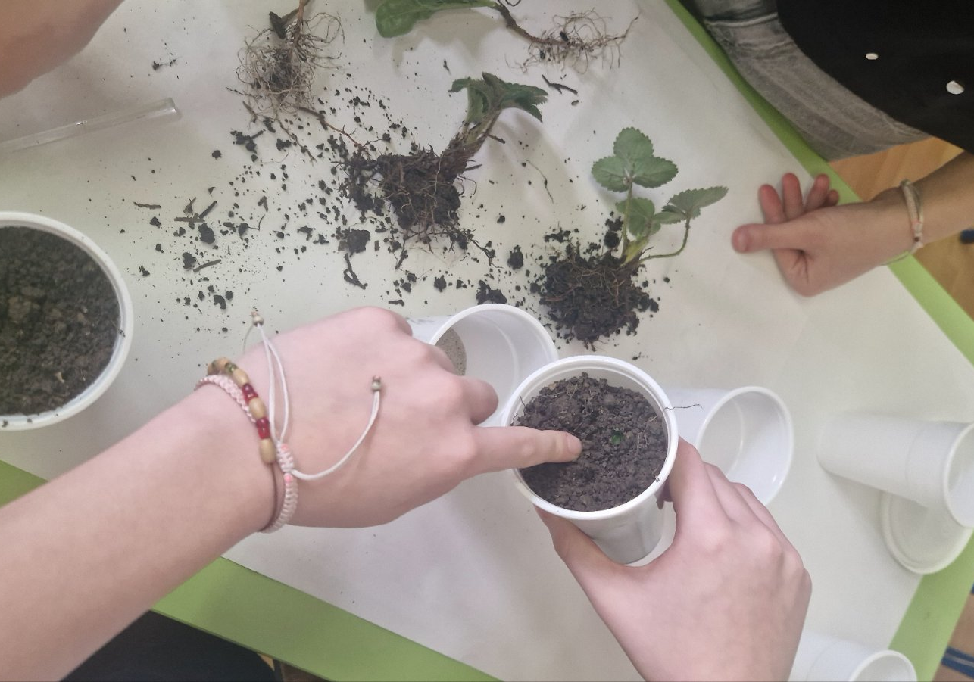
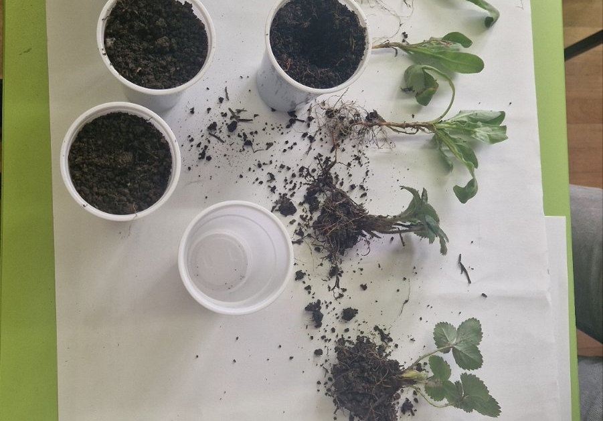
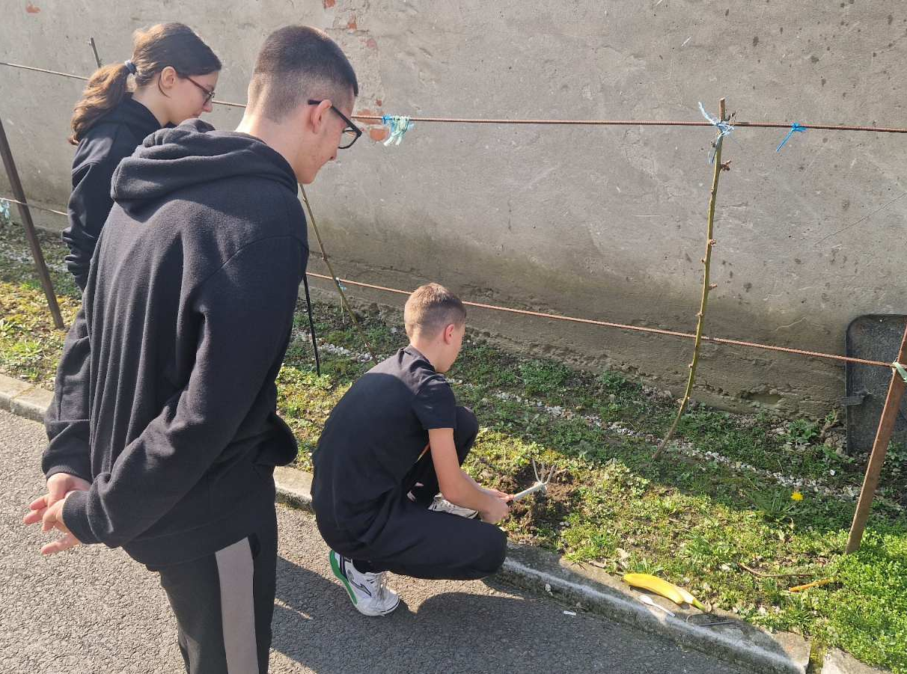
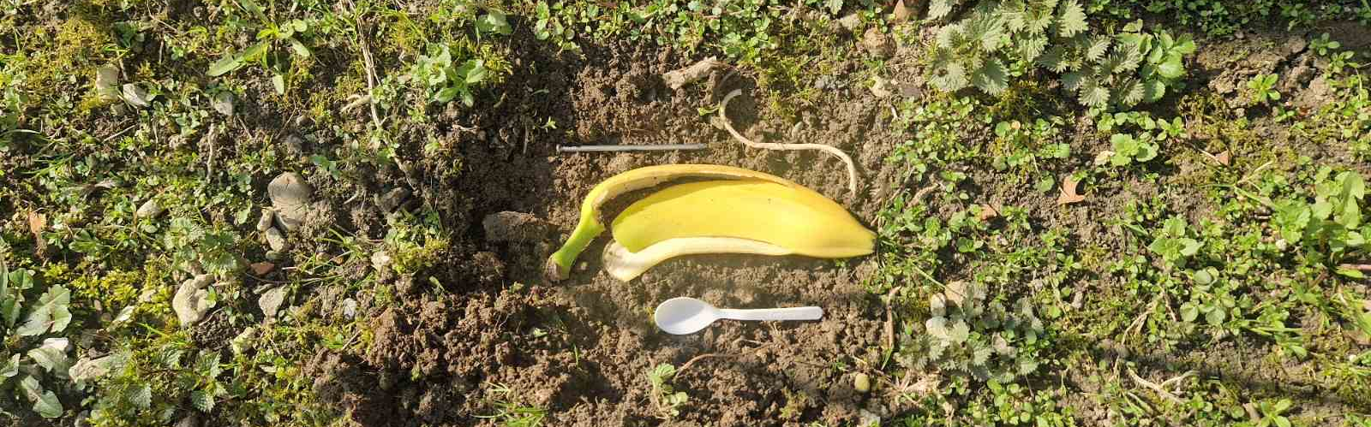
Studying Plants, Soil Types and Natural Composting
8
Notes:
BZVZ stands for “Budrovci for a Brighter Community”. Original logos and documentary photographs are retained.

Slide 12
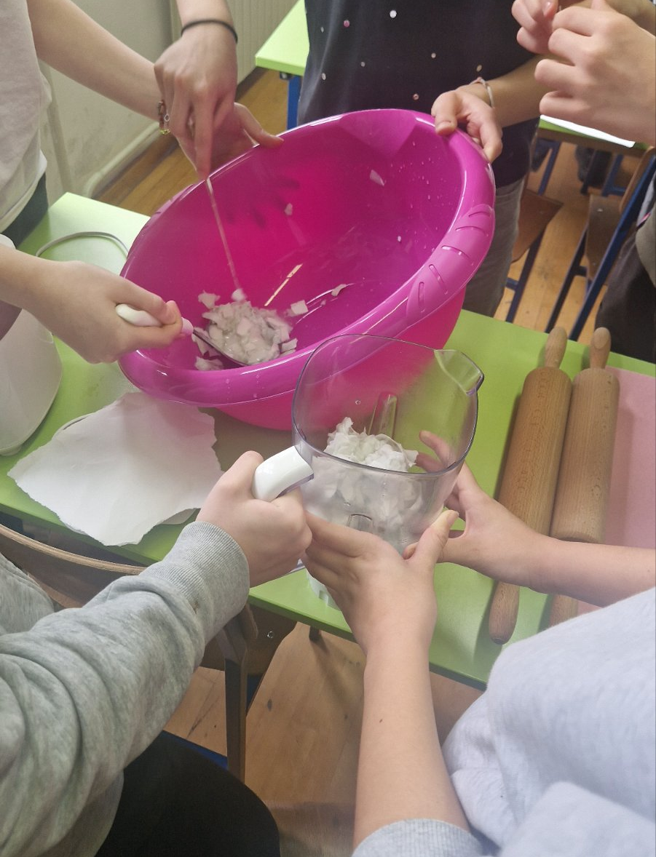
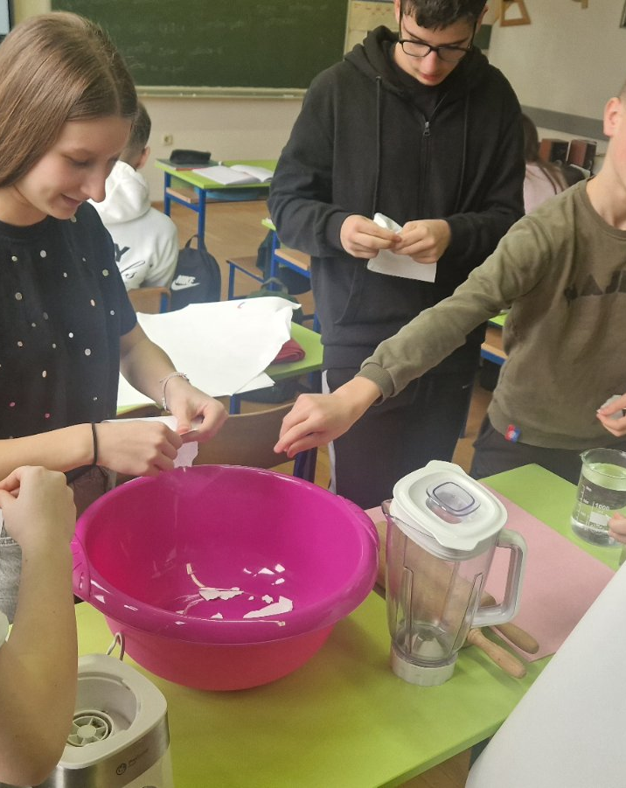
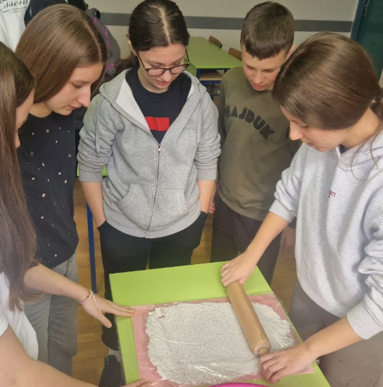
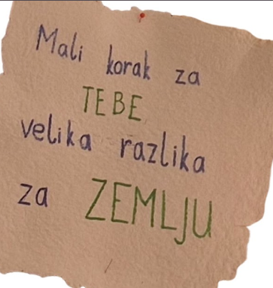
Reuse and Waste
A small step
for YOU,
a big difference
for the EARTH
10
Notes:
BZVZ stands for “Budrovci for a Brighter Community”. Original logos and documentary photographs are retained.

Slide 13
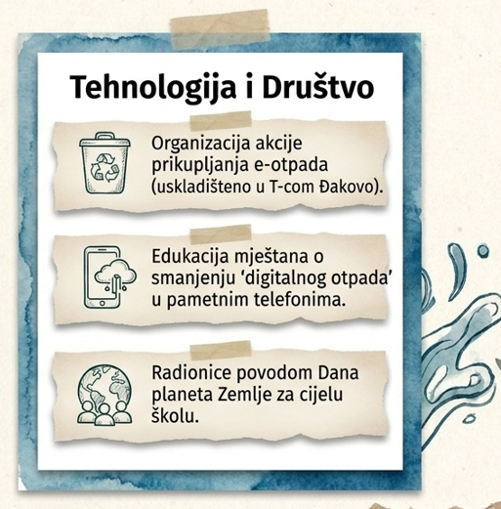
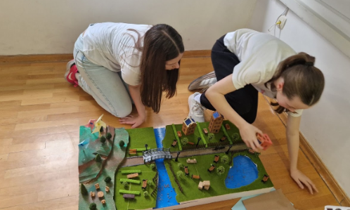
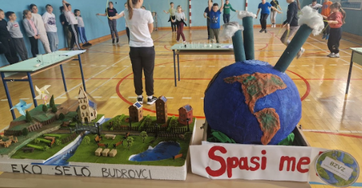
More Activities
Earth Day workshops for the whole school.
Teaching residents how to reduce digital waste on smartphones.
Organising an e-waste collection drive (stored at T-Com in Đakovo).
13
Notes:
BZVZ stands for “Budrovci for a Brighter Community”. Original logos and documentary photographs are retained.

Slide 14
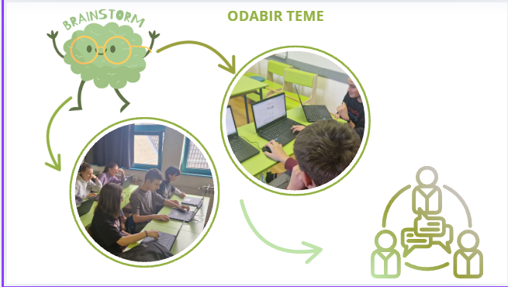
Digital Waste
CHOOSING A TOPIC
13
Notes:
BZVZ stands for “Budrovci for a Brighter Community”. Original logos and documentary photographs are retained.

Slide 15

Digital Waste
More than 50 pupils and teachers from Budrovci Primary School took part.
More than 150 GB of storage cleared on mobile devices.
Digital
Cleanup
14 March 2025
Young Scientists
Budrovci Primary School
More than 400 GB of storage cleared in Google accounts.
Many people invited to join through social media.
13
Notes:
BZVZ stands for “Budrovci for a Brighter Community”. Original logos and documentary photographs are retained.

Slide 16
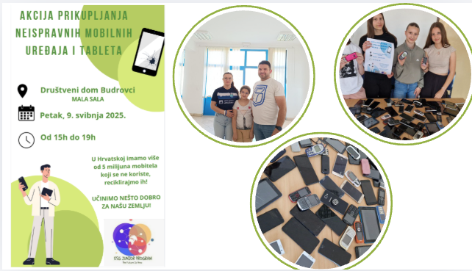
Digital Waste
COLLECTION DRIVE FOR
BROKEN MOBILE PHONES
AND TABLETS
Budrovci Community Centre
SMALL HALL
Friday, 9 May 2025
3 p.m. to 7 p.m.
Croatia has over 5 million unused mobile phones. Let’s recycle them!
LET’S DO SOMETHING GOOD FOR OUR PLANET!
13
Notes:
BZVZ stands for “Budrovci for a Brighter Community”. Original logos and documentary photographs are retained.

Slide 17
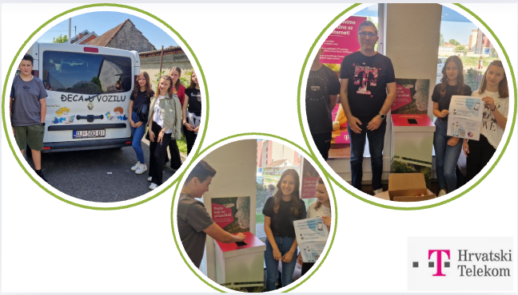
Digital Waste
13
Notes:
BZVZ stands for “Budrovci for a Brighter Community”. Original logos and documentary photographs are retained.

Slide 18
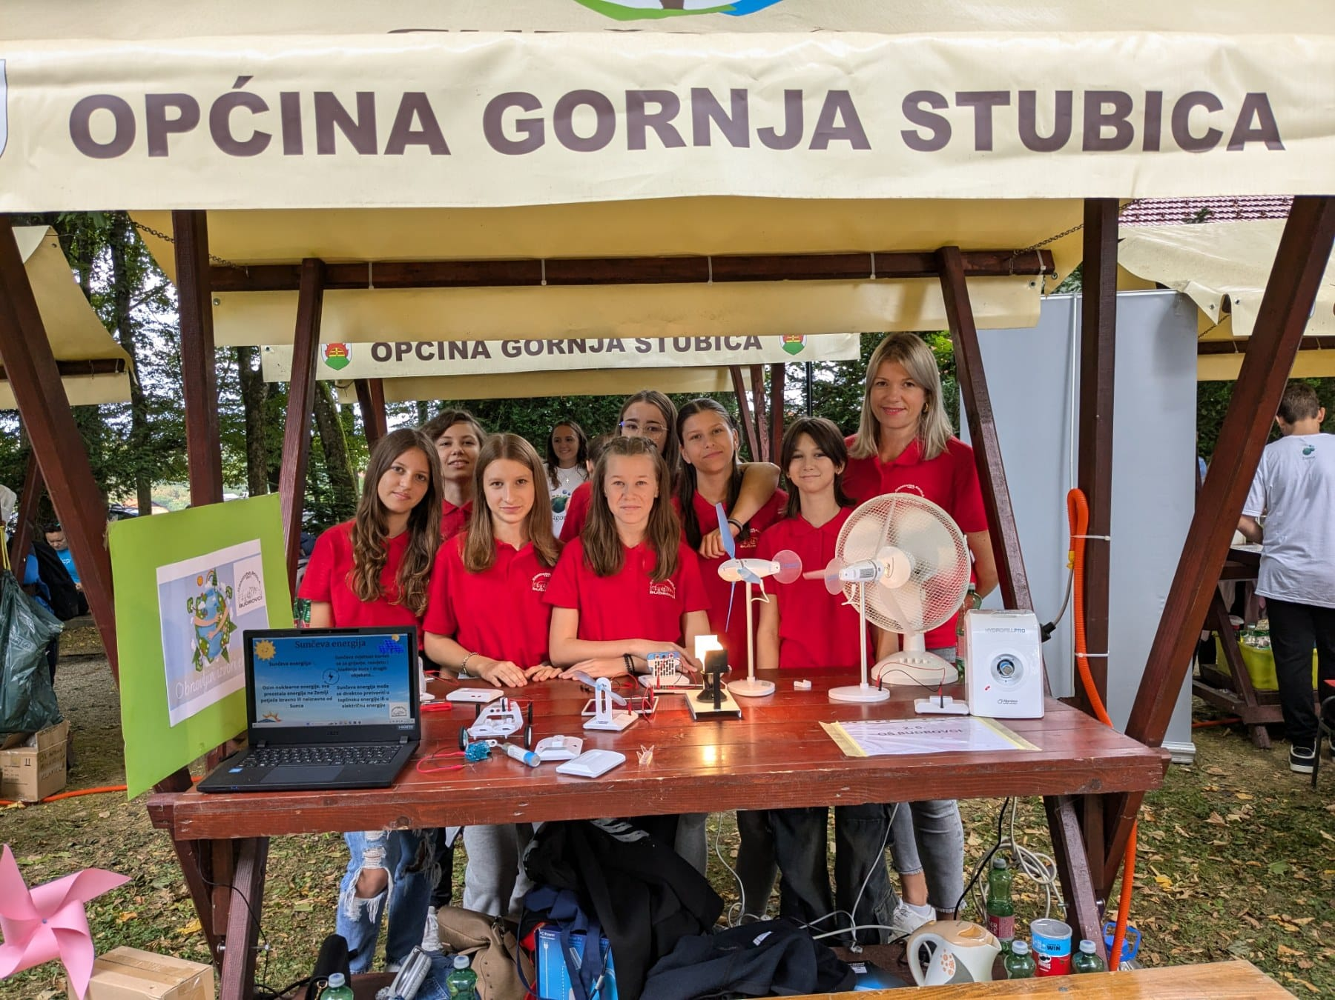

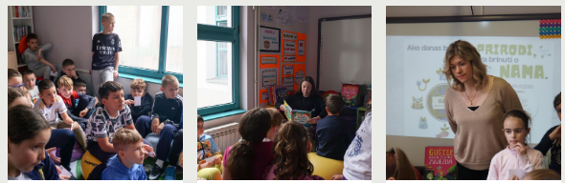
Sharing Knowledge
If we care for NATURE today,
it will care for US tomorrow.
SCHOOL LIBRARY
Budrovci Primary School
13
Notes:
BZVZ stands for “Budrovci for a Brighter Community”. Original logos and documentary photographs are retained.

Slide 19
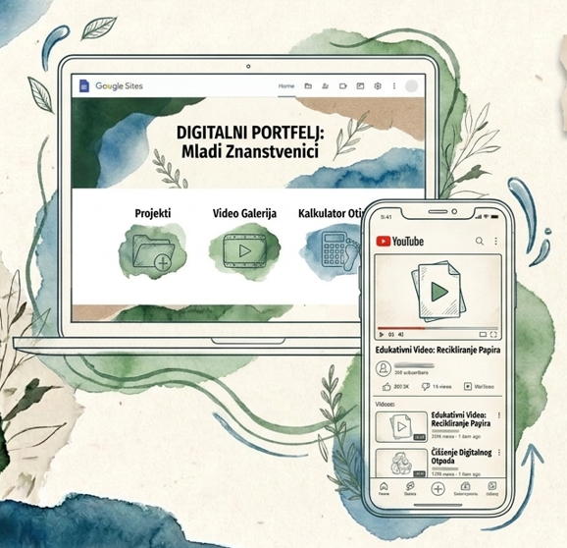
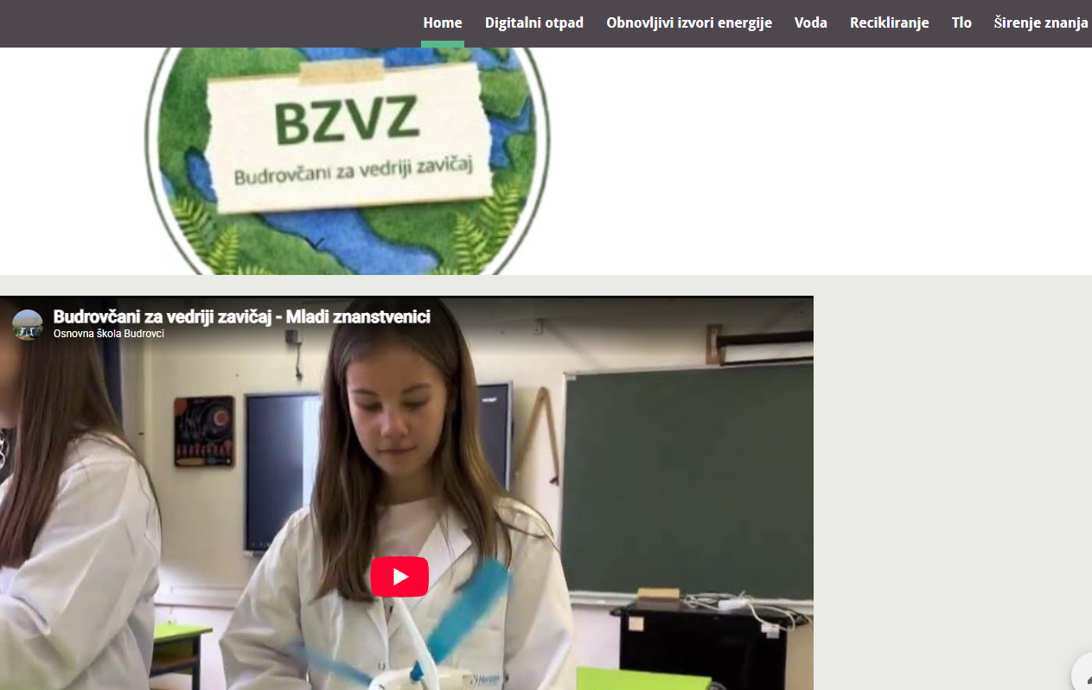
Sharing Knowledge
Home Digital Waste Renewable Energy Water Recycling Soil Sharing Knowledge
DIGITAL PORTFOLIO:
Young Scientists
Projects
Video Gallery
Footprint Calculator
Budrovci for a Brighter Community – Young Scientists
Educational Video: Paper Recycling
Educational Video:
Paper Recycling
Digital Waste
Cleanup
7
Notes:
BZVZ stands for “Budrovci for a Brighter Community”. Original logos and documentary photographs are retained.

Slide 20
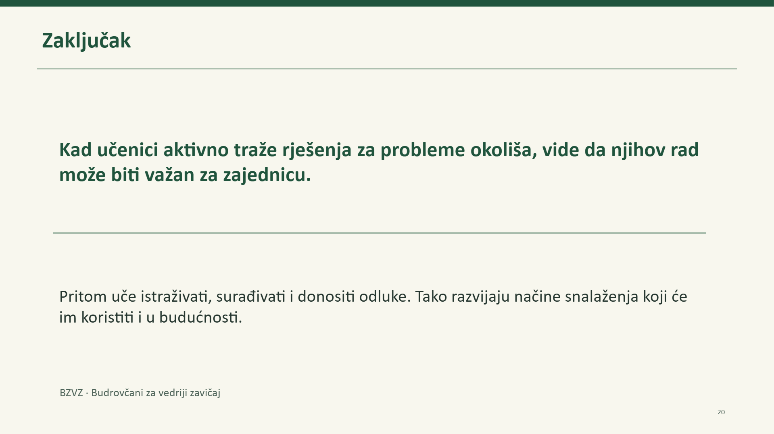

Conclusion
Conclusion
When pupils actively seek solutions to environmental problems,
they see that their work can matter to the community.
They learn to investigate, collaborate and make decisions.
They develop skills that will also help them in the future.
BZVZ · Budrovci for a Brighter Community
7
Notes:
BZVZ stands for “Budrovci for a Brighter Community”. Original logos and documentary photographs are retained.

Slide 21
THANK YOU FOR YOUR ATTENTION!
7
Notes:
BZVZ stands for “Budrovci for a Brighter Community”. Original logos and documentary photographs are retained.

