Slide 1





Impact of the Energy Renovation of the Building of the Department of Physics and the School of Applied Mathematics and Informatics on Indoor Radon Concentration
Denis Stanić
Department of Physics, J.J. Strossmayer University of Osijek, Croatia
dstanic@fizika.unios.hr
Kopacki rit, past, present, future
5th International Symposium, Osijek, 01-02 October 2026.

Slide 2
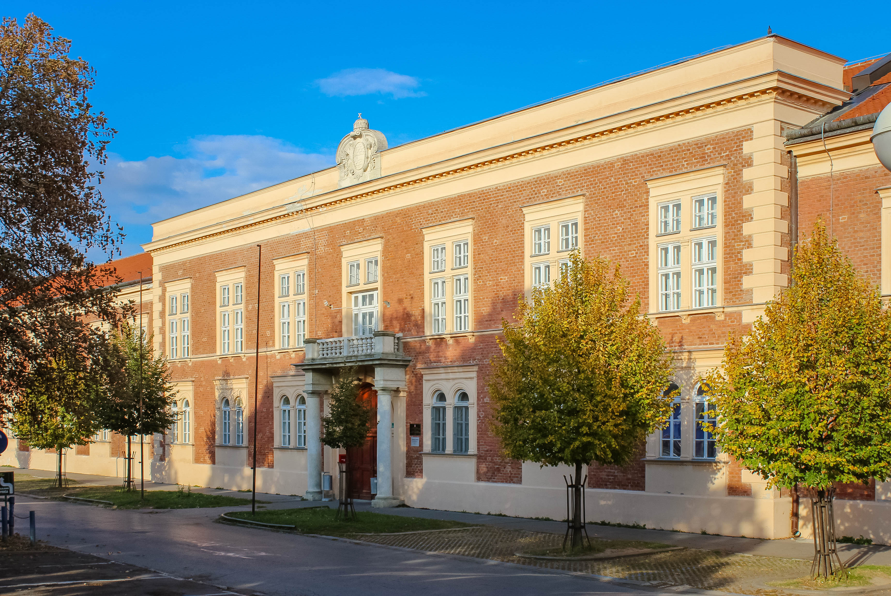
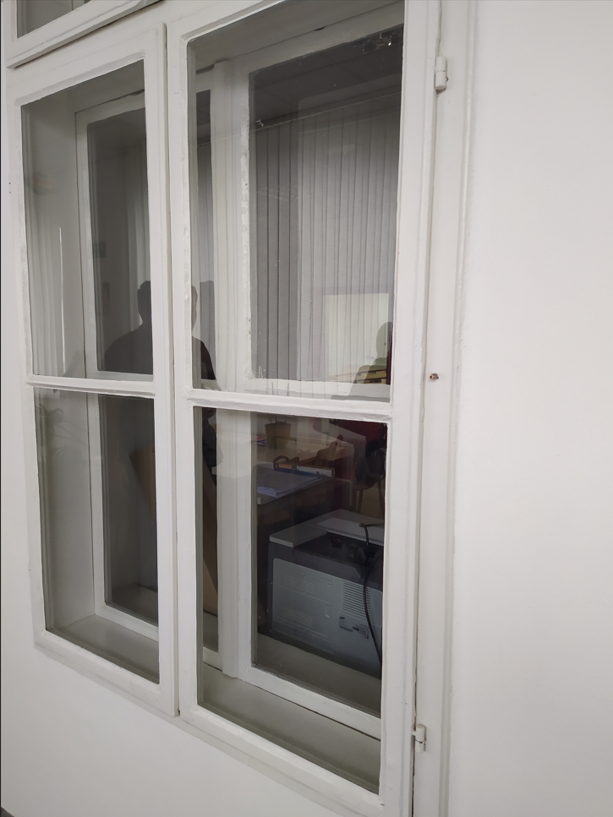
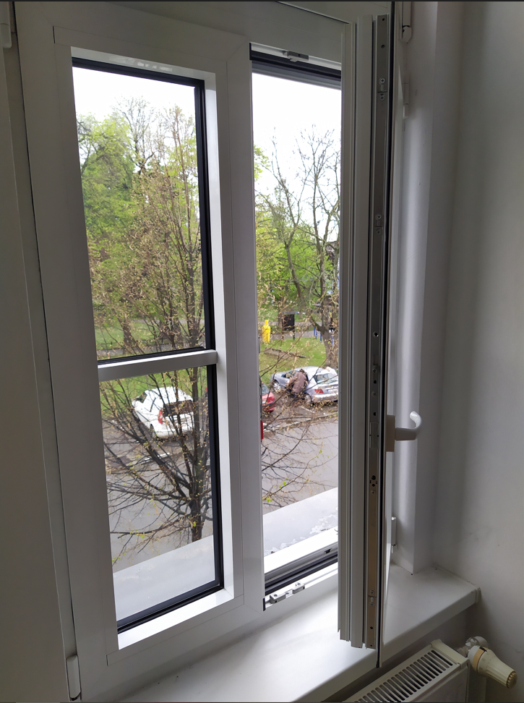
Motivation
Energy
Renovation
Radon
Concentration
???
wooden
windows
PVC
windows

Slide 3
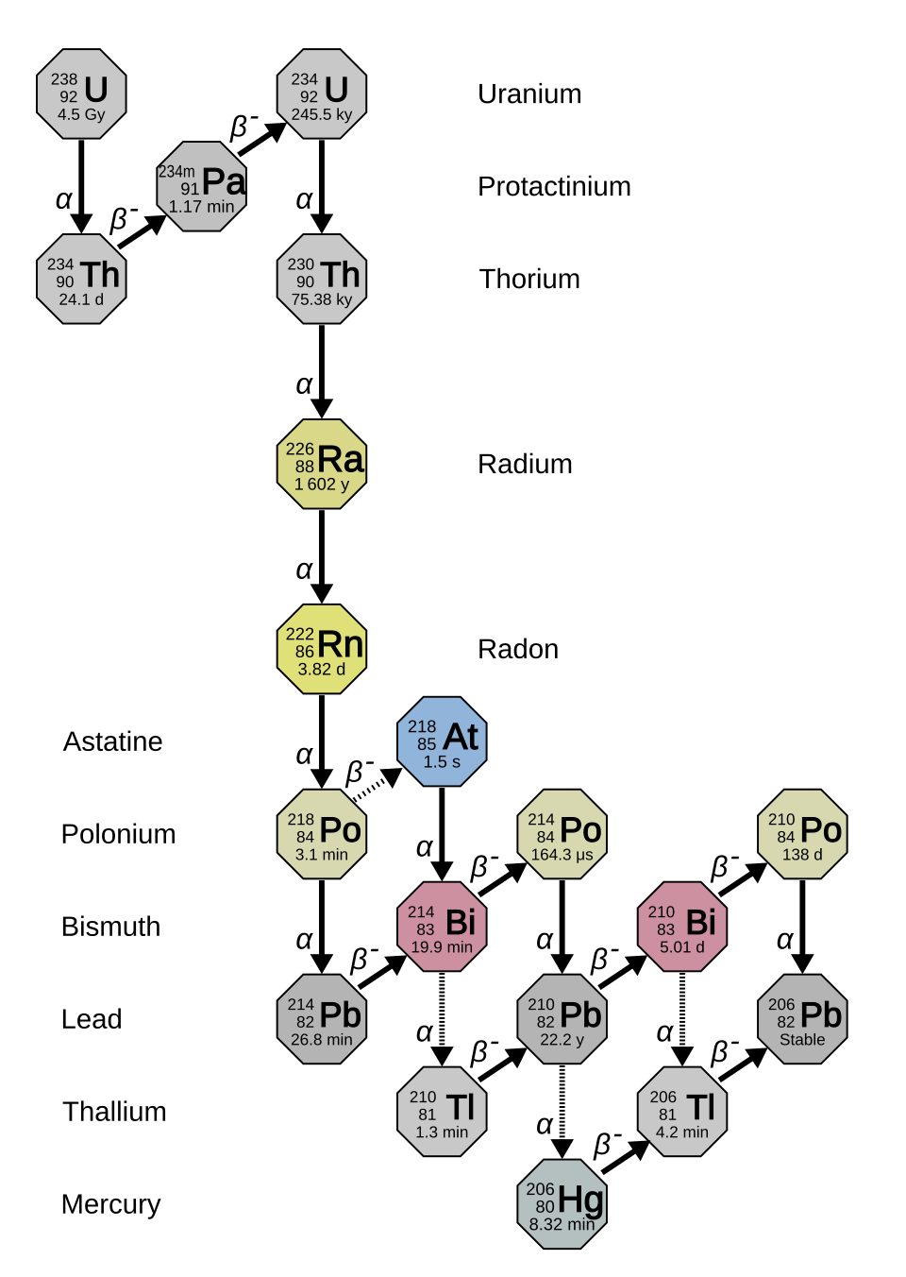

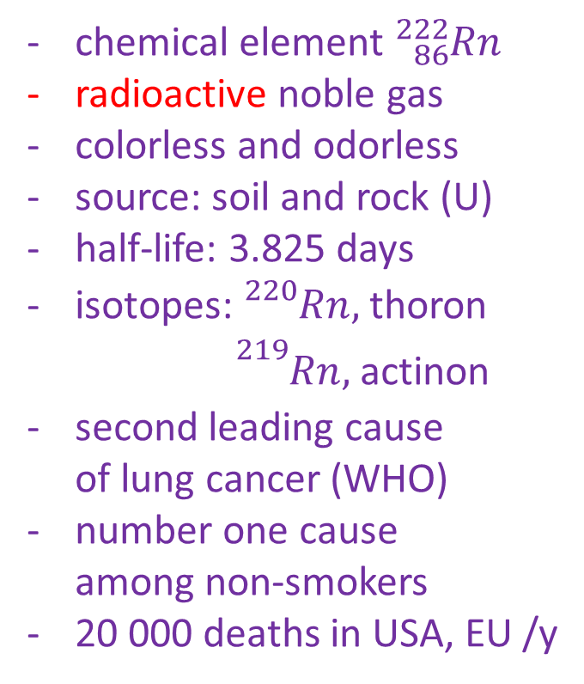
What is radon, Rn?
chemical element ${}_{86}^{222}{Rn}$
radioactive noble gas
colorless and odorless
source: soil and rock (U)
half-life: 3.825 days
isotopes: ${}_{}^{220}{Rn,}$ thoron
      ${}_{}^{219}{Rn,}$ actinon
second leading cause
of lung cancer (WHO)
number one cause
among non-smokers
20 000 deaths in USA, EU /y

Slide 4
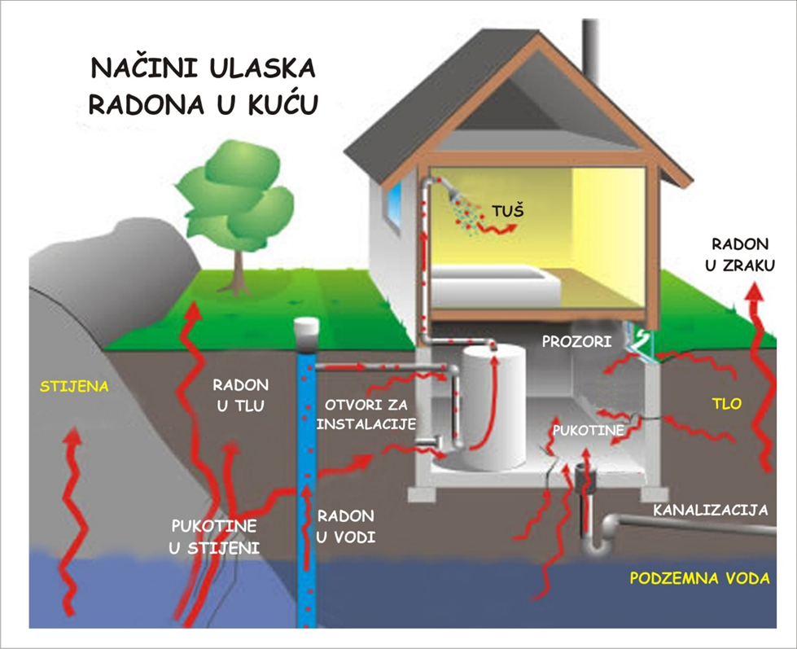
Indoor radon
the ways radon enters the house
Reference level
300 Bq/m³

Slide 5
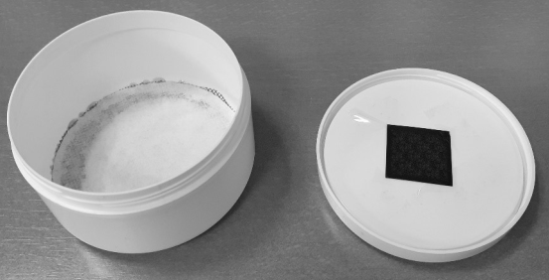
Hypothesis?
Rn concentration will increase (PVC windows)
experiment to test it
BC thesys by Bruno Kovač
Method
passive method* using strippable LR115 type II nuclear track detectors (Dosirad, France)
* V. Radolić et al., National survey of indoor radon levels in Croatia, J Radioanal Nucl Chem 2006; 269: 87-90

Slide 6
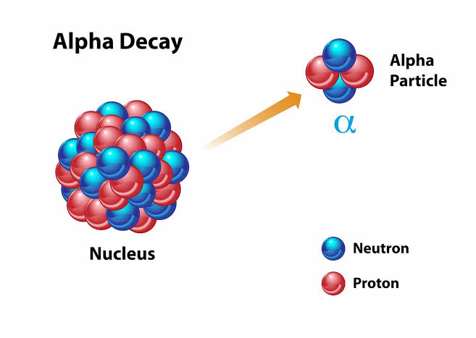
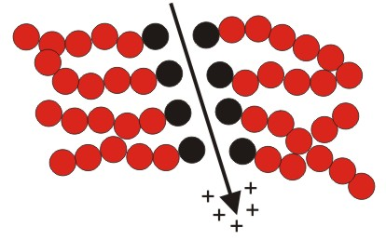
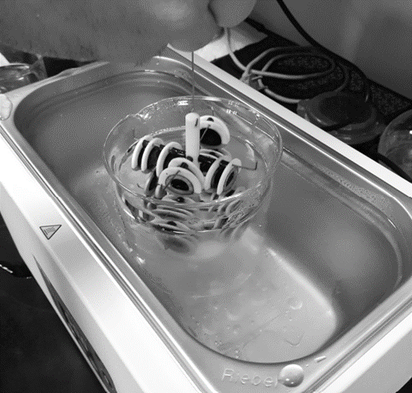
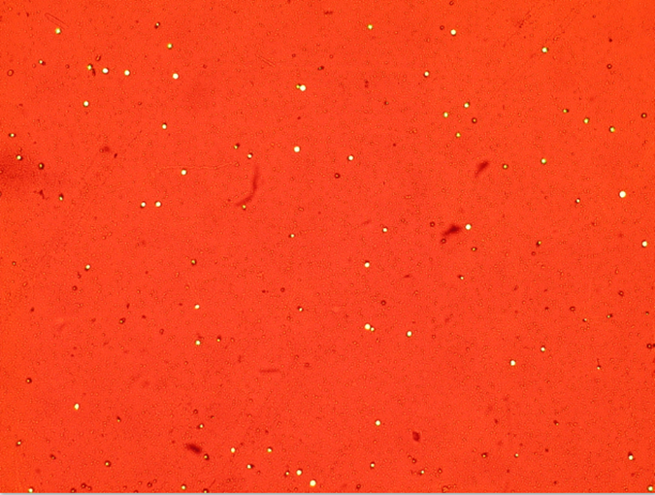
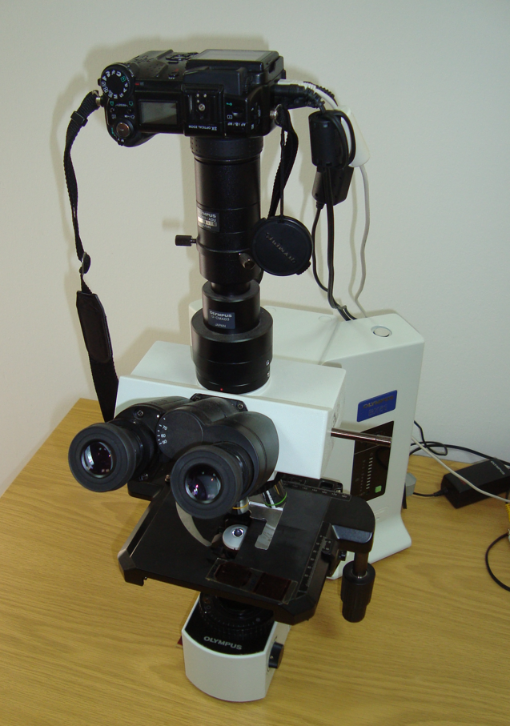
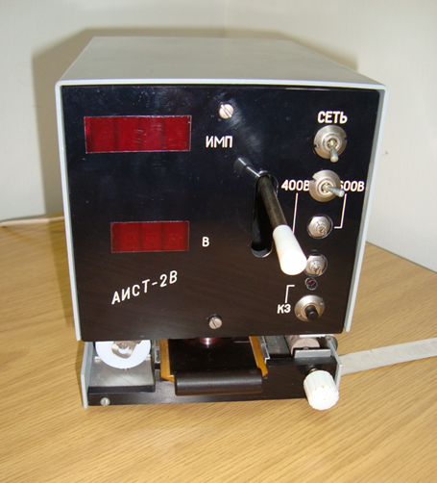
Track formation
size ~ nm
Rn
Etching & counting
size ~ μm
- 10% aqueous NaOH solution
at 50 °C for 150 minutes

Slide 7
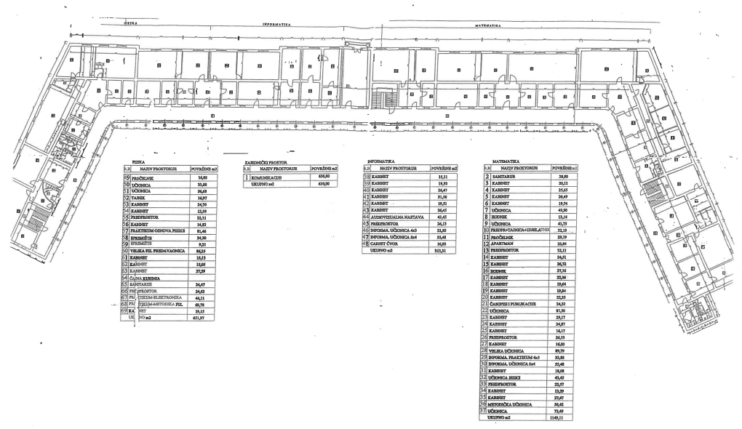
Results

Slide 8
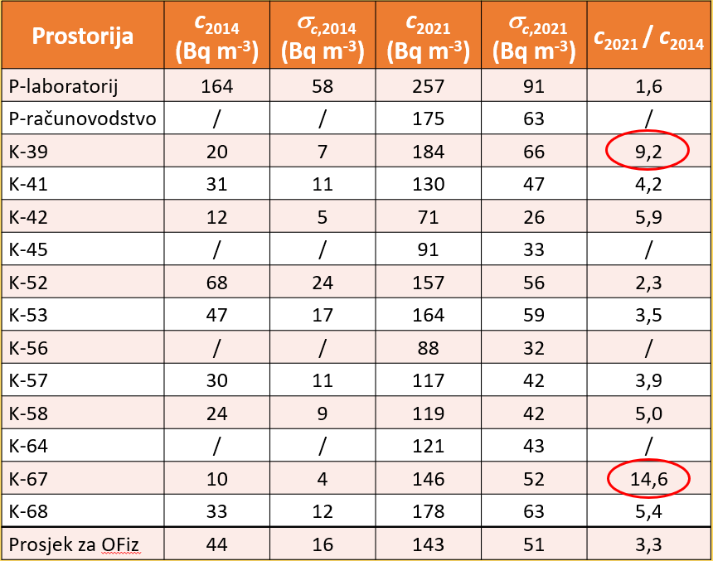

1 year
6 months
Results
Department
of Physics

Slide 9
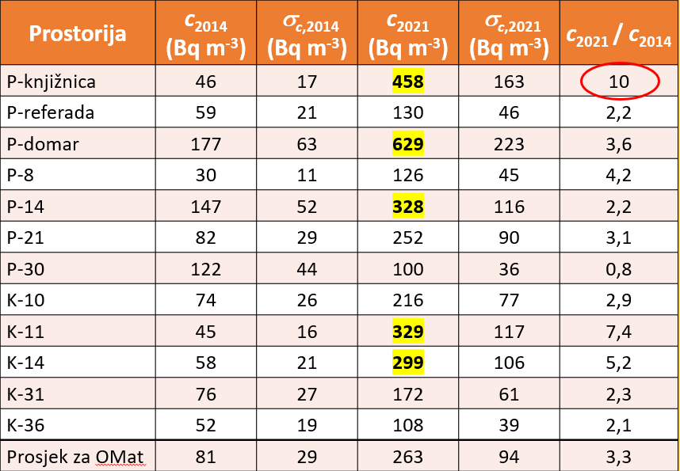

1 year
6 months
Results
School of Applied Mathematics and Informatics

Slide 10
Conclusion
 |  | Number of detectors | indoor radon concentration c (Bq m⁻³) | standard deviation σ (Bq m⁻³) | Min – Max (Bq m⁻³)
Department of Physics | BEFORE | 10 | 44 | 16 | 10 – 164
 | AFTER | 14 | 143 | 51 | 71 – 257
School of Applied Mathematics and Informatics | BEFORE | 12 | 81 | 29 | 30 – 177
 | AFTER | 12 | 263 | 94 | 100 – 629
3,3x
→ systematic monitoring and measurement of radon concentration after any construction intervention that may affect building ventilation, with the aim of protecting human health.

Slide 11

Acknowledgements
Department of Physics, J. J. Strossmayer University of Osijek
Vanja Radolić
Marina Poje Sovilj
Igor Miklavčić
Ana Pavlačić
Bruno Kovač

