Slide 1
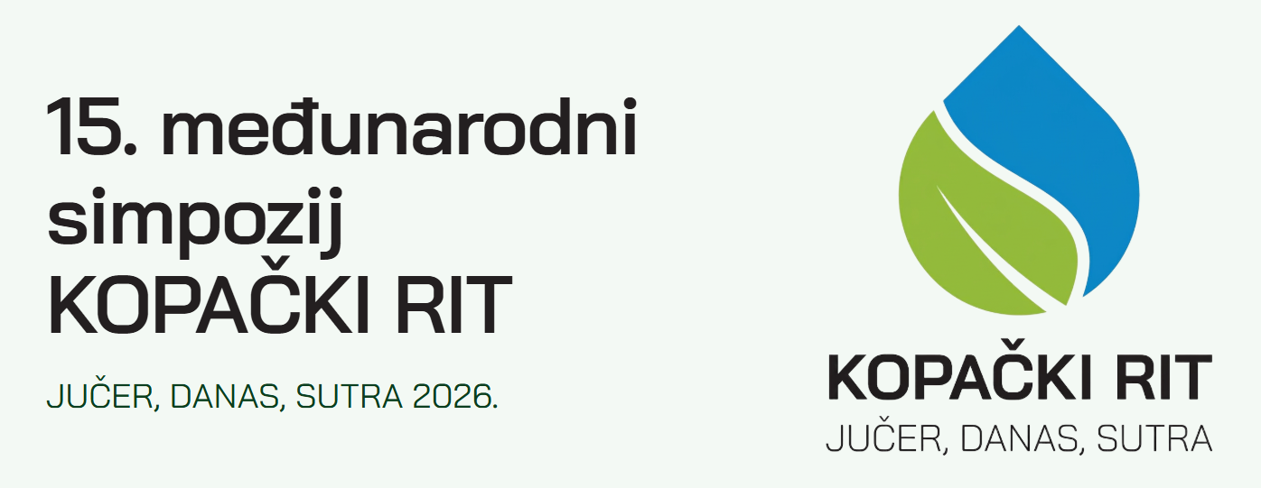
OKOLIŠNA DIMENZIJA ODRŽIVOSTI U OKVIRU CILJEVA ODRŽIVOG RAZVOJA: KOMPARATIVNA ANALIZA PROMJENA 2020. I 2025. GODINE
The Environmental Dimension of sustainability within the Sustainable Development Goals: A Comparative Analysis of the 2020 and 2025 Changes
PhD Katarina Marošević, Associate Professor
katarina.marosevic@pravos.hr
Faculty of Law Osijek
J. J. Strossmayer University in Osijek, Croatia

Slide 2
„Development that meets the needs of the present without compromising the ability of future generations to meet their own needs”.
Source: Edward B. Barbier, Joanne C. Burgess (2015). Sustainable Development: An Economic Perspective, J. D. Wright (ed.). International Encyclopedia of the Social & Behavioral Sciences, Elsevier, pp. 823-827. https://doi.org/10.1016/B978-0-08-097086-8.91029-8

Slide 3
Outline
1. Introduction
2. Sustainable Development Goals: Definition and Theoretical Perspective
3. Analysis of Sustainable Development Goals in Croatia
4. Environmental Dimension of Sustainable Development Goals: 2020 vs. 2025
4. Conclusion

Slide 4
RESEARCH BACKGROUND
Sustainable development as a balance in the social, economic and environmental dimensions is more and more often visible in scientific research but also strategic documents and even legislative framework.
Sustainable development analysis via Sustainable Development Goals (SDGs) set by the United Nations in 2015 based on 17 goals, also known as the 2030 Global Development Program, but also as the 2030 Agenda for Sustainable Development.

Slide 5
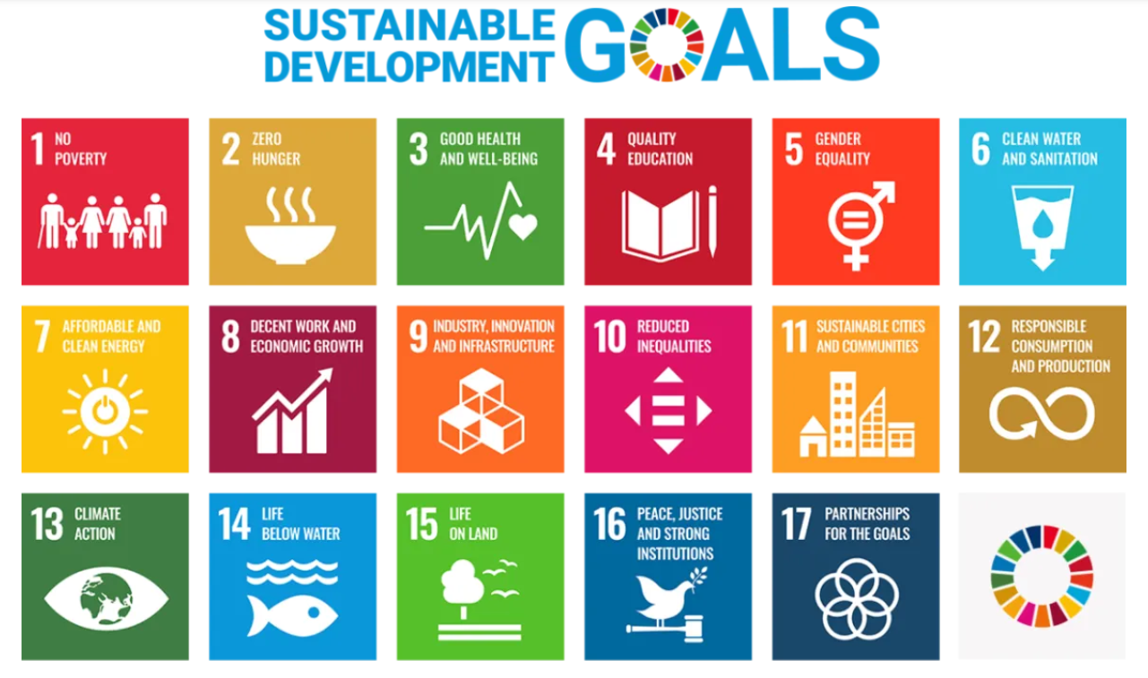
Source: United Nations. https://unosd.un.org/en/content/sustainable-development-goals-sdgs, (30.09.2026.)

Slide 6
„With just five years to reach the Sustainable Development Goals, we need to shift into overdrive.”
António Guterres Secretary-General, United Nations

Slide 7
Aim(s) of the Paper and Definition
The goals of the paper are to:
Analyze the SDGs related to environmental dimension for the Republic of Croatia and…
Compare the achieved SDG’s results in 2020 compared to 2025.
After gaining insight into the state of the SDGs environmental dimension, selected projects that could increase environmental dimension of SDGs, as well as recommendations that could be given based on an insight into the review of relevant literature is given, in order to take into account not only the national perspective, but also the important local perspective.
The methodological work is based on the following methods: historical, comparative, induction and deduction, and theoretical analysis of relevant scientific literature.
The environmental dimension includes the following SDGs – Goal 6 “Clean Water and Sanitation”, Goal 13 “Climate Action”, Goal 14 “Life below Water” and Goal 15 “Life on Land”.

Slide 8
Sustainable Development Goals in Croatia in 2026 – last available results, rank 13, SDI 81,8

Slide 9
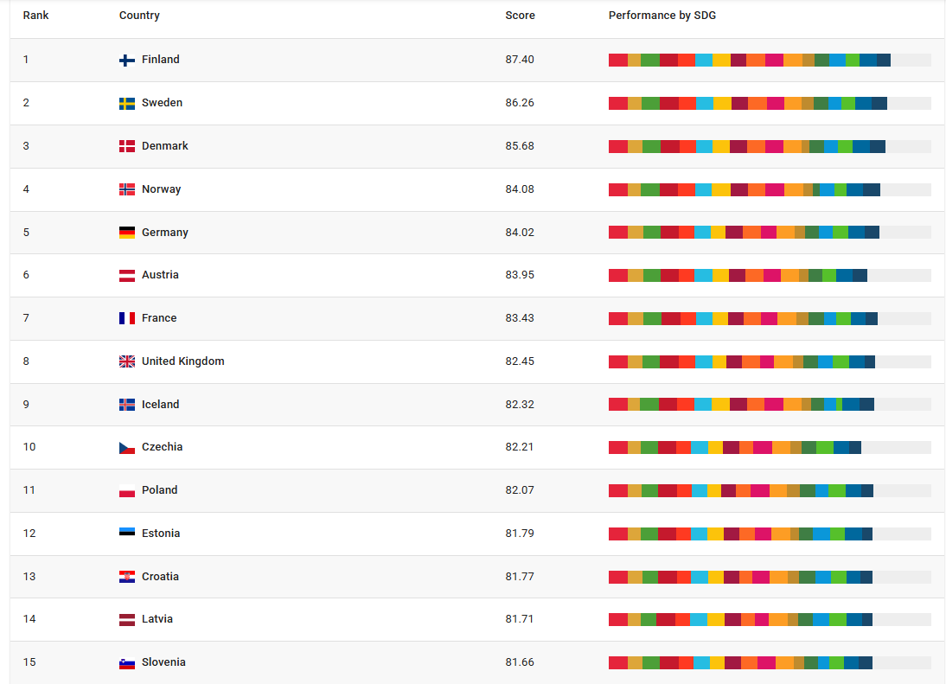
What about first 15 rankings?
Source: Sustainable Development Report, https://dashboards.sdgindex.org/rankings/, (30.09.2026.)

Slide 10
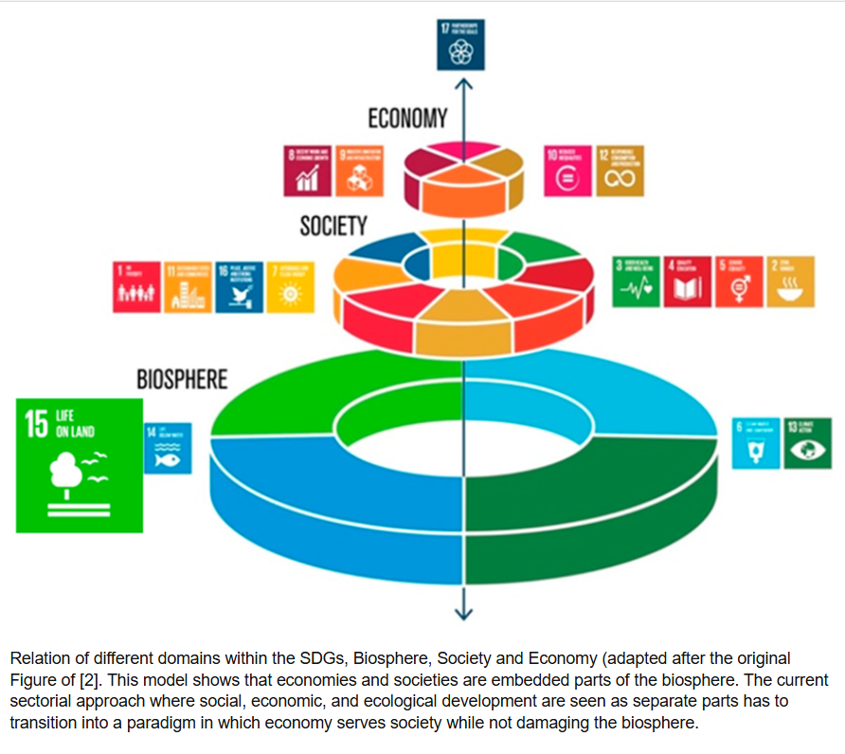
Source: https://www.researchgate.net/figure/Relation-of-different-domains-within-the-SDGs-Biosphere-Society-and-Economy-adapted_fig1_337639803, (30.09.2026.)

Slide 11
Domain of SDG 6
SDG 6: Access to safe water, sanitation, and hygiene as the most basic human need for health and well-being. Today, global demand for water is outpacing population growth due to rapid urbanization and the rising needs of the agriculture, industry, and energy sectors.
WHAT IS NEEDED…?
To ensure universal access to safe and affordable drinking water by 2030, we must invest in infrastructure, protect water-related ecosystems, and promote hygiene education. Improving water-use efficiency is also key to reducing overall water stress. At our current pace, however, the world will not achieve sustainable water management until at least 2049, and reaching water, sanitation, and hygiene (WASH) targets in schools by 2030 will require doubling our current rate of progress.
Source: https://www.un.org/sustainabledevelopment/water-and-sanitation/, (1.10.2026.)

Slide 12
Domain of SDG 13 & SDG 14
SDH 13: Climate change impacts each person.
Adapting to the consequences of climate change protects people, homes, businesses, livelihoods, infrastructure and natural ecosystems.
SDG 14: Life below Water
Focused on conserving and sustainably using the oceans, seas and marine resources.
Protecting the open ocean requires strong international cooperation to build effective, well-managed systems of government-protected areas.
On a local level one should make ocean-friendly choices when buying products or seafood, consuming only what you need, and actively reducing your use of single-use plastics.
Source: https://www.un.org/sustainabledevelopment/water-and-sanitation/, (1.10.2026.)

Slide 13
Domain of SDG 15
Earth’s ecosystems are vital for sustaining human life. They contribute to more than half of global GDP and embody diverse cultural, spiritual, and economic values. However, we are currently facing a triple crisis of climate change, pollution and biodiversity loss.
Forests cover 31.8% of Earth’s land today, but from 2000 to 2020, we lost about 100 million hectares of forest cover.
Between 2015 and 2019, the global proportion of degraded land rose from 11.3% to 15.5%, undermining the well-being of 3.2 billion people.
Source: https://www.un.org/sustainabledevelopment/water-and-sanitation/, (1.10.2026.)

Slide 14
Comparison of SDG’s in 2020 (SDI 81,4) vs. 2025 (81,8): Croatia
6. Clean Water and Sanitation
Source: Author’s graphics according to official Sustainable Development Report, https://dashboards.sdgindex.org/explorer/, (30.09.226.)

Slide 15
Conclusion
  There was a paradox with sustainable development indeks, since the indeks rose from 2020 to 2025 – for the most SDG’s of social and economic dimensions the Sustainable Development Index has rosen when 2020 compared to 2025, but it is not the case for Environmental Dimension.
  Development should be more focused to the Environment Dimension as well – not only on legislative level, but for the implementation cases.
  Education of all aged groups, with local development based activities on its inhabitants – glocalization implementation.
  Achieving sustainability within starting from our own „little steps” behaviour and that is confirmed via data for SDG 12: Sustainable Consumtion and Production that are traditionally lowest one.

Slide 16
Thank you for your attention!
If any additional questions, please be free to contact:
katarina.marosevic@pravos.hr

