Slide 1
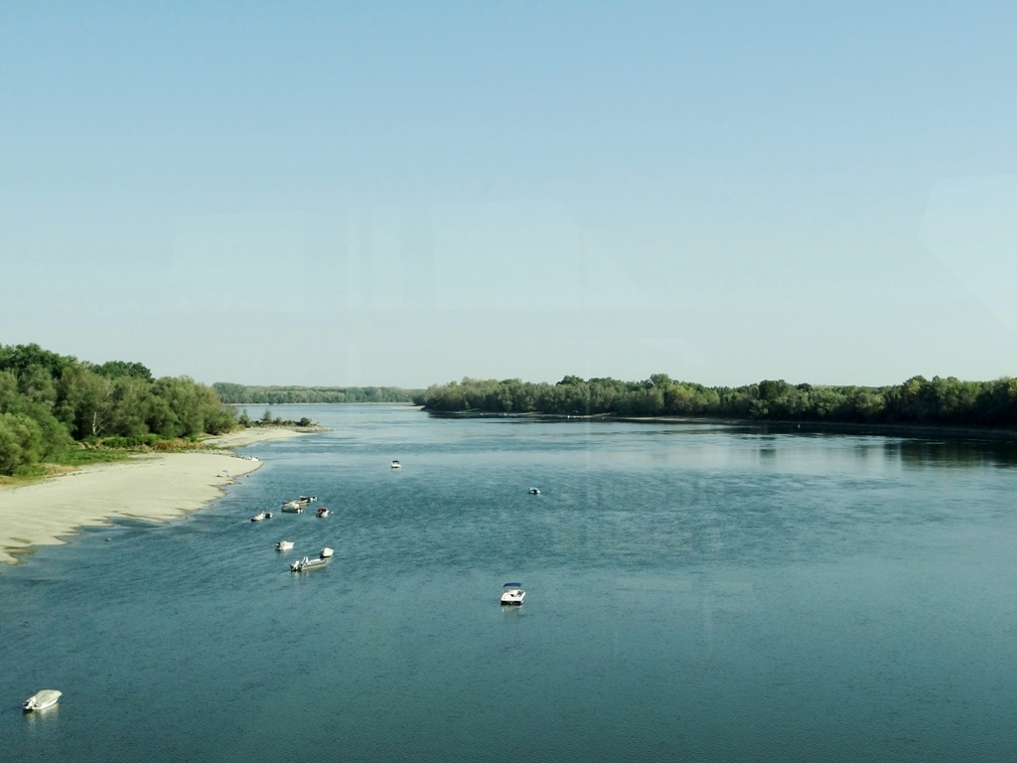
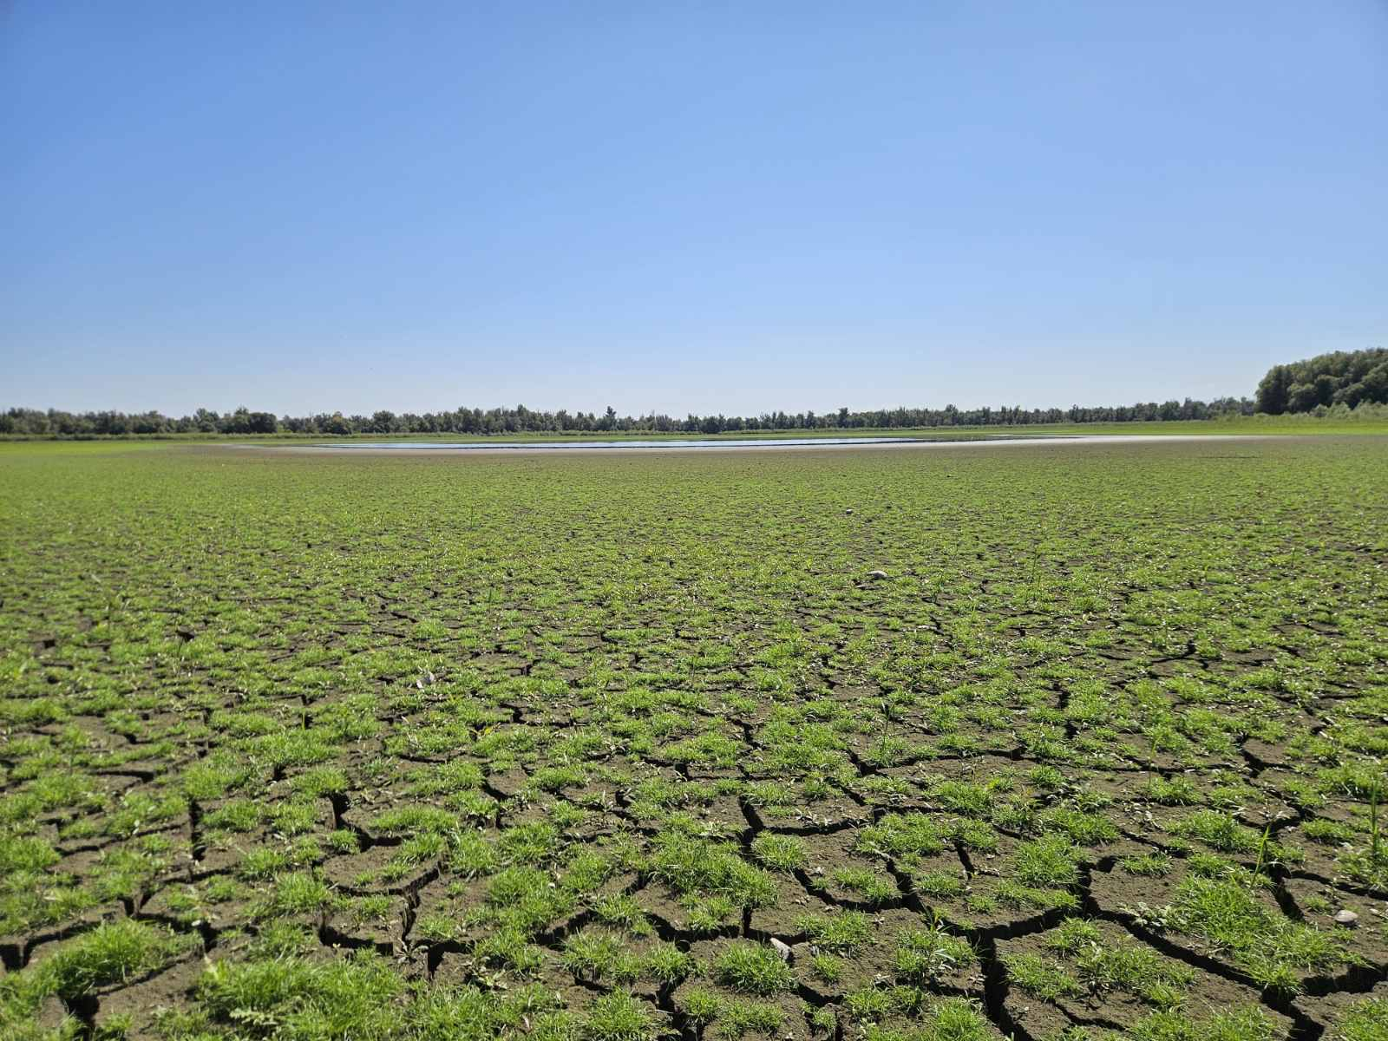
Utjecaj ekstremnih suša na vodene ekosustave poplavnog područja Kopačkog rita
The impacts of extreme droughts on water ecosystems of Kopački rit floodplain
Danube River in Hungary, September 2026. Photo: IAD
Melita Mihaljević*, Filip Stević, Dubravka Špoljarić Maronić, Tanja Žuna Pfeiffer, Vanda Zahirović
Department of Biology, Josip Juraj Strossmayer University of Osijek, Croatia
NP Kopački rit – Kopačko jezero, September 2026. Photo: S. Ozimec

Slide 2
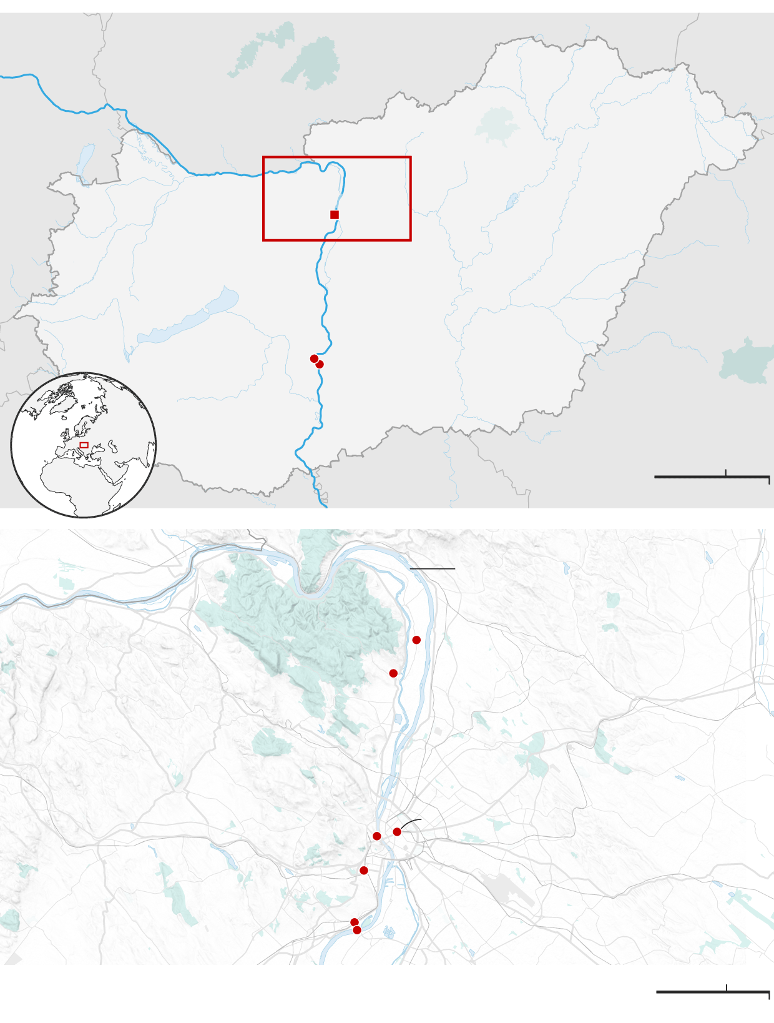

Droughts in the Danube River Basin in 2026
According to a statement by the International Association for Danube Research (IAD), low water levels are being recorded along 96% of the assessed sections of the Danube, with 80% approaching record lows
IAD
In August 2026 an extreme drought affect the entire Danube River Basin.
On September 8, 2026, the Danube's water level at Budapest dropped to a historic low of just 0.01 m.
Destroyed crops, riverbed cyclists and a ‘Rock of Starvation’: how drought has devastated the Danube | Climate crisis | The Guardian
Foto:Guardian, 16 Aug 2026

Slide 3
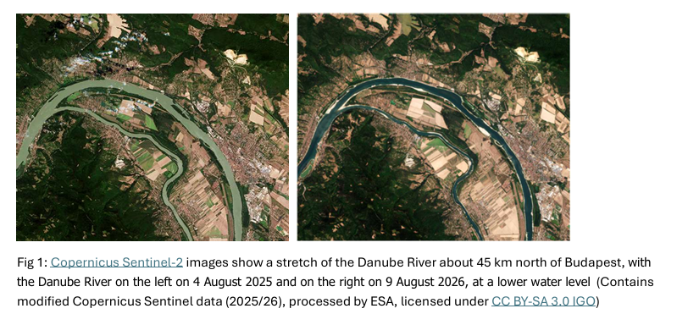
Danube River drought in summer of 2026
Parts of western, central, and eastern Europe are facing severe droughts, with above-average temperatures and below-average rainfall.
Guardian, 16 Aug 2026

Slide 4
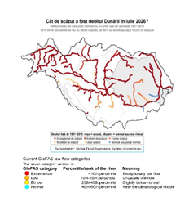

The Danube at extreme Low Flow in 2026
An assessment prepared by the International Association for Danube Research (IAD).
What is happening?
The Danube is experiencing exceptionally low water levels across large parts of its course:
Approximately, 96% of Danube River sections are experiencing low flows, while 80% are approaching record low conditions.
Figure : How low was the Danube’s discharge in July 2026? The figure compares average July 2026 discharge with July flows recorded during 1981–2010. The six scale colouring scale indicates water courses from exceptional low flow (red) to near climatological middle flow (blue). Courtesy: Dr. Monica Ionita, AWI Bremerhaven, Germany (IAD, 2026 )

Slide 5
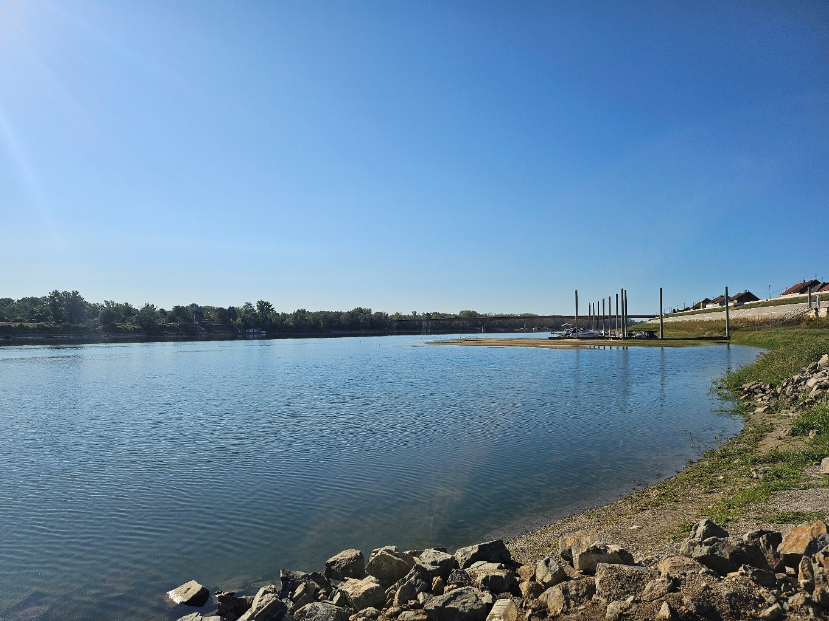
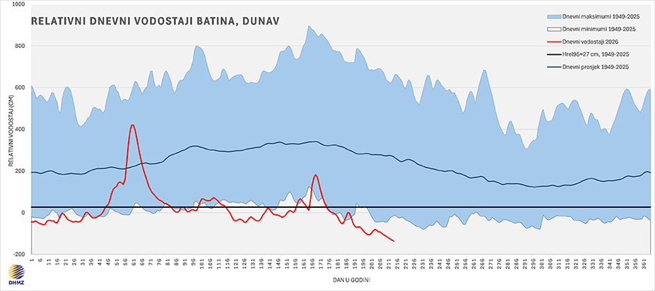
Danube drought – Batina, 2026
On August 3, 2026, the Danube reached a level of -142 cm at the Batina hydrological station, marking a new record low.
Danube River at Batina (Croatia) in August 2026 – Foto: F. Stević
Na hidrološkoj postaji Batina Dunav je 3. kolovoza 2026. dosegnuo -142 cm, što je novi najniži zabilježeni vodostaj.
Izvor: DHMZ, 3. 8. 2026. DHMZ - Državni hidrometeorološki zavod
Slika 3. Kretanje vodostaja Dunava u Batini tijekom 2026. u usporedbi s dugogodišnjim (1949. - 2025.) dnevnim minimalnim i maksimalnim vodostajima (donji i gornji rub plavog područja), prosječnim dnevnim vrijednostima (plava linija) i graničnim relativnim vodostajem hidrološke suše od 27 cm (crna linija). Crvena linija prikazuje vodostaj u 2026. Izvor: DHMZ, 27. 09. 2026)

Slide 6
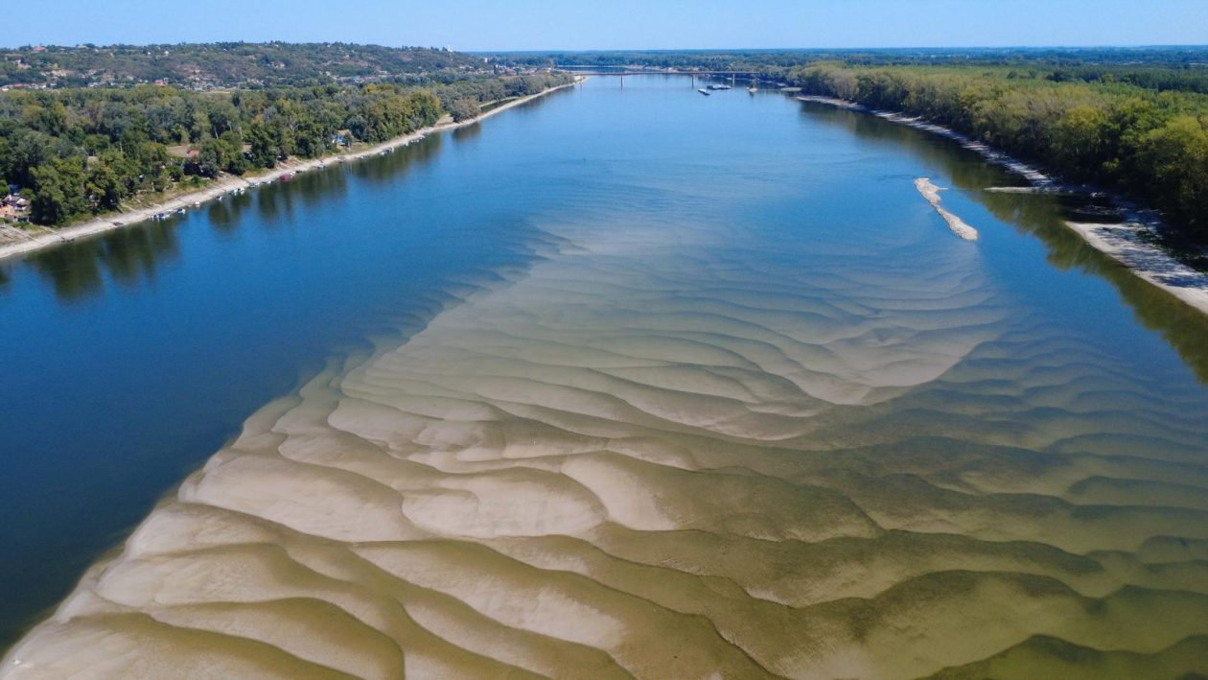

Danube- Vukovar, September 2026
SiB.hr , 01.08.2026., Dunav na povijesnom minimumu: Pogledajte fotografije koje ostavljaju bez daha, ali i zabrinjavaju - SiB.hr

Slide 7
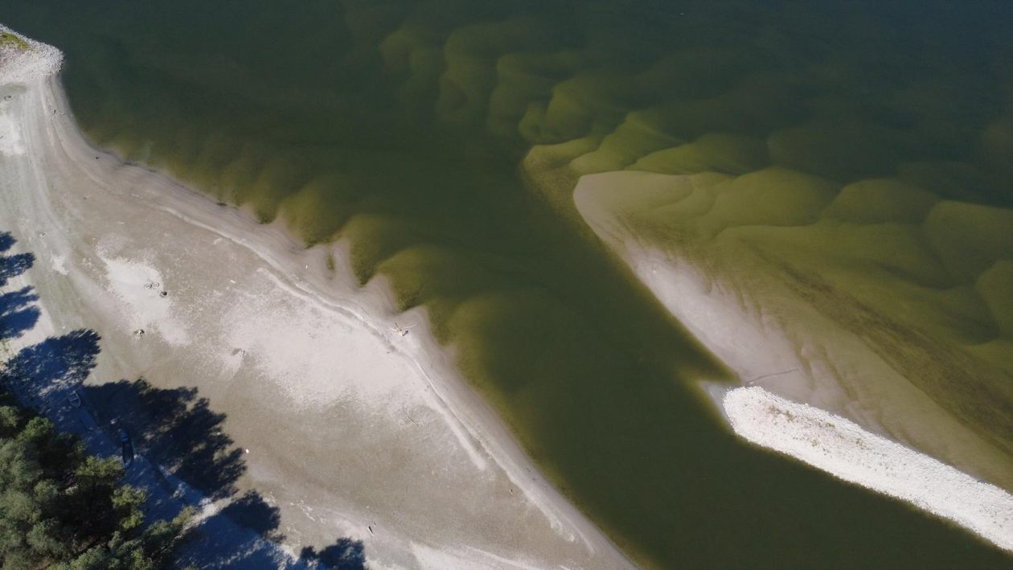
Danube- Vukovar, September 2026
SiB.hr , 01.08.2026., Dunav na povijesnom minimumu: Pogledajte fotografije koje ostavljaju bez daha, ali i zabrinjavaju - SiB.hr

Slide 8
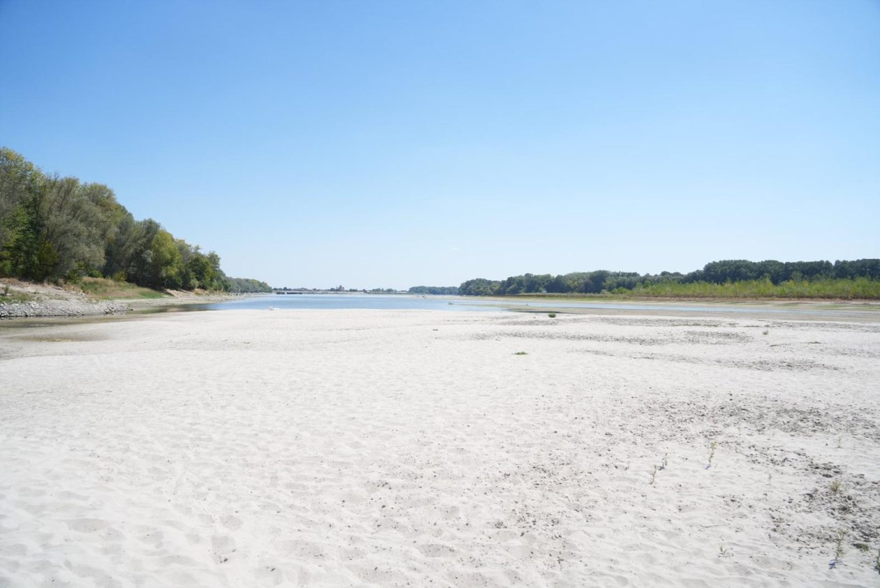
Danube- Vukovar, September 2026
SiB.hr , 01.08.2026., Dunav na povijesnom minimumu: Pogledajte fotografije koje ostavljaju bez daha, ali i zabrinjavaju - SiB.hr

Slide 9
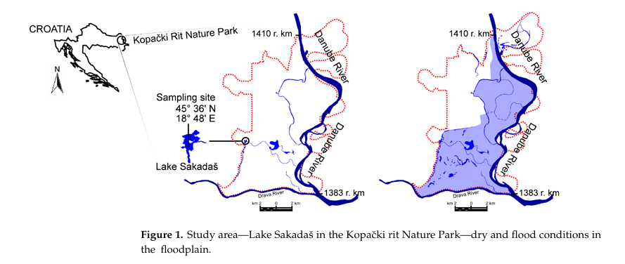
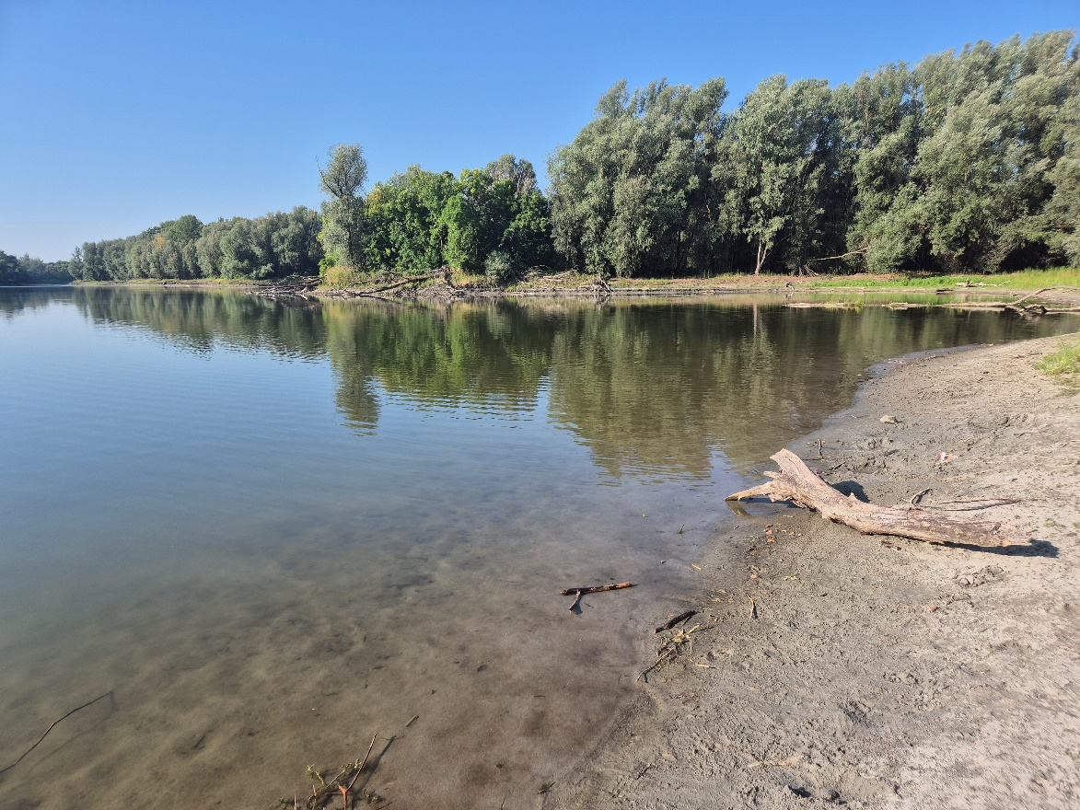
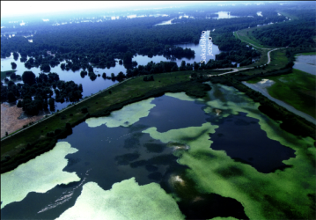
Danube – Kopački rit floodplain
Flooding of the floodplain begins when the Danube water level (DWL) at the gauge station near Apatin (river 1401.4 km) rises above 3 m.
Minor floods (3–3.5 m DWL) inundate less than 10% of the floodplain area;
Extremely high floods (more than 5 m DWL) inundate almost the entire floodplain.

Slide 10
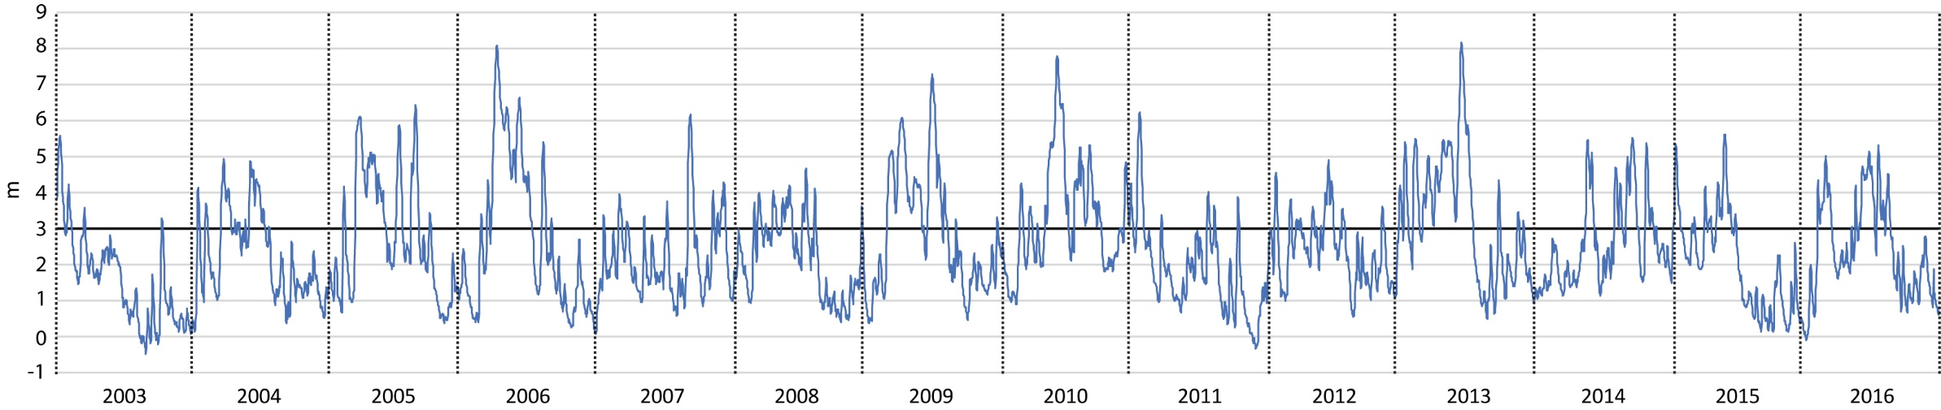
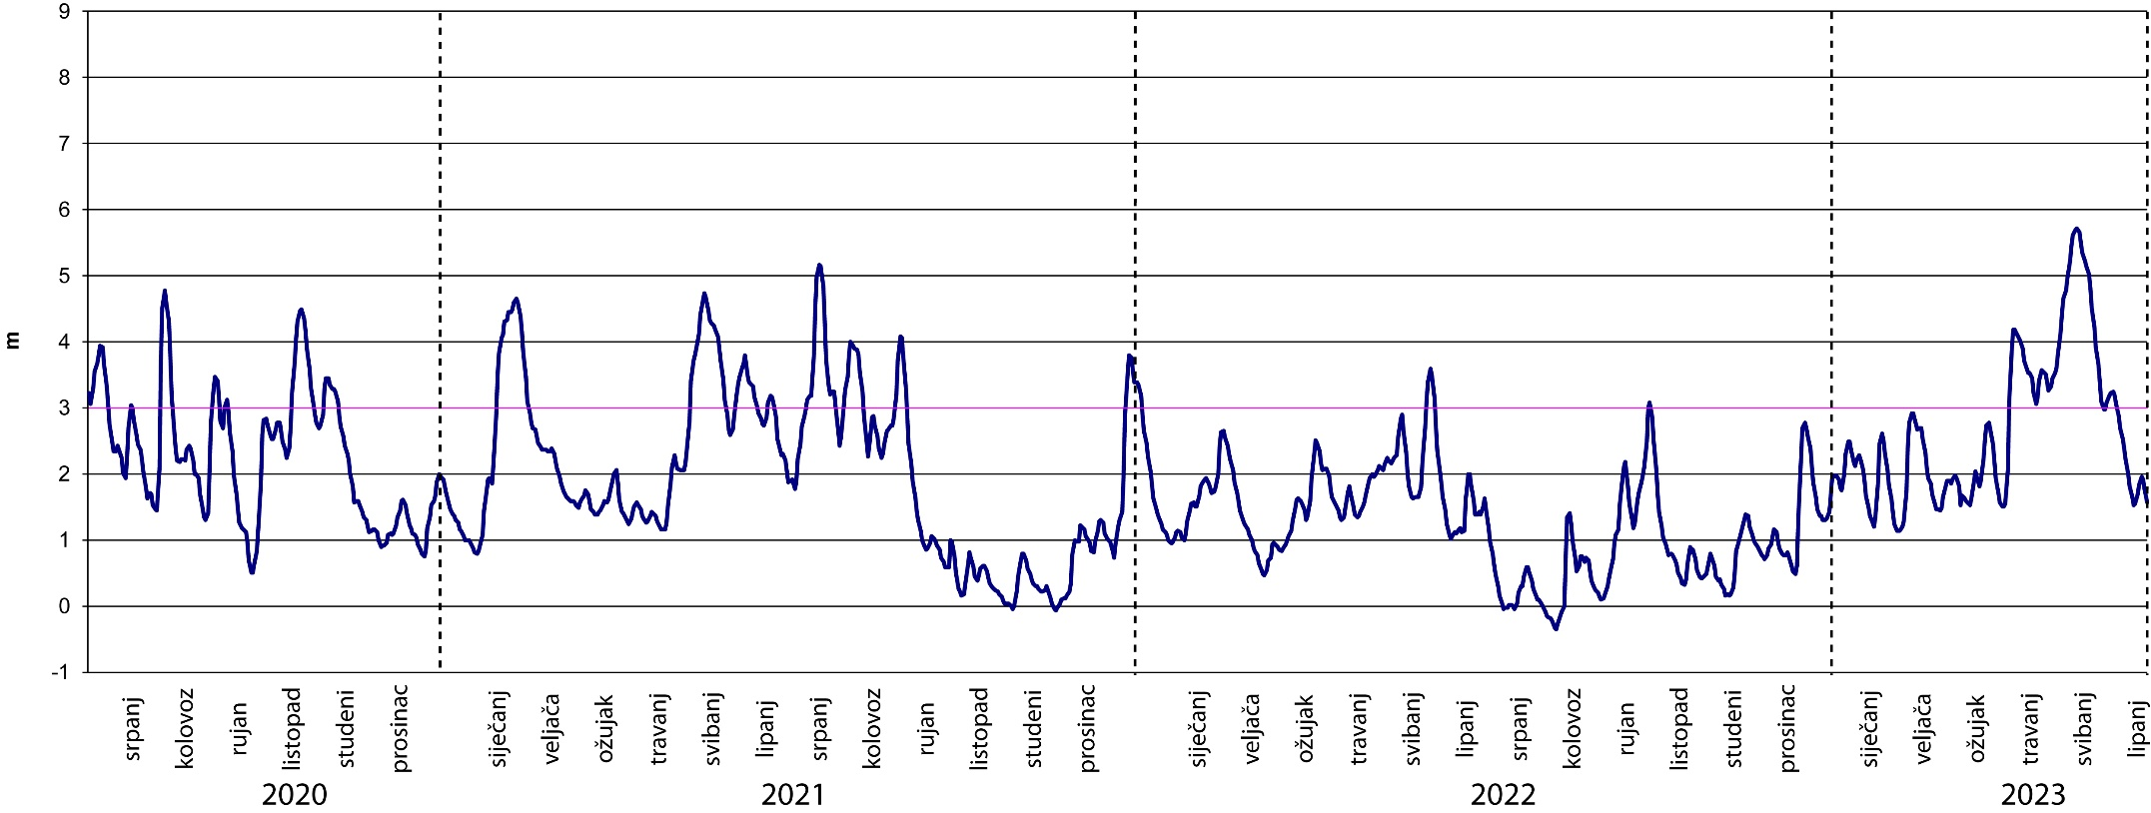
Danube water level
Figure . The daily fluctuations of the Danube water level (DWL) at river kilometer 1401.4.
Note: Blue circles represent the highest and line represent extremely low DWL.

Slide 11
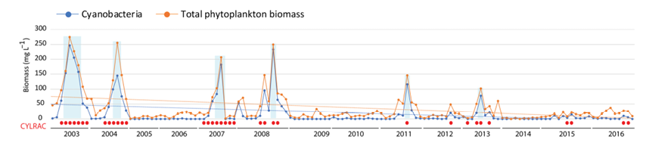
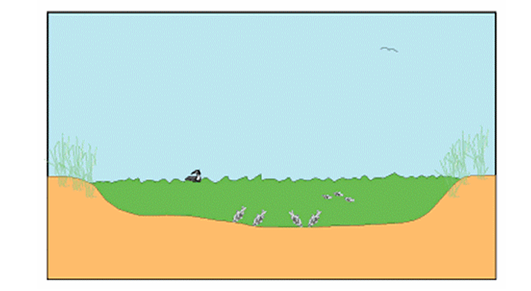
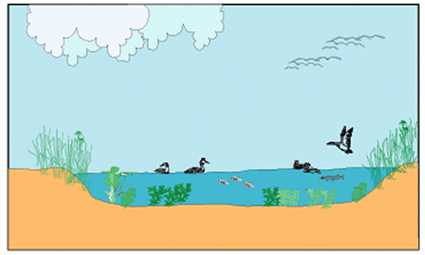
Alternative stable states
Turbid state :
phytoplankton dominated
Clear state :
vegetation dominated
Figure: Dynamics of total phytoplankton biomass and cyanobacteria biomass in Lake Sakadaš in the period 2003–2016. Red dots show the occurrence of R.raciborskii regardless of the abundance achieved; the shaded area shows the cyanobacteria bloom; the dashed line shows the trend.
FIGURE: Schematic representation of a shallow lake in a vegetation-dominated clear state (b) and in a turbid phytoplankton-dominated state (a) in which submerged vegetation is largely absent and fish and waves stir up the sediments (Scheffer, 2001).

Slide 12
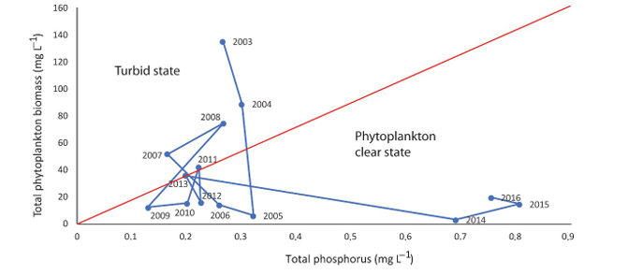
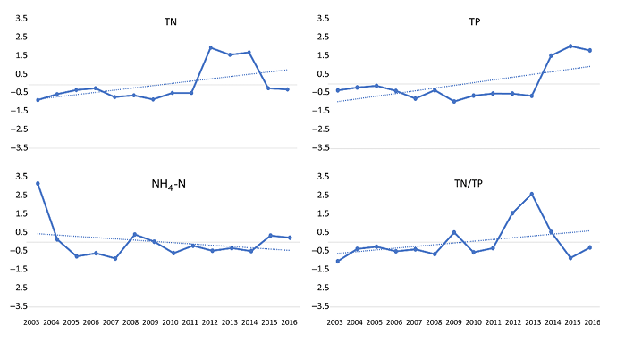
Alternative stable states
Trend of nutrient increase
Figure. Shifts in states occurred in Lake Sakadaš in the period 2003- 2016 based on phytoplankton total biomass and phosphorus concentrations
Figure: Annual mean values of the chemical properties of the waters of Lake Sakadaš in the period 2003–2016. The dashed line indicates the trend. Each ser

Slide 13
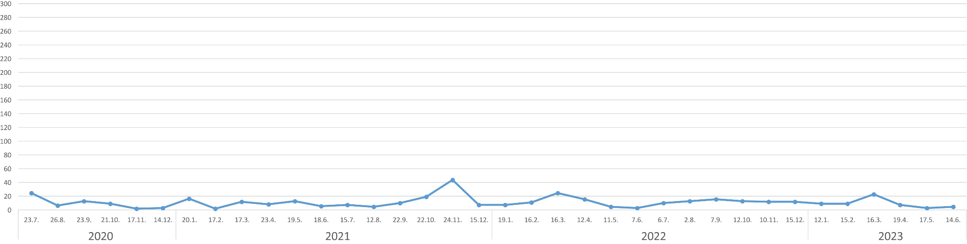
Phytoplankton clear state
Extreme dry
During the extreme dry year of 2022 phytoplankton biomass was at very low level and the lake remained in a clear state.
Unexpectedly, there was no occurrence of an cyanobacterial bloom, as was recorded during the extremely dry period in 2003.
Danube water level (m)
Phytoplankton clear state
Phytoplankton biomass (mg/L)

Slide 14
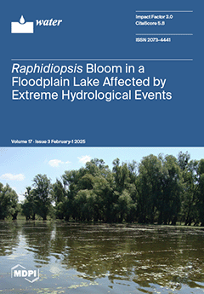
Cosequences of extreme hydrological events on the Kopački rit waters
Our results suggest that the decreasing trend of total cyanobacterial biomass as well as total phytoplankton biomass in the studied floodplain shallow lake with a clear trend of nutrient increase is related to the increasing frequency of extreme hydrological events.
Therefore, the effects of climate change on the progressive development of invasive cyanobacterial species, including Raphidiopsis raciborskii, may be less detrimental in dynamic ecosystems as they are floodplain lakes with a preserved natural connection to the parent river.

Slide 15
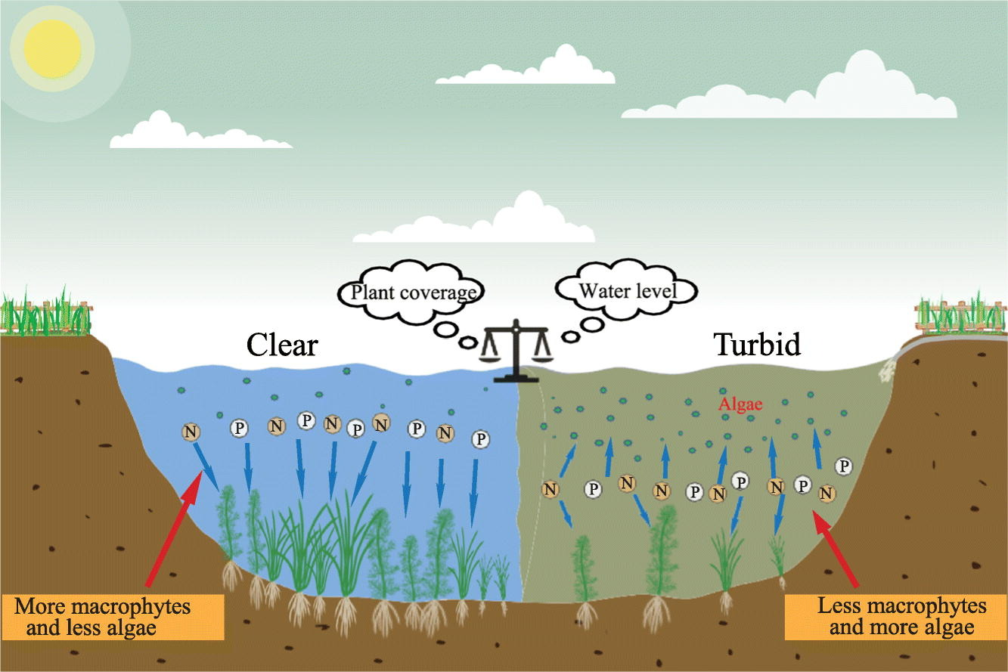
Role of macrophytes
Alternative stable states in shallow lakes
E
As the main primary producer in shallow lakes, submerged macrophytes perform key ecological functions in lake ecosystems, such as:
providing shelter and food for organisms;
reducing phytoplankton biomass by allelopathic inhibition;
removing nutrients in water and controlling sediment resuspension;
- improving water quality and maintaining a clear water state.
Figure: Chao et al., 2022)

Slide 16
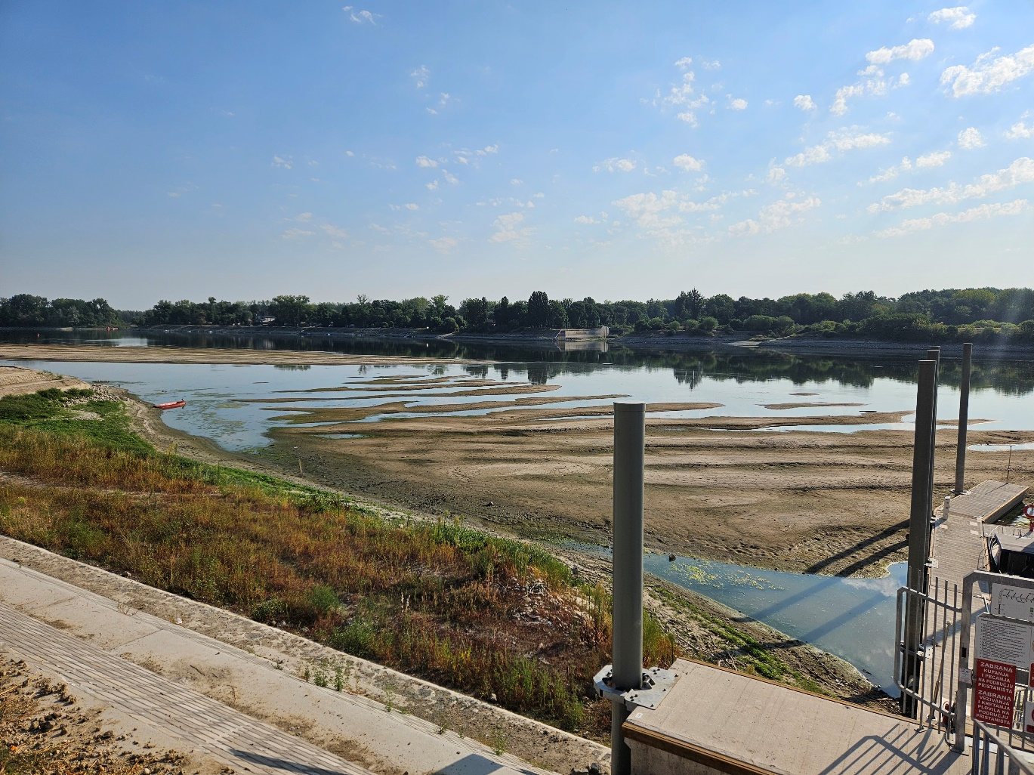
Hydrological extreme - potential consequences
Generally, the impacts of single extreme events such as floods, droughts, etc., depend on the context and can ultimately be deleterious but also beneficial;
the factors that need to be considered are the magnitude, extent, and timing of the event in relation to the life cycles of the constituent species [Ledger and Milner, 2015]

Slide 17
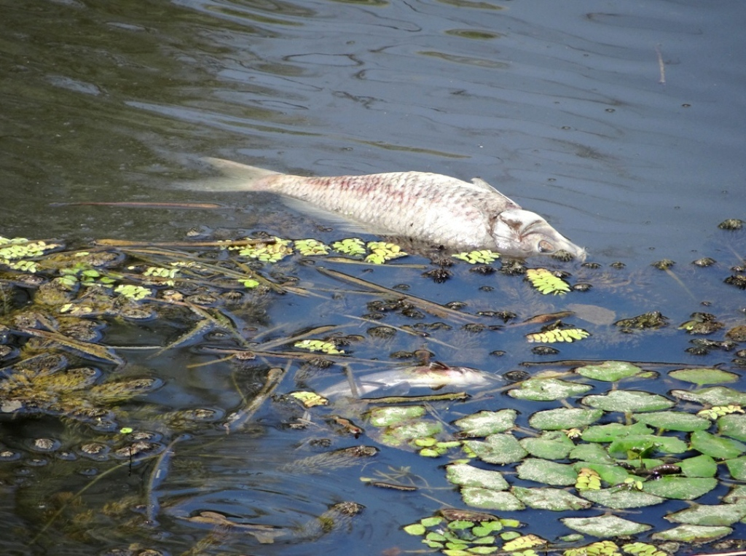
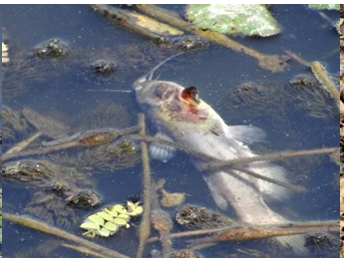
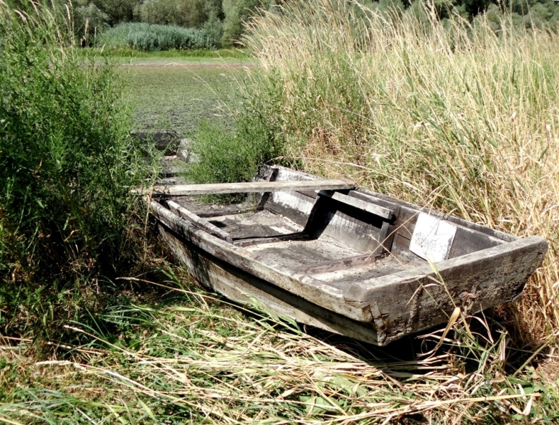
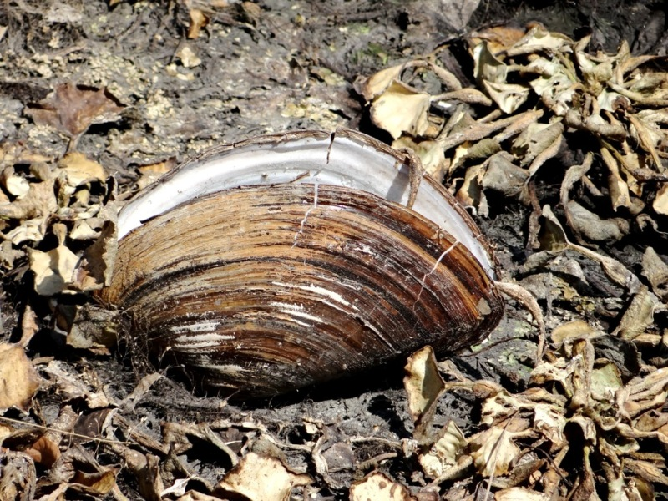
IAD - Fact Sheet
Low water is not simply a local problem visible at one gauge.
Low water reflects:
the availability, movement, retention and use of water across the entire Danube River Basin,
ecosystem degradation,
creating favourable conditions for invasive alien species,
contributing to declining aquatic and wetland biodiversity.
The Danube at Low Flow
problems and possible negative impacts
Photos : Aquatic biota cannot escape the drying of floodplain side channels, including both native and invasive species.
Native wild common carp (Cyprinus carpio) and invasive fish North American black bullhead (Ameiurus melas); detail of this invasive fish; invasive Chinese pond mussel (Sinanodonta woodiana). Native aquatic plants include European water chestnut (Trapa natans) and floating fern (Salvinia natans). All photos Danube-Drau (Duna-Dráva) National Park. IAD, 2026)

Slide 18
IAD Fact Sheet
Low water in the Danube – - central message
The IAD's central message is that low water in the Danube cannot be addressed at the river channel alone:
the basin must retain water when it is abundant,
restore connections between rivers and the surrounding landscape across the Danube River Basin,
strengthen our understanding of the role of healthy floodplain ecosystems,
use water more carefully,
improve knowledge and forecasting,
manage this shared resource cooperatively across national borders.

Slide 19
References
Woodward, G.; Bonada, N.; Brown, L.E.; Death, R.G.; Durance, I.; Gray, C.; Hladyz, S.; Ledger, M.E.; Milner, A.M.; Ormerod, S.J.; et al. The Effects of Climatic Fluctuations and Extreme Events on Running Water Ecosystems. Philos. Trans. R. Soc. Lond. B. Biol. Sci. 2016, 371, 20150274. [CrossRef] [PubMed]
Stević, F.; Mihaljević, M.; Špoljarić Maronić, D.; Žuna Pfeiffer, T.; Zahirović, V. The Decreased Incidence of Raphidiopsis raciborskii Bloom in a Temperate Floodplain Lake in the Middle Danube Affected by Extreme Hydrological Events. Water 2025, 17, 309. https://doi.org/10.3390/w17030309
Scheffer, M. (2001) Alternative attractors of shallow lakes. TheScientificWorld 1, 254-263.
International Association for Danube Research (IAD) (2026). 46th IAD Conference 2026 — Book of Abstracts. Baja, Hungary, 10–13 August 2026. DOI 10.36250/01379.
Chao C., , T. Lv, L. Wang, Y. Li, C. Han, W. Yu, Z. Yan, X. Ma, H. Zhao, Z. Zuo, C. Zhang, M. Tao, D. Yu, C. Liu, The spatiotemporal characteristics of water quality and phytoplankton community in a shallow eutrophic lake: Implications for submerged vegetation restoration, Science of The Total Environment, 821, 2022, 153460,
https://doi.org/10.1016/j.scitotenv.2022.153460.
Ledger, M.; Milner, A. Extreme Events in Running Waters. Freshw. Biol. 2015, 60, 2455–2652. [CrossRef]

Slide 20

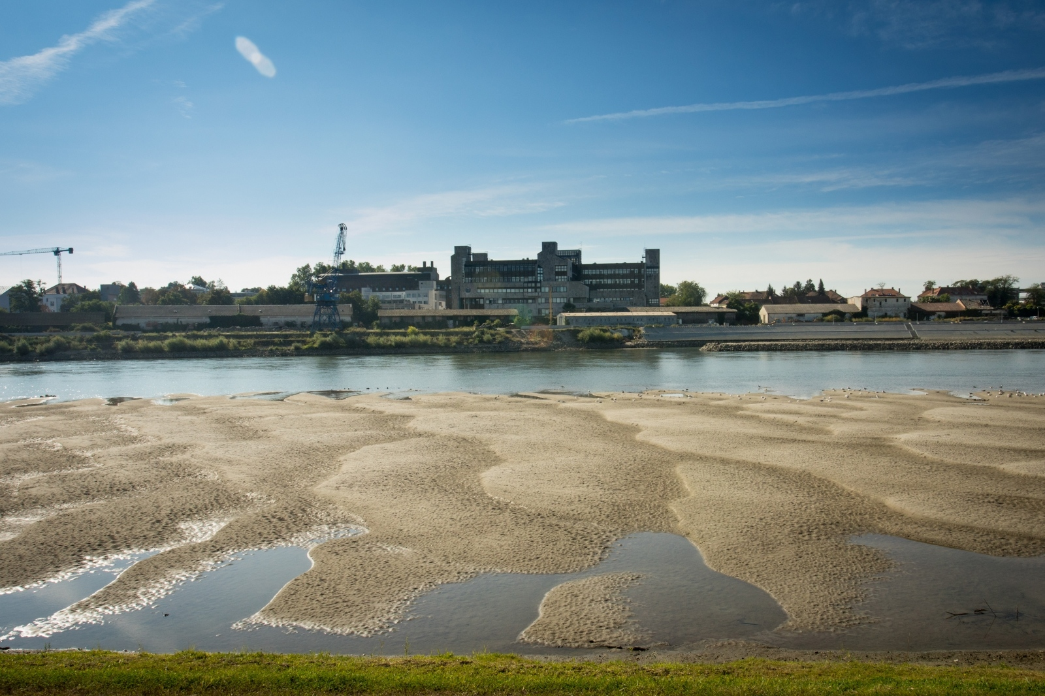
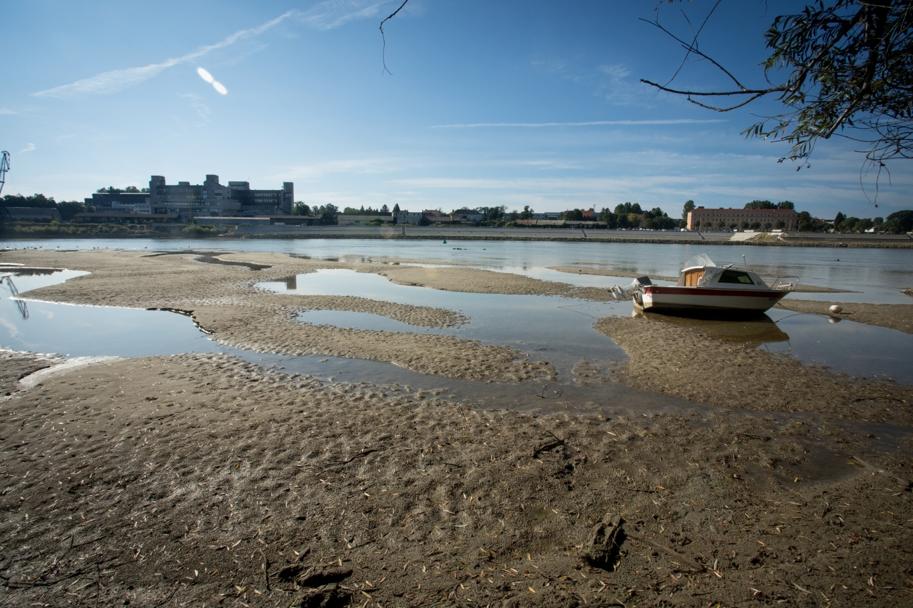
At the end….
Nikada niža rijeka
Novi povijesni rekord: Drava kod Osijeka pala na -201 centimetar (SIB/NET, 28.09.2026 Mirela Belaj)
.
,
Na Dravi kod Osijeka jučer (27. 09.2026) je izmjeren najniži vodostaj u povijesti, minus 201 centimetar.
Photo: Dubravka Petrić /PIXELL
Yesterday, (27. 09. 2026) the lowest water level in history—minus 201 centimeters—was recorded on the Drava near Osijek. (SIB/NET, 28.09. 2026).
Photo: Dubravka Petrić /PIXELL

